Slide 1
Cost-Effective Methodology for Providing Reserves
Power Committee
May 26th, 2021
John Ollis

Slide 2
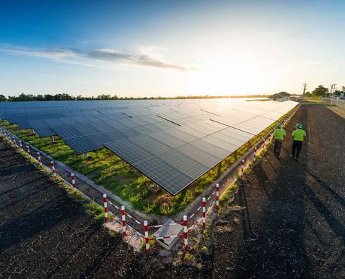
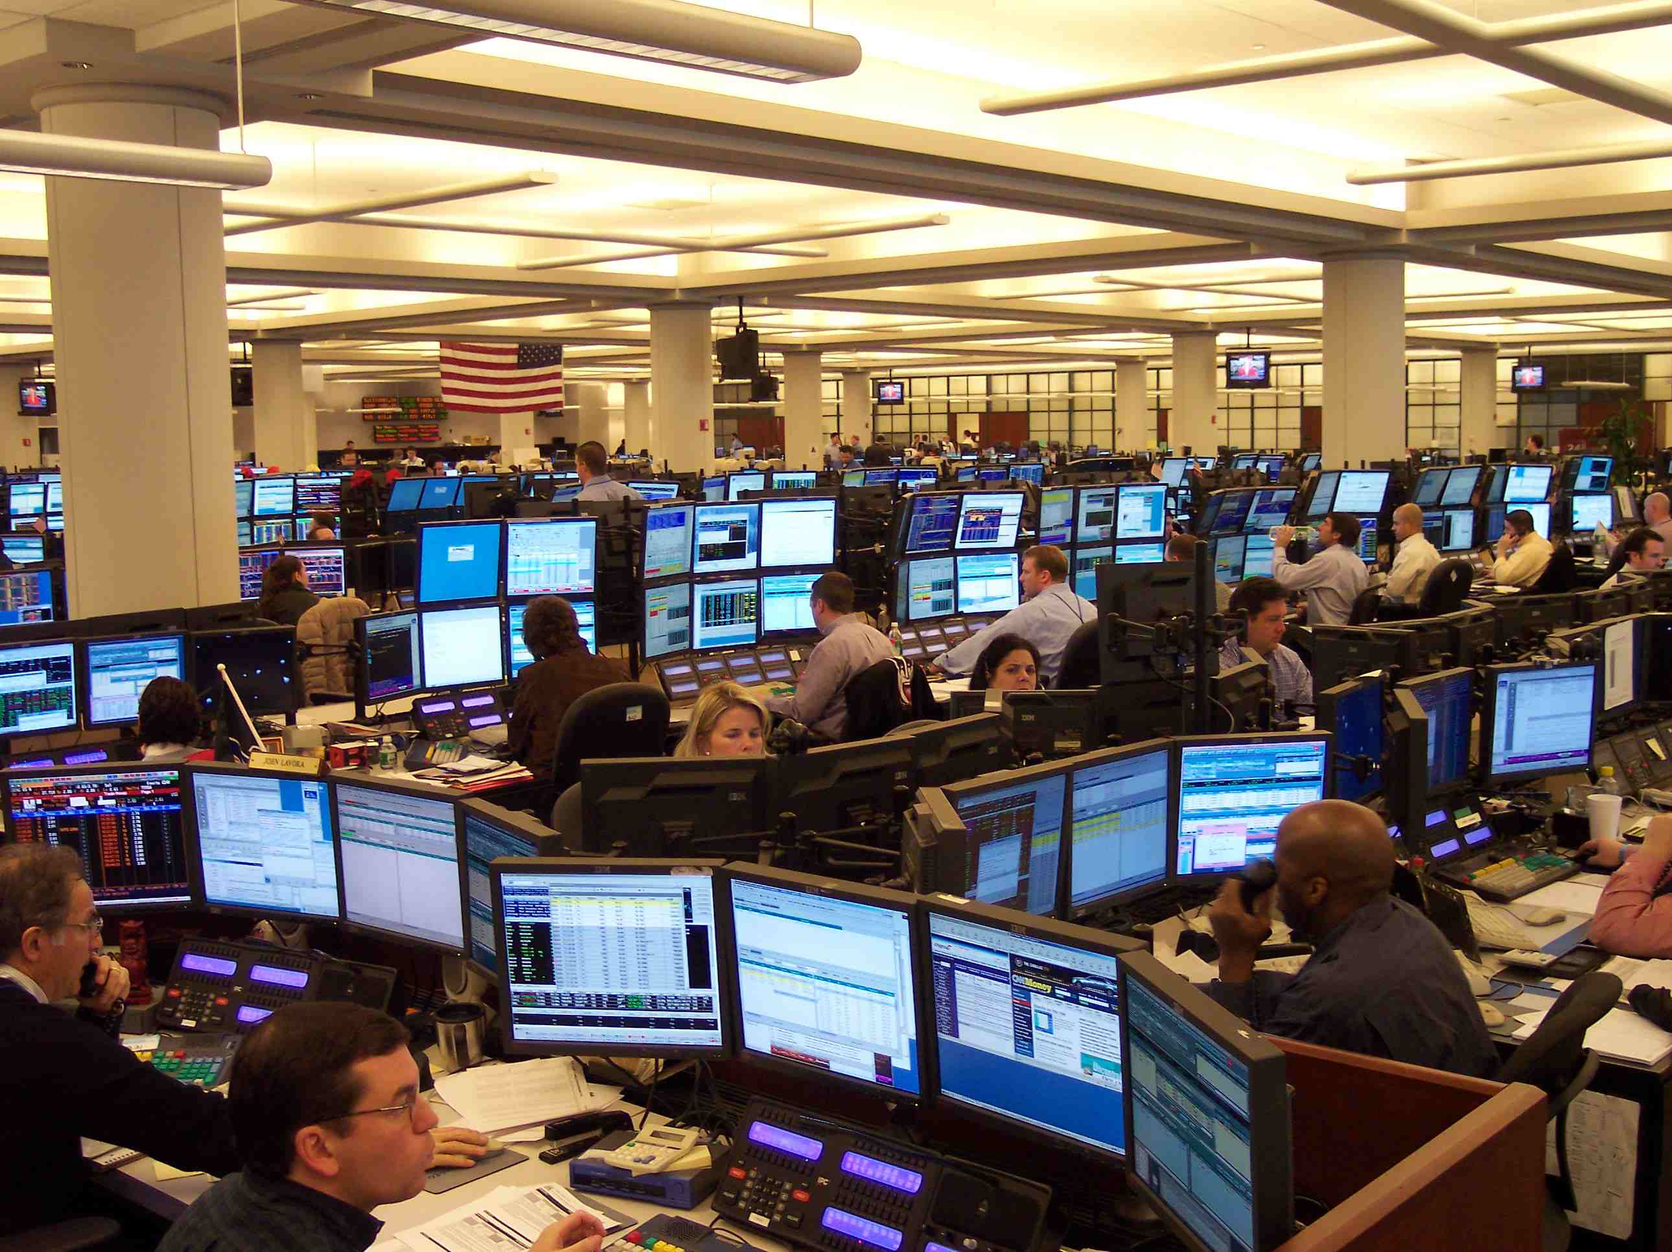




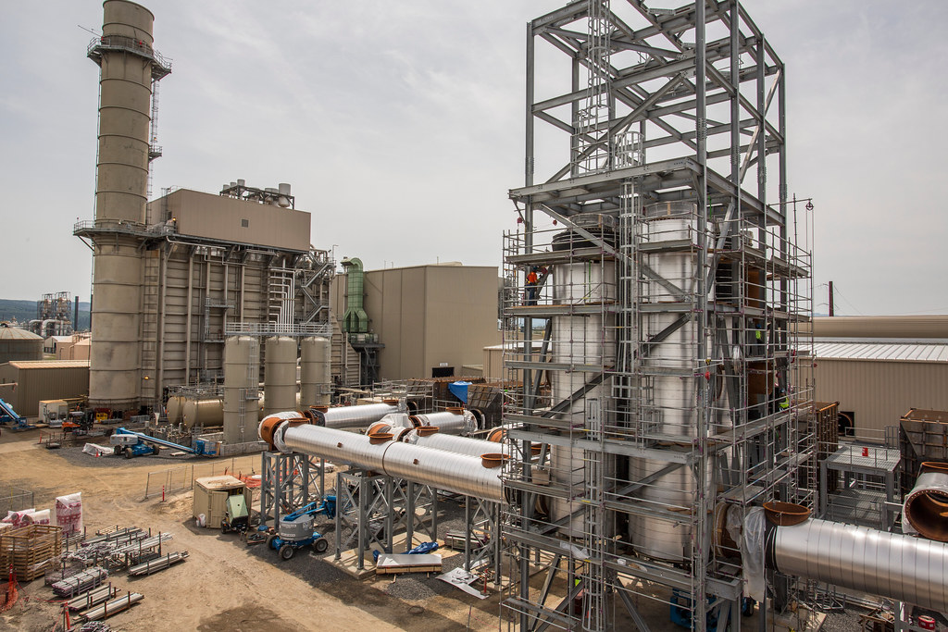

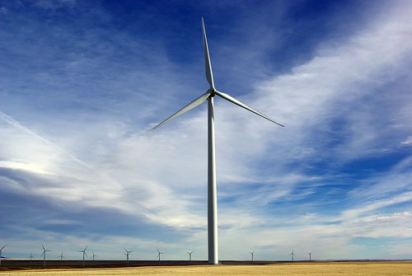
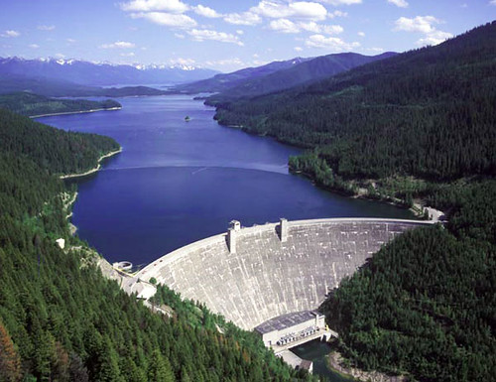
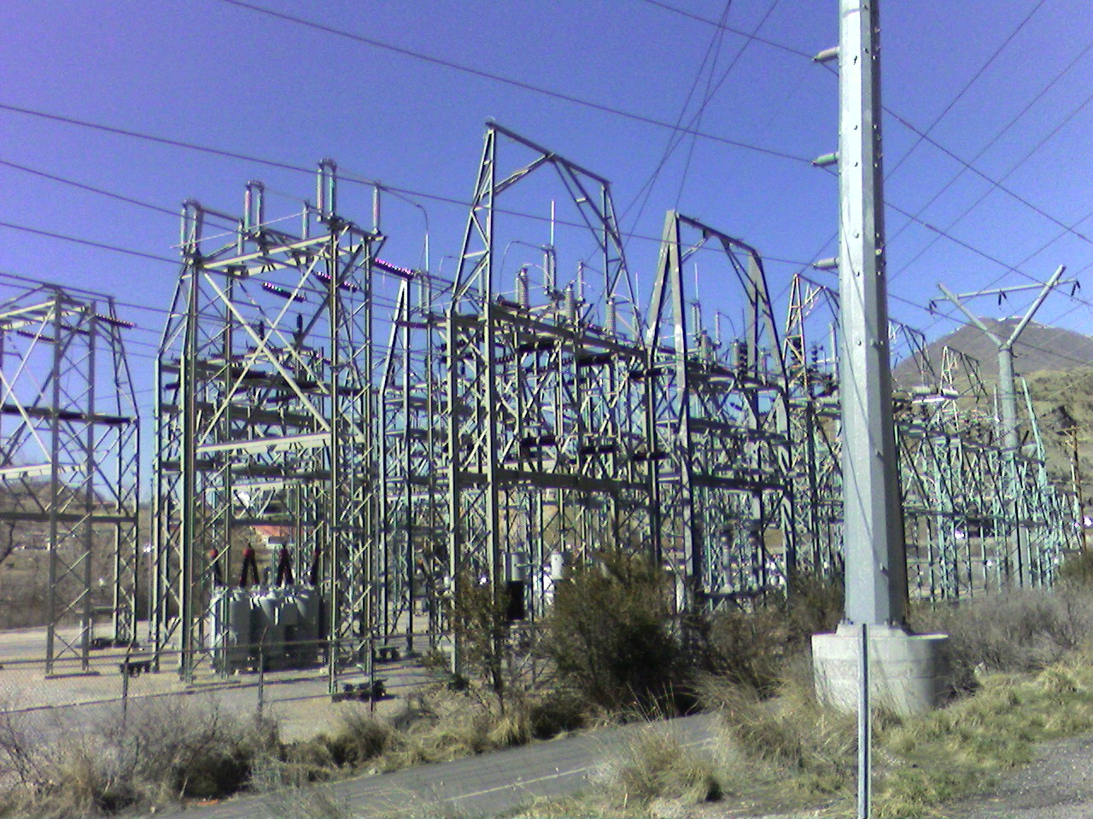

Slide 3
Summary
Role of reserves in the plan
How do reserves fit into the analysis of different resource strategies?
How do we evaluate cost-effectiveness of reserve strategies?
Tradeoffs

Slide 4
Power Act Requirement
Per Section 839b(e)(3)(E), in the NW Power Act, the plan shall include the following element:
An analysis of reserve and reliability requirements and cost-effective methods of providing reserves to insure adequate electric power at the lowest probable cost.

Slide 5
Reserves Examined in GENESYS
Planning Reserves
  Sufficient reserves/resources to meet Council’s 5% LOLP Adequacy Standard
  We use the Adequacy Reserve Margin to enforce this in the RPM
  In the NW this is primarily used to hedge against bad hydro conditions or high load years
Operating Reserves
Balancing Reserves
  Reserves held in day-ahead, hour-ahead stage in preparation for forecast error in load or renewable generation forecast in the true-up
  Maximum sum of regional entities reserves from NW Power Pool EIM Study (per previous SAAC discussion)
  2900 MW up reserves and 3345 MW down reserves for the whole region
Contingency Reserves – spinning and supplemental
  3% Load
  3% Generation

Slide 6
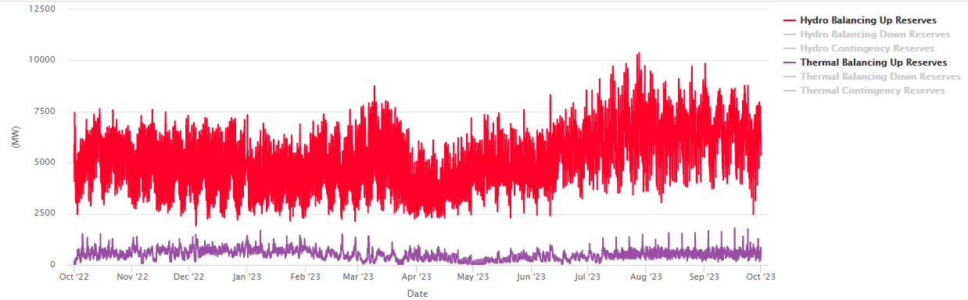
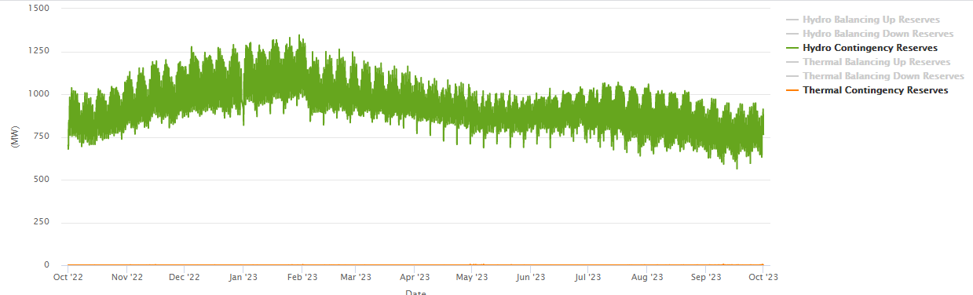
GENESYS tends to assign most contingency reserves to hydro and balancing reserves to marginal resources

Slide 7
Planning Reserves Studies Include Effect of Balancing and Contingency Reserves
Planning reserves could be an additional reserve required to ensure the adequacy standard is met.
  In other words, this is an additional reserve over the 7000 to 7500 MWs of operating reserves already held in all studies.
In the past, additional reserve needs have been met by new resources/reserves
  Energy Efficiency
  Demand Response
  Generation (thermal or renewable)
Portfolio Approach: Due to the flexibility of the hydro system, needs could be met with either resources that exactly matched the need or resources that allowed the hydro generation to shift to better meet needs.

Slide 8

Handling Reserves in the 2021 Power Plan
The goal in this plan was to have GENESYS calculate
  The needs required to serve regional loads and reserve obligations and adhere to the constraints on the hydro system for each relevant scenario.
  (Adequacy Reserve Margin)
  The portfolio capability of each resource combination considered to address that need.
  (Associated System Capacity Contribution)
Since the reserve requirement information is implicit in the determination of the regional need and resource capabilities than theoretically the Regional Portfolio Model would have enough information to make adequate resource decisions after contemplating the cost
  The reserve strategy should be implicit in the regional strategy analysis
This Photo by Unknown Author is licensed under CC BY-SA-NC

Slide 9
Review:
Needs Assessment Role in Power Plan
How do these simulations guide our result in the plan?

Slide 10
Get A Strategy
AURORA Buildout
Long term capital expansion for the WECC ensures that price simulations in AURORA are informed by an adequate system that meets policies
AURORA Price Runs
Hourly WECC-wide price simulations inform market prices and associated emissions in the RPM, both can significantly impact regional resource strategy economics
Hourly market capability is needed for GENESYS to provide a good adequacy signal for the NW informed by changing market fundamentals
GENESYS
RPM
Hourly analysis in GENESYS creates quarterly ARMs and ASCCs, which the RPM uses to select an adequate resource strategy

Slide 11

Check A Strategy
AURORA Buildout
Long term capital expansion for the WECC ensures that a check in AURORA is informed by an adequate system that meets policies
AURORA Check
Candidate regional resource strategy may be checked within the context of the WECC to ensure we are consistent with policies and operational feasibility within a WECC-wide context.
GENESYS Check
RPM
Candidate regional resource strategy is checked in GENESYS to ensure the system is adequate and operationally feasible.

Slide 12
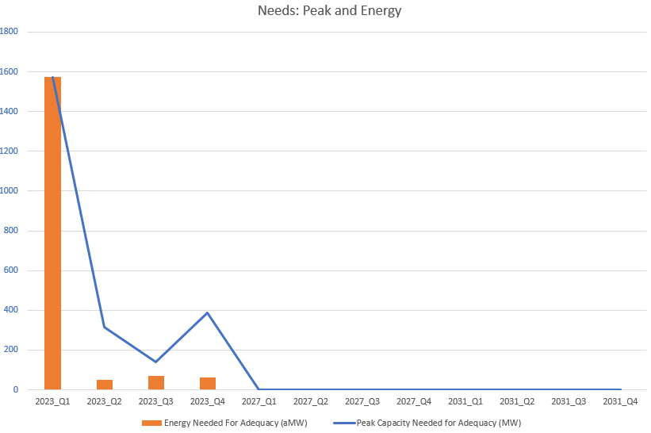
Large peak adequacy issues in 2023 (primarily winter)
It was noted in previous presentations that the regional thermal fleet was not fully utilized during some of these adequacy issues

Slide 13
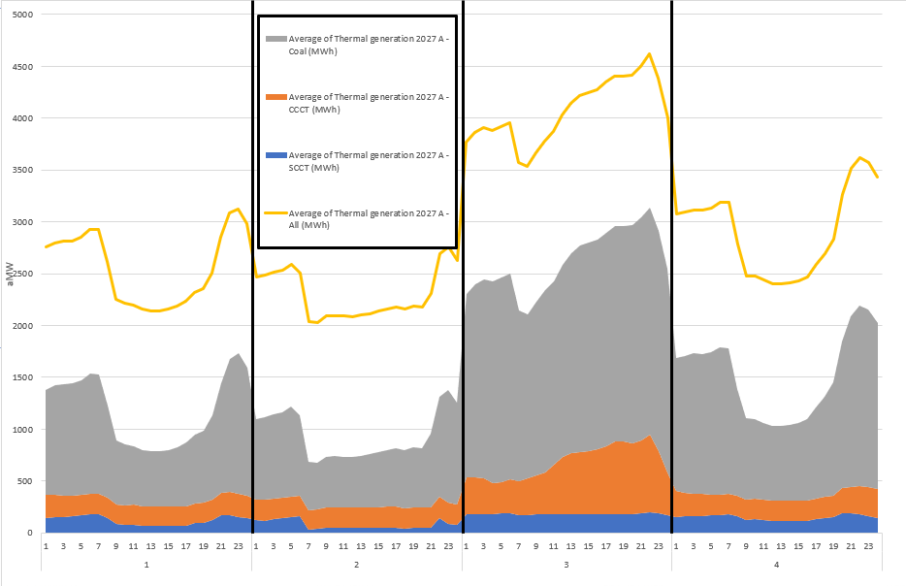
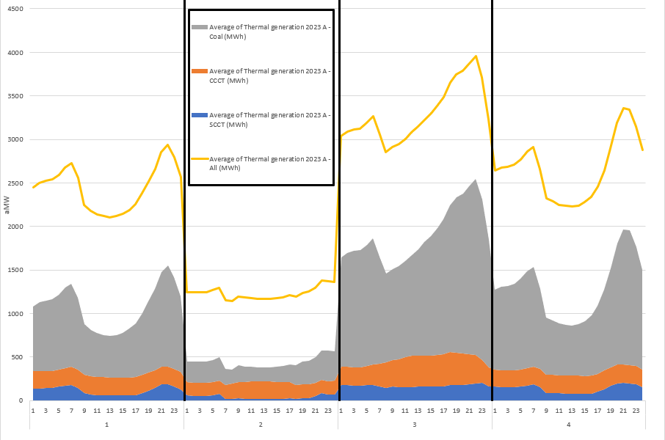
Higher Thermal Unit Commitment in 2027, especially coal and CCCTs increases regional adequacy

Slide 14
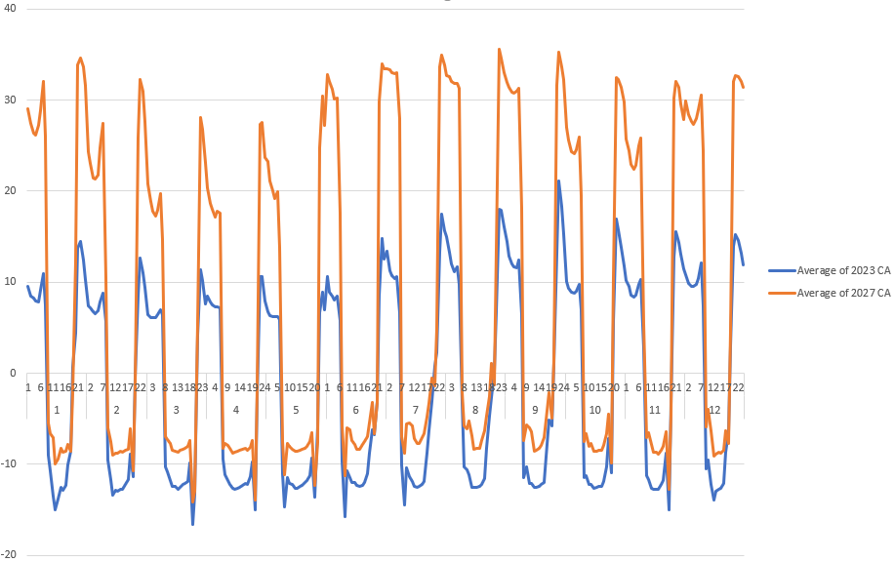
Loads are Higher in 2027 which Leads to Higher Prices Overnight Supporting More Thermal Commitment

Slide 15
What Makes a Reserve Cost-Effective?
Co-optimize resources, reserves and market exposure…

Slide 16
Timing and Cost
Addressing Regional Needs
More Resources
More Reserves
More Market Exposure
Observations
Most deficits and high pricing events occur during the
Morning ramp (5 am to 10 am) when solar generation ramps up and load ramps down
Evening ramp (5 pm to 10 pm) load ramps up and solar generation ramps down.
During deficit events in our simulations, thermal generation is not fully utilized due to low prices midday and overnight.
Investing in new resources can be costly Increasing market exposure can open the region up to additional risks
Operating more conservatively, or said differently, increasing reserves to support the morning and evening ramps can alleviate operational challenges

Slide 17
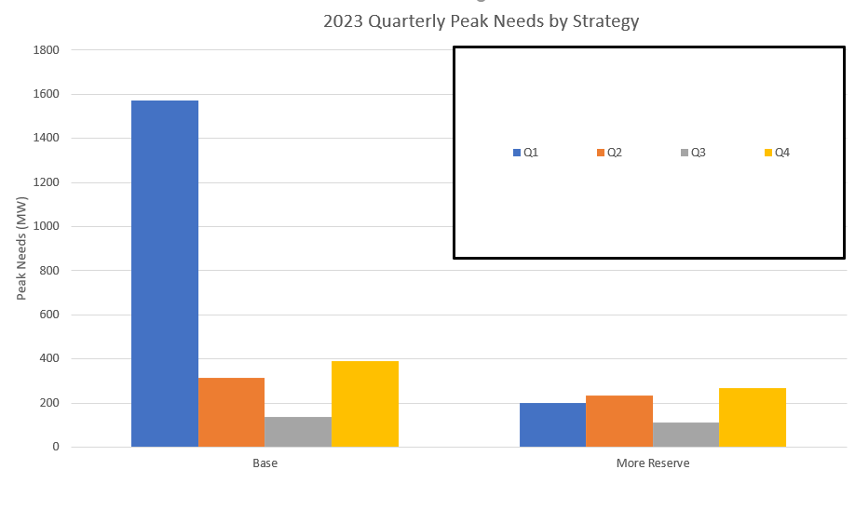
Holding More Reserves as a Strategy
By increasing quarterly INC reserves by the size of the need in the baseline
(1) LOLP is reduced from 16% to 9%
(2) Winter peak needs are reduced from nearly 1600 MW to under 200 MW

Slide 18
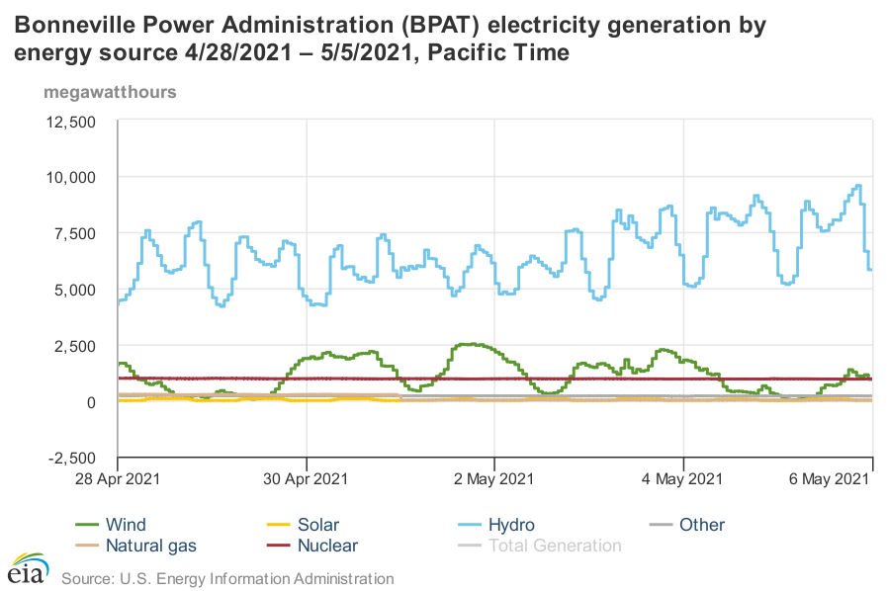
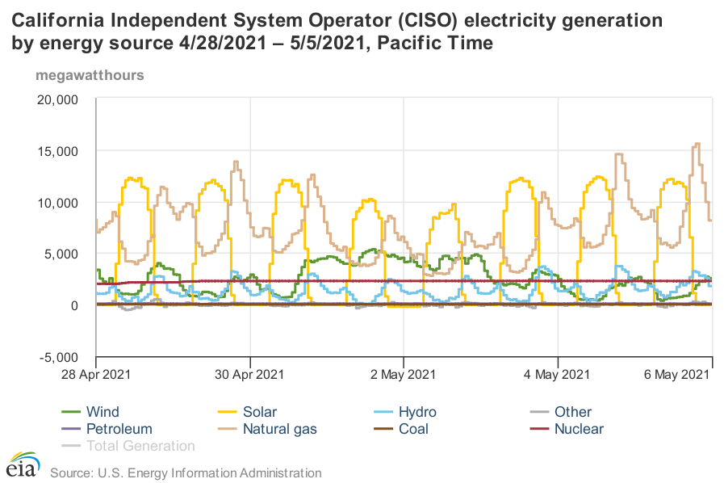
Current Hourly Operations Show Discretionary Hydro and Thermal Generation Pushed to Ramps and Overnight Periods https://www.eia.gov/electricity/gridmonitor/dashboard/

Slide 19
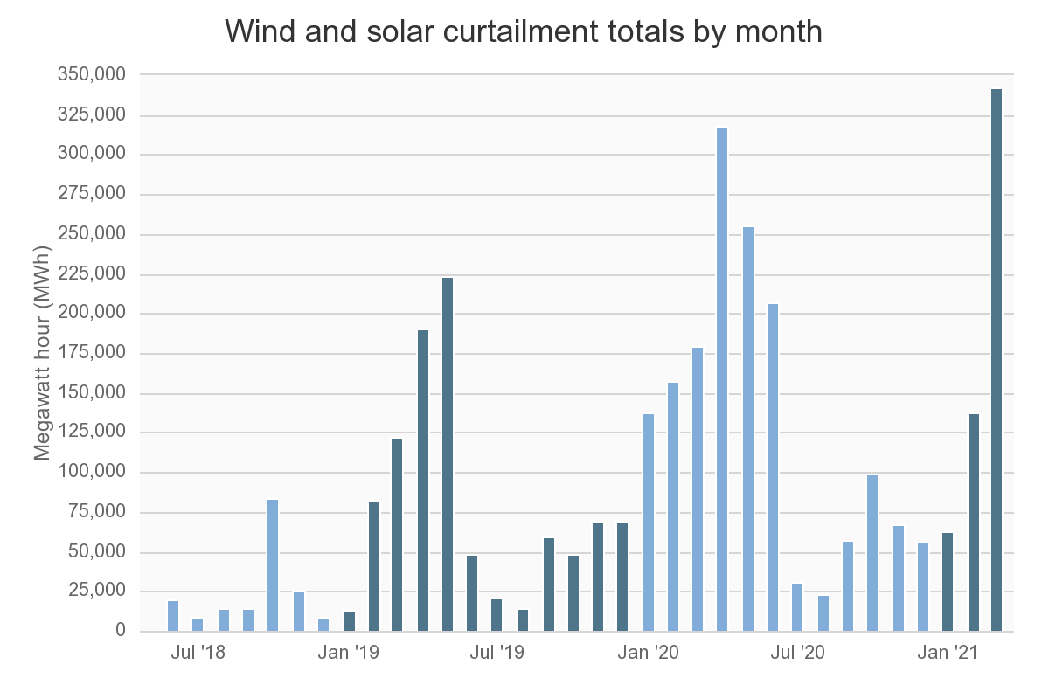
California Already Experiencing Ramping Issues Related to Renewables
Data Source:
http://www.caiso.com/informed/Pages/ManagingOversupply.aspx
Flexible Ramping Product:
https://www.oasis.oati.com/PPW/PPWdocs/2016-06-24_FlexibleRampingProduct_ER16-2023.pdf
https://www.caiso.com/Documents/DraftFinalTechnicalAppendix-FlexibleRampingProduct.pdf

Slide 20
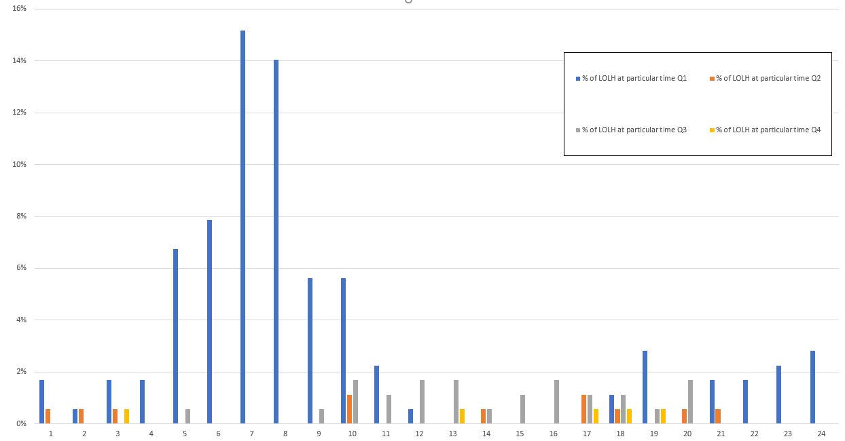
Issues in 2023 by Time of Day
% of Loss of Load Event Hours
Most winter adequacy issues overnight or during ramping periods
Most summer adequacy issues during mid-day and evening ramp

Slide 21
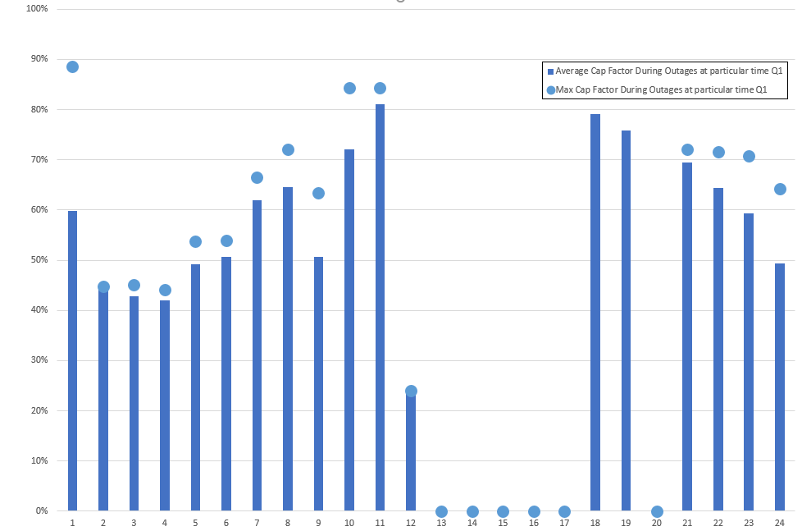
2023 Winter Thermal Generation Capacity Factors During Outages Always Lower Than 90%

Slide 22
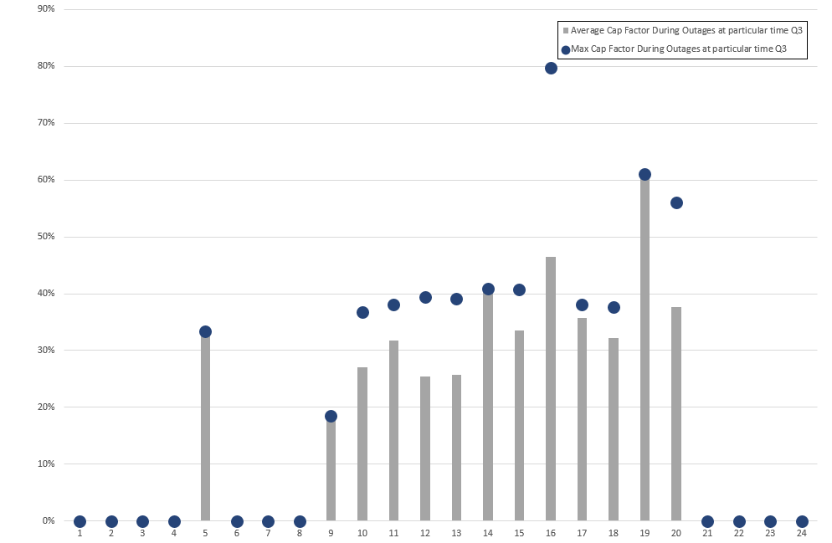
2023 Summer Thermal Generation Capacity Factors During Outages Always Lower Than 80%

Slide 23
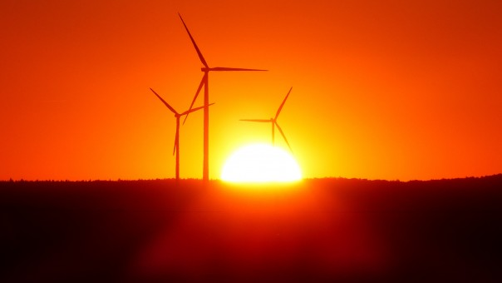
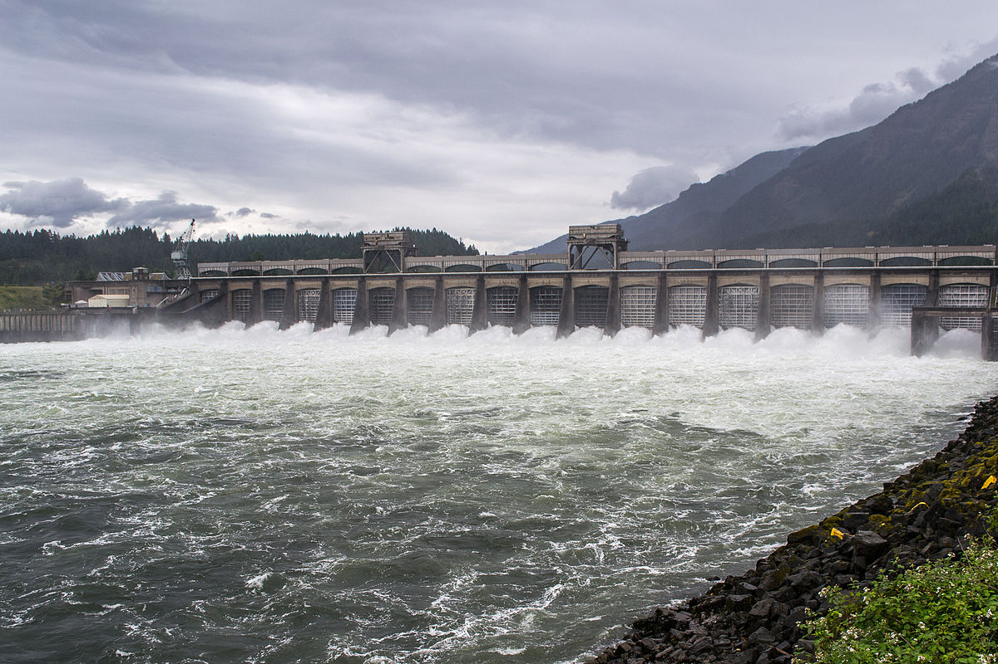
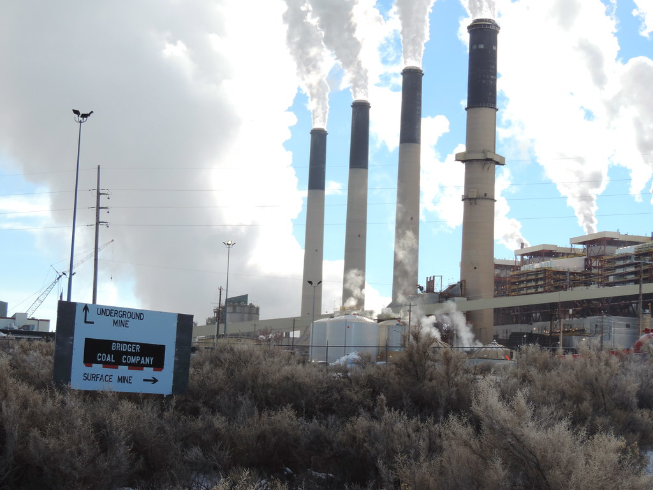
Example
Morning Ramp Issues (Baseline)
  Renewable generation high in day-ahead competing with coal and CCCT units
  Coal ramps down and gas units don’t commit (order fuel).
  Renewable generation forecast drops and regional load forecast is higher after day-ahead forecasts (between 2500 MW and 3000 MW of total forecast error)
  Hydro generation and market cannot make up difference due to congestion on some lines
This Photo by Unknown Author is licensed under CC BY-NC-ND

Slide 24
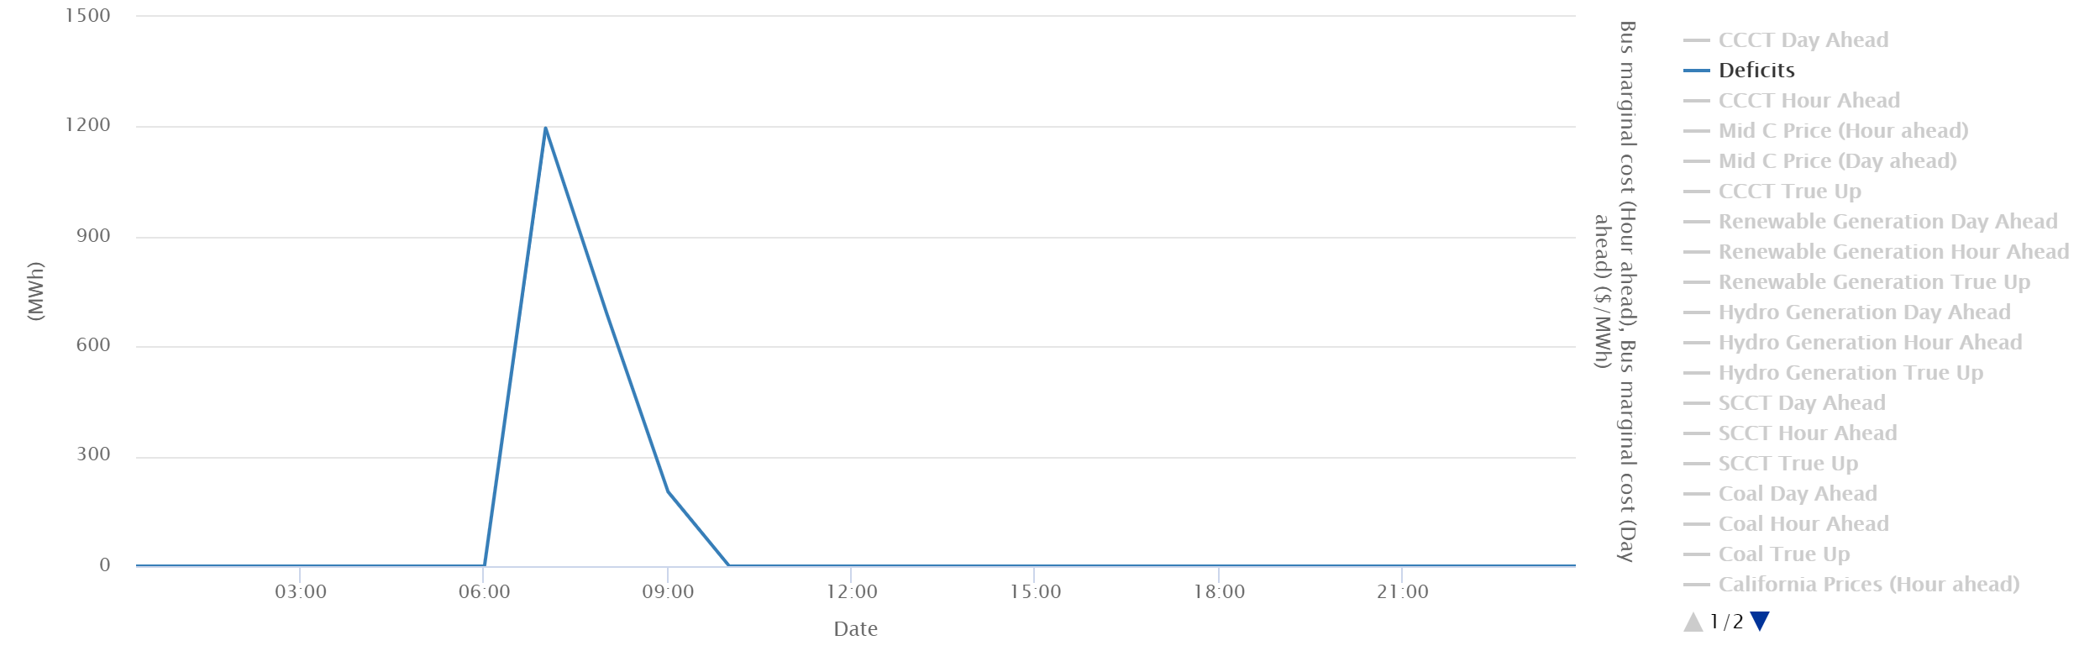
Morning Ramp Issue

Slide 25
Issue – Bridger Shuts Down Before the Morning Ramp
High day-ahead wind forecast in Wyoming and a low day-ahead price forecast cause Bridger to shut down before the morning ramp at 5 am
Regional coal and hydro units holding contingency and balancing reserves
Hour ahead wind forecast in Wyoming is lower by nearly 600 MW
Market was importing at regional limits from 7 am to 6 pm in day ahead corresponding with midday negative pricing in California
With forecasted drop in renewable generation (a few hours ahead) regional prices are higher than external market prices so the region imports and Bridger shuts off earlier than planned in the day-ahead plan
Bridger cannot turn back on due to minimum down time requirement
Hydro ramps up to full capability but cannot generate more without violating constraints or leaving region short on reserves
Not enough other thermal plants to respond on due to low prices during midday and overnight (SCCTs respond but are not enough)

Slide 26
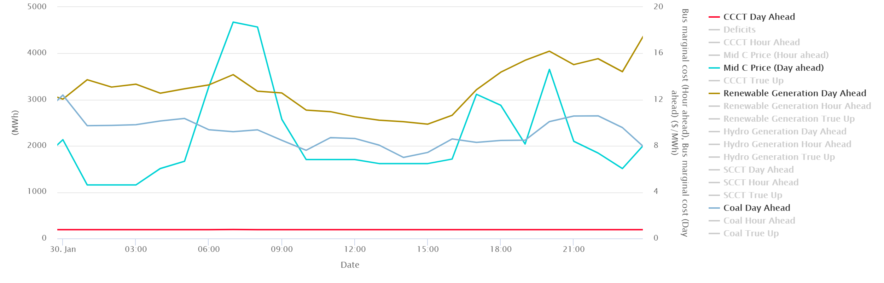
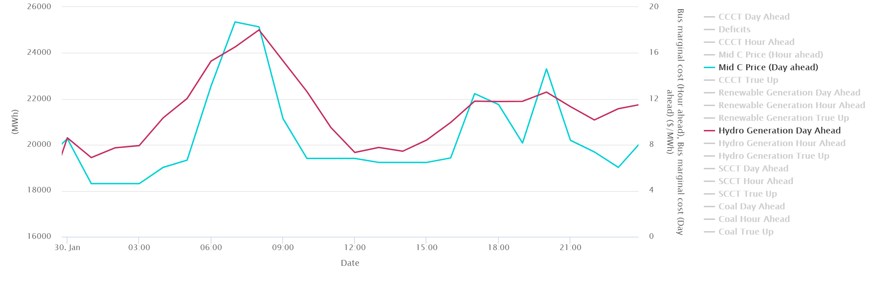
Morning Ramp Issue – January 30th Deficit
Day Ahead Plan
Thermal Unit Commitment:
190 MW of CCCT gas and 1750 MW to 3000 MW of coal committed
Planned Renewable Gen:
2500 MW midday to over 4000 MW end of day
Planned Hydro Gen:
Ramps up to hit morning and evening ramps 4000 and 2000 MW respectively.
Prices and Market:
Average under $8/MWh all day during non-ramping hours. Importing to limits from 7 am to 6 pm

Slide 27
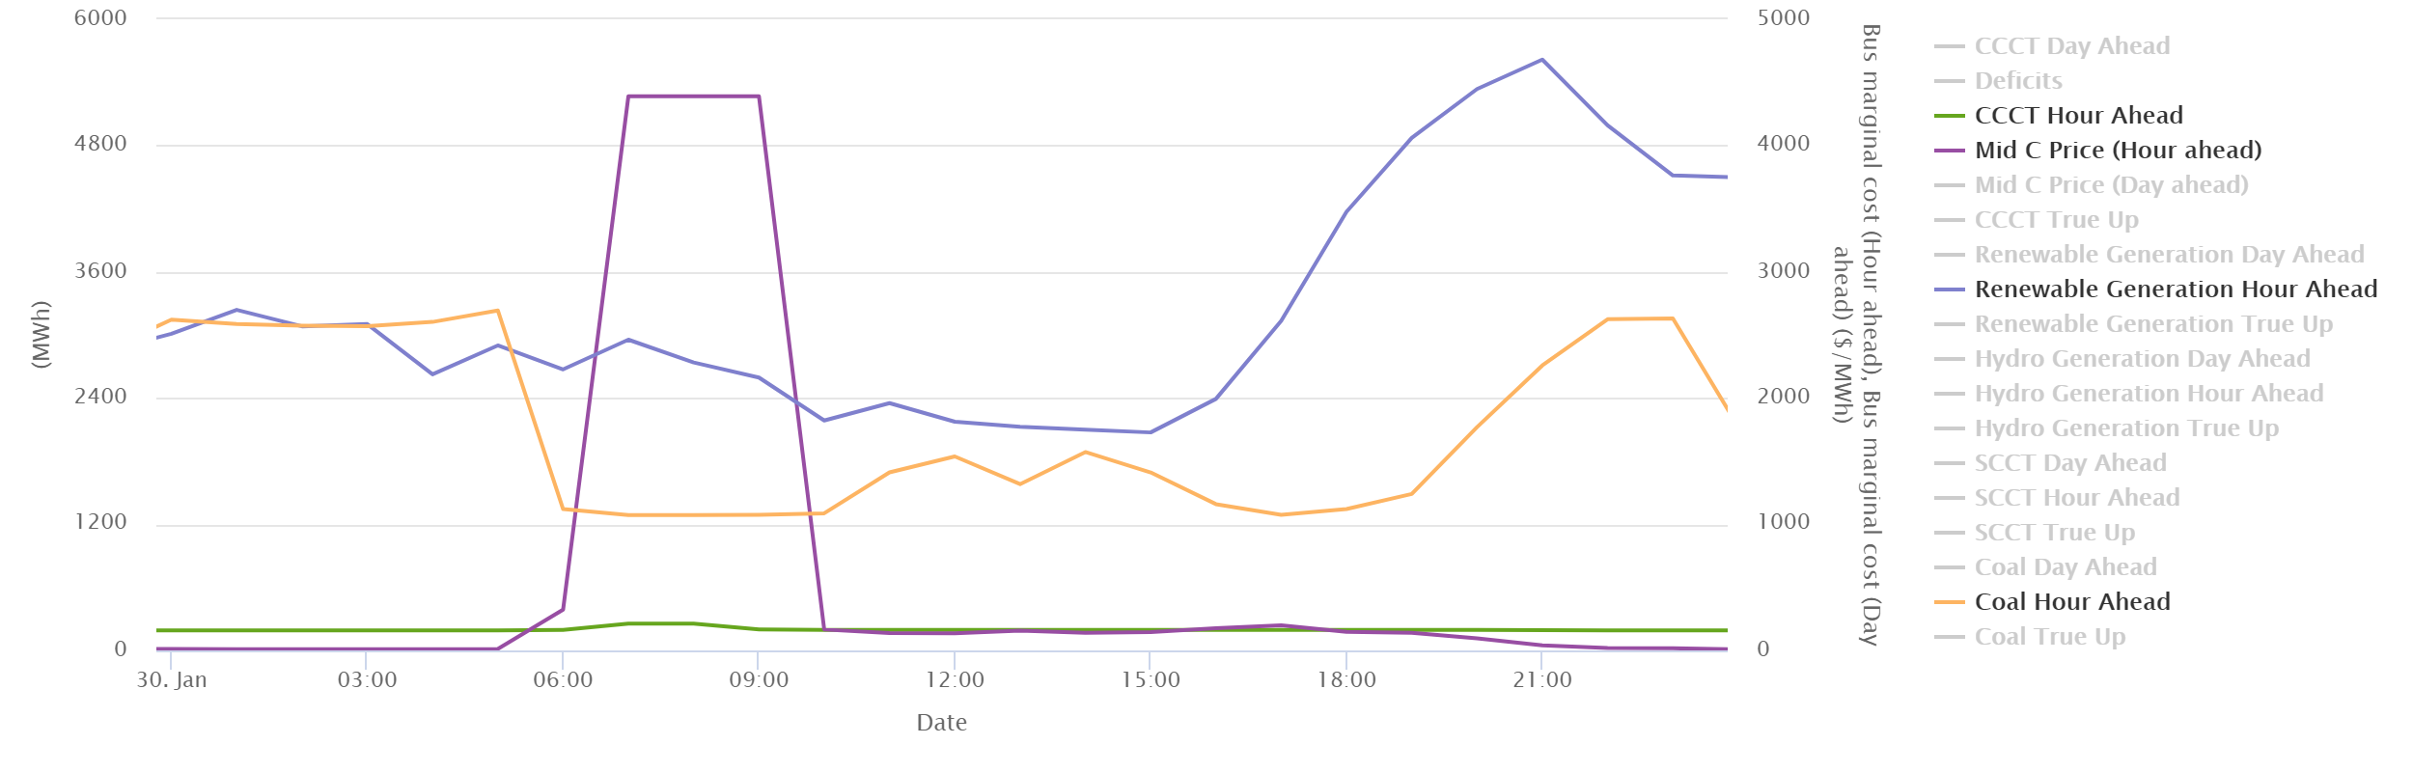
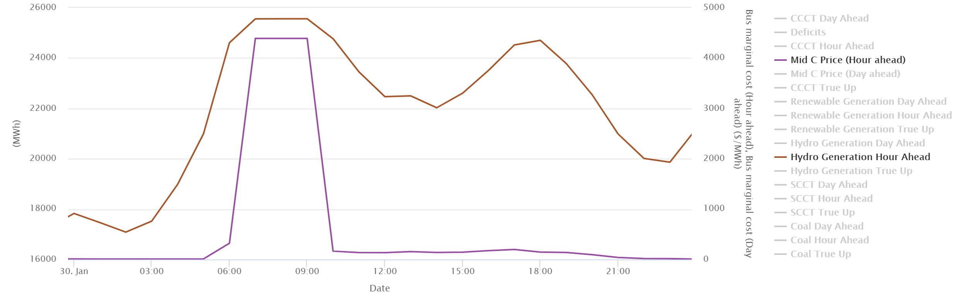
Projected low prices Bridger shuts off
January 30th Deficit
Hour Ahead Plan –
Load forecast increases 2000 MW
Thermal Unit Commitment:
190 MW of CCCT gas and 1300 MW to 3200 MW of coal committed
Planned Renewable Gen:
2000 MW midday to over 5600 MW end of day (600 MW less than planned during morning ramp)
Planned Hydro Gen:
Ramps up to hit morning and evening ramps 8000 and 3000 MW respectively. Runs into limits of capability in morning ramp hours
Prices and Market:
Average under $8/MWh in morning until Bridger shuts off during non-ramping hours then deficit pricing and $100/MWh pricing until the next evening. Imports to limits from 5 am to 9 pm

Slide 28
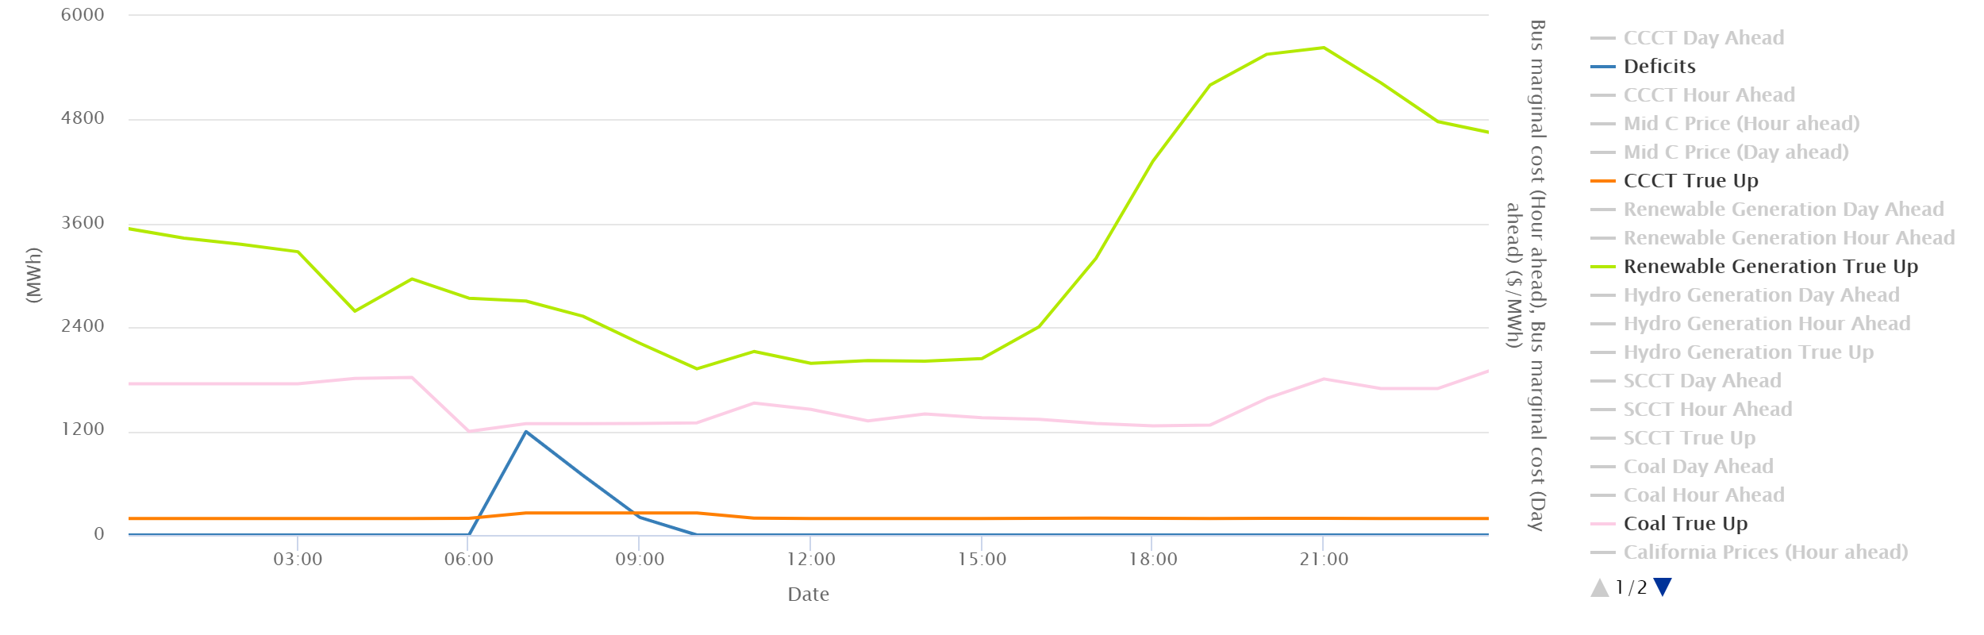
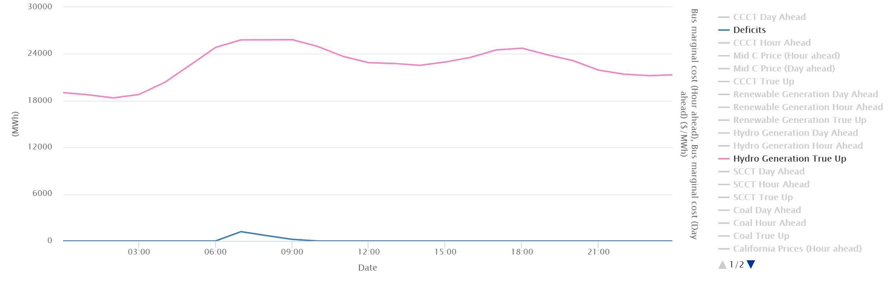
Not enough units online to have flexibility to meet additional forecast error
January 30th Deficit
Actual Operations (simulated) –
Load 2000 MW higher than day-ahead forecast
Thermal Generation:
190 MW of CCCT gas and 1300 MW to 1800 MW of coal generation
Renewable Gen:
2000 MW midday to over 5600 MW end of day (850 MW less than initial plan during morning ramp)
Hydro Gen:
Ramps up to hit morning and evening ramps 7000 and 2000 MW respectively. Runs into limits of capability in morning ramp hours
Market:
Imports to limits from 5 am to 9 pm, no additional market available.

Slide 29
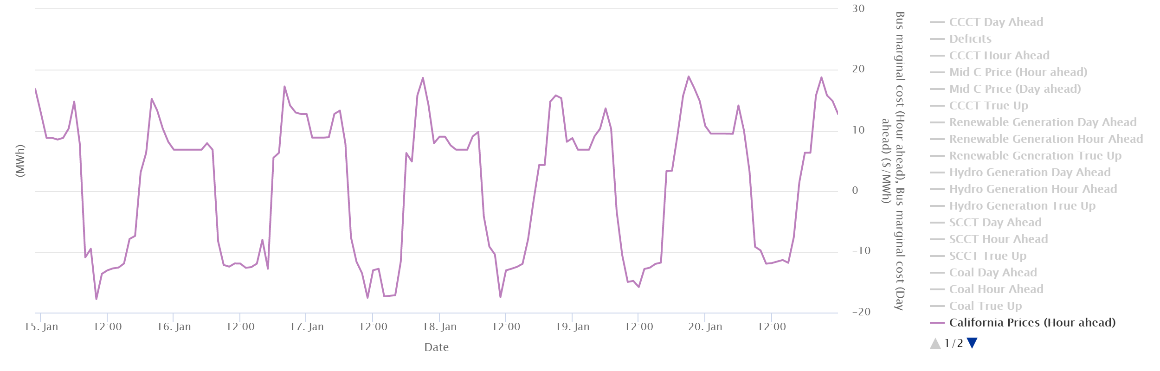
What Happened?
Prices were forecasted to be low all day, especially for all hours midday and overnight when larger gas units (CCCTs) order fuel and when coal units have time to ramp up.
Hydro and renewable generation, a few regional coal units and market imports only resources available to address any changes moving into the day.
Not much additional room on the hydro available for ramping, so when renewable forecast in the hour ahead time frame indicated lower planned generation and much higher loads, not enough resource available on a planning basis.

Slide 30
What Might Actually Happen?
Regional operators/schedulers might be more conservative and not go as deep into the low priced market. (more reserves)
  Energy Imbalance Market might defray some of these issues, but it is unclear
  No coordinated NW market on a day-ahead basis
Intraday gas availability might support some gas units committing after the day-ahead time period
Extra-regional markets might be more deeper than our current market reliance limits and not go as deep into the low priced market. (higher market reliance)

Slide 31
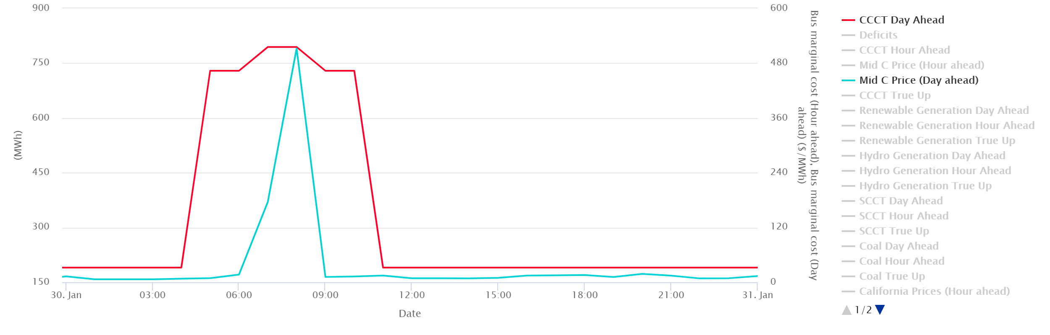
With Increased Reserves, More Thermal Units Commit and Imports before Ramp
Due to increased reserves, Mid-C Prices are raised in the day-ahead planning which supports more imports and thermal plant commitment
Which allows the regional hydro and thermal to have more capability to respond to forecast error
Same hydro, load and renewable conditions, but no deficit due to increased reserves

Slide 32

Comparing Costs of Reserve Strategies
Emulate the cost analysis done in resource strategy analysis
  Fixed cost investment in resource/reserve
  Variable costs
  Value
  Adequacy
This Photo by Unknown Author is licensed under CC BY-SA

Slide 33
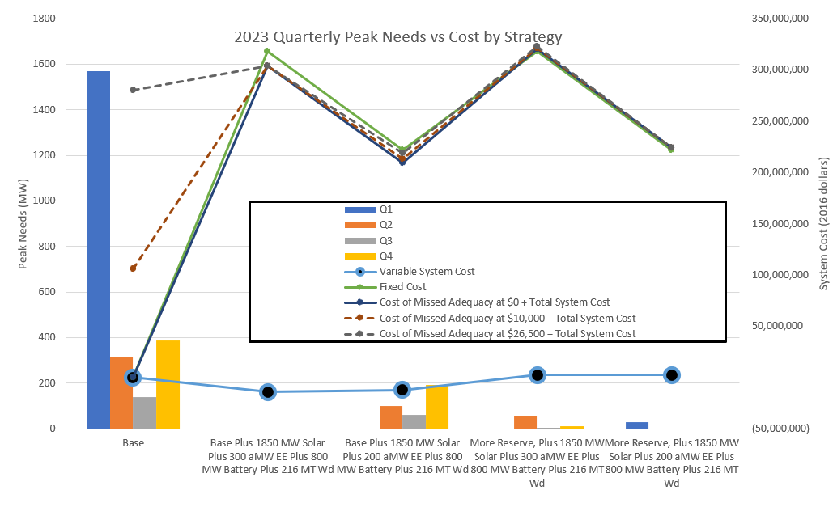
More EE or More Conservative Utilization of Existing System?

Slide 34
What Can We Do in a Resource Strategy?
Invest in more resources that are either always available or valuable used in conjunction with reserves
  One of the traditional tools to support adequacy might not help much without reserves: CCCTs
  SCCTs, energy storage and some DR products might help, but will likely be used infrequently and likely would be most useful when used with reserves
  Additional investment in EE can eliminate these issues but might more expensive than other solutions in the long run
Hold back additional reserves to better utilize the existing system
  For example, in a test to emulate the price support in overnight periods in 2027 we increased the reserves by 3100 MW to better prepare for the ramping periods. Holding additional operational reserves overnight eliminated many but not all of these issues (dropped LOLP from 16% to 7%) by allowing for a higher utilization of the existing system.
Increase reliance on the extra-regional market
  This tends to be the least expensive on an expected basis, but traditionally the riskiest solution
Combination of strategies
  The regional buildout from the RPM plus significant additional reserves better utilizes the existing system for adequacy and seems to be the least expensive, adequate solution.
  It is promising that regional collaboration is already happening on the RA from per the NWPP RA effort, but perhaps an expanded scope is needed to address these forecasted near-term operational challenges.
  EE seems to be the most effective resource at addressing adequacy issues. If counting on regional collaboration to better utilize existing system seems too risky, further investment than identified in the RPM could be required to maintain adequacy.

Slide 35
Resource Additions and Reserve Strategies Can Both Be Used to Maintain Adequacy
Increasing reserves improves regional adequacy and can be a low cost method to temporarily deal with planning shortfalls associated where the existing system is underutilized.
Energy efficiency improves regional adequacy but will need work well with solar to keep overall costs down.
New solar generation within the region does not improve regional adequacy, but decreases system costs enough that any reserve or resource strategies likely will need work well with solar even though it causes operational challenges.

Slide 36
Questions
John Ollis
jollis@nwcouncil.org

Slide 37
Additional Slides

Slide 38
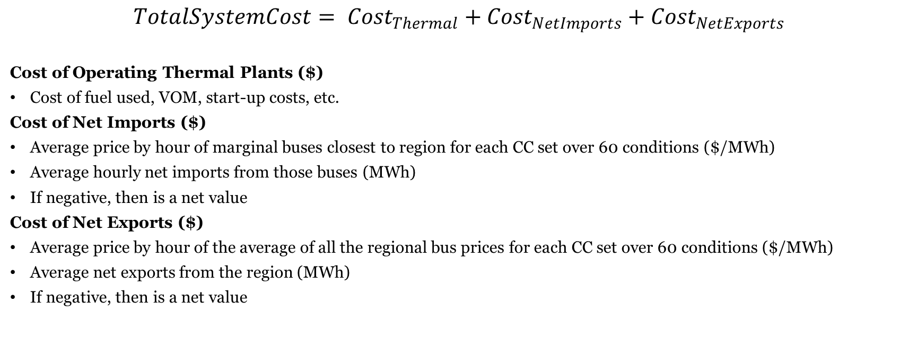
How can we Compare the Variable Costs and Value of those Strategies in GENESYS?
$$TotalSystemCost= {Cost}_{Thermal}+{Cost}_{NetImports}+{Cost}_{NetExports}$$
Cost of Operating Thermal Plants ($)
Cost of fuel used, VOM, start-up costs, etc.
Cost of Net Imports ($)
Average price by hour of marginal buses closest to region for each CC set over 60 conditions ($/MWh)
Average hourly net imports from those buses (MWh)
If negative, then is a net value
Cost of Net Exports ($)
Average price by hour of the average of all the regional bus prices for each CC set over 60 conditions ($/MWh)
Average net exports from the region (MWh)
If negative, then is a net value

Slide 39
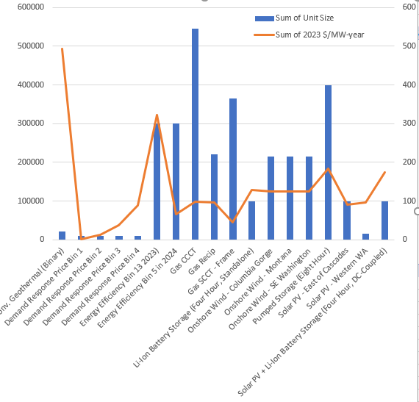
Use Levelized Fixed Costs
Note that the levelized cost is in 2016 dollars per MW-year with the exception of EE which is in 2016 dollars per aMW-year
Additionally, if the amount of EE tested was available one year later the cost goes down considerably

Slide 40
Costs Associated with Adequacy
Just for illustrative purposes let’s assign an adequacy MWh above the Council’s standard a cost. Let’s make those costs of the magnitudes that get discussed in value of lost load studies, here are two examples.
  10,000 $/MWh
  26,500 $/MWh
We are not saying this is the cost of an adequacy event, but it is likely to be expensive. For example, the events on the western grid in 2001 had a very high cost, but the lights still stayed on.

Slide 41
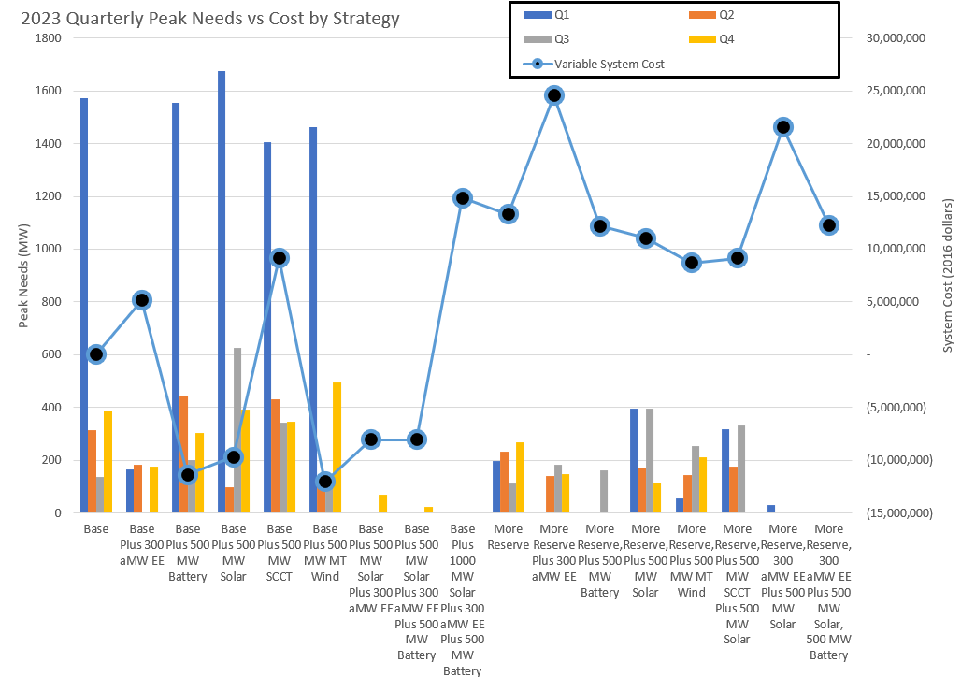
Variable Costs
Increasing reserves and adding EE increase variable system costs.
Renewables, batteries and DR lower variable system costs
Adequate strategies

Slide 42
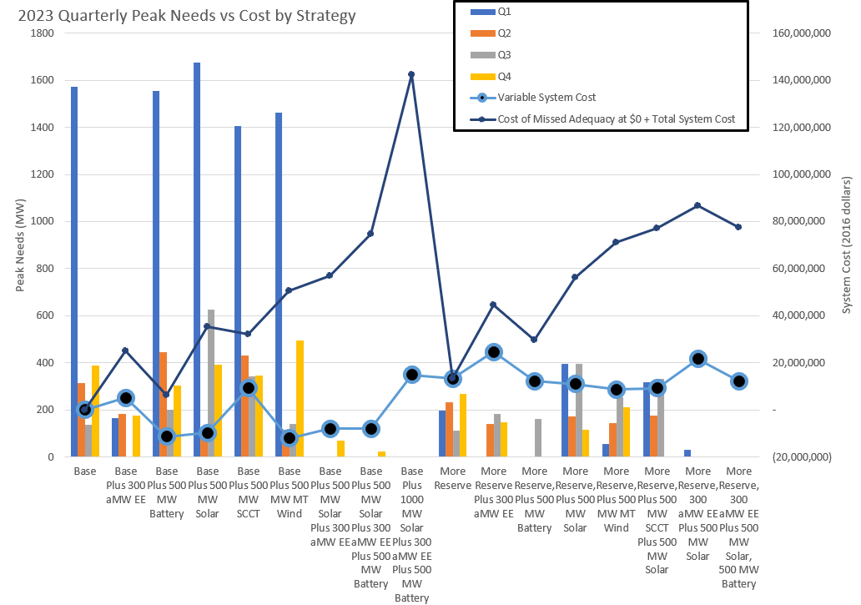
Total System Costs w/o Adequacy Consideration
Low fixed cost resources like DR, Solar, and less expensive EE are lower cost but have very different adequacy outcomes.
Adequate strategies

Slide 43
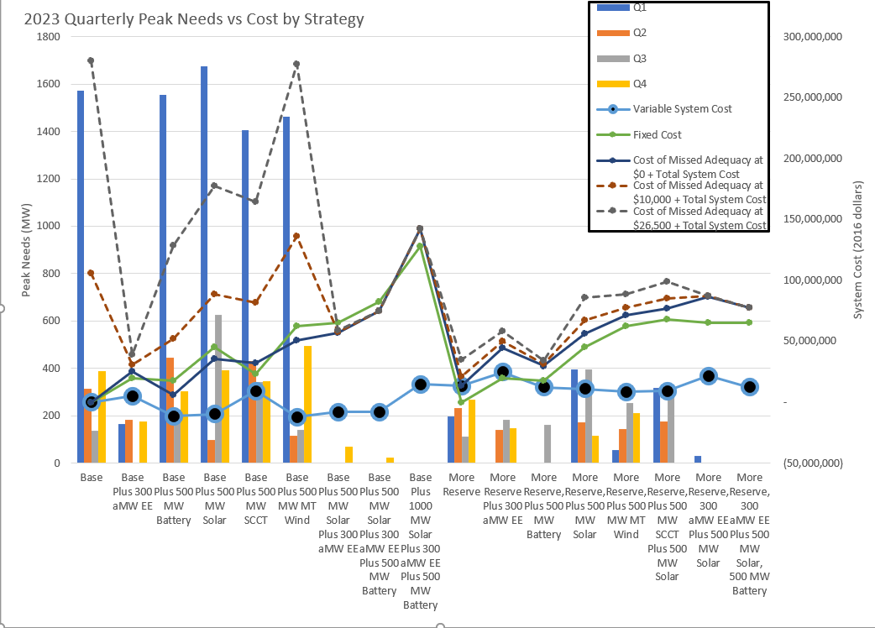
Strategy Highlights
Increasing reserves is a less expensive way to reduce need in the short run.
Solar in general creates more need but lowers costs
EE is a key feature of all the most adequate systems
Adequate strategies

Slide 44
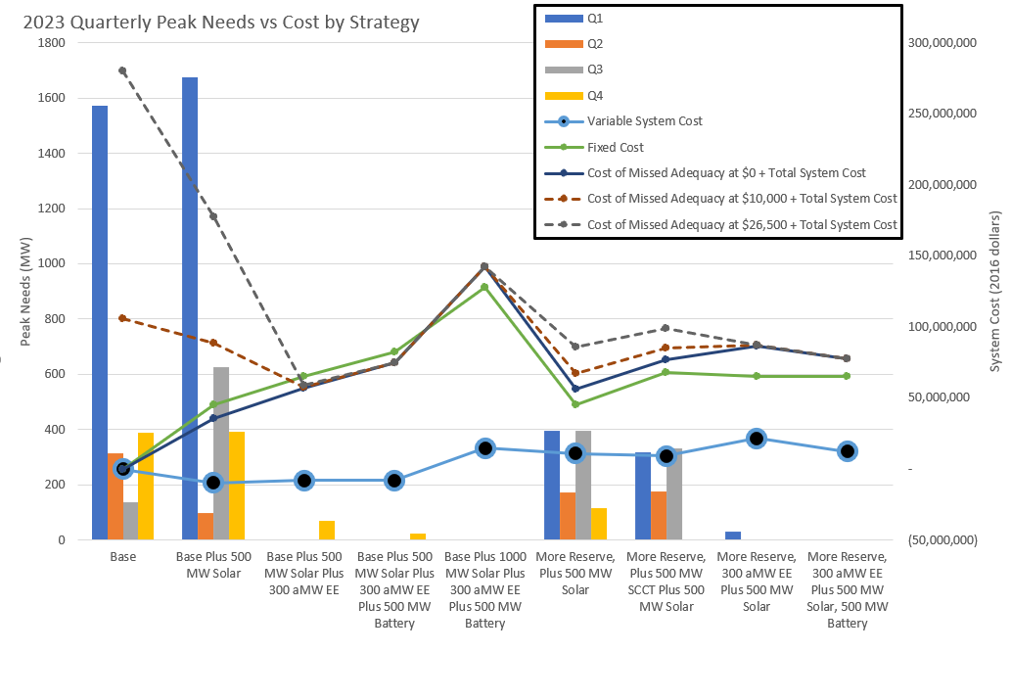
Strategy Highlights – Portfolios with Solar
Increasing reserves is a less expensive way to reduce need in the short run.

Slide 45
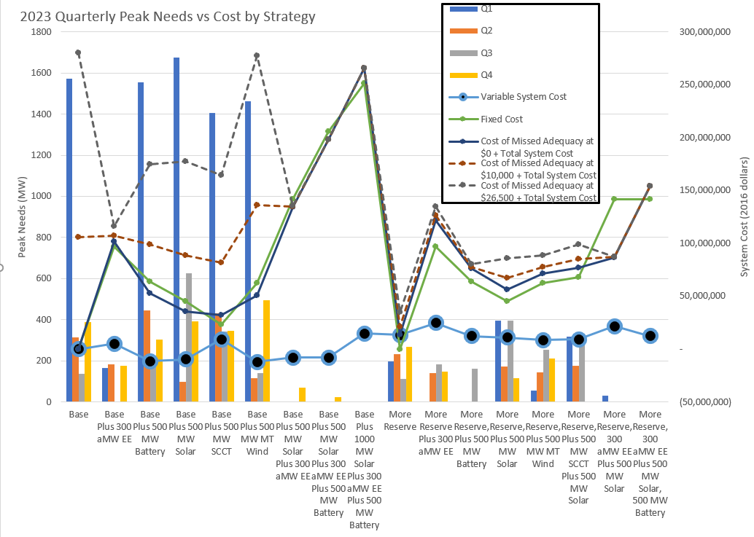
Strategy Highlights
Increasing reserves is a less expensive way to reduce need in the short run.
More expensive EE does not necessarily have need reduction value to offset the higher cost
Batteries are less cost-effective than DR at being used as a reserve
Adequate strategies

Slide 46
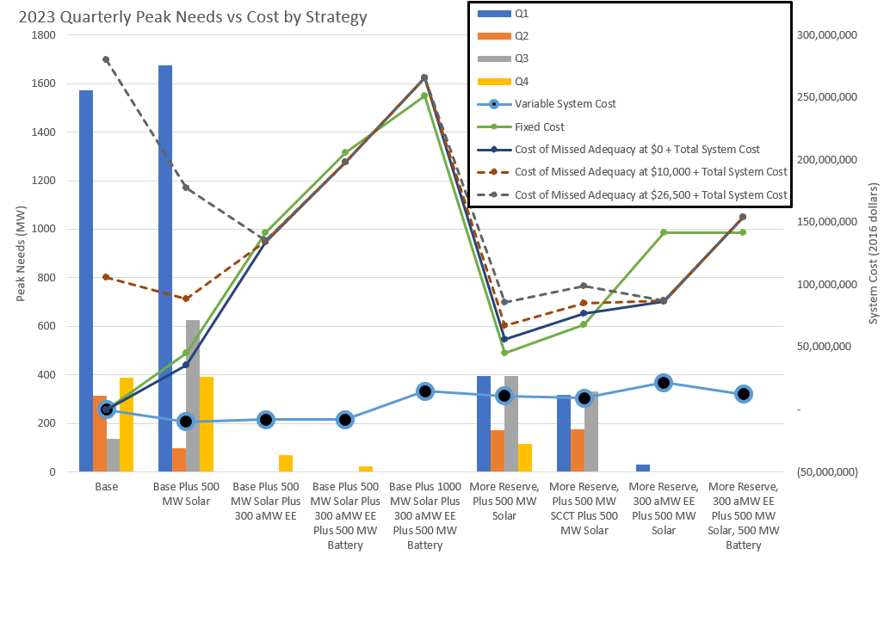
Strategy Highlights – Portfolios with Solar
Increasing reserves is a less expensive way to reduce need in the short run.

Slide 47
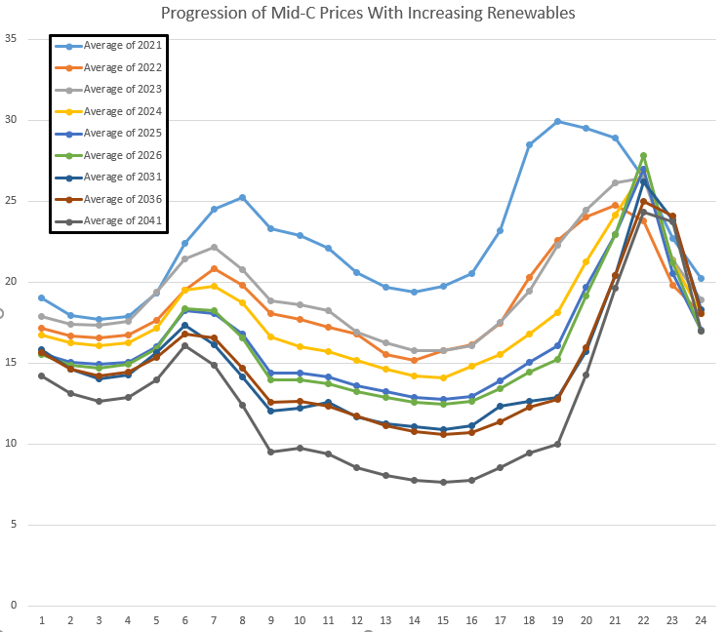
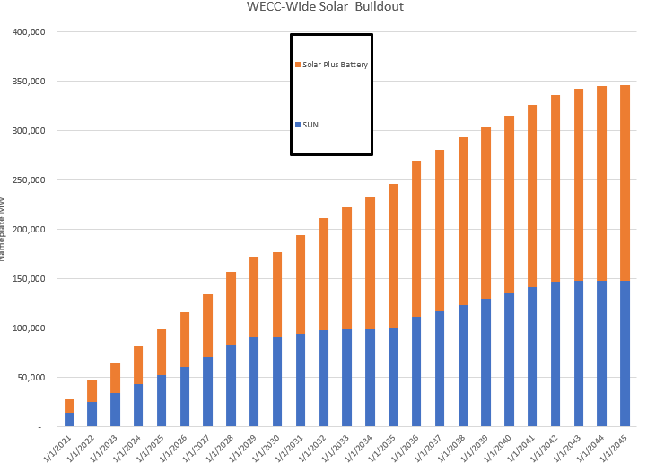
Daily shape changes with more WECC- wide solar

Slide 48


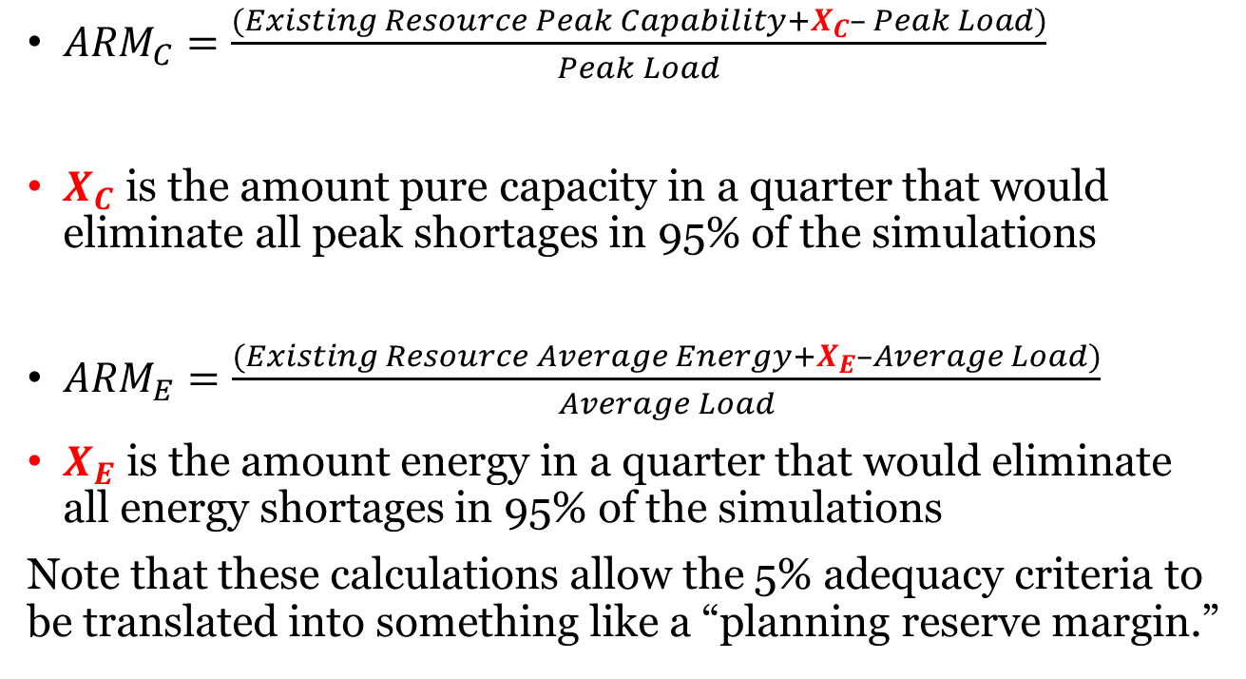
Review: Calculation of Adequacy Reserve Margins
${ARM}_{C}=\frac{(Existing Resource Peak Capability+X_{C}– Peak Load)}{Peak Load}$
$X_{C}$ is the amount pure capacity in a quarter that would eliminate all peak shortages in 95% of the simulations
${ARM}_{E}=\frac{(Existing Resource Average Energy+X_{E}–Average Load)}{Average Load}$
$X_{E}$ is the amount energy in a quarter that would eliminate all energy shortages in 95% of the simulations
Note that these calculations allow the 5% adequacy criteria to be translated into something like a “planning reserve margin.”

Slide 49
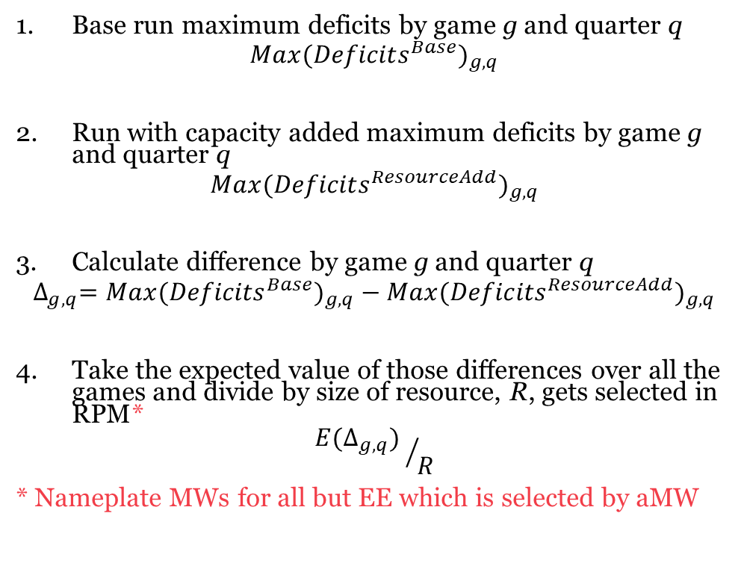
Modified ASCC Methodology –
Using two sets of GENESYS simulations
Base run maximum deficits by game g and quarter q
$${Max({Deficits}^{Base})}_{g,q}$$
Run with capacity added maximum deficits by game g and quarter q
$${Max({Deficits}^{ResourceAdd})}_{g,q}$$
Calculate difference by game g and quarter q
$${{∆_{g,q}=Max({Deficits}^{Base})}_{g,q}−Max({Deficits}^{ResourceAdd})}_{g,q}$$
Take the expected value of those differences over all the games and divide by size of resource, R, gets selected in RPM*
$${{E(∆}_{g,q}) }/R$$
* Nameplate MWs for all but EE which is selected by aMW
Peak needs before adding resources
Peak needs after adding resources
Peak needs reduction by adding resources
Expected peak needs contribution by adding resources

Slide 50
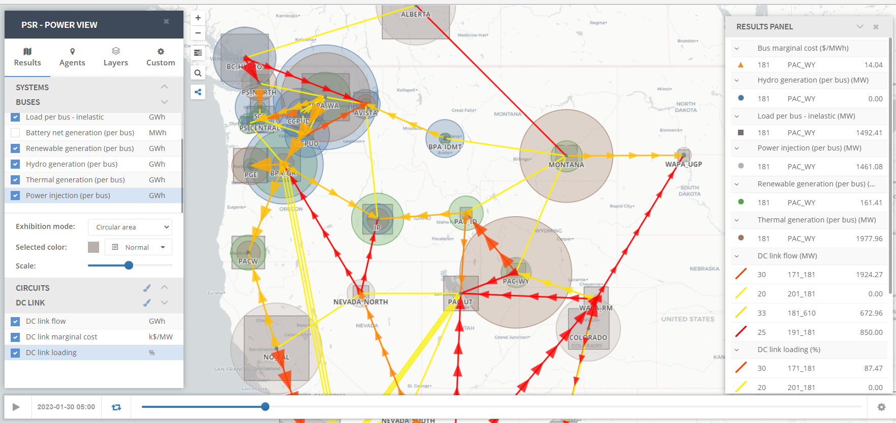

Slide 51
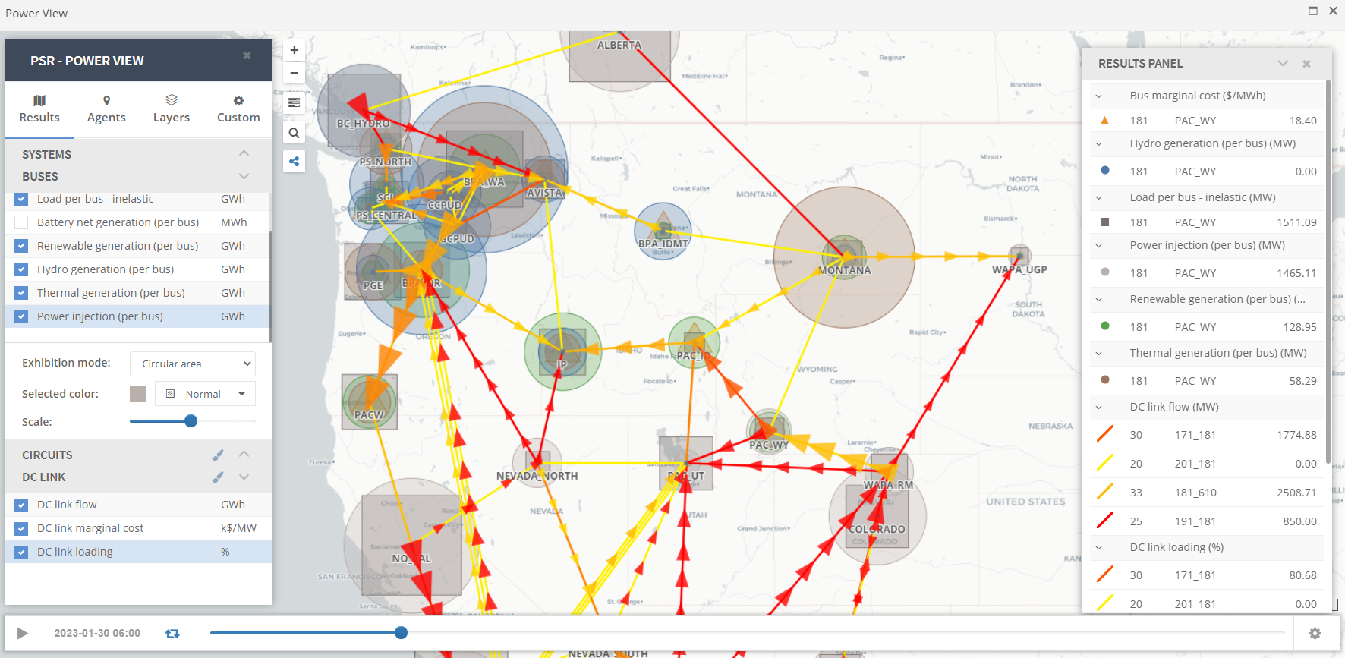

Slide 52
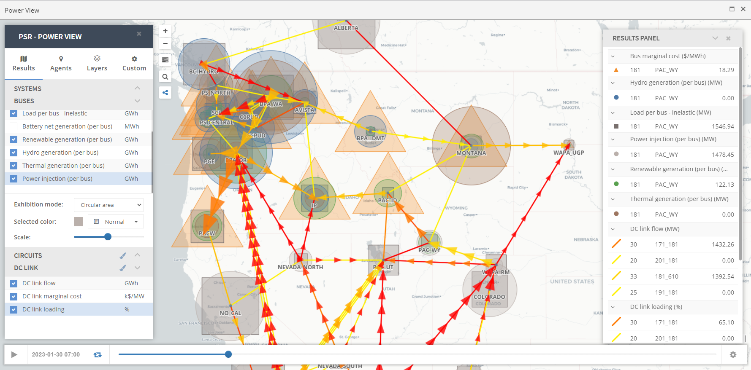

Slide 53
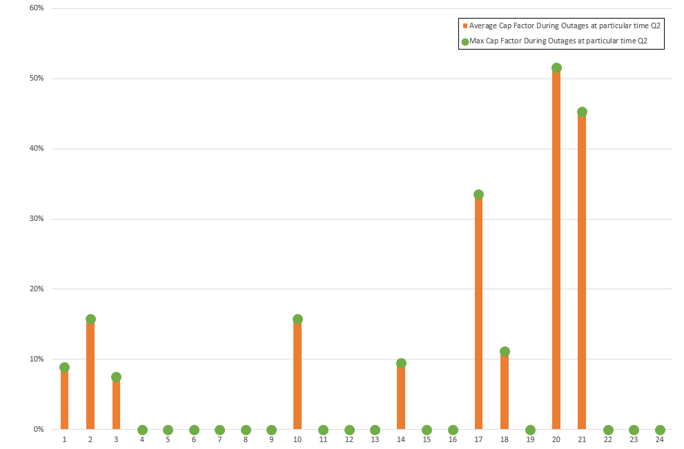
2023 Spring Thermal Generation Capacity Factors During Outages Always Lower Than 55%

Slide 54
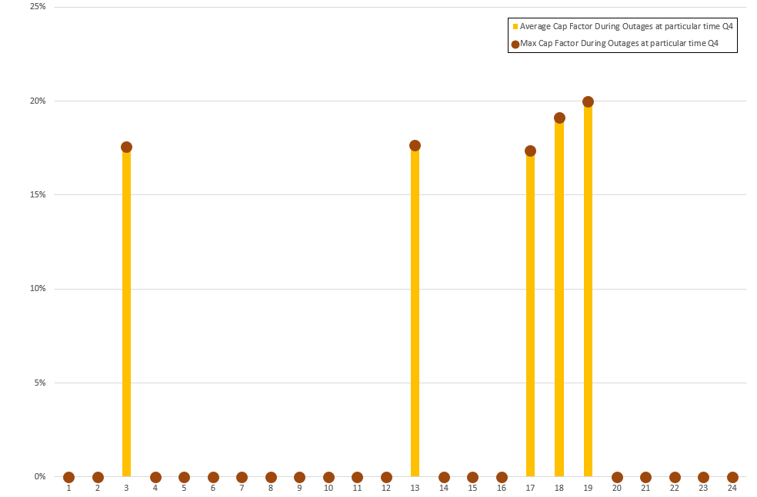
2023 Fall Thermal Generation Capacity Factors During Outages Always Lower Than 20%

Slide 55
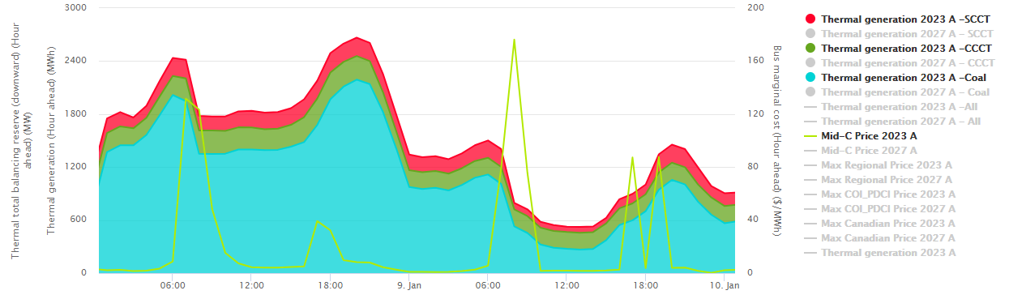

There were at least 10 GW more thermal not generating

