Slide 1
Unit Commitment Challenges Leading to Adequacy Issues
System Analysis Advisory Committee
5/19/2021
John Ollis

Slide 2
Summary
All the needs in our current assessments can be solved with a mix of the following:
  More resources
  More reserves
  More market exposure
Most deficits and high pricing events occur during the morning and evening ramps (5 am to 10 am) and (5 pm to 10 pm), respectively.
During deficit events in our simulations, thermal generation is not fully utilized due to low prices midday and overnight.
Investing in new resources can be costly and increasing market exposure can open the region up to additional risks
Operating more conservatively, or said differently, increasing reserves to support the morning and evening ramps can alleviate operational challenges

Slide 3
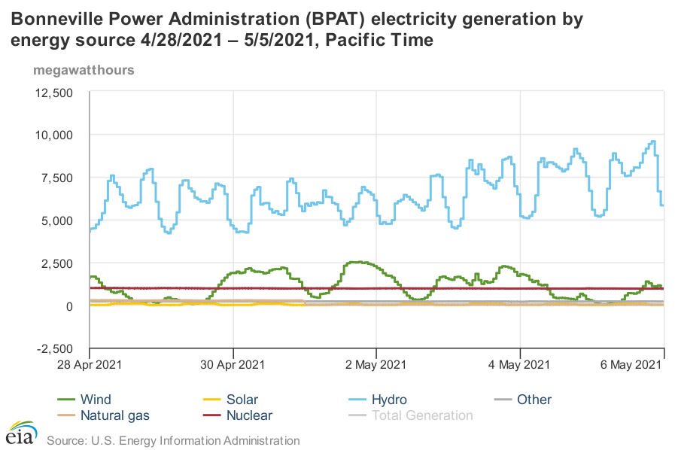
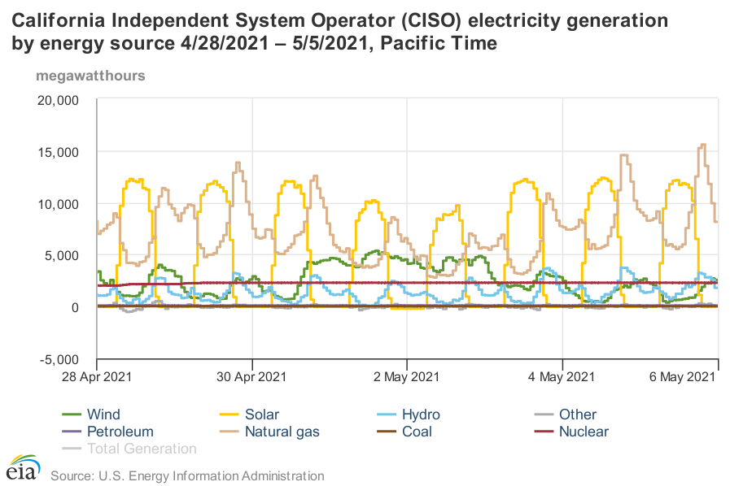
Current Hourly Operations Show Discretionary Hydro and Thermal Generation Pushed to Ramps and Overnight Periods https://www.eia.gov/electricity/gridmonitor/dashboard/

Slide 4
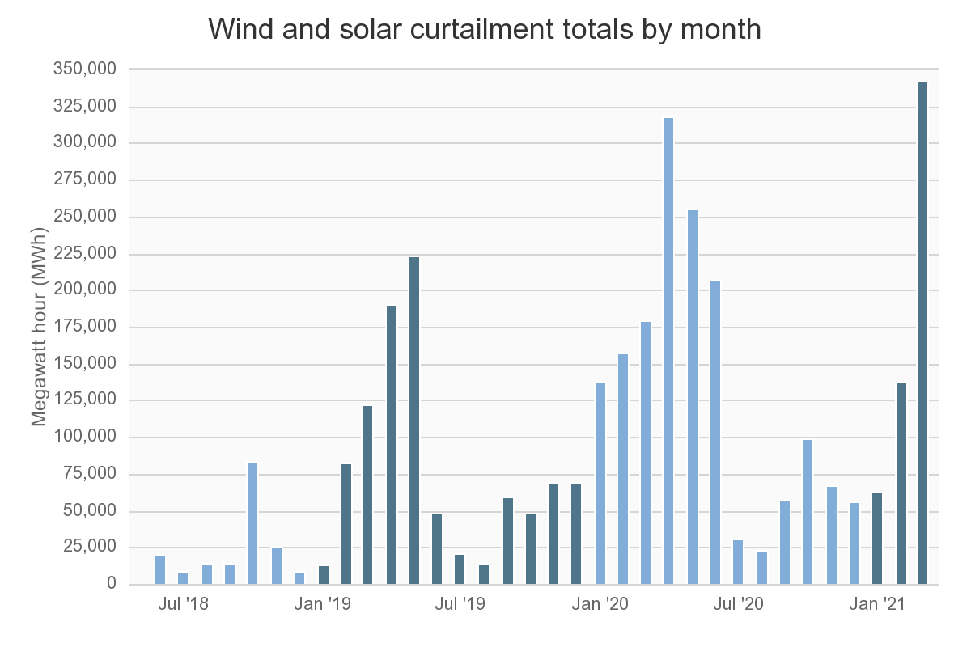
California Already Experiencing Ramping Issues Related to Renewables
Data Source:
http://www.caiso.com/informed/Pages/ManagingOversupply.aspx
Flexible Ramping Product:
https://www.oasis.oati.com/PPW/PPWdocs/2016-06-24_FlexibleRampingProduct_ER16-2023.pdf
https://www.caiso.com/Documents/DraftFinalTechnicalAppendix-FlexibleRampingProduct.pdf

Slide 5
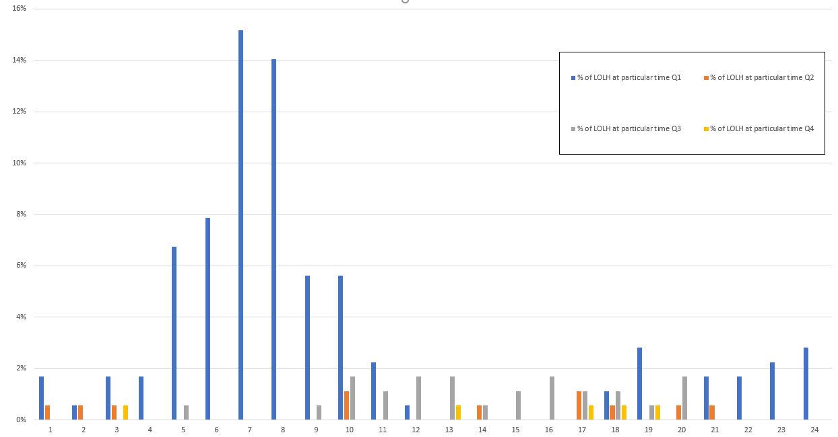
Issues in 2023 by Time of Day
Loss of Load Event Beginning Hours
Most winter adequacy issues overnight or during ramping periods
Most summer adequacy issues during mid-day and evening ramp

Slide 6
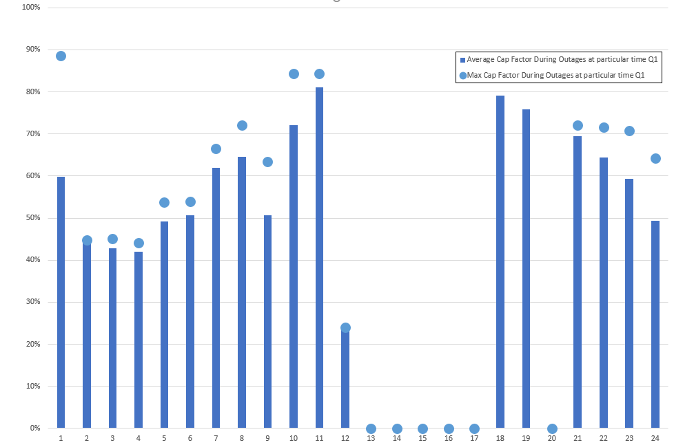
2023 Winter Thermal Generation Capacity Factors During Outages Always Lower Than 90%

Slide 7
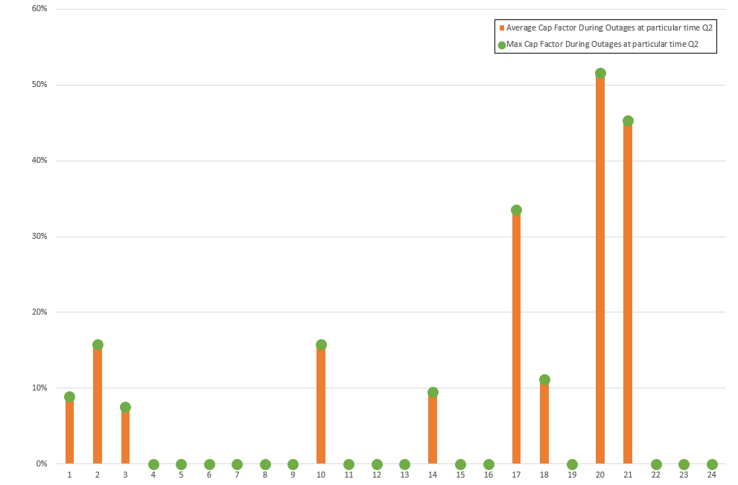
2023 Spring Thermal Generation Capacity Factors During Outages Always Lower Than 55%

Slide 8
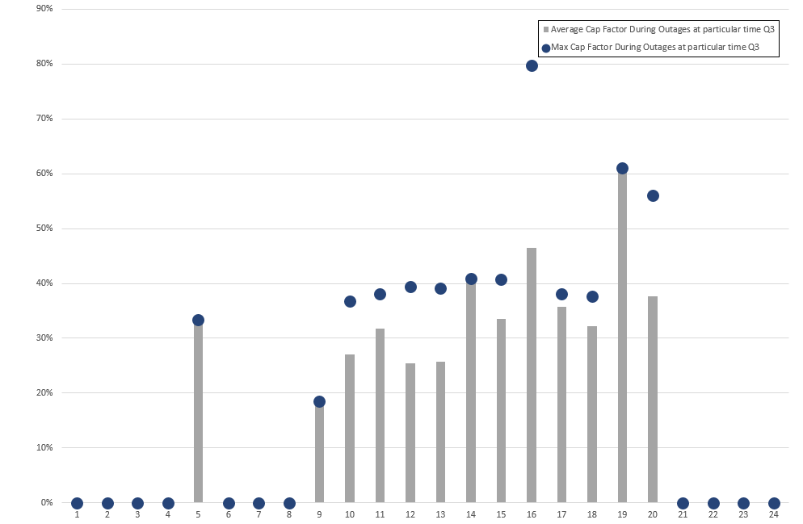
2023 Summer Thermal Generation Capacity Factors During Outages Always Lower Than 80%

Slide 9
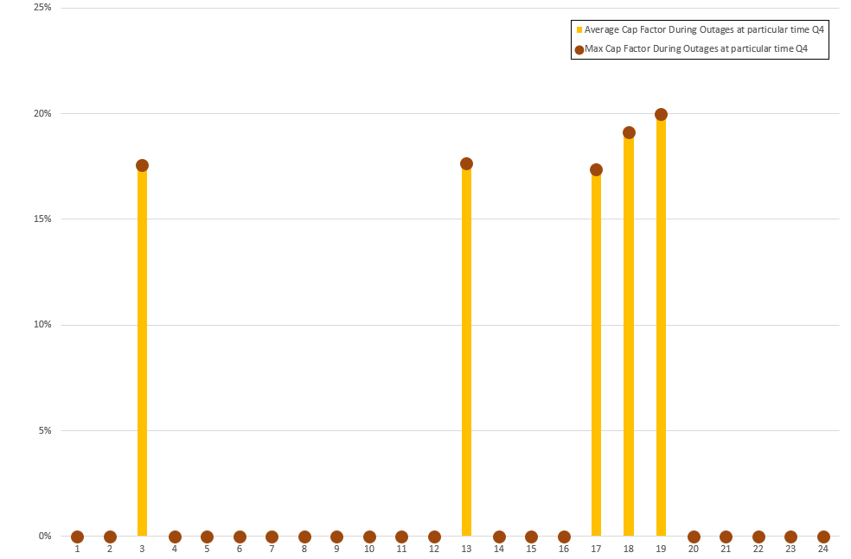
2023 Fall Thermal Generation Capacity Factors During Outages Always Lower Than 20%

Slide 10

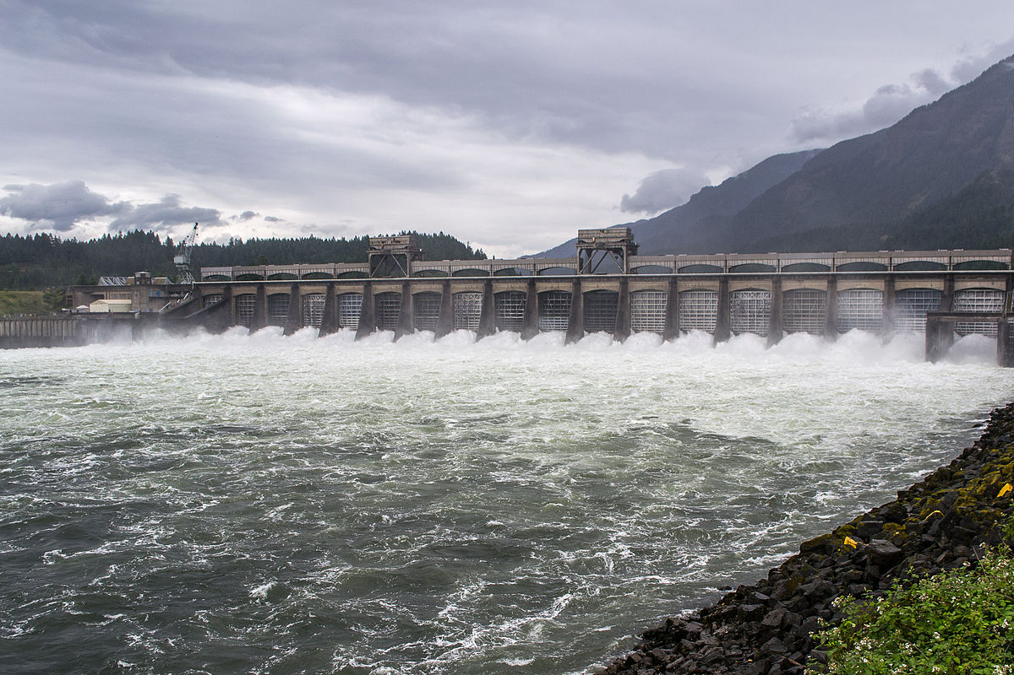
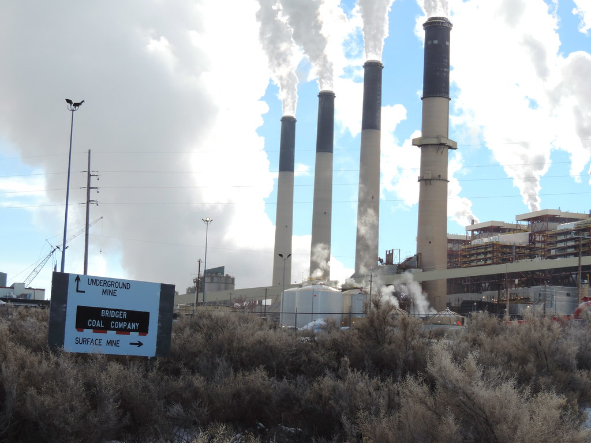
Example
Morning Ramp Issues (A2 – Baseline)
  Renewable generation high in day-ahead competing with coal and CCCT units
  Coal and gas units decommit.
  Renewable generation forecast drops and regional load forecast is higher after day-ahead forecasts (between 2500 MW and 3000 MW of total forecast error)
  Hydro generation and market cannot make up difference due to congestion on some lines
This Photo by Unknown Author is licensed under CC BY-NC-ND

Slide 11
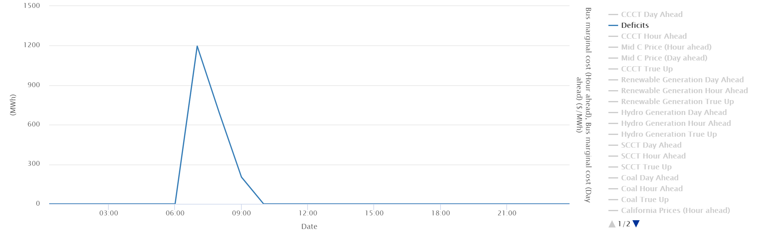
Morning Ramp Issue

Slide 12
Issue – Bridger Shuts Down Before the Morning Ramp
High wind day-ahead forecast in Wyoming and low price forecast cause Bridger to shut down before the morning ramp at 5 am
Regional coal and hydro units holding contingency and balancing reserves
Hour ahead wind forecast in Wyoming is lower by nearly 600 MW
Market was importing at regional limits from 7 am to 6 pm in day ahead corresponding with midday negative pricing in California
With forecasted drop in renewable generation (a few hours ahead) regional prices are higher than external market prices so the region imports and Bridger shuts off earlier than planned in the day-ahead plan
Bridger cannot turn back on due to minimum down time requirement
Hydro ramps up to full capability but cannot generate more without violating constraints or leaving region short on reserves
Not enough other thermal plants to respond on due to low prices during midday and overnight (SCCTs respond but are not enough)

Slide 13
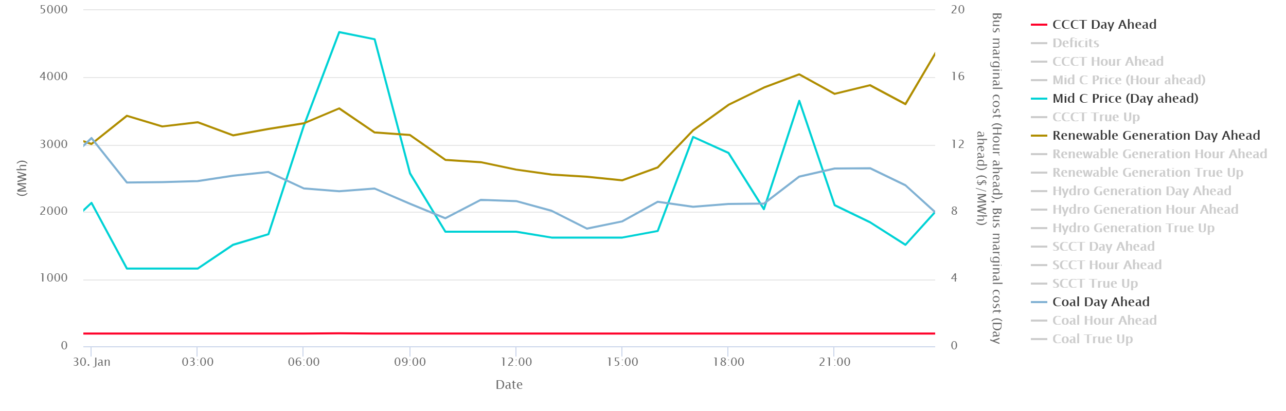
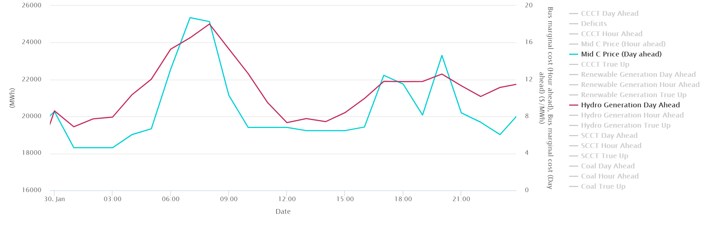
Morning Ramp Issue – January 30th Deficit
Day Ahead Plan
Thermal Unit Commitment:
190 MW of CCCT gas and 1750 MW to 3000 MW of coal committed
Planned Renewable Gen:
2500 MW midday to over 4000 MW end of day
Planned Hydro Gen:
Ramps up to hit morning and evening ramps 4000 and 2000 MW respectively.
Prices and Market:
Average under $8/MWh all day during non-ramping hours. Importing to limits from 7 am to 6 pm

Slide 14
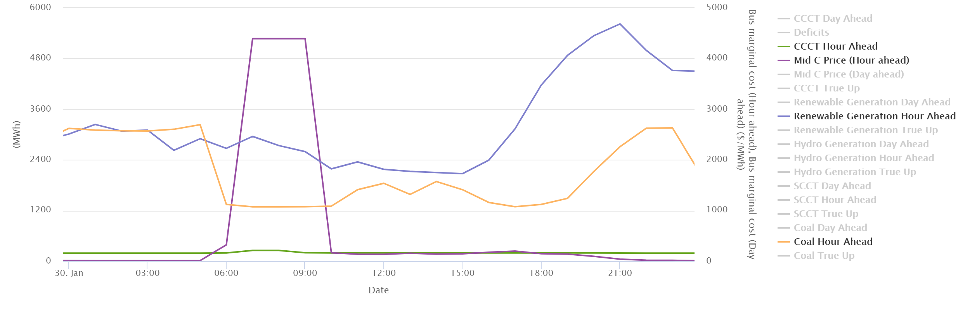
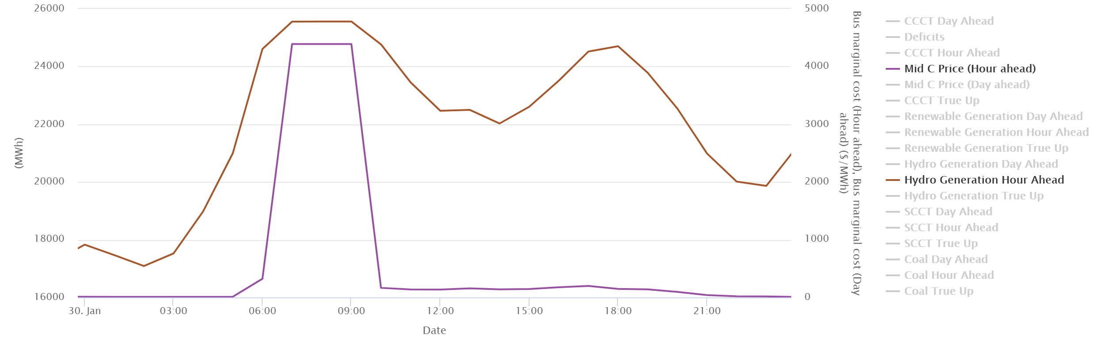
Projected low prices Bridger shuts off
January 30th Deficit
Hour Ahead Plan –
Load increases 2000 MW
Thermal Unit Commitment:
190 MW of CCCT gas and 1300 MW to 3200 MW of coal committed
Planned Renewable Gen:
2000 MW midday to over 5600 MW end of day (600 MW less than planned during morning ramp)
Planned Hydro Gen:
Ramps up to hit morning and evening ramps 8000 and 3000 MW respectively. Runs into limits of capability in morning ramp hours
Prices and Market:
Average under $8/MWh in morning until Bridger shuts off during non-ramping hours then deficit pricing and $100/MWh pricing until the next evening. Imports to limits from 5 am to 9 pm

Slide 15
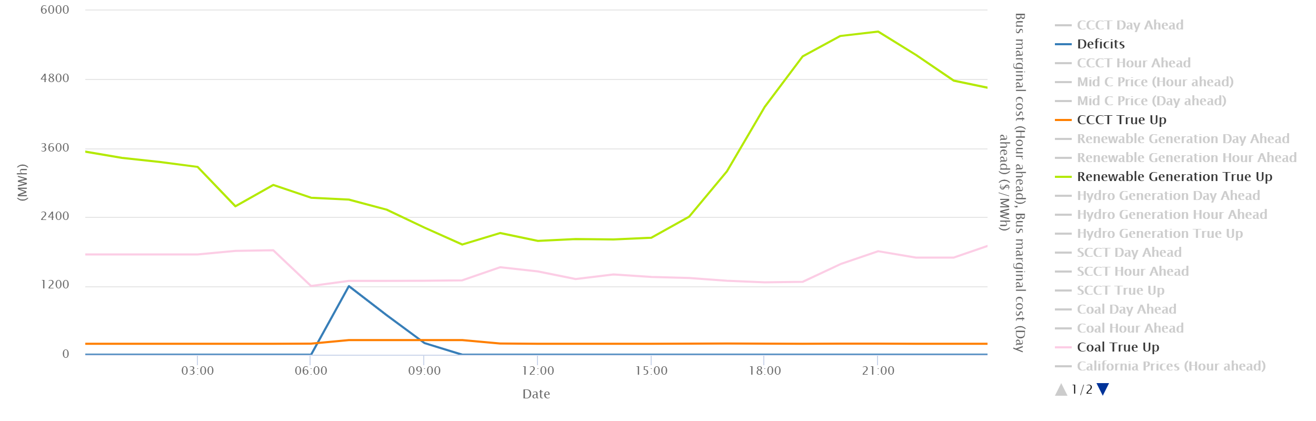
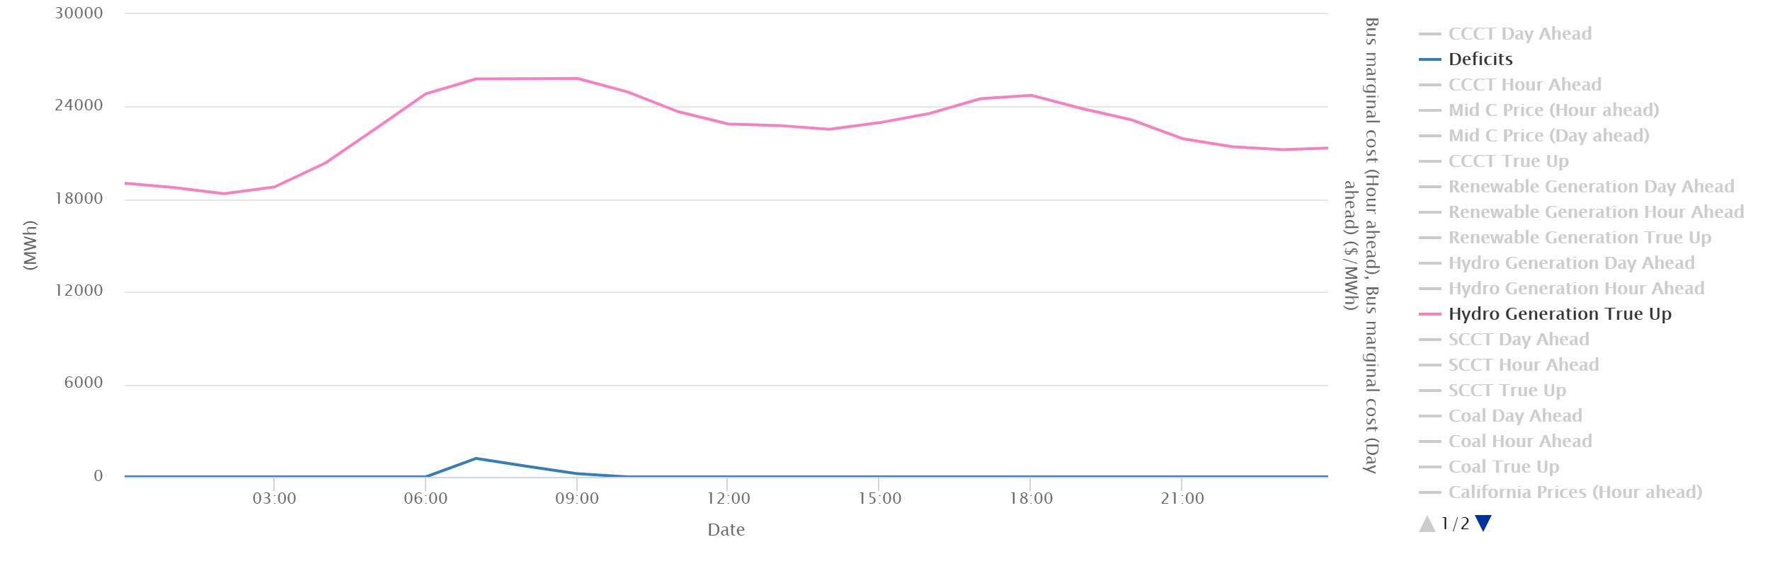
Not enough units online to have flexibility to meet additional forecast error
January 30th Deficit
Actual Operations (simulated) –
Load 2000 MW higher than day-ahead forecast
Thermal Generation:
190 MW of CCCT gas and 1300 MW to 1800 MW of coal generation
Renewable Gen:
2000 MW midday to over 5600 MW end of day (850 MW less than initial plan during morning ramp)
Hydro Gen:
Ramps up to hit morning and evening ramps 7000 and 2000 MW respectively. Runs into limits of capability in morning ramp hours
Market:
Imports to limits from 5 am to 9 pm, no additional market available.

Slide 16
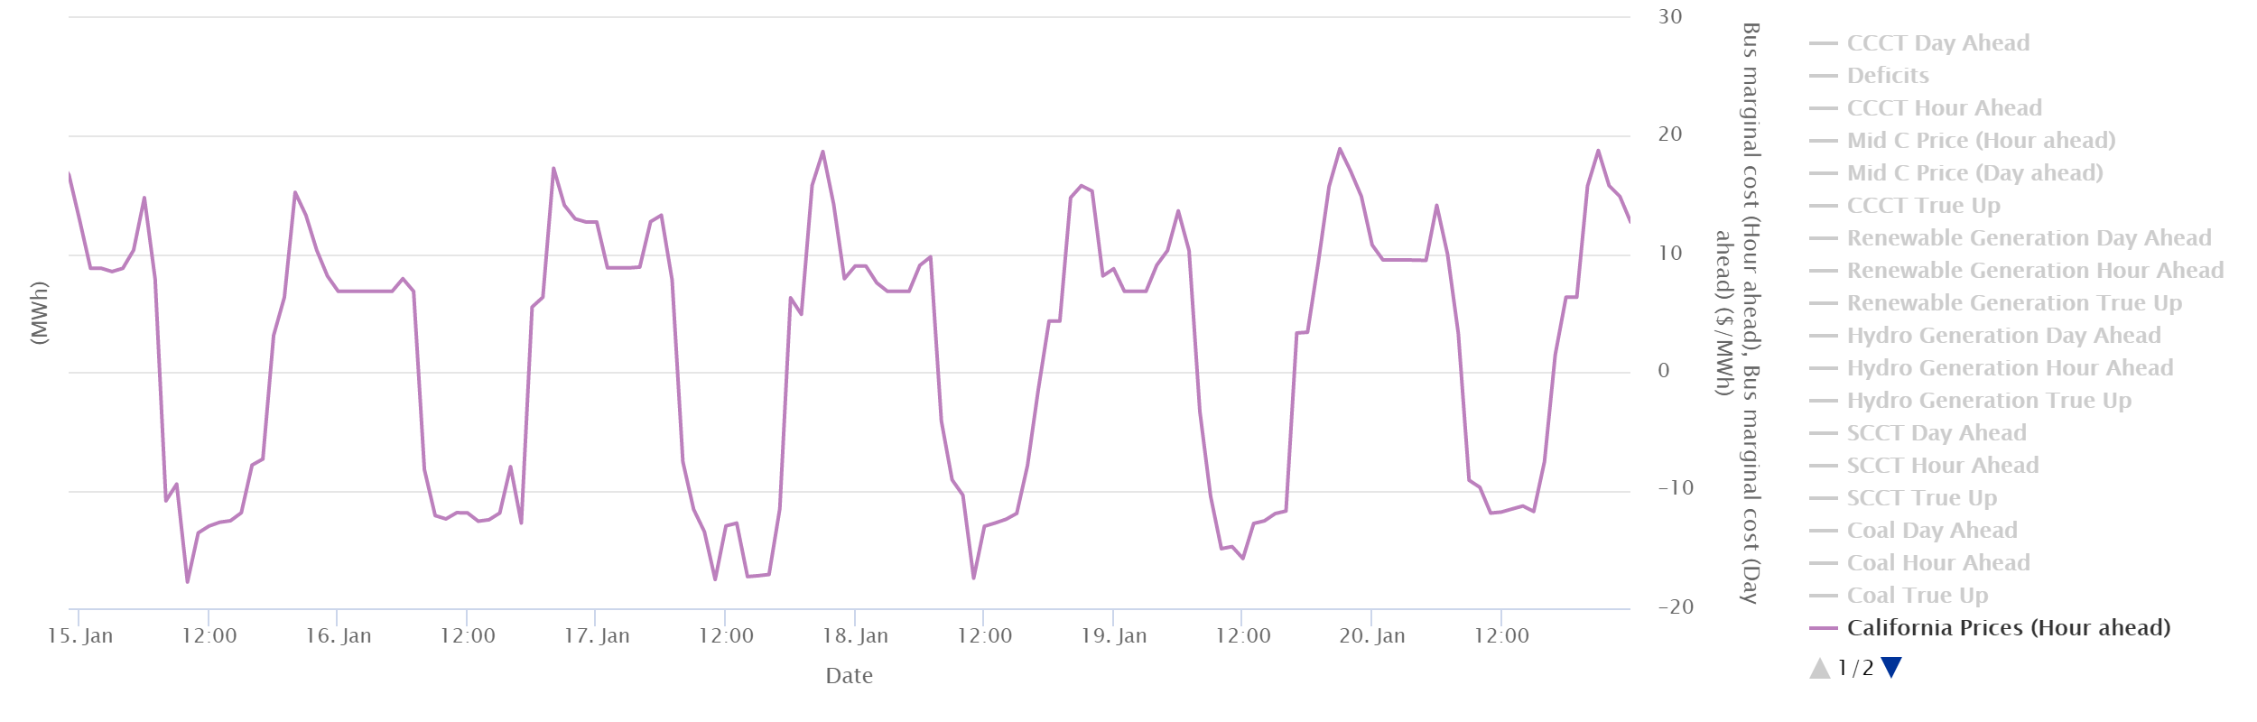
What Happened?
Prices were forecasted to be low all day, especially for all hours midday and overnight when larger gas units (CCCTs) order fuel and when coal units have time to ramp up.
Hydro and renewable generation, a few regional coal units and market imports only resources available to address any changes moving into the day.
Not much additional room on the hydro available for ramping, so when renewable forecast in the hour ahead time frame indicated lower planned generation and much higher loads, not enough resource available on a planning basis.

Slide 17
What Might Actually Happen?
Regional operators/schedulers might be more conservative and not go as deep into the low priced market. (more reserves)
  Energy Imbalance Market might defray some of these issues, but it is unclear
  No coordinated NW market on a day-ahead basis
Intraday gas availability might support gas units committing after the day-ahead time period
Extra-regional markets might be more deeper than our current market reliance limits and not go as deep into the low priced market. (higher market reliance)

Slide 18
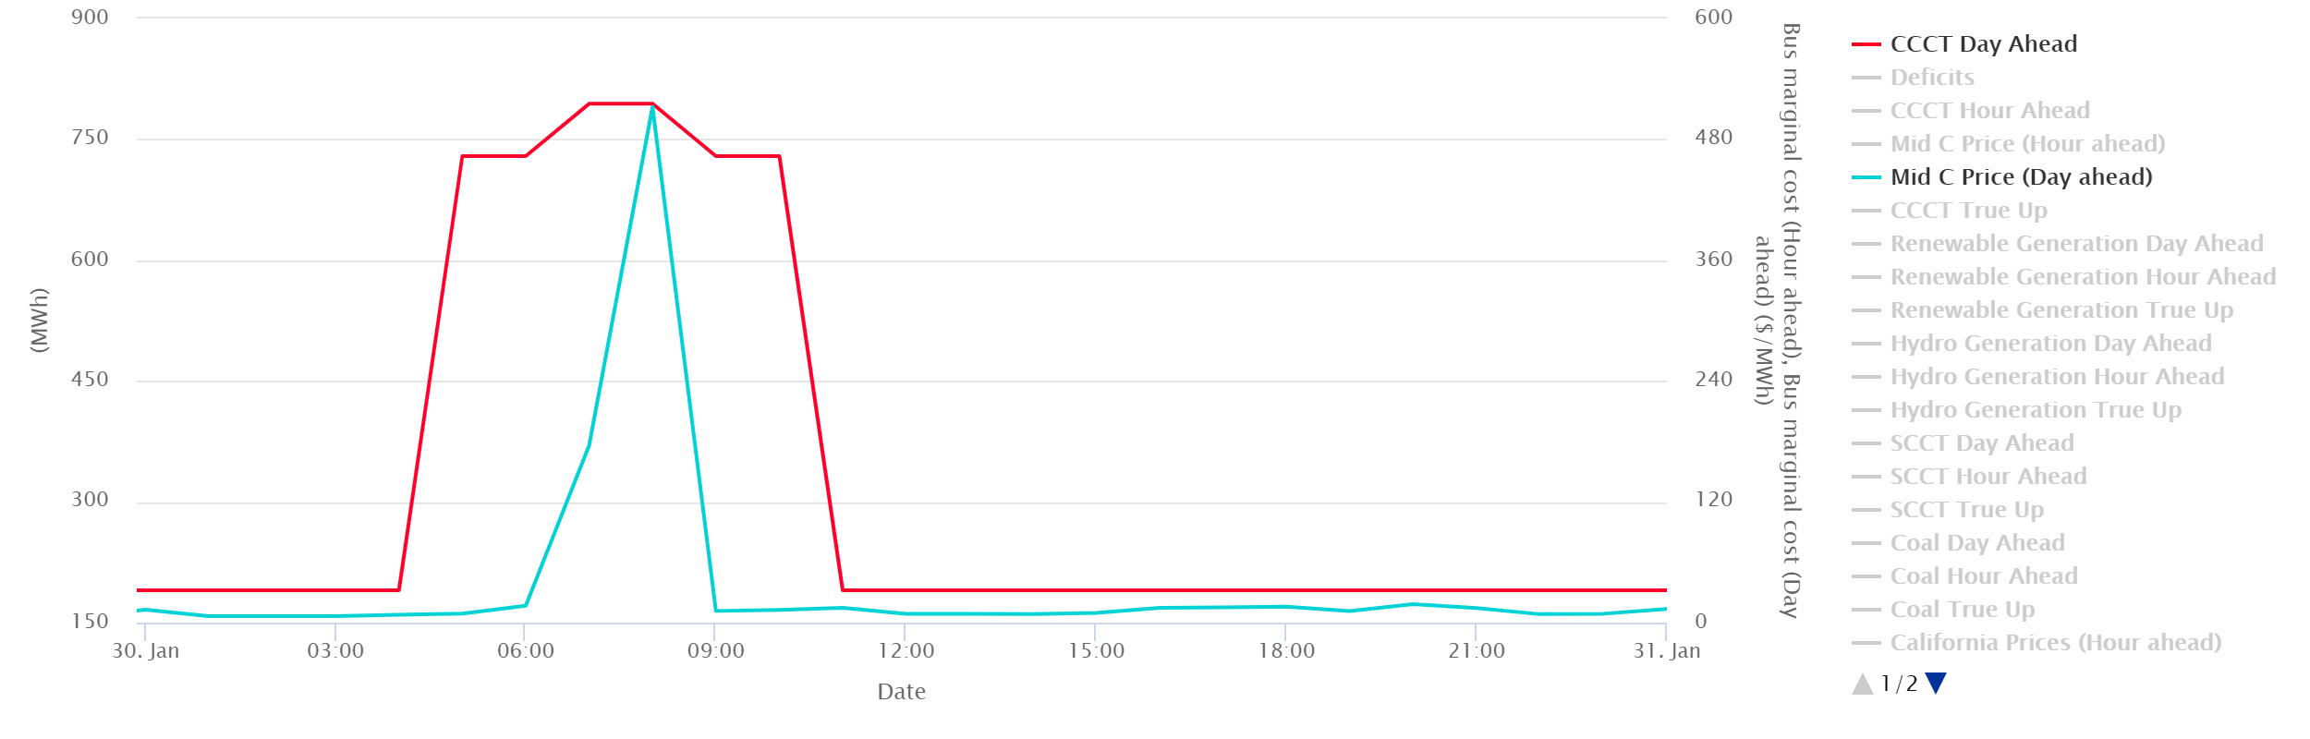
With Increased Reserves, More Thermal Units Commit and Imports before Ramp
Mid-C Prices are raised in the day-ahead planning which supports more imports and thermal plants earlier…
Which allows the regional hydro and thermal to have more capability to respond to forecast error
No deficit

Slide 19
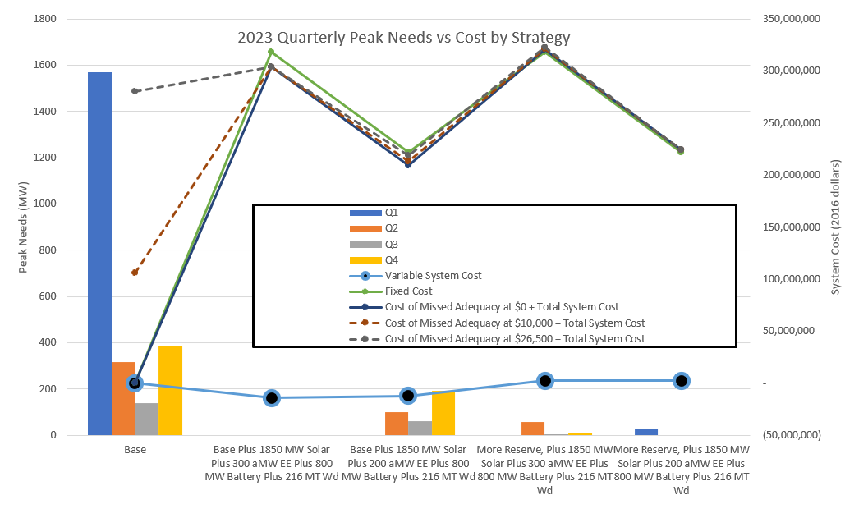

Slide 20
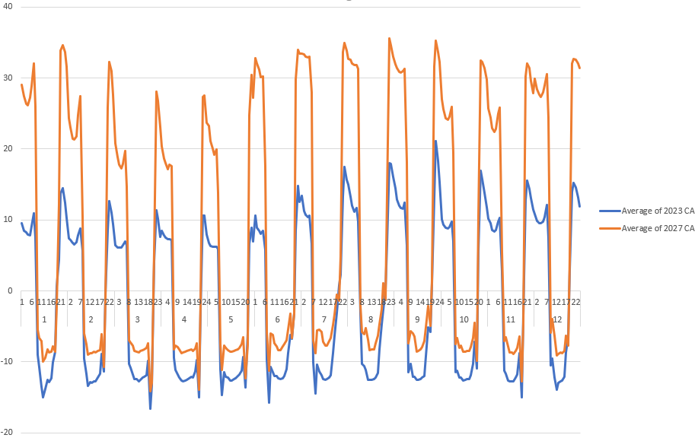
Loads are Higher in 2027 which Leads to Higher Prices Overnight Supporting More Thermal Commitment

Slide 21
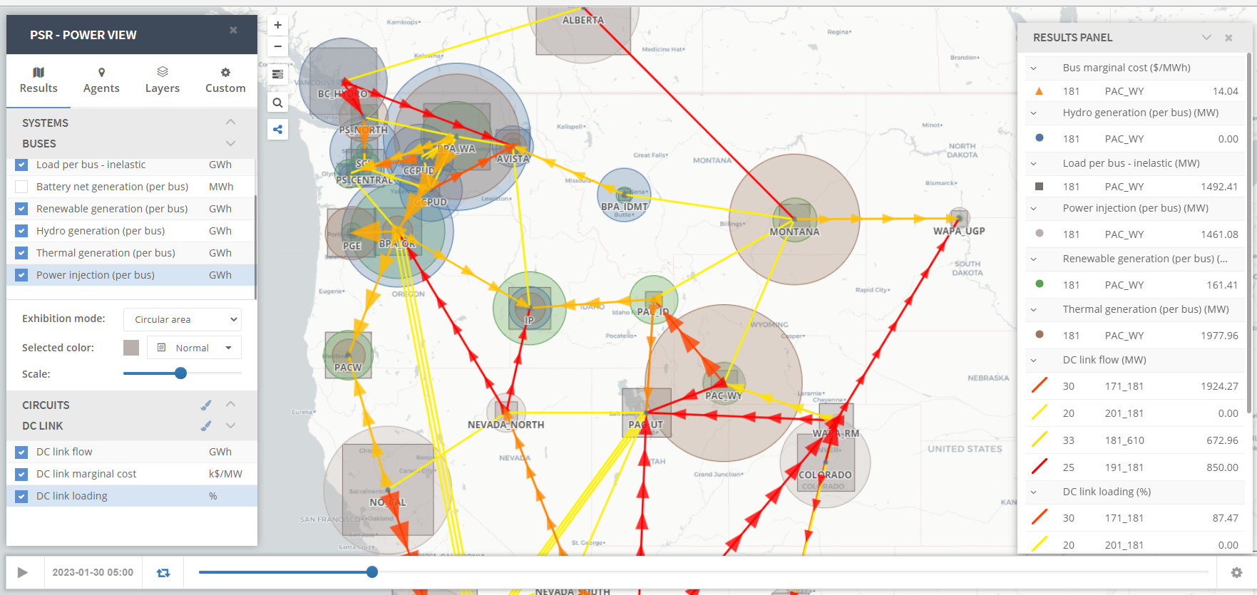

Slide 22
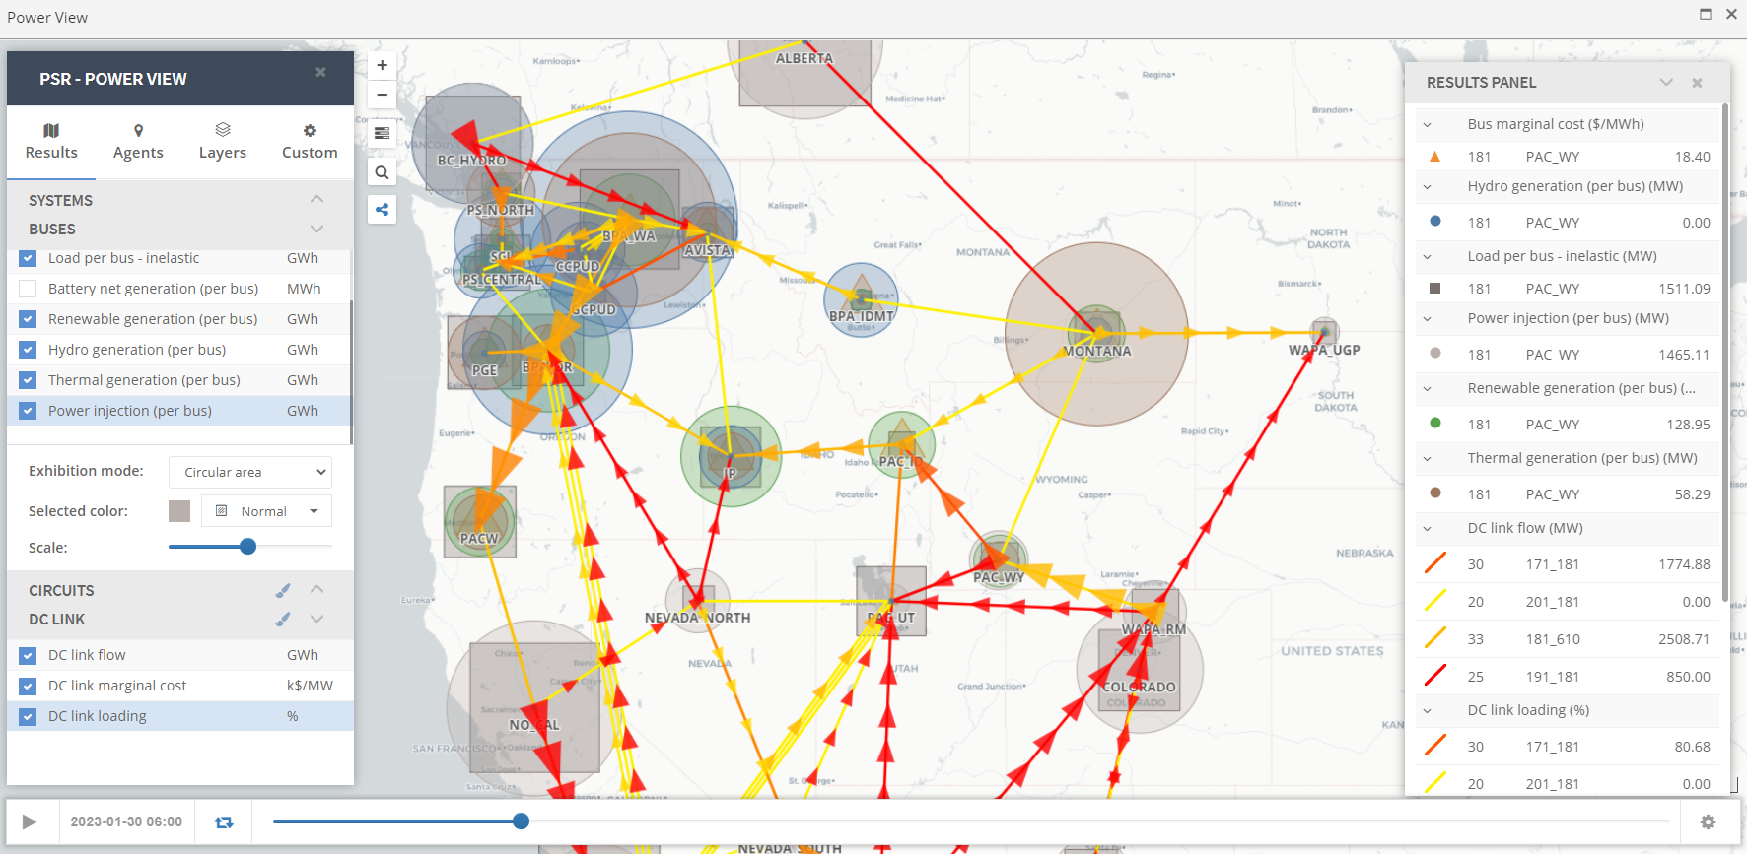

Slide 23
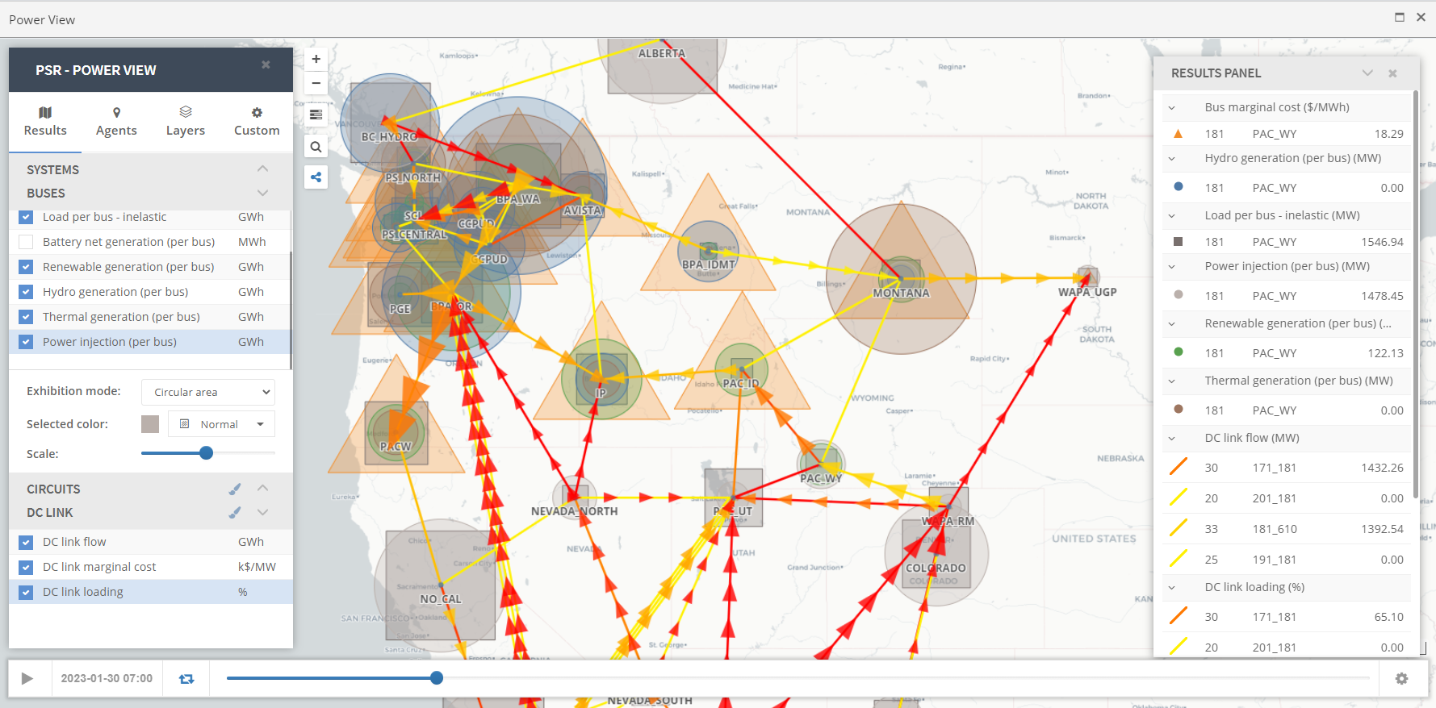

Slide 24
What Can We Do in a Resource Strategy?
Invest in more resources that do not require commitment in day-ahead
  One of the tools to support adequacy might not help much: CCCTs
  Additional investment in EE can eliminate some of these issues but might more expensive than other solutions in the long run
  SCCTs, energy storage and some DR products might help, but will likely be used infrequently and likely would be most useful when used with reserves
  Hold back additional reserves to better utilize the existing system
  Test case: Trying to emulate the price support in overnight periods in 2027 increased the reserves by 2000 MW to better prepare for the ramping periods. Eliminated many but not all of these issues (dropped LOLP from 16% to 9%)
Increase reliance on the extra-regional market
  This tends to be the least expensive on an expected basis, but traditionally the riskiest solution
Combination of strategies
  The regional buildout from the RPM plus additional ramp reserves to better utilize the existing system to stay adequate seems to be the least expensive, adequate solution.
  Promising that regional collaboration is already happening on the RA from per the NWPP RA effort, but perhaps expanded scope to address these forecasted near-term operational challenges.

Slide 25
Discussion About Assumptions and Next Steps
Up balancing reserves at 2900 MW in GENESYS, is that consistent with current regional assumptions?
Does the EIM currently account for this for all regional entities?
Has this been discussed in the NWPP RA effort?
Is this consistent with what you have been hearing from operators?

Slide 26
Questions
John Ollis
jollis@nwcouncil.org

