Slide 1
Existing Generating Resources – Inputs to the Models
RAAC/SAAC/GRAC
May 6, 2020 - Gillian Charles

Slide 2
Existing System
Building resource blocks and translating into model inputs

Slide 3

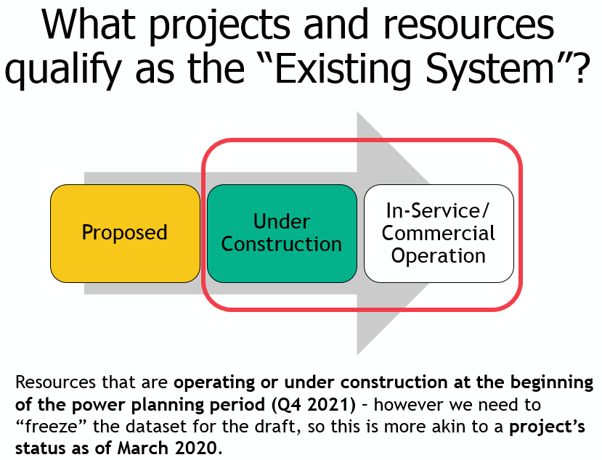
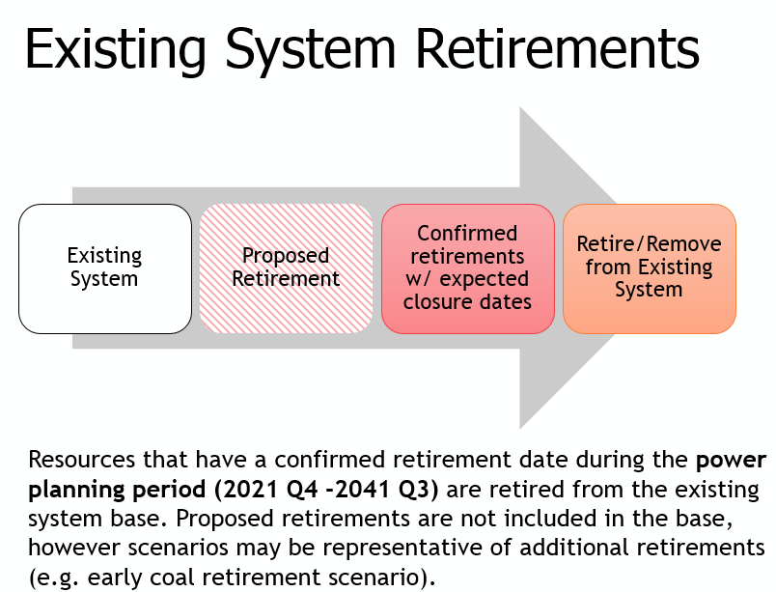
April 23 SAAC/RAAC/GRAC
Discussed existing system resources - what’s in, what’s out, and how to count them

Slide 4
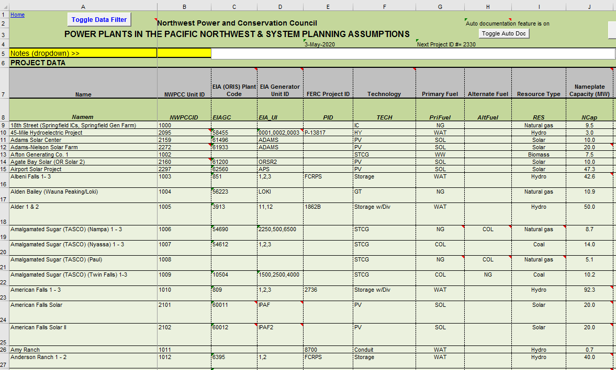
Project Database & Components
Project/Unit-level data
Resource fuel
Technology type
Nameplate capacity
Operating status
Location
Ownership/electrical load
Historical energy
… and many more!
Assumptions
Heat rate
Seasonal outages
… and many more!

Slide 5
Existing System – Aggregate units
Aggregate unit-level data and sort into resource blocks
  Some resources have multiple blocks (ex. A)
  Some resources are aggregated into one block (ex. B)
Example A: natural gas
Gas West 1
Gas East 1
Gas West 2
Gas East 2
Example B: Biomass, Geothermal, Petroleum
Gas West 3
Gas East 3
Other Must Run

Slide 6

Developing Resource Blocks
Each resource block has attributes that have been aggregated from unit-level data
  Nameplate capacity (MW), average heat rate, average fixed O&M, average variable O&M, average forced outage rate, etc.
The model dispatches resources by block to meet load; dispatch considers the heat rate and VOM, along with fuel and electricity prices

Slide 7

Draft 2021 Plan – Generating Resource Blocks
Where is hydro? Hydro generation info is provided by BPA thru PNCA; includes operating constraints and variations due to water conditions
Gas West 1
CGS
Gas West 2
Other Must Run
Gas West 3
Announced Retirements
Gas East 1
Colstrip 3
Gas East 2
Colstrip 4
Gas East 3
Other Coal
Wind
Solar
Notes:
PNCA -

Slide 8
Coal – The Ins and Outs
Review
What’s IN:
Jim Bridger 1 (ret EOY 2023)
Centralia 2 (ret EOY 2025)
North Valmy 2 (ret EOY 2025)
Jim Bridger 2 (ret EOY 2028)
Colstrip 3
Colstrip 4
Jim Bridger 3, 4
Montana One (Colstrip Energy)
Amalgamated Sugar
Announced Retirements
Colstrip 3
Colstrip 4
Other Coal
What’s OUT:
Boardman (ret EOY 2020)
Centralia 1 (ret EOY 2020)
Colstrip 1, 2 (ret EOY 2019)
Hardin (OOR; ???)
North Valmy 1 (ret EOY 2021; IPC ended “participation” in EOY 2019)
EOY = end of year; OOR = out of region

Slide 9
RPM Inputs & Formulas
Parameter | Description
Resource size (MW) | Sum of installed nameplate capacity of units in resource block
Fixed O&M ($-kw/year) - Includes operating and maintenance, labor and materials, and administrative overhead (routine maintenance, and major maintenance and capital replacement are assumed to be included) | Weighted-average FOM of units in resource block; based on average historical data (5 years) or best available info
Variable O&M ($/MWh) - Includes all costs that are a function of the amount of power produced (consumables such as water, chemicals, lubricants, and catalysts, and waste disposal) | Weighted-average VOM of units in resource block; based on average historical data (5 years) or best available info
Forced outage rate (%) - expected number of hours a resource is forced out of service (i.e. unplanned outage) divided by the total number of hours in the year | Weighted-average FOR of units in resource block
Maintenance outage rate - expected number of hours a resource will be out of service during the year for planned maintenance divided by the total number of hours in the year | Seasonal weighted-average MOR of units in resource block
Heat rate (MMBtu/MWh) - amount of input (fuel) energy required by a power plant to produce one kilowatt-hour of electrical output | Weighted-average heat rate of units in resource group; Based on average of last five years, or best available information
Fraction dedicated to region – expectation that the region bears the fixed cost of the resource | Weighted-average RPM % rate-based to region of units in resource group
Capability available to region - amount resource can be dispatched to the region | Weighted-average RPM % capability to region of units in resource group

Slide 10
Contributions to the Existing System
Review
How do we determine which resources “count” towards the region, and at what amount?
e.g. IPP-owned resource, uncommitted load (market)
e.g. NorthWestern Energy owned/contracted resource
e.g. PacifiCorp OOR renewable resource
e.g. Resources that have been idled or mothballed
e.g. IPP resource w/ OOR long-term PPA
e.g. Joint ownership, multiple load shares
Percent Rate - Based to the Region – the expectation that the region bears the fixed cost of the resource
Percent Capability to the Region – amount resource can be dispatched to the region

Slide 11

What do the resource blocks look like as inputs in the model and how do they contribute to the system?

Slide 12
Background

Slide 13
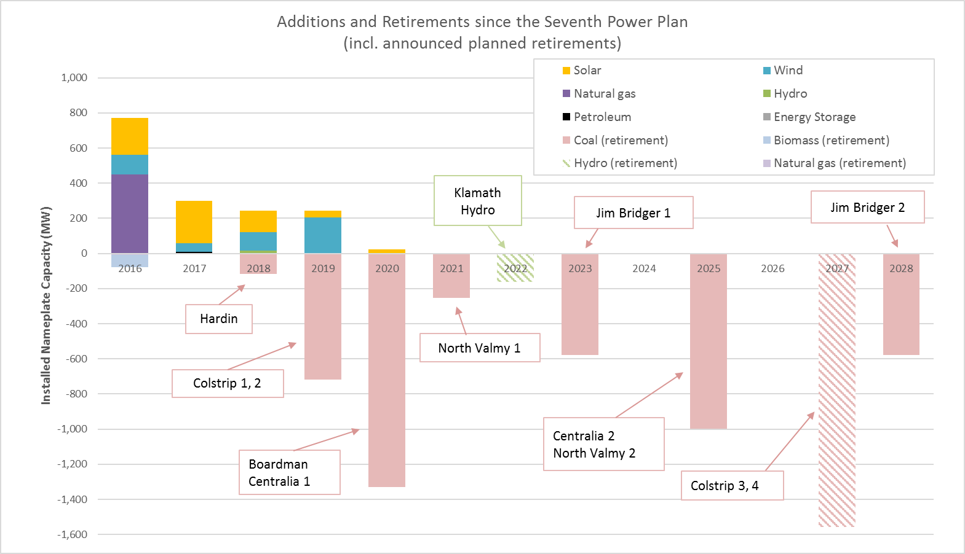
Planned retirements based on agreements, announcements, IRPs; subject to change
Idaho Power intends to end its participation in North Valmy 1 in 2019
Uncertainty remains over timing of Jim Bridger 1,2 potential accelerated retirements
Hardin Generating Station was sold to an out-of-region cryptocurrency company; therefore no longer “counts” towards the region
Colstrip 3,4 should be considered very tentative
Updated Mar 2020
Data source: Council’s project database

