Slide 1
Update on Power Plan Needs Assessment, Part 2:
Revised Baseline ARMs and Capacity Contribution Studies
System Analysis Advisory Committee
2/17/2021
John Ollis

Slide 2
Goals Since Last SAAC
Lock down setup of redeveloped GENESYS for running baseline needs assessment
Run updated Adequacy Reserve Margins and begin capacity contribution studies

Slide 3
Agenda
Walk SAAC through two different sets assumptions for baseline needs assessment studies
  The studies presented at the February Council meeting
    Adequacy Reserve Margin results
    Stand alone capacity contribution studies (same setup)
  Modified setup to better capture all resource attributes
    Adequacy Reserve Margin results
    Stand alone capacity contribution studies
  Discuss staff recommendation on preferred setup

Slide 4
Needs Assessment Role in Power Plan
How do these simulations guide our result in the plan?

Slide 5

Get A Strategy
AURORA Buildout
Long term capital expansion for the WECC ensures that price simulations in AURORA are informed by an adequate system that meets policies
AURORA Price Runs
Hourly WECC-wide price simulations inform market prices and associated emissions in the RPM, both can significantly impact regional resource strategy economics
Hourly market capability is needed for GENESYS to provide a good adequacy signal for the NW informed by changing market fundamentals
GENESYS
RPM
Hourly analysis in GENESYS creates quarterly ARMs and ASCCs, which the RPM uses to select an adequate resource strategy

Slide 6
Check A Strategy
AURORA Buildout
Long term capital expansion for the WECC ensures that a check in AURORA is informed by an adequate system that meets policies
AURORA Check
Candidate regional resource strategy may be checked within the context of the WECC to ensure we are consistent with policies and operational feasibility within a WECC-wide context.
GENESYS Check
RPM
Candidate regional resource strategy is checked in GENESYS to ensure the system is adequate and operationally feasible.

Slide 7
Assumptions Review
Existing resources, market availability and size, reserves

Slide 8
Review:
Existing Resources
For the Needs Assessment for the plan:
Inside the region: No additional generating resources or EE, coal retirements as currently announced.
  Jim Bridger 1 out after 2023
  Centralia 2 and North Valmy 2 out after 2025
  Jim Bridger 2 out after 2028
Outside the region: The long term AURORA buildout
  Represented as extra-regional load forecasts as in AURORA and market supply price bins reflecting retirements and additions per the AURORA forecast
Transmission limitations: Similar to AURORA

Slide 9
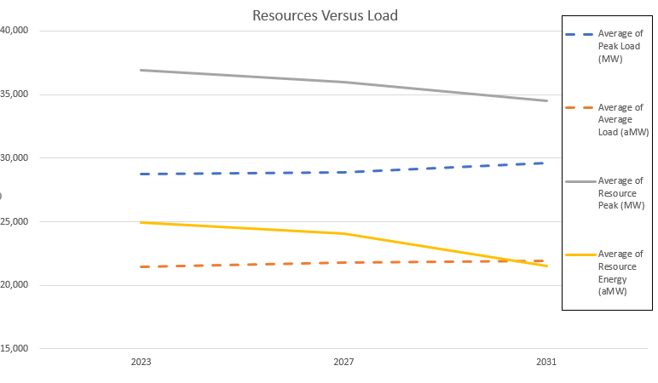
Review: Regional Portfolio Capability is Decreasing and Loads are Growing

Slide 10
Review: Market Reliance Assumptions in the Classic and Redeveloped GENESYS
Resource | Redeveloped GENESYS Assumptions | Classic GENESYS Proposed Assumptions
Winter SW spot market | 2,500 MW total all hours | 2,500 MW all hours
Winter SW purchase ahead market | 2,500 MW total all hours* | 3,000 MW off peak hours
Winter IPP availability | Full (2,403 MW) | Full (2,403 MW)
Summer SW spot market | 1,250 MW total all hours | 1,250 MW 9am to 2pm
Summer SW purchase ahead | 1,250 MW total all hours | No purchase ahead market
Summer IPP availability | Full (2,403 MW) all hours | Full (2,403 MW) 8am to 6pm
MT and WY wind | 1,461 MW included | 1,461 MW included
* See next slide (depends on market fundamentals)

Slide 11
Review: Incorporating Market Supplies
Classic GENESYS – User provided fixed inputs
  SW Spot Market – 2500 MW winter, 1250 MW summer (limited to 5 hours/day)
  SW Purchase ahead – 3000 MW winter limited to off-peak hours, none in summer
  Max 3400 MW total import (spot + purchase ahead)
  SW market priced higher than any NW resource
  NW IPP market resources – fully available (limited to 10 hours/day in summer)
New GENESYS – Dynamic assessment of supply, user provided limitations
  Simulates dispatch of out-of-region resources & loads
  User can limit imports into the PNW by season (after accounting for regional resources that are physically outside our region)
  No option to control hour-of-day market availability
  NW IPP market resources available to all markets (not just the PNW)
  Market exchanges (for all regions) based on price dynamics

Slide 12
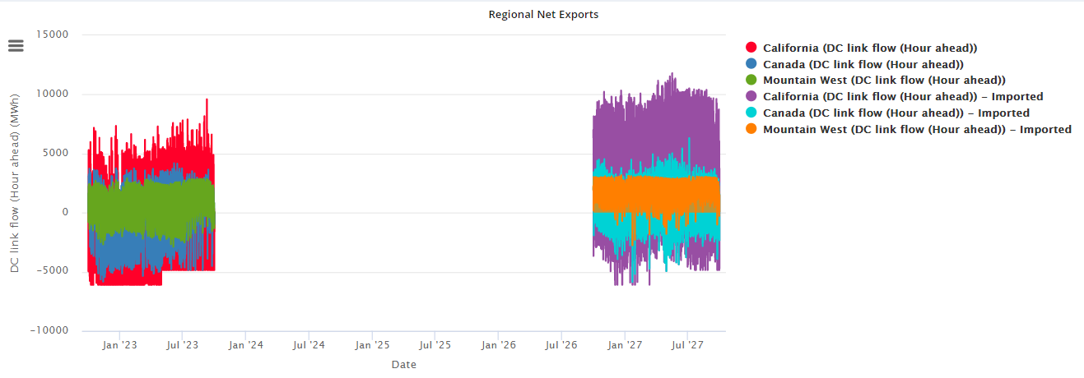
Market reliance limit plus room for firm external resources (like Bridger and Valmy) to import to the region .
Note the considerable amount more net exports total and decrease in net imports.
Comparison between 2023 and 2027 net market position by net export region.

Slide 13
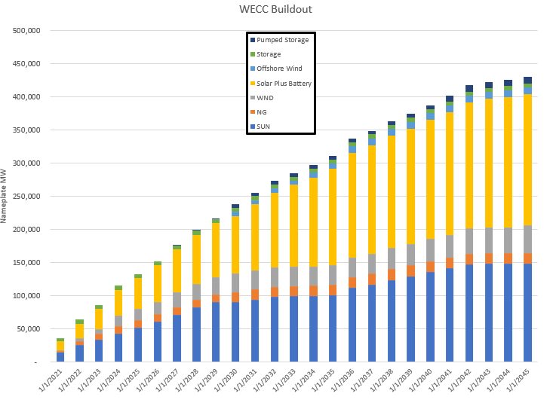
Even though net market reliance is limited the large external buildout still effects market supply fundamentals

Slide 14
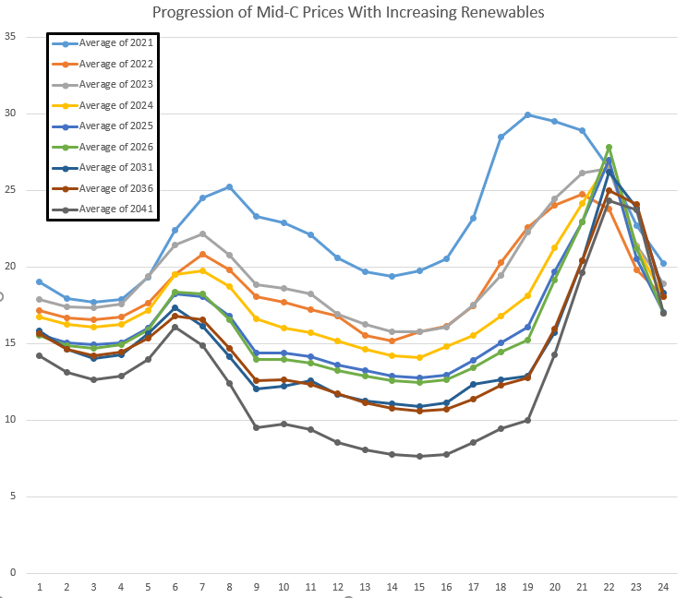
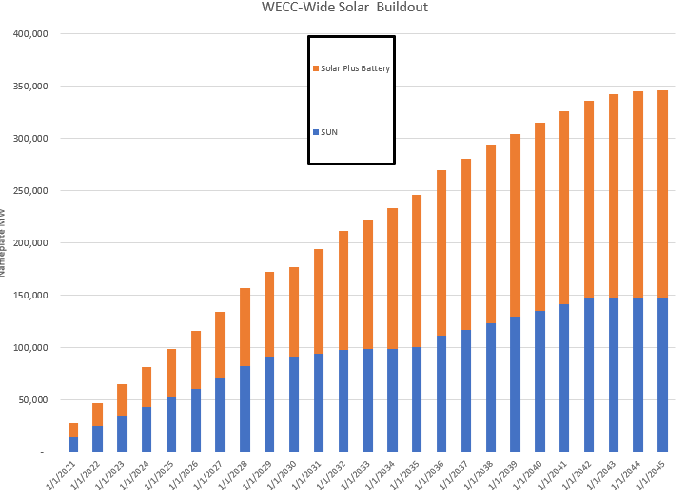
Daily shape changes with more WECC- wide solar

Slide 15
Review: Balancing Reserve Assumptions
Per Northwest Power Pool EIM Study (public data)
Each BA has to hold and provide balancing reserves specified in the study on existing (or new) resources
  Consistent with assumptions for AURORA
  Fidelity on a monthly basis for hour of day
No balancing reserve sharing between BAs
  Very conservative considering all entities would be in EIM and holding all the reserves from the NWPP EIM study should ensure sufficiency
  Since the model does not currently reserve transmission for reserves there was some congestion/reserve provision adequacy issues for utilities with remote resources (SCL, PGE, PSE, PAC) that would not happen in operations (per modern transmission scheduling practices).

Slide 16
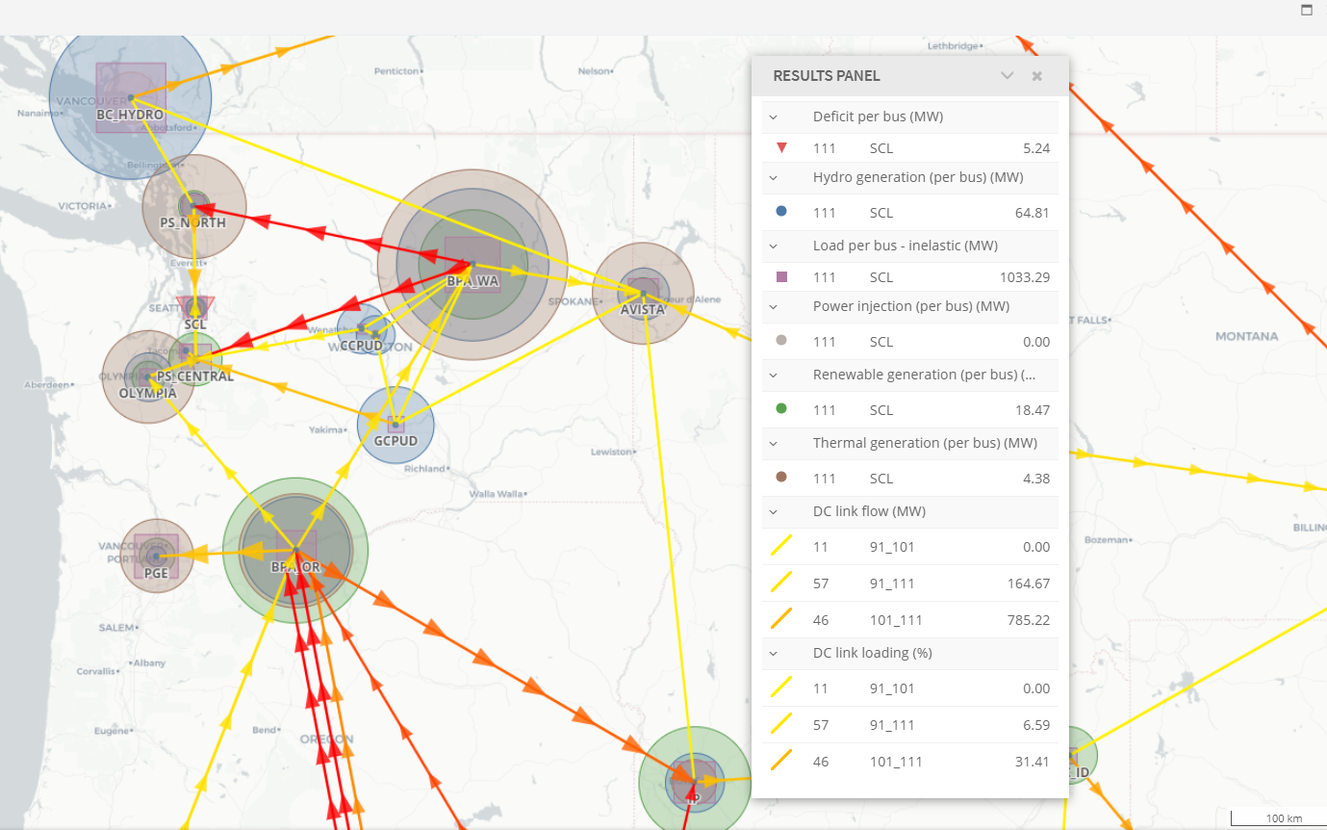
Example: On Sept 2nd, at 8 am, there is a small deficit in Seattle. The region is long in aggregate and could have covered the deficit with contingency reserves but this is still considered an adequacy event for planning purposes. Why?

Slide 17
While theoretically this could still be an issue, in the model this is happening because firm transmission is not scheduled for reserve provision. In practice, the transmission likely would have been scheduled…

Slide 18
Fuel Accounting for All Resources
Reserve Provision
All resources must have fuel available to provide reserves
  Energy limited resources (Hydro, demand response, batteries and pumped storage)
  Variable availability fuel resources (Wind, solar and hydro)
  On call fuel resources with limits (most gas resources)
  On call fuel resources with no limits (some gas and coal resources)
Future value of stored fuel
  Hydro (also pumped storage and batteries to an extent)
Conservative assumption on gas fueling flexibility
  Draft and pack limits at 3% with exception of plants with access to storage (eastside gas likely has more flexibility)
  One nomination assumed per day (5 nomination windows)

Slide 19
2/3 SAAC and Stakeholder Feedback
Concern about market effects on adequacy
  Market reliance limits are effectively mitigating much of these concerns and are definitely responsible for more adequacy events in the simulations
  Testing of different market conditions is a planned part of scenario work especially the scenario focused on market reliance and organized markets
Some forecast error based events are reasonable, should there be so many?
  Staff has a proposal for two modeling changes that will reduce some of these deficits associated with reserve/forecast error treatment.
  Early results show promise.

Slide 20
Adequacy Reserve Margin Results Part 1
Review of results presented at the Council Meeting

Slide 21


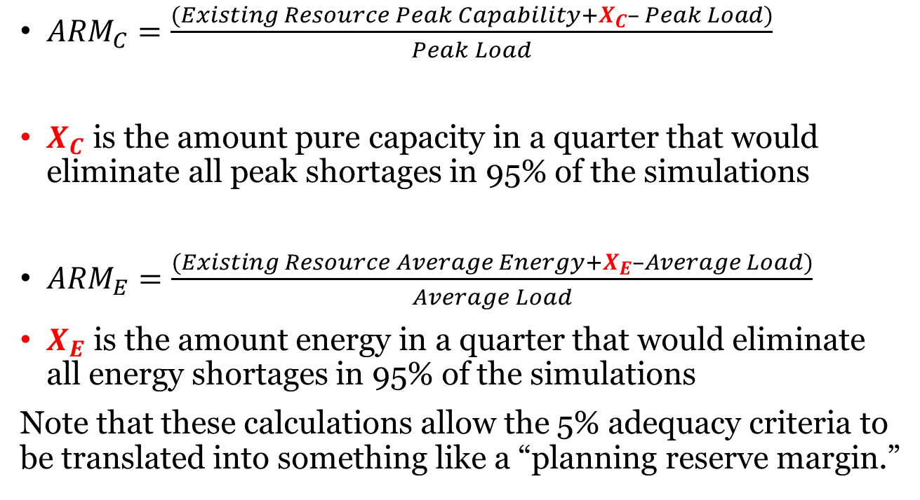
Review: Calculation of Adequacy Reserve Margins
${ARM}_{C}=\frac{(Existing Resource Peak Capability+X_{C}– Peak Load)}{Peak Load}$
$X_{C}$ is the amount pure capacity in a quarter that would eliminate all peak shortages in 95% of the simulations
${ARM}_{E}=\frac{(Existing Resource Average Energy+X_{E}–Average Load)}{Average Load}$
$X_{E}$ is the amount energy in a quarter that would eliminate all energy shortages in 95% of the simulations
Note that these calculations allow the 5% adequacy criteria to be translated into something like a “planning reserve margin.”

Slide 22
Effects of New Features on LOLP: Redeveloped GENESYS versus Classic GENESYS
Out-of-region market supply Decrease
if supply is limited to classic GENESYS assumptions (due to dynamic vs. prescribed hourly availability)
Plant specific hourly hydro simulation: Increase
New model has more hourly operating constraints, but classic model sustained peaking may be conservative
Multiple NW nodes: Increase
Classic GENESYS only models 2 NW nodes
Unit commitment: Increase
Classic GENESYS has very limited unit commitment logic
Dynamic balancing reserves: Increase
Classic GENESYS only includes a fixed allocation of hydro reserves and no thermal reserves
Forecast error: Increase
Classic GENESYS does not model forecasting error
Optimization: Decrease
All else being equal, this should lower LOLP in order to reduce curtailment costs
Forecast error is associated with deficit issues in around 40% of the simulations
2023 LOLP | 2025 LOLP | 2027 LOLP | 2031 LOLP
47% | 27% | 16% | 27%
Classic GENESYS result

Slide 23
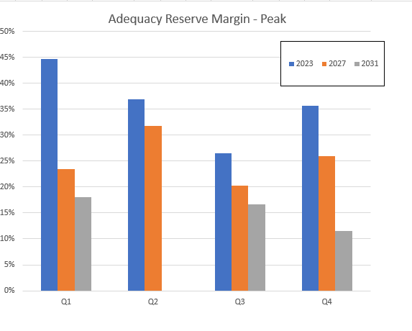
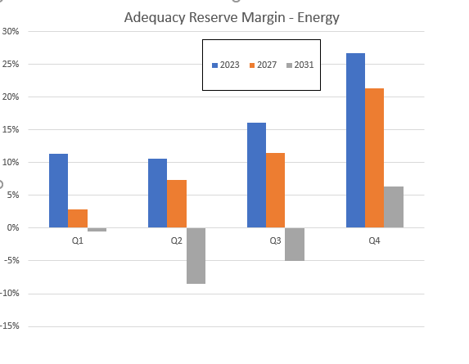
Summary of Adequacy Reserve Margin Results
Required reserve margin to meet a 5% LOLP standard decreases over time on a peak and energy basis.
Adequacy signal higher in early years than classic GENESYS!
System is becoming more adequate without adding resources due to WECC buildout!

Slide 24
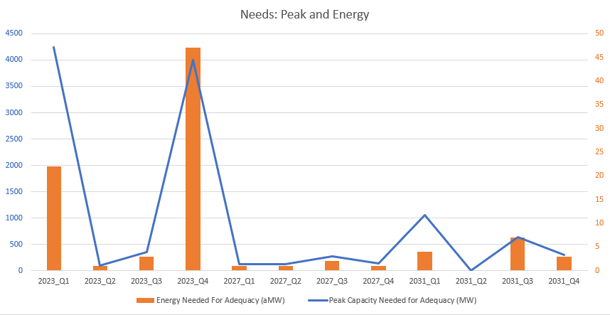
Large peak adequacy issues in 2023 (winter and fall)
Increasing lower priced WECC market supply leads to less adequacy issues.

Slide 25
ARM Results Summary (Part 1)
More adequacy issues in the needs assessment simulations in the redeveloped GENESYS primarily due to forecast error and more detailed operational considerations.
Adequacy issues decrease over time due to increase in inexpensive external market supply even though net market reliance limit is held constant.

Slide 26
Capacity Contribution Results Part 1
After a bunch of caveats…

Slide 27

Associated System Capacity Contribution (ASCC) Purpose
Is not a “capacity factor”
Is not a “effective load carrying capability”
Is the capacity contribution associated with adding a particular portfolio of new resources in context of the existing system.
  Like the ARM is just a way to turn the 5% LOLP adequacy criteria into a quarterly need
  The ASCC is just a way to get a portfolio of resources expected capacity contribution in terms of how many of those quarterly needs it can address specific to how the RPM considers peak adequacy.
  The ASCC is specific to the regional footprint and portfolio
These numbers only mean something in context of the RPM

Slide 28


Pop Quiz!
Should I use the Council’s ASCC numbers as a proxy for capacity factor or ELCC for my own portfolio?
NO!
This Photo by Unknown Author is licensed under CC BY
This Photo by Unknown Author is licensed under CC BY-ND

Slide 29


Associated System Capacity Contribution Limited Usefulness
Without lots of iterative hourly studies we can take a bunch of more complicated operational aspects of a set of resources or resource types and convert those into a peak capacity contribution,
A few notes:
  It would be calculated differently if we did not use LOLP as our adequacy metric
  It is calculated differently per the assumptions in the model used to estimate it.
    Market economics and reliance key assumptions
  It is only an estimate of a resource or set of resources’ contribution to peak adequacy needs in the RPM
This Photo by Unknown Author is licensed under CC BY-SA

Slide 30
Stand Alone Capacity Contributions to Test Setup for ASCC Array
Staff ran some tests to see check the implementation of individual proxy resource types in GENESYS
  5350 MW Thermal – modeled as 2 CCCT and 4 SCCT on the east side of the region (also modeling proxy for existing coal)
  3000 MW Short Duration Energy Limited Resources – modeled as 300 MW, 4 hour batteries in 10 different BAs
  2000 MW Long Duration Energy Limited Resources – modeled as three 8 hour pumped storage plants (one 1200 MW and two 400 MW)
  300 aMW EE – modeled as a proportional reduction in load in every BA in the region with hourly shapes appropriate to the first few bins of EE
  5000 MW Solar - modeled as five 1000 MW east side solar plants
  6000 MW Montana and SE WA Wind - modeled as a one ASCC resource type and two 1500 MW plants.

Slide 31
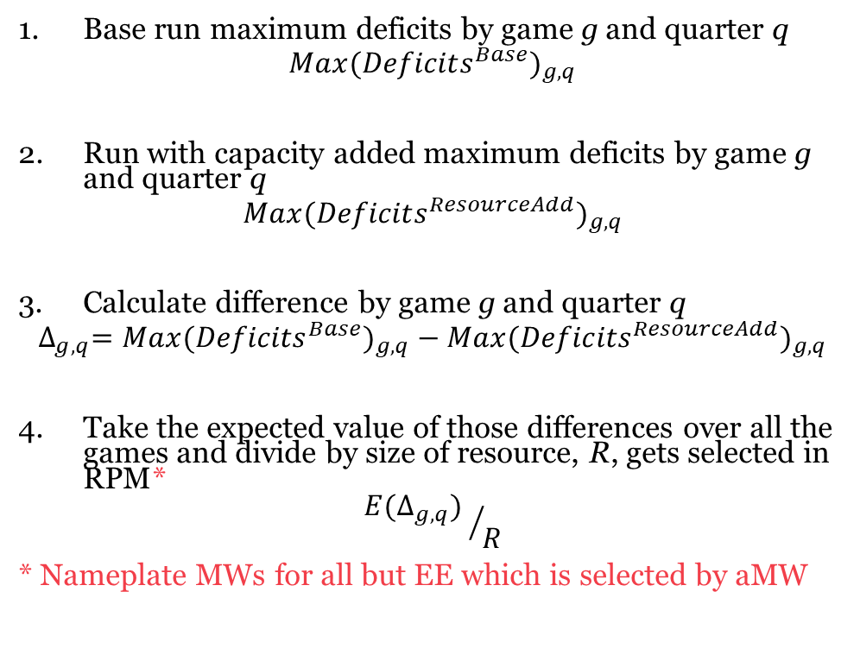
Modified ASCC Methodology
Base run maximum deficits by game g and quarter q
$${Max({Deficits}^{Base})}_{g,q}$$
Run with capacity added maximum deficits by game g and quarter q
$${Max({Deficits}^{ResourceAdd})}_{g,q}$$
Calculate difference by game g and quarter q
$${{∆_{g,q}=Max({Deficits}^{Base})}_{g,q}−Max({Deficits}^{ResourceAdd})}_{g,q}$$
Take the expected value of those differences over all the games and divide by size of resource, R, gets selected in RPM*
$${{E(∆}_{g,q}) }/R$$
* Nameplate MWs for all but EE which is selected by aMW
Peak needs before adding resources
Peak needs after adding resources
Peak needs reduction by adding resources
Expected peak needs contribution by adding resources

Slide 32
Initial Stand Alone Capacity Contribution Results
This implies 5000 MW of solar reduces 600 MW of winter need
Quarter | 300 aMW EE | 3000 MW Short Duration Energy Limited | 5350 MW Thermal | 5000 MW Solar | 3000 MW Montana and SE WA Wind
1 | 0.71 | (0.11) | 0.08 | 0.12 | 0.03
2 | (0.09) | (0.11) | (0.01) | (0.04) | (0.01)
3 | 0.13 | (0.07) | 0.01 | 0.02 | 0.00
4 | 0.42 | (0.18) | 0.04 | 0.03 | 0.05
Spurred staff to investigate why this was so low…

Slide 33
Observations
Upon further examination thermal units seemed to have limited flexibility due to fuel accounting limits.
Gas plants on the eastside likely to have more flexibility in nomination schedules
Proxy resource capacity contributions were sensitive to where they were added at least in part due to congestion/reserve provision issues
Recall transmission not scheduled for reserve provision
Balancing reserve daily shape might be too much fidelity
It is possible to have negative contributions when adding the resource creates more expected unserved peak than existed in the base run for a quarter.
Some resource attributes can cause the inherent peaking capability of the system to decrease in some quarters.
This happened occasionally in previous classic GENESYS studies as well, especially on studies with lower base LOLP.

Slide 34
Adequacy Reserve Margin Results Part 2
Modified setup

Slide 35
Proposed Changes in Methodology per Observations
Increase fuel flexibility of eastside gas units (existing and new)
Change from ± 3% to ± 50% the daily nomination schedule for all units with access to eastside gas
Work around transmission reservation issue for reserves held on remote resources to reduce forecast error related deficits
Let regional reserves to be the sum of the maximum balancing reserves held by each BA (maintain sufficiency)
Allow reserves to be shared within the region in the true up stage (allow for sharing of reserves
Reduce negative capacity contributions
Start with a less adequate system (maybe a different base year, maybe more retirements…)
Share results as they are ready

Slide 36
After first two proposed changes…
Reduced LOLP in base case
  2031 LOLP goes from 27% to 8%
  Needs are greatly reduced
Many of the events associated with forecast error related deficits were eliminated, and transmission congestion does not seem to prevent reserve provision.
Quarter | 2031 Peak Needs After Changes | 2031 Peak Needs Before Changes
1 | 59 | 1057
2 | 60 | 105
3 | 243 | 630
4 | 0 | 303

Slide 37
Capacity Contribution Results Part 2
Modified setup

Slide 38
Stand Alone Capacity Contribution Results – After Proposed Changes
Quarter | 300 EE | 3000 Short Duration Energy Limited | 5350 Thermal | 5000 Solar | 2000 Long Duration Energy Limited
1 | 3.00 | 0.79 | 0.44 | 0.16 | 1.01
2 | 0.20 | 0.02 | (0.06) | (0.01) | (0.08)
3 | 0.19 | 0.02 | 0.03 | 0.01 | 0.06
4 | (5.29) | (0.08) | 0.03 | (0.03) | (0.06)
These numbers are significantly lower than we might expect. Is the base system adequacy skewing results?

Slide 39
Planned Future Tests and 2023 Needs Sneak Peek
Use a less adequate system to find more stable expected capacity contributions while maintaining a representative snapshot
Test capacity contributions in 2023
  Reduced LOLP in base case
    2031 LOLP goes from 41% to 31%
    Needs are significantly reduced in winter
Test capacity contributions in 2031 with more coal retirements
2023 will not have as much effect of policies
RPM signal
Quarter | 2023 Peak Needs After Changes | 2023 Peak Needs Before Changes
1 | 2675 | 4247
2 | 129 | 96
3 | 331 | 353
4 | 3250 | 3998
Council standard of 5%
2031 will not be as representative of Action Plan time period

Slide 40
Discussion –
Do the changes make sense?
Fuel accounting flexibility
Transmission schedule for reserves work around
Implications on base studies for capacity contribution studies

Slide 41
Next Steps: Ensuring a Resource Strategy is Adequate
Classic GENESYS Needs Assessment Data (ARM, ASCC and hydro generation) for testing
Studies in Redeveloped GENESYS to derive Adequacy Reserve Margins (ARM) and hydro Generation
Studies in Redeveloped GENESYS to derive Associated System Capacity Contribution (ASCC)
Check Resource Strategy
Repeat ARM calculations and checks for scenarios

Slide 42
Questions
jollis@nwcouncil.org – John Ollis

Slide 43
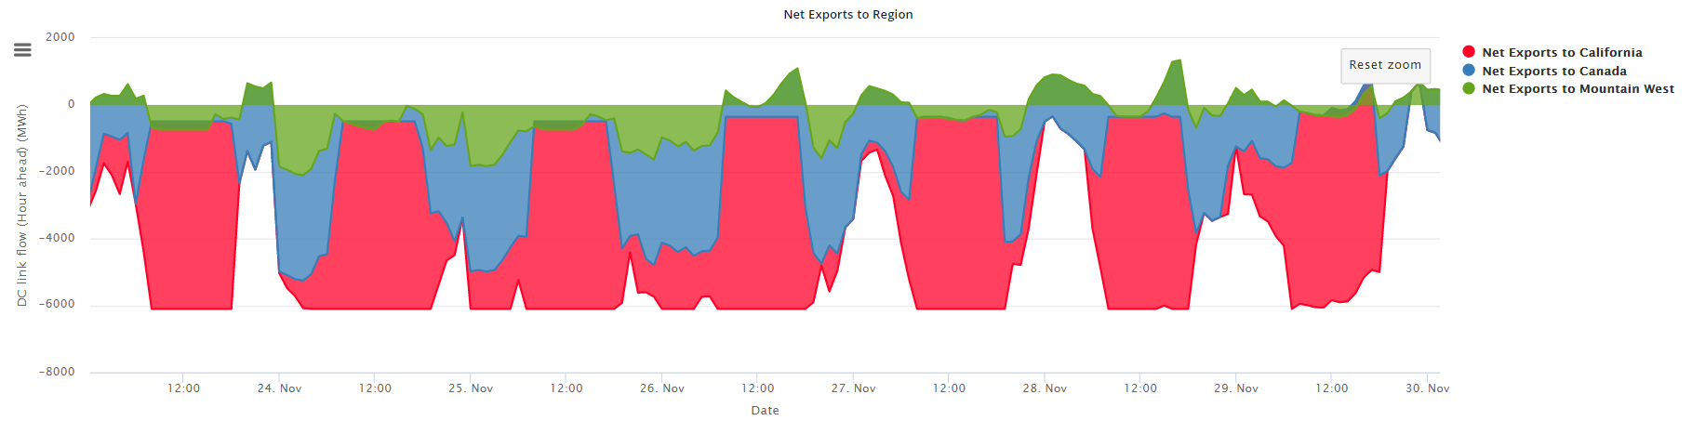
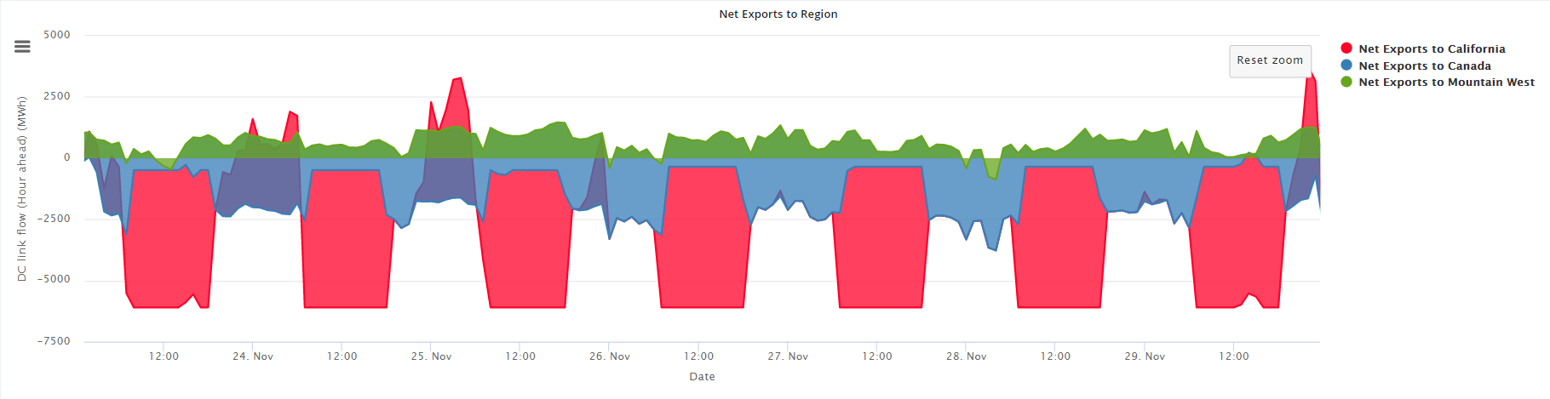
External Market - Fall
2023
At full import capability often during day Canadian exports support regional needs and California and Mountain West positions. Less net imports to region in 2027 than 2023
2027

Slide 44
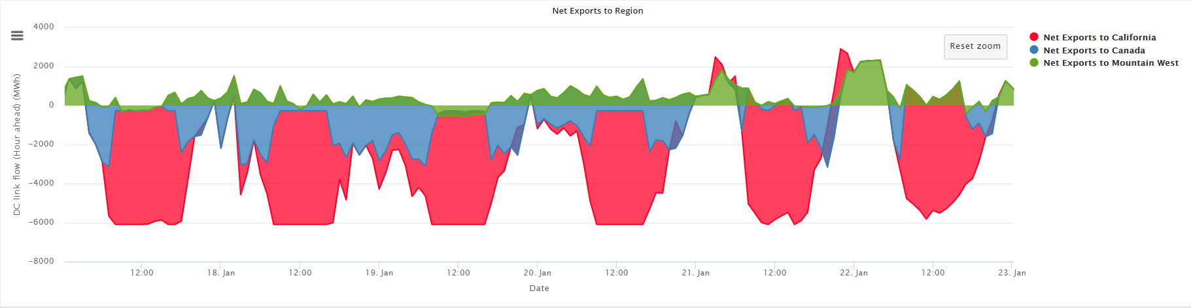
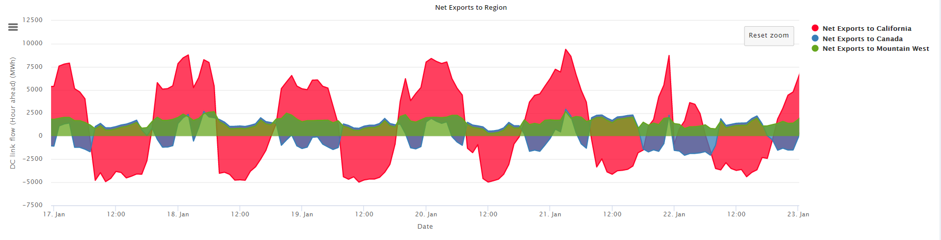
External Market - Winter
2023
Less net imports to region in 2027 than 2023. Significant exports to California during non-solar hours especially in 2027, and Mountain West in all hours.
2027

Slide 45
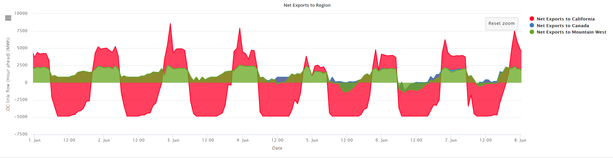
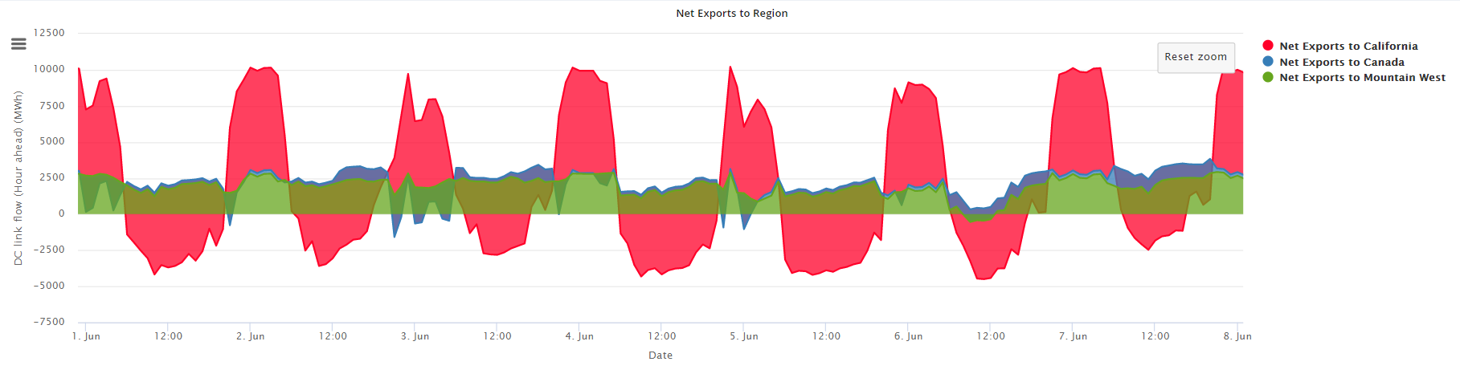
External Market - Spring
2023
More imports to region in 2027 than 2023. Significant exports to California during non-solar hours, and Mountain West and Canada in all hours.
2027

Slide 46
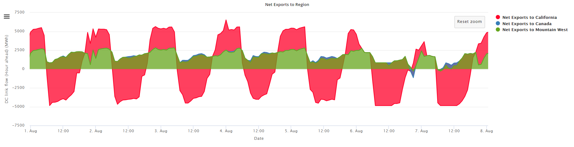
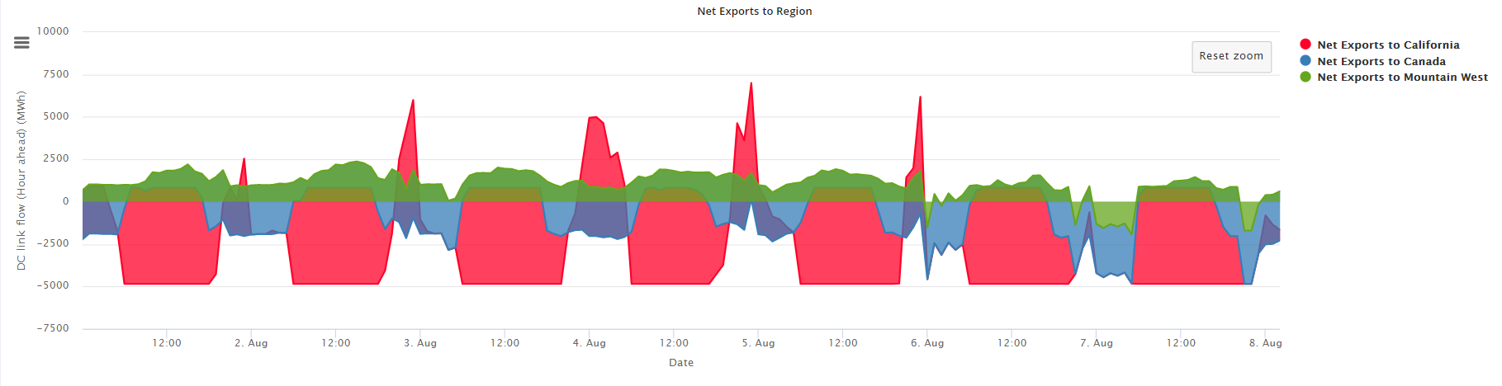
External Market - Summer
2023
More net imports to region in 2027 than 2023.Volume of exports lessen to California and Canadian imports increase during non-solar hours.
2027

Slide 47
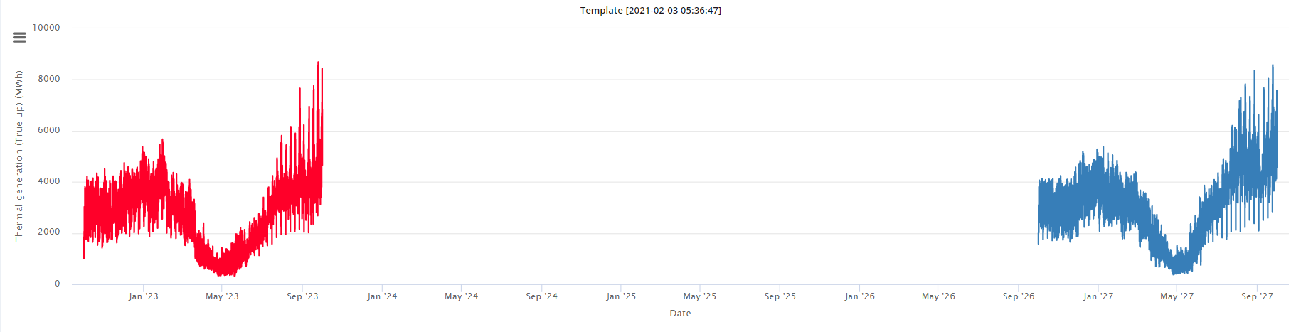
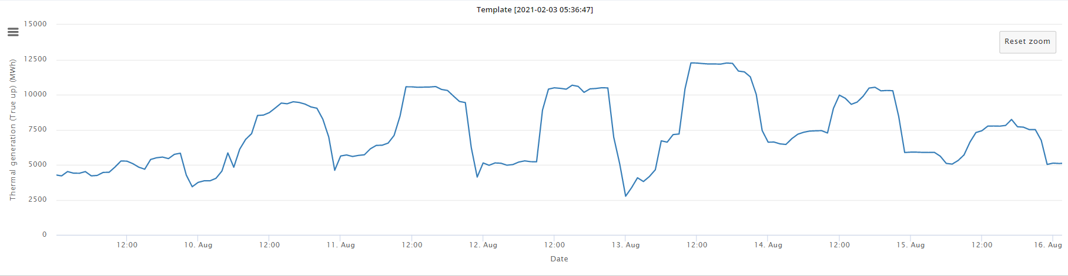
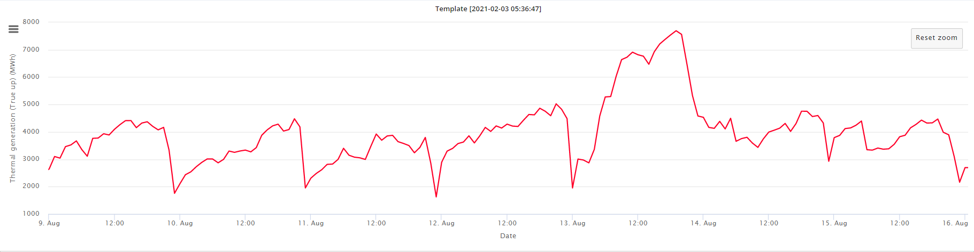
Thermal Generation looks similar in magnitude but different in usage
More cheap solar available midday, even in summer shifts thermal use for capacity and adequacy purposes

Slide 48
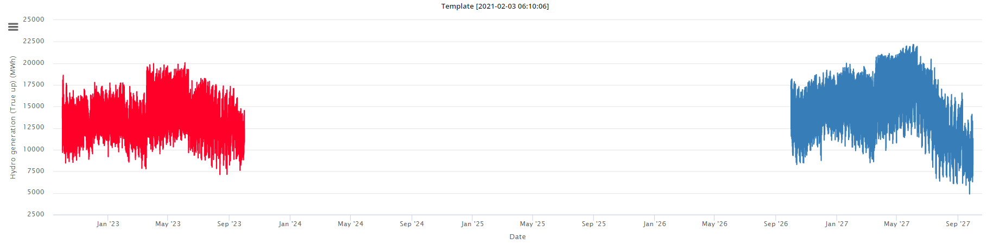
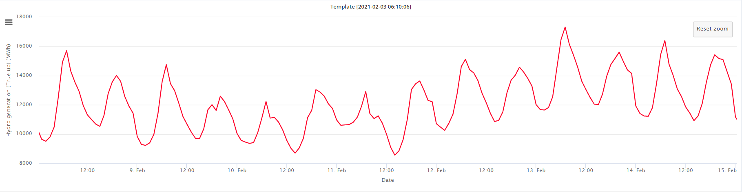
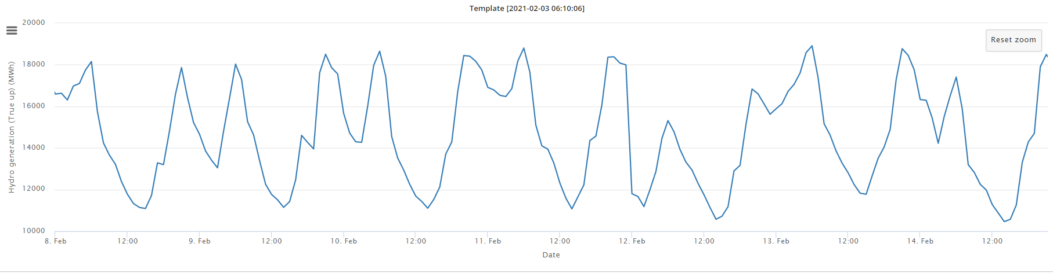
Hydro Generation similar in magnitude but shaping becomes more extreme

