Slide 1
2021 Power Plan Resource Adequacy Assessment
July 16, 2021
RAAC Steering Committee
9:00-12:00
SAAC/RAAC Technical Committees
1:00-4:00
John Fazio, John Ollis, Dan Hua

Slide 2
Agenda
RAAC Steering Committee (9:00 to 12:00)
PNW resources and loads
Addressing stakeholder concerns about the redeveloped GENESYS
Resource adequacy assessment
Next steps
SAAC/RAAC Technical Committees (1:00 to 4:00)
More detailed review and discussion of simulated operations
Q and A session

Slide 3
2025 Loads and Existing Resources
Resource | Nameplate Capacity (MW) | Percent
Biomass | 1,026 | 1.6%
Coal | 6,415 | 10.1%
Hydro | 34,544 | 54.6%
Natural Gas Baseload | 7,289 | 11.5%
Natural Gas Peaking | 2,168 | 3.4%
Nuclear | 1,200 | 1.9%
Wind | 9,495 | 15.0%
Solar | 649 | 1.0%
Other | 516 | 0.8%
Total | 63,301 | 100%
Annual Load | Winter Peak Load | Summer Peak Load
21,884 aMW | 32,957 MW | 33,726 MW

Slide 4
In-Region Market Resources (IPP)
IPP Resource | Nameplate Capacity (MW)
Grays Harbor Energy | 604
Centralia 2 (IPP portion) | 362
Hermiston Power Project | 615
Hermiston Generating | 232
Klamath Cogeneration | 490
Klamath Generation | 50
Klamath Generation | 50
Total Winter | 2403
Previous Summer | 1116
Additional Summer IPP | 1287
Total Summer | 2403

Slide 5
Coal Plant Retirements
Coal Plant Retirement Schedule
Cumulative MW of Retired Nameplate Capacity
Coal Plant | Capacity (MW) | Retire Date (EOY) | Total MW Retired
N Valmy 1 | 127 | 2021 | 127
Bridger 1 | 530 | 2023 | 657
N Valmy 2 | 134 | 2025
Centralia 2 | 670 | 2025 | 1,461
Bridger 2 | 530 | 2028 | 1,991
Colstrip 3 | 518 | 2035
Colstrip 4 | 681 | 2035 | 3,190
Total | 3,190 |  | 3,190

Slide 6
Load/Resource Balance
 | 2023 | 2025
Energy L/R Balance | 3,106 aMW | 2,665 aMW
Energy Surplus | 14% | 12%
Winter Peak L/R Bal | 6,502 MW | 5,881 MW
Winter Peak Surplus | 20% | 18%
Summer Peak L/R Bal | 3,156 MW | 2,829 MW
Summer Peak Surplus | 10% | 9%
2001 Energy Crisis
Due to little resource development during the 1990s, the region’s load/resource balance steadily declined over the decade. By 1998, the L/R balance was estimated to be near 4,000 aMW deficit, a much more dire situation than today.
Notes
Resource energy availability assumes an average of 6% FOR and 6% MOR
Winter/summer resource capacity does not include FOR or MOR
Based on expected annual average and, winter and summer peak-hour loads
Includes firm out-of-region contracts
Does not include in-region or out-of-region market resources
Based on critical (lowest) annual average hydro generation and, winter and summer 2-hour sustained peaking hydro capability
Forecast loads and stream flows are based on climate change data

Slide 7
Addressing Stakeholder Concerns about the redeveloped GENESYS model
Generates more annual average hydro generation (at the median) than the 2019 BPA White Book or the past 20-years of historical generation. More generation is unexpected since the median annual water supply in the climate change data is similar to the 80-year water record.
Produces more monthly energy than the White Book and historical generation in most months. The variability of the monthly generation also differs from the White Book and recent historical data.
Displays greater hour-to-hour flexibility at individual hydro projects as compared to historical data. The model regularly violates minimum generation constraints at projects and can ramp from 0 MW to near nameplate within an hour at some large projects.

Slide 8
RA 2025 Hydro Generation Comparisons with Historical Data

Slide 9
Redeveloped GENESYS for RA-2025
Uses data from 3 Climate Scenarios:
A - CanESM2_RCP85_BCSD_VIC_P1
C - CCSM4_RCP85_BCSD_VIC_P1
G - CNRM-CM5_RCP85_MACA_VIC_P3
For each climate scenario:
Use 10 years of streamflow, temperature and wind* data, from 2020 to 2029
For each wind year, use 6 historical hourly wind generation profiles
Totaling 60 years of GENESYS simulation (hourly hydro generation)

Slide 10
Observed Historical Data
From US Energy Information Administration (EIA)
Total hydro-generation data from the 4 states: Idaho, Montana, Oregon and Washington
20 years of monthly averaged generations from 2001 to 2020

Slide 11
BPA White Book Data
For year 2019
Hydro-generation data calculated from the HYDSIM model using 80 years of historical streamflows, from 1929 to 2008
Resulting in 80 years of monthly averaged generations

Slide 12
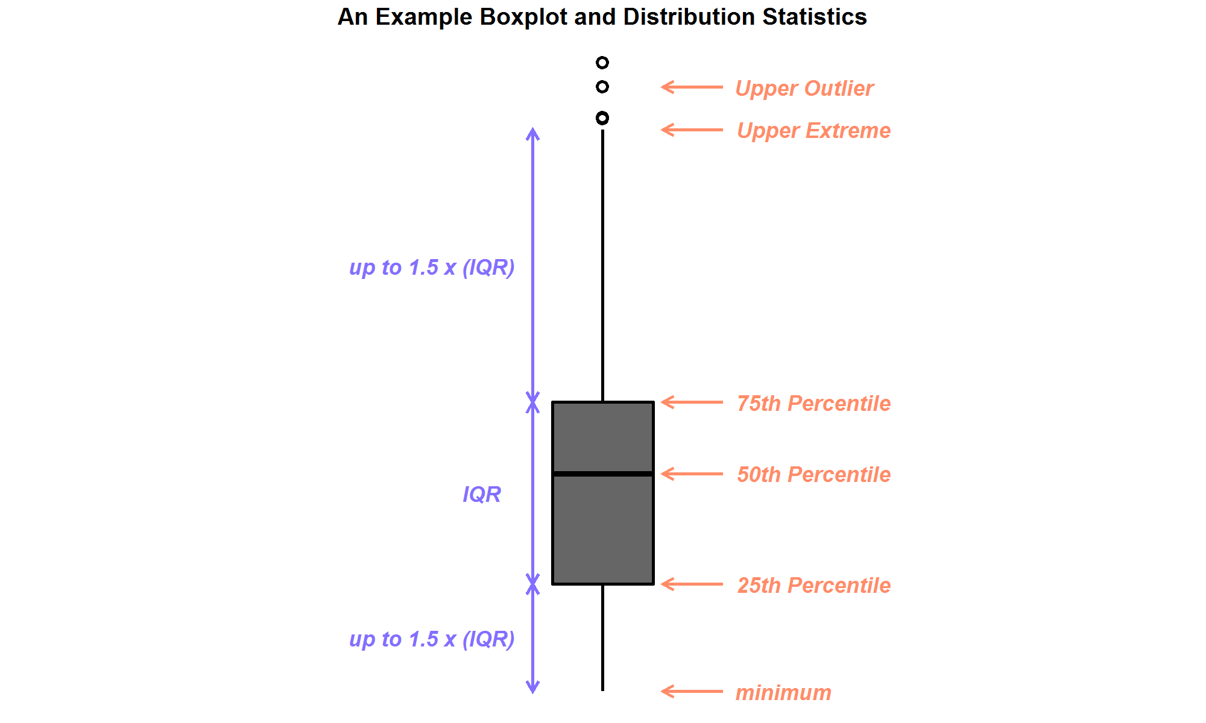
Boxplot Comparison of Data

Slide 13
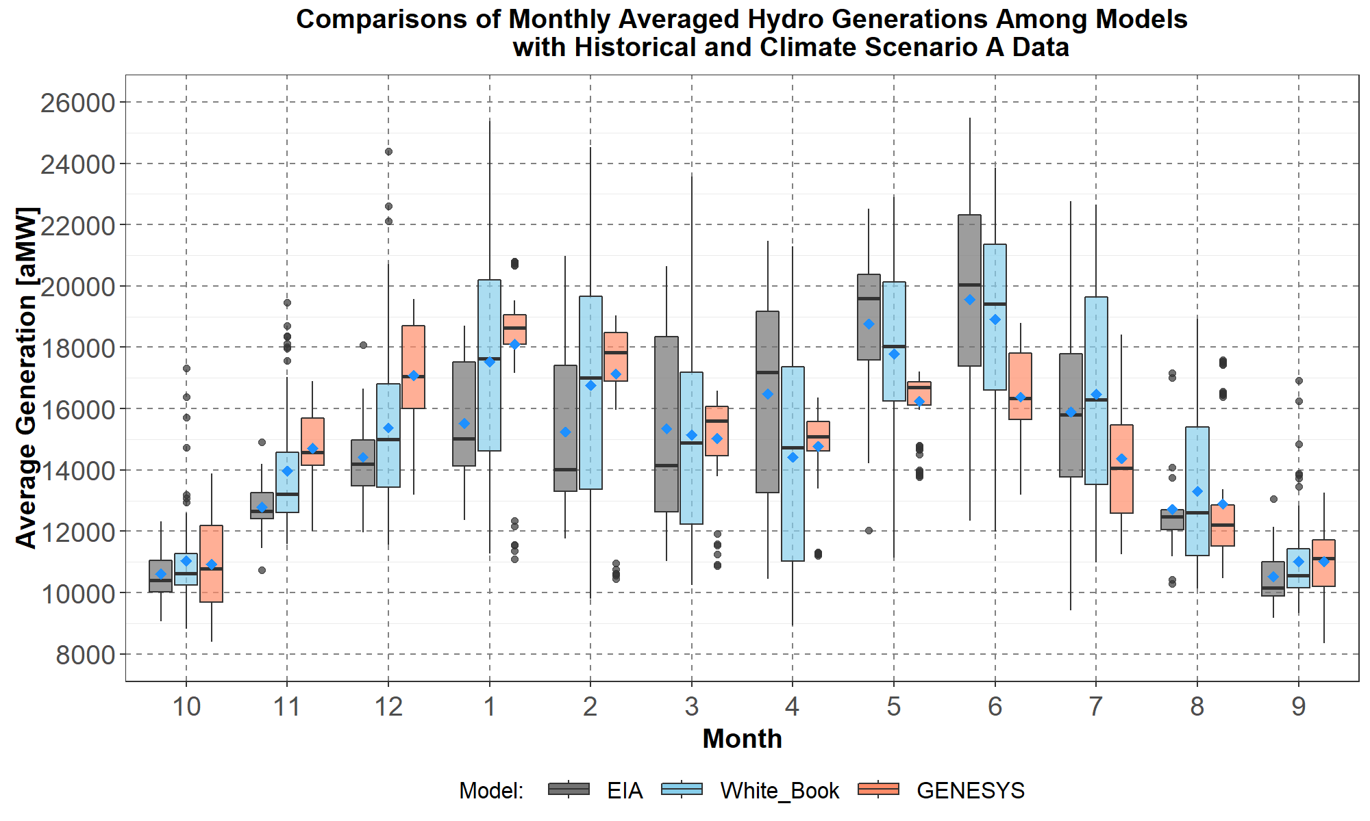
Hydro-Generation Comparisons for Climate Scenario A

Slide 14
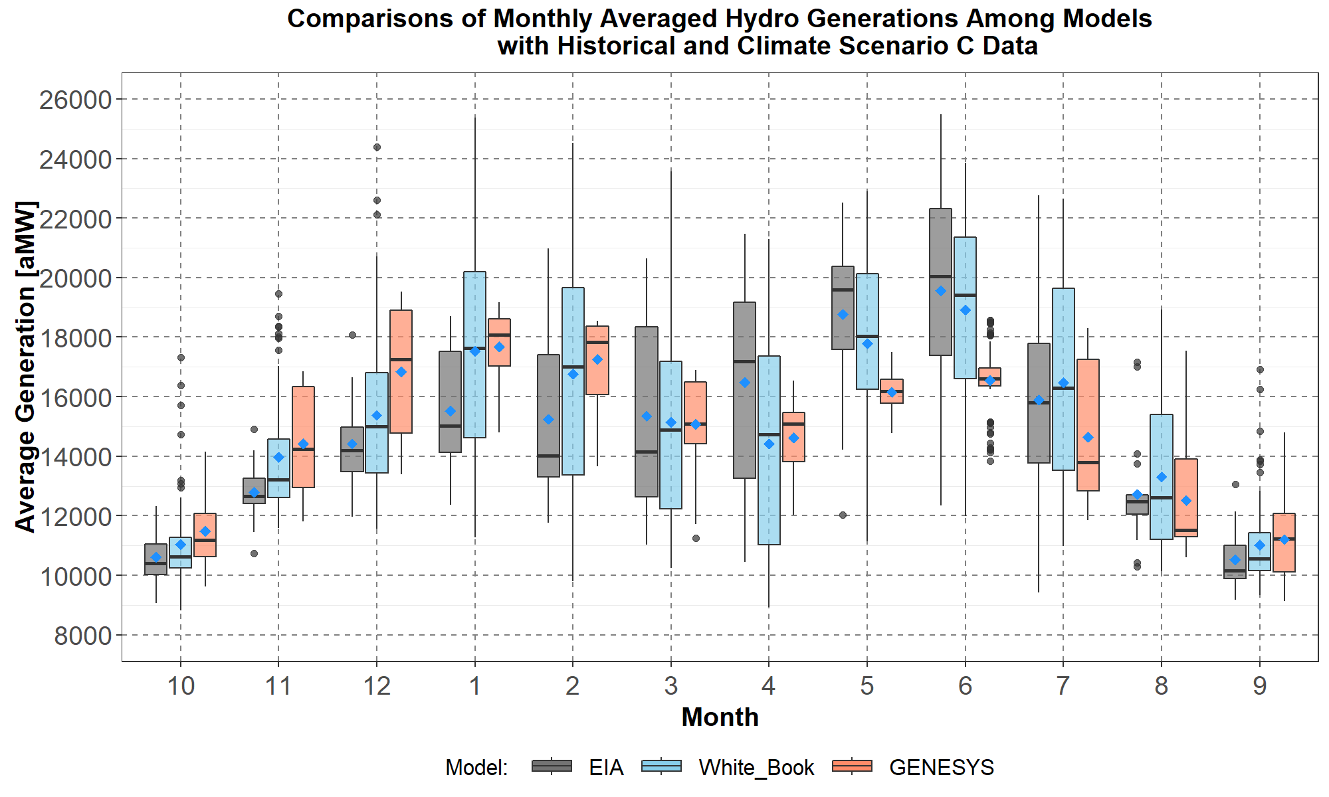
Hydro-Generation Comparisons for Climate Scenario C

Slide 15
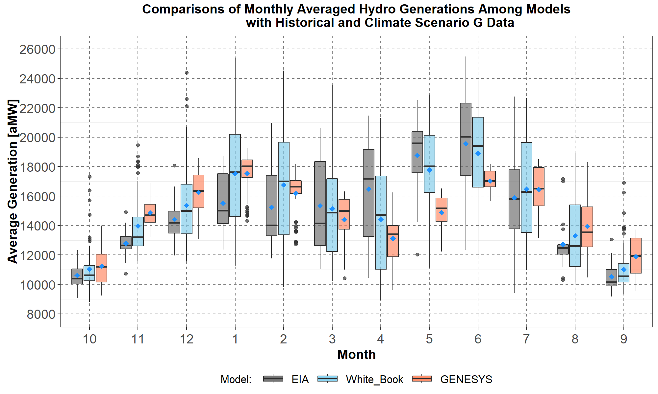
Hydro-Generation Comparisons for Climate Scenario G

Slide 16
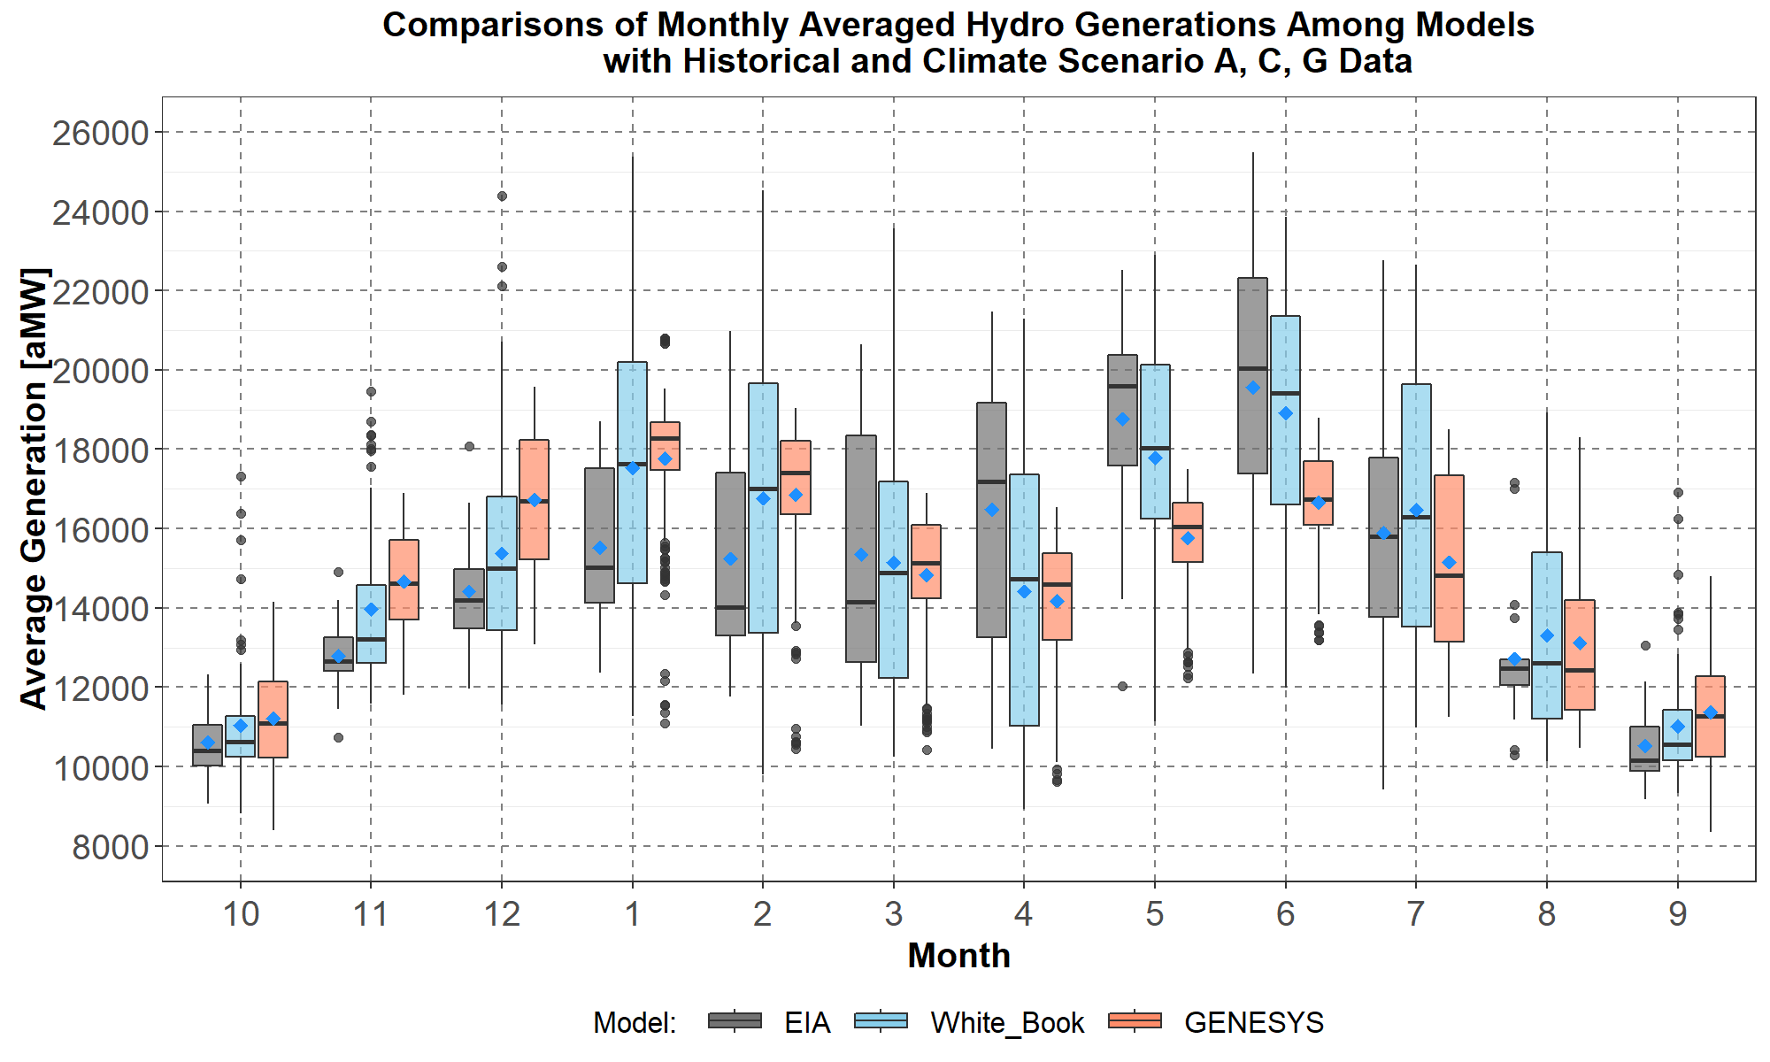
Hydro-Generation Comparisons for Ensemble Climate Scenarios A, C, G

Slide 17
PNW Resource Adequacy Assessment
2025 Operating Year | LOLP
Reference case | 0%
Early coal retirement (N Valmy 2, Centralia 2, Colstrip 3 and 4) | 0.6%
High load (Council’s load forecasting model – about 5% higher loads) | N/A
Classic GENESYS reference case | 22.6%
Redeveloped GENESYS shows an adequate supply through 2025, even under an early coal retirement scenario
Load/resource balance shows a surplus under critical hydro with no market supplies
Classic GENESYS incorporates very conservative assumptions for market supply and hydro flexibility (i.e., sustained peaking estimates do not include all available storage)

Slide 18
Key Differences: New vs. Classic GENESYS
Unit commitment
Classic GENESYS essentially has no unit commitment, resources are always available
New GENESYS commits resources based on forecasted prices
Market supply and price
Classic GENESYS has a fixed high-price market supply
New GENESYS dynamically assesses market supply and price
Even though both models have the same hourly import limit, new GENESYS generally imports over more hours (based on market price)
Hourly hydro generation and flexibility
New GENESYS models more dams as reservoirs, optimizes use of storage and dispatches reserves (classic GENESYS does not) and thus, generally shows greater hydro generation
A more detailed list of factors contributing to different hydro generation is shown later
Thermal forced outages
New GENESYS uses a fixed FOR of 5.9%
Classic GENESYS models forced outages stochastically (with a 5.9% mean)

Slide 19
Modeling Market Supplies
Data are not available to model regions outside the PNW stochastically.
On an expected basis, market supply generally exceeds intertie capacity, except during critical periods of the day (e.g., evening ramp in California).
However, it would be incorrect to assume expected market supply for adequacy studies. This is somewhat akin to assuming average river flow.
In lieu of stochastic analyses, a net import limit is applied, which represents available market supply during critical conditions.
This may be a reasonable assumption for adequacy studies but may skew results for economic studies (i.e., limiting a potentially cheap supply of energy could bias results toward higher overall cost).
For a low market supply sensitivity study, simply reducing the net import limit can be problematic because flow-through generation (e.g., California to and from British Columbia) would be affected, likely resulting in unrealistic simulated operations.

Slide 20
Market Assumptions
Resource | Classic GENESYS | Redeveloped GENESYS
Winter SW spot market | 2,500 MW any hour | 2,500 MW net, any hour price dependent
Winter SW purchase ahead | 3,000 MW 8 hours (10pm to 6am) | 2,500 MW net, any hour price dependent
Winter IPP availability | 2,400 MW | 2,400 MW
Total winter hourly max import | 3,400 MW | 2,500 MW
Summer SW spot market | 1,250 MW 5 hours (9am to 2pm) | 1,250 MW net, any hour price dependent
Summer SW purchase ahead | None | 1,250 MW net, any hour price dependent
Total summer hourly max import | 1,250 MW | 1,250 MW
Summer IPP availability | 2,400 MW 10 hours (8am to 6pm) | 2,400 MW, any hour price dependent

Slide 21
New GENESYS Distribution of Number of Import Hours by Percentile
Year | Month | 0% | 5% | 10% | 20% | 30% | 40% | 50% | 60% | 70% | 80% | 90% | 95% | 100%
2024 | Oct | 0 | 1 | 3 | 7 | 8 | 9 | 10 | 11 | 12 | 13 | 14 | 16 | 24
2024 | Nov | 0 | 4 | 6 | 8 | 8 | 9 | 10 | 11 | 12 | 13 | 17 | 21 | 24
2024 | Dec | 0 | 5 | 6 | 7 | 8 | 9 | 11 | 11 | 12 | 13 | 16 | 20 | 24
2025 | Jan | 0 | 3 | 4 | 6 | 7 | 8 | 9 | 10 | 11 | 13 | 16 | 23 | 24
2025 | Feb | 0 | 1 | 2 | 5 | 6 | 7 | 8 | 9 | 10 | 11 | 13 | 16 | 24
2025 | Mar | 0 | 0 | 1 | 4 | 5 | 7 | 8 | 9 | 10 | 11 | 12 | 13 | 24
2025 | Apr | 0 | 6 | 8 | 9 | 10 | 10 | 11 | 12 | 13 | 13 | 14 | 14 | 20
2025 | May | 2 | 6 | 7 | 8 | 9 | 10 | 10 | 11 | 12 | 13 | 14 | 15 | 24
2025 | Jun | 0 | 5 | 6 | 8 | 9 | 9 | 10 | 11 | 12 | 13 | 15 | 17 | 23
2025 | Jul | 0 | 5 | 6 | 9 | 10 | 11 | 12 | 13 | 13 | 14 | 16 | 18 | 24
2025 | Aug | 0 | 2 | 4 | 7 | 9 | 10 | 11 | 12 | 14 | 15 | 15 | 18 | 24
2025 | Sep | 0 | 3 | 5 | 7 | 9 | 10 | 12 | 13 | 13 | 14 | 17 | 21 | 24

Slide 23
Effect of import hours in the classic GENESYS
Annual LOLP | 2025
Redeveloped GENESYS | 0%
Classic GENESYS with 5 hours summer market and 1,000 MW hydro flex | 22.6%
Classic with 18 hours summer market and 1,000 MW hydro flex | 7.6%
Both versions limit the summer maximum hourly import to 1,250 MW
Classic model limits imports to 5 hours (6,250 MW-hours/day) and only as a last resort (market prices are set higher than all NW resources)
New model can import over 24 hours (30,000 MW-hours/day) and imports when market prices are lower than NW resources, which can lead to better utilization of hydro storage
Allowing 18 hours of import in the classic model increases the maximum daily imported energy by 16,250 MW-hours and dramatically reduces LOLP

Slide 24
Effect of import hours & hydro flex¹ in classic GENESYS
Annual LOLP | 2025
Redeveloped GENESYS | 0%
Classic GENESYS with 5 hours summer market and 1,000 MW hydro flex | 22.6%
Classic with 18 hours summer market and 1,000 MW hydro flex | 7.6%
Classic with 18 hours summer market and 2,000 MW hydro flex | 1.8%
Some enhancements in the redeveloped GENESYS increase LOLP (more PNW nodes and transmission, forecast error, unit commitment)
Two enhancements decrease the LOLP (dynamic market and price, hydro operations)
New GENESYS has same hourly import limits but tends to import over more hours
New GENESYS models more dams as reservoirs and optimizes use of storage
¹Hydro flex is drafting below the critical rule curve for short periods of time and then replacing that water as soon as possible.

Slide 25
Effect of Using a Fixed Forced Outage Rate
Annual LOLP | 2025
Redeveloped GENESYS | 0%
Classic GENESYS with 5 hours summer market and 1,000 MW hydro flex | 22.6%
Classic GENESYS using a fixed 5.9% FOR | 8.7%
Modeling forced outages stochastically is better than simply using a fixed FOR
However, the resultant FOR distribution should be checked to ensure that, over a sufficiently large number of games, the mean FOR equals the expected FOR
Secondly, the FOR-probability distribution should be examined to ensure that the range of uncertainty (i.e., standard deviation) is reasonable – that is, that the likelihood of extreme FOR values is not too high or too low
However, adding stochastic forced outage to the new GENESYS is not likely to make a significant difference in LOLP because in almost all conditions examined, thermal resources were never fully utilized (i.e., they could absorb a higher outage rate)

Slide 26
Observations
The redeveloped GENESYS model provides a much more detailed and accurate representation of real-life operations. It incorporates more aspects of power system operations and therefore, can explicitly examine more risks to maintaining an adequate supply
While the classic GENESYS provides a good assessment of energy needs, it falls short on assessments of capacity or peak-hour needs. It includes conservative assumptions (e.g., market supply and hydro flexibility) and therefore may show a higher resource need than the redeveloped GENESYS
While the redeveloped GENESYS may still need some fine tuning, the Council believes results from the new model will lead to a better assessment of future power supplies and a more robust resource strategy for the region.

Slide 27
Comparison of Simulated Operations Classic vs. Redeveloped GENESYS (July 31 to August 2, CC scenario A, Water year 2020)

Slide 28
Classic GENESYS Curtailment Event

Slide 29
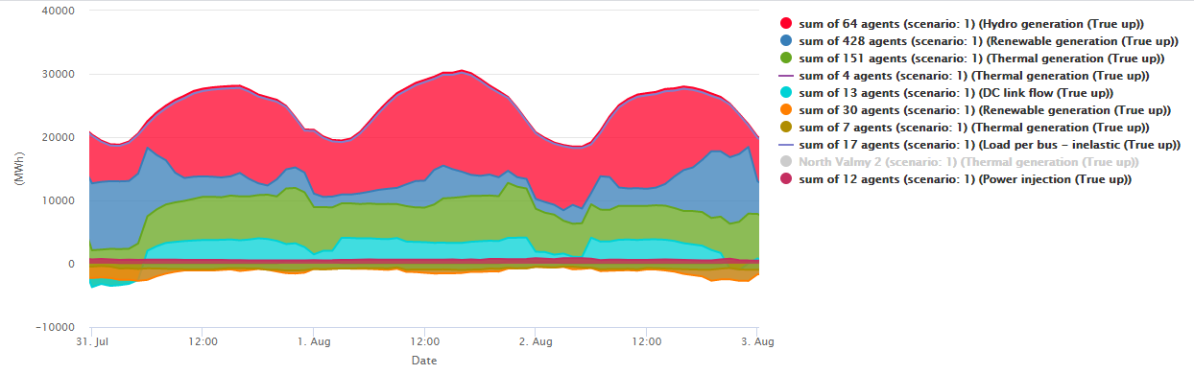
Redeveloped GENESYS Scenario A, July 31-August2, Water year 2020

Slide 30
Next Steps
Member feedback
Recommendations for the Council
Improving future adequacy assessments
Model enhancements (e.g., transmission FOR, more detailed and/or stochastic WECC representation)
Better adequacy metrics
Monthly or seasonal assessments

Slide 31
Additional Slides

Slide 32
Load/Resource Balance
Calculation

