Slide 1
Study of migrant juvenile salmonid survival and travel time, 1993-present
Northwest Fisheries Science Center
Briefing for NW Power and Conservation Council
Fish and Wildlife Committee
April 12, 2022
Steven G. Smith
steven.g.smith@noaa.gov

Slide 2
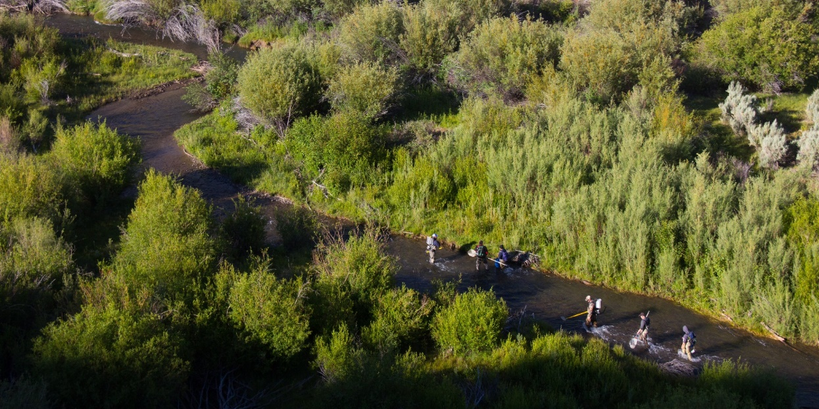
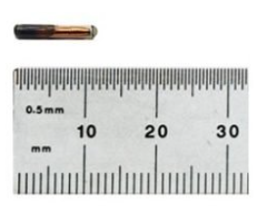
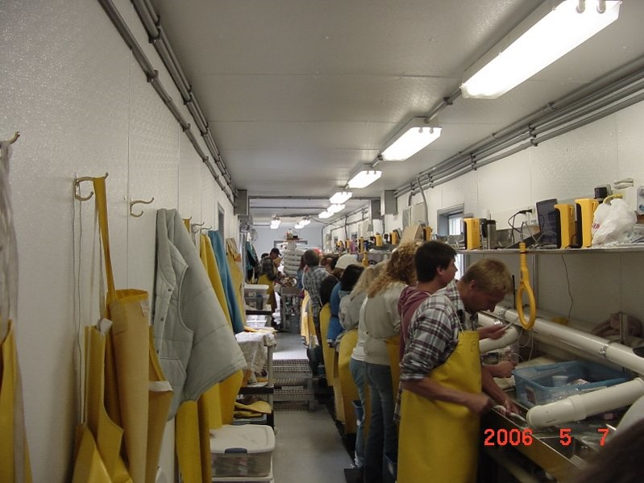
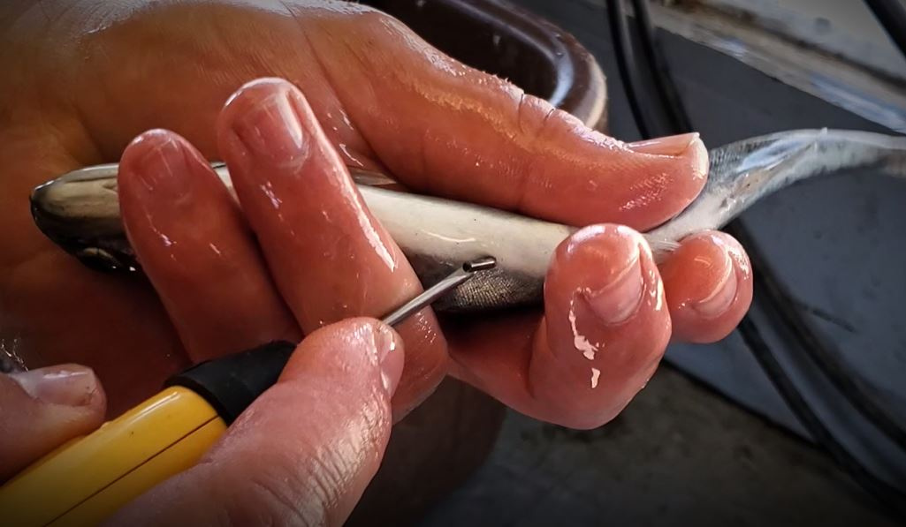
Council Project 1993-029-00: “Survival Estimates for Juvenile Salmonids”
Ben Sandford
Tiffani Marsh
Scott Putnam

Slide 3
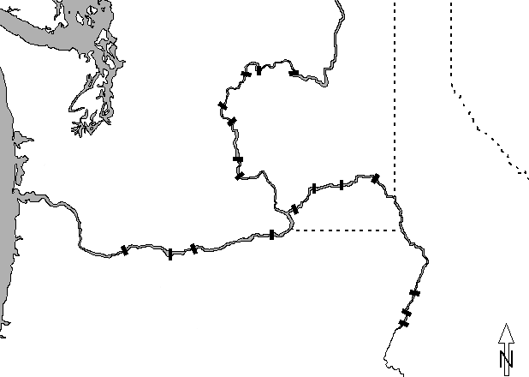

PIT-tag Data Sources
Chief Joseph
Hatchery
Releases
Wells
Grand Coulee
Rocky Reach
Rock Island
PIT-trawl
Bird colonies
Pile dike
PIT barge
Wanapum
Tailrace
Releases
Ice Harbor
Priest Rapids
Snake R. trap
PIT-trawl
Bird colonies
Pile dike
PIT barge
Juvenile detectors
Lower Granite
Little Goose
Hatchery, Trap
Electrofishing
Releases
Lower Monumental
McNary
Bonneville
John Day
The Dalles
Hells Canyon
Oxbow
Brownlee
Notes:
Map etc.

Slide 4
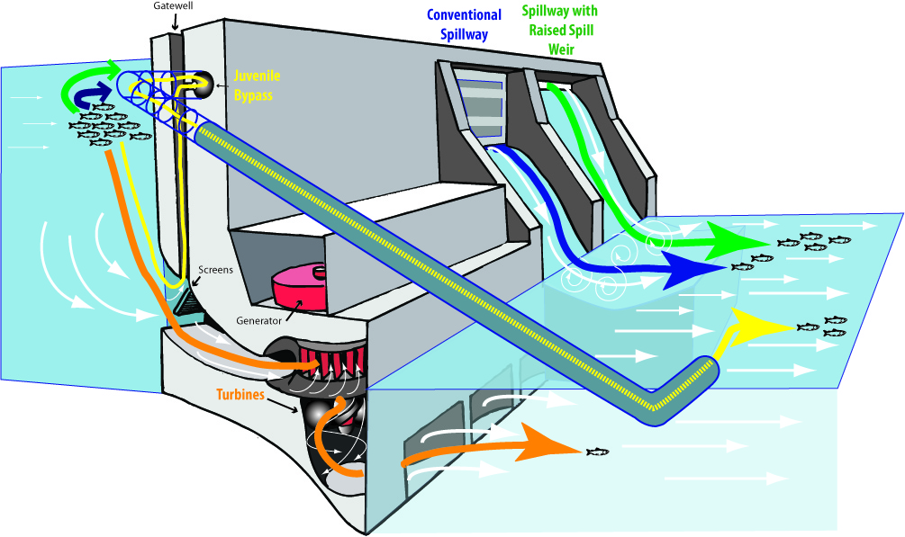

Slide 5
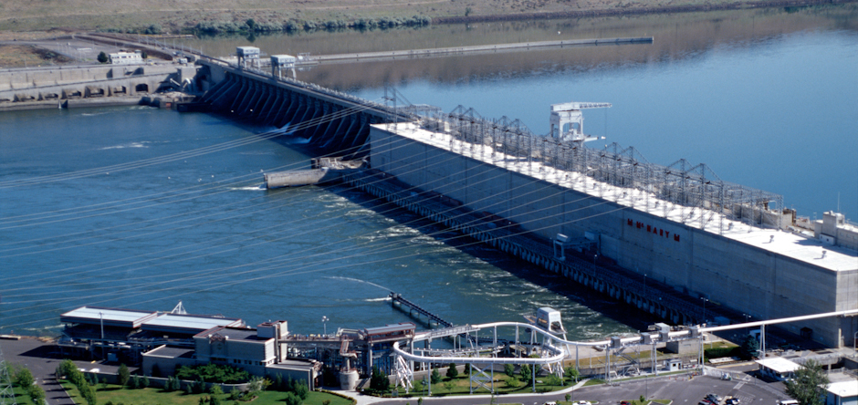

Slide 6
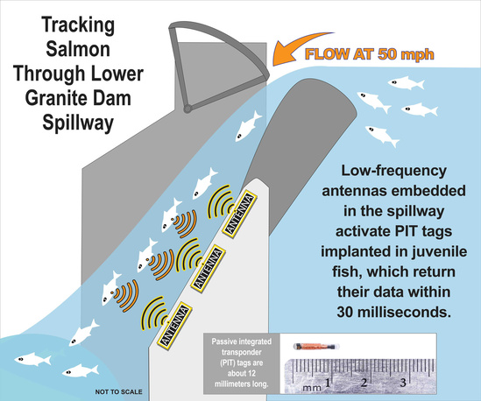
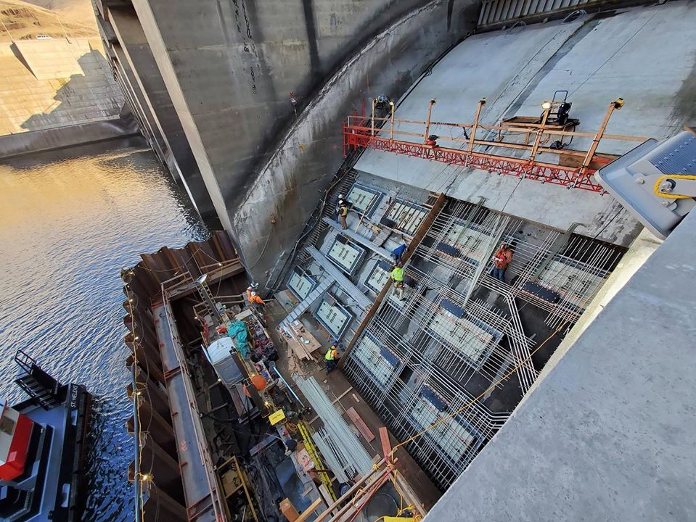
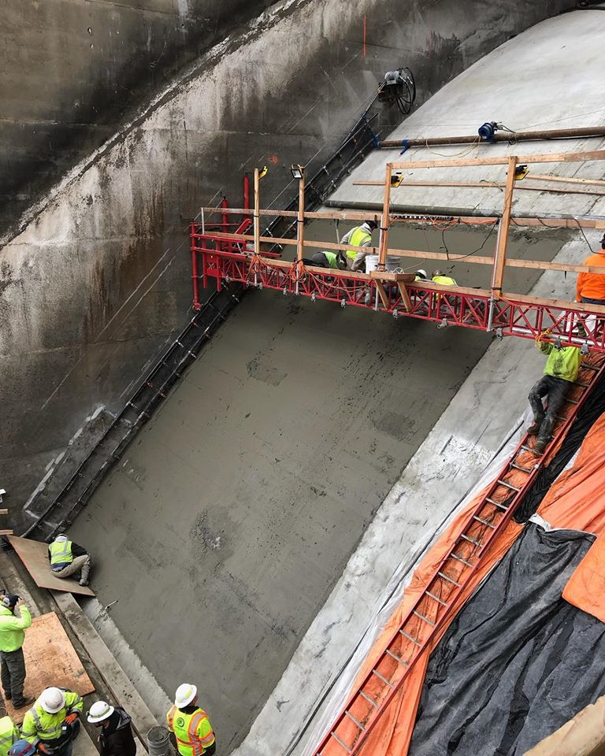
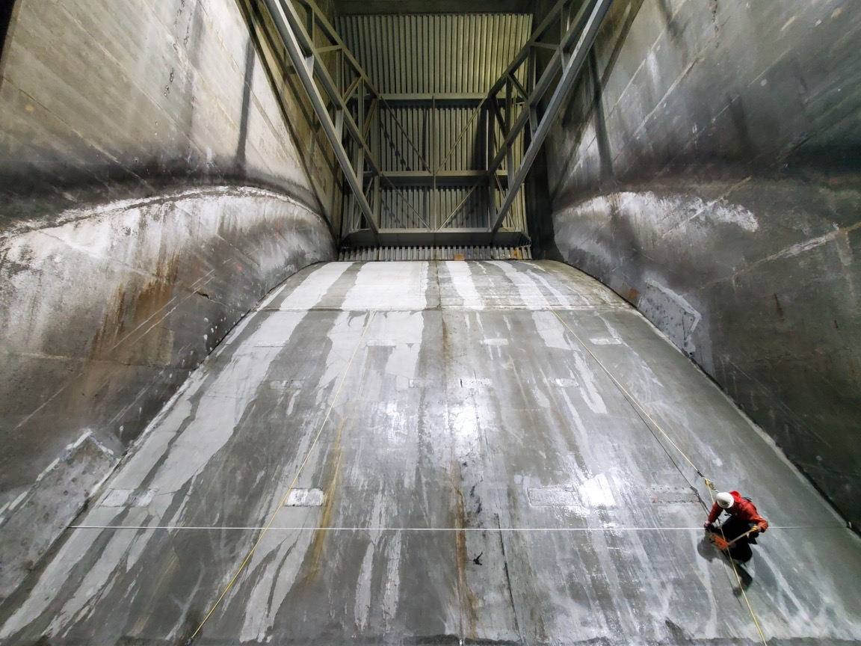
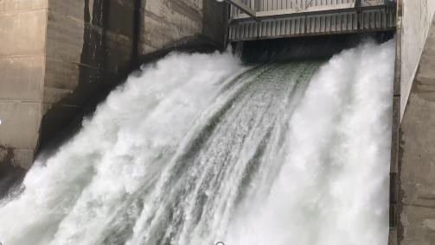
Spillway PIT Detection at Lower Granite Dam
Biomark
Biomark
Biomark
Biomark

Slide 7
Estimated proportion detected of passing PIT-tagged Snake River yearling Chinook

Slide 8
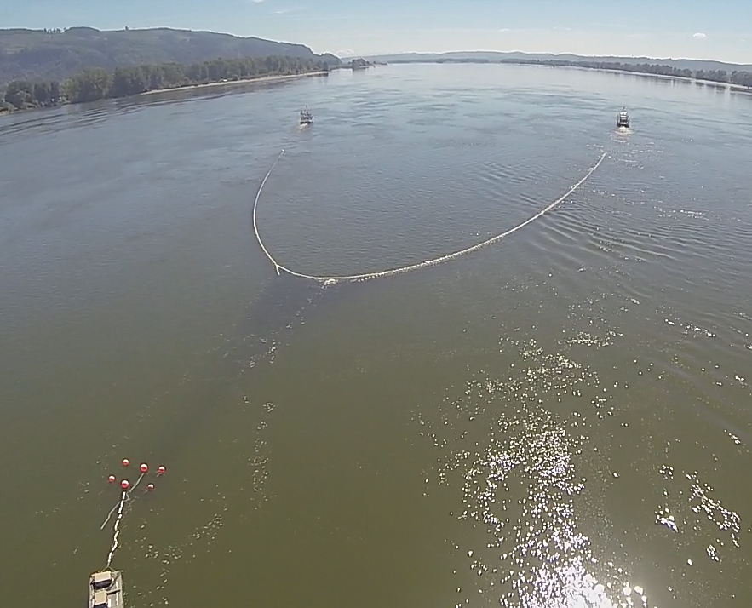
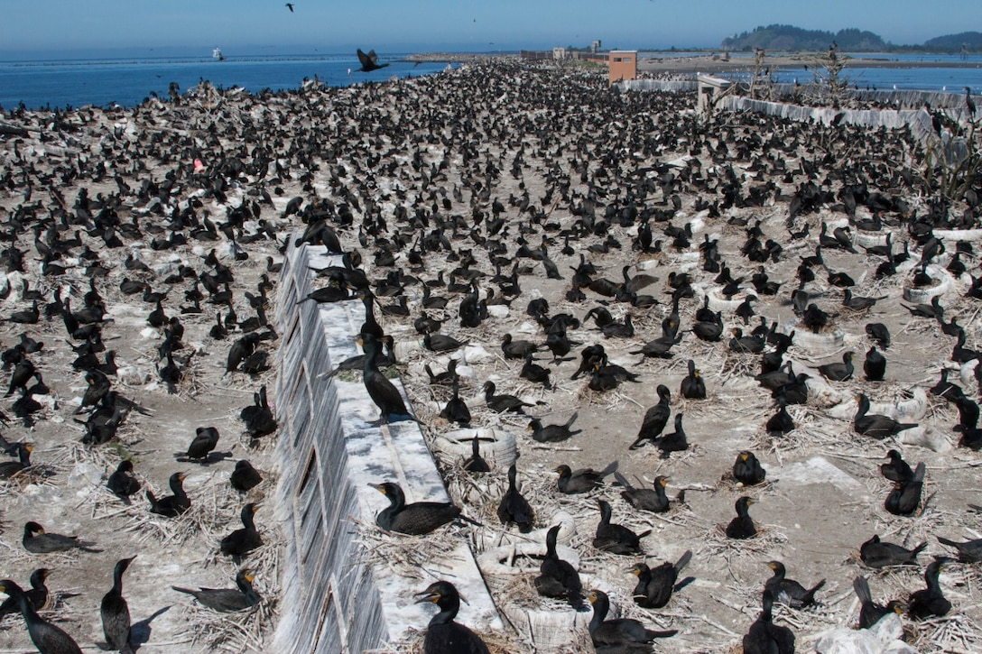
Downstream of Bonneville Dam
NOAA
Billie Johnson

Slide 9
Outline – Smolt Survival
Migration conditions, travel time and survival of PIT-tagged smolts through the hydropower system in 2021
  Preliminary Results Memo: October 7, 2021 – no bird recovery data
  Today – bird recovery data from estuary included
  Annual Report to BPA in prep
    – potential to include mid-river bird recovery data
    Only those fish left to migrate in-river
    Only juvenile data, not survival to adult

Slide 10
2021 Spring Conditions
  Flow well below average throughout season
  Water temperature above average most of season
  Record high spill percentage
  Moderate dissolved gas,
    probably because of low flow

Slide 11
2021 Spring Migration
  Travel times
    Slightly shorter than in other recent low-flow years
  Less than 10% transported
  Very low numbers passed dams via juvenile bypass systems
    Low PIT-tag detection probabilities (data quality diminished)
    Low numbers collected for transportation

Slide 12
2021 Spring Survival Estimates
Snake River Yearling Chinook: Near average
Snake River Steelhead: Below average
Columbia River Yearling Chinook and Steelhead:
  - Below average, both to McNary Dam and in lower Columbia
McNary-to-Bonneville below average for multiple stocks
Generally imprecise because of low detection rates
- some >100%, likely for same reason

Slide 30
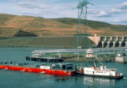

Slide 31
Almost 30 Years of Survival Study
  Warming of river is evident in data
  Increase in spill percentage over years
  Smolt travel times reduced
  No unequivocal long-term trends in smolt survival

Slide 32
Estimated proportion detected of passing PIT-tagged Snake River yearling Chinook

Slide 33
Consequences of (Very) Low
PIT-Tag Detection Rates
Less information means generally lower precision in all estimates
Analytical measures taken to get broad-scale estimates
  - Adjustments for finer scales not possible
Lost Resolution
  Subsets of smolts (e.g. wild vs hatchery; LGR spillway-detected vs. bypass-detected)
  Some one-project reaches extremely imprecise
  Temporal resolution degraded; virtual release groups must be pooled over longer periods
  More difficult to investigate effects of seasonally changing conditions
    “2021 is basically worthless for the COMPASS model” – J. Faulkner

Slide 34
Consequences of (Very) Low
PIT-Tag Detection Rates
Increased spill is intended to benefit fish, but the current information environment decreases power to understand the actual effect
  Difficult to demonstrate a benefit
  Difficult to recognize if harm is being done inadvertently

Slide 35
Acknowledgments
Bonneville Power Administration
Northwest Power and Conservation Council
PTAGIS – Pacific States Marine Fisheries Commission
Avian Predation Detection Project
  Real Time Research -- Astoria-Megler Bridge etc.
  Corps of Engineers Fish Field Units – East Sand Island
DART – University of Washington Columbia Basin Research
NOAA Colleagues: Jim Faulkner, Dan Widener
Legions of Taggers, Coordinators, Agencies, etc.

Slide 36
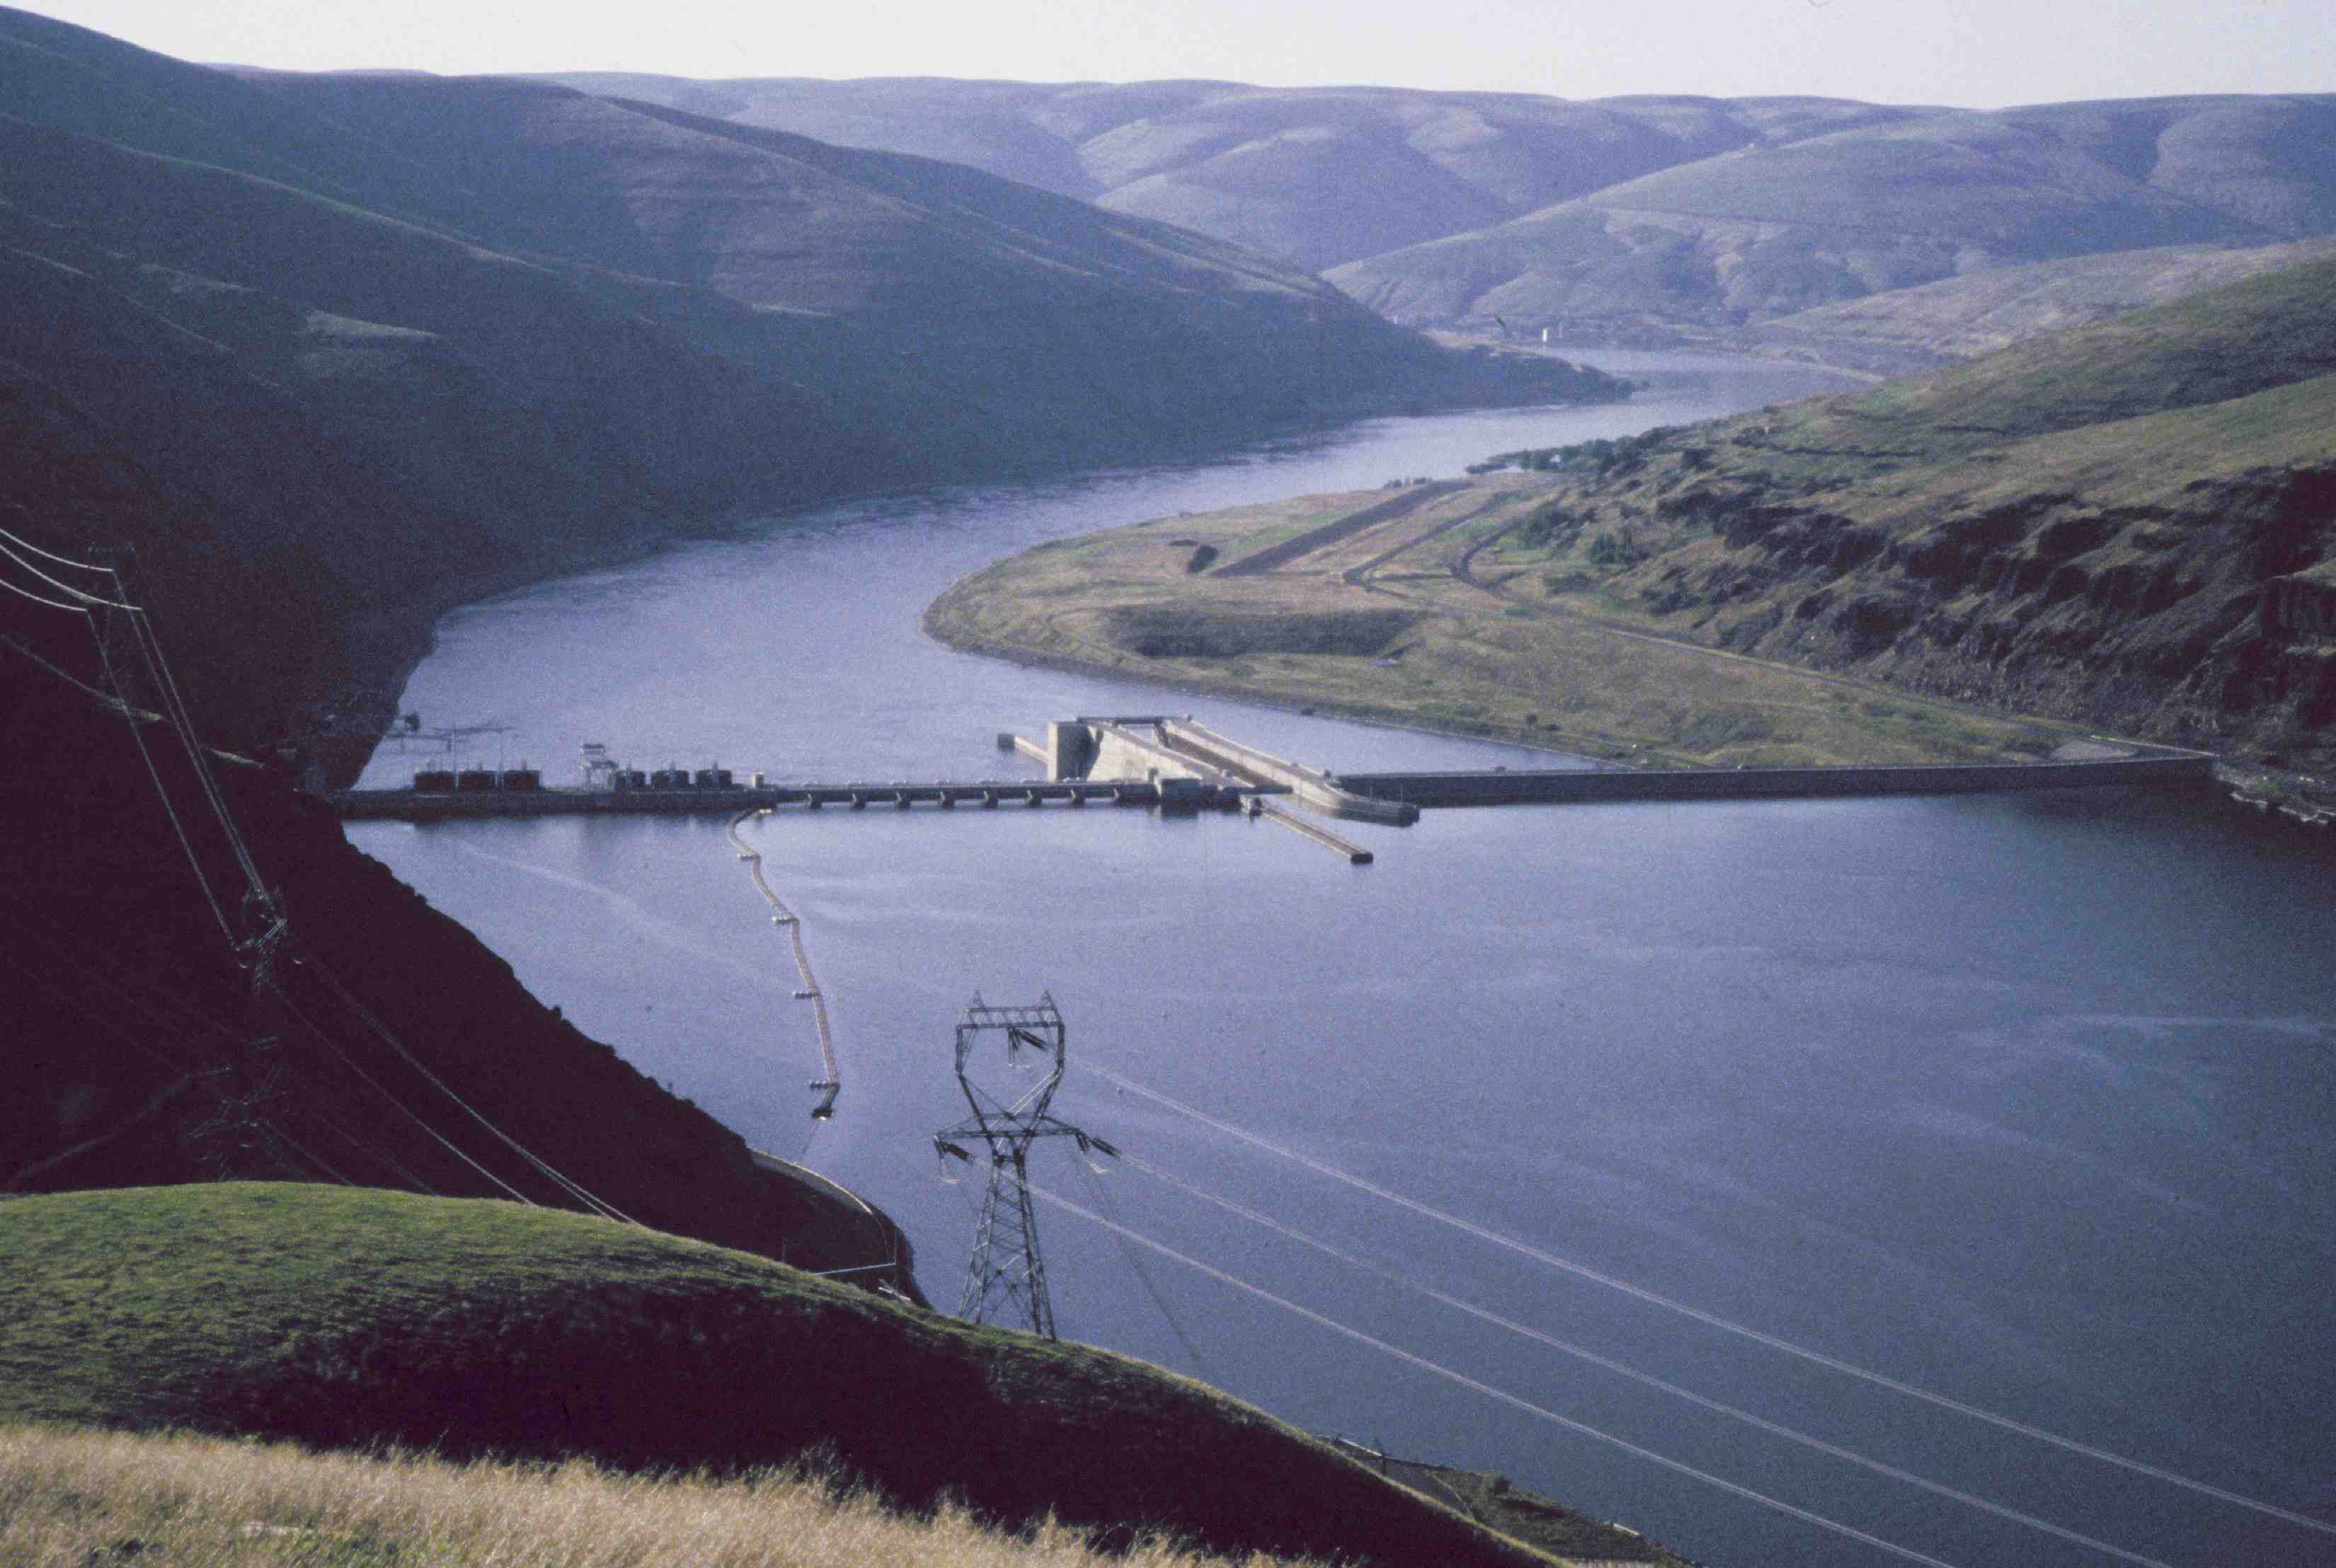
Questions

