Slide 1
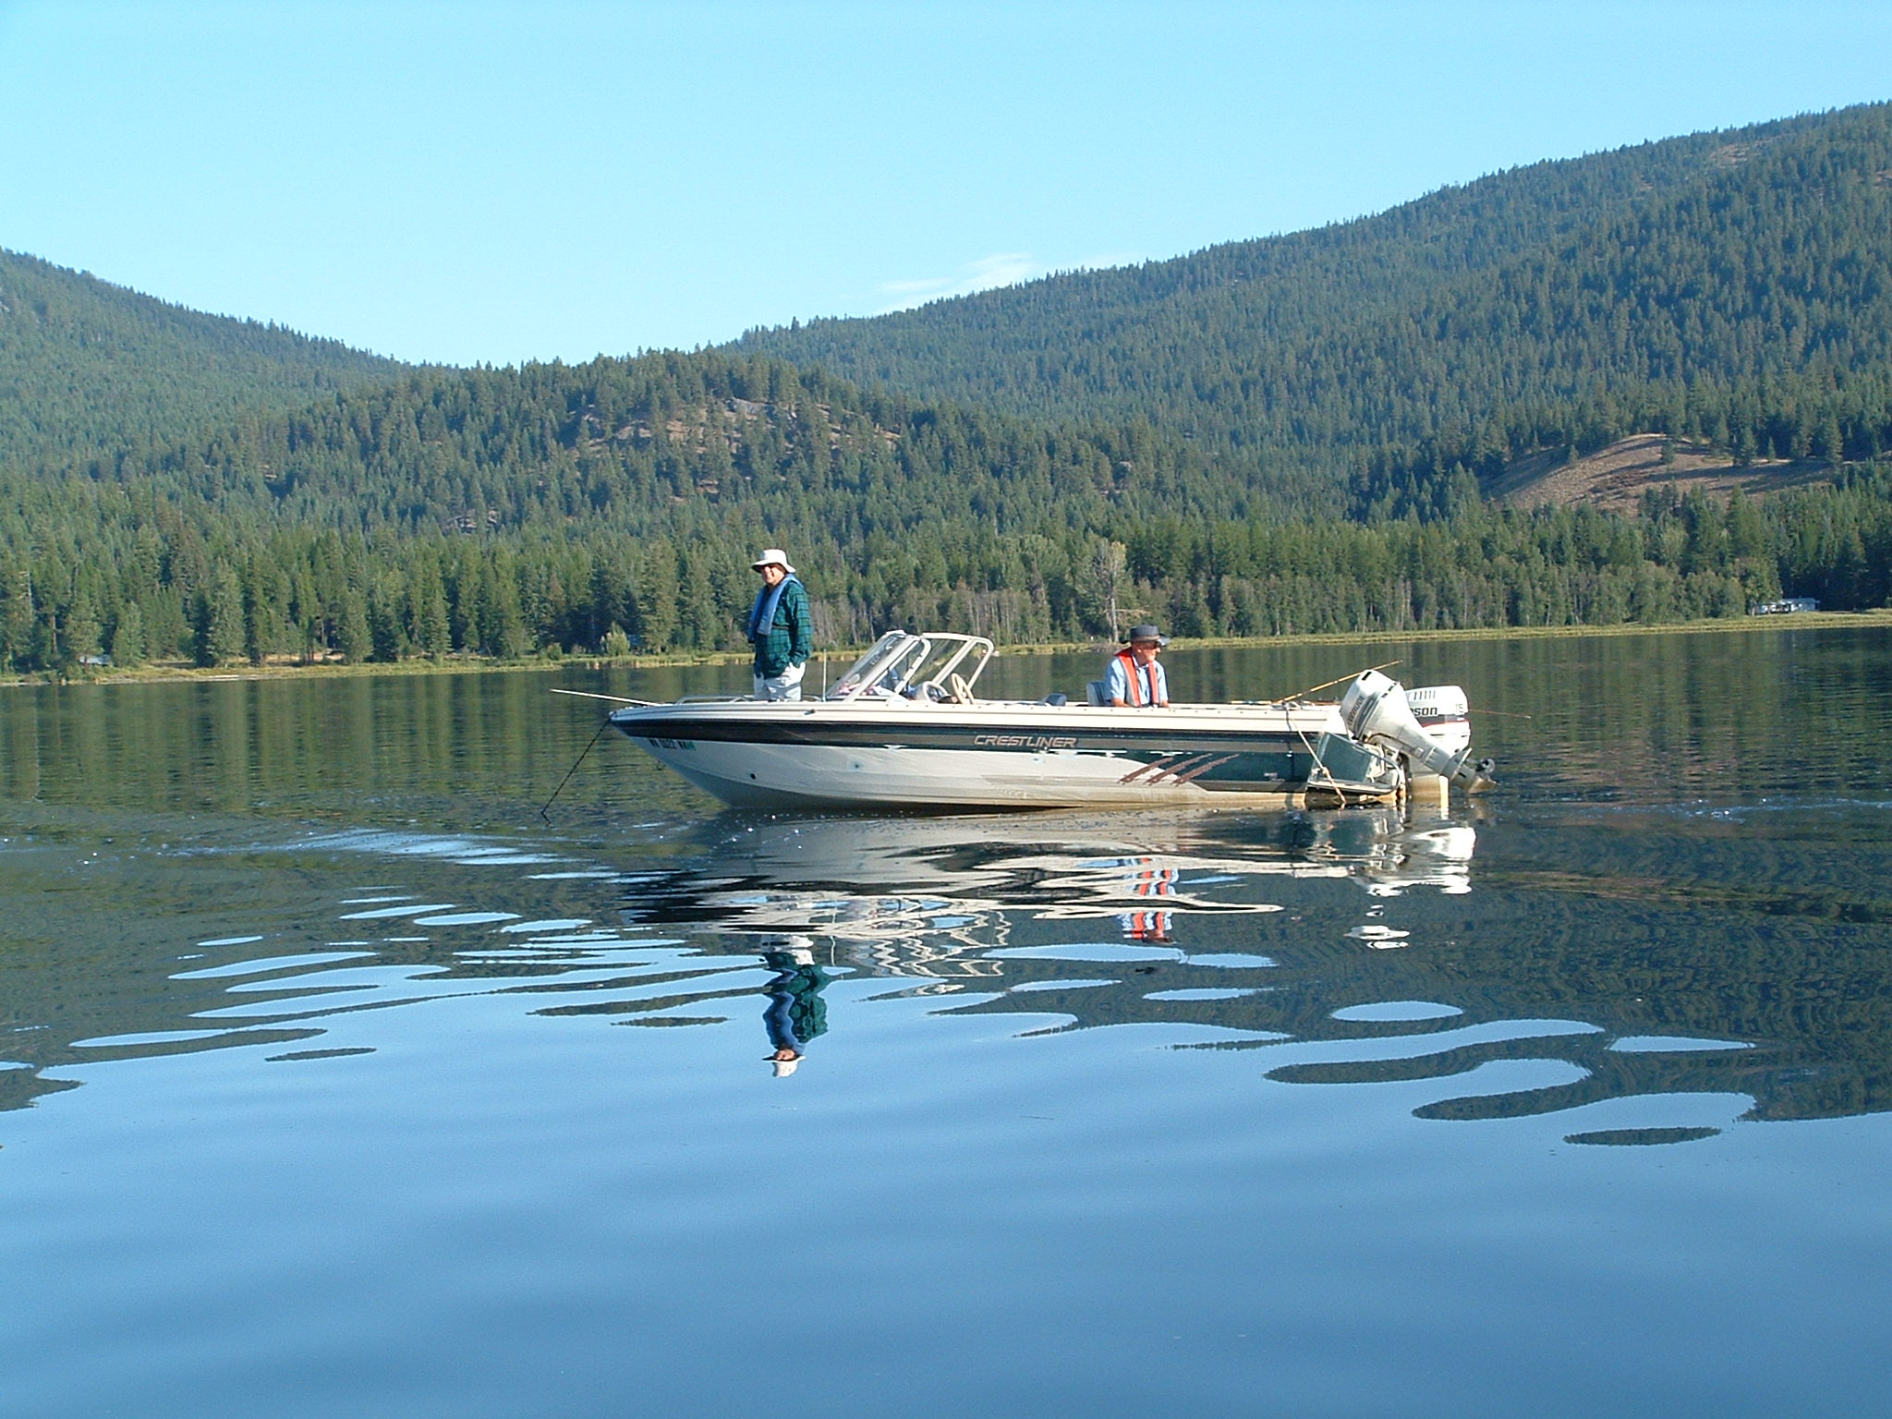
Colville Confederated Tribes Hatchery Subdivision

Slide 2
Hatchery Subdivision
Hatchery Project
Raise Fish
Stock lakes and streams
M&E
Twin Lakes Oxygenation
Oxygenate Hypolimnion
Monitor Effects
Stock Lake
Evaluate effects of oxygenation on fish
Reduce Hatchery Densities
Release Fish
Rufus Woods M&E
Release Fish
Rufus Woods Creel
Creel Survey
Release Fish
M&E
Rufus Woods Net Pens
Raise Fish
Monitor Fish Releases
Release Fish

Slide 3
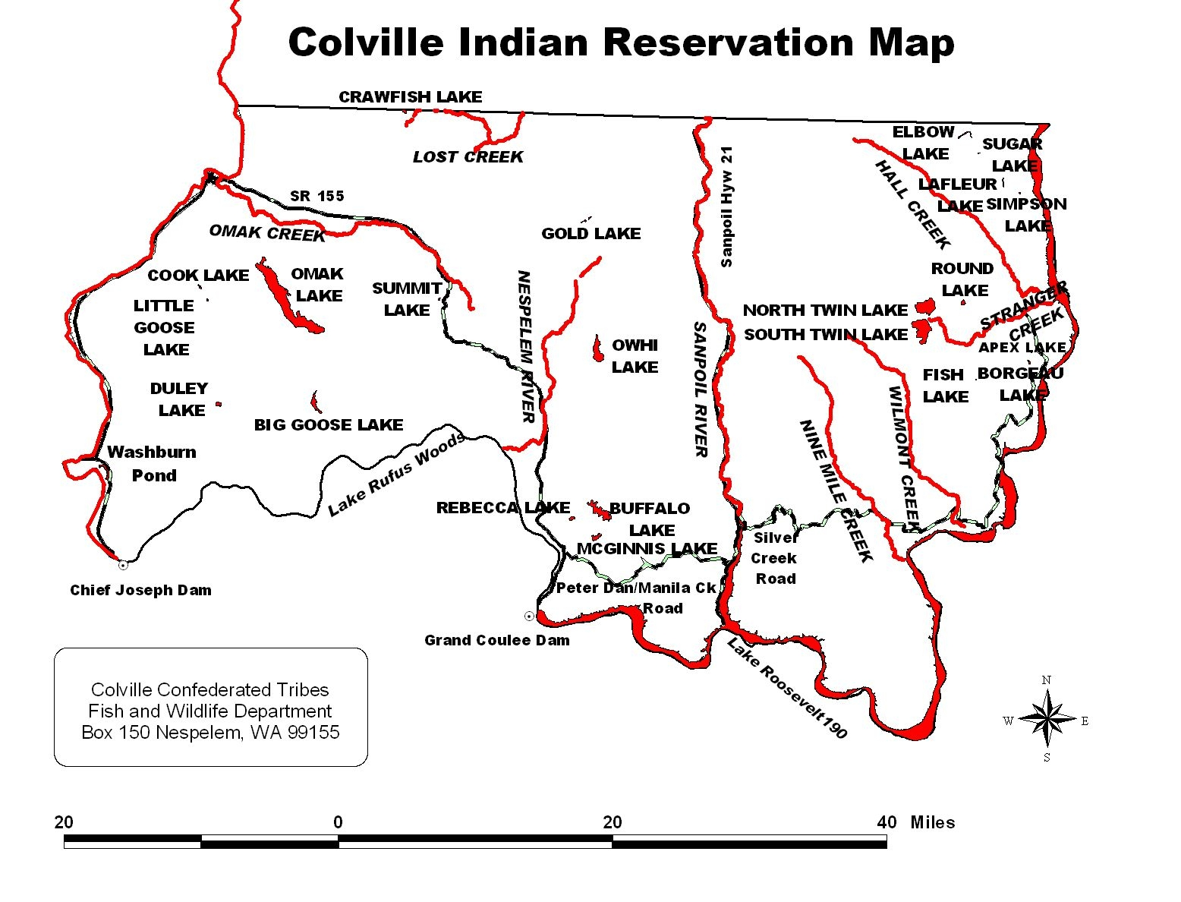

Slide 4
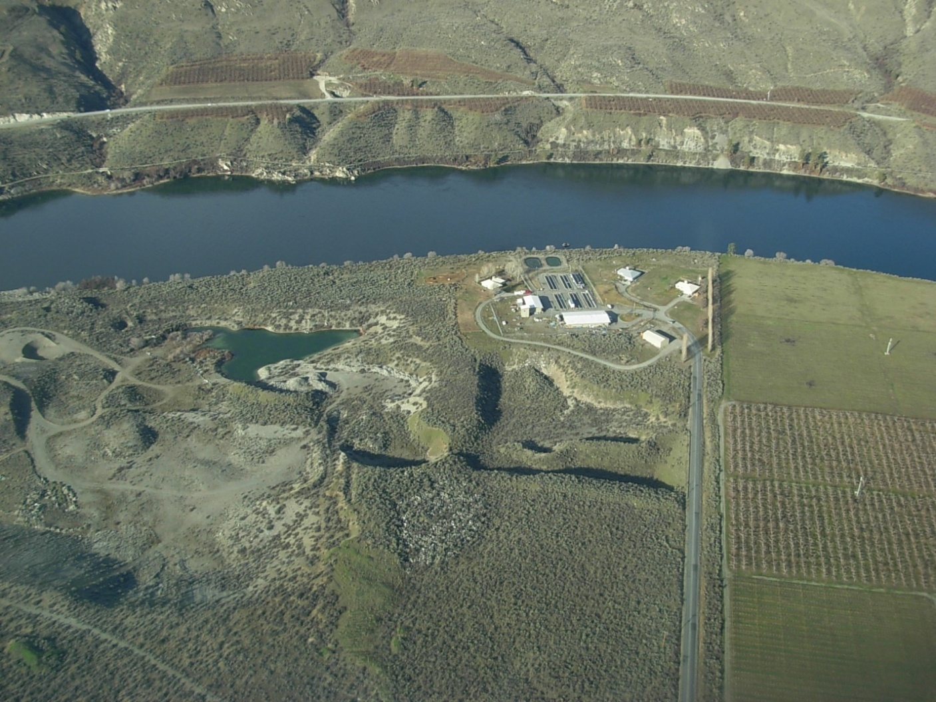
Hatchery Project

Slide 5
Primary Goals
Raise fish for Reservation Waters.
Monitor Reservation waters to determine most efficient stocking strategies.
Evaluate projects that effect fish numbers/size in stocked waters.
Education and community involvement
Notes:
Annual production and stocks. Add list to appendix. Also add that it is two divisions within the project—Hatchery and M&E

Slide 6
Hatchery Accomplishments
Major Reduction in Mortality
Improvement in angler catch rates, average fish size and fish quality
Development of redband broodstock, evaluation and decision to eliminate redband program
Match stocking program to lake needs
Improvements to hatchery water system
Hatchery tours and fishing derbies
Graduate student program
Notes:
Water quality and quantity

Slide 7
Reduction in Hatchery Mortality
Eastern Brook Trout Program over the past years.
Brood Year | # Green Eggs |  | # Eyed Eggs |  | # Ponded |  | # Planted |  | % Planted
2005 | 655,477 |  | 397,999 |  | 57,592 |  | 38,007 |  | 5.80%
2006 | 1,544,307 |  | 1,108,086 |  | 576,475 |  | 351,454 |  | 22.76%
2007 | 1,063,047 |  | 512,602 |  | 268,857 |  | 206,179 |  | 19.40%
2008 | 930,981 |  | 683,402 |  | 520,671 |  | 470,731 |  | 50.56%
2009 | 436,655 |  | 388,115 |  | 341,727 |  | 338,772 |  | 77.58%
2010 | 278,829 |  | 193,482 |  | 183,808 |  | 157,931 |  | 56.64% |  | *
2011 | 260,058 |  | 234,385 |  |  |  |  |  |  |  | **
* A large number of eggs identified were unfertilized, hatchery currently has 22,952 EBT10 on station.
** Hatchery culled 63,113 eyed eggs from population since egg mortality was very low.
Notes:
My only credit is for having the wisdom to hire a competent person to be onsite

Slide 8
Improvements to Catch Rate and Size

Slide 9
Redband Rainbow Broodstock Development
Broodstock collection began in 2003
First planted in 2006
100% redband plant 2009-2011
Poor hatchery performance
Poor lake performance
Outmigration
Genetic issues
Last redband plant in 2012
Notes:
Even though project was not a success, the evaluation was thorough

Slide 10
Matching stocking program to lake needs
Eliminate stocking in Gold and Round Lakes
Reduce stocking in Owhi and Twin Lakes
Notes:
Mention species, Owhi is EBT, Twin Lakes is RBT

Slide 11
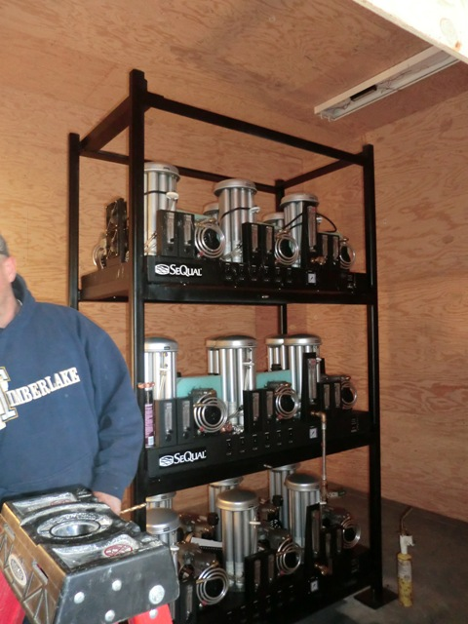
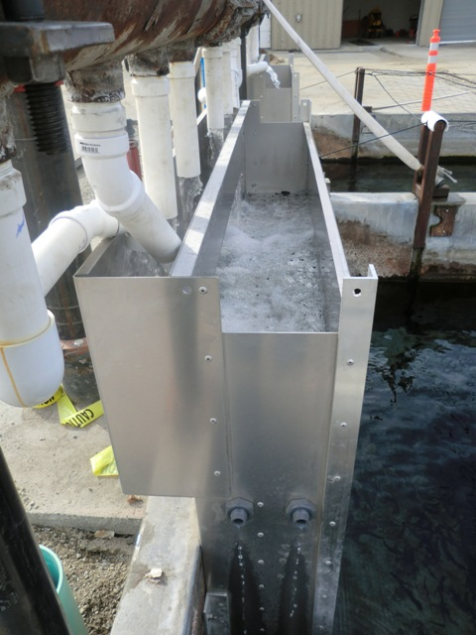
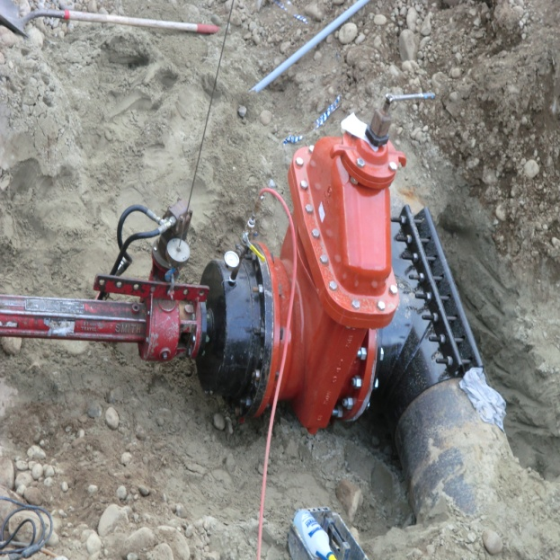
Water System Improvements
Completed Construction Project in October 2011
  Installed Low Head Oxygenators (LHO’s) and Oxygen Generators
  Bypassed Water Distribution Tower (25’) by piping directly to raceways.
  Installed gate valves to allow flexibility in directing water and well usage.
Notes:
Independent Consultant will be scheduled this year to assess overall energy efficiencies from implementing project.

Slide 12
Education programs
Frequent hatchery tours for school groups
Fishing derbies
Graduate student program with WSU
  8 MS degrees completed
  2 PhD degrees completed
  2 MS degrees in progress
  3 PhD degrees in progress

Slide 13
Monitoring and Evaluation
Whole Lake Study
Detailed study in cooperation with WSU. Presently studying Owhi Lake. Previously studied Twin Lakes.
Major Lakes.
Smaller stocked lakes
Streams
Evaluate other related projects.
Twin Lakes Oxygenation

Slide 14
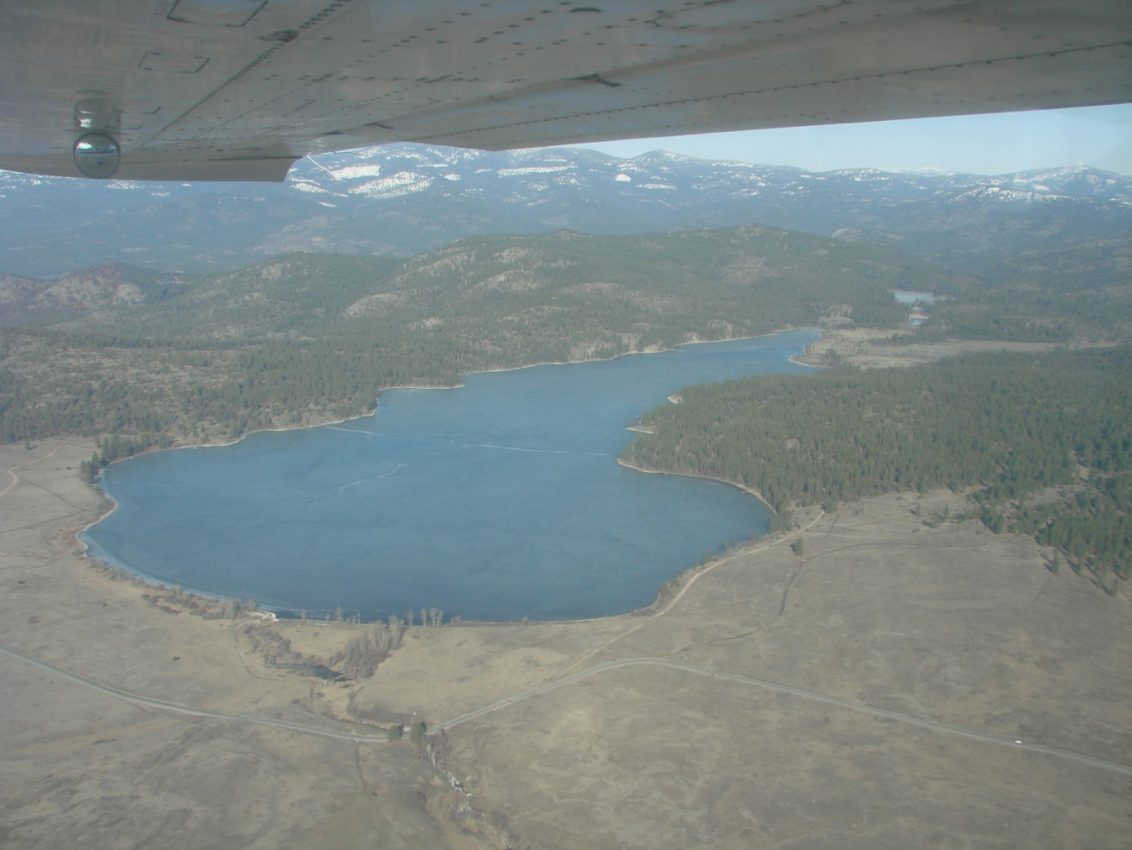
Whole Lake Study
Owhi Lake
Limnology
Cyanobacteria
Creel
Fish numbers and condition

Slide 15
Major Lakes
Twin, Owhi, Buffalo, Omak
Goals
Fish numbers, growth and condition
Appropriateness of present stocking strategy
Potential for major problem (e.g. algae bloom)
Tools
Monthly gill net survey
Monthly hydroacoustic survey
Creel surveys

Slide 16
Small Lakes
All small lakes that are stocked
Goals
Appropriateness of present stocking strategy
Fish growth and condition
Tools
August/September gill net survey
Results
1. Substantial modification to stocking strategy.

Slide 17
Streams
Goals
Appropriateness of present stocking strategy
Tools
Pre and post stocking electro-fishing surveys
Results
No fall stocking
Multiple small plants instead of one large one
Notes:
Adaptive changes: No fall plants, small (multiple) rather than one large, reduced total # (50%)

Slide 18
Project Evaluation
Goals
Evaluate effectiveness of specific project
(e.g. Twin Lakes oxygenation).
Tools
Gill net surveys
Hydroacoustic surveys
Creel surveys
Measurement of physical parameters

Slide 19
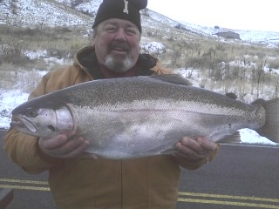
Rufus Woods Creel Project

Slide 20
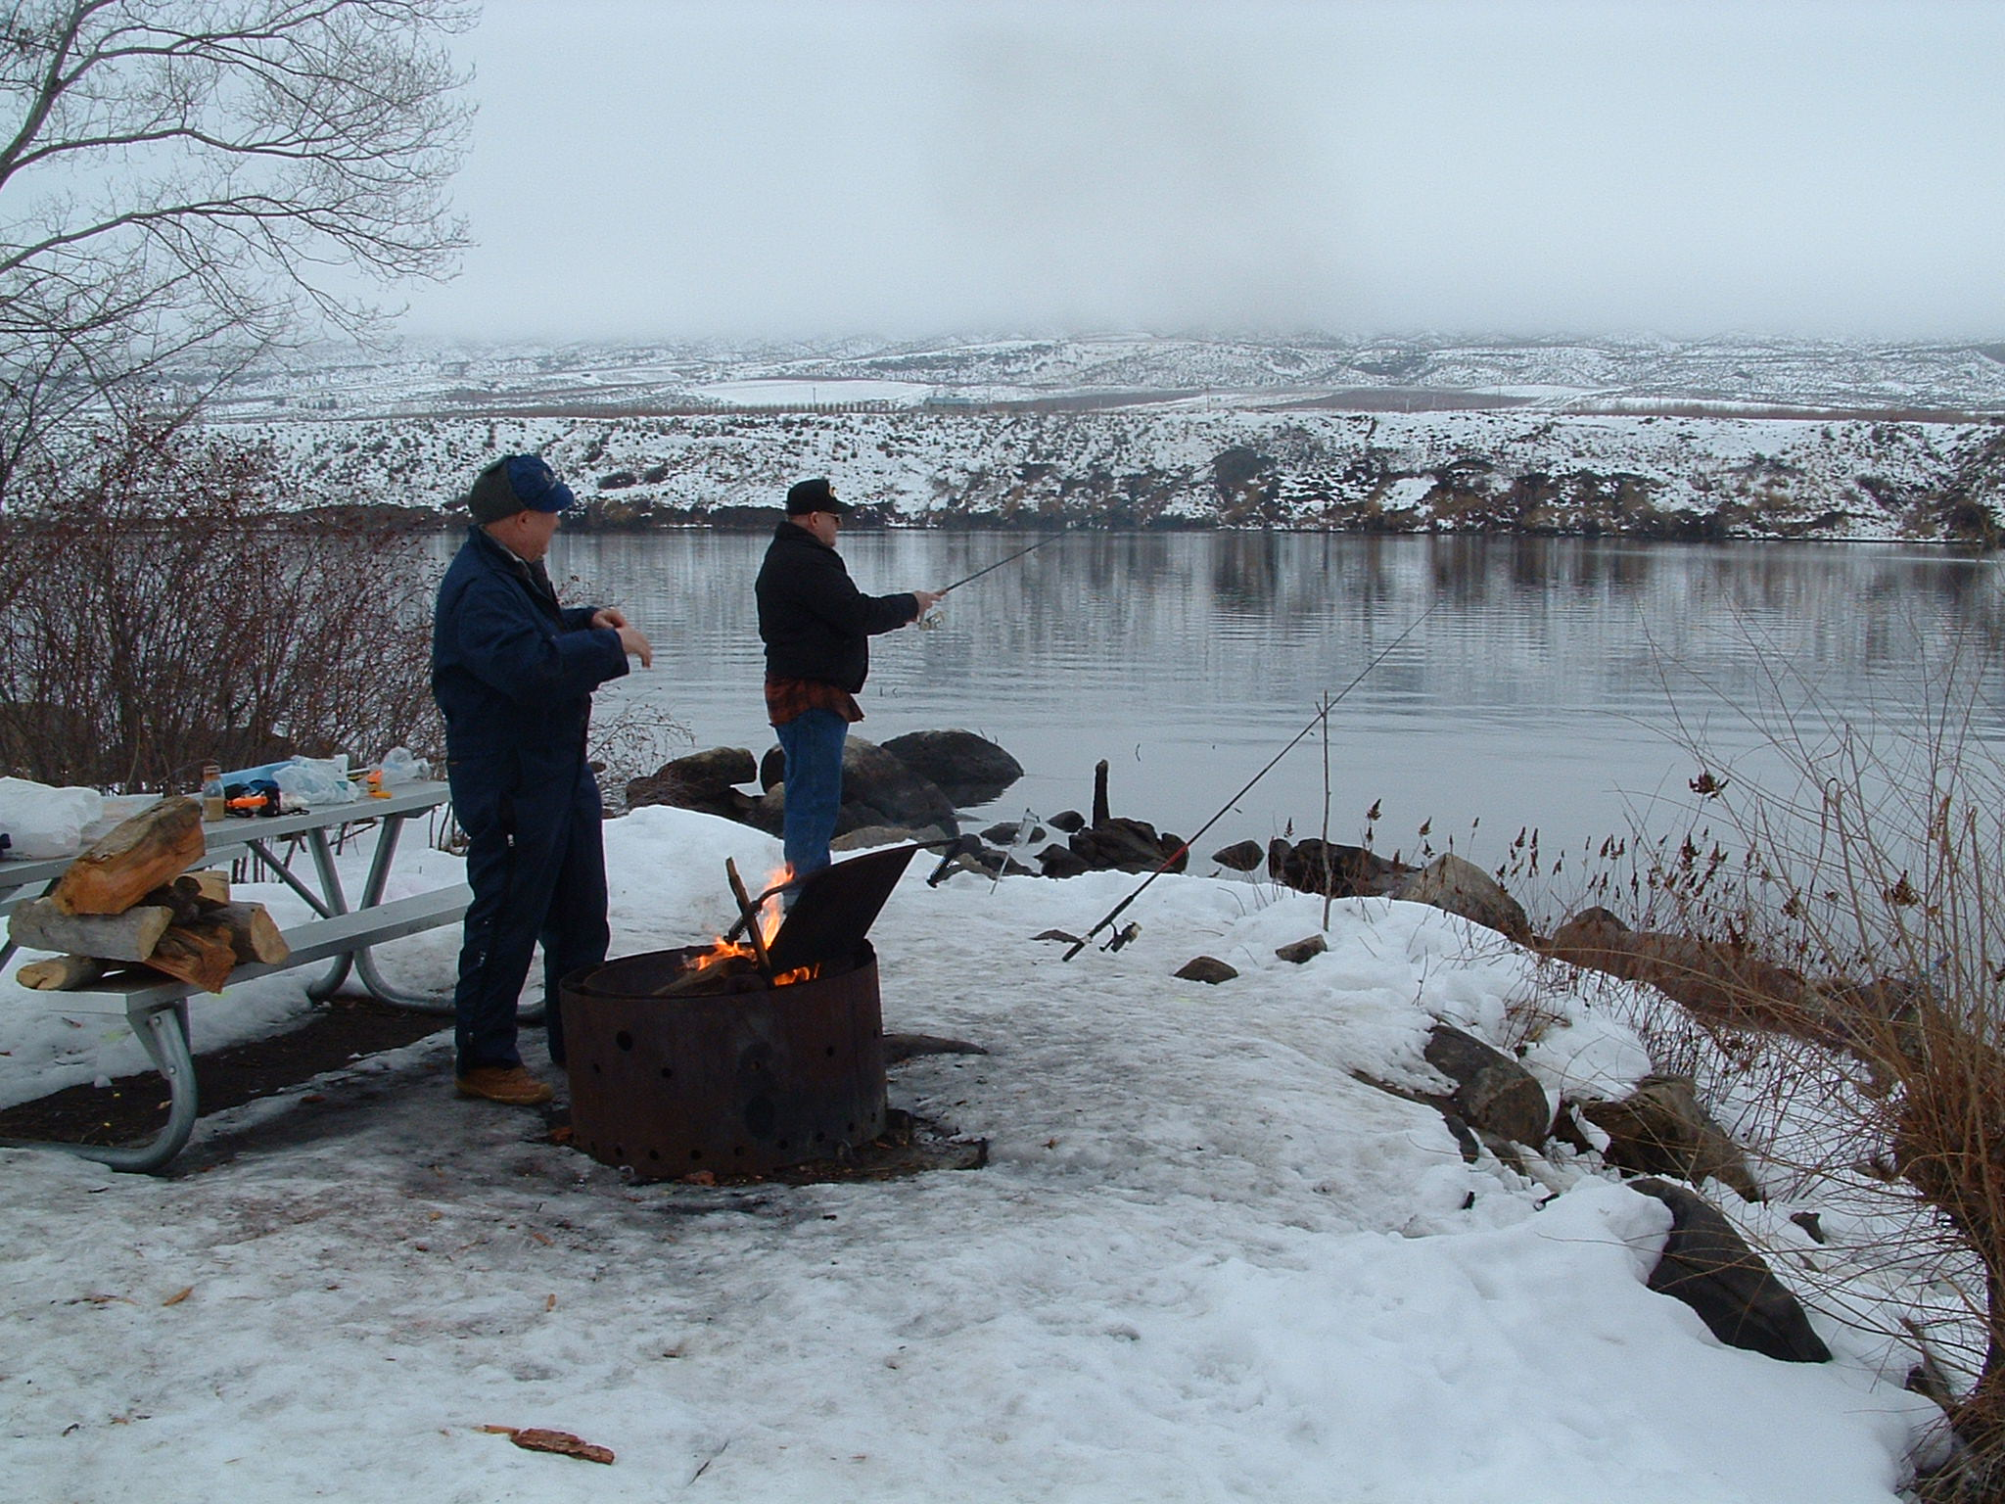
Rufus Woods Creel

Slide 21
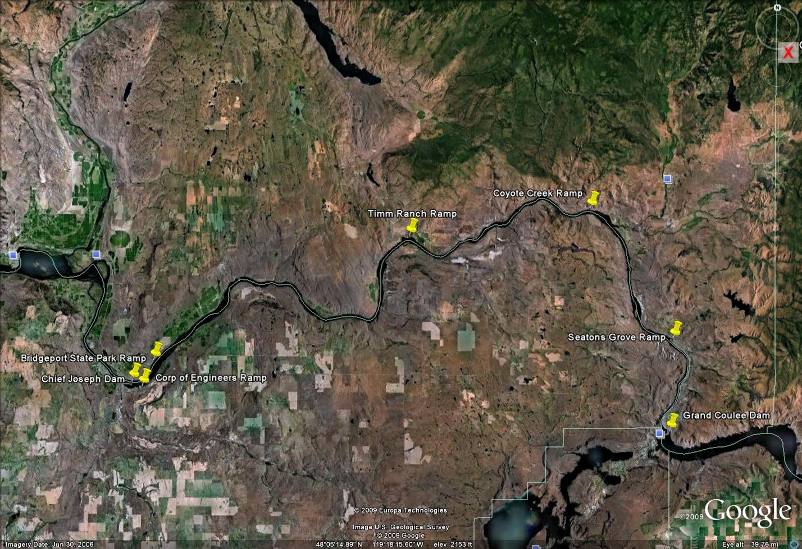

Slide 22
Background
Rufus Woods Aquaculture
Stocking History
State and Tribal Hatcheries
Early Net Pen Releases
Rufus Woods Net Pen Project
Creel Studies
Angling Pressure
Fish Origin

Slide 23
Study Goals
Maintain Quality Fishery
Determine Most Economic Way to Supplement Fishery
Determine Causes of Fish Loss
Determine Risk to ESA listed fish below CJD

Slide 24
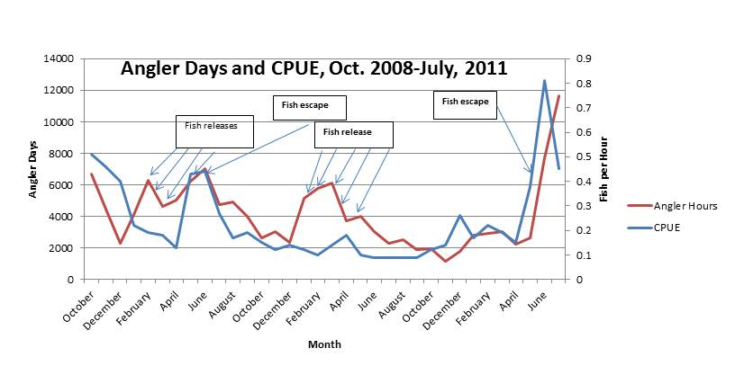
Catch Rates and Angling Pressure

Slide 25
Production Potential
EcoAnalysts Study
Goals
Potential Food Resources
Determine What Trout are Eating
Tools
Stomach sample analysis
Basic Rufus Woods Background Study
Suction dredge
Cobble basket
Bathymetry

Slide 26
RBT stomach content analysis

Slide 27
Fish Movements
Battelle Study
Goals
  Quantify entrainment
  Understand fish movement
  Quantify effects of fish size on movements and entrainment
Tools
  JSATS tags and receivers
  Fish releases

Slide 28
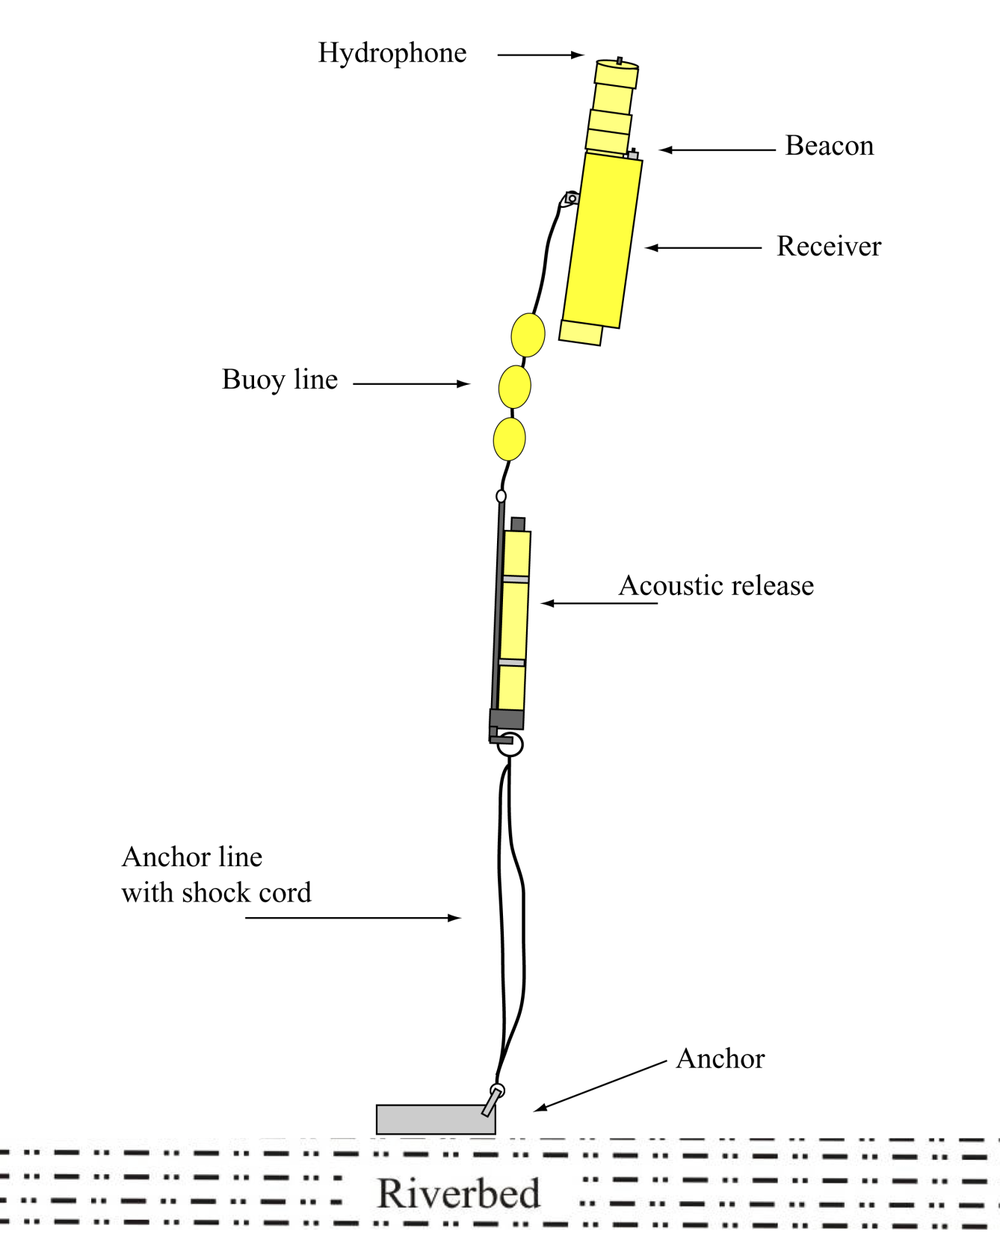

Slide 29
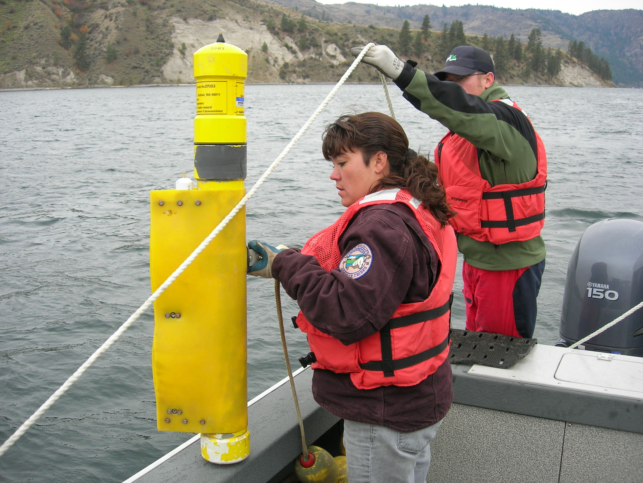

Slide 30
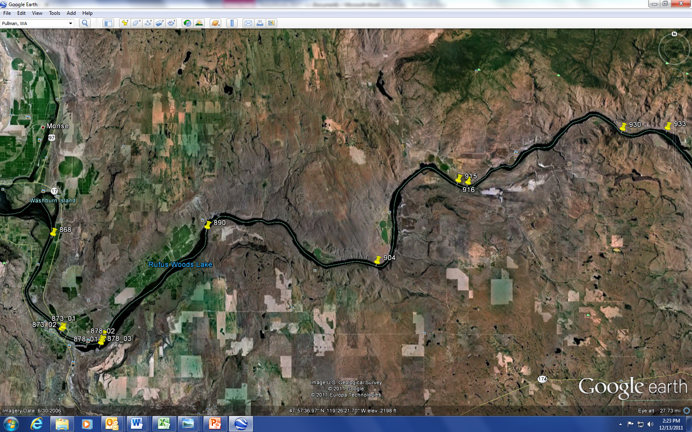
Lake Rufus Woods and Lake Pateros Receiver Locations

Slide 31
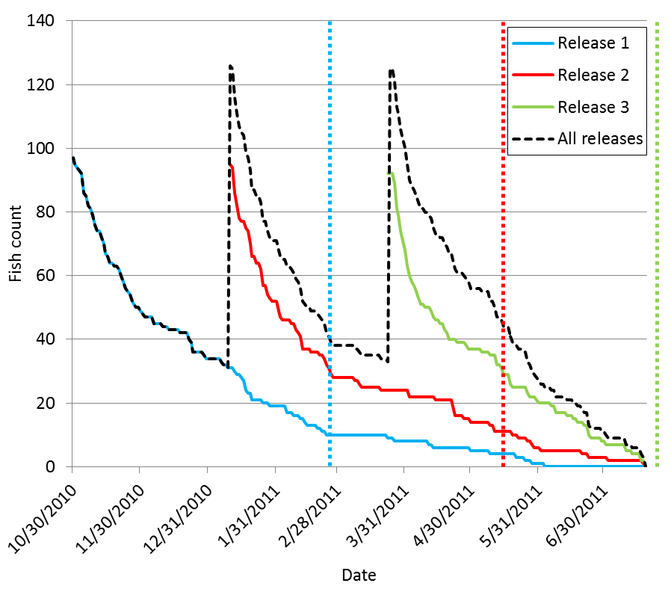

Slide 32
The Future
Continue Creel Survey
Stock Fish 1 – 3 lbs
Use Rufus Woods Net Pen Project to Help Supplement Fish
Continue Stomach Sample Analysis
Re-evaluate parts of Production Potential Study in “normal” year

Slide 33
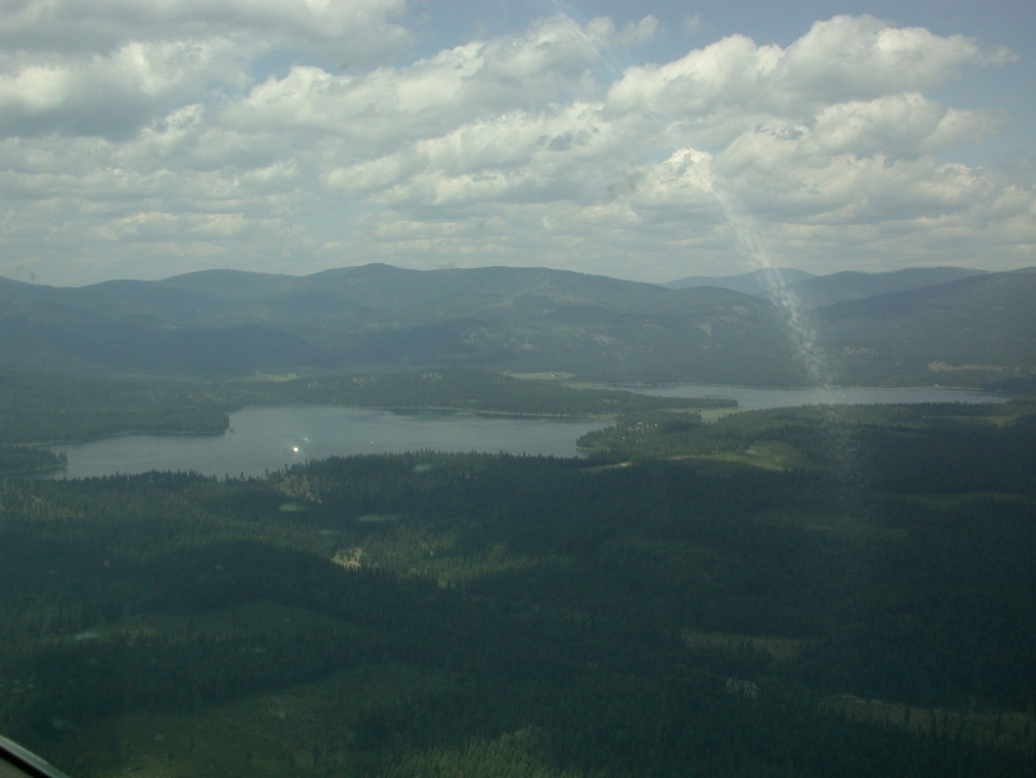
Twin Lakes Oxygenation Project

Slide 34
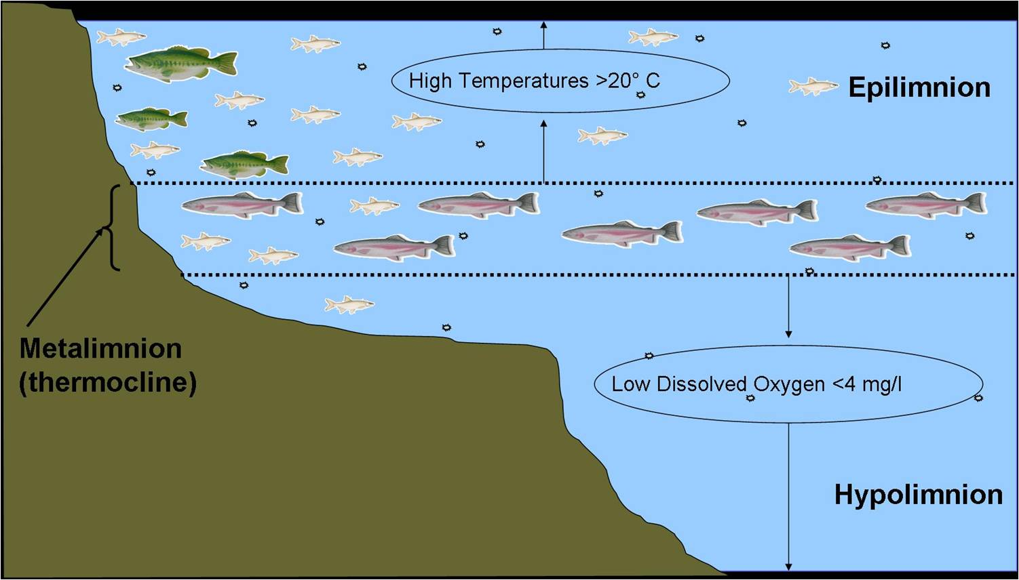
Notes:
2 Meter metalimnion

Slide 35
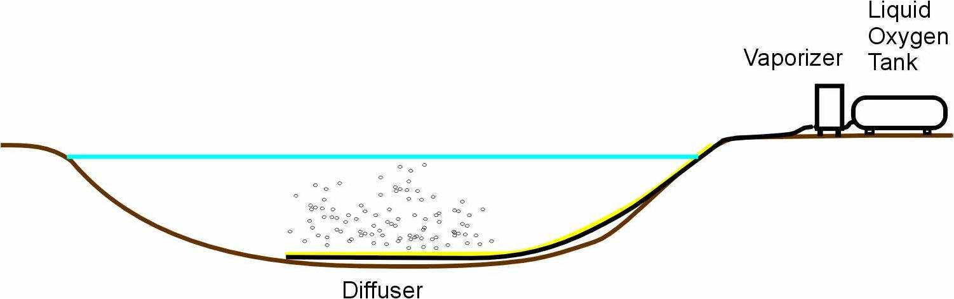

Slide 36
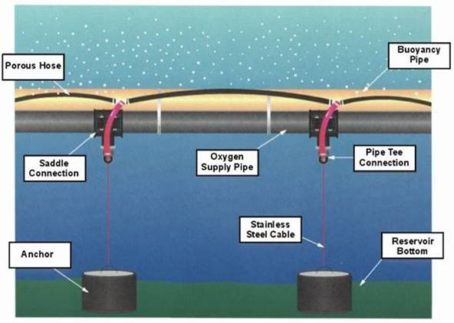

Slide 37
Evaluation
Questions to answer
Is lake oxygenated?
Is hypolimnion utilized by fish?
Is summer mortality reduced?
Is fish growth increased?
What are the other effects of oxygenation?
Zooplankton?
Heavy metals (particularly methyl mercury)?

Slide 38
Oxygen Levels
North Twin
South Twin

Slide 39
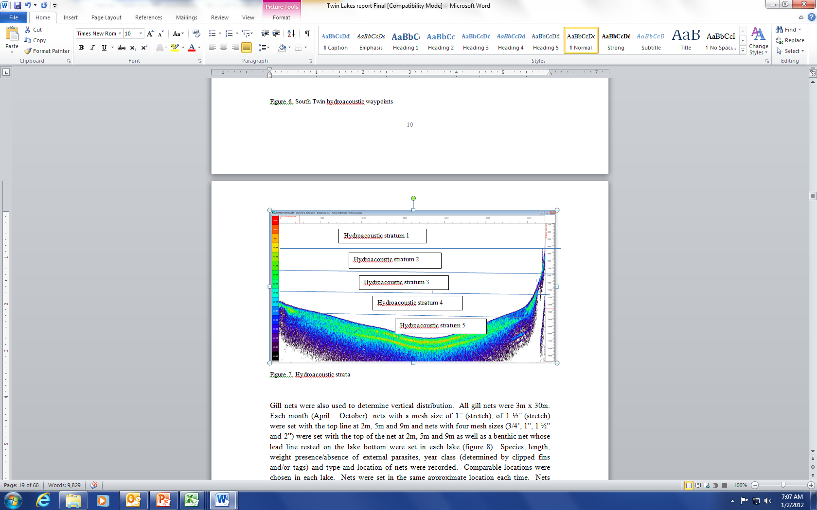
Hypolimnion Utilization

Slide 40
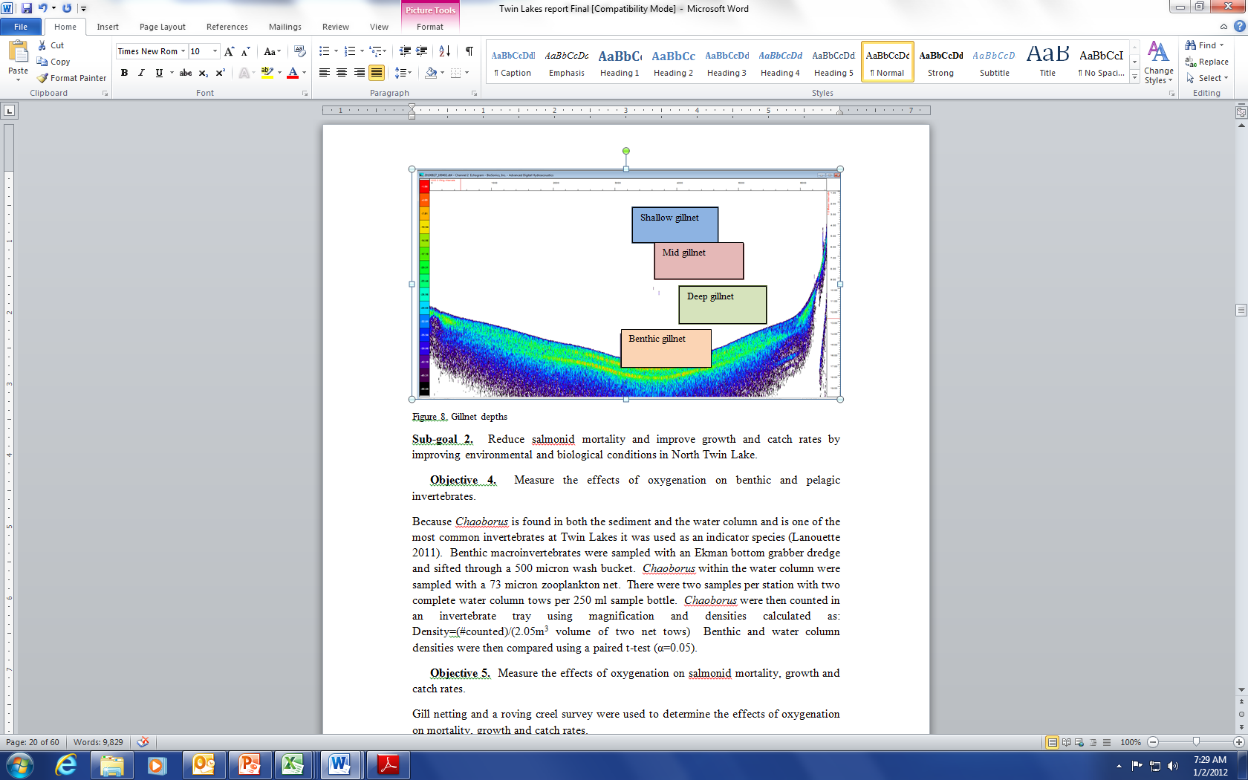
Gill Net Surveys

Slide 41
Percentage of Angler Caught Carryover Fish
All carryovers pre redband
begin oxygenation
Notes:
Point out the complexity due to several variables

Slide 42
Zooplankton
Chaoborus densities

Slide 43
Total Mercury in Twin Lakes Fish

Slide 44
The Future
Oxygenate South Twin
Produce oxygen onsite
Evaluate project success

Slide 45
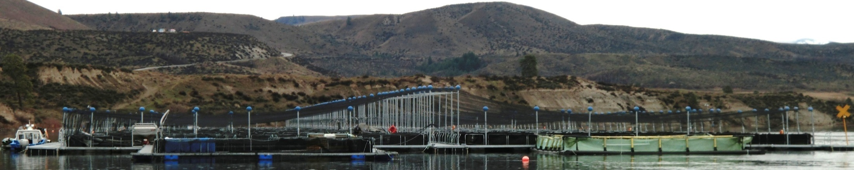
Rufus Woods Net Pen Project
Objectives
Reduce rearing costs for large fish
Reduce pressure on the hatchery
Produce large fish for Rufus Woods and
reservation lakes
Notes:
More flexibility with trips. Potential cost savings

Slide 46
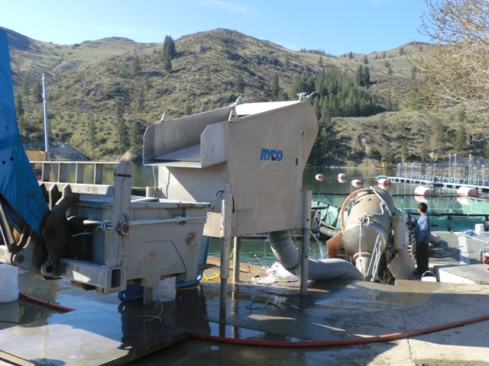
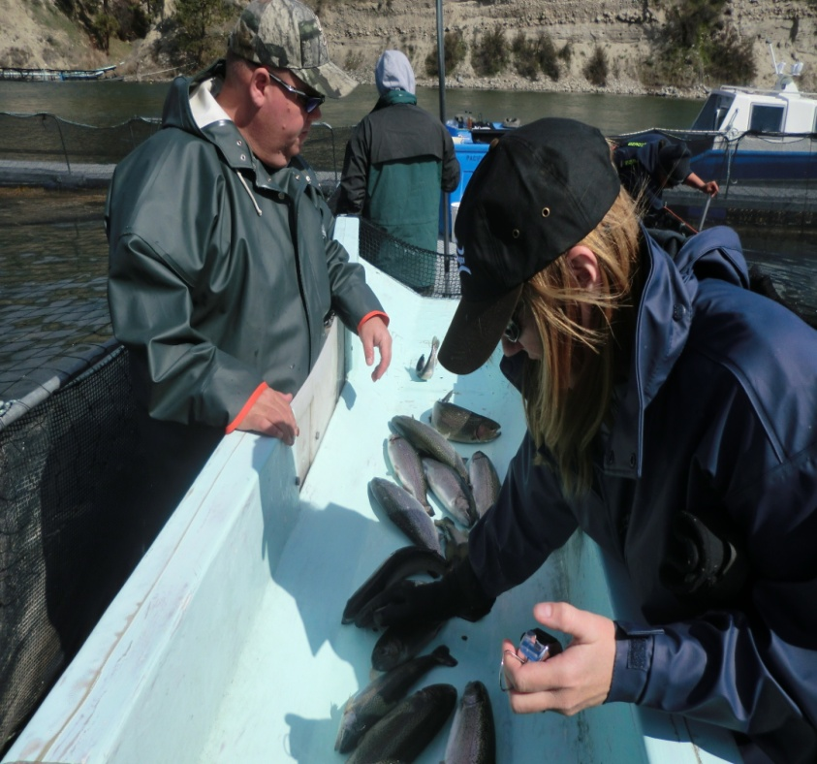
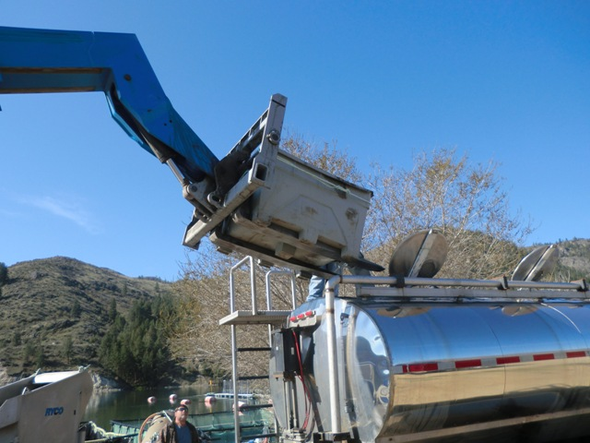
Project is an extension of Colville Hatchery O&M and M&E project
Eggs & Fish are reared and marked at hatchery, then transported to net pen site.
Hatchery personnel assist with fish distribution from net pens (directly to Rufus Woods or by utilizing fish transport tanks).
Colville Hatchery M&E staff monitor success of fish outplants.
The Rufus Woods Supplemental Creel project staff assist in providing angler success on the Rufus Woods outplants.
Notes:
The Monitoring and Evaluation portion of the project is completed by the Hatchery Project M&E staff and Rufus Woods Supplemental Creel staff. Data is gathered through these projects and evaluated in attempts to measure the effectiveness of the net pen stocking program, ensure the most efficient use of the net pen production and attempt to determine angler pressure, success and satisfaction.

Slide 47
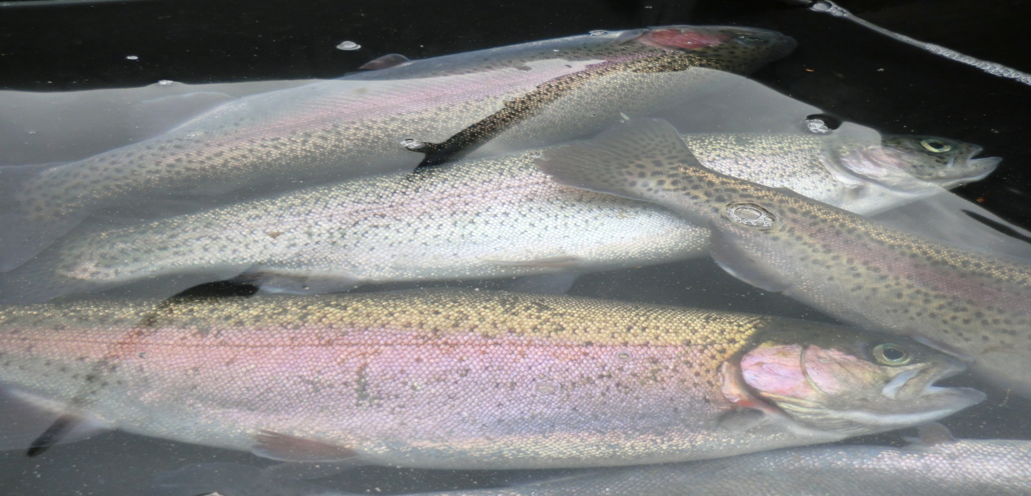
Accomplishments
Project successfully released over 37,000 lbs. of redband rainbow trout into Lake Rufus Woods and Reservation lakes in the spring of 2011.
Average fish size was 430 grams
Notes:
All fish were outplanted prior to forecasted high spring runoff. Total dissolved gas pressure in the Columbia River exceeded 130% which can be detrimental to fish, especially in a net pen environment where they are unable to retreat to water depths they can tolerate. Anglers at North & South Twin lakes were very happy with the size, and coloration and the net pen fish brought this spring (get CPUE, Avg size from ED).

Slide 48
Future Considerations
Expand Project to be more cost efficient.
Utilize a sterile “triploid” stock toward production.
Environmental considerations; Spring runoff, Columbia River water temperatures, and bacteria load on fish health.
Manage Lake Rufus Woods for a successful fishery?
Notes:
1.) Expand project as funds are available. Goal to expand project 150kto 200k to bring cost per pound down under $2.25/lb. Current price commercial facility charges.
2.) Management decision to change stock.
3.) Decision will be made to outplant all net pen fish if high TDGP is forecasted to be elevated & cause heavy mortality, water temperatures in the Columbia River during late July, August, Sept. cause high mortality and also assist bacteria (columnaris) growth. Upon observing elevated mortality, a fish health specialist will perform an examination and diagnose for treatment.
4.) Project will assist in providing fish for Lake Rufus Woods. Creel staff and other lake studies will assist management in measuring success of fish outplants into Rufus Woods. Information still needed in developing a successful fishery: distinguish release time & area, amount and fish size.

Slide 49
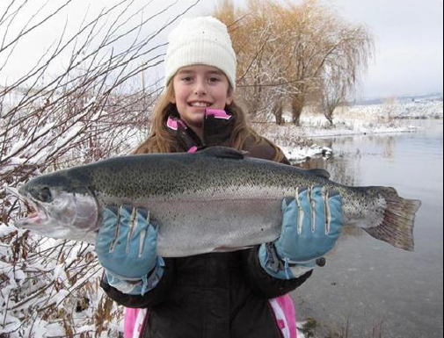
Questions?

Slide 50
Appendix
Hatchery Project
Owhi Lake August Gill net Surveys
2004 |  | 2010/2011
Ave. wt. | Wr | Ave. wt. | Wr
387 | 101.6 | 582 | 105.6

Slide 51
Redband vs Spokane Stock
Location | Category | Redband | Spokane
Hatchery
 | Mortality | 35% higher | Lower
 | Feed Conversion | as high as 2::1 | typically 1::1
 | Rearing density | 30% less | high
 | Fin erosion | high | moderate
 | Spawning season | spring | fall
 | Growth | 18 months to 100 grams | 12 months to 100 grams
Twin Lakes
 | Carry over % | >2% | 10%
 | Outmigration | >50% | <10%
 | Physical condition | poor in spring | excellent in spring
 | Presence of copepods | frequent | frequent
 | Genetics | stream derived stock | triploid
 | Growth | 153 g to 188 g over summer | 183 g to 243 g over summer

Slide 52
Redband vs Goldendale Growth Comparison

Slide 53
Appendix
Rufus Woods Creel

Slide 54
Monthly Angling Pressure

Slide 55
Location of Last Detection

Slide 56
Entrainment
Release | Date | n released | n entrained | % entrained
1 | Nov. 1 | 99 | 10 | 10.1
2 | Jan. 13 | 100 | 10 | 10
3 | Mar. 28 | 94 | 7 | 7.4
All |  | 293 | 27 | 9.2

Slide 57
Appendix
Twin Lakes Oxygenation

Slide 58
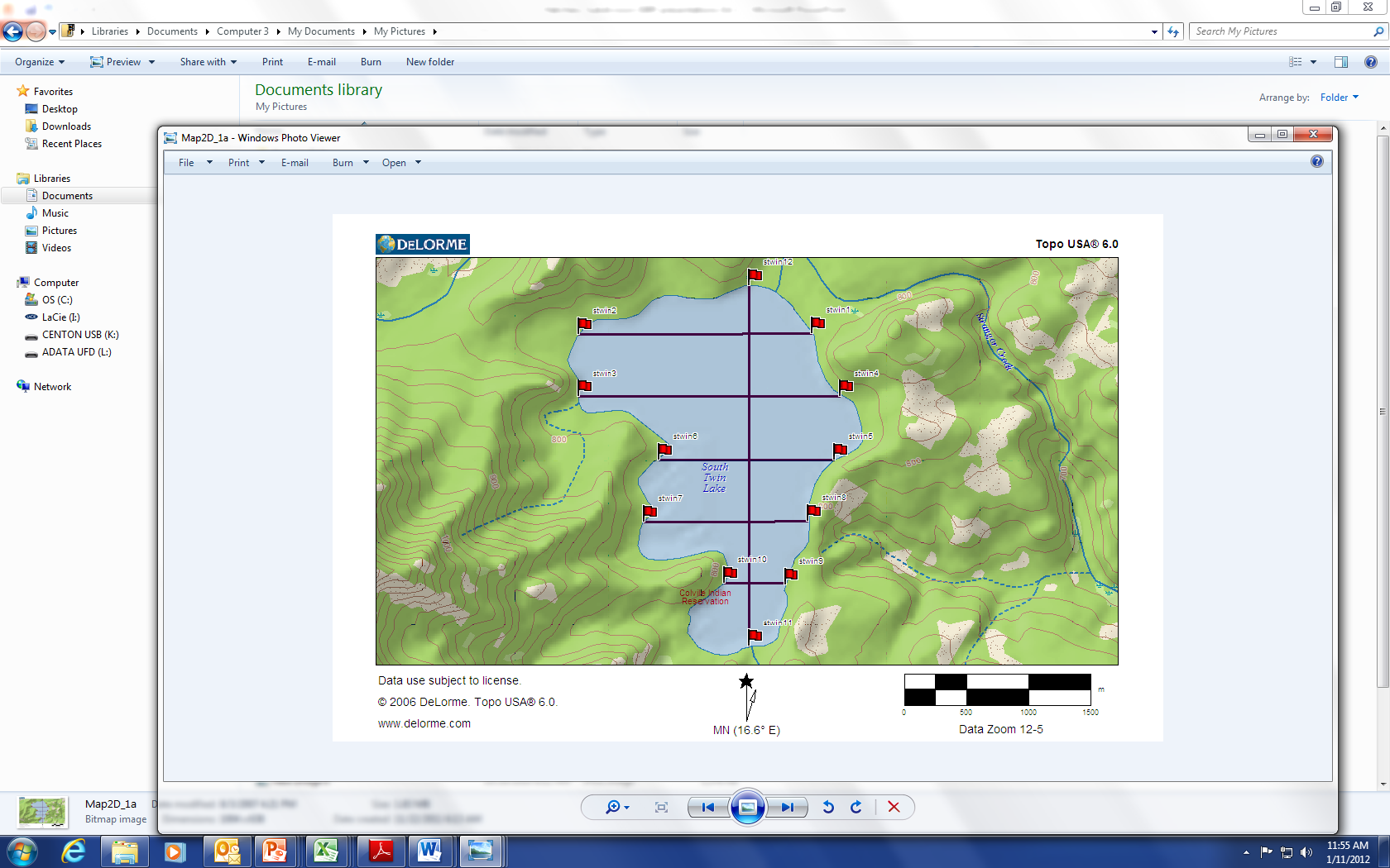
Twin Lakes Hydroacoustic Passes
North Twin
South Twin

Slide 59
Hydroacoustic Fish Targets
Twin Lakes Hydro Acoustic Surveys, 2010
Targets
Lake | Strata | 6-Apr | 19-Apr | 10-Jun | 28-Jun | 28-Jul | 27-Aug | 22-Sep | Total
 | 1 | 0 | 15 | 9 | 5 | 0 | 0 | 1 | 30
 | 2 | 6 | 4 | 5 | 5 | 19 | 2 | 25 | 66
N. Twin | 3 | 14 | 4 | 2 | 9 | 7 | 5 | 7 | 48
 | 4 | 3 | 0 | 5 | 1 | 1 | 0 | 29 | 39
 | 5 | 0 | 0 | 1 | 6 | 3 | 6 | 8 | 24
 | 1 | 0 | 21 | 2 | 1 | 0 | 0 | 2 | 26
 | 2 | 1 | 9 | 6 | 3 | 12 | 1 | 16 | 48
S. Twin | 3 | 1 | 0 | 1 | 9 | 4 | 0 | 19 | 34
 | 4 | 10 | 4 | 0 | 10 | 1 | 0 | 0 | 25
 | 5 | 0 | 0 | 0 | 0 | 0 | 0 | 0 | 0

Slide 60
Gill Net Catch Rates
North Twin Lake Gill Net Catch Rate
 | Net Depth in meters
Month | 2-5m | 5-8m | 8-11m
April | 1.3 | 0.7 | 0.0
May | 6.0 | 3.7 | 1.0
June | 2.0 | 4.3 | 0.3
July | 0.0 | 1.7 | 0.3
August | 0.0 | 7.0 | 1.7
September | 1.3 | 3.3 | 0.3
October | 2.7 | 1.3 | 0.0
South Twin Lake Gill Net Catch Rate
 | Net Depth in meters
Month | 2-5m | 5-8m | 8-11m
April | 0.3 | 0.7 | 0.0
May | 1.7 | 2.7 | 0.0
June | 0.3 | 3.3 | 0.3
July | 0.0 | 1.0 | 0.0
August | 0.0 | 1.0 | 0.3
September | 0.0 | 0.0 | 0.0
October | 1.3 | 0.0 | 0.0

Slide 61
Total Mercury in Twin Lakes Trout

Slide 62
Mercury in large body zooplankton

Slide 63
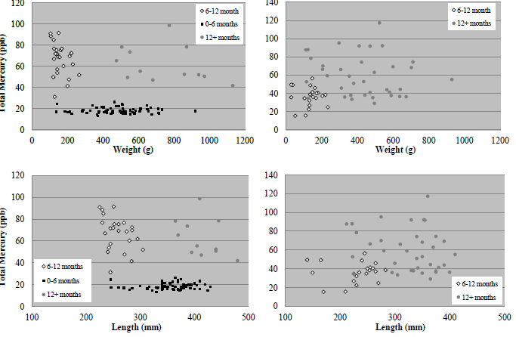
Mercury levels in Twin Lakes Trout
Rainbow trout
Brook trout
Rainbow trout
Brook trout

