Slide 1
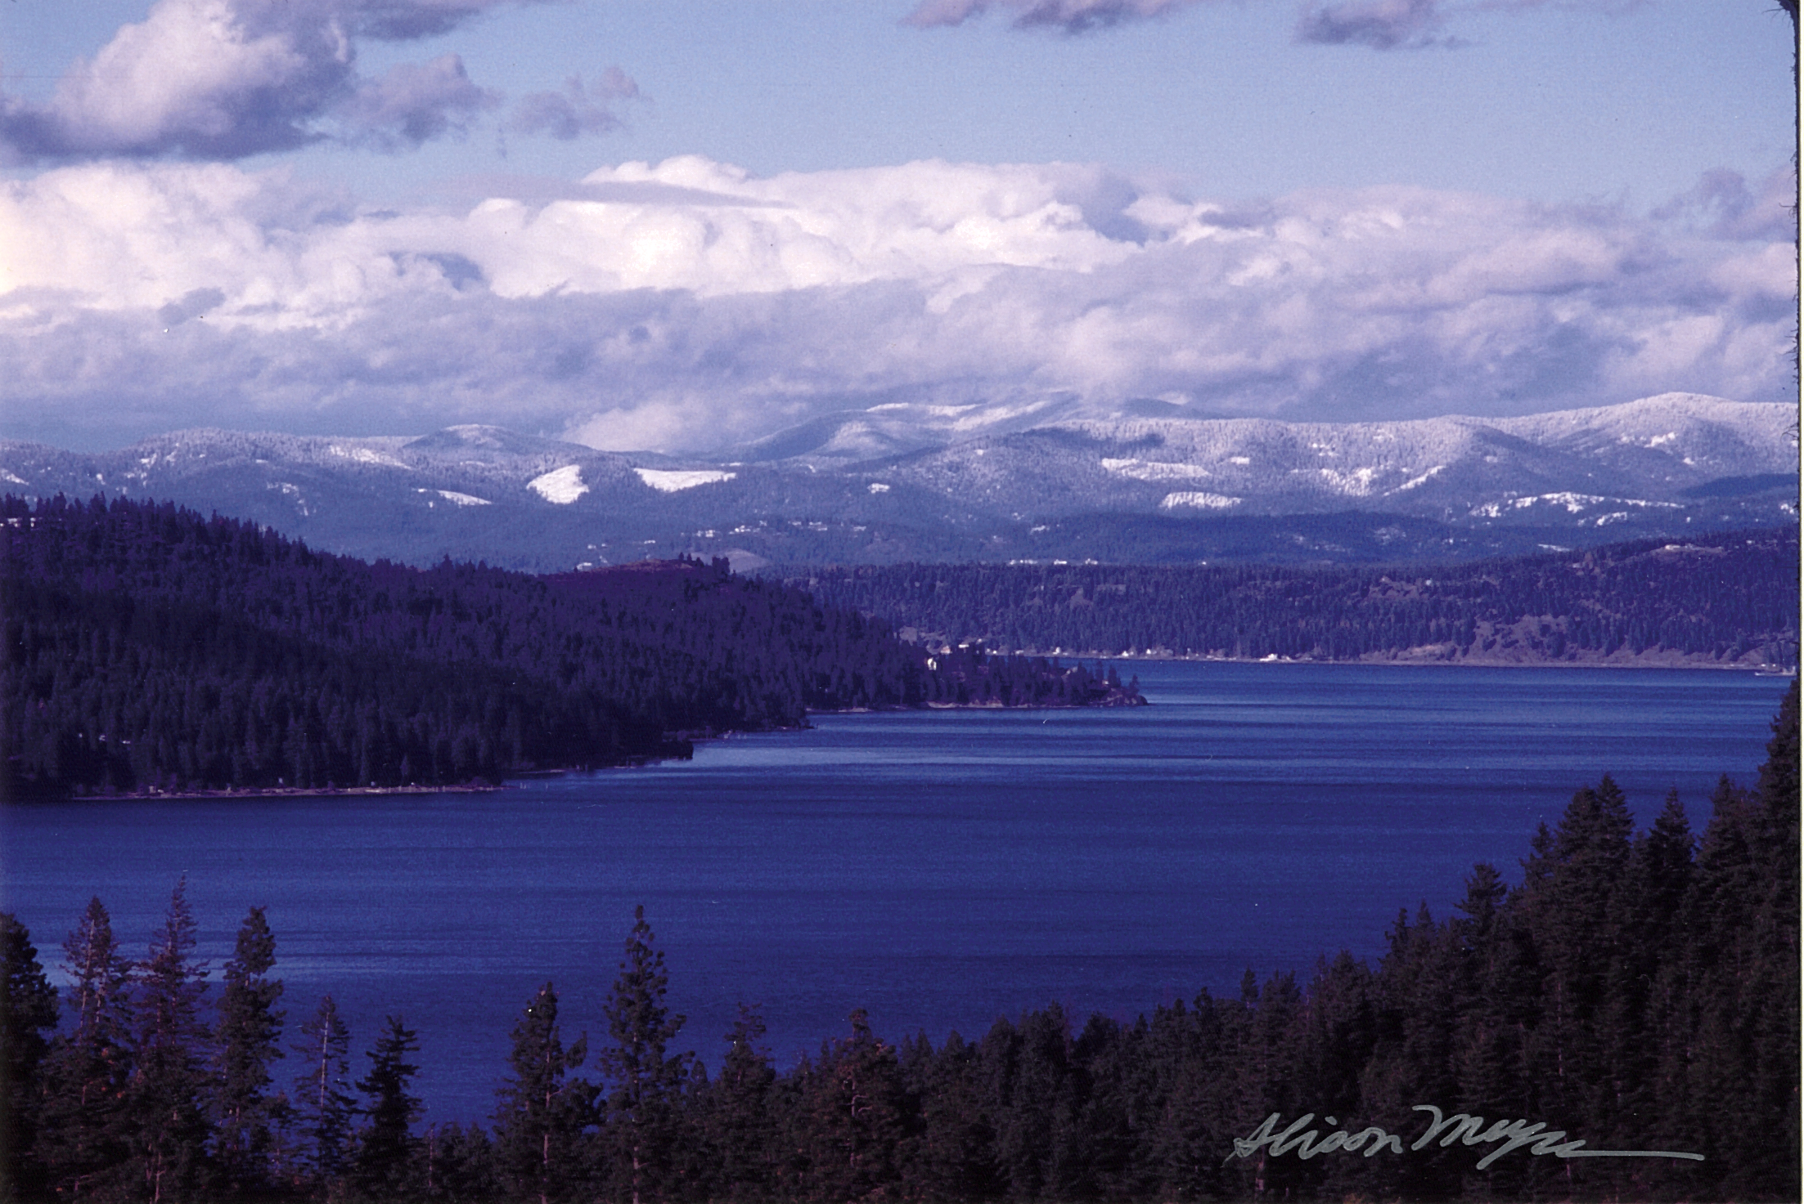

Proposal 1990-044-00
Coeur d’Alene Subbasin Fisheries Restoration and Enhancement
  Project overview
  Recent project history
  Prioritizing restoration actions
  Implementation /effectiveness monitoring strategy
  Non-native species management approaches
  Status and trend monitoring

Slide 2
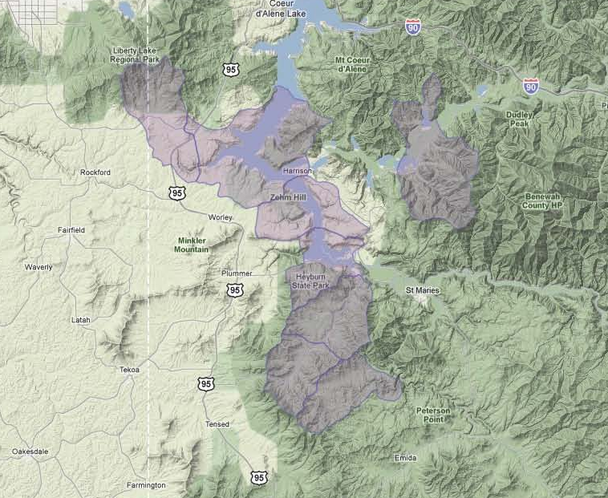
Project Overview
Notes:
Overview
Goal – To protect and restore remaining stocks of native resident westslope cutthroat trout to ensure their continued existence in the basin and provide harvestable surpluses of naturally reproducing adfluvial adult fish in Coeur d’Alene Lake with stable or increasing population trends for resident life history types.
Project Location encompasses several low elevation tributaries that feed the southern end of Coeur d’Alene Lake as well as the lake habitats
Project objectives are related to 1) improving stream habitats, 2) tracking trends in salmonid demographics and population structures, 3) evaluating the effectiveness of habitat restoration, 4) address impacts from non-native fishes, and 5) coordinating with stakeholders and other managers. The specific objectives for this project are found in the project proposal as well as in the Resident Fish Monitoring Strategies document which is intended to be appended to the NPCC MERR Plan.

Slide 3
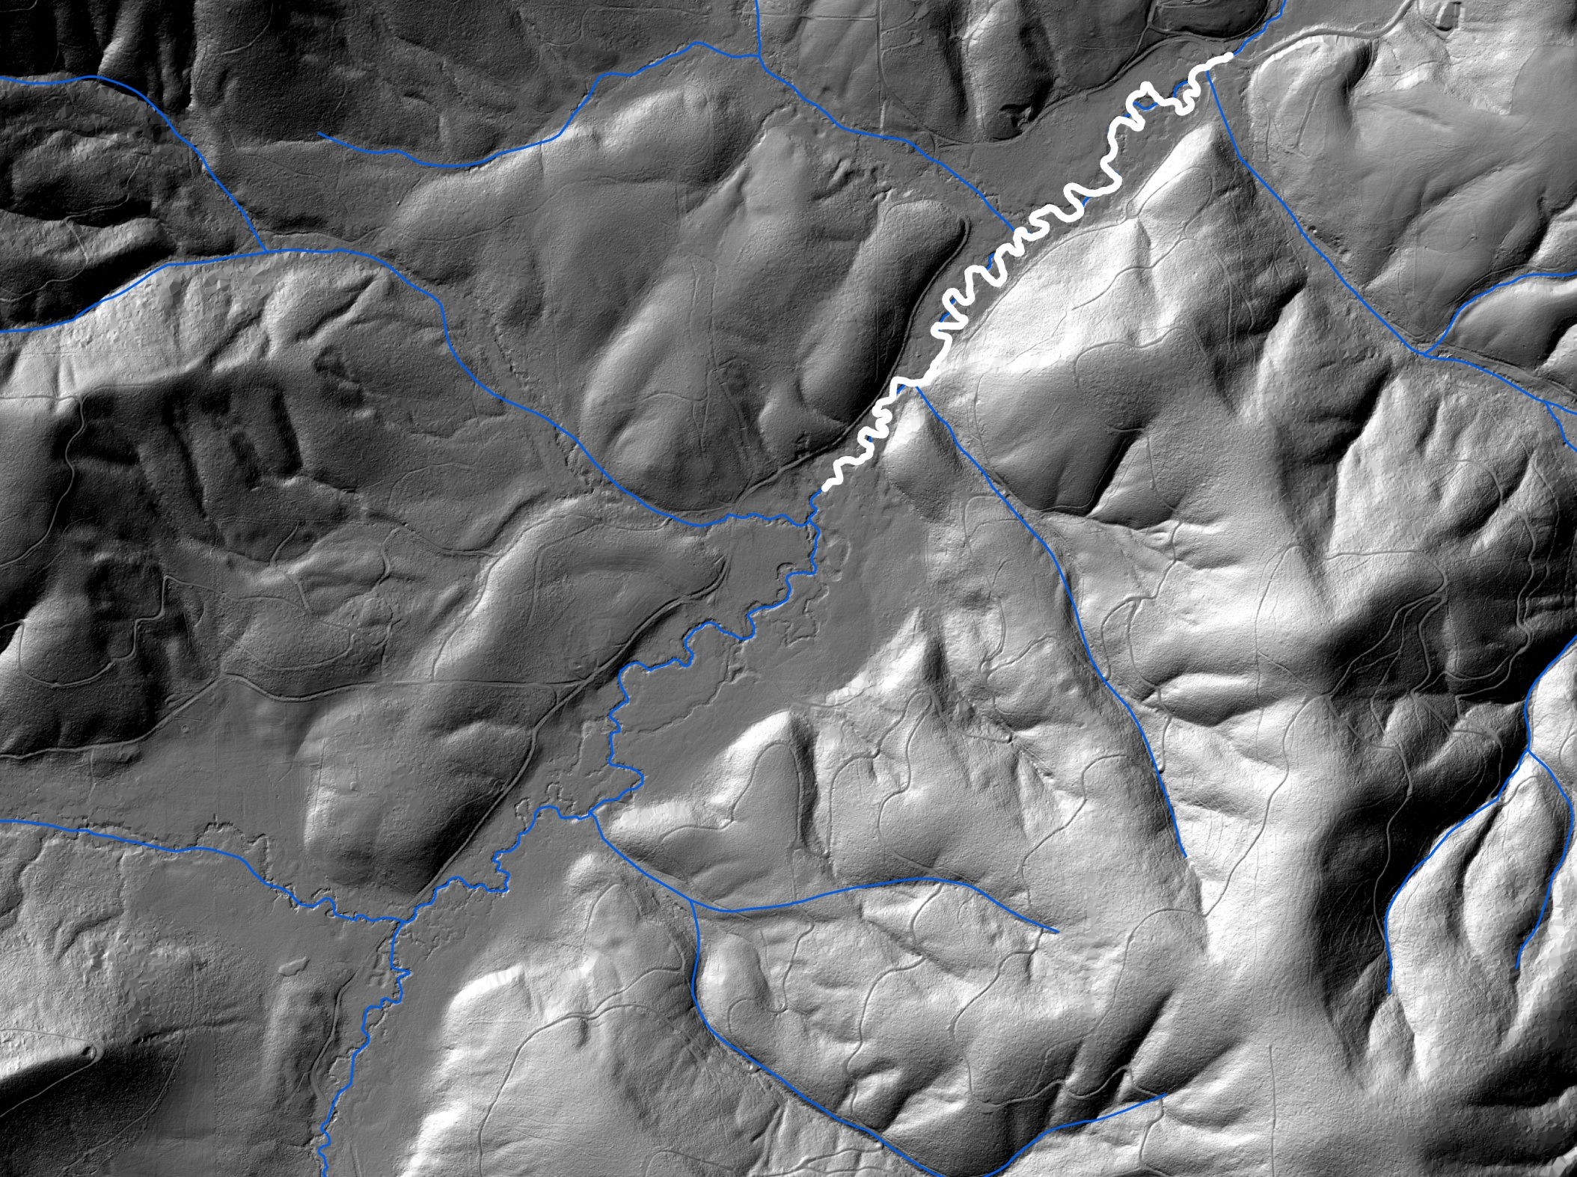
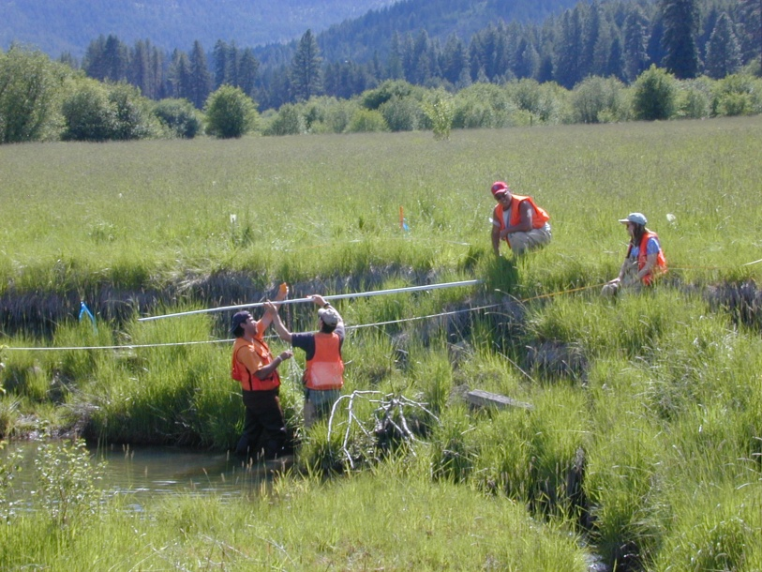
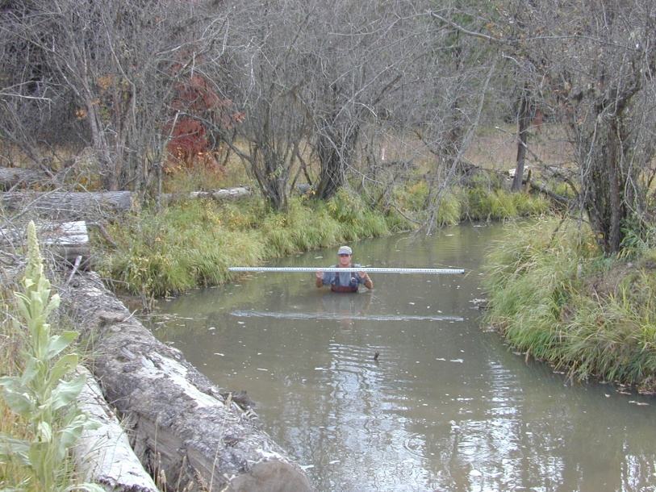
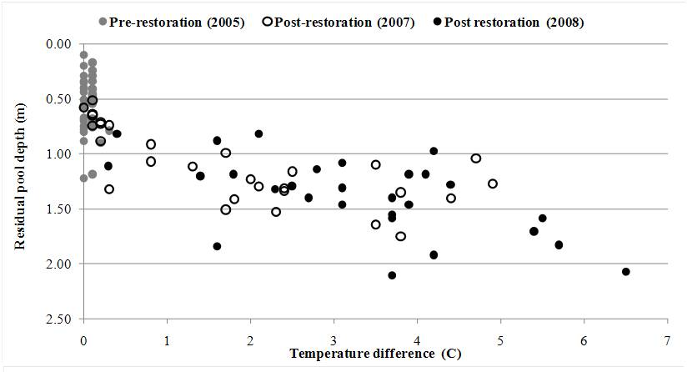
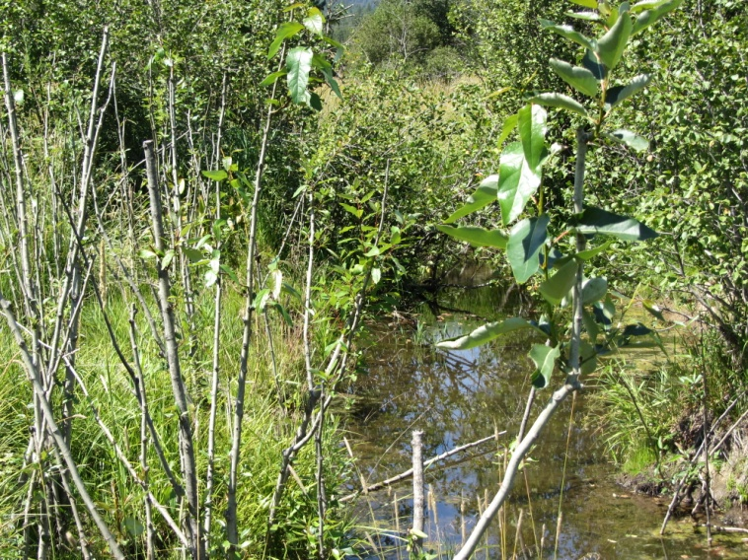
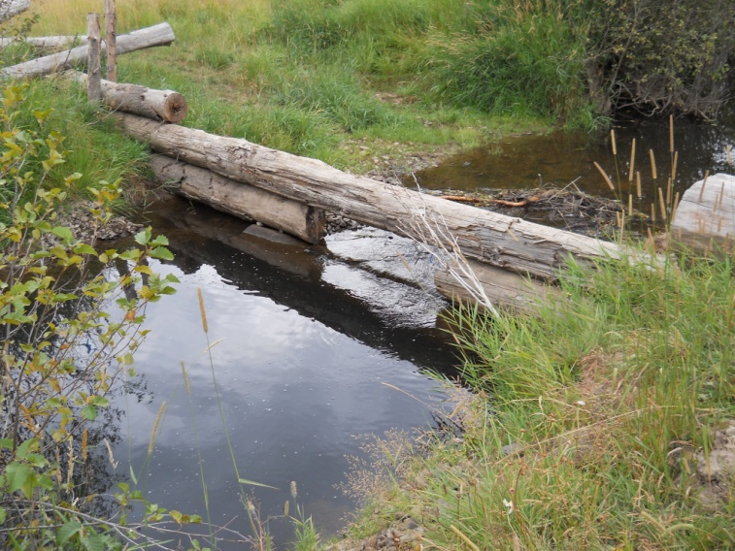
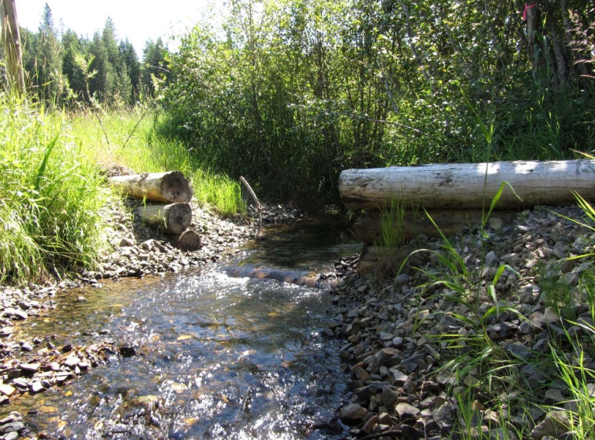
Recent Project History
Phase II
2009-2012 (3 km)
Bankfull
Bankfull
Before
After
Response variable | Before | After | Change | Objective
Sinuosity | 1.28 | 1.68 | +25 | >1.50
Entrenchment ratio | 2 | 12.3 | +515 | >12
Percent eroding banks | 30.0 | 10.5 | -65 | <10%
Percent pools | 39.6 | 49.2 | +24 | 48-53
Residual pool depth (m) | 0.57 | 1.18 | +107 | >1.0
Large wood volume (m³/100 m) | 3.15 | 7.67 | +143 | >9.0
Mean depth to groundwater (m) | 1.32 | 0.62 | -47 | <1.2
Phase I
2005-2008 (2.5 km)
Notes:
Much of the recent restoration actions have been implemented in the upper mainstem of Benewah Creek in an effort to improve degraded rearing habitats and reconnect 6 of the 9 principle spawning tributaries in the watershed.
Project work was conducted in two phases working from downstream to upstream to facilitate an adaptive approach to large scale restoration and effectiveness monitoring. The first phase took the approach of filling the channel to create raised riffles through the profile of the stream to reconnect the channel and floodplain.
A different approach to the phase II work was informed, in part, by monitoring that described a more favorable temperature dynamic in the reach compared to downstream reaches as well as our observation of increasing beaver activity even as restoration was proceeding downstream. Furthermore, during development of the design we found evidence that suggested the channel was not as deeply incised as previously thought, although the historic channel likely had a much lower width/depth ratio and the channel capacity increased greatly following removal of native vegetation communities in the valley. Also, the historic channel was likely slow to adjust its boundaries through lateral erosion.
Collectively this information led us to reconsider the channel forming processes which allowed flood flows to engaged the valley bottom on a frequent basis. Our new understanding suggested that accumulations of in-channel wood from the mature floodplain forest as well as strong, persistent beaver dams created channel obstructions that resulted in local accumulations of gravel and facilitated frequent flooding.

Slide 4
Prioritizing Restoration Actions
Summary of assessments and inventories used to identify the condition of watershed processes and function.
Notes:
In the context of implementing restoration actions we used the available information to answer the question, “What are the highest priorities for restoration at the watershed scale and at finer spatial scales”? “Where are restoration actions most likely to elicit biological responses”?

Slide 5
Step 1 Define restoration objectives
Sediment
Flood hydrology
Riparian function
Channel
Water quality
Biological productivity
Step 1 Define restoration objectives
Channel
Objective 1: Remediate all anthropogenic barriers to adult fish passage
Objective 2: Stream reaches well connected with floodplain at 1.5-2.0 year RI flood
Objective 3: 70% of available habitat to meet LWD loading criteria of 6m³/100m over 150 years
Step 1 Define restoration objectives
Channel
Objective 3: 70% of available habitat to meet LWD loading criteria of 6m³/100m over 150 years
High: > 50% of channel not meeting criteria
Mod: 30-50% of channel not meeting criteria
Low: < 30% of channel not meeting criteria
Notes:
We began this prioritization exercise by defining restoration objectives for watershed process-functions, including: sediment, flood hydrology, riparian function, channel function, water quality, and biological productivity. By way of example, for channel function we defined three objectives. Then for each objective, we developed criteria to describe nominal rankings for impairment to these processes.

Slide 6
Step 2 Assess problems and identify restoration actions
Summary of restoration needs and relative restoration priority by subbasin within the Lake Creek and Benewah Creek watersheds.
Notes:
The criteria were used to identify process-function impairment in 3 subbasins in Lake Creek and 9 subbasins in Benewah Creek. Where these ratings were moderate or high, restoration actions were identified to address the objectives. The combined ratings were assigned a score to describe the relative restoration priorities within the respective watersheds.

Slide 7
Step 3 Prioritize restoration actions
11 weighted criteria
Project benefits
Causal processes
Uncertainty
Socioeconomic factors
Example:
What is the project’s contribution to meeting the objective for the impaired process?
Notes:
A score sheet was developed as a decision support tool to facilitate the prioritization of projects at the subbasin scale. Weighted criteria were included that addressed anticipated benefits, the degree to which actions address causal processes, project uncertainty, and how the project accommodates local socioeconomic goals. The process is designed to be transparent and easily understood.

Slide 8
Proposed scope of work
  105 projects identified in 9 subbasins within Benewah and Lake creeks
  Targeted for completion over 5-10 years
Notes:
Projected impact of implementation
46 miles of affected stream/riparian habitats (30 miles in Benewah, 16 miles in Lake)
SOW
26 Passage projects, 2013-17 (28 km of stream habitats)
39 Road improvement projects to address hydrology and sediment, 2013-2023 (19 km of roads)
41 Riparian and Channel projects, 2013-2020 (14 km of stream/riparian habitats, respectively)

Slide 9
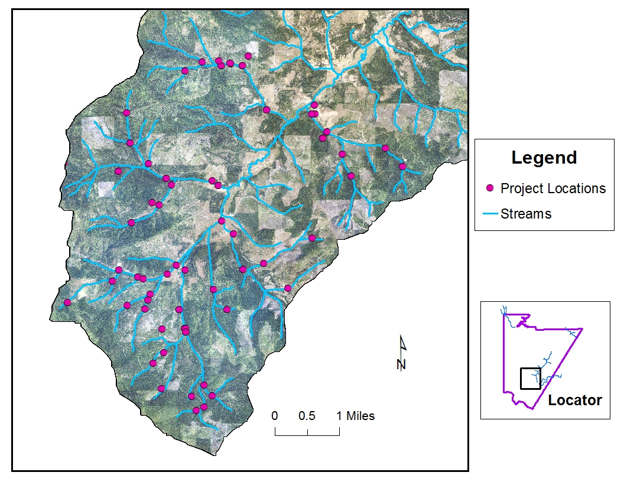

Slide 10
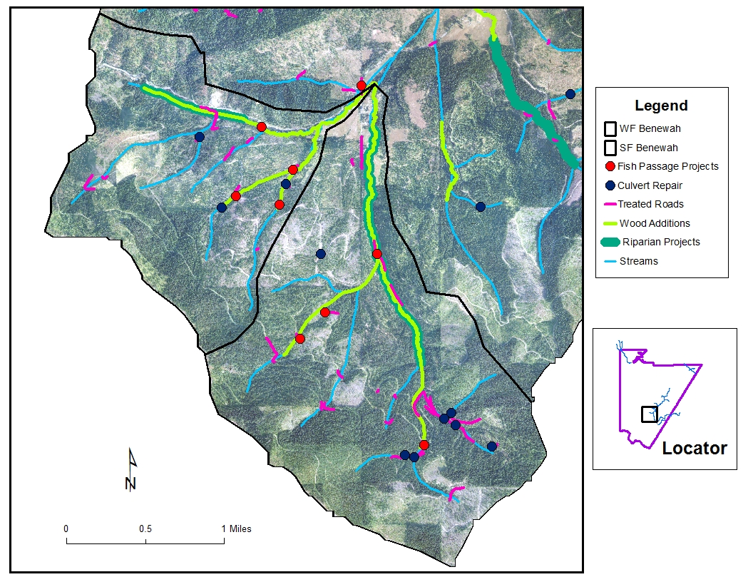

Slide 11
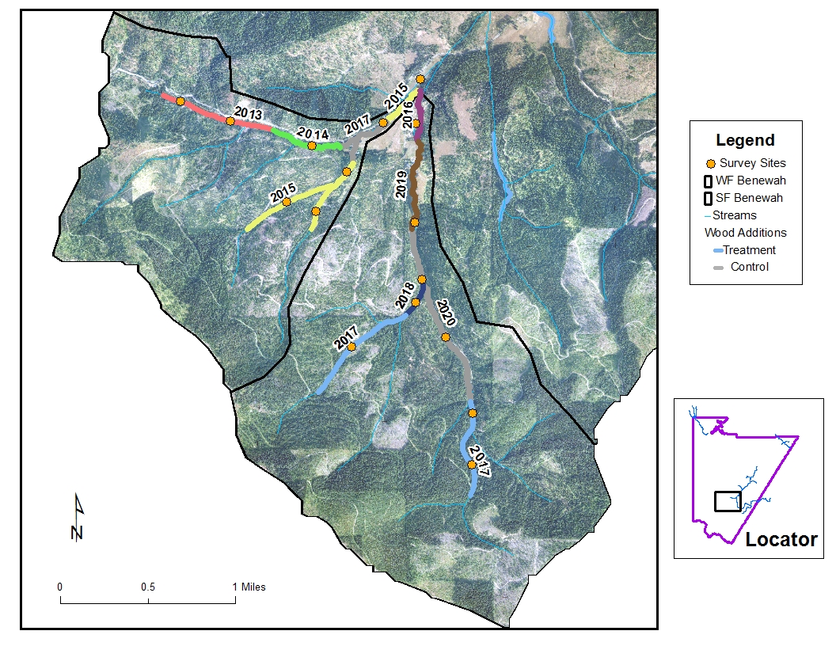
Notes:
The implementation approach results in multiple replicates for treatments and controls at various spatial/temporal scales for monitoring the effectiveness of habitat and biological responses. The approach is similar to the hierarchical, staircase design used for some of the intensively monitored watersheds described in the ISEMP Program sponsored by NOAA Fisheries.

Slide 12
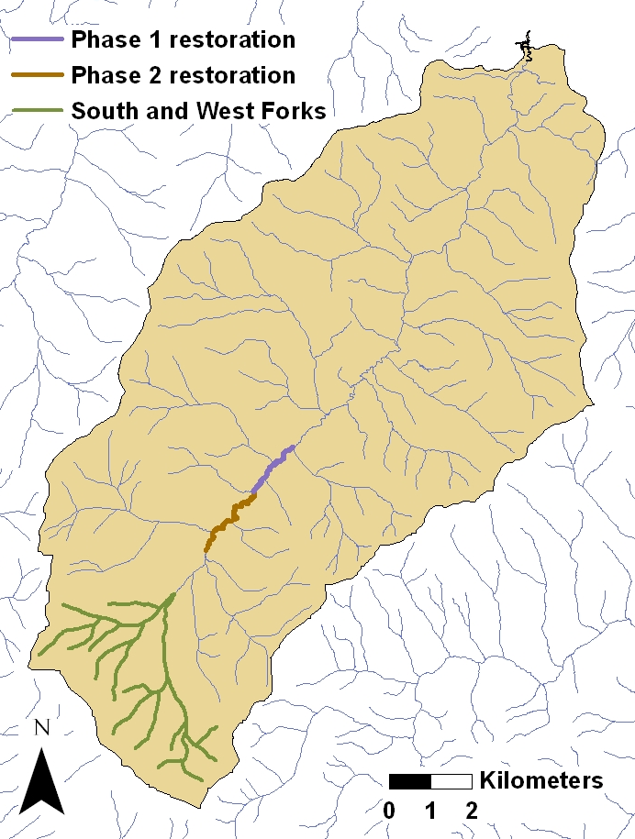
Effectiveness monitoring – Fixed PIT-tag interrogation stations in upper Benewah
Fixed PIT station
Mouth of
Benewah
Track survival rates of adfluvial juveniles as sub-watersheds are incrementally restored
Evaluate overwintering behavior and use of restored mainstem reaches

Slide 13
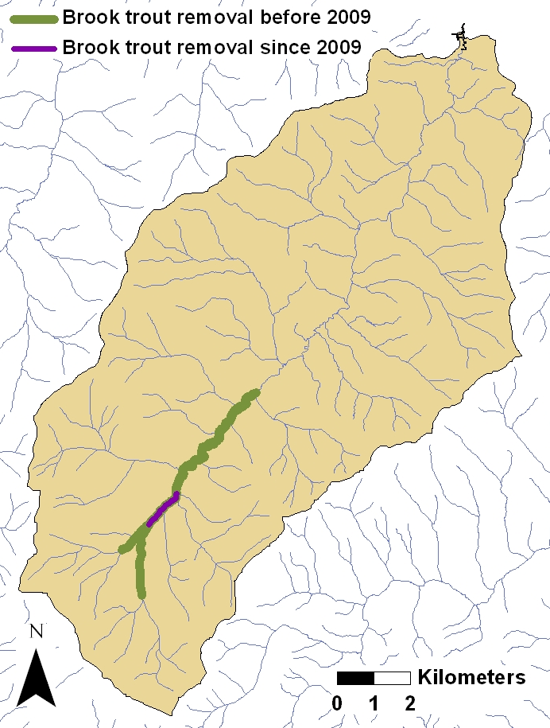

Non-native management - Brook trout suppression in upper Benewah
Mouth of
Benewah
Notes:
Overview

Slide 14
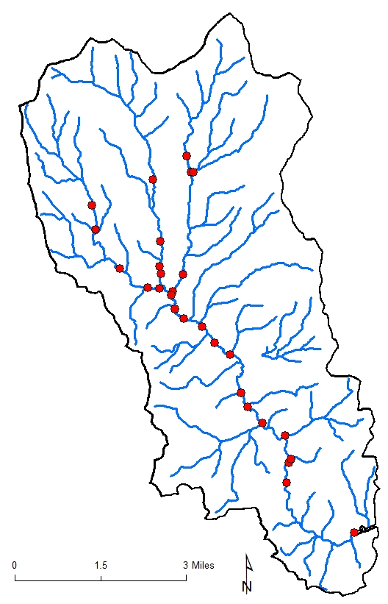
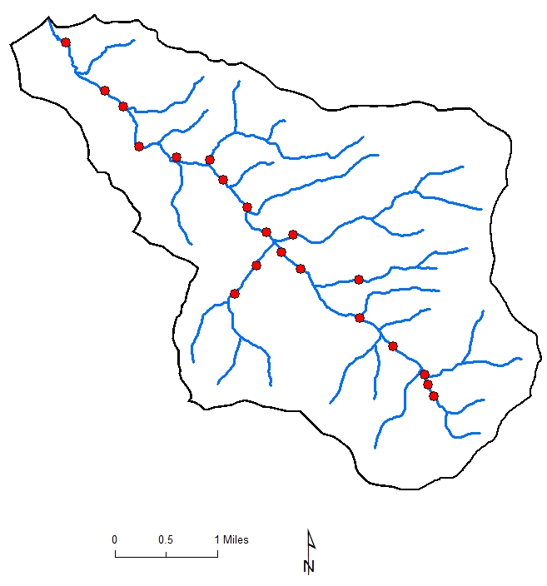
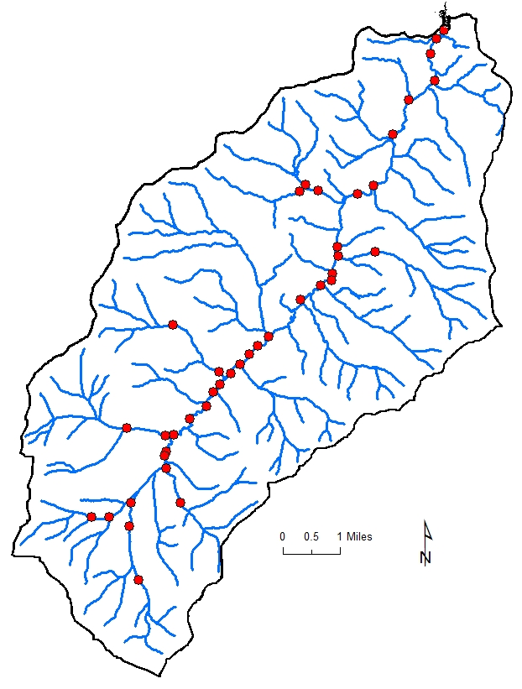
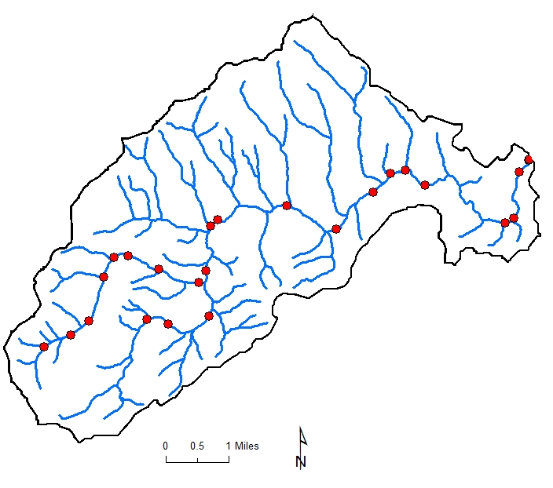
Status and trend monitoring - Spatial distribution of index sites
Evans
Creek
Lake
Creek
Benewah
Creek
Alder
Creek
Notes:
Overview

Slide 15
Cutthroat trout (age 1+) trends in tributaries of upper Benewah watershed
Notes:
Overview

Slide 16
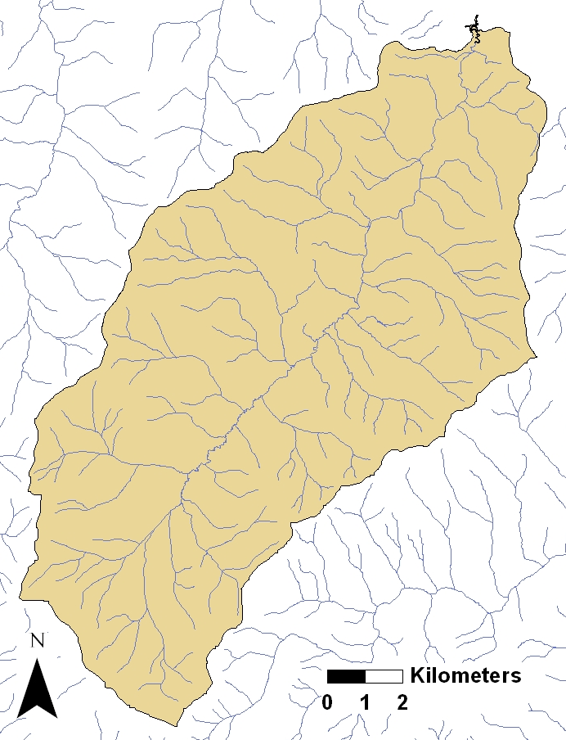
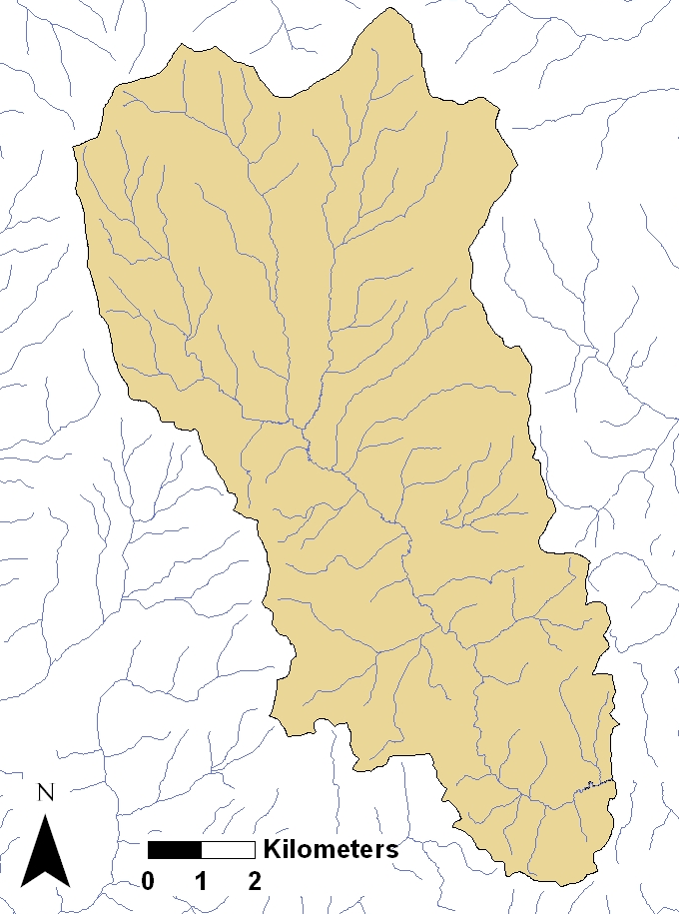
Status and trend monitoring –
Adfluvial production
Benewah Creek
Lake Creek
Mouth of
Benewah
Mouth of
Lake Creek
Notes:
Overview

Slide 17
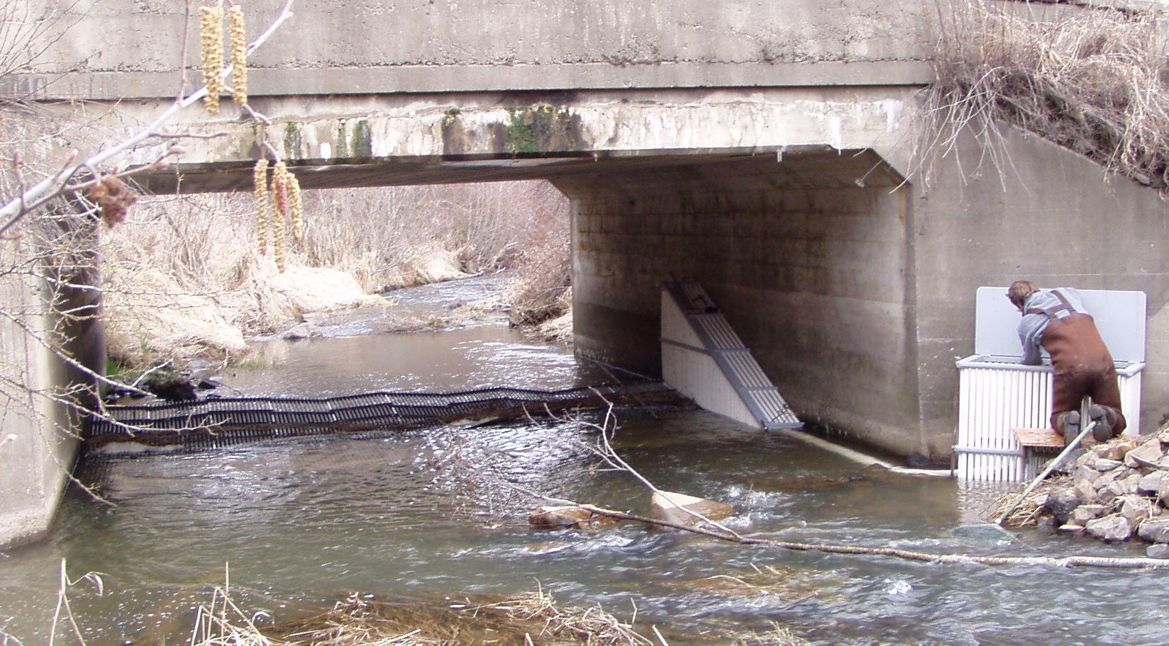
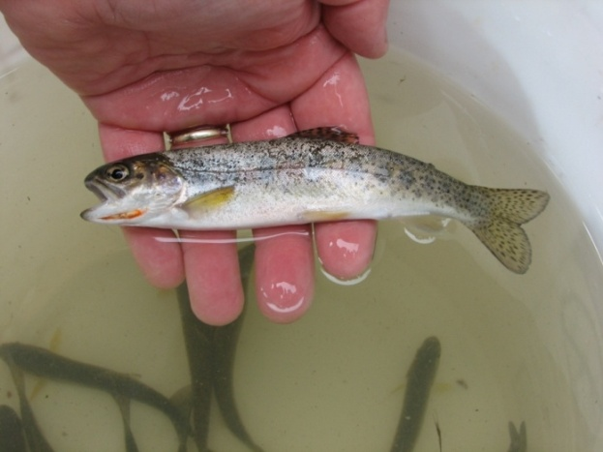
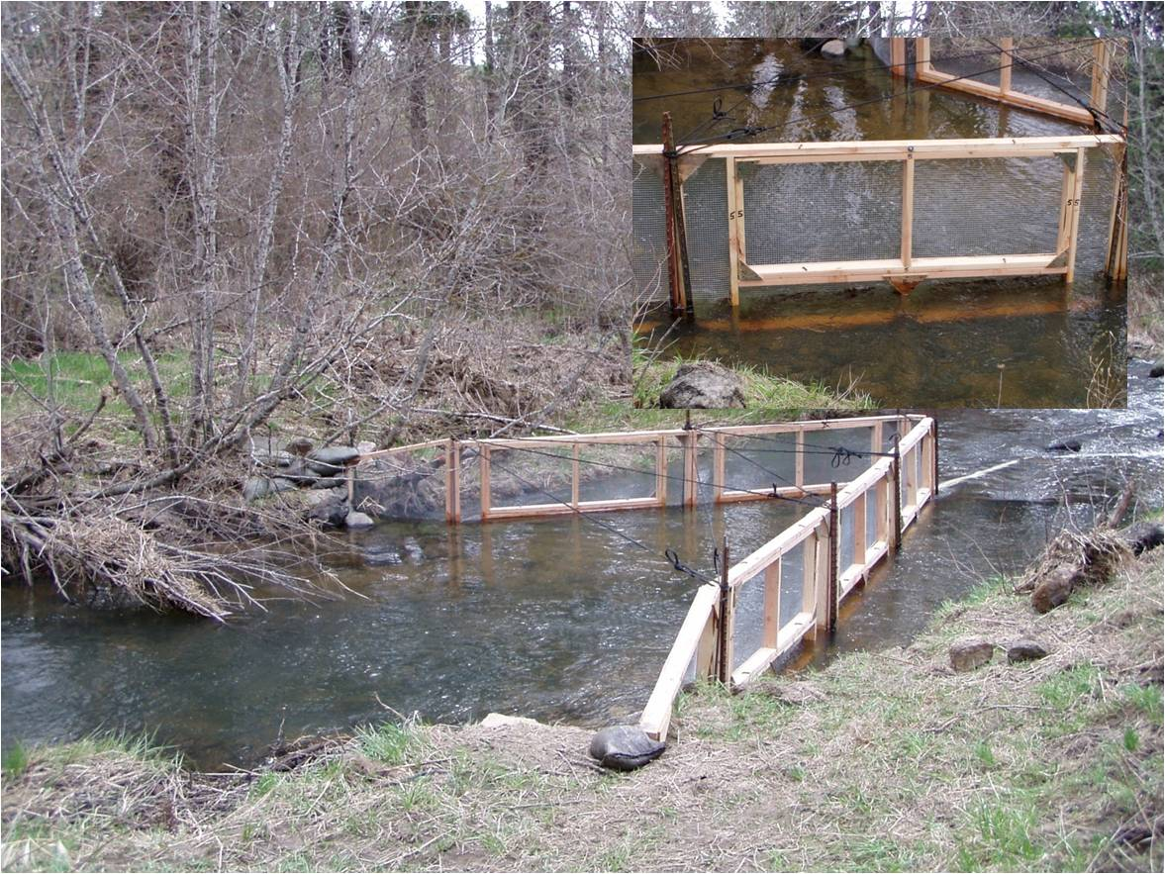
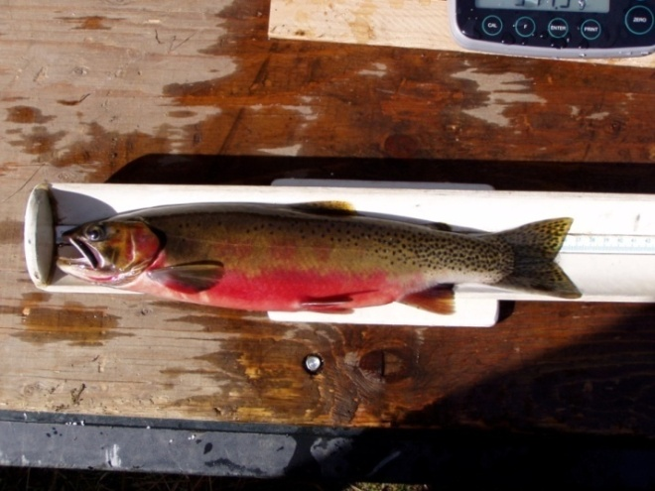
Status and trend monitoring –
Adfluvial production
Notes:
Overview

Slide 18
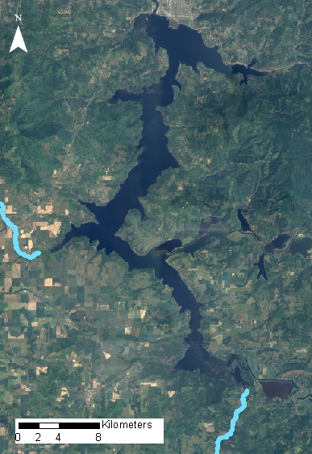
Evaluate predatory impact of northern pike and smallmouth bass
Wolf Lodge
Bay
Cougar Bay
Intensive spring sampling in Windy Bay and Benewah Lake
Less frequent sampling in summer and fall
Seasonal diets and abundance estimates used in bioenergetic analyses
Windy Bay
Benewah Lake
Notes:
Overview

Slide 19
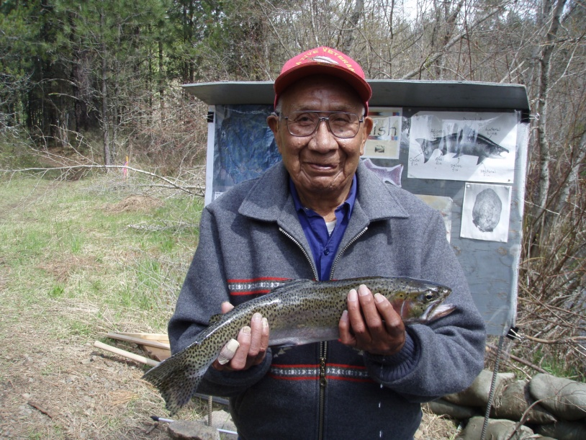
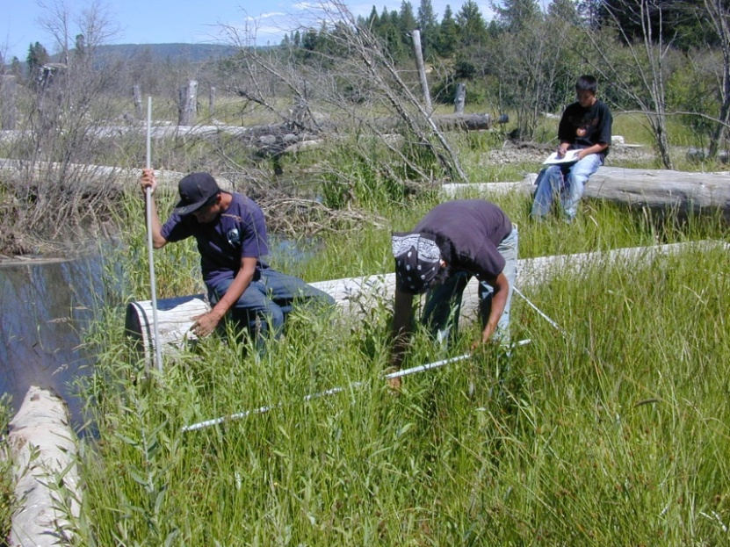
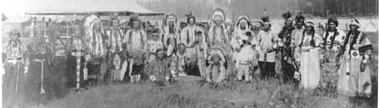
Questions?

