Slide 1

Pacific Northwest Aquatic
Monitoring Partnership (PNAMP)
Project Overview for
Data Management & Coordination
Category Review
Presented to:
NPCC Independent Scientific Review Panel
Jennifer Bayer, PNAMP Coordinator (US Geological Survey)
January 17, 2012

Slide 2
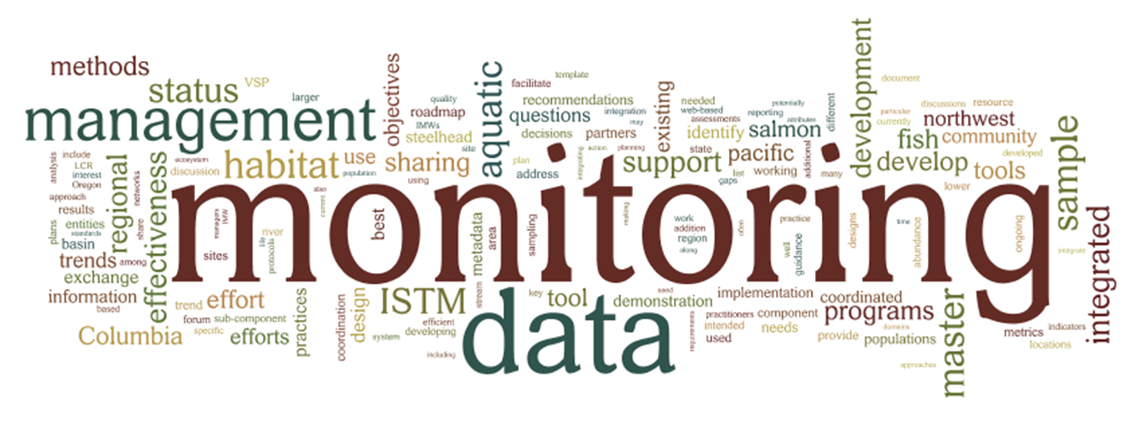
Pacific Northwest Aquatic Monitoring Partnership (PNAMP)
(Project 2004-002-00)
Regional Data Management Support and Coordination
(Project 2008-727-00)
Notes:
Today I will focus on PNAMP’s proposal; however, I will also briefly describe how PNAMP has supported BPA’s “Data Mgmt Placeholder” project.
PNAMP originally focused on supporting collaboration to identify needs for data management for monitoring. However, as NED, the CBFWA DM WG, & PNW RGIC dissipated, PNAMP was asked to also support collaboration about how to meet the needs identified in our collaborative processes.
This includes using the PNAMP DMLT in general, and also the Coordinated Assessments Project in particular, to identify needs, solutions, & to make recommendations to BPA as to work they could consider funding that would advance data management and sharing of monitoring results.
I will provide a brief summary of how these funds have been spent to date.
Following my talk, you will hear from project sponsors who have participated in these processes and are now proposing work to meet the needs identified. This includes
Tom Iverson: next steps for managing the Coordinated Assessments project
Bruce Schmidt: aligning StreamNet with new priorities, providing resources for more entities to participate in StreamNet
Phil Roger: supporting tribes to participate in Tribal Data Network, including CA tasks

Slide 3

PNAMP Mission
PNAMP provides a forum to enhance the capacity of multiple entities to collaborate to produce an effective and comprehensive network of aquatic monitoring programs in the Pacific Northwest based on sound science designed to inform public policy and resource management decisions.
Notes:
PROVIDE A FORUM TO ENHANCE MULTIPLE ENTITIES’ CAPACITY TO COLLABORATE TO CREATE A MONITORING NETWORK

Slide 4
Development of Tools & Processes
Funding Agencies
(e.g. BPA FWP, OWEB,
WA SRFB)
PNAMP
Monitoring Resources.org
Master Sample
Monitoring Methods
Metadata Builder
Monitoring Locator
Elements for which partners collaborate
to develop tools & processes
Integration
Project Tracking Systems
(e.g. HWS, Pisces/Cbfish)
Data
Access
NPCC
&
BPA
Researchers
Data Repositories & Exchange Networks
Reports
Monitoring Projects
(e.g. AREMP, CHaMP, LCREP)
Data Stewards
Governors &
Federal Caucus
Notes:
BIGGER CONTEXT IN WHICH PNAMP WORKS…
Vision for info mgmt in PNW…stars are opportunities for collaboration…PNAMP helps support conversations among many partners, etc
We are working to support integration of resources & activities to increase quality and efficiency of monitoring …
Data/info mgmt key to monitoring coordination, integration
Reporting needs demand better data mgmt
NOTE, this is an example for NPCC (could put CRB Federal Caucus, etc)

Slide 5






Partnership Projects Emphasized Today
T
Federal
Tribal
CRITFC
PSMFC
CBFWA
Regional
Notes:
5
5
MANY MORE ENTITIES participate in addition to signatories…including NGO, other state/fed/tribal individuals
20 Charter signatories as of 2011:
Tribal Entities
Columbia River Intertribal Fish Commission
Confederated Tribes of the Colville Reservation
Northwest Indian Fisheries Commission
State Agencies
California Department of Fish and Game
Oregon Watershed Enhancement Board
Washington Recreation & Conservation Office
Washington Department of Ecology
Washington Dept of Fish & Wildlife
Washington Governor’s Salmon Recovery Office
Federal Agencies
Bonneville Power Administration
National Oceanic and Atmospheric Administration Fisheries
U.S. Army Corps of Engineers
US. Bureau of Land Management
U.S. Bureau of Reclamation
U.S. Environmental Protection Agency
U.S. Forest Service
U.S. Geological Survey
Regional Entities
Columbia Basin Fish and Wildlife Authority
Northwest Power and Conservation Council
Pacific States Marine Fisheries Commission

Slide 6













PNAMP Signatory Partners
T
ACOE
Federal
Tribal
NWIFC
BLM
Colville Tribes
CRITFC
USFS
EPA
USBR
CDFG
WA RCO
WDFW
PSMFC
CBFWA
WA ECY
WA GSRO
State
Regional
Notes:
6
6
MANY MORE ENTITIES participate in addition to signatories…including NGO, other state/fed/tribal individuals
20 Charter signatories as of 2011:
Tribal Entities
Columbia River Intertribal Fish Commission
Confederated Tribes of the Colville Reservation
Northwest Indian Fisheries Commission
State Agencies
California Department of Fish and Game
Oregon Watershed Enhancement Board
Washington Recreation & Conservation Office
Washington Department of Ecology
Washington Dept of Fish & Wildlife
Washington Governor’s Salmon Recovery Office
Federal Agencies
Bonneville Power Administration
National Oceanic and Atmospheric Administration Fisheries
U.S. Army Corps of Engineers
US. Bureau of Land Management
U.S. Bureau of Reclamation
U.S. Environmental Protection Agency
U.S. Forest Service
U.S. Geological Survey
Regional Entities
Columbia Basin Fish and Wildlife Authority
Northwest Power and Conservation Council
Pacific States Marine Fisheries Commission

Slide 7
PNAMP Structure & Planning Process
Activities
Coordinated Assessments
Project
Steering Committee
&
PNAMP Coordination Team
Data Management
Leadership Team
Executive Network
MonitoringMethods.org
Project
Leaders
ISTM Project
Master Sample Tool
Metadata WG
Effectiveness
Monitoring WG
Notes:
HOW PNAMP WORKS
Steering Committee drives the organization – two way communication between respective agencies, workgroups to describe needs for PNAMP work & find resources to accomplish tasks
Tasks/WGs – technical topics, projects
Coordination Team facilitates work (USGS employees, serve PNAMP)
executive network not formal
Annual process to review progress & determine priorities
Funding: confirmed annually but some multi-year agreements
primarily in-kind for participation (HOURS ESTIMATE?)
staff supported via IA’s between federal agencies & USGS (about 75/25 split currently between BPA/OFA’s)

Slide 8
A Brief History of the Regional DM Support and Coordination Project
2009
Environmental Data Svcs | Metadata Consultation | $67,051
2010
USGS personnel & assoc. costs |  | $139,935
USGS subcontracts for:
DM Facilitation/Consultation |  | $151,498
Metadata Consultation |  | $23,800
Web tool development |  | $103,109
USGS indirect costs |  | $81,658
Total expenditures |  | $500,000
2011
USGS subcontracts for:
Web tool development |  | $131,563
Regional DM Consultation |  | $50,000
USGS indirect costs |  | $34,220
StreamNet - Coordinated Assessments |  | $284,217
Total expenditures |  | $500,000
2012
USGS subcontracts for:
Master Sample tool development |  | $245,375
Metadata tools |  | $32,675
Monitoring Locator tool |  | $34,777
USGS indirect costs |  | $70,039
CRITFC - Salmon population names database tool |  | $79,634
unallocated balance as of Jan 2012 |  | $50,000
Total expenditures |  | $512,500
Funds contracted directly from BPA to organization listed in each row
2009: Project 2008-727-00 (Regional DM Support and Coordination) initiated
2010: Portion of funds used to support new Information Mgmt Liaison position in PNAMP
2011: PNAMP staff no longer supported from these funds
2013-15: portion used for Data Coordinators (StreamNet & CRITFC); portion used for tools developed by PNAMP
Notes:
PNAMP DMLT used as a forum to identify needs, discuss proposed solutions, and develop recommendations for BPA to consider funding.
2013-15: CA project specifically intended to identify needs, facilitate process to agree on proposed solutions; inform this Category Review cycle topic (DM)

Slide 9
Proposed Activities for 2013-2017
Current Workplan (2012)
Proposed 2013-17
  5 Objectives, 20 Deliverables outlined
  Continuation of current tasks, products
  Respond to needs identified by partners (adapt)
The further out in time we look, the harder it is to describe details but the need to support collaboration will not likely cease.
Notes:
Current Activities/2012 Workplan: provided in handout
Proposed 2013-17: 20 WE’s
Continue to support collaboration & coordination of ongoing topics:
fish monitoring,
habitat monitoring,
effectiveness monitoring,
data/info mgmt best practices
Continue to web tools/resources
Develop new,
Sustain existing,
Integrate with PNAMP and others’ resources
New tech opportunities will unfold

Slide 10
Proposal Objectives
OBJ-1: Maintain Monitoring Coordination Framework for the PNW (via PNAMP & its committees)
OBJ-2: Identify coordinated monitoring needs
OBJ-3: Provide recommendations to region
OBJ-4: Develop a regional data management strategy
OBJ-5: Develop and maintain web resources
Notes:
Our proposal describes 5 Objectives & 20 deliverables…however, we don’t have time today to describe these in detail, so I will highlight topics & some tasks. Many deliverables & objectivesa re inter woven…this presentation is organized more along the PNAMP workplan.
OBJ-1: Maintain Monitoring Coordination Framework for the PNW, the monitoring coordination framework should do the following:
Provide policy support and direction by member organizations;
Commit technical resources and staff time;
Provide funding for desired levels of coordination; and
Provide higher-level focus and guidance for regional monitoring outcomes.
OBJ-2: Identify coordinated monitoring needs
Identify information needs and coordinate information sharing so that high level management questions may be answered by agencies in the region by aggregating monitoring and/or effectiveness research results across different spatial and/or temporal scales.
Identify the key questions that could be addressed by coordinated monitoring in support of management. Identify the current and proposed metrics, monitoring designs and evaluation methods needed to answer these questions.
OBJ-3: Provide recommendations to region
Recommendations will provide guidance for common methodologies, compatible protocols, and partnership agreements needed for regional
monitoring programs to achieve the shared coordination objectives of the PNAMP membership entities.
OBJ-4: Develop a regional data management strategy
Identify/develop data standards as they relate to the monitoring of fish and aquatic habitat.
Improve access, sharing, and coordination among different collectors and users of fish and aquatic habitat monitoring data.
Develop a data reporting foundation that would lead toward coordinated reporting, consistent monitoring methods, and improved data quality
and quantity.
OBJ-5: Develop and maintain web resources
Based on practitioner needs and PNAMP work group and Steering Committee recommendations, develop web based applications to provide monitoring design guidance and support information collection, storage, and dissemination among the aquatic resource community. In addition to this, there will be a need to provide training, long term maintenance, and oversight of any web resources developed.

Slide 11

PNAMP Supports Monitoring Collaboration & Coordination
Guidance for monitoring design, methods for data collection, analysis, management, and sharing
Tools to make it easier to:
  Design & document monitoring
  Collaborate, discover & share data
Notes:
Data/info mgmt key to monitoring coordination, integration
Reporting needs demand better data mgmt
key tasks/roles:
Facilitation,
Coordination
tool development – sustains agreement/meets needs identified
Tasks cross-cut monitoring themes (fish, habitat, effectiveness monitoring):
Protocols: what to measure and how to measure it
Survey design: how to decide where and when to monitor
Data management: what are our data needs; what must we do before, during, and after data collection to facilitate data sharing
Monitoring inventory: better facilitate coordination by describing ‘who is doing what monitoring where’
High level indicators: seek agreement on a set of indicators (and metrics necessary to determine indicators) to describe landscape level changes in the region
Regional network of monitoring efforts: explore ways to continuously improve our efficiency and effectiveness of monitoring on a regional scale

Slide 12
Current PNAMP Projects
Integrated Status and Trend Monitoring (ISTM) Demonstration Project
  Fish, Tributary Habitat, Mainstem Components
Effectiveness Monitoring Coordination
Data Management Leadership Team (DMLT)
Roadmap for Regional Data Management Implementation
Coordinated Assessments Project
Habitat Data Sharing Project
Remote Sensing Forum
Data Steward Community of Practice
Regional Metadata Guidance
Web resources
  Master Sample Tracking Tool
  MonitoringMethods.org
  Metadata Builder (scoping)
  Monitoring Locator (scoping)
  SalmonMonitoringAdvisor.org
Protocol/Methods Workshop Series
Modeling for Monitoring Design Review Workshop
Notes:
MENTION THE HANDOUT…UPDATE FROM DECEMBER 2011 OF CURRENT TASKS, 2012 WORKPLAN COMPLETE FEBRUARY

Slide 13
Monitoring Design & Methods for Data Collection, Management, & Sharing
Focus on Alignment of Existing Programs
(From PNAMP ISTM Demonstration Project)
Identify & prioritize decisions, questions, and objectives
Determine adequacy of existing programs, potential efficiencies, existing gaps
Identify monitoring designs, sampling frames, protocols, and analytical tools
Use trade-off analyses to develop recommendations for monitoring including priorities and range of budgets
Recommendations for implementation, data management, reporting, and adaptive management
Notes:
Specifically:
Integrated monitoring (across jurisdictions & topics: fish/habitat/ action effectiveness)
See also: Habitat Data Sharing
See also: Coordinated (fish population) Assessments

Slide 14
Habitat Data Sharing Project:
Proposed Activities
List of Priority Habitat Characteristics
Prototype Data Exchange Template (DET)
Normalization as a Step to habitat Indices
Habitat Data Sharing Needs Assessment
Macroinvertebrate Data for Habitat Data Sharing
Remote Sensing Forum
Habitat Data Discovery
Notes:
BLUE text indicates – (inter)related with other tasks

Slide 15
Data Best Practices
The Roadmap: identify best practices for data management and sharing
Metadata: guidance on standards; support & aid metadata creation & posting
Data Steward Community of Practice: support data professionals via expert exchange forums, trainings, etc.

Slide 16
Tools to Make It Easier to
Design & Document Monitoring
MonitoringMethods.org: library of monitoring protocols & methods
SalmonMonitoringAdvisor.org: expert guidance from NCEAS; PNAMP to expand
Master Sample Tracking Tool: monitoring design & documentation
Notes:
Data/info mgmt key to monitoring coordination, integration
Reporting needs demand better data mgmt
Several key tasks, including tool development, also facilitation, coordination

Slide 17
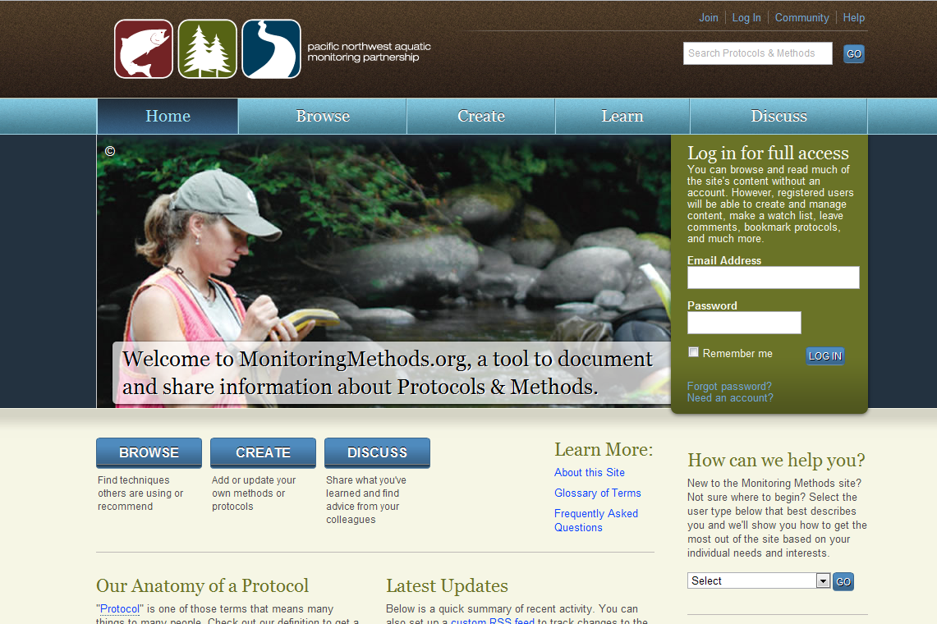
Protocols – 600+
Methods – 1100+
Metric/Indicator Subcategories – 400+
Organizations – 145+

Slide 18
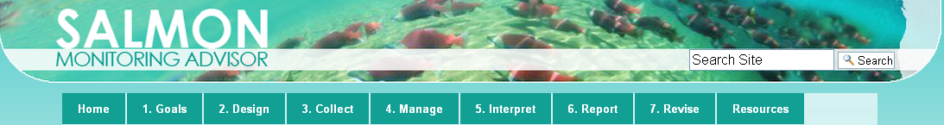
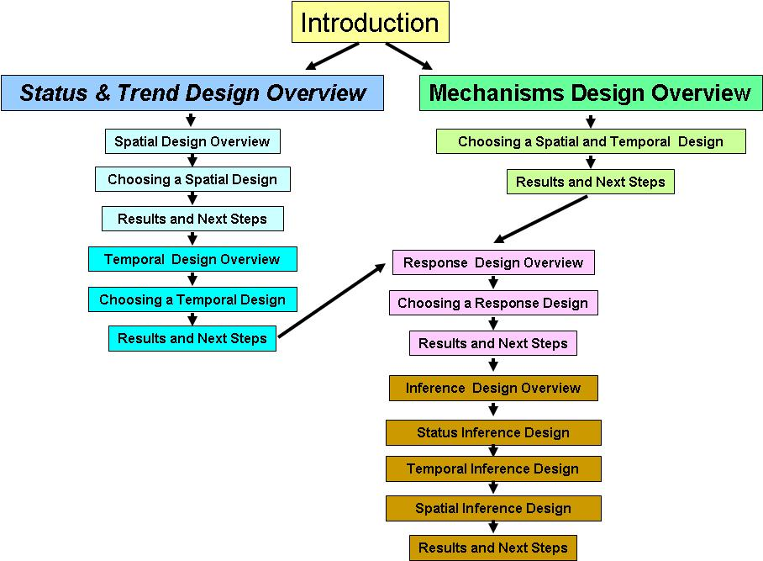
Notes:
MM.Org - Tie in to SMA cycle.

Slide 19
Master Sample Tracking &
Site Management System
Store linear and area based Master Samples and metadata
Download of relevant parts of the MS
Upload info about MS sites (site evaluation, indicators measured, protocols used)
Provide tracking system to record history of sites selected
Download histories of previously selected sites
Incorporate GRTS based samples that are not from the MS (legacy sites)
Learn, explore
Select master sample, define frame
Add attributes, stratify
Add sites, create panels
Evaluate sites
Collect data
Analyze data, generate estimates
Notes:
•Store master samples and associated metadata (e.g., design documentation) on a commonly available server;
•Allow users to download relevant parts of the master sample;
•Allow users to upload information about master sample sites that they have evaluated (to include design documentation, site evaluation, indicators measured, protocols used);
•Provide a tracking system that documents the history of sites selected from the master sample;
•Allow users to download histories of previously selected sites (to include design documentation, site evaluation, indicators measured, protocols used);
•Allow scaling up to a statewide, or multi-state system (this primarily means the capability to manage substantially larger master samples than that used for the prototype);
•Incorporation of GRTS based samples that are not drawn from the master sample;
•Development of training materials to guide the use of the system
•Allow extension to area based master samples;

Slide 20
Tools to Make It Easier to
Collaborate, Discover & Share Data
‘Who’s doing what where?’
  Metadata Builder: build MD records from project tracking systems scoping 2012
  Monitoring Locator: linked to MS Tool but also including other monitoring scoping 2012
Notes:
Data/info mgmt key to monitoring coordination, integration
Reporting needs demand better data mgmt
Several key tasks, including tool development, also facilitation, coordination

Slide 21
Coordinated Assessments Project
PNAMP
StreamNet
CBFWA
Notes:
Develop individual and regional data sharing strategies that identify the capacities and business practices necessary for integrated data sharing of three specific Viable Salmonid Population (VSP) indicators in the Basin;
Refine and promote the use of Data Exchange Templates (DETs) among the Basin fisheries co-managers as a business practice for sharing the three VSP indicators for salmon and steelhead.

Slide 22
Upcoming Presentations
CBFWF (Tom Iverson): Program Coordination and Facilitation Services
PSMFC (Bruce Schmidt): StreamNet - Coordinated Information System (CIS)/ Northwest Environmental Database (NED)
CRITFC (David Liberty & Henry Franzoni): StreamNet Library & Tribal Data Network

Slide 23
Questions?

Slide 24
Supplemental Slides

Slide 25
Proposal Deliverables
Administrative/General Support
DELV-1: Steering Committee support
DELV-2: Data Management Leadership Team Support
DELV-3: Administrative Support provided by PNAMP staff (USGS employees)
DELV-4: Communication and Facilitation Support
Data Management & Sharing
DELV-13: Data Management Best Practices
DELV-7: Facilitate Habitat Data Sharing Project
DELV-9: Facilitate Coordinated Assessments Task
DELV-16: Promote Application of the Columbia River Basin Population Crosswalk Geodatabase and Online Interactive Mapping Application
Monitoring Design & Data Collection
DELV-5: High Level Indicators Coordination
DELV-6: Facilitate monitoring methods reviews
DELV-10: Facilitate regional use of results from PNAMP ISTM task
DELV-8: Facilitate Effectiveness Monitoring Coordination Task
DELV-17: Facilitate coordination of remote sensing applications for monitoring
Web Resources
DELV-11: Provide long term support and maintenance for Master Sample Tracking Tool
DELV-12: Provide long term support and maintenance for MonitoringMethods.org
DELV-14: Regional deployment of Metadata Builder Tool
DELV-15: Sustain PNAMP website
DELV-18: Sustain Salmon Monitoring Advisor web resource
DELV-20: Develop and maintain Monitoring Site Management online resource
DELV-19: Integrate PNAMP online resources

Slide 26
Guidance for Regional Data
Collection, Sharing and Exchange
Monitoring design
Methods for data collection
Data management & sharing
“Best Practices”
Notes:
o What are the key products or services that you plan to achieve?
Data/info mgmt is fundamental to monitoring coordination, integration
Reporting needs demand better data mgmt
Several key tasks, including tool development, also facilitation, coordination

Slide 27
Successes, Strengths, Mission Fulfillment
Steering Committee and participants offered similar feedback
Information sharing (host/convene meetings, workshops)
A forum for collaboration & coordination with respect to monitoring programs
Developing specific products (final documents, web resources)
Initiating pilot projects and developing recommendations appropriate for use at different scales (HLI, ISTM)

Slide 28
Integrated Status & Trends Monitoring Demonstration Project (ISTM)
PNAMP
ODFW
WA Ecology
USFS & BLM
CHaMP
Clark Co.
ODEQ
SRFB
WDFW
ISTM Components
Fish (incl. data mgmt)
Habitat (tributary)
Mainstem
Notes:
highlights, next steps (participants)
Fish (green)
Habitat – tributary (blue AND green)
Mainstem (not listed in bubbles)

