Slide 1

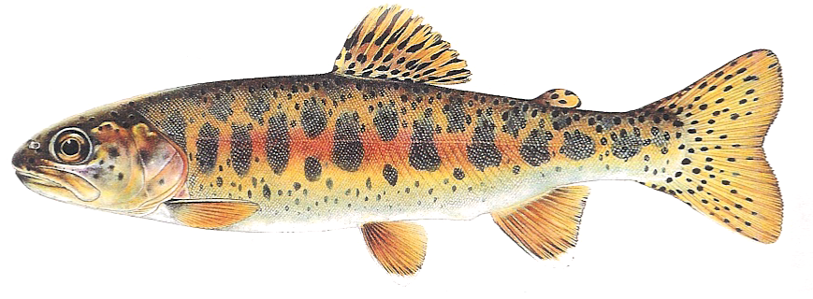
Redband trout
(Onchorhynchus mykiss gairdneri)
Hangman Creek Fisheries Enhancement
BPA Project 2001-032-00
&
Hangman Restoration Project: Wildlife
BPA Project 2001-033-00

Slide 2
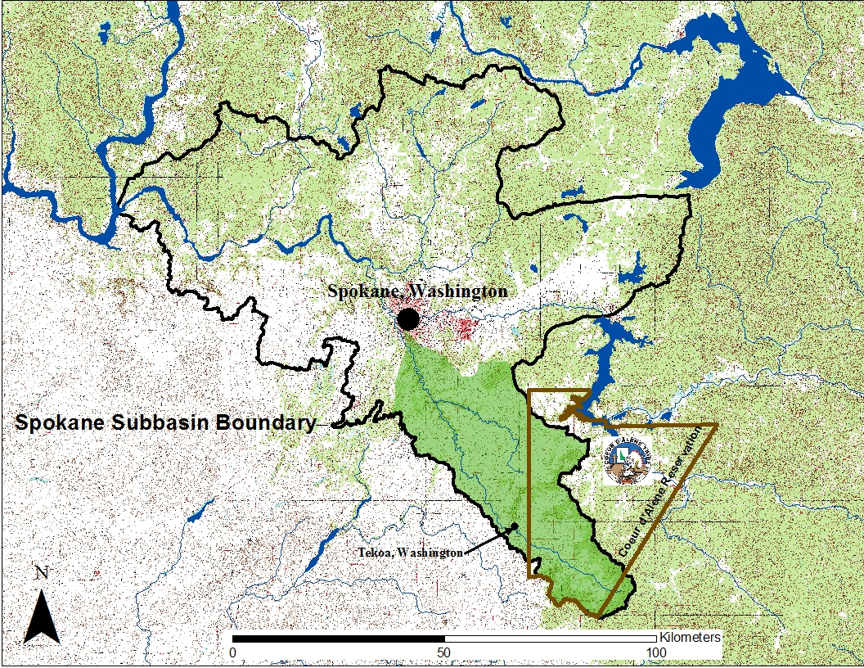

Slide 3
2001-033 Project Objectives
Objectives
Decrease rate of floodplain groundwater depletion through the dry season
Increase baseflows in Project Area streams
Involve students in the process
Notes:
Because of the loss of subsistence and recreational fisheries for the blocked areas, Bonneville Power was obligated to mitigate for this loss to the Tribes and states affected using a Resident Fish Substitution Policy.
Funding for Redband Trout in Hangman Creek is one example where this is being implemented. In the interim , the Coeur ‘Alene Tribe is maintaining “Put and Take” ponds that provide fishing opportunities .

Slide 4
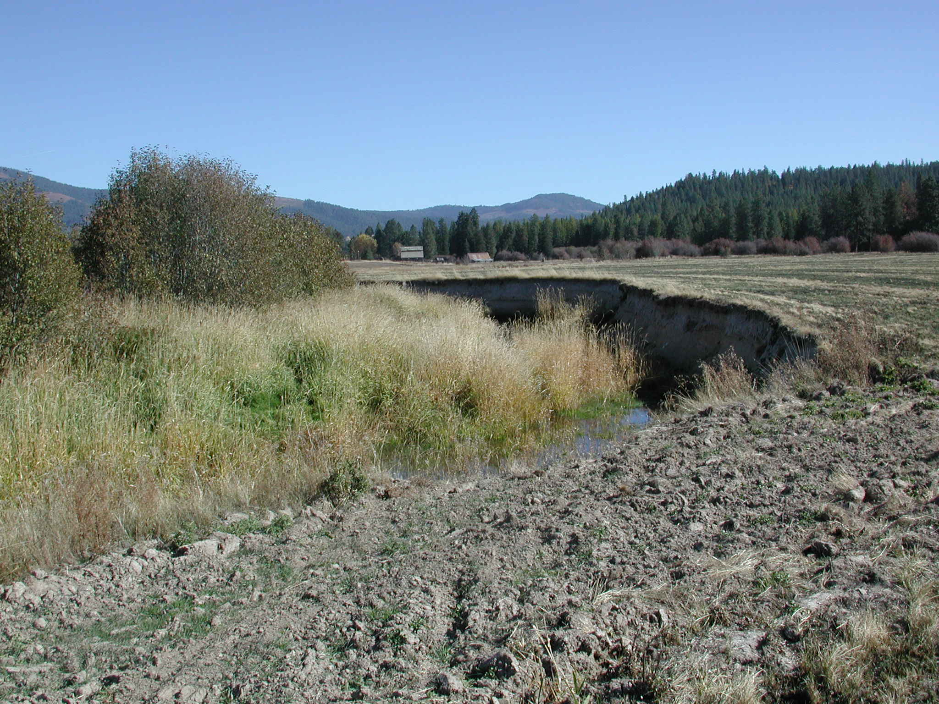
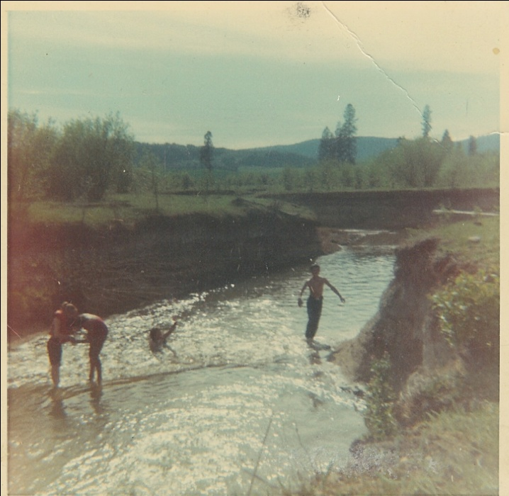

Slide 5
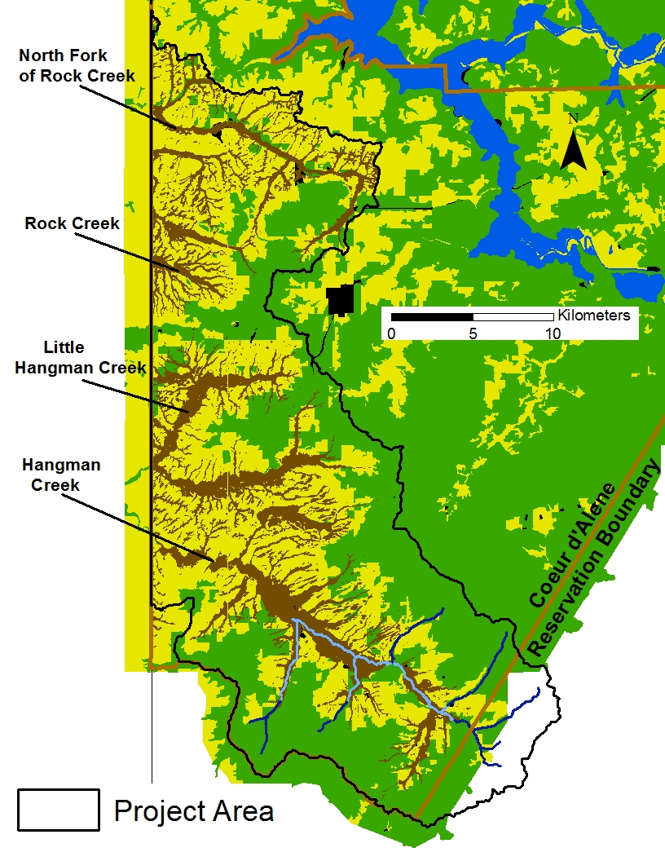
Project Area Priority Habitats
Fisheries Priority
Habitats (2001-032-00)
Fish Bearing Reaches
Potential Connecting Reaches
Wildlife Priority
Habitats (2001-033-00)
Hydrologic Priority Area:
Low Gradient Floodplain

Slide 6
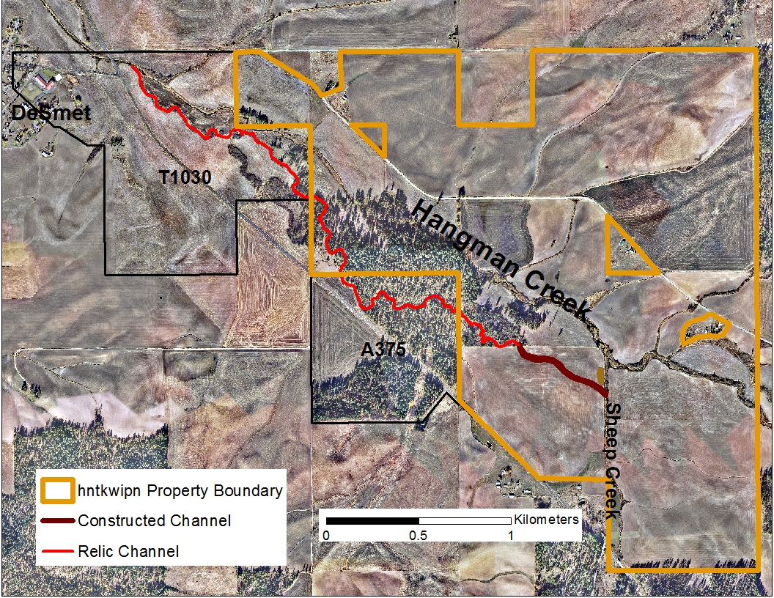
Sheep Creek Realignment

Slide 7
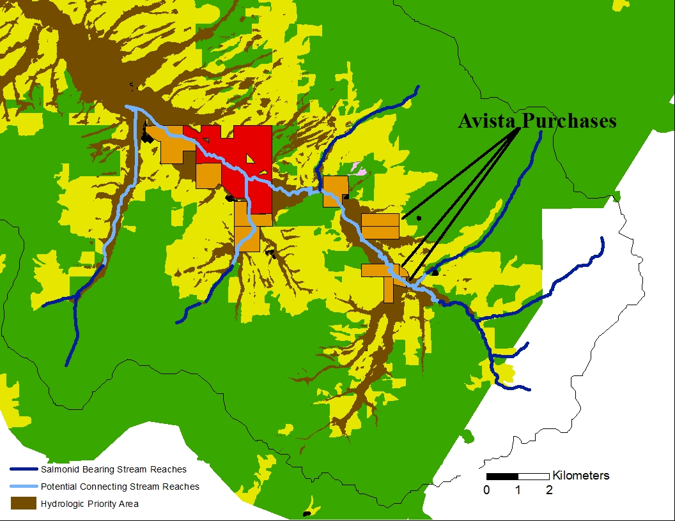

Slide 8
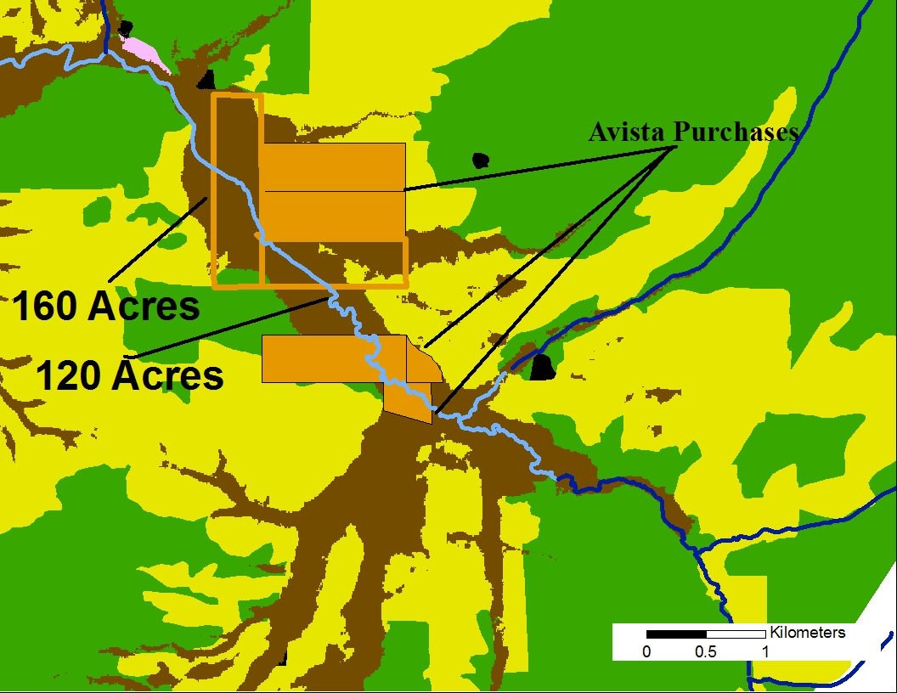

Slide 9
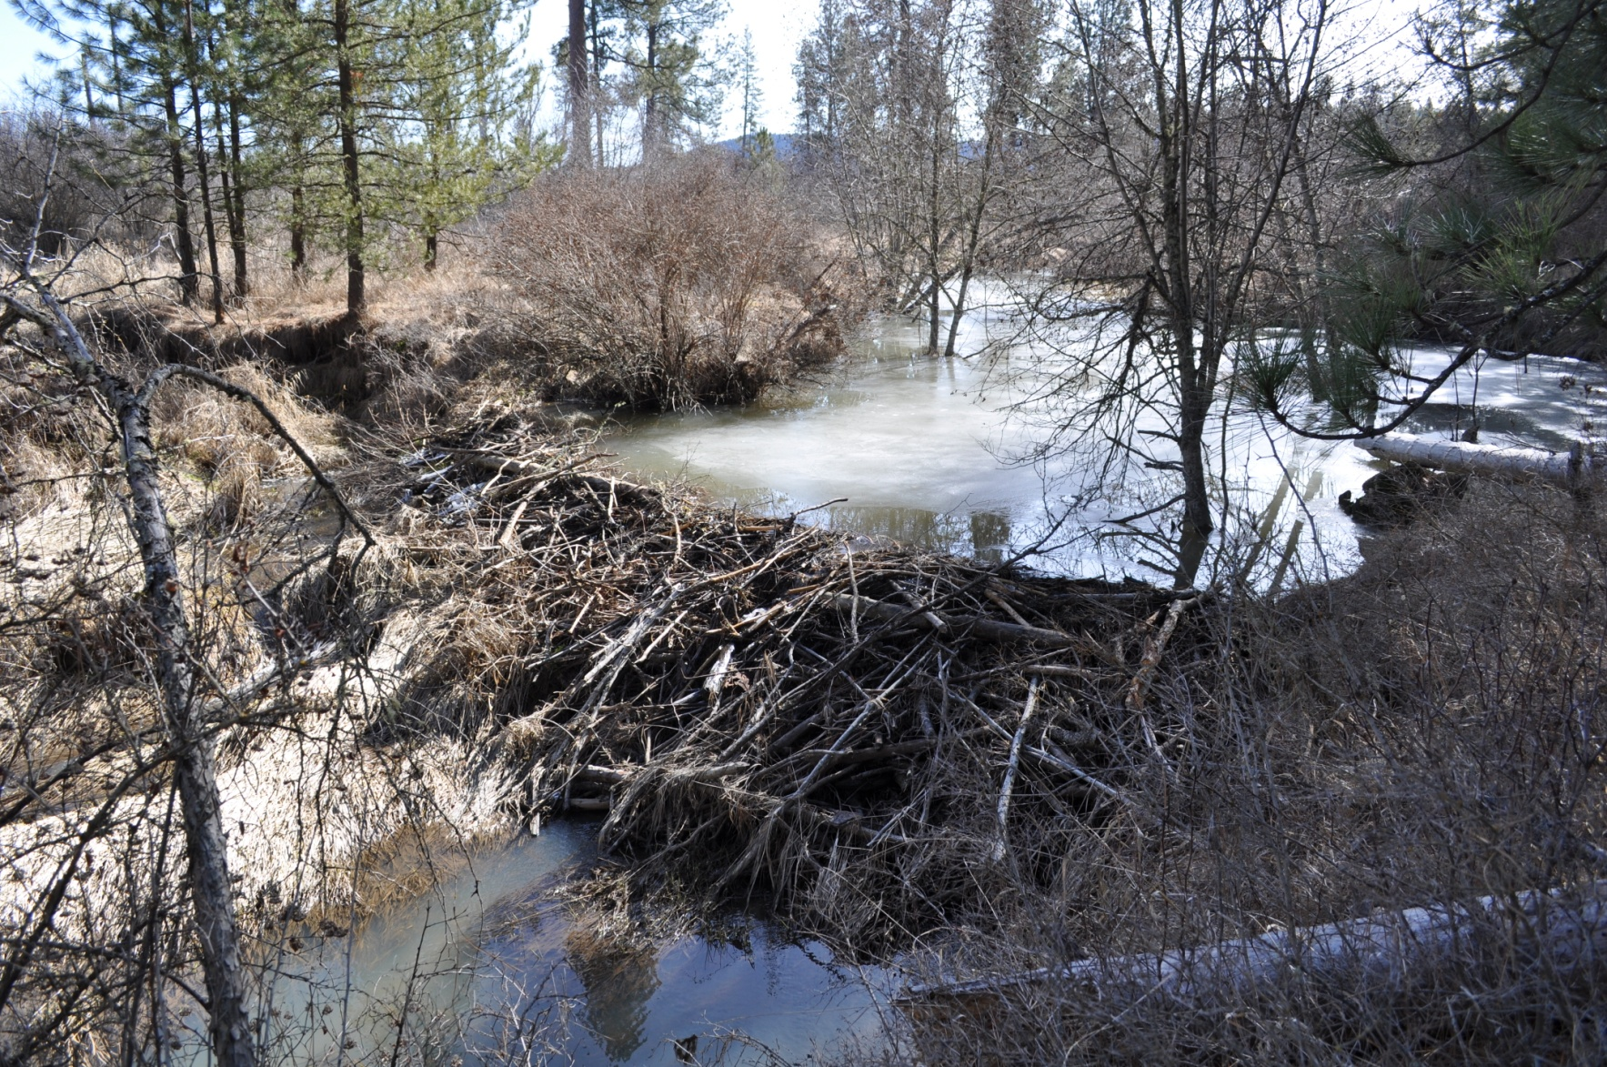
Notes:
Because of the loss of subsistence and recreational fisheries for the blocked areas, Bonneville Power was obligated to mitigate for this loss to the Tribes and states affected using a Resident Fish Substitution Policy.
Funding for Redband Trout in Hangman Creek is one example where this is being implemented. In the interim , the Coeur ‘Alene Tribe is maintaining “Put and Take” ponds that provide fishing opportunities .

Slide 10
2001-032 Project Objectives
Improve Stream Habitats
  Increase frequency of over-bank flows to insure stream/riparian connection
  Treat streams to meet wood loading criteria
  Increase Canopy cover in tributaries and mainstem
  Decrease stream temperature
Track Trend and Status of Redband Trout Demographics & Pop Structure
Evaluate Effectiveness of Restoration actions
Notes:
There are three objectives as outlined in our proposal.
The first is to improve stream habitats with four things in mind
1) implement restoration techniques which will connect the floodplain to the stream thus insuring our riparian enhancement efforts will be cost efficient.
2)Treat stream reaches with large woody debris to meet our loading criteria as set forth in Project 1990-044
3) Increase canopy cover in both tributaries and the mainstem
4) Decrease stream temperatures which is a function of both pool depths and canopy cover
Objective #2 is to track trend and status of redband populations with migration trapping in 2 tributaries, pit tagging with arrays set up at three key locations, and summer electroshocking surveys at approximately 35 sites.
The third objective is to evaluate the effectiveness of our restoration efforts with habitat surveys pre and post restoration and using control sites

Slide 11
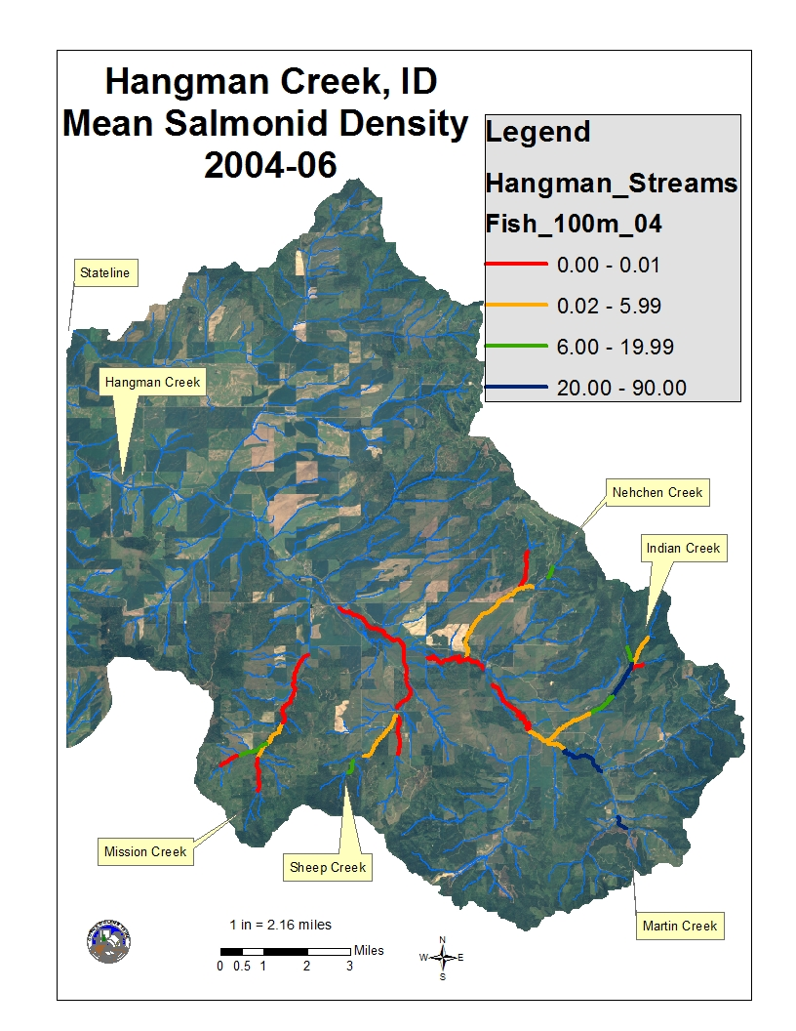

Notes:
Fisheries work has revealed that remnant populations of genetically pure redband trout exist in isolated headwater locations in various densities. Limited numbers of fish are found in lower portions of tributaries and the connective habitat on the mainstem. Indian Creek and upper Hangman east of the Reservation, along with short reaches in Mission, Sheep, and Nehchen contain the highest densities. The mainstem of Hangman below Indian Creek is essentially absent of measureable densities with occasional fish caught during summer electroshocks. Our trapping data does show fish are utilizing the mainstem during spring. Data shown in 2004-6 and in 2009-2010 show a slight uptrend in many locations, and a decrease in Nehchen Creek due to dewatering following large scale timber removal in the upper watershed

Slide 12
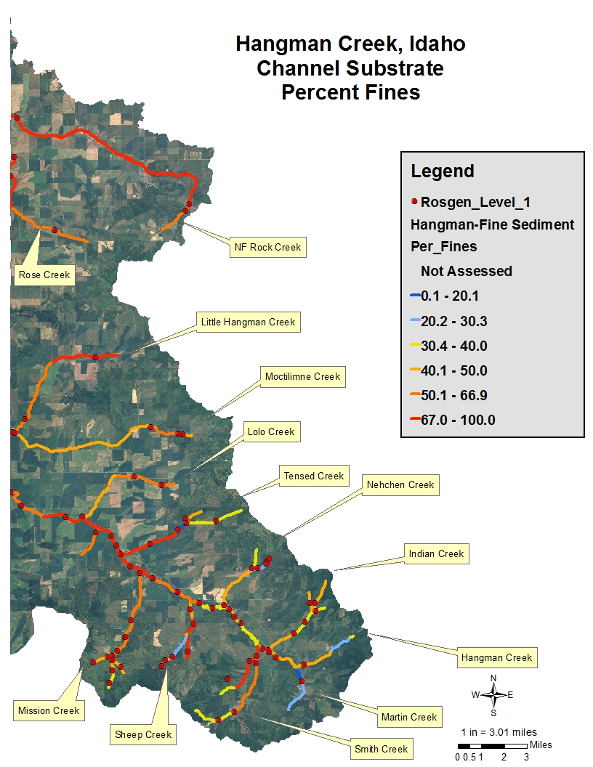
Notes:
Percent Fines was calculated from surveys completed in 2003 as part of a larger sampling effort that included macroinvertebrate sampling and electroshocking. Other pebble counts were obtained from Rosgen Channel typing surveys.
The entire northern watershed and the mainstem of Hangman up to Sheep Creek had in excess of 50% fines. The lowest reaches of all tributaries show similar results. Only upper reaches of Nehchen, Indian, Mission, and Sheep show values less than 40% along with upper Hangman east of the reservation

Slide 13
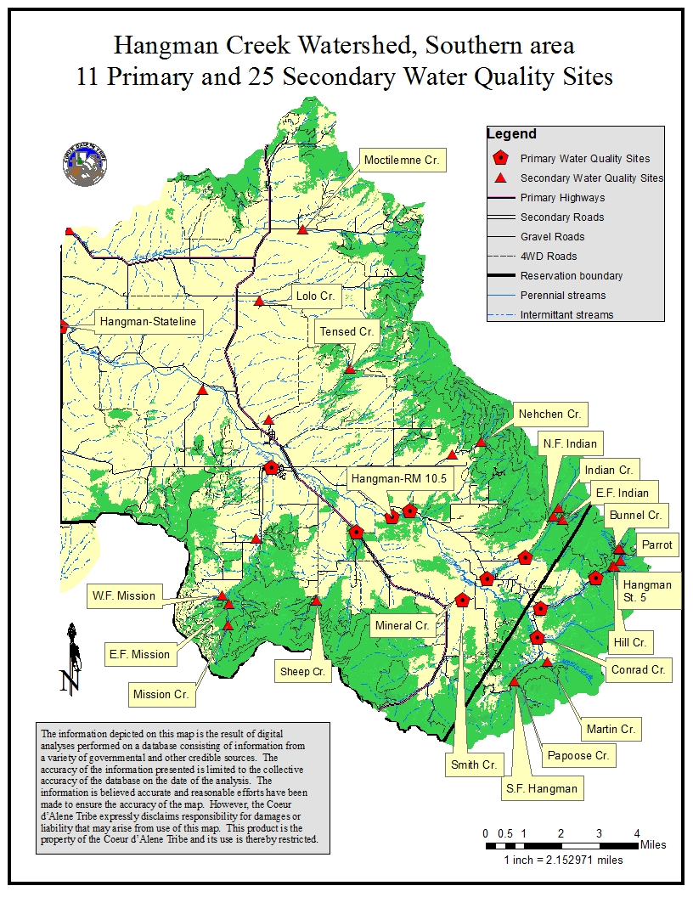
Notes:
Dissolved oxygen, TSS and temperature is shown as limiting factors in many locations in the watershed.
D.O. has been known to drop below 7 mg/L in much of the mainstem of Hangman and lower reaches of tributaries except for Indian and the SF Hangman. IT follows closely with a lack of discharge
TSS is primarily a factor in high flow events that show concentrations and duration high enough to cause sub-lethal effects

Slide 14
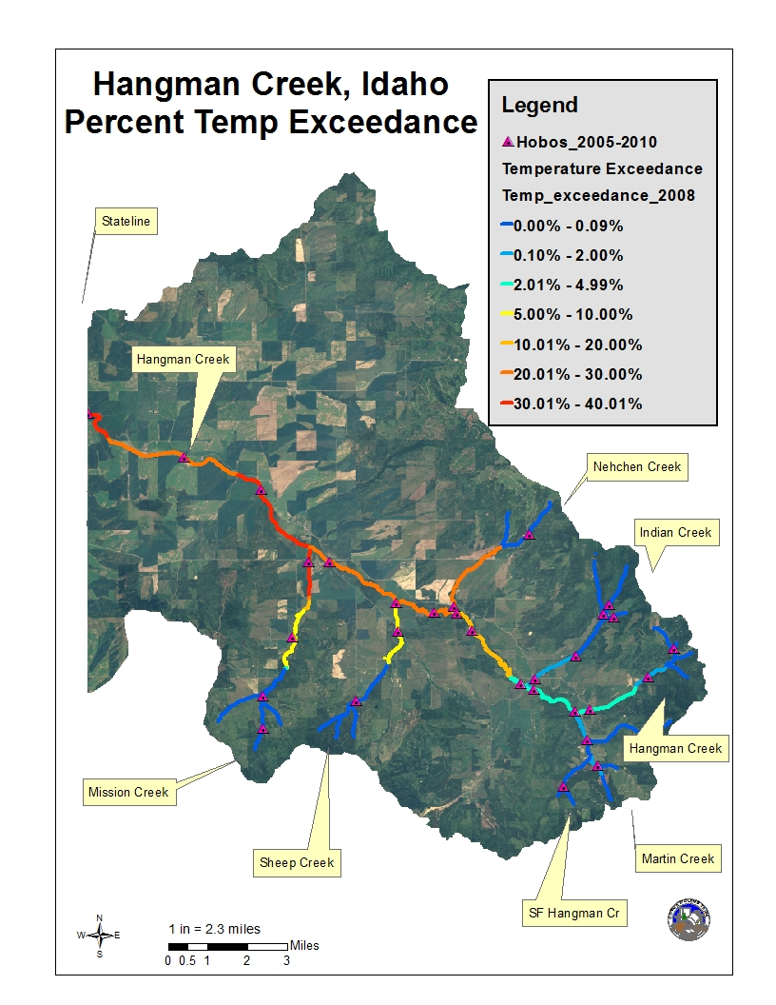
Notes:
Temperature is a problem throughout the watershed where agriculture dominate the riparian zone. We set a limit of 14 degrees C for a spawning/emergence timeframe o May-June and 20 degrees for July and August for a rearing timeframe. As you can see from the blue colors temperature is not a limiting factor in the upper reaches of the tributaries where forest dominates. Any tributaries not shown would be either dry of with very high temps.

Slide 15
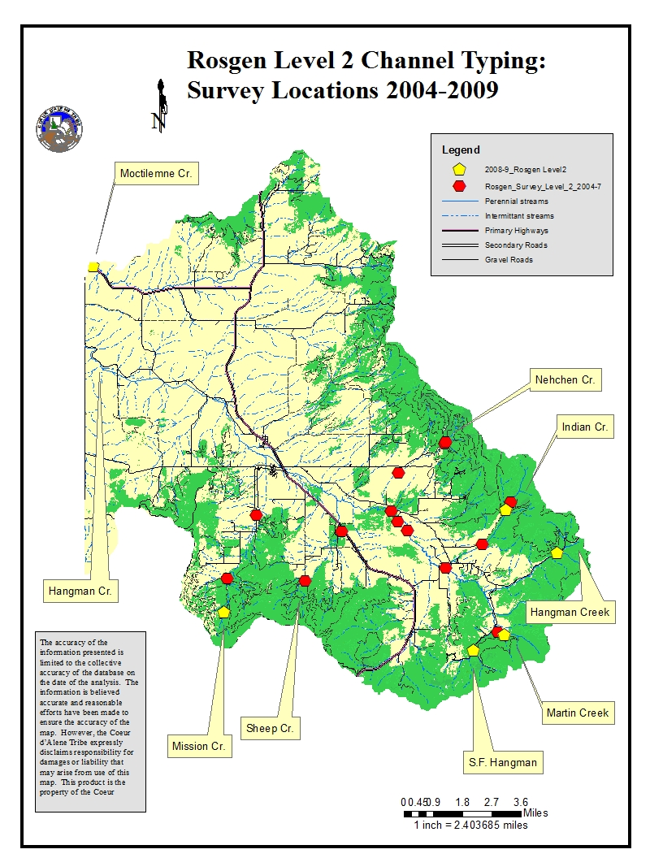
Notes:
We conducted 22 Rosgen channel typing surveys over the course of 6 years and identifed additional Limiting factors including;
lack of LWD except for Indian Creek and very pronounced in the mainstem
Lack of Canopy throughtout the mainstem and lower tributary reaches
-Channel Entrenchment was found in most mainstem reaches as well as some tributary reaches

Slide 16
Initial Restoration Directives
Prioritization Plan
Northern Watershed (Rock Creek) eliminated based on cumulative impacts
Conserve core fish-bearing reaches
Restore Connective Habitat
Remove migration barriers
IFIM Report directives
  Increase Canopy on mainstem habitats
  Increase pool depths in tributaries
Notes:
Our initial restoration was directed thru the many sampling efforts undertaken and summarized in our Prioritization plan which eliminated the northern watershed from further Fisheries work, as well as tributaries downstream of Mission Creek. We were looking to conserve the existing populations in Indian Creek and begin to work on the connective habitat on the mainstem of Hangman
The Instream Flow Incremental Methodolgy further defined our plan by directing us to increase the depth of pools in the tributaries as a means of increasing useable fish habitat. It also directed us to decrease the temperature in the mainstem through additional canopy as a means of adding useable fish habitat. It was estimated that 50% canopy would decrease the water temperatures by 2 degrees C. This would put many reaches within the guidelines we set for temperature.

Slide 17
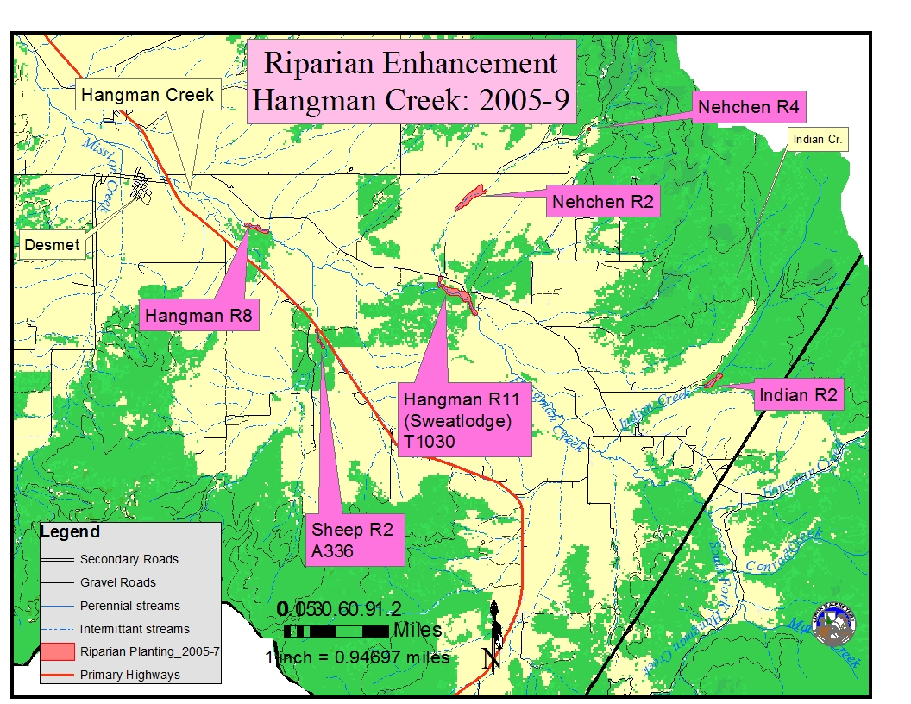
Initial Restoration:
Riparian & LWD
Notes:
We began implementation in 2005 in more of a fashion of opportunity than prioritization. While tree survival was very successful in Indian Creek, it was very poor in the main area of work on the mainstem. Over the course of 2005-9 we found several ways to get trees to survive like using only 5 gallon pots with tall trees, watering during July, and using hog panels to protect from high flows and wildlife, especially beaver. But we had to replant the same areas again after learning this.
What was really the problem was the lack of connection if the stream and the riparian zone. Remember most of the channel was entrenched, in fact enough to be classified a F channel by Rosgen methodology.
To date we have successfully treated 2100 meters of riparian with hardwoods, willows, and conifers with most of the successful work done from 2007-2009 which included 12,000 conifer plugs and over 4,000 hardwood trees

Slide 18
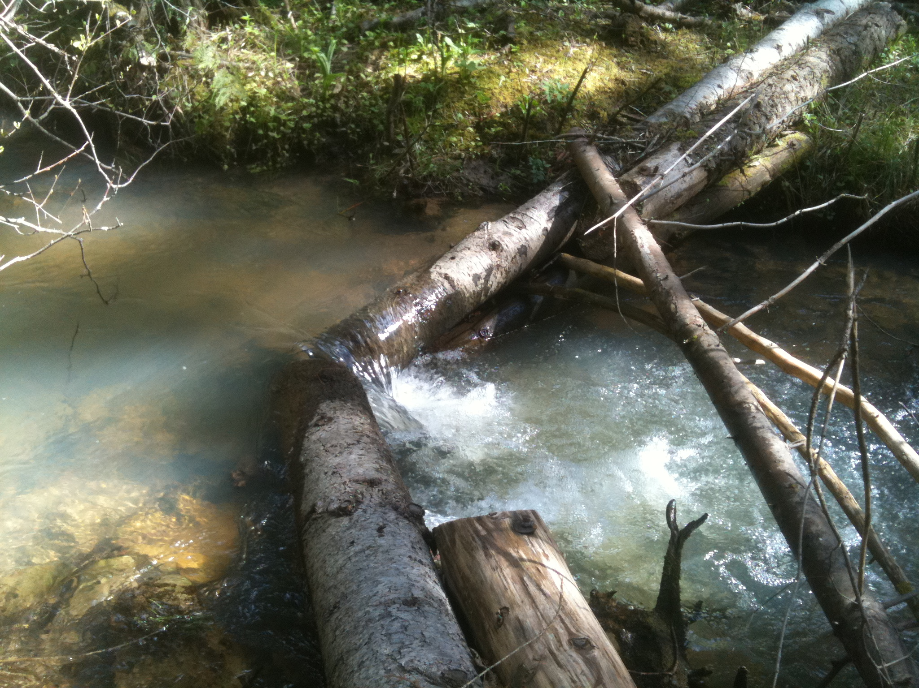
X-Vein at Indian Creek
Notes:
We also completed a pilot project of hand placed large woody debris placement. The most successful structure was a wood cross vein which created pools with 2-3 feet of residual depth. We used various other designs for bank protection and deflection of fast water. Total pool length and mean residual pool depths have dramatically improved. Currently we are seeing large numbers of fish occupying this area

Slide 19
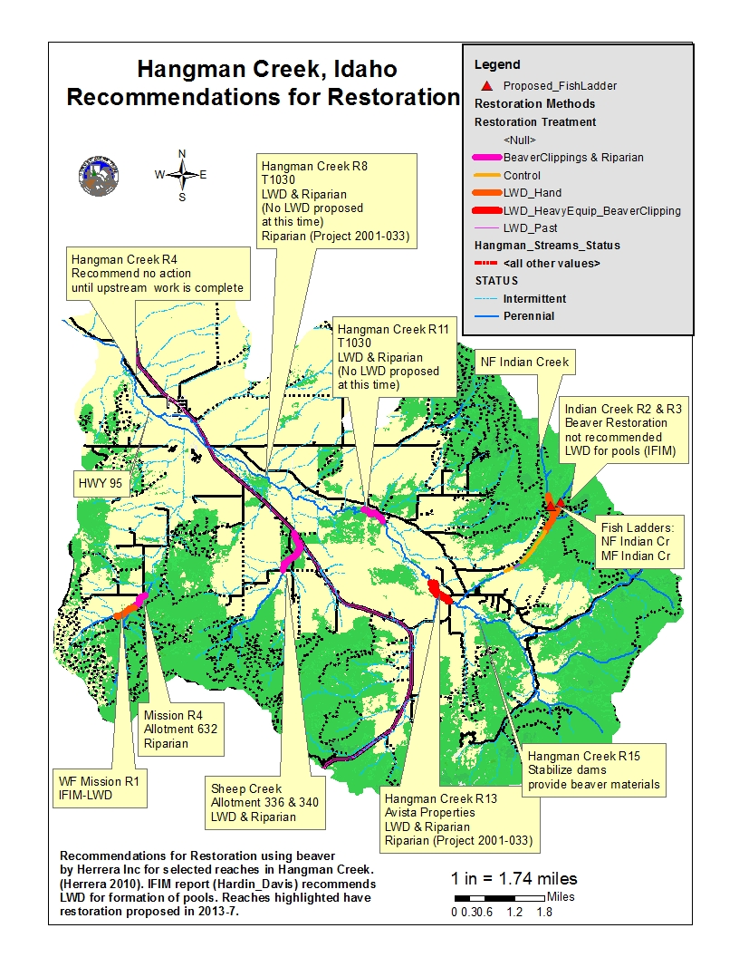
Restoration Proposed: Herrera Subcontract
- LWD: Heavy Equipment
- LWD: By Hand
- Riparian Enhancement
- Beaver Clippings
- Fish Ladders installed
Notes:
Beaver is the central theme to restoration of the mainstem of Hangman Creek as well as most of Mission and Sheep Creek as prioritized by Herrera Environmental Associates. The newly purchased Avista properties will be treated with beaver attracting structures using heavy equipment accounting for 1,200 m of stream as well as delivered beaver clipping. Three other locations will be treated with riparian enhancement and beaver clippings accounting for 3600 m of stream. Much of the work will involve bioengineering to repair sloughing stream banks.
We will also treat 1800 m of stream in the Indian Creek watershed, and 700 m in the WF Mission drainage with hand placed LWD.
Finally we will build 2 fish ladders as shown in our proposal in the Indian Creek drainage that will allow access to an additional 1400 m of stream

Slide 20
RME Elements
Pit tagging program to accompany summer electroshocking
Summer abundance estimates
Continuous Temperature Monitoring
Discharge
Habitat Surveys.
Notes:
The RME portion of the Hangman Fisheries project closely follows methods used the Coeur d’Alene Subbasin project in order to assess trends and the effectiveness of restoration.

Slide 21
Conclusions
Restoration will closely follow a clear progression of priority habitats
Beaver will be used as a cost effective means to agrade channels
Riparian enhancements will follow channel work
Long term goals of the project are met by efforts of the Project 2001-033
Short term goals are met by efforts of Project 2001-032
Notes:
Restoration will now done in order of priority rather than by opportunity. Beaver will be used as a central theme to agrade the channels and reconnect the floodplains.

