Slide 1

StreamNet
Project Overview for
Data Management Category Review
Bruce Schmidt
Pacific States Marine Fisheries Commission
Presented to:
NPCC Independent Scientific Review Panel
January 17, 2012

Slide 2
StreamNet Mission:
Facilitate the distribution and use of scientifically collected information on fish and aquatic resources and their habitats…
Why?
Data have been stored and managed locally, hard to obtain

Slide 3
Base Functions:
Disseminate data (locate, update, standardize, summarize, georeference, share)

Slide 4
StreamNet Data Flow
CRITFC
Tabular Query
IDFG
Interactive Maps
SN
Data-
base
MFWP
Web Services
PSMFC
Standardize
Georeference
Data Store
ODFW
USFWS
Source documents
SN
Library
Online Catalog
WDFW
CRITFC
PSMFC

Slide 5
Current Data Types
Redd counts
Spawner counts
Population estimates
Dam/weir counts
Hatchery returns
Age composition
Anad. fish distribution
Res. fish distribution
Fish Barriers
Hydrography
Facilities
  Dams
  Hatcheries
Protected Areas
Subbasin planning
Independent data (Data Store)
  Archive
  Metadata
Reference documents
  StreamNet Library contract

Slide 6
Basic Functions:
Disseminate Data
Support data system development
Assist regional data users
Support regional collaboration
  PNAMP
    Steering Committee
    Metadata Work Group
    Data Management Leadership Team
  CBFWA
    Data to SOTR report
    Data Management Framework Subcommittee
  Coordinated Assessments
    Lead DET development,
    Supplement agency infrastructure
    Tools
Shoulder data request workload

Slide 7
StreamNet Staffing
Current
Partner Staff FTE
PSMFC 5 4.5
IDFG 5 3.3
MFWP 3 2.0
ODFW 8 3.8
USFWS 3 0.2
WDFW 5 3.8
CRITFC* 5 3.2
Total 34 17.0
New Request
Partner Staff FTE
Colville 1 0.5
Sho Ban 1 0.5
Nez Perce* 3 3.0
Yakama* 1 1.0
Umatilla* 1 1.0
Warm Springs* 1 0.5
PSMFC 0 0.5
Total 8 1.5
& 5.5
Support from agency
Non-StreamNet work
* CRITFC and its member tribes are funded on other contracts

Slide 8
Regional Database Projects
StreamNet*
RMPC*
PacFIN
PTAGIS*
FPC
RecFIN
AKFIN
EFIN/AKFED
DART
SOTR
SPS
Fish related data, inland
Coded wire tag data, W coast
Marine harvest data, W coast
PIT tag data, Columbia Basin
Mainstem passage, smolt study
Marine recreational harvest
Marine commercial harvest, AK
Commercial fish economic data
Second tier data, some analysis
Dissemination of status information
ESA assessment data

Slide 9
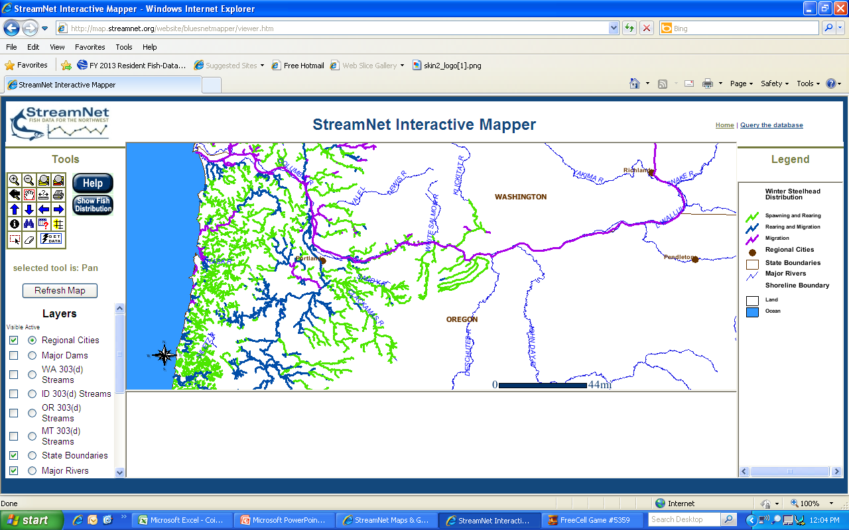

Slide 10
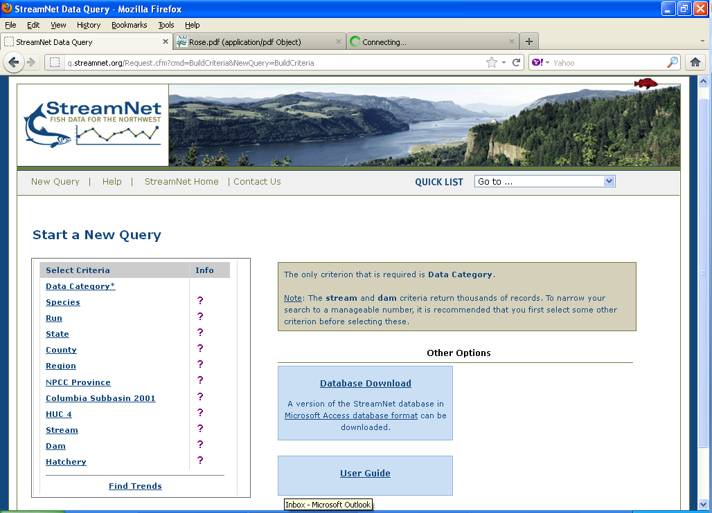

Slide 11
Project Results - Website Use

Slide 12
Project Results: % Use of Website
User type | Website | Query | Mapper | Combined
ISP | 68.4% | 36.1% | 43.4% | 52.1%
Federal | 10.4% | 24.0% | 32.9% | 21.8%
State | 15.5% | 28.4% | 11.1% | 16.8%
Consultant | 2.8% | 4.6% | 8.3% | 5.2%
University | 2.8% | 5.6% | 2.5% | 3.3%
County | 0% | 0% | 1.4% | 0.5%
School | 0% | 0% | 0.4% | 0.1%
Tribe | 0% | 0.4% | 0% | 0.1%

Slide 13
New Directions
Expand data types
Change Emphasis
Increase tribal support
New Data Query
Response to Coordinated Assessments:
Derived estimates (VSP Indicators):
  Natural Origin Spawner Abundance
  Adult to Adult Return
  Smolt to Adult Return
Expand from there
Toward distributed database technology
StreamNet data as web services
Provide temporary technical support for agencies
Support data system develop in agencies
Enable automated conversion to data standards
Speed data assembly
Requisite for distributed data dissemination
Become members
CA data assembly
Data system development
Tribal data to StreamNet

Slide 14
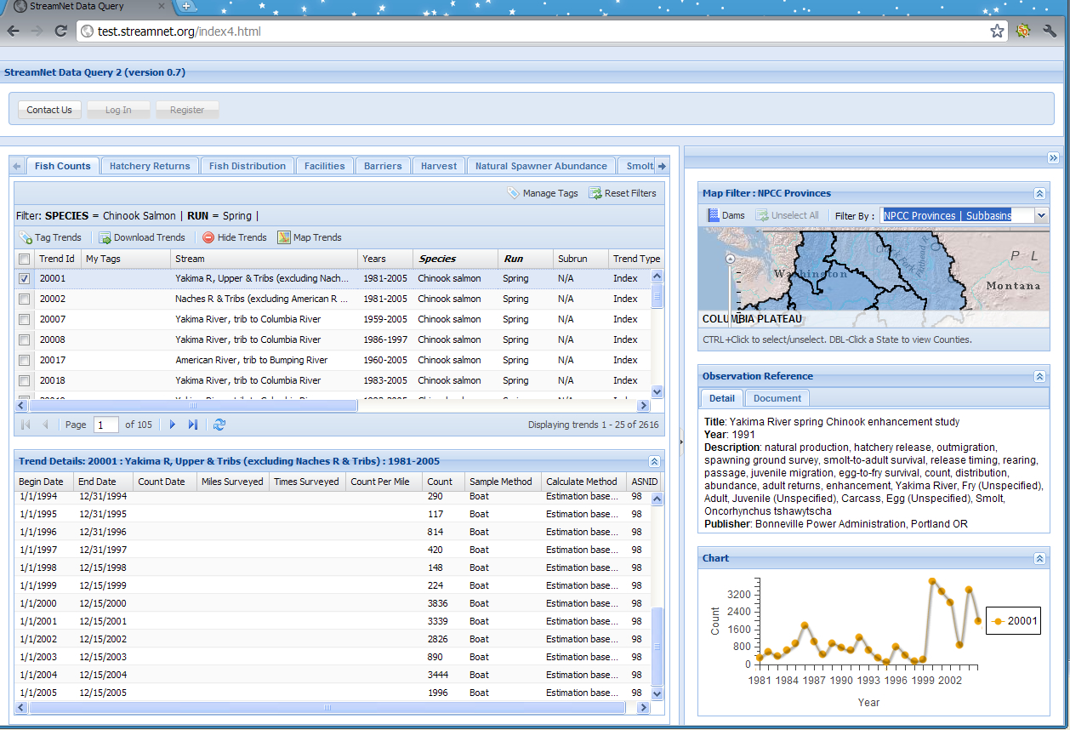

Slide 15
Implications for Fish Management
Consistent access to hard-to-find data:
  Data for High Level Indicators, SOTR, regional reports, population assessments, etc.
  Interoperable data
    Better ability to do assessments across agencies
    Wider scale analysis
A/T internal database systems:
  Increase speed of data location, assembly
  Automated (faster) conversion to standards
  Consistent data
  Result: Faster analysis
  Ability to host data as web services

Slide 16
Implications for Fish Management
Bottom line:
Access to current, consistent, transparent and reliable data to support wide scale fish management

Slide 17
Conclusions/Lessons Learned
Embedding data specialists in agencies works
We have successful data dissemination tools
  Tabular data query
  Interactive maps
  Data Store archive
  Data/metadata as web services
  Library of source documents
“…thanks a lot! I hope you have a great New Year's and had a great Christmas. You have put together a very good web page and data system. I use it a lot and am grateful for it.” Received 12/27/2011

Slide 18
Conclusions/Lessons Learned
Embedding data specialists in agencies works
We have successful data dissemination tools
Growing interest in sharing data
Can’t get more people, so need better use of technology
StreamNet’s role will have to continue to adjust
Collaborative, regional guidance is needed
  Data priorities
  Regional strategy
  CA is providing useful guidance

Slide 19
Will Need in the Future:
Continued dissemination of updated data sets
And, new emphasis on:
Add new types of data
Regional data standards
  Define what will be shared
  Definitions
  Formats
Data coordinators in the agencies
Agency capacity to manage data internally and to host data as web services
Central ‘Exchange Network’ interface & tools

Slide 20
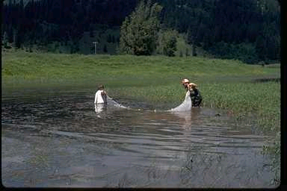
Questions?

