Slide 1
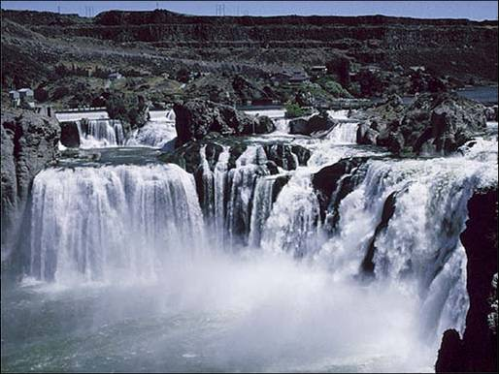
The Upper Snake River Tribes
“For those who lived along the waterways of the Salmon and its tributaries or along the Snake below Shoshone Falls, anadromous fish were the primary aquatic food source.”
  Rivers and Fisheries of the Shoshone-Bannock Peoples, by Patricia Albers 1998.
Notes:
Good afternoon, My name is Chad Colter, Interim Executive Director for the Compact of the Upper Snake River Tribes
On behalf of the Upper Snake River Tribes I would like welcome the Council to the Upper Snake River and thank you for providing us with an opportunity to inform and educate.
Introductions of Staff: Jason Kesling, Buster Gibson, and Daniel Stone
These Folks are here to provide you with an overview of their respective Fish and Wildlife projects.
But First I would like to take a minute to tell you about the Upper Snake River Tribes

Slide 2
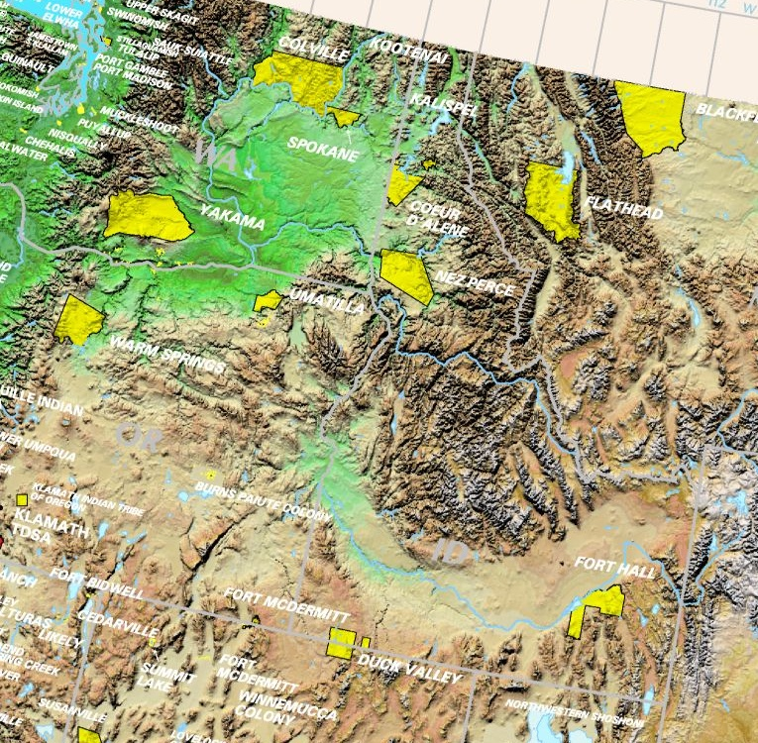
Notes:
In 2007 the Shoshone-Bannock Tribes, Shoshone-Paiute Tribes and Burns Paiute Tribes stood at a Council meeting here in Boise and shared the signing our Upper Snake River Tribes Charter.
An event that I believed showed our unity and willingness to work together on tough resource issues.

Slide 3
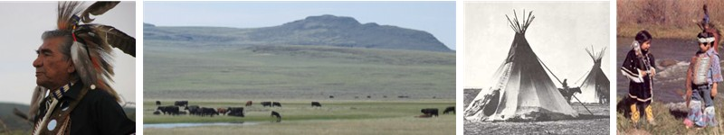
USRT Policy Statement
  The Compact of the Upper Snake River Tribes will work to ensure the protection, enhancement, and restoration of natural and cultural resources, activities, and rights of the Compacting Tribes that are reserved by Treaties and Executive Orders, protected by federal laws and agreements, or are the subject of aboriginal claims asserted by the Tribes.
Notes:
Through this Charter, the USRT will pursue, promote and initiate efforts to restore the Snake River Basin, its affected tributaries and lands to a natural condition; and,
facilitate Tribal unity to protect and nurture all Compacting Tribes’ rights, languages, cultures and traditions in addressing issues related to the Upper Snake River Basin.

Slide 4
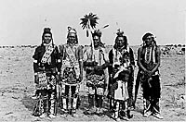
USRT MEMBERSHIP
Shoshone-Paiute Tribes
  Duck Valley, Idaho/Nevada
Shoshone-Bannock Tribes
  Fort Hall, Idaho
Burns Paiute Tribe
  Burns, Oregon
Paiute-Shoshone Tribes
  Fort McDermitt, Nevada
Notes:
The Upper Snake River Tribes membership has grown since we signed our charter back in 2007, the Paiute-Shoshone Tribes of Fort Mcdermitt, Nevada became members in 2009.
We have also established a USRT Office in Eagle, Idaho; and we are in the final year of our BPA Regional Coordination Contract.

Slide 5
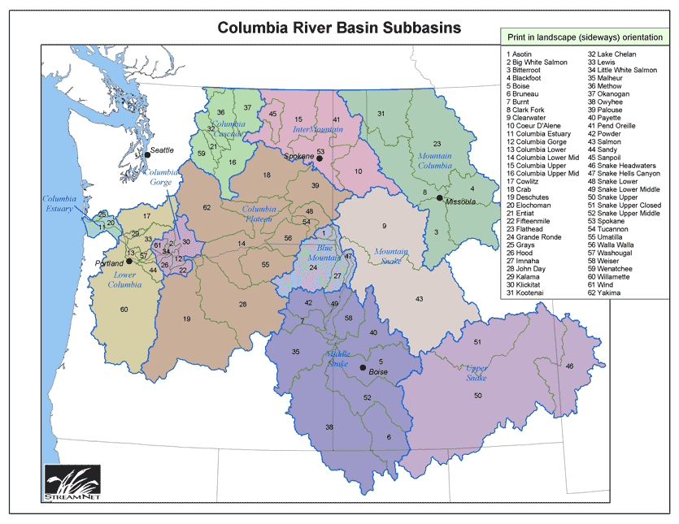
Fish & Wildlife Mitigation
Notes:
Our member tribes sponsor fish and wildlife mitigation projects through the Council’s Fish and Wildlife Program.
We sponsor anadromous, resident fish and wildlife projects in the Middle Snake, Upper Snake and Mountain Snake Provinces.

Slide 6
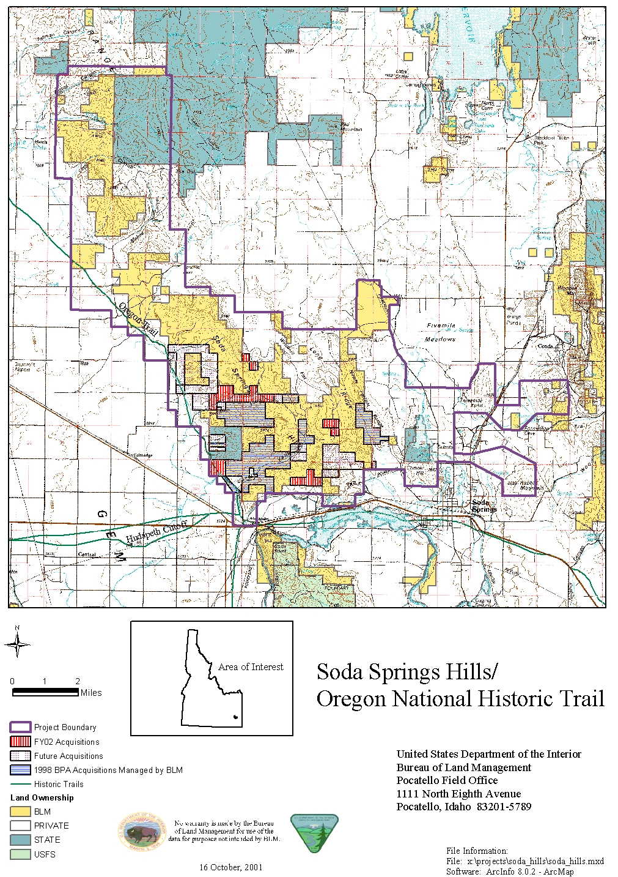
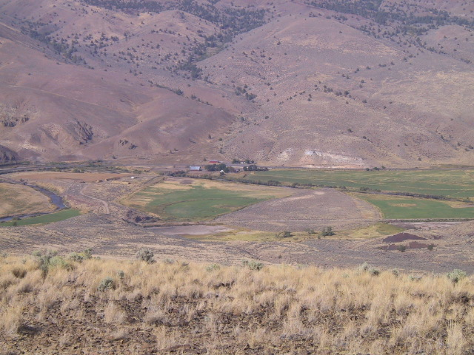
Wildlife Mitigation
Malheur River parcel
Notes:
We’ve protected through acquisition over 12,000 acres of wildlife habitat

Slide 7
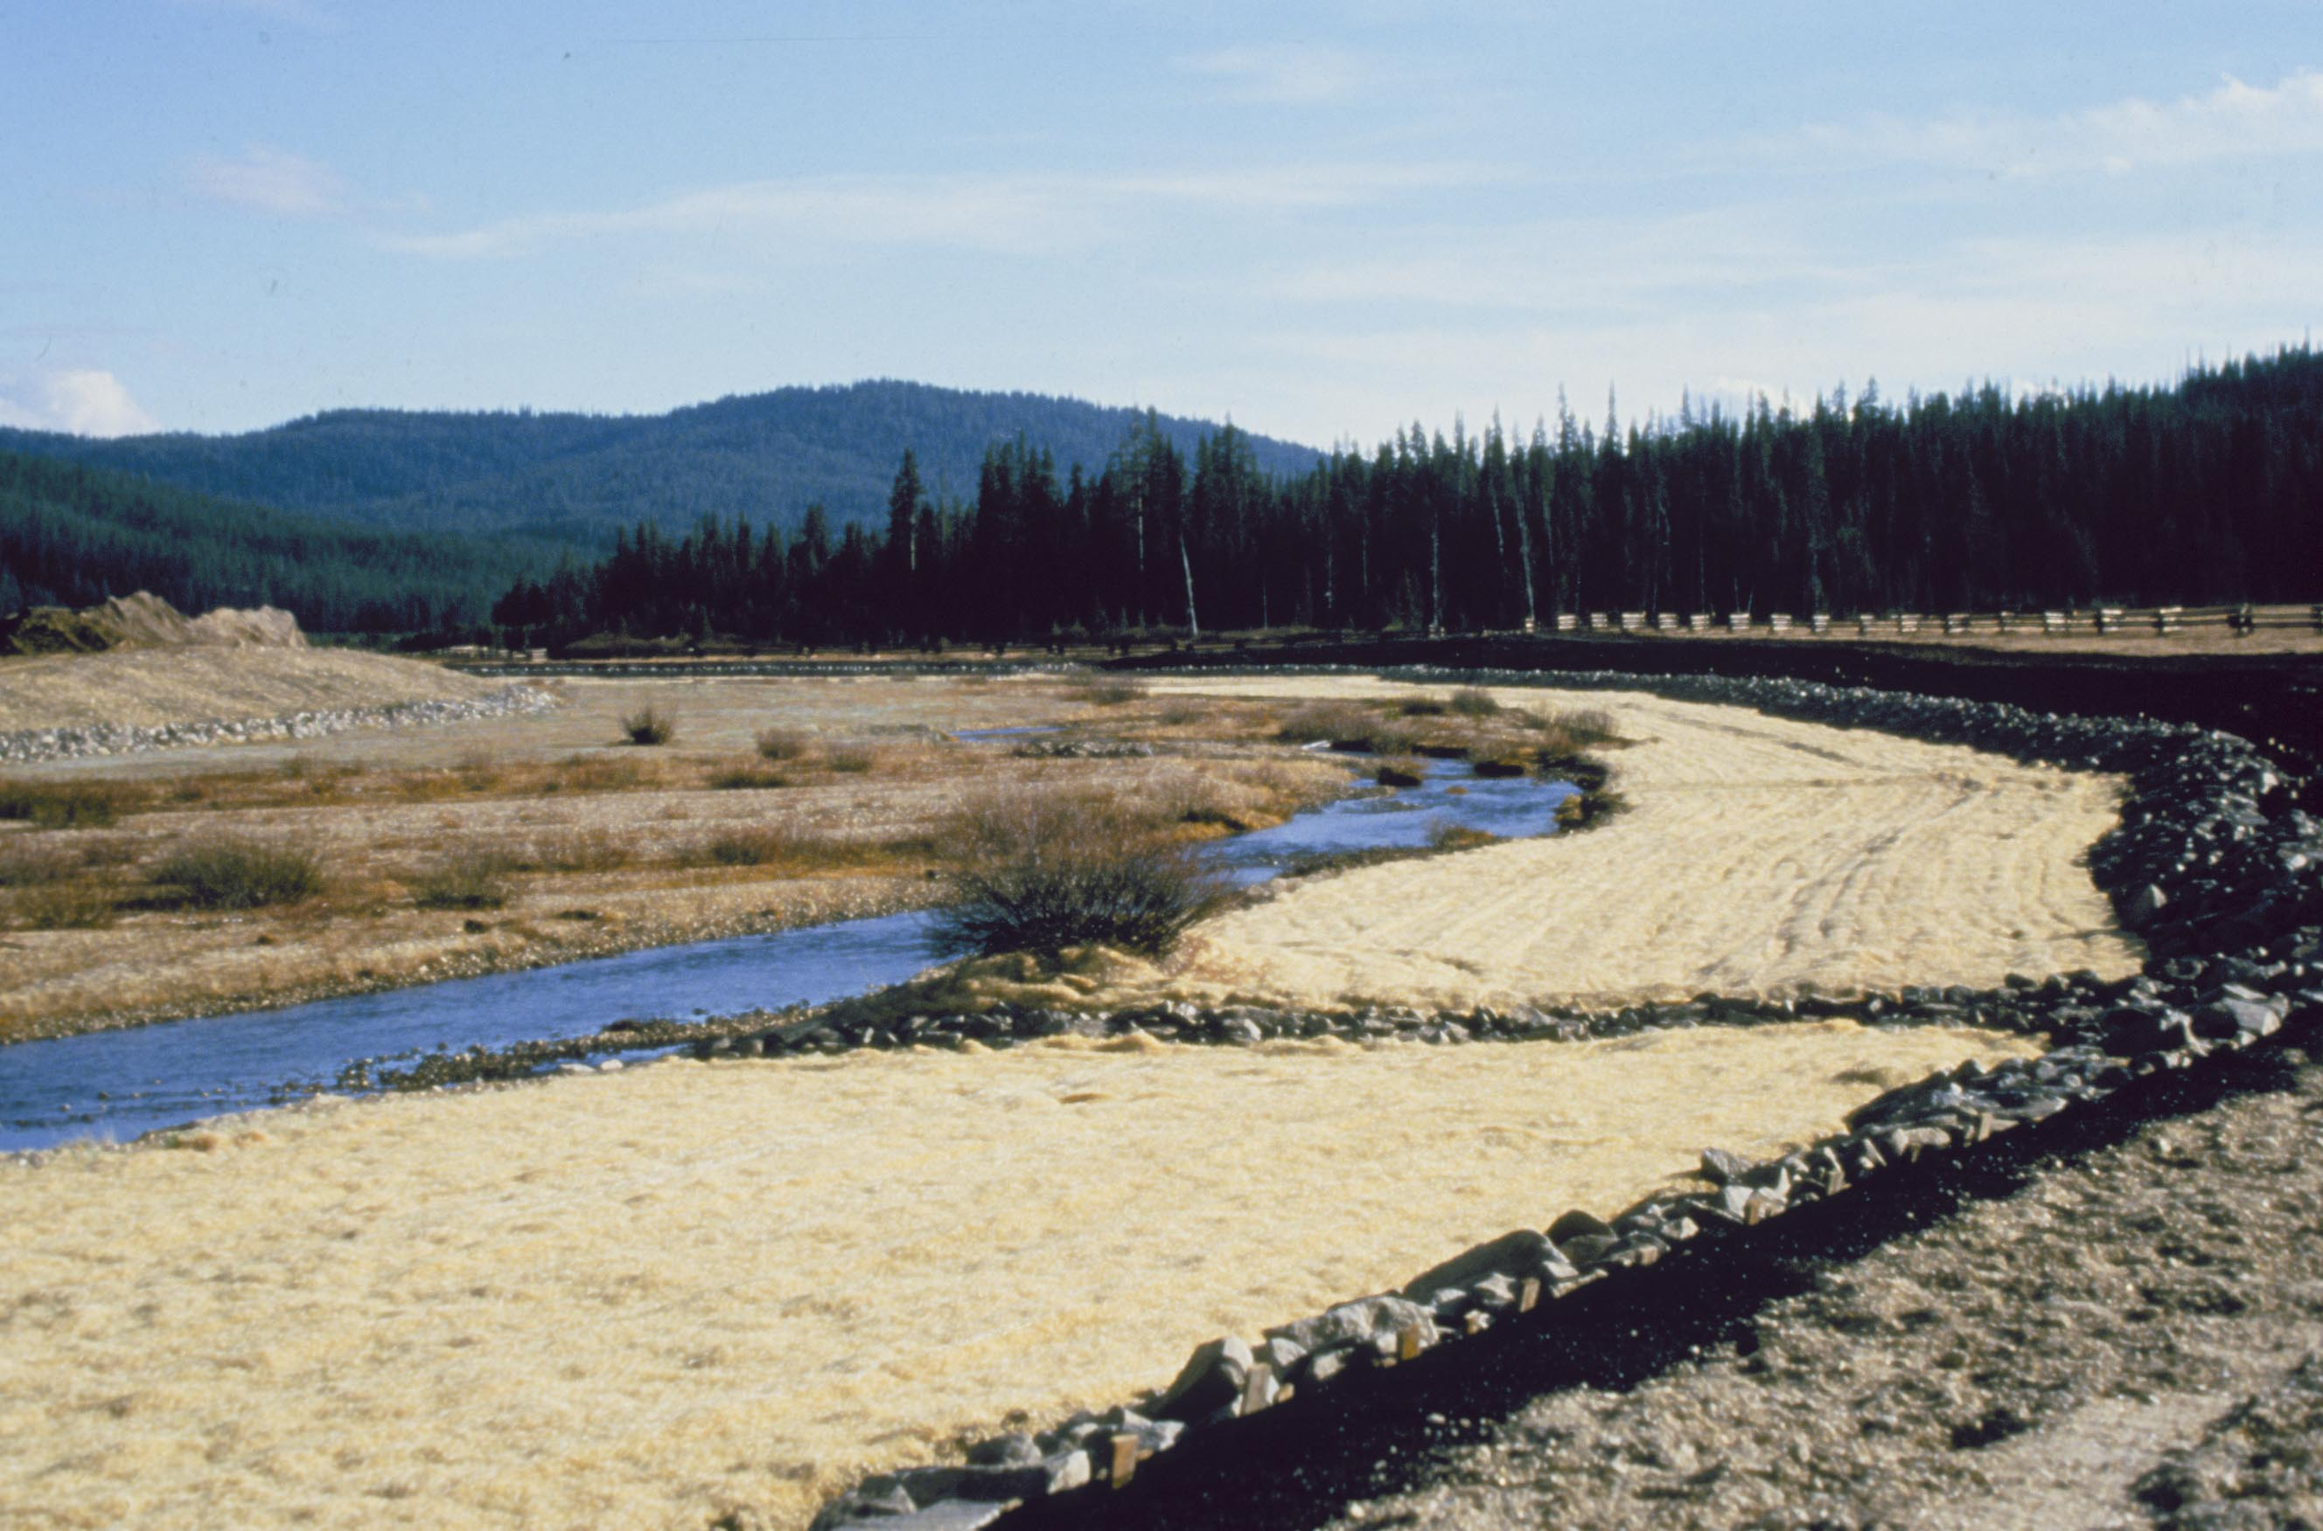
Bear Valley Reconstruction
Notes:
We’ve contributing to habitat enhancement through reconstruction efforts.

Slide 8
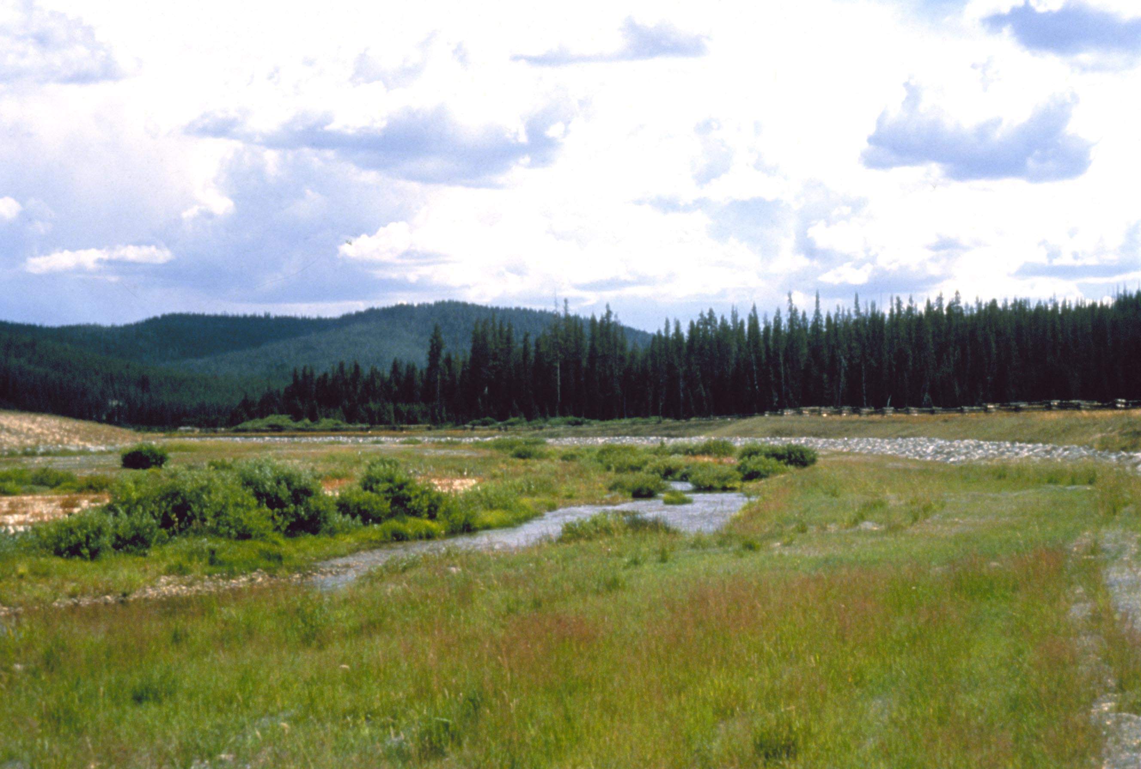
Bear Valley After Reconstruction
Notes:
Eliminated 2.5 km dredged area as source of fine sediment to Bear Valley Creek and Middle Fork Salmon River
Significant decreases in surface fine sediments within and below enhancement site
Significant increases in non-anadromous salmonid densities in pools within and below enhancement site

Slide 9
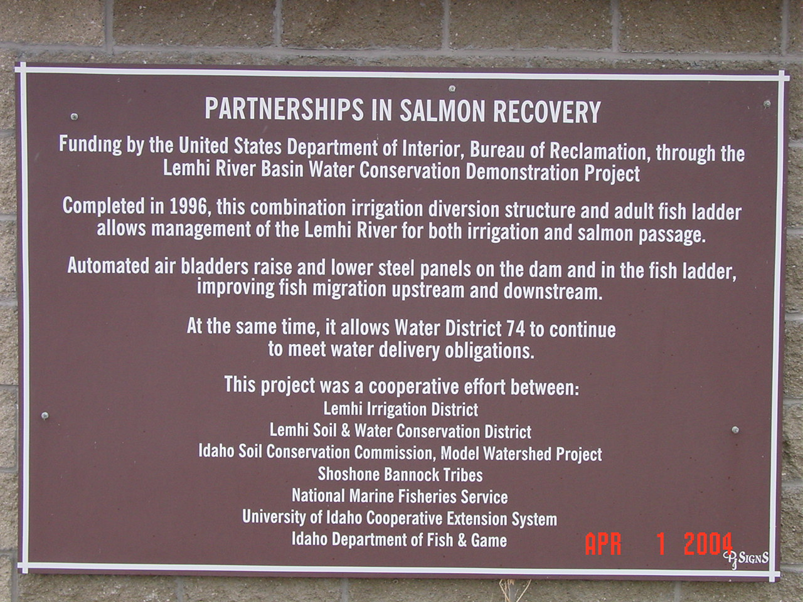
Notes:
We’ve participated in Partnerships

Slide 10
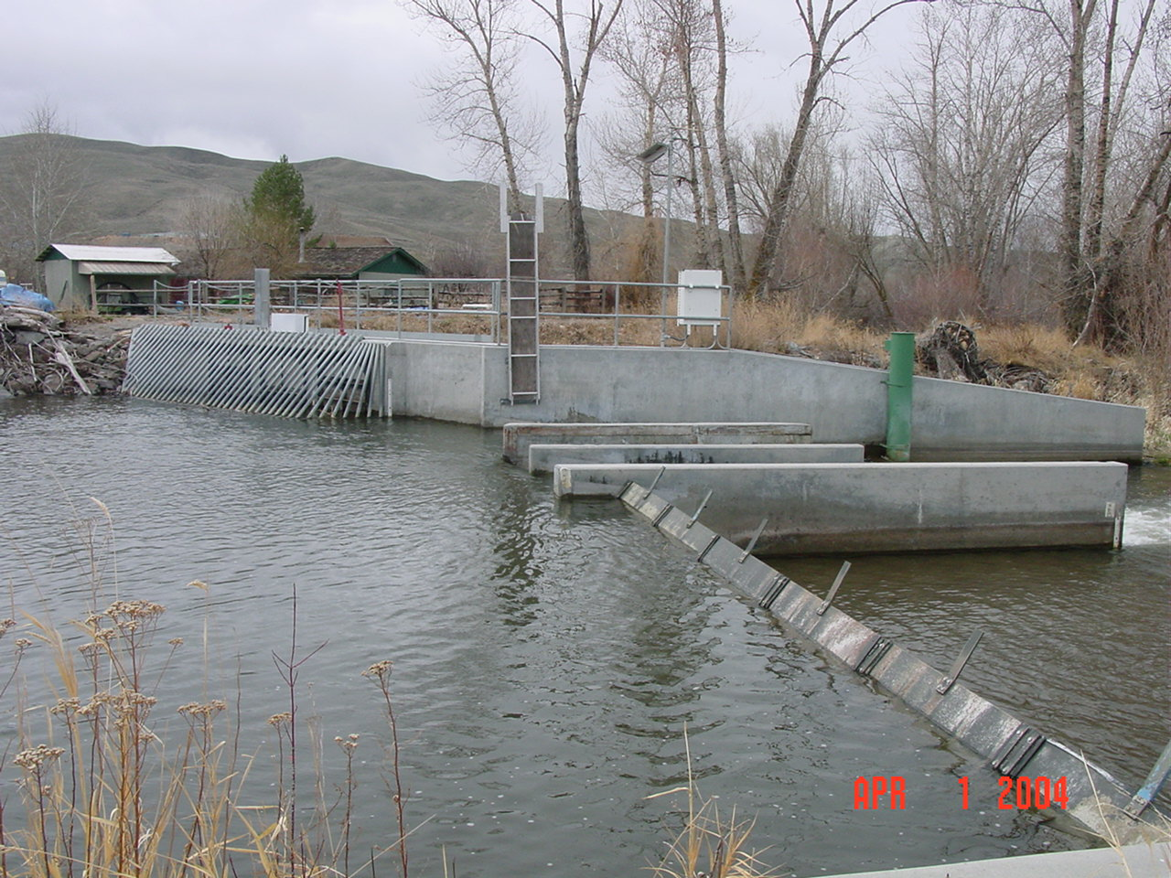
Lemhi River
Diversion Consolidation

Slide 11
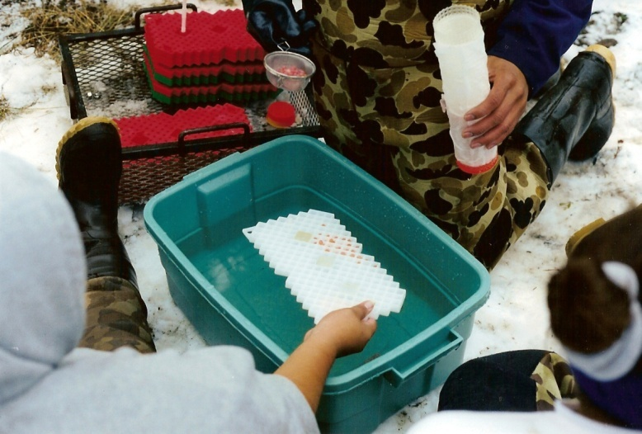
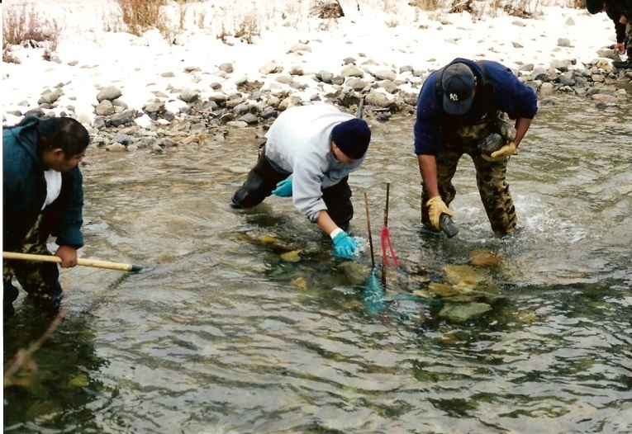
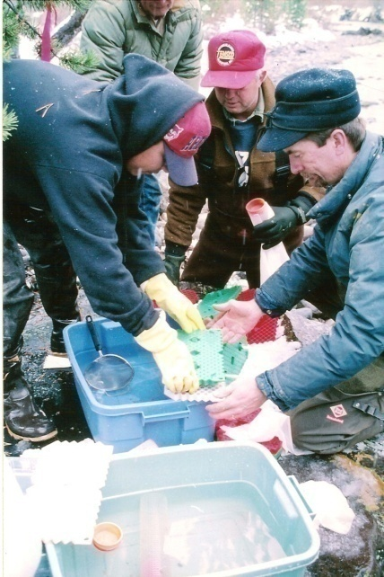
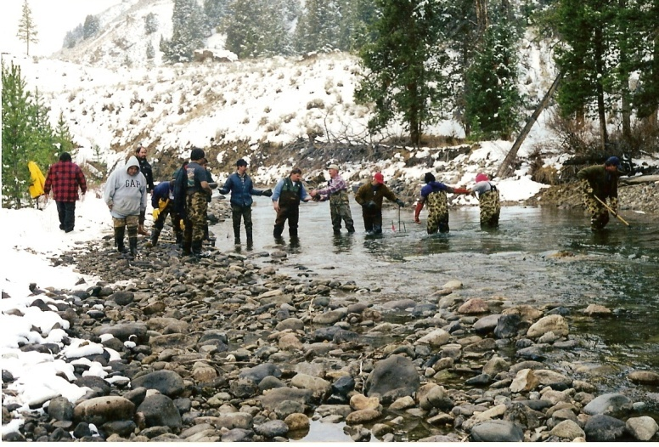
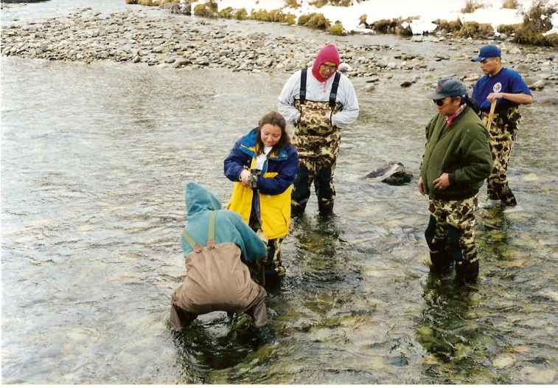
CHINOOK EGG OUTPLANTING
East Fork of the Salmon River
Forest Service, BLM, IDFG and our Tribal youth
Notes:
We’ve spearheaded efforts to provide for production through simple low-tech and low cost production Techniques
We work with our youth and other natural resource co-managers to build partnerships

Slide 12
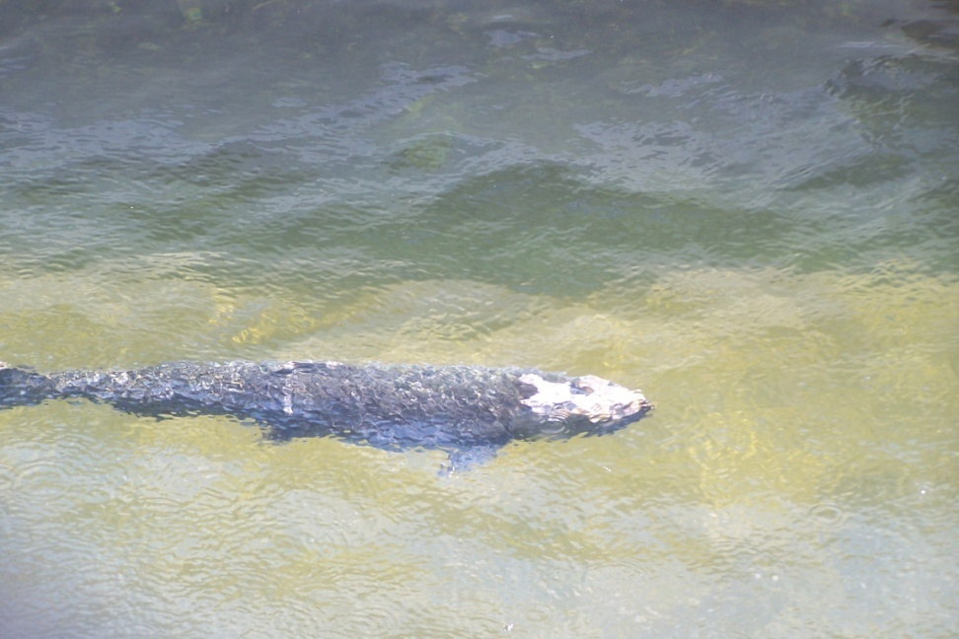
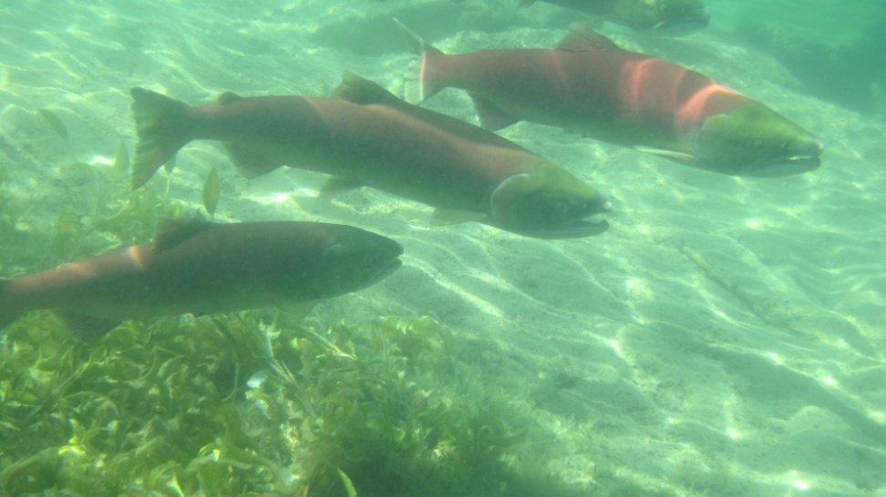
The Snake River
Average annual fish harvest from 1992-2006 for the Shoshone-Bannock Tribes was ~ 200 salmon/ year… 0.6 lbs. of salmon/person.
Notes:
The Snake River and its tributaries is the lifeblood of the Shoshone, the Bannock and Paiute peoples.
The chinook, sockeye, steelhead, sturgeon, lamprey, mussels, and trout that once sustained the people of the Snake River, have been blocked from a large portion of its historic range in Idaho.
Those remaining native stocks are listed as endangered or threatened.
Only the lower Snake, Salmon and Clearwater provide for Idaho’s anadromous fishery.

Slide 13
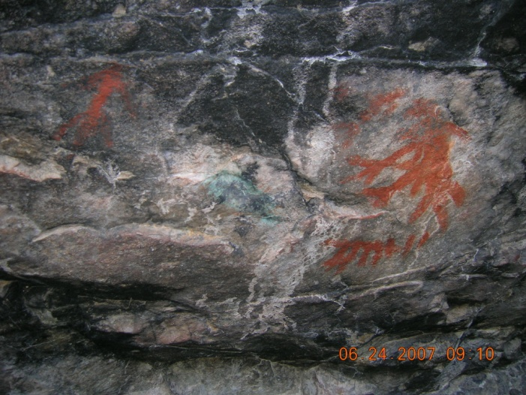
The Future
Notes:
The Upper Snake River Tribes seek to:
Provide future generations the opportunity to exercise reserved treaty, executive order and inherent rights.
Provide for the reintroduction of anadromous fish through out historic range
Provide for adequate water quantity and quality
Protect cultural resources, traditional cultural properties and Practices

