Slide 1

Chief Joseph Kokanee Enhancement
Project 1995-011-00
Presented by: Holly McLellan
Shay Wolvert, Charlie Joseph, Todd Nanamkin, and Arkie Andrews

Slide 2
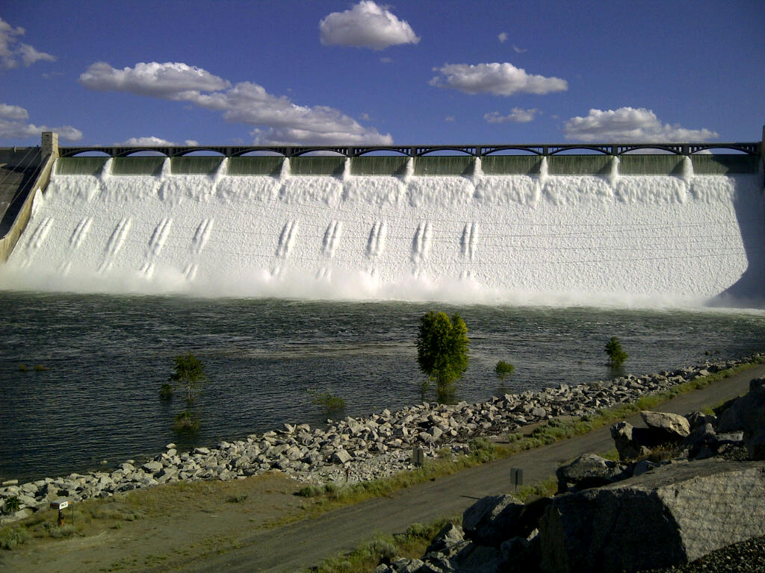
Project Goal
Protection and enhancement of naturally reproducing kokanee populations in the blocked area above Chief Joseph Dam to support tribal subsistence and non-tribal recreational sport fisheries
Notes:
The Chief Joseph Kokanee Enhancement Project’s goal is the
Protection and enhancement of naturally reproducing kokanee populations in the blocked area above Chief Joseph Dam to support tribal subsistence and non-tribal recreational sport fisheries

Slide 3
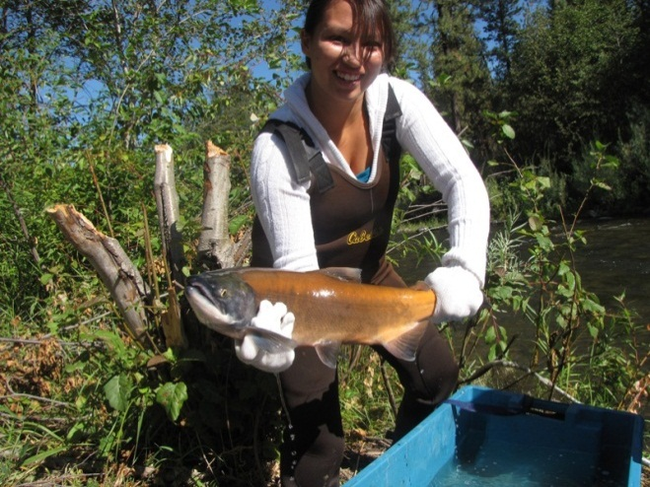
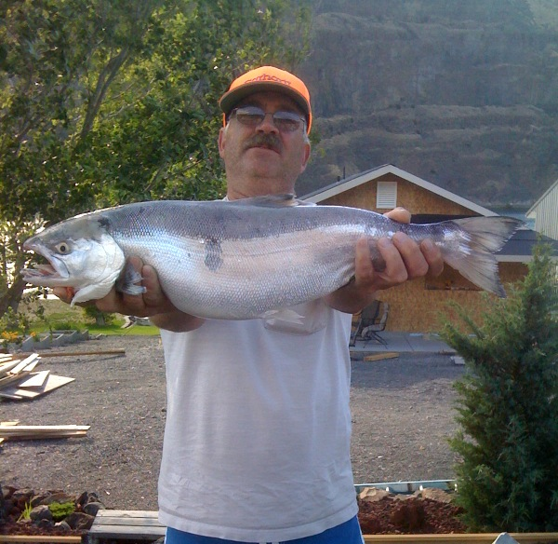
Project Objectives
  Objective 1: Establish a run of naturally produced kokanee salmon in select tributaries on the Colville Confederated Tribes Reservation that supports tribal and recreation fisheries
  Objective 2: Enhance the wild kokanee population found within Lake Roosevelt
  Sub-objective: Facilitate the development of a Colville Tribe Resident Fish Database (expected completion 2013)
Notes:
The CJKEP program has 2 primary goals.
Objective 1: Establish a run of naturally produced kokanee salmon in select tributaries on the Colville Confederated Tribes Reservation that supports tribal and recreation fisheries
Objective 2: Enhance the wild kokanee population found within Lake Roosevelt
Sub-objective: Facilitate the development of a Colville Tribe Resident Fish Database (expected completion 2013)

Slide 4
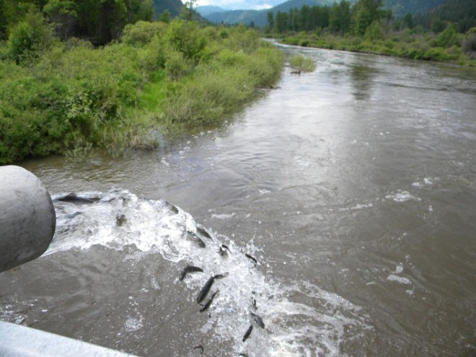
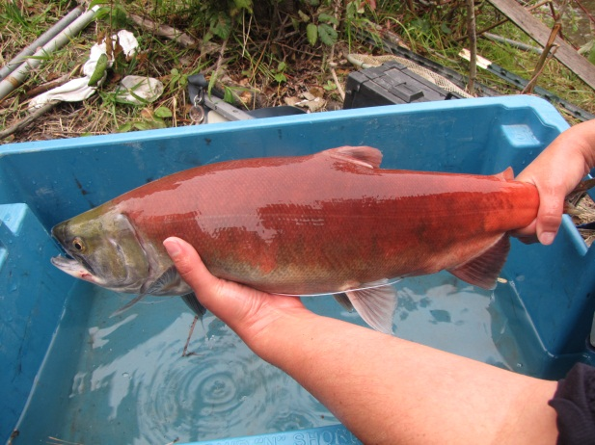
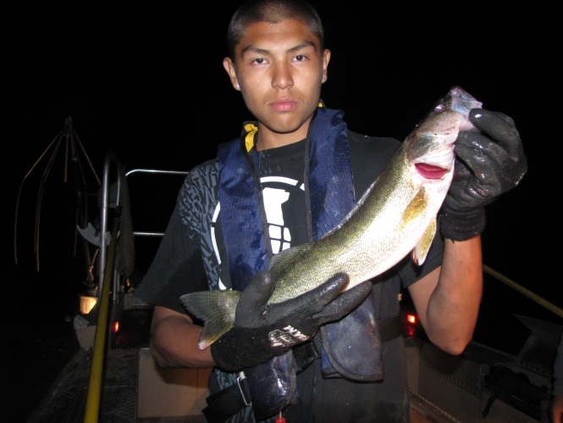
Objective 1
Establish a run of naturally produced kokanee salmon
Selected the Sanpoil River for kokanee enhancement
  Stocking
  Monitoring
  Non native predator reduction
Notes:
To achieve the first goal, the Project has selected the Sanpoil River for kokanee enhancement.
The Project will use stocking, monitoring, and non-native predator reduction to achieve this goal.

Slide 5
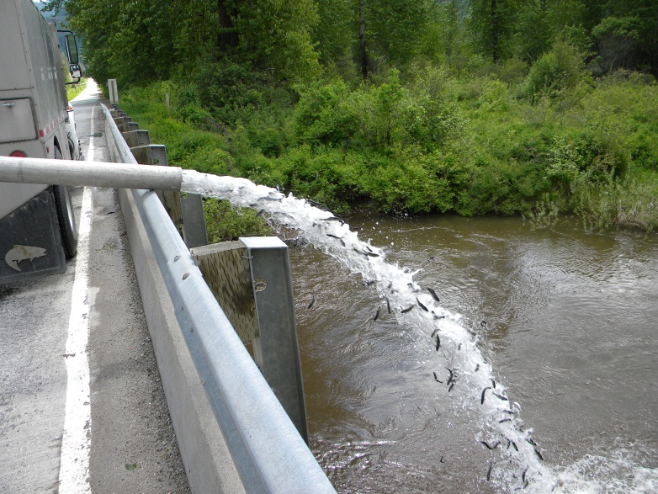
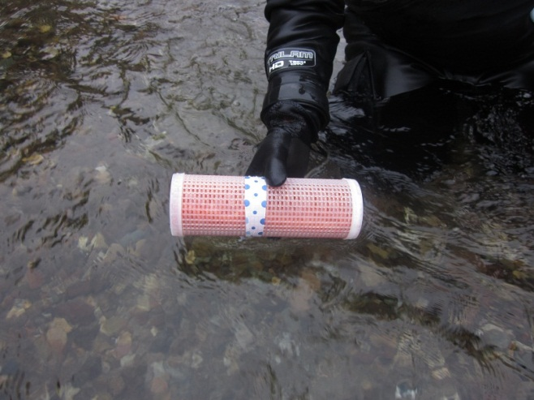
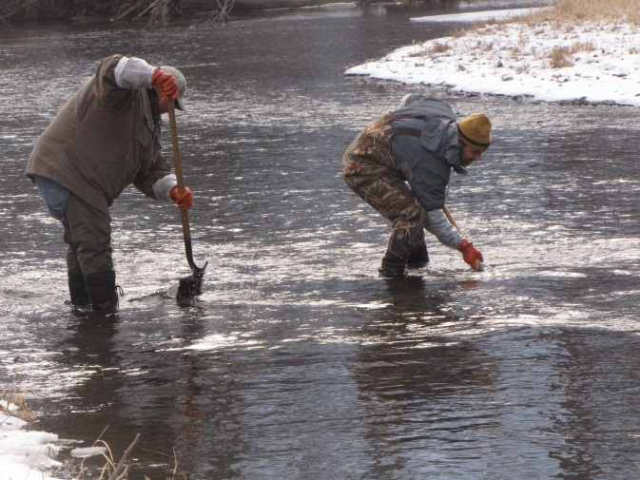
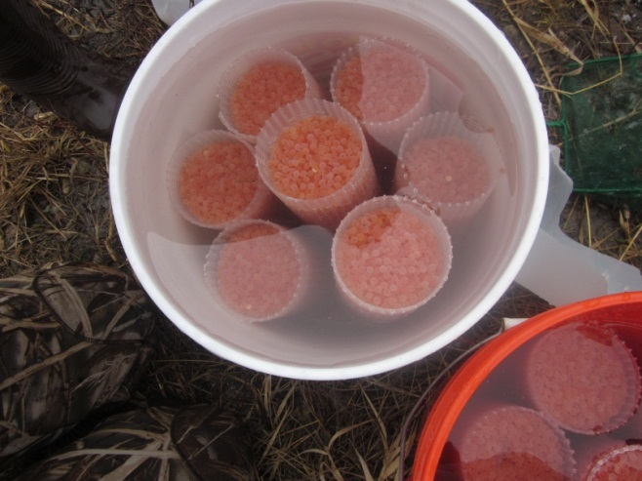
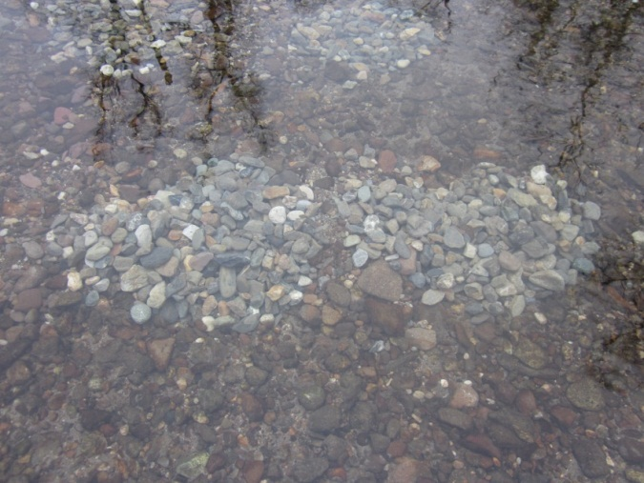
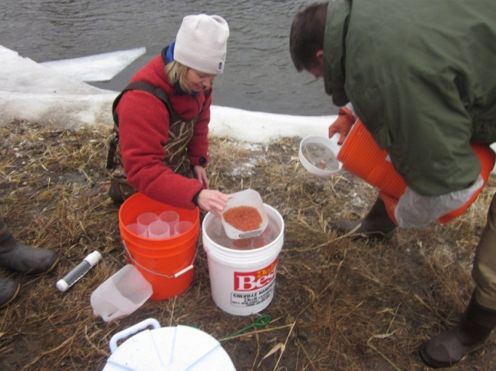
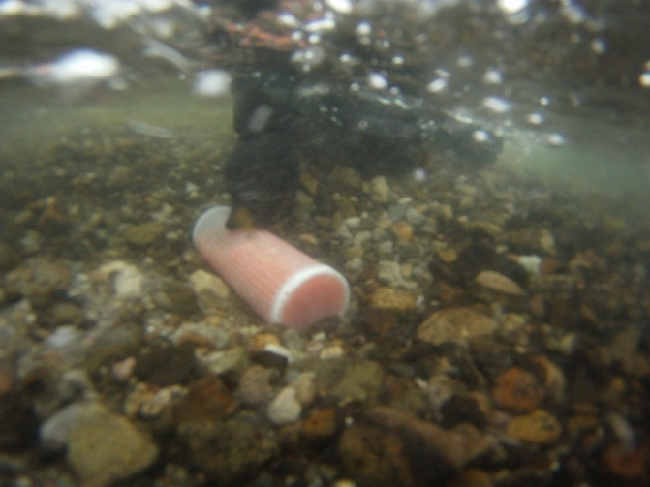
Stocking
Yearling Plants (through 2017)
  20,000 ad clipped annually through 2017 from Bridge Creek bridge
  Effort coordinated LRFEP
Egg Plants (through 2017)
  3 sites; 1 million otolith marked eggs per year
  Eggs purchased from WDFW
  Egg tubes = 6,000 eggs
Notes:
We will utilize kokanee yearling plants and kokanee eggs for our stocking efforts. The project plans to stock 20,000 kokanee yearlings from Bridge Creek bridge annually through 2017. These fish are part of the Lake Roosevelt Fisheries Evaluation Project program. This effort is coordinated with the Spokane Tribe and the WDFW.
The Project plans to purchase 1 million eggs from the WDFW captive brood stock in Spokane. The eggs are otolith marked by WDFW in the Spokane Hatchery. We selected 3 sites within the Sanpoil River that have adequate gravels and flows for kokanee spawning.
1) We utilize eggs tubes for planting, each tube holds about 6,000 eggs. The eggs are loaded into the tubes, capped and labeled,
2) A redd is dug, tube placed in the gravel, then fresh gravels are shoveled onto the tube.

Slide 6
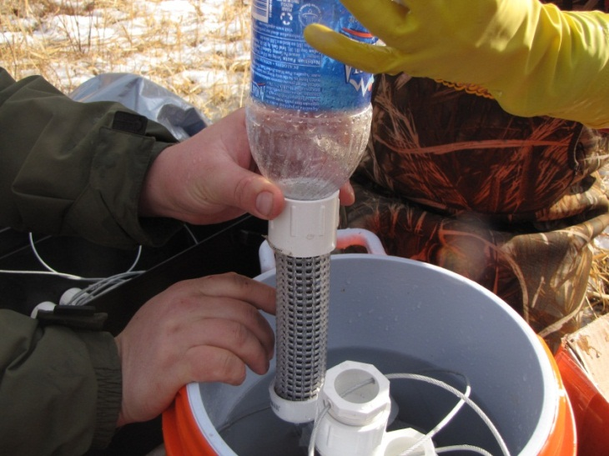
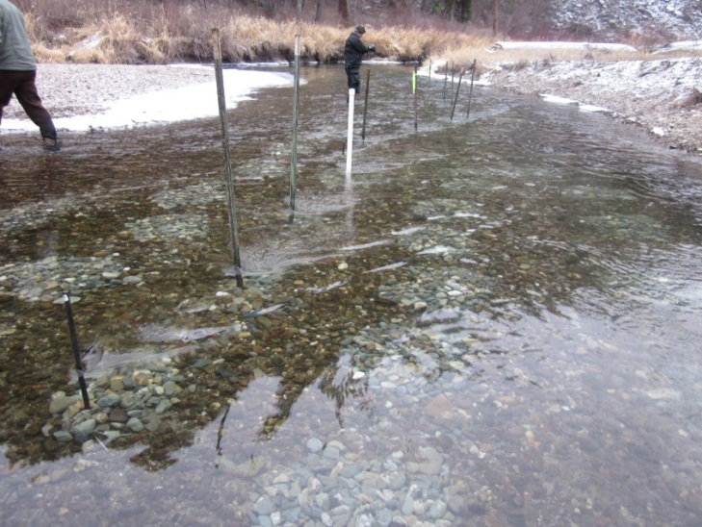
Monitoring
Egg to fry survival study to ensure survival to out-migration is not a limiting factor
48 experimental egg tubes
  2 sites : 12 tubes with 500 eggs
  1 site : 24 tubes 1,000 eggs
Monitor tubes for 10 weeks
  Egg to alevin survival during gravel burial
  Growth
  Emergence times
  D-Ring nets
  Juvenile size and outmigration timing
Developmental parameters correlated with physical parameters
  DO, Temperature, pH, and fine sediments
Notes:
An egg to fry survival study is being conducted to ensure survival to out-migration is not a limiting factor for kokanee in the Sanpoil River.
We placed 48 experimental tubes at the 3 egg sites, 2 sites have 12 tube with 500 eggs in each, and 1 site has 24 tubes with 1,000 eggs in each tube.
Beginning the 3rd week of January, one tube will be removed from the gravels at each of the sites for 10 weeks to determine egg to alevin survival, determine growth, and emergence times.
D-Ring nets will be used to determine size and outmigration timing.
The developmental parameters will be correlated with physical parameters (dissolved oxygen, temperature, pH, fine sediments).
Discuss picture.

Slide 7
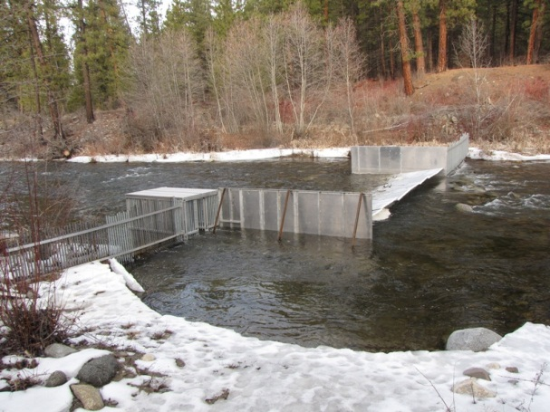
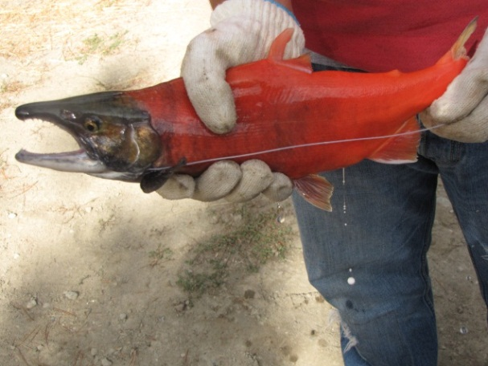
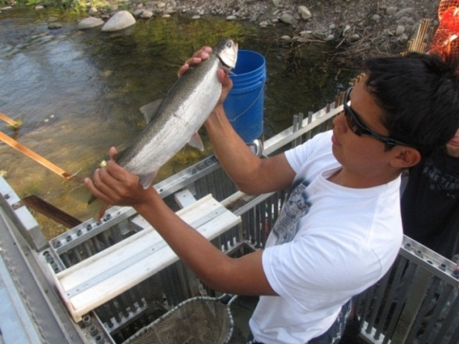
Monitoring
Adult Escapement
A resistance panel weir is used to capture adult migrating fish.
Kokanee escapement monitoring
  August – November (early and late run kokanee)
Biological data collected on all fish
Efforts planned through 2017
Notes:
The Project will monitor adult escapement back to the Sanpoil River with a resistance panel weir that will capture migrating adult fish.
Kokanee escapement monitoring begins early August and lasts until late November to capture both early and late run kokanee.
Standard biological data will be collected, we anticipate this collection occurring through 2017.

Slide 8
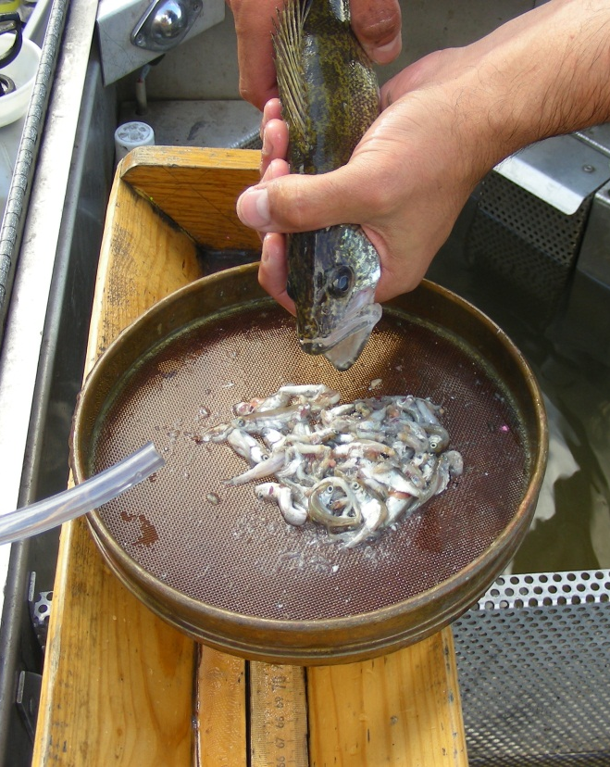
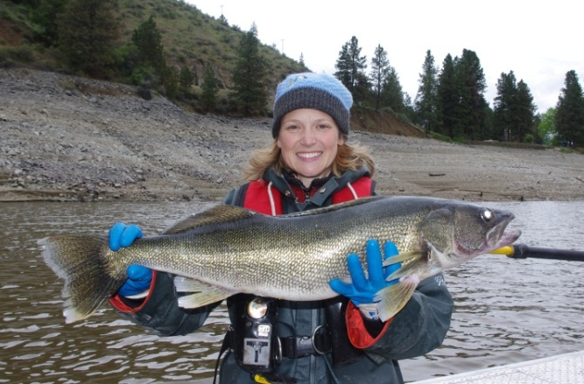
Predator Reduction
Implemented because bioenergetics model study indicated walleye and bass consumed (Stroud et al. 2011)
  95% kokanee fry released
  40% kokanee yearlings
  27% age 2 and 3 redband rainbow trout
Impacts detrimental to the recovery of kokanee and redband trout in Sanpoil River
Notes:
Predator Reduction has been implemented as part of this program because a bioenergetics study conducted in 2009 and 10 determined walleye and smallmouth bass consumed 95% of the kokanee fry released, 40% of the kokanee yearlings, and 27% of the age 2 and 3 redband rainbow trout.
The impacts from this level predation are detrimental to the recovery of kokanee and redband trout in the Sanpoil River.
As you can see from the picture, this average size walleye had gorged himself on kokanee fry.

Slide 9
Predator Reduction
Goal: remove non-native predators in the bottleneck area without negatively impacting native fish
Bioenergetics study indicated bottleneck
Non-native predator removal
  Peak out-migration May – June
  Electrofishing and gillnetting
    2 net sets and 2 nights E-fishing per week
    Study gill net mesh size and orientation.
Weekly hydroacoustics used to monitor the fish population density changes over time
Sacrificed fish provided to tribal members
Efforts planned annually through 2017
Notes:
The goal of our predator reduction program is to “remove non-native predators in the bottleneck area of the Sanpoil Arm without negatively impacting native fish”
The bioenergetics model indicated this 3 km section near the reservoir/ river interface as a primary spot for the heavy predation on out-migrating fish.
Predator removal occurs during the peak kokanee and rainbow trout out-migration periods, May through June.
We use boat electrofishing and experimental gill nets two nights a week during the study period.
We have implemented a study to monitor catch by gill net mesh size and gill net orientation.
Weekly hydroacoustics surveys are used to monitor population densities over time. We have sub-contract LGL Limited to analyze the data for us.
Sacrificed fish are provided to the tribal members for subsistence.
We are planning on continuing predator reduction through 2017.

Slide 10
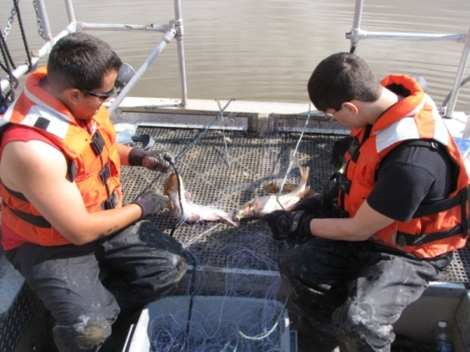
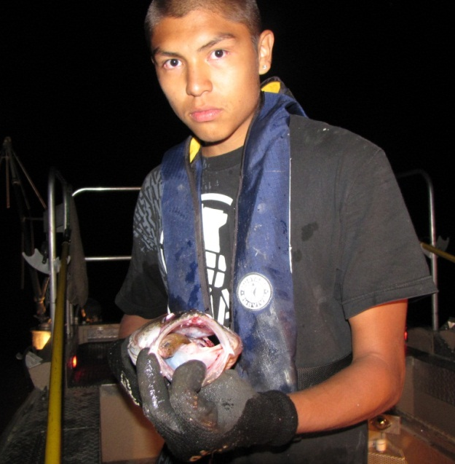
2011 Predator Study
Captured 2,359 fish
1,108 walleye and 439 smallmouth bass
Notes:
During the 2011 study, we captured 2,359, which included 1,108 and 439 smallmouth bass. Boat electrofishing removed the most walleye and bass, and had the least impact to other fish species; however it was also the most labor intensive.
Gill nets were the least labor intensive and also captured the target species. We captured more burbot that we would have like, however most of these were released alive. Impacts to kokanee and rainbow trout were minimal.
Note walleye with kokanee in its mouth.

Slide 11
2011 Predator Study
Gill net mesh sizes
Notes:
We experimented with gill net mesh size that ranged from 1 to 6 inch stretch mesh to determine if we could utilize certain mesh sizes to increase predator catch while reducing impacts to native fish.
Walleye were primarily captured in the 2 and 2.5 inch stretch mesh, while kokanee and rainbow trout were most susceptible to 1.5 inch mesh.
The burbot tended to recruit to the larger 3 and 4 inch mesh sizes).
We plan to repeat this study in 2012 to see if we get similar results before implementing net with new mesh sizes.

Slide 12
2011 Predator Study
Gill net orientation: parallel vs. perpendicular
Notes:
We also experimented with gill nets set parallel and perpendicular to the shoreline.
Gill nets are typically set perpendicular to the shoreline. However, it was hypothesized that nets set parallel to shore might capture more walleye and less rainbow trout because trout tend to cruise the shoreline at night and might avoid a parallel set, and walleye tend to diel migrate, therefore making them more susceptible to parallel nets.
Walleye did appear to recruit to parallel sets at a higher rate. It didn’t seem to matter for smallmouth bass, or rainbow trout. The kokanee sample size was too small to tell. However burbot clearly recruited to perpendicular sets at a higher rate then parallel sets.
When we graph walleye capture by date, the results give a different picture. Here we see parallel sets capturing more fish, until the peak in mid-June, then perpendicular sets capture more fish until it leveled off at the end of the study. We are not sure why this happened, maybe it has to do with walleye migration timing, the removal impacts, or reservoir operations.
We plan on repeating this study again in 2012 to verify our results.

Slide 13
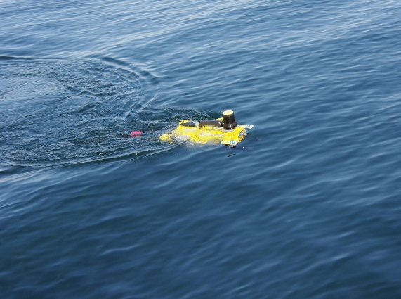
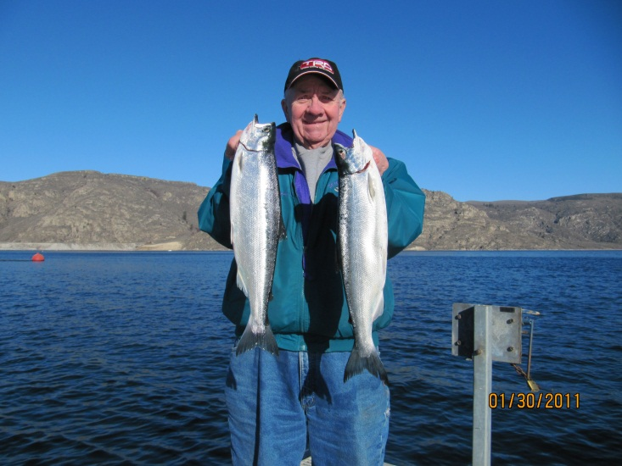
Objective 2:
Enhance the wild kokanee population found within Lake Roosevelt
Locate the wild spawning population
Genetics study: genetically distinct Lake Roosevelt stock of kokanee (Kassler et al. 2010)
Conduct deep water surveys
  12 surveys during spawning period
  Use hydroacoustics in crisscross pattern to locate congregations below 25 ft
  Use ROV to identify species within congregation
5 year plan
  Divide reservoir into sections, work north
Notes:
Objective 2 of our study is to “enhance the wild kokanee population found in Lake Roosevelt”
A basin wide genetics study conducted by Kassler et al. determined that Lake Roosevelt has a genetically distinct population.
Therefore, our goal is to locate the spawning population.
Previous studies conducted by multiple agencies indicate the population is not spawning in any of the primary tribuaties to FDR, therefore, we hypothesized that the fish could be spawning in deep water. We are using hydroacoustics, in a crisscross pattern, to locate congregations of fish below 25 feet.
A ROV is lowered into the congregation for species identification, but if water clarity is poor, we use gill nets.
Our 5 year plan is to complete the Sanpoil Arm, then begin at Grand Coulee Dam and work our way up to the Spokane River.

Slide 14
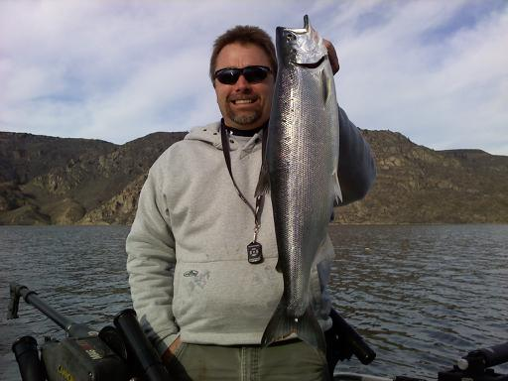
Sub-objective
Facilitate CCT Resident Fish Database
Resident Fish Division struggled with
  Loss of field data
  Inadequate data collection methods
  Inadequate data entry protocols
  Poor archiving resulting in lost data.
To fix these issues Resident Fish Division
  Implemented standard field protocols
  Standardized datasheets, data collection techniques, measurement units
  Implemented training for all biologists and technicians
  Implemented the development of the RFD Database
2012 Began 3rd Phase of 4 Phase process
  Anticipate online server March 2012 (hosted cloud solution)
  Compatible with
    CCT Anadromous Database (OBMEP) and
    Kalispel Tribes Intermountain Province / Pend Oreille Subbasin Database
Notes:
Our sub-objective is to facilitate the development of a resident fish database. The current program has struggled with the loss of data, inadequate data collection methods, inadequate data collection protocols, and poor archiving which has resulted in data loss.
To fix these issues, the RFD implemented standard field protocols, standard datasheets, data collection techniques, and measurement units.
We have implemented training for all biologists and technicians
And implemented the development of the Resident Fish Database. In 2012 we began the 3rd phase of a 4 phase project. We anticipate being online in March of 2012, we have elected to go with a hosted cloud solution. This database will be compatible with the CCT Anadromous database, or OBMEP, and the Kalispel Tribes, Intermountain Province/ Pend Oreille Subbasin Database.

Slide 15
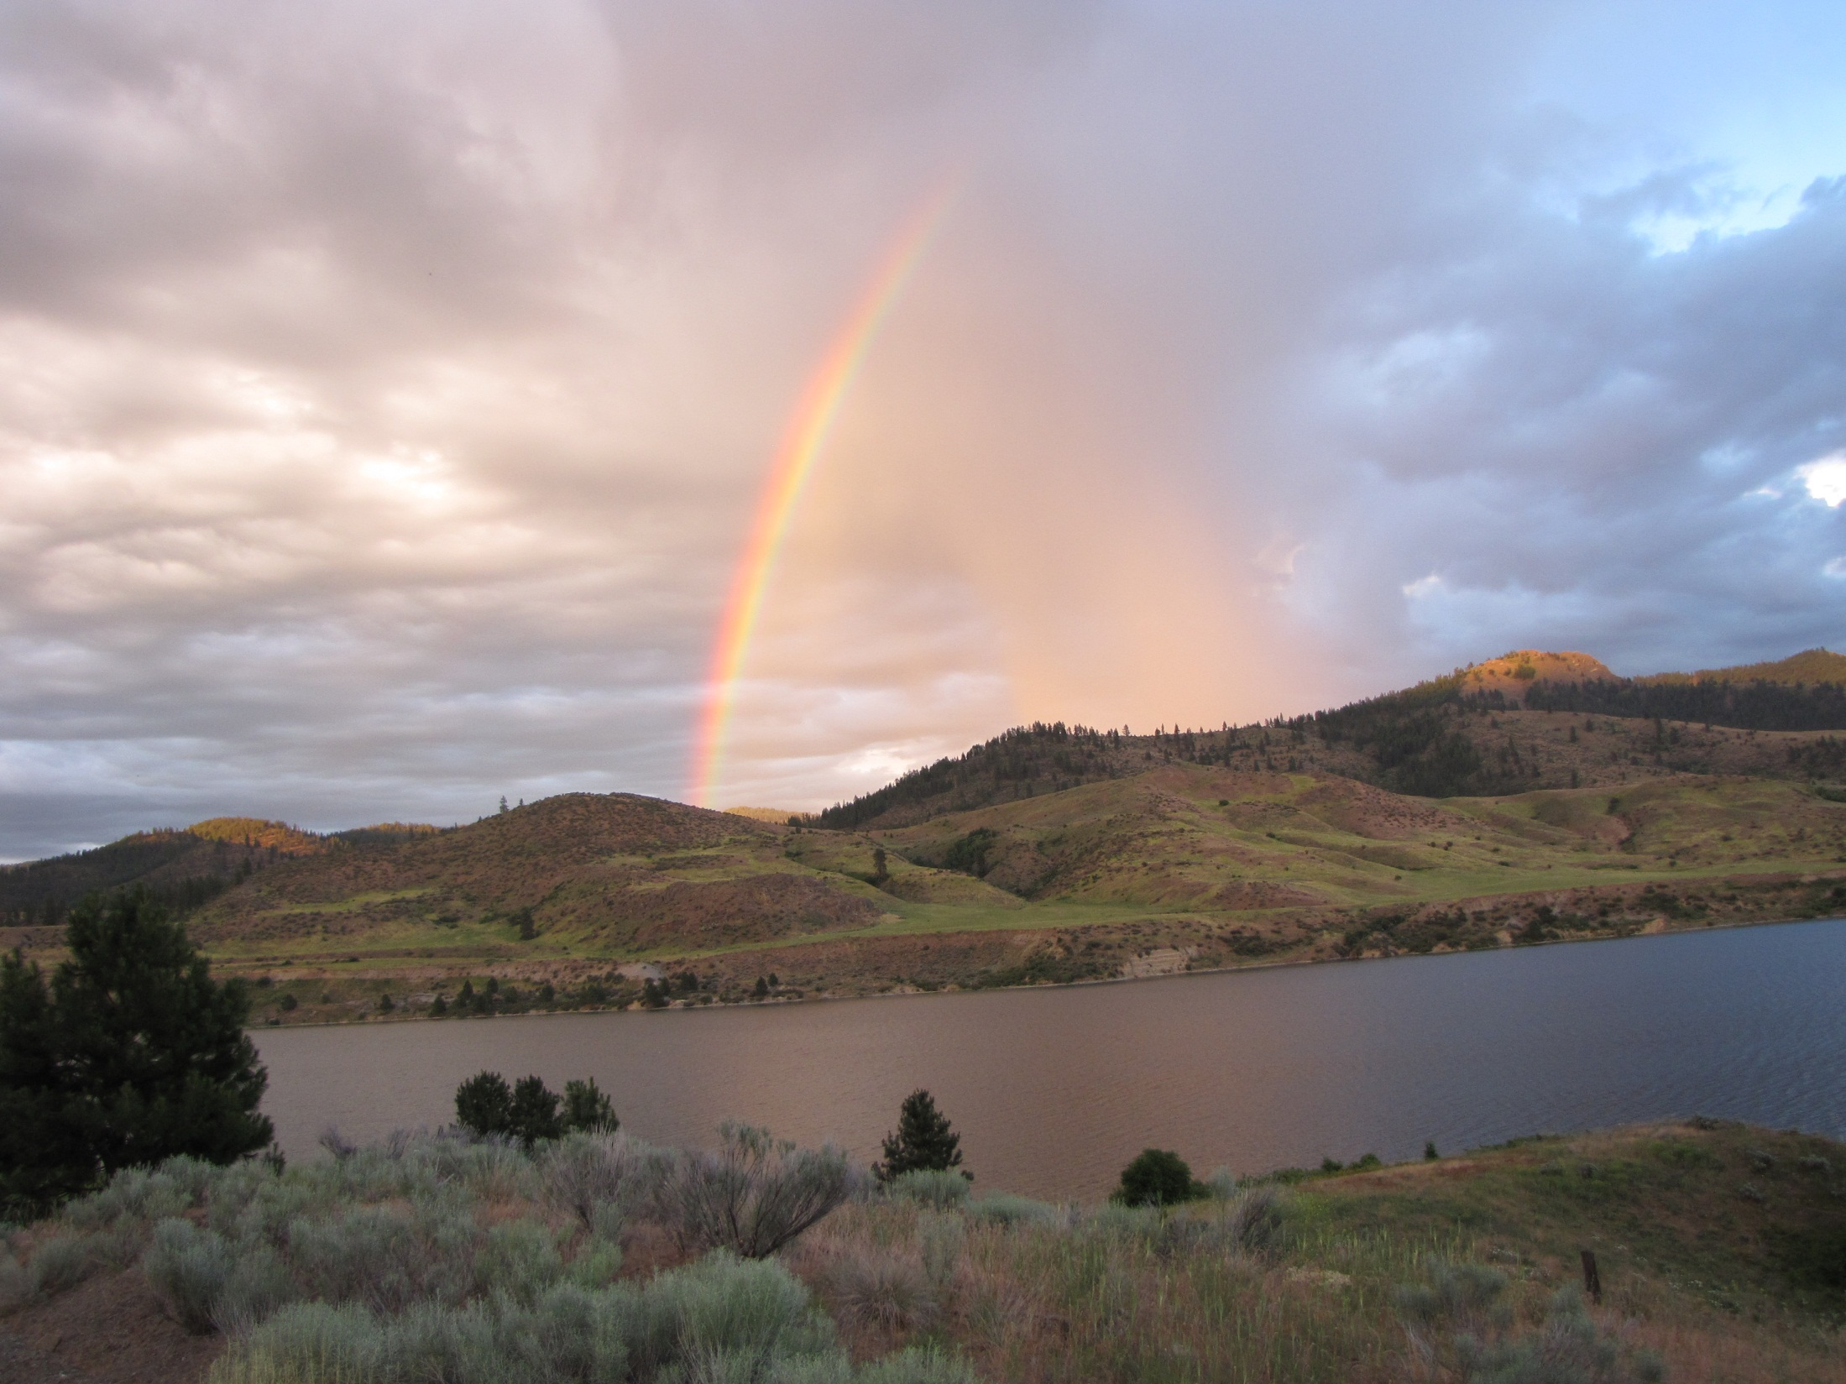
Special Thanks
Colville Confederated Tribes : Bret Nine, Erick Simonsen, William Dick, Dennis Moore, Jared Ericksen, Leslie Plum, Ben Samuels, Dakota Davis, Otis Seastrom, Cory Peone, Mitch Combs, Josh Hall, Tyson Marchand, Kevin Clark, Jeff Palmer, Bill Laramie, Rahnee Jane, Merle Picard, Dominick Cotton, Lucera Carden, Richard LeCaire.
Spokane Tribe of Indians: Tim Peone, Deanne Pavlik-Kunkel, and Andy Miller
Washington Department of Fish and Wildlife: Mitch Combs, Ace Trump, Chris Donley
Bonneville Power Administration: Carlos Matthew
Thank you,
Any Questions?

