Slide 1
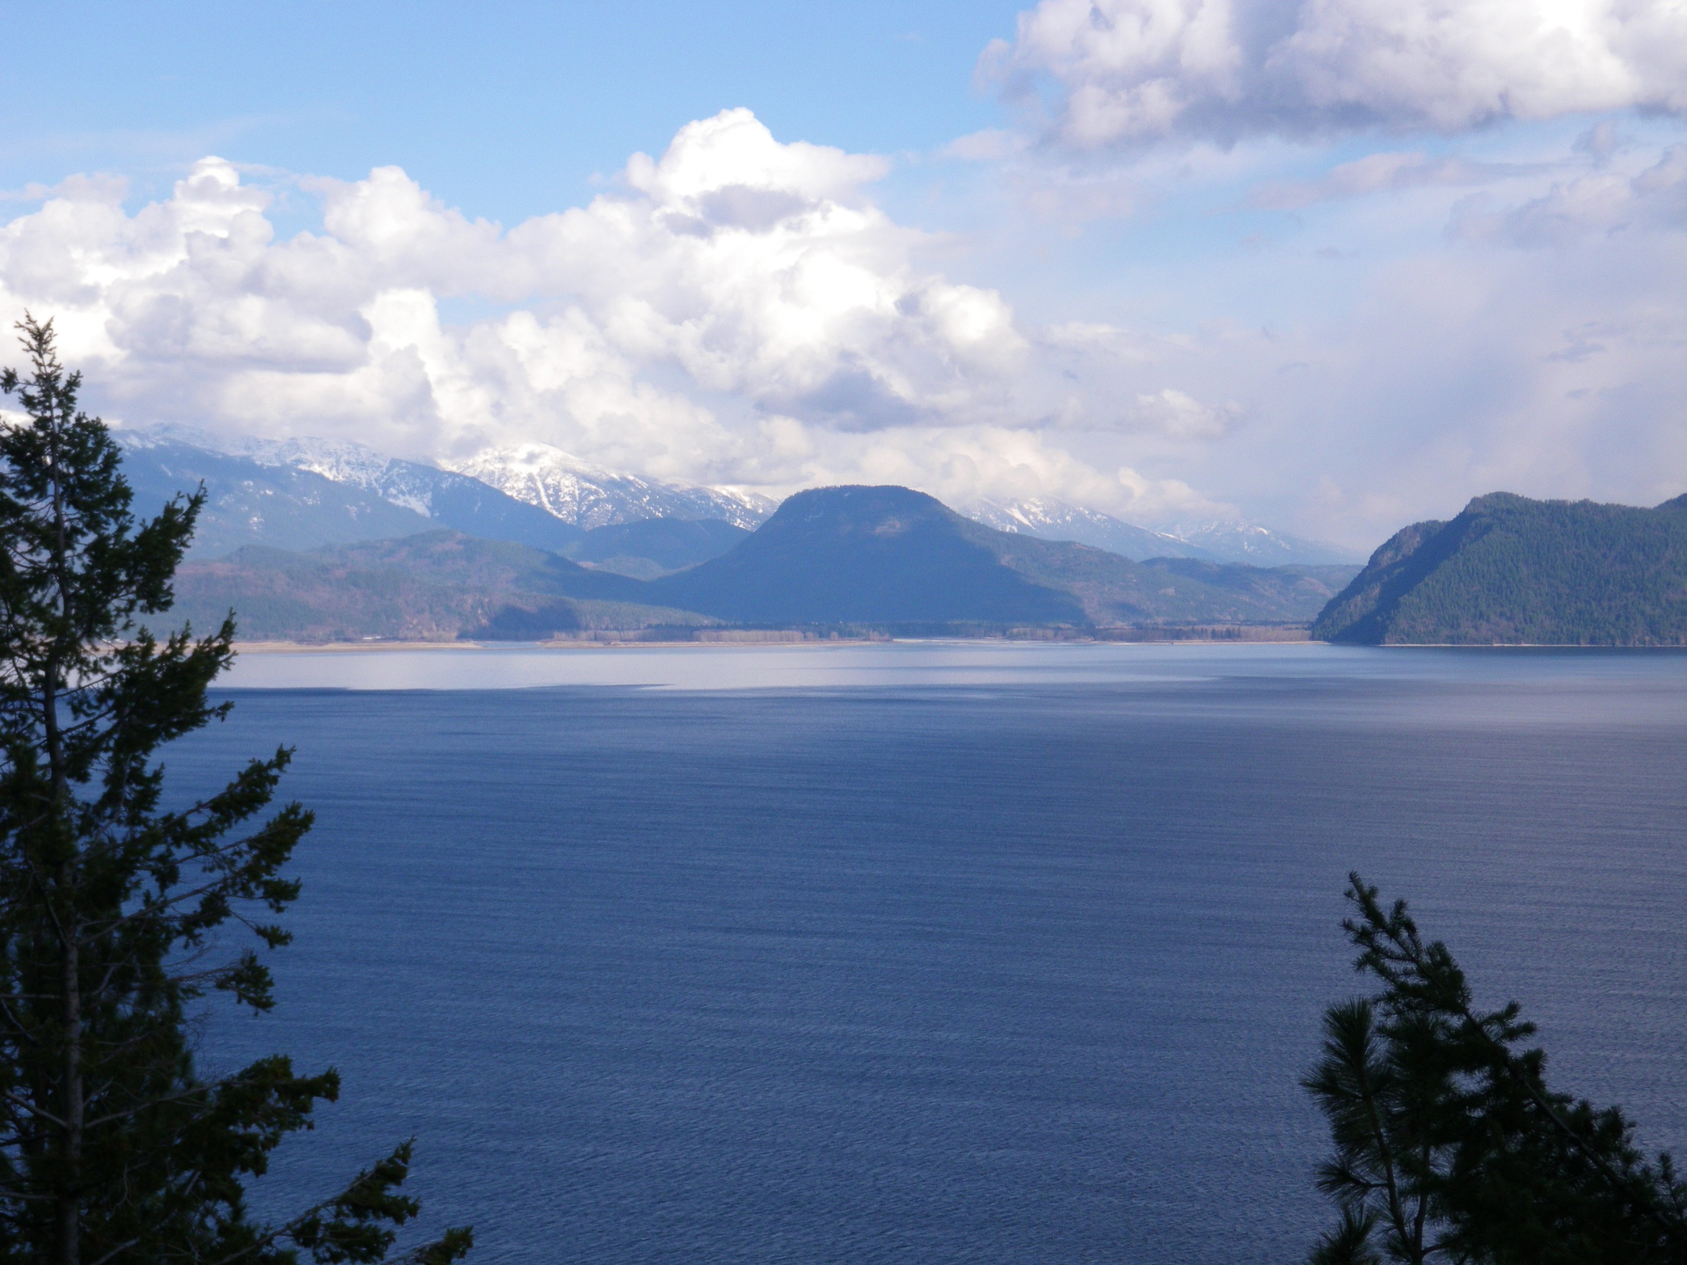
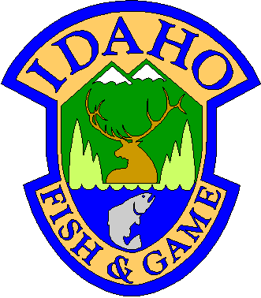
Lake Pend Oreille Fishery Recovery Project
Andy Dux and Nick Wahl
Idaho Department of Fish and Game
Project # 1994-047-00

Slide 2
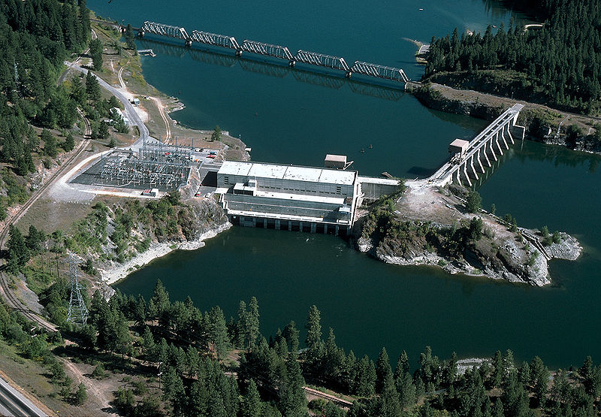
Sandpoint
Lake Pend Oreille
Pend Oreille
Hope
River
Idaho
Montana
Albeni
Clark
Largest lake in Idaho
- 90,000 acres
5th deepest natural lake in U.S.
Avg. depth 538 ft
Max. depth 1,151 ft
Upper 11.5 ft regulated by Albeni Falls Dam
Clark Fork River blocked by Cabinet Gorge Dam
Falls Dam
Fork
River
Cabinet
Gorge
Dam
Bayview
10 Km
Albeni Falls Dam on Pend Oreille River
Notes:
Lake Pend Oreille, located in the northern panhandle of Idaho, is the state’s largest lake with a surface area greater than 38,000 hectares. LPO is fed by the CF River on the E shore, while the outflow on the W shore forms the Pend Oreille River. It’s average depth is 164m, with a maximum depth of 351m. Lake Pend Oreille historically provided the largest sport fishery in Idaho. For example, from 1952 until 1966, it produced an angler harvest that averaged over 1 million kokanee annually.

Slide 3
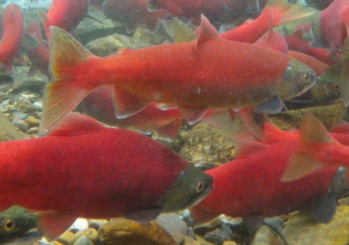
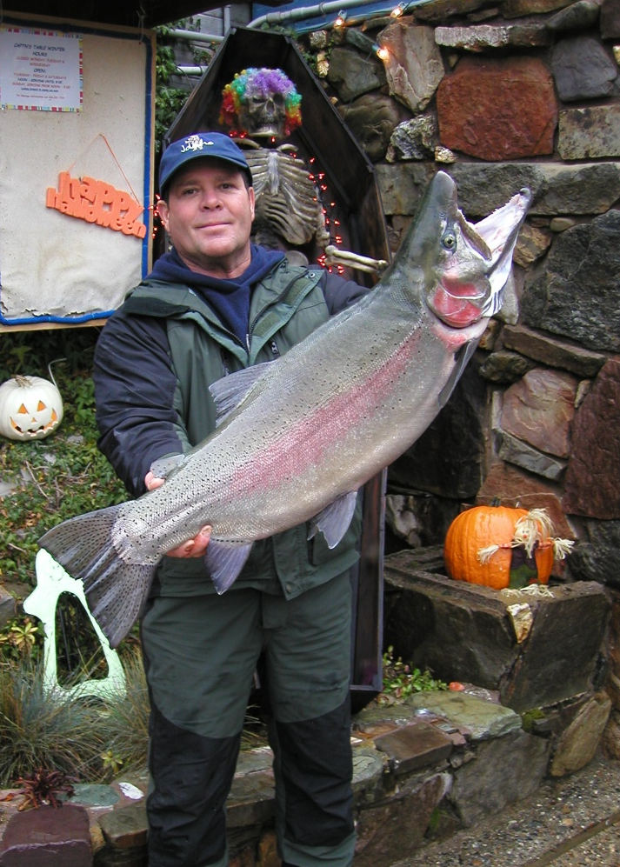
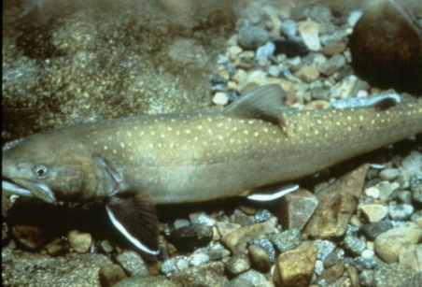
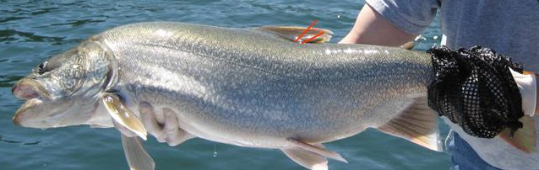
Lake Pend Oreille Fishery
Key players
Kokanee – established in 1930’s; keystone species
  1 million harvested annually in 1950’s-60’s; most popular fishery in ID
  Primary prey source for predators
Bull trout – native (ESA listed)
Gerrard rainbow trout – introduced 1941
Lake trout – introduced; exploded over past decade

Slide 4
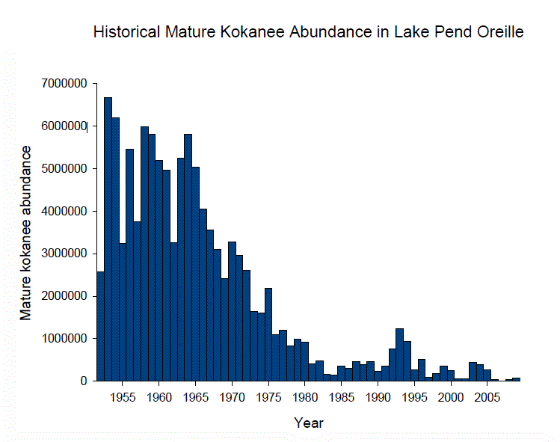
Kokanee Population Decline

Slide 5
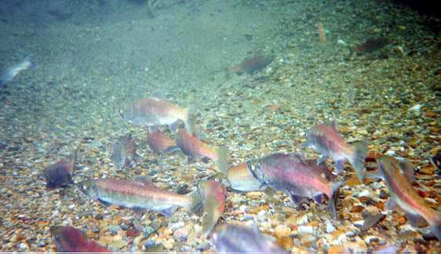
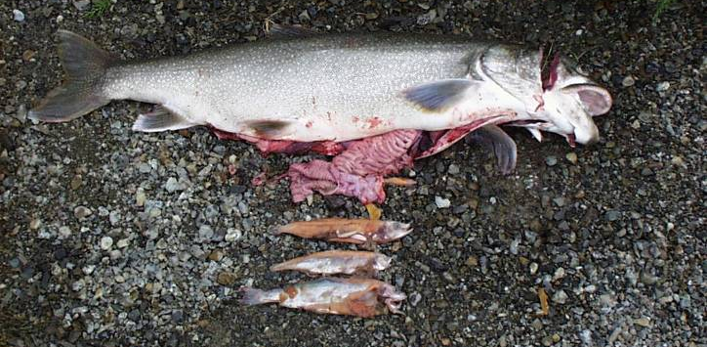
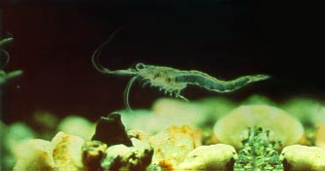
Kokanee Recovery: Limiting Factors
Spawning habitat
  Operations at Albeni Falls Dam starting in 1966; reduced lakeshore spawning habitat
Predation
  Lake trout population explosion over past 10-15 yrs
  Surpassed spawning habitat as primary limiting factor
Altered food web/nutrient dynamics
  Mysis shrimp introduction caused changes
  Extent unclear; not limiting at current kokanee densities

Slide 6
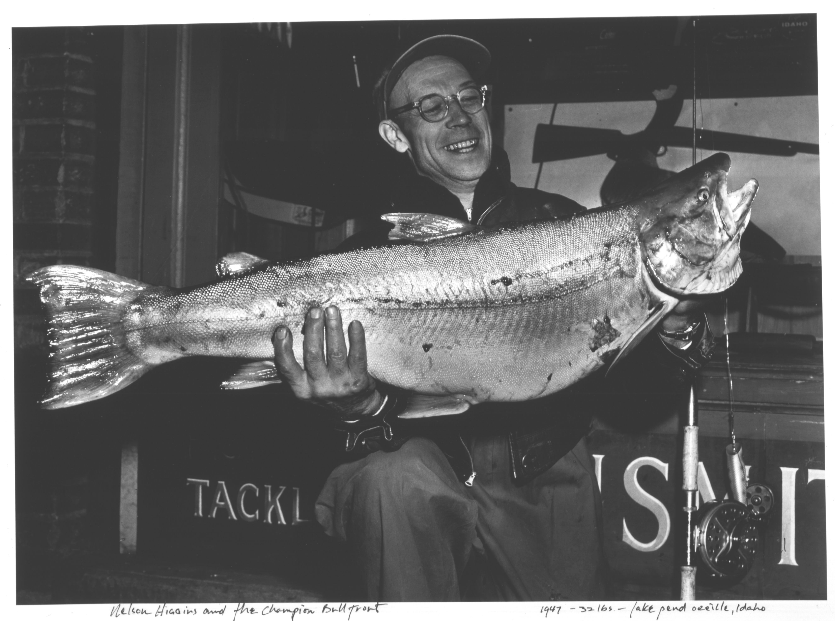
Fishery Recovery Objectives
Kokanee restoration
  High yield KOK fishery
  Prey source for BLT and RBT
Bull trout and cutthroat trout preservation
  Reduce LKT population
Restore trophy fishery
  RBT and BLT
32 lb world record bull trout
Lake Pend Oreille - 1947

Slide 7
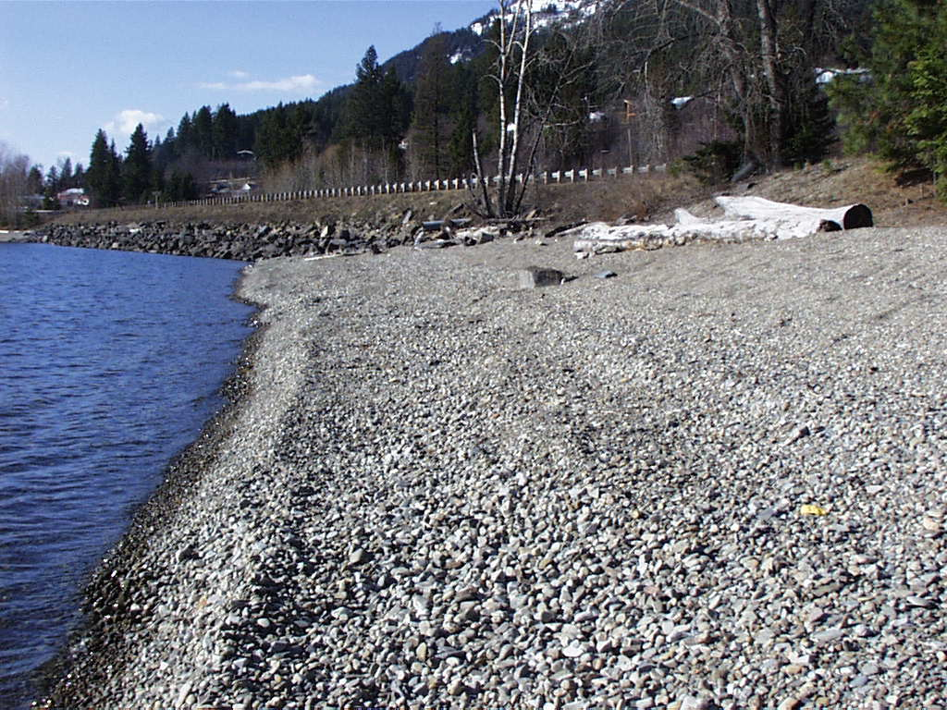
Lake Level Evaluation
>80% of KOK spawning habitat above traditional winter lake level
1996 – lake level management began
  Hold lake level 4’ higher in some years
Research focus:
  KOK recruitment response
  Physical habitat response
Complications:
  1997 – Record flood event (KOK mortality)
  2000 – LKT population explosion began (predation)

Slide 8
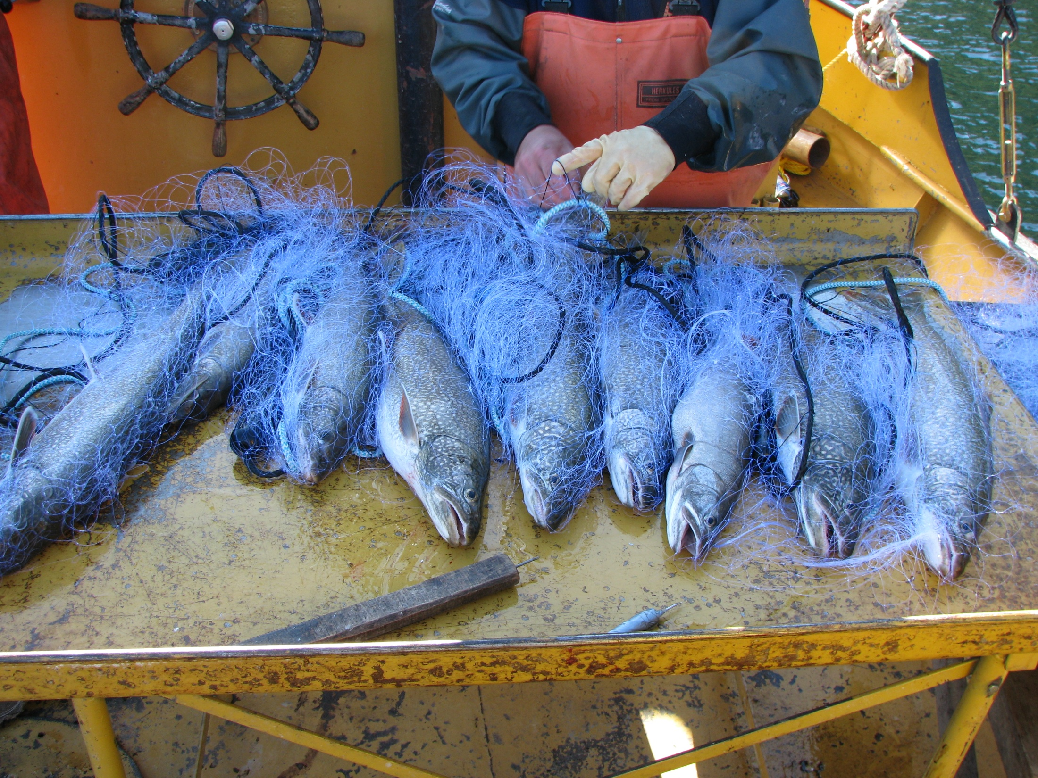
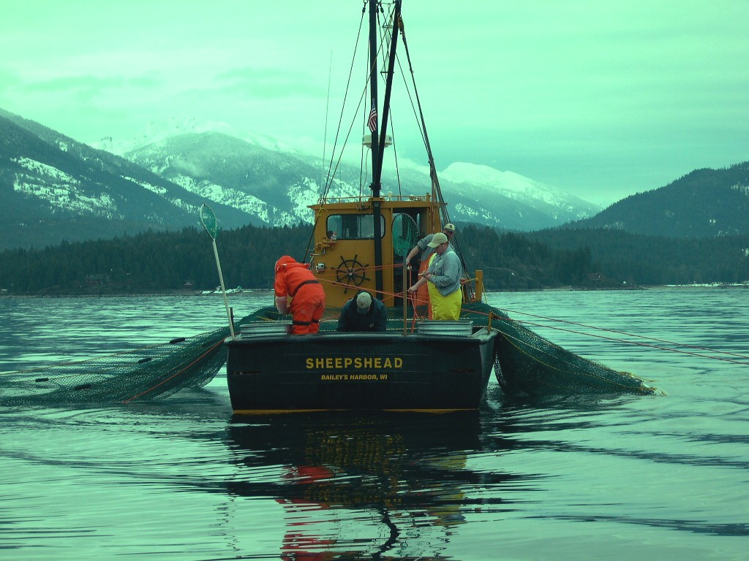
Predator Removal
Contracted commercial fishing company to remove LKT
Angler Incentive Program ($15/fish bounty) to remove LKT and RBT
Removals began in 2006
Funded by Avista and BPA
Research to guide and evaluate removal
  Telemetry, population estimates, etc.

Slide 9

Key Results
Higher lake level benefits KOK recruitment
  Egg-to-fry survival 6.2% higher
  Lesser benefit at low KOK densities
  Inability to fully test (low KOK densities)
LKT suppression is working
  Adults reduced >75%; juvenile catch rates down 60%
RBT fairly stable; exploitation low
BLT stable; netting bycatch not problematic
KOK steadily rebounding since 2007

Slide 10
Wild egg-to-fry survival
N = 6
N = 6

Slide 11
Lake Trout Abundance
Increasing 54.7%/year
Doubling every 1.6 years
Declining 58.5%/year
Halving every 1.3 years
July-11

Slide 12
Adult Kokanee Abundance
Predator removal starts

Slide 13
Proposed Work
Lake level evaluation continued
  Refine sampling and analysis techniques
  New research to evaluate egg survival/spawning requirements
Gravel addition study
  Create spawning habitat below minimum lake level
  Can we reduce frequency of higher lake level?
Predator removal continued
  Continue research and monitoring to guide/evaluate efforts
Nutrient/food web dynamics
Kokanee population assessment

Slide 14
Project Implications
Guides water management decisions
May lead to new method for providing KOK spawning habitat that places less demand on hydrosystem
LKT suppression will reduce predation on KOK and benefit native salmonids (BLT, WCT)
Model for lake trout suppression elsewhere
Improved sport fishery in Lake Pend Oreille

Slide 15
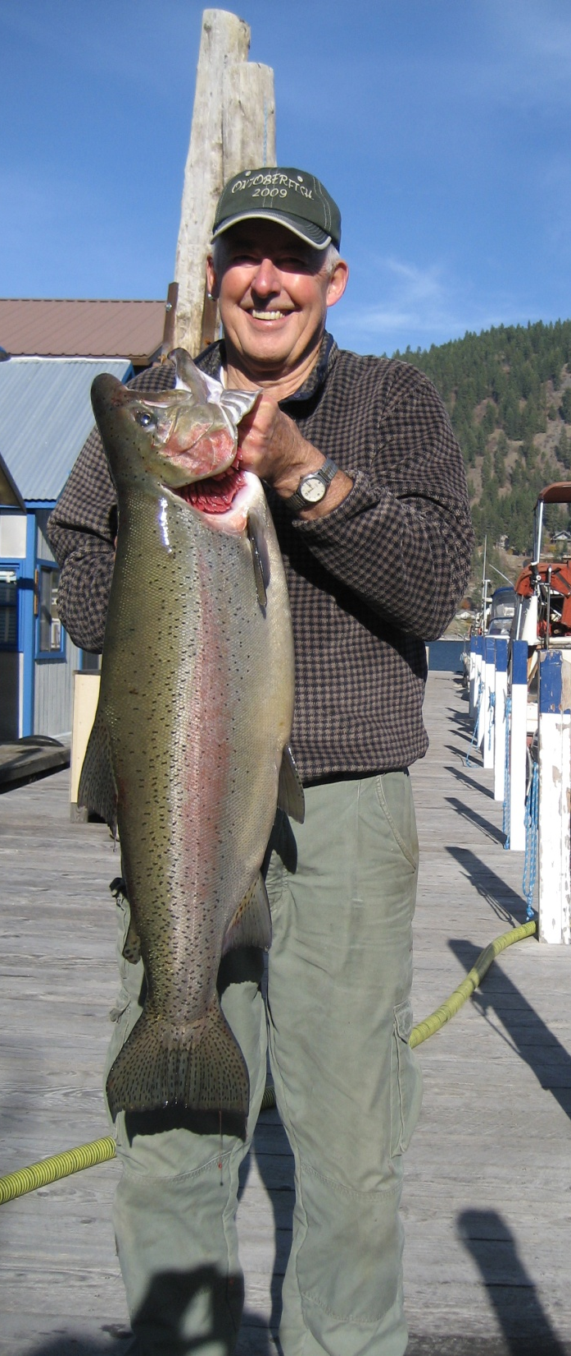
Conclusions
Much progress has been made
  Limiting factors being addressed
  Kokanee responding favorably
Further success relies on continued implementation of recovery actions
And, testing new strategies
  Responsive to increasing demands on hydrosystem

Slide 16
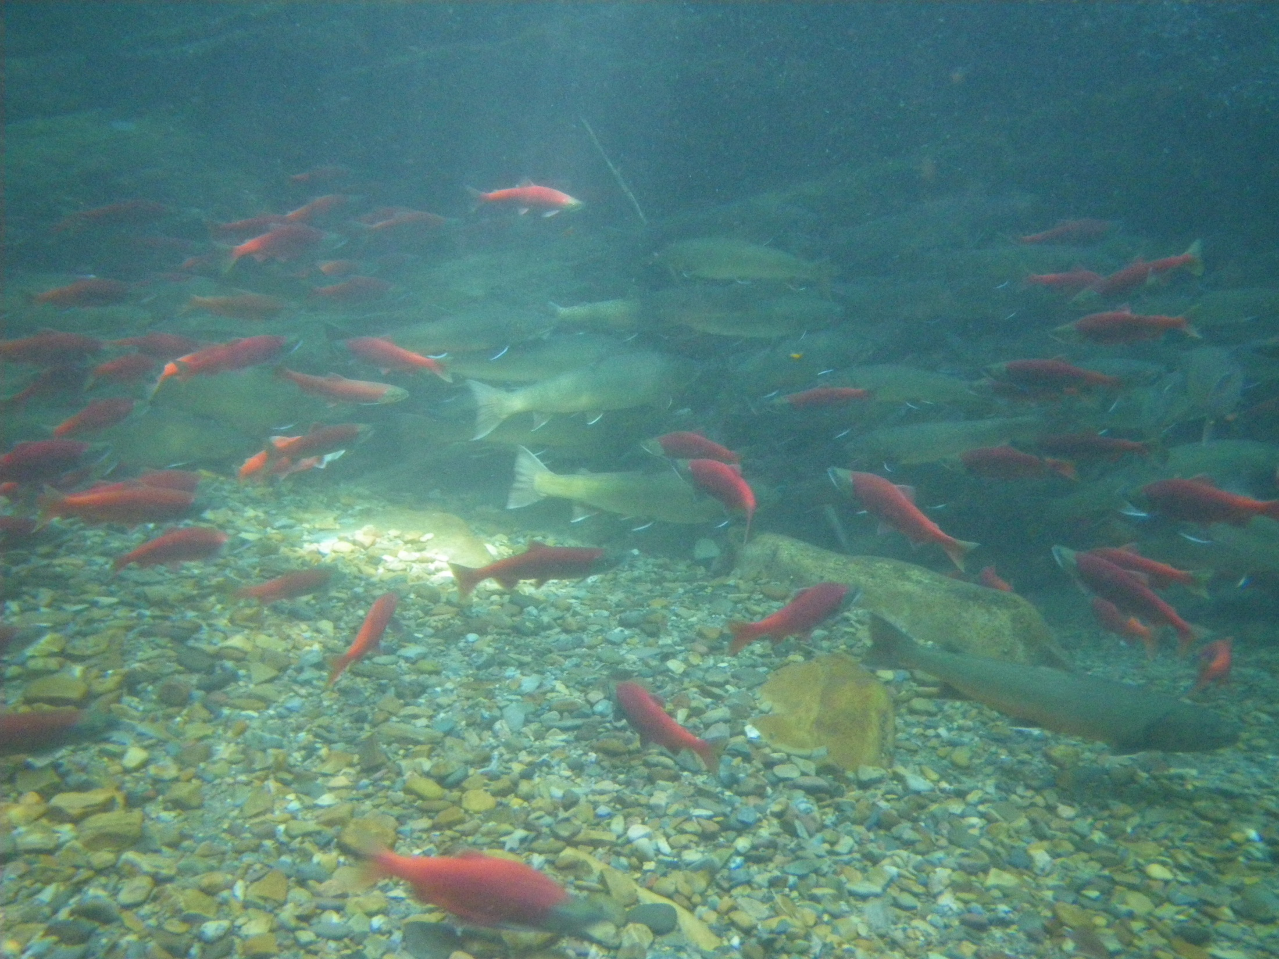
Questions?
Bull Trout Population Status

