Slide 1
Tribal Data Network
Columbia River Inter-Tribal Fish Commission
Notes:
Good mornng NWPCC, and thank you for allowing me to present my project.

Slide 2
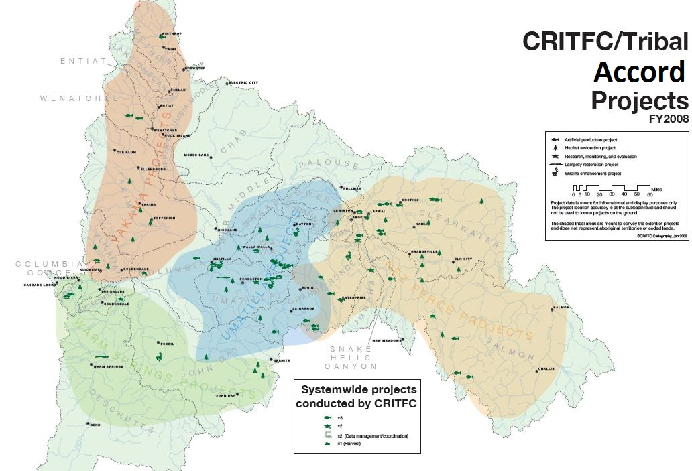
4 Tribes, 11 Field offices, area equal to State of Georgia, 25% of Columbia Basin
Notes:
4 Tribes, 11 Field offices, area equal to State of Georgia, or about 25% of the entire Columbia Basin
The Tribal Data Network seeks to assist tribes in building cyberinfrastructure capacity to meet their
Individual and regional co-management responsibilities.
This map shores the wide distribution of projects funded by the Accords across the Columbia Basin region.

Slide 3
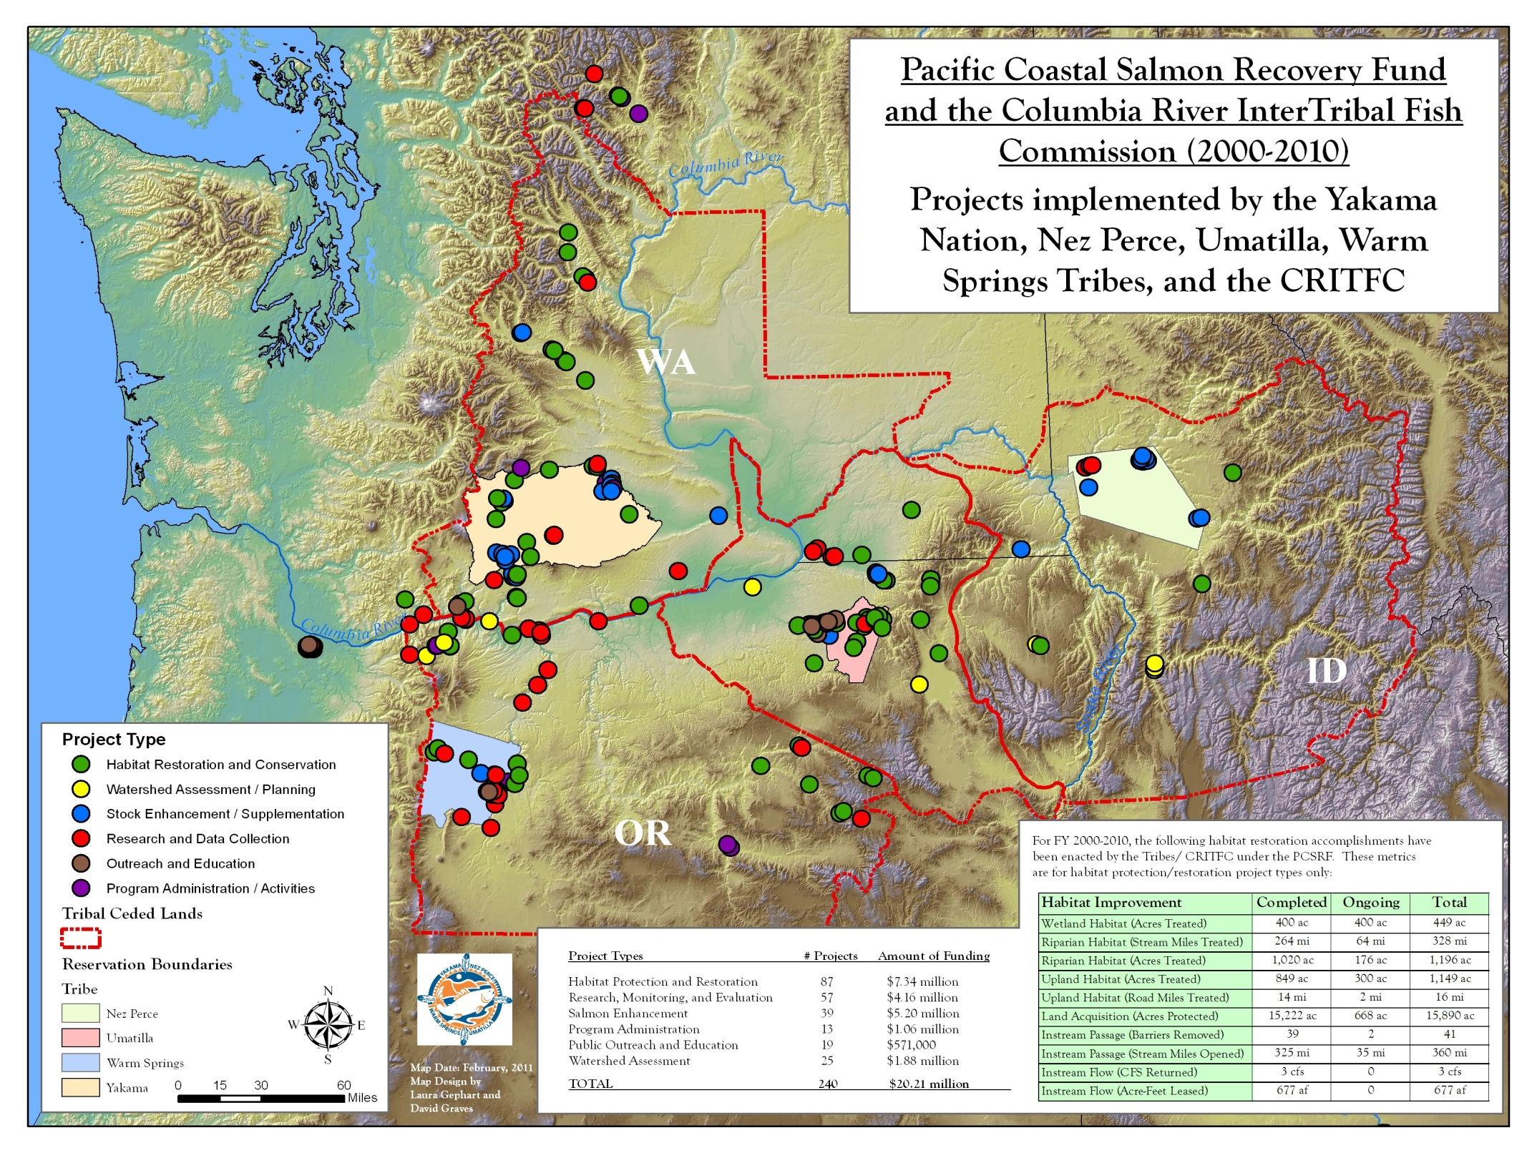
Notes:
In addition the CRITFC tribes conduct a number of restoration projects funded by the PCSRF throughout the Columbia Basin.

Slide 4
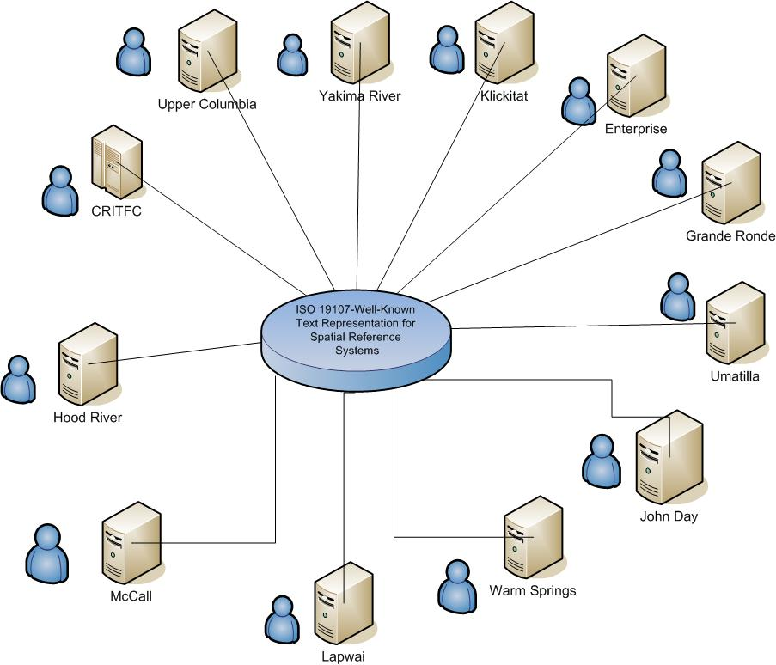
Distributed Data System, Each Tribe controls its Own Data, Shared Technology and Expertise… All Tribes Collectively Share Data to Provide Gravel to Gravel Management
Notes:
This is a structural diagram of the Tribal Data Network’s overall architecture. It is a distributed system. Each of the Tribal Field offices has an SQL server and internet connectivity to host and share local data.

Slide 5
Tribal Data network – MISSION and
Key objectives
Mission: To Provide Tribes the Capacity to Efficiently Manage and Share Their Own Natural Resource Data, by Sharing Technology and Expertise
Obj 1: Enable tribal participation in regional data management coordination, sharing, and standardization processes.
Obj 2: Assist member tribes to build internal capacity for improved data management for the tribal gravel-to-gravel management framework.
Obj 3: Provide data management services to the tribes;
Obj 4: Facilitate inter-tribal coordination to produce and disseminate high value standardized data sets;
Obj 5: Manage and share CRITFC data; much of which are used directly in various management processes, (e.g. harvest, hydropower management)
Notes:
There is a mission statement and five main objectives for the project.

Slide 6
Enable tribal Participation in Regional processes
Tribal Data Workshop
Coordinated Assessment (CBFWA/PNAMP/StreamNet)
Pacific Northwest Aquatic Monitoring Partnership
Columbia Basin Fish Accords
US v OR
Pacific Salmon Commission (PSC)
Notes:
Details for each objective follow:

Slide 7
Assist tribes to build internal capacity
Development of Tools and Infrastructure: Sharing Expertise
One-Time Purchases of Hardware and Software
Production of Data Management Tools for tributary Harvest Estimates
Development of Lamprey Data Management Tools

Slide 8
data management services for the tribes
Support for tribal data coordinators (in this expanded proposal)
Evaluation and application of new technology
Developing and sharing data capture, management, and reporting tools
Sharing of expertise, experiences, and coordination of effort through the annual tribal data workshops
Notes:
A key function is to provide data management services to the tribes, and to build tools for the tribes.

Slide 9
Produce standardized data sets
Initial Focus on assisting in the production of Number of Smolts per Spawner
Recruits per Spawner
Smolt and Adult Abundance Data through the use of Portable Anadromous Database Structures (PADS)
Data to Feed DETs
Egg to Smolt Survival Estimates
Data to Feed the AHSWG Standard Performance Measurements (Already reviewed by the ISRP)

Slide 10
Manage and share critfc data
Bonneville Adult Fish Facility Data Management System
Interactive Map of Tribal PCSRF Projects
Interactive Regional Map of Watershed Limiting Factors
Habitat Data Collected in the Grand Ronde Basin Ocean and mainstem harvest data Estuary and ocean environmental conditions

Slide 11
Key tribal data network accomplishments
Developing Network Infrastructure for Monitoring Data Management
Snake river spring/summer Chinook harvest estimate system (Nez Perce) (uses Digital Data Pen)
Grand Ronde lifecycle database pilot project (CRITFC/ODFW)
Bonneville dam adult fish facility data management system (CRITFC) (uses Digital Data Pen, and is integrated with PTAGIS)
Real time adult passage at mainstem dams
Tribal data needs assessment was completed
Tribal data network preliminary design
Interactive web map of tribal PCSRF projects
Interactive web map of watershed limiting factors
Lamprey data entry and population estimation tools. (CTWSRO/Yakima)
Notes:
Key accomplishments in the first two years of the project are listed here.
A network infrastructure platform was developed to support data management
Successful pilot projects were built on top of it.
I would like to highlight two of these pilot projects that use new technology – the Digital Data Pen that first records data on paper forms, and later transmits that data to remote databases., and the harvest estimate system developed with the Nez Perce tribe for managing creel survey data and producing harvest estimates from it.

Slide 12
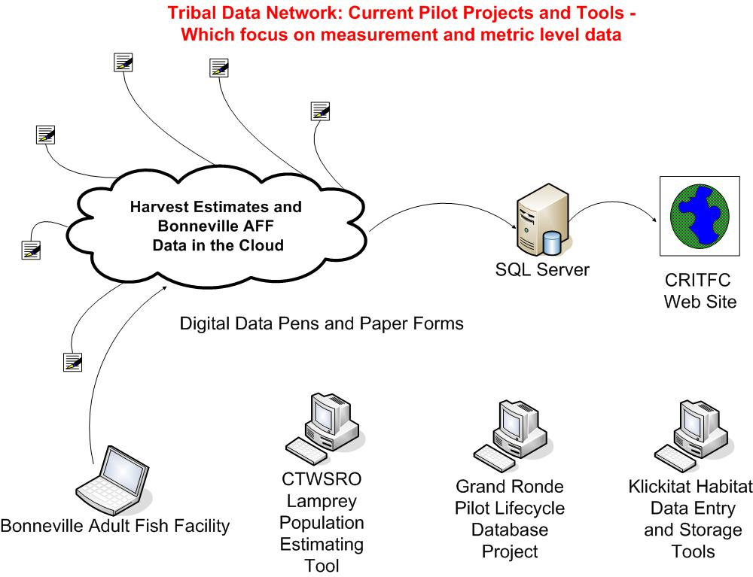
Notes:
This is a generalized picture of how data flows for applications using the Digital Pen.
The pen records data on paper forms and stores an electronic copy of the forms for later upload to a SharePoint server in the cloud.
The data are then downloaded into local SQL databases for quality control, analysis and reporting.
This technology produces very fast incorporation of field data into electronic databases.
It also produces a traditional hardcopy of the field data for storage and error checking, if required.

Slide 13
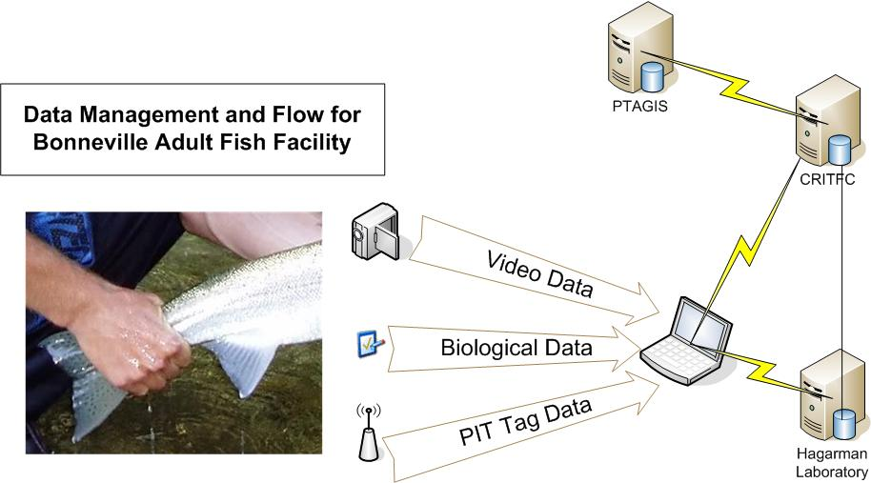
Notes:
The first example pilot project is sampling of salmon runs at the Bonneville Adult Fish Facility which integrates the digital pen technology with PIT tag technology.
This is just a picture of the data flow from the Bonneville Adult Fish Facility.
This project manages monitoring data end to end, from measurement to summarized data. It’s focus is on the field measurement and metric level data.
It feeds higher level aggregations of data and these data are available on our web site (http://fishery.critfc.org).

Slide 14
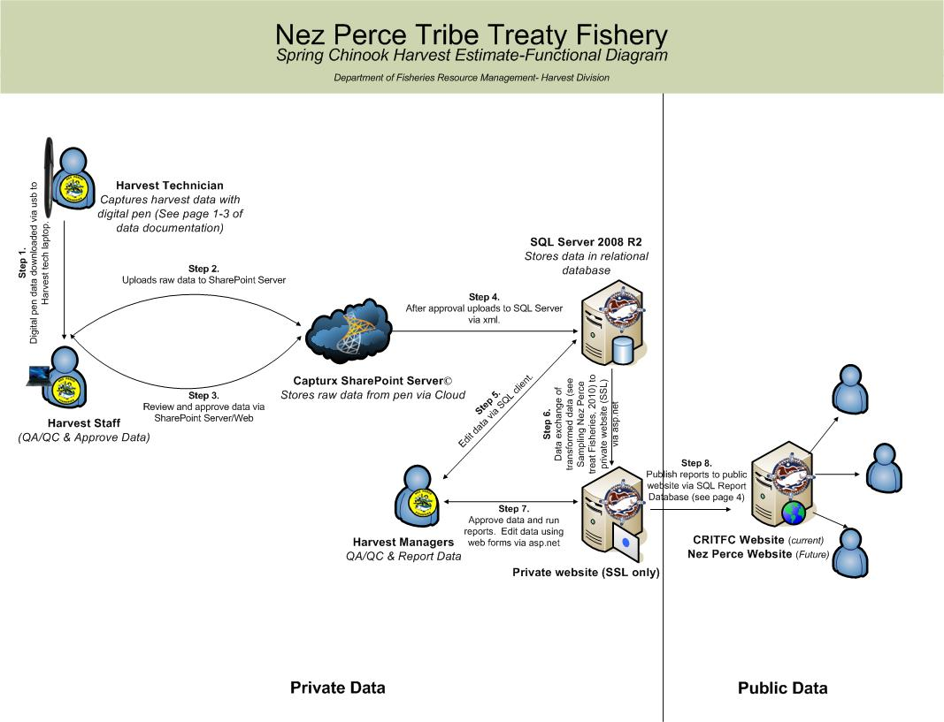
Nez perce harvest monitoring system
Notes:
The second example pilot project is the Nez Perce Tribe’s harvest monitoring system for their tributary fisheries.
The harvest technicians shown on the left edge fill out paper forms, and then send their data to the cloud,
where it is consolidated, QA/QC’d, and transferred to SQL servers at CRITFC and then to the NPT harvest office.
Data is then made available on a web site. (Currently CRITFC, soon to be NPT)
This project has been tested and will be in production use next year. The functions presently performed at CRITFC will be transferred to the Nez Perce central office.

Slide 15
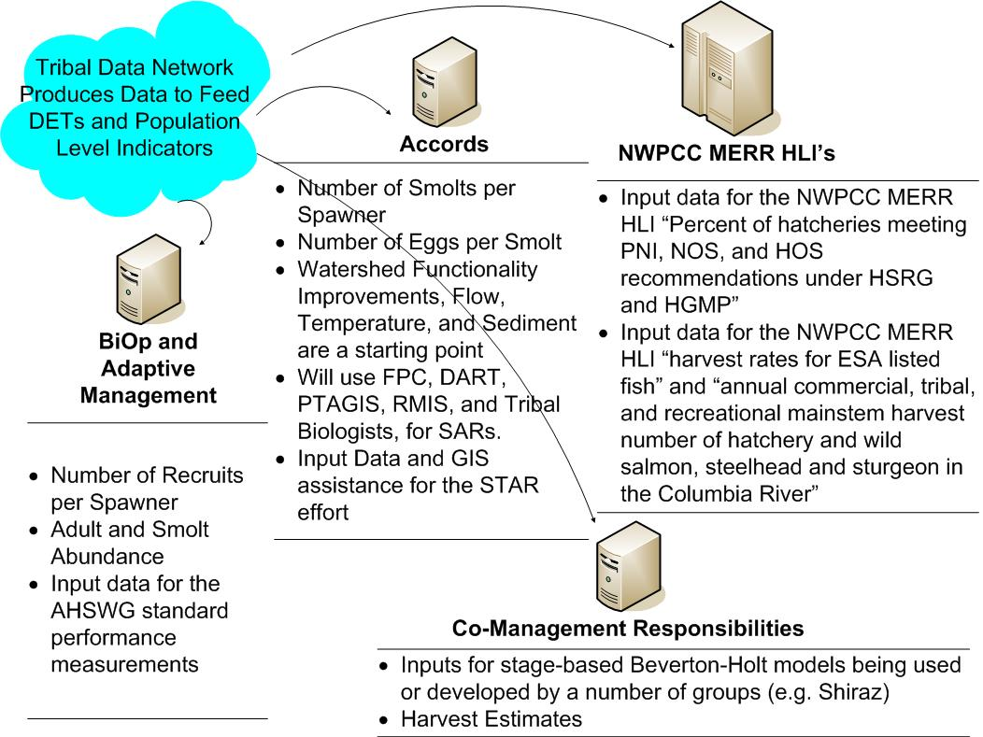
Notes:
These are the specific types of data summaries that the Tribal Data Network will assist the tribes to deliver.
They are grouped into four regional drivers of priority management data needs to be initially addressed by the Tribal Data Network.

Slide 16
Lessons learned
Tribal basic data management capacity has been only indirectly addressed in the past
We have demonstrated the ability to solve data management problems through a series of pilot projects
Data management issues can be addressed efficiently by sharing expertise and experience
Additional resources will be required to complete tribal data management programs
It will take sustained effort over several years to address tribal data management issues

Slide 17
future directions
Provide support for data coordinators at each tribe (this expanded proposal)
Participate in development of regional data management processes and sharing agreements
Continue to build tribal data management capacity
Continue developing common data management and reporting tools

Slide 18
Questions?

Slide 19
The end
Optional Appendix of extra slides begins

Slide 20


Digital Pen data collection
Streamlined field data collection, QA/QC, and data backup
Data is entered one time only.

Slide 21
Creel Survey Harvest estimate form
Produces Snake River Harvest Estimates for Spring/Summer Chinook, Fall Chinook, and Steelhead

Slide 22
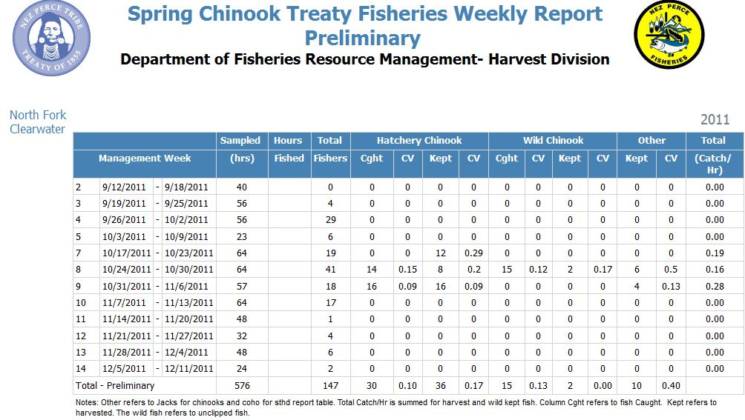

Slide 23
Bonneville Adult fish Facility DATA Form
Adult Data Collected for Spring, Summer, Fall Chinook,
Steelhead, and Sockeye

Slide 24
