Slide 1
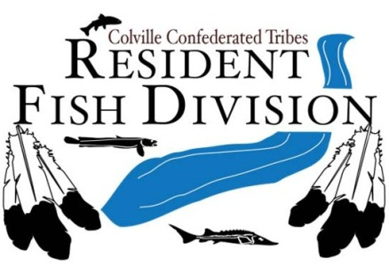
Lake Roosevelt Rainbow Trout Habitat/Passage Improvement
Project No. 1990-018-00
Jason McLellan
Confederated Tribes of the Colville Reservation

Slide 2
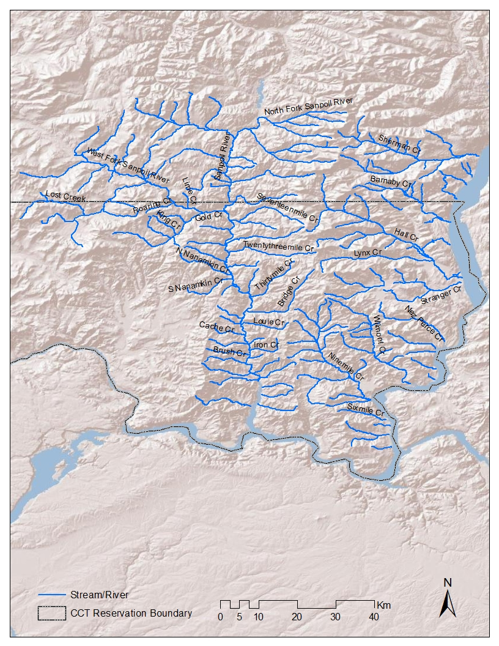
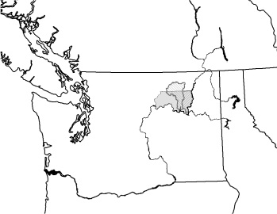
Background
Habitat surveys
Restoration Projects
  Riparian fencing/planting
  Culvert replacements
  Channel reconstruction
  Road decommissioning
  Nutrient enhancement
  Water right transfers

Slide 3
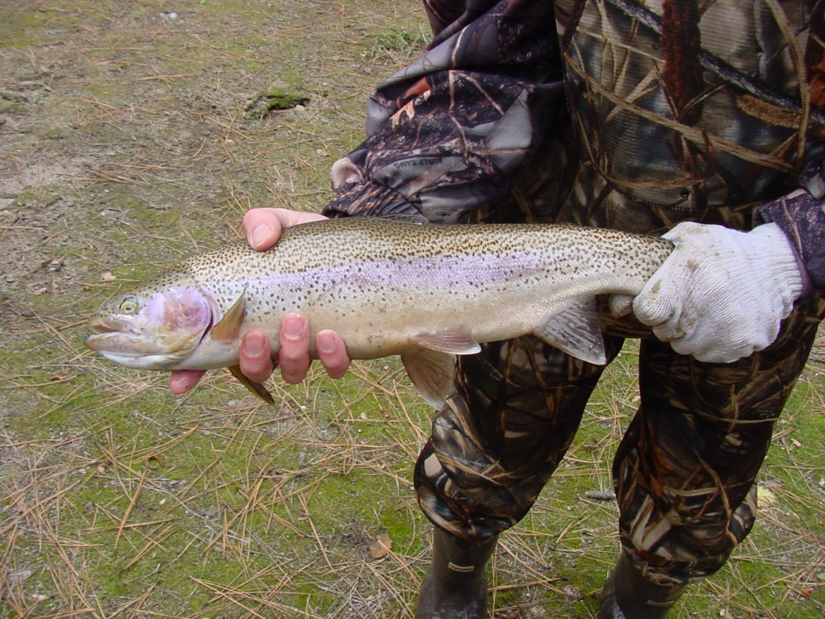
Background
Monitoring and Evaluation
  Spawning escapement
  Invertebrate – nutrient enhancement
  Limited due to small sample sizes
Genetic Assessments
  Some “pure” populations
New leadership
  Status and trend monitoring
  Project No. 2008-109-00

Slide 4
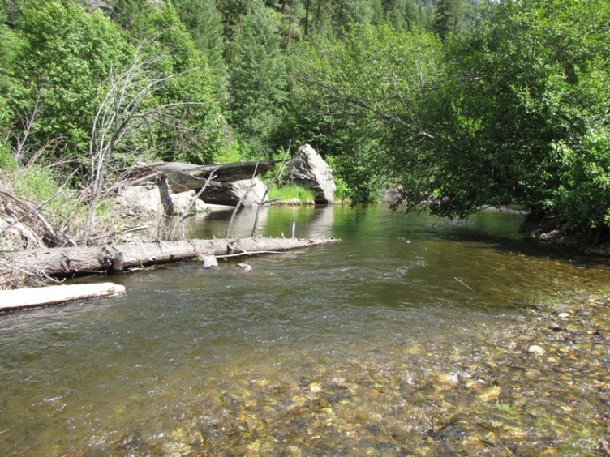
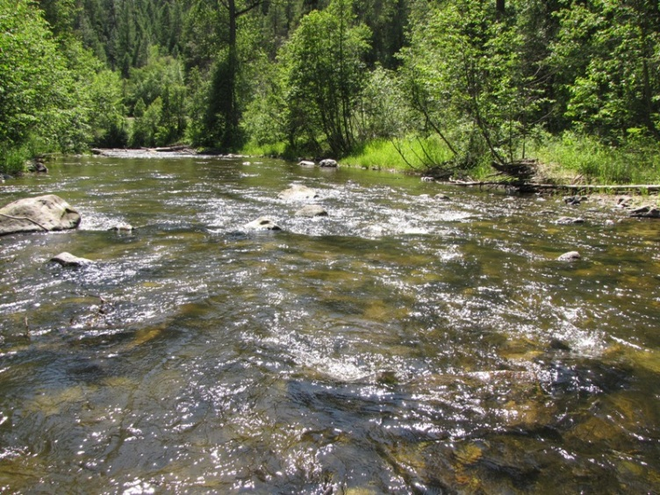
Goal and Objective
Goal – restore healthy and harvestable salmonid populations
Objective – rehabilitate stream habitat and restore ecological function in the riparian corridors

Slide 5
Management Questions
What are current habitat conditions?
Where are natural barriers?
Root causes of habitat degradation?
Highest priority restoration actions?
Current distribution and density of fish?

Slide 6
Project Design
Inventory and Assessment
Ecosystem Diagnosis and Treatment (EDT)
Habitat Restoration and Protection Plan
Plan Implementation
Concurrent Project Implementation

Slide 7
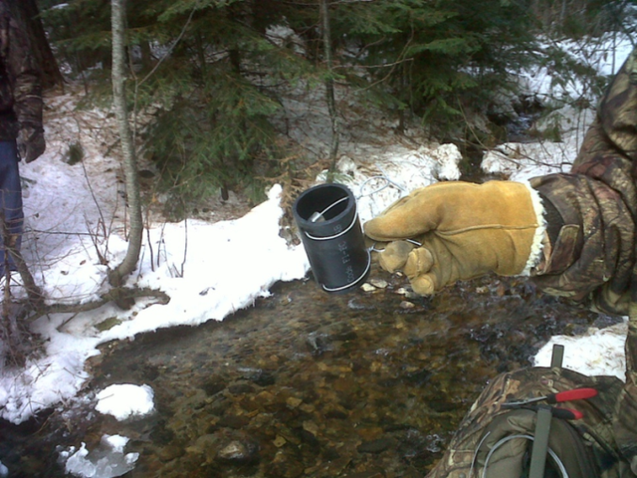
Inventory and Assessment
Habitat
Water Quality
Discharge
Invertebrate drift
Fish presence, relative density, and species composition
Level II – environmental attributes – EDT

Slide 8
Study Design – Habitat Conditions
Current Conditions – census
  Habitat Inventory – ODFW protocol
  Natural barriers – WDFW protocol
Degradations – census
  Culverts – National Inventory and Assessment Procedure
  Diversions, pumps, dikes, levees, rip rap, riparian clearing – WDFW protocol

Slide 9
Study Design – Other Components
CHaMP
50 sites – two strata
  Sanpoil (n=25); E. side streams (n=25)
  12 fixed, 13 rotating panel (3 yr)
Balanced across 6 multi-density categories
  Land ownership (private, public)
  Valley segment (source, transport, response)

Slide 10
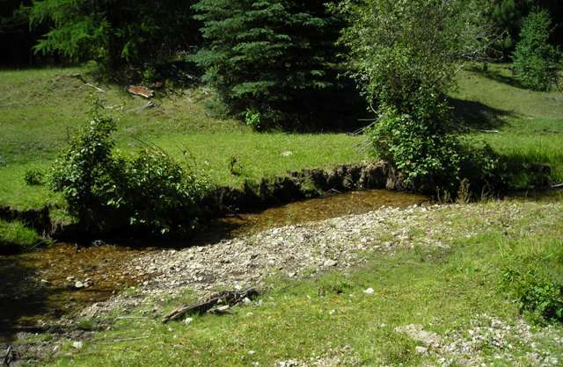
Habitat Protection and Restoration Plan
Process-based principles (Beechie et al. 2010)
Sequence of actions (Roni et al. 2008)
Empirical observation
EDT Model results

Slide 11
Restoration Projects
Riparian vegetation and streambank conditions
Fish passage
Channel migration potential & floodplain and sidechannel connectivity
Instream flow & prevent entrainment or impingement of fish in irrigation structures

Slide 12
Restoration Project Prioritization
TIER 3 | TIER 1
TIER 4 | TIER 2
Feasibility
Biological Benefit

Slide 13
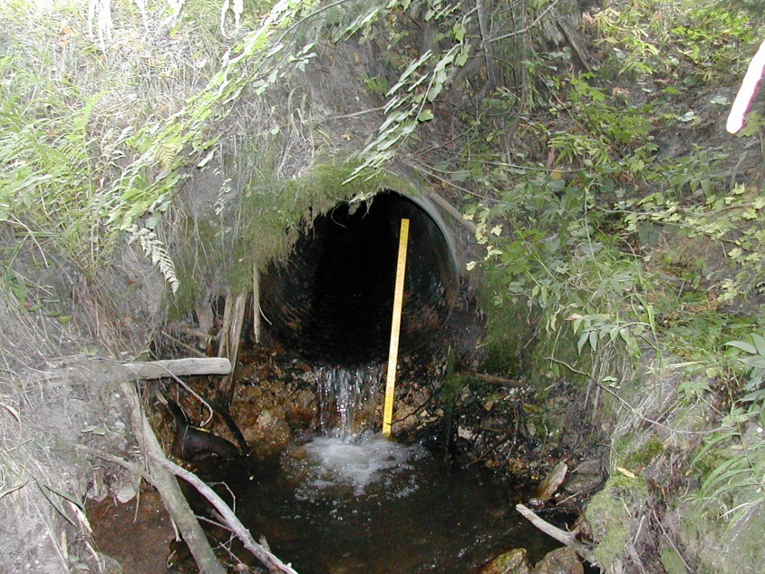
Example Prioritization Criteria - Barriers
Biological
  Quantity and quality of habitat upstream
  Extent of passage in current condition
  Number of focal species affected
  Other benefits
  Risk of catastrophic failure
Feasibility
  Land ownership
  Size of road
  Cost

Slide 14
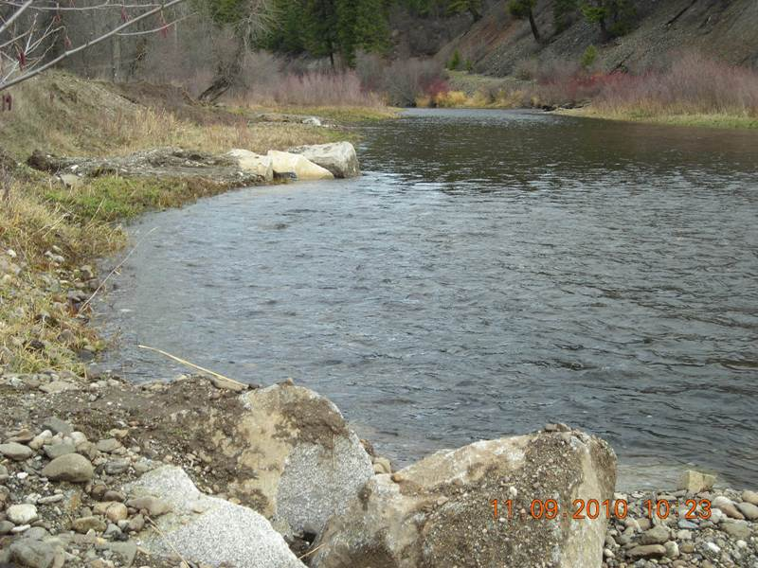
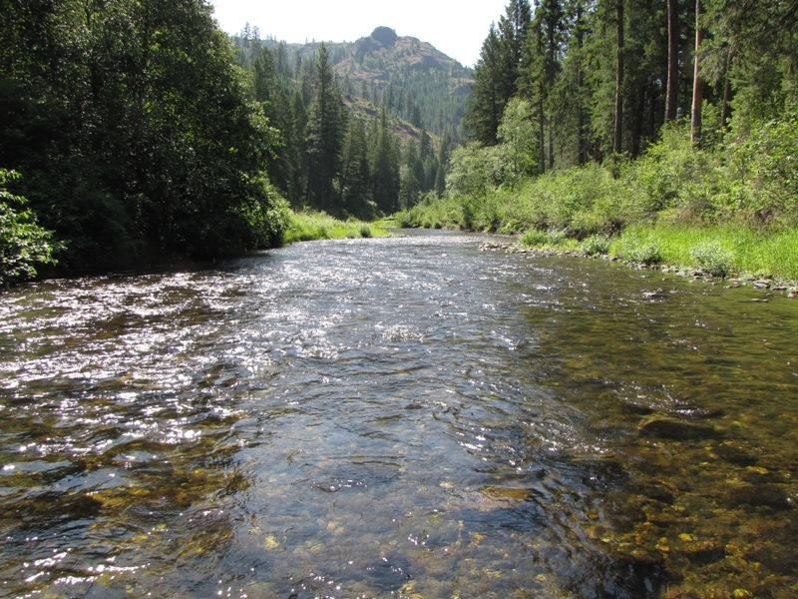
Summary
Assessment
Develop restoration plan
Implementation

Slide 15
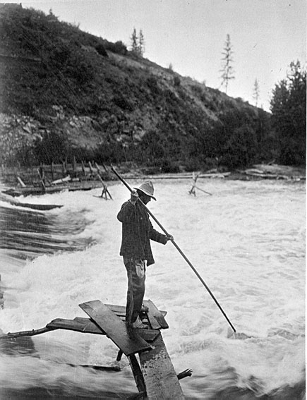
Questions?

