Slide 1

Pend Oreille Nonnative Fish Suppression Project
Todd Andersen
Jason Connor
Kalispel Tribe of Indians
Project Number 2007-149-00
January 18, 2012

Slide 2
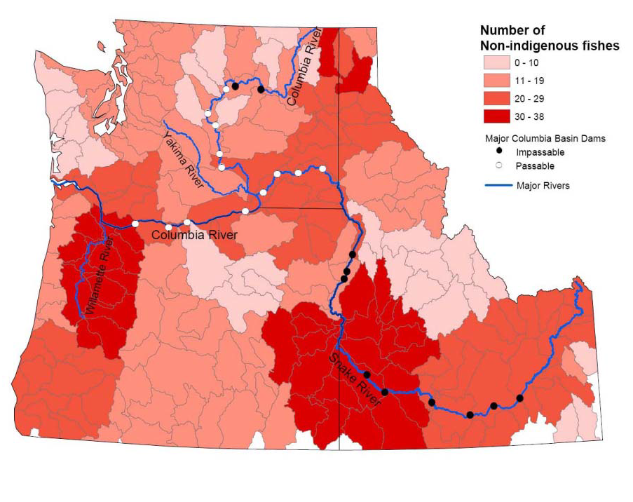
Lower Pend Oreille
Priest River
ISAB Non-native Species Report
ISAB 2008-4

Slide 3
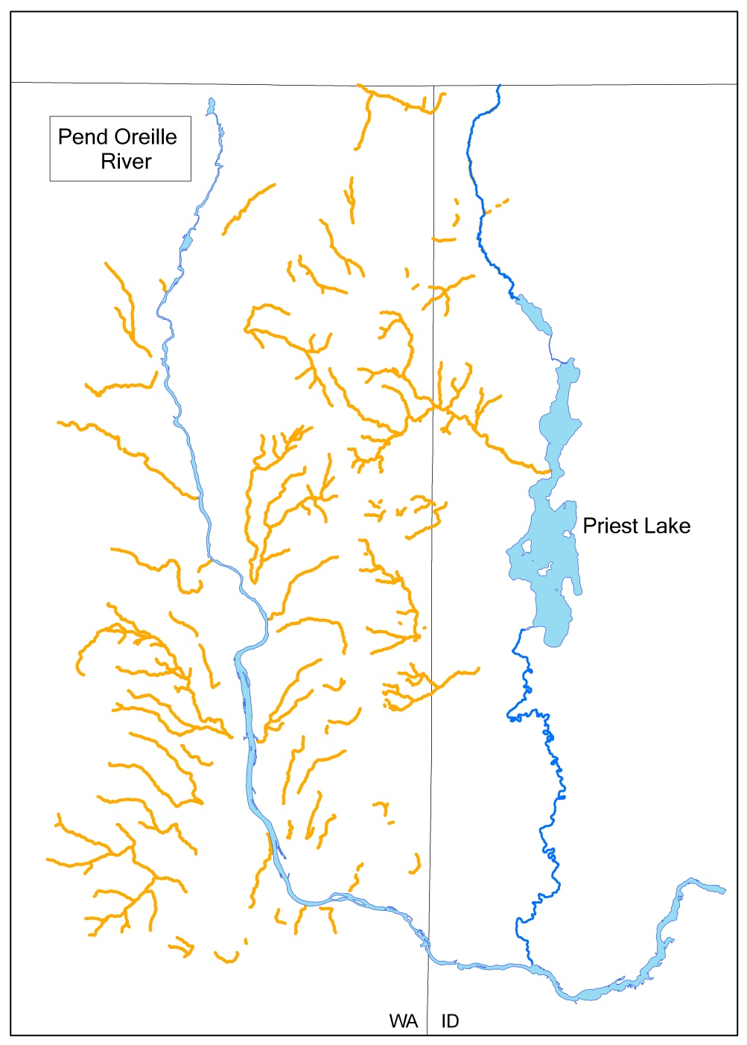
>500 Km of Stream Miles Surveyed Since 1996

Slide 4
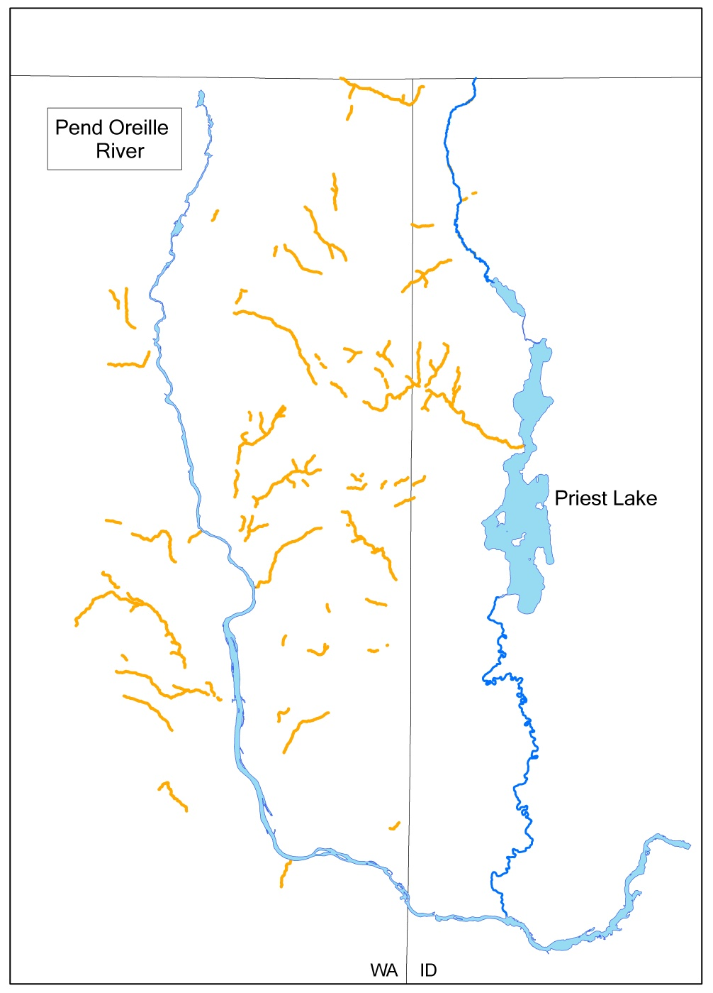
Current Westslope Cutthroat Trout Distribution

Slide 5
Past Accomplishments
Constructed barrier on Graham Creek and removed non-native fish with electrofishing gear from 700m of upstream channel.
Successfully eradicated brook trout with a piscicide in 5.2 miles of upper Cee Cee Ah Creek.
Translocated 100 mature westslope cutthroat trout into upper Cee Cee Ah Creek from a nearby watershed.
Provided funding (match) for IDFG fall Thorofare netting to preclude migrating lake trout from Upper Priest Lake.
From 2003 to present, 2,126 brook trout were removed from WBL Tributary 1 using electrofishing gear.

Slide 6
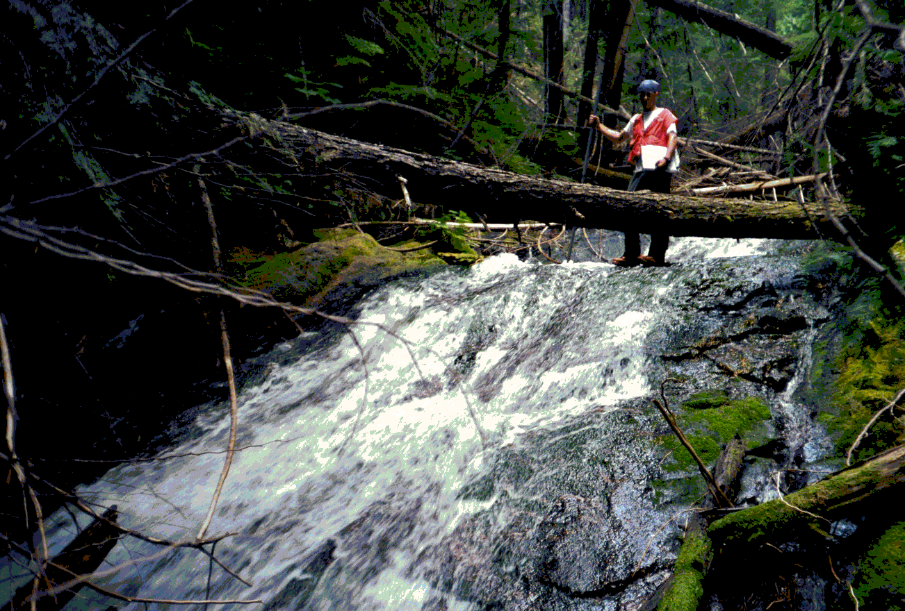
OBJECTIVE (2013-2016)
Reintroduce Westslope Cutthroat Trout to Smalle Creek
Annually apply liquid rotenone to all fish bearing stream channel upstream of the waterfall barrier (8 Km).
Translocate cutthroat trout into Smalle Creek from appropriate donor streams.

Slide 7
OBJECTIVE (2013-2017)
Eradicate Brook Trout in West Branch LeClerc Tributary 1
Numbers of westslope cutthroat trout (WCT) and brook trout (BKT) removed in the first electrofishing pass in WBL Tributary 1. In 2011, the second pass yielded 686 WCT (more than the first pass) and 4 BKT.

Slide 8
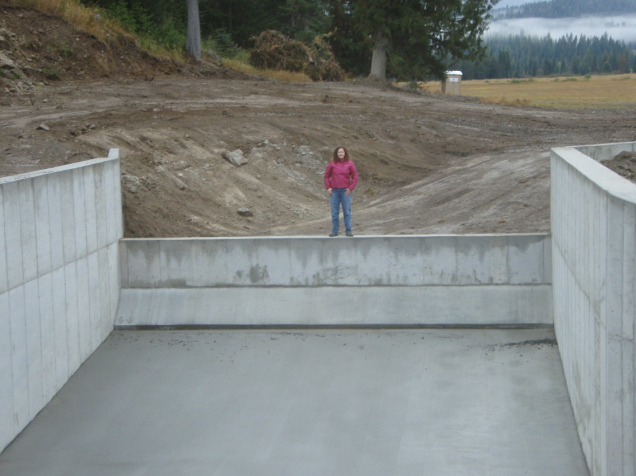
OBJECTIVE (2015-2017)
Reintroduce Westslope Cutthroat Trout to Goose Creek
In 2015, begin preliminary work to implement rotenone treatments.
Annual rotenone treatments to begin in 2016. Approximately 30 Km of stream channel will be treated.

Slide 9
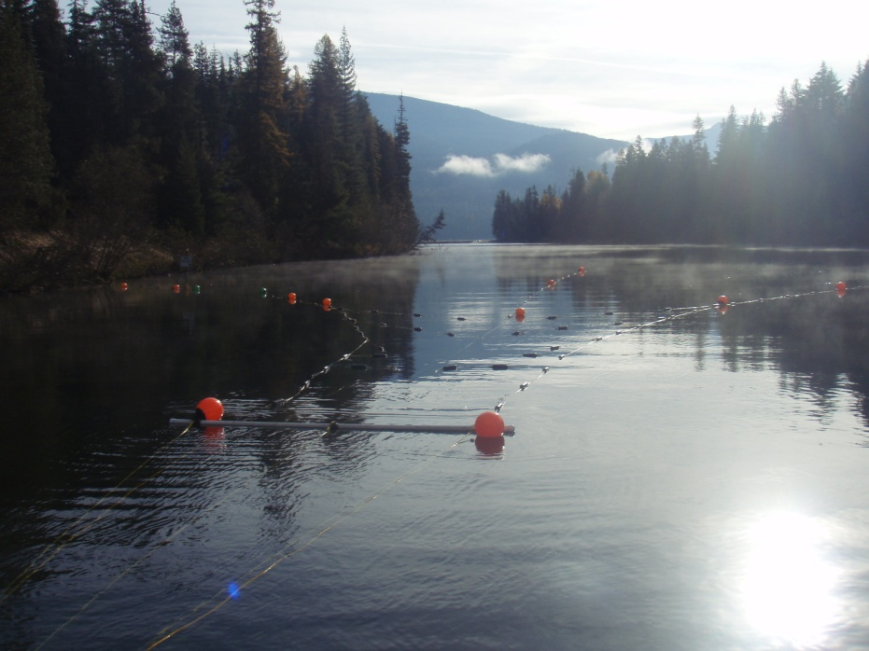
OBJECTIVE (2013-2017)
Maintain Stable or Reduced Lake Trout Numbers in Upper Priest Lake
Approximately 75% of the lake trout population in Upper Priest Lake removed annually.
Continue to provide matching funds for lake trout removal efforts.

Slide 10
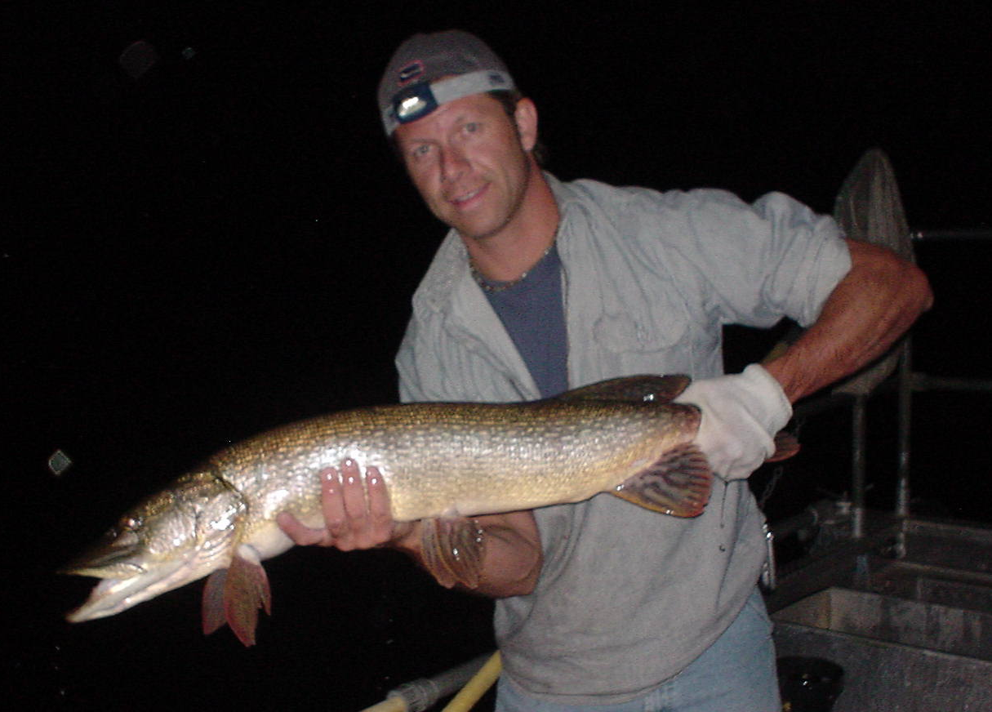
OBJECTIVE (2013-2017)
Reduce the abundance of northern pike in Box Canyon Reservoir from 13.2 NP/net to < 1.7 NP/net in southern ½ and < 0.5 NP/net in north ½ during SPIN.
Minimize impacts to native species
Reduce the spread of northern pike downstream to the Columbia River and prevent further illegal introductions

Slide 11
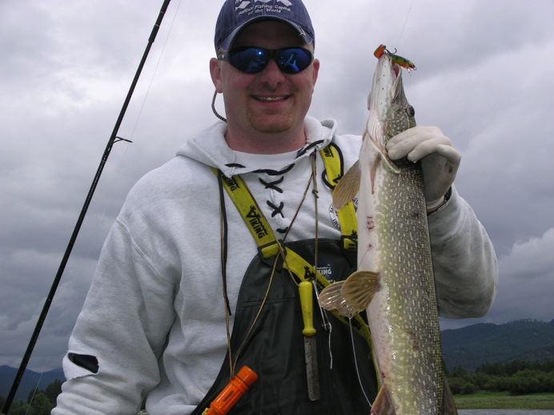

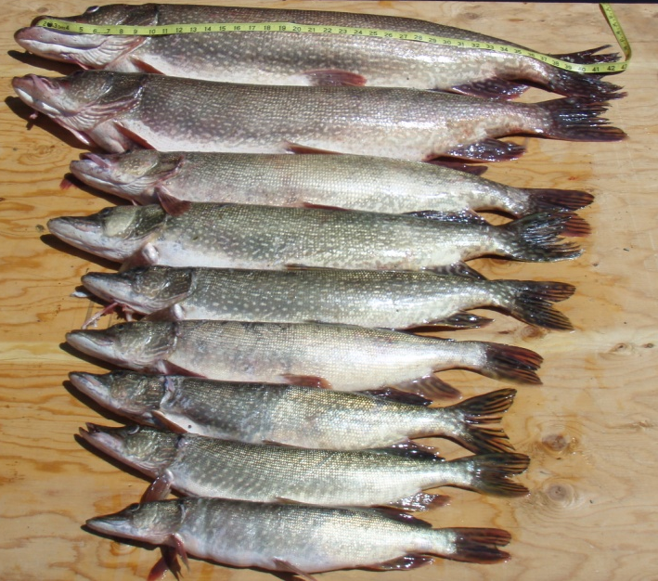
METHODS
Angler education
Angler incentive
Mechanical suppression

Slide 12
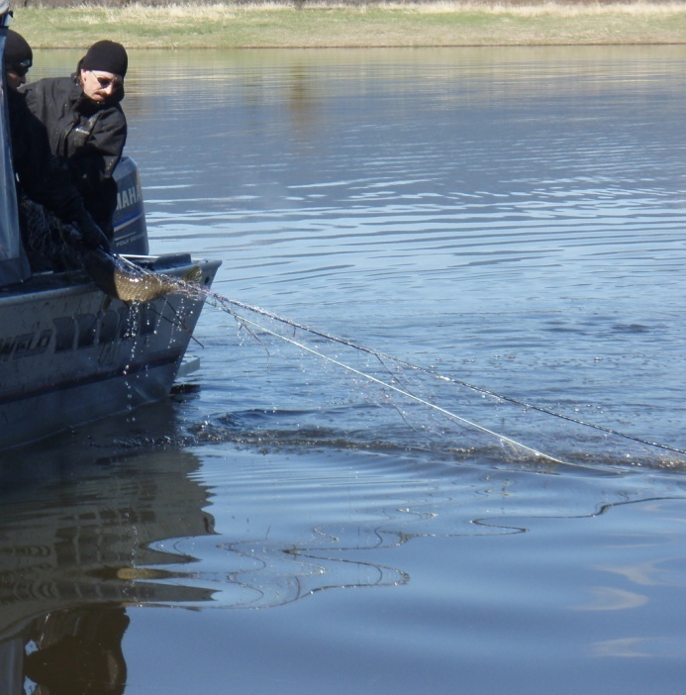
Mechanical suppression
Ice-off through June
Custom 24’ Almar, shallow draft landing craft, hydraulic gill net drum roller
7 days per week
150 ft x 6 ft variable mesh gillnets (1”, 1.25”, 1.5”, 1.75”, 2”)
12-15 nets/day (~1,200 nets)
Systematically net 25-30 spawning locations at saturation levels until catch falls by 85%.
Estimated NP catch (>10,000 fish,
  20 mT)
Estimated bycatch (~6,000 fish),
85% BBH, TNC, YP, PMO

Slide 13
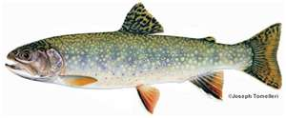
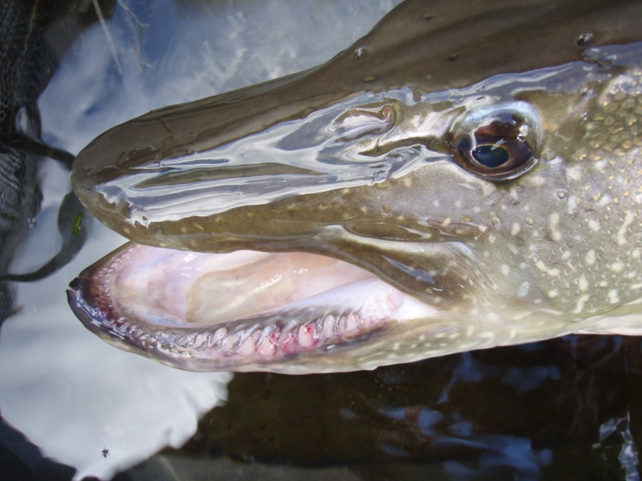
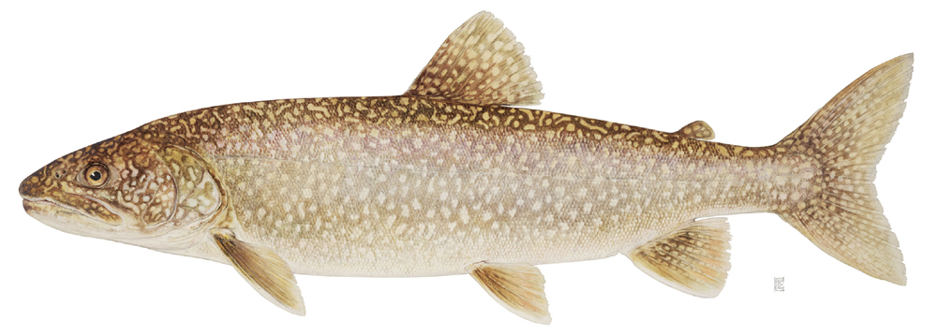
Questions?

