Slide 1

Lake Roosevelt Burbot Population Assessment
Project No. 2008-115-00
Jason McLellan
Confederated Tribes of the Colville Reservation

Slide 2
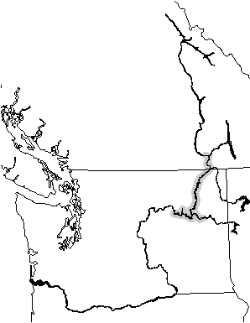
Background
Status reviews (1997, 2001)
  “Healthy”
  Abundance increasing
  Poor growth/condition
  Based on by-catch
Lack standardized monitoring

Slide 3
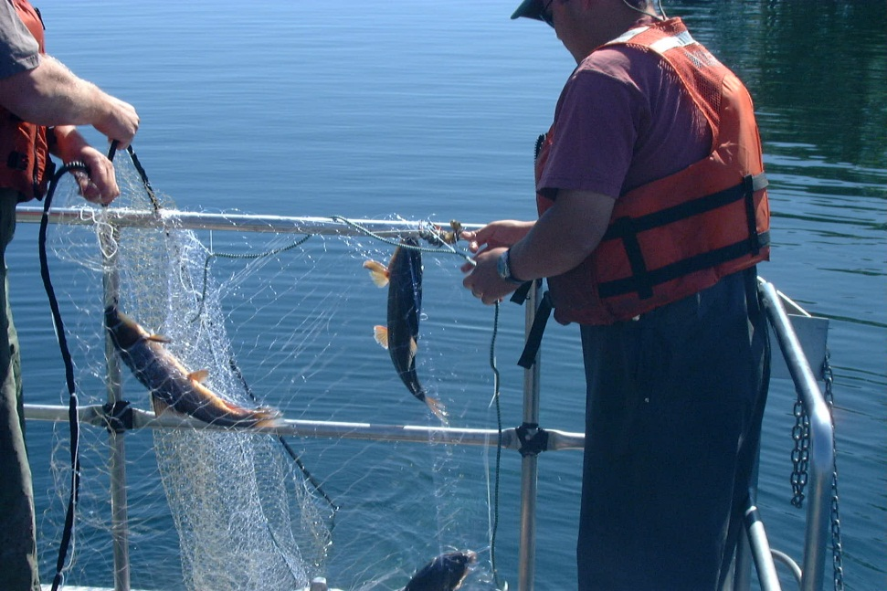
Background
Fall Walleye Index Netting (FWIN)
  BPA Project No. 1994-043-00
  Gill nets
Data – burbot by-catch
  No analysis
Burbot monitoring?

Slide 4

Goal and Objective
Goal - Healthy & harvestable population
Objective - Monitor population status and trend

Slide 5
Management Questions
Is FWIN by-catch adequate for monitoring?
Differences between gear types?
Most efficient gear for non-lethal capture?
Relationship - catch rate and abundance?
Status of the population?

Slide 6
Project Design
Evaluate FWIN (2013-2017)
  analyze existing data
Gear Comparisons (2013-2015)
  FWIN gill nets, cod traps, trammel nets
Stock Assessment (2013-2017)
  Adapt – gear comparison

Slide 7
Study Design
Gear Comparison FWIN
  FWIN gill nets, cod traps, trammel nets
  GRTS strategy
  50 sets/gear
  November (1 wk)
Gear Comparison/Stock Assessment
  cod traps, trammel nets
  GRTS strategy
  240 sets/gear
  late Fall - early Spring

Slide 8
Analysis
FWIN
  Analyze existing data – year effect, power analysis
  Gear comparison – gear type and year effects
Gear Comparison/Stock Assessment
  Analyze indices – gear and year effects, power
  Capture-recapture – abundance & survival
  Use most efficient after 3 years

Slide 9
Analysis
Survival
Capture-recapture
Abundance
Catch rate (C/f)
Proportion positive catch (Ep)
Capture-recapture
ANOVA
Binomial Logistic Regression
Robust Design
Robust Design

Slide 10
Analysis
Size Structure
Length-Frequency
Proportional Size Distribution
Mean Length
ANOVA
Cumulative Frequency Distribution
Ordinal Logistic Regression

Slide 11
Analysis
Condition
Mean Relative Weight (W_{r})
Length-Weight Relationship
Growth
Capture-recapture
Absolute Growth Rate
ANOVA
ANCOVA

Slide 12
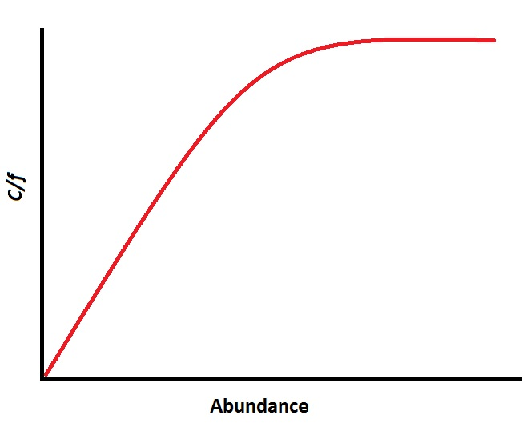
Analysis
Catch rate – abundance relationship

Slide 13

Management Implications
Current status and trends
Standardized stock assessment protocol
Standardized data for management

Slide 14

Questions?

