Slide 1



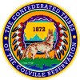
Upper Columbia
White Sturgeon Recovery
Lake Roosevelt Sturgeon Recovery (LRSRP)
BPA Project No. 1995-027-00
White Sturgeon Enhancement (WSEP)
BPA Project No. 2008-116-00
Jason McLellan (CCT), Deanne Pavlik-Kunkel (STOI), and Matt Howell (WDFW)

Slide 2
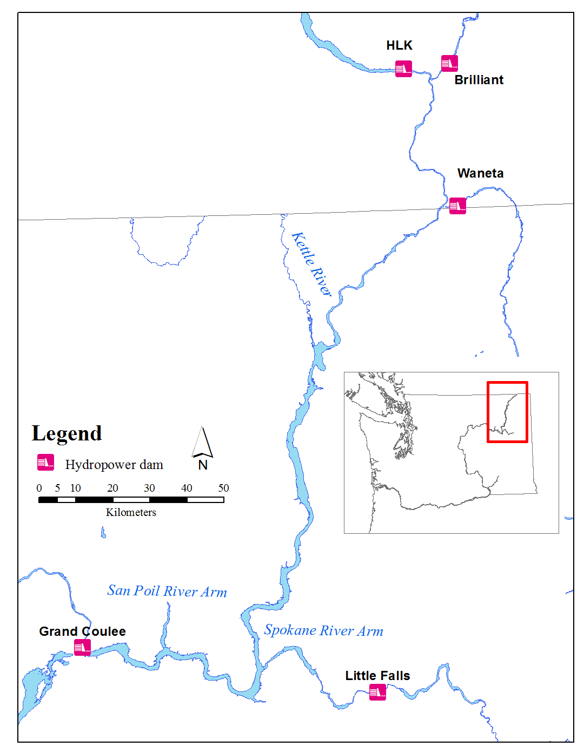
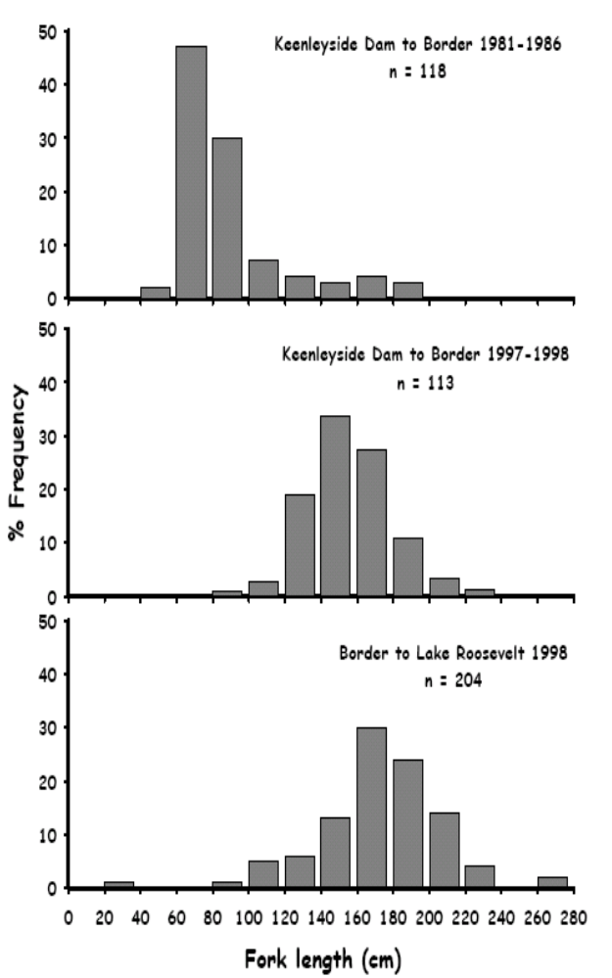

Upper Columbia White Sturgeon Recovery Initiative
Established in 2000
Recovery Plan in 2002
Goal: “…ensure the persistence and viability of naturally-reproducing populations…” and “restore opportunities for beneficial use if feasible.”
LRSRP (1995-027-00)
  implement RP in the US

Slide 3
Lake Roosevelt Sturgeon Recovery Project
Population assessment
Setline Surveys
Acoustic telemetry
Recruitment failure research
Conservation aquaculture
ELH studies
Preserve genetics
Rebuild demographics
Fall Gill Netting
(Natural recruitment monitoring)
Food availability
Predation

Slide 4
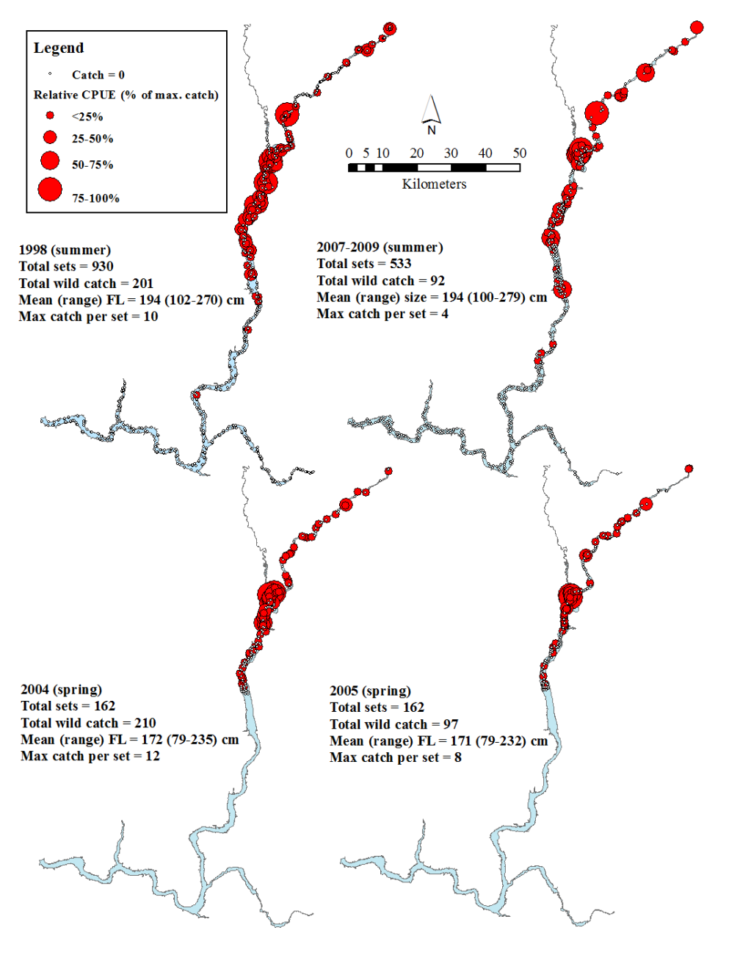
Population Assessment (wild fish)
Setlining
Acoustic telemetry
(GRTS)

Slide 5
Population assessment
(wild fish)
Setline catch composition
“Adult” (FL>150 cm) condition

Slide 6
Population assessment
(wild fish)
Reach | Origin | N | 95% CI | S | 95% CI
WA¹ | Wild (>70 cm FL) | 2,037 | 1,093-3,293 | - | -
BC² | (>34 cm FL) | 1,151 | 414-1900 | 0.97 | 0.92-0.99
WA & BC³ | Hatchery (6 mo. post rel.) | - | - | 0.28 | 0.11-0.54
WA & BC³ | Hatchery (2-5 yr post rel.) | - | - | 0.88 | 0.35-0.99
¹ Howell and McLellan (2007); ² Irvine et al. (2007) ; ³ Golder (2007)

Slide 7
Conservation Aquaculture
-Implementation and Adaptation-
Reach | Origin | N | 95% CI | S | 95% CI
WA¹ | Wild (>70 cm FL) | 2,037 | 1,093-3,293 | - | -
BC² | (>34 cm FL) | 1,151 | 414-1900 | 0.97 | 0.92-0.99
WA & BC³ | Hatchery (6 mo. post rel.) | - | - | 0.28 | 0.11-0.54
WA & BC³ | Hatchery (2-5 yr post rel.) | - | - | 0.88 | 0.35-0.99
LRSRP program
  BY 2003-2005
    Canada broodstock
  BY 2006-2010
    Northport broodstock
  BY 2010-2011
    Larval collection
UCWSRI aquaculture review
  Factorial mating
  Canada releases reduced
  Effective as of 2008 BY
¹ Howell and McLellan (2007); ² Irvine et al. (2007) ; ³ Golder (2007)
Total transboundary releases through 2010 = 118,412
(WA sub-yearling releases from
BY 2011 larvae = 3,590)

Slide 8
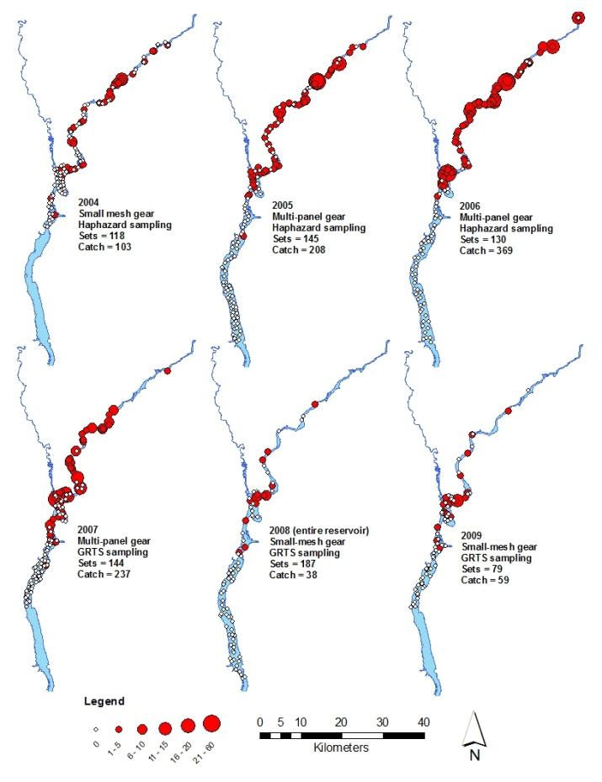
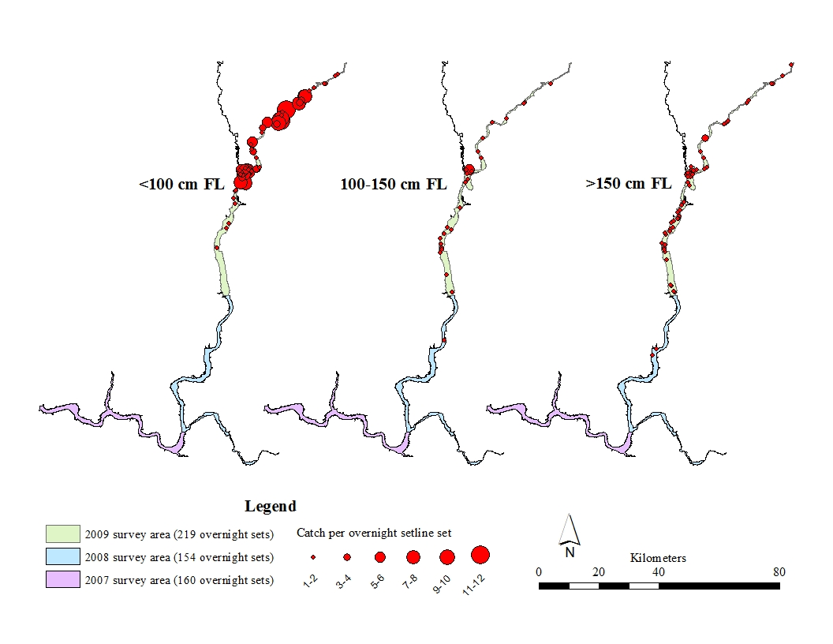
Conservation Aquaculture
-Evaluation-
Fall Gill Net Surveys
Juveniles generally confined to river-reservoir
transition zone
2007-2009 Summer Setline Surveys

Slide 9
Conservation Aquaculture
-Evaluation-

Slide 10
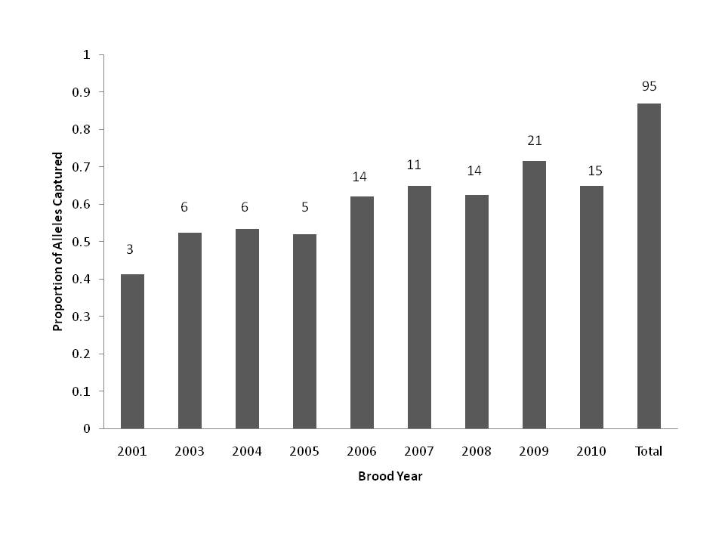
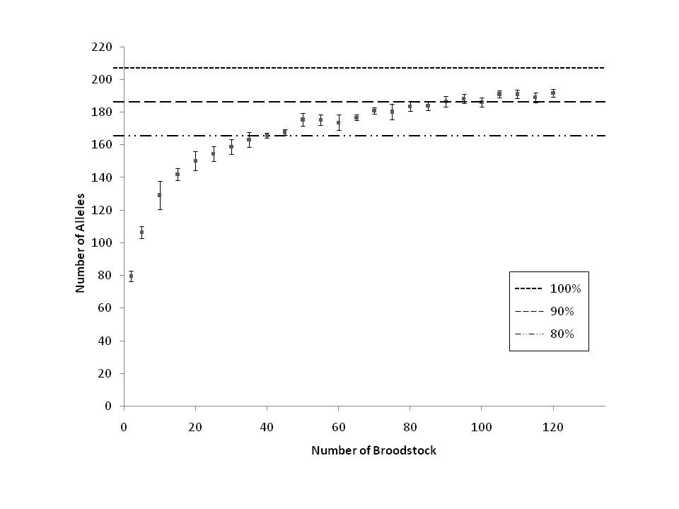
Conservation Aquaculture
-Evaluation-
100 broodstock spawned
  95 genotyped
~87% alleles represented
Rare alleles in broodstock not in population sample
Greater population diversity?

Slide 11
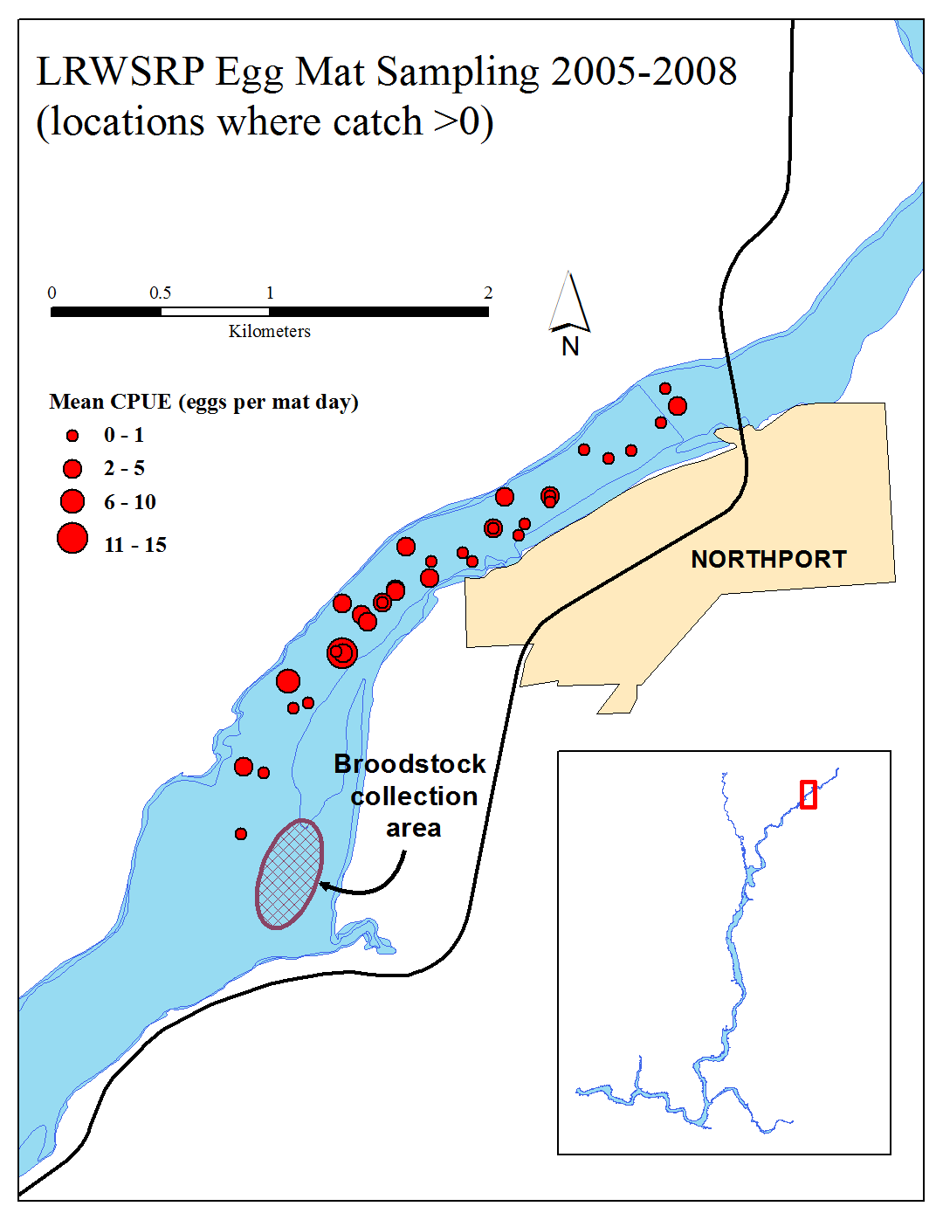
Early Life History
-Spawning-
Northport area
  Inferred from telemetry of pre-spawn adults (2004-2005)
  Documented with egg mat gear (2005-2008)
Protracted spawning period
  mid-late June through (at least) July
Commences when temp ~13-14 C at border
Not associated with dam tailrace

Slide 12
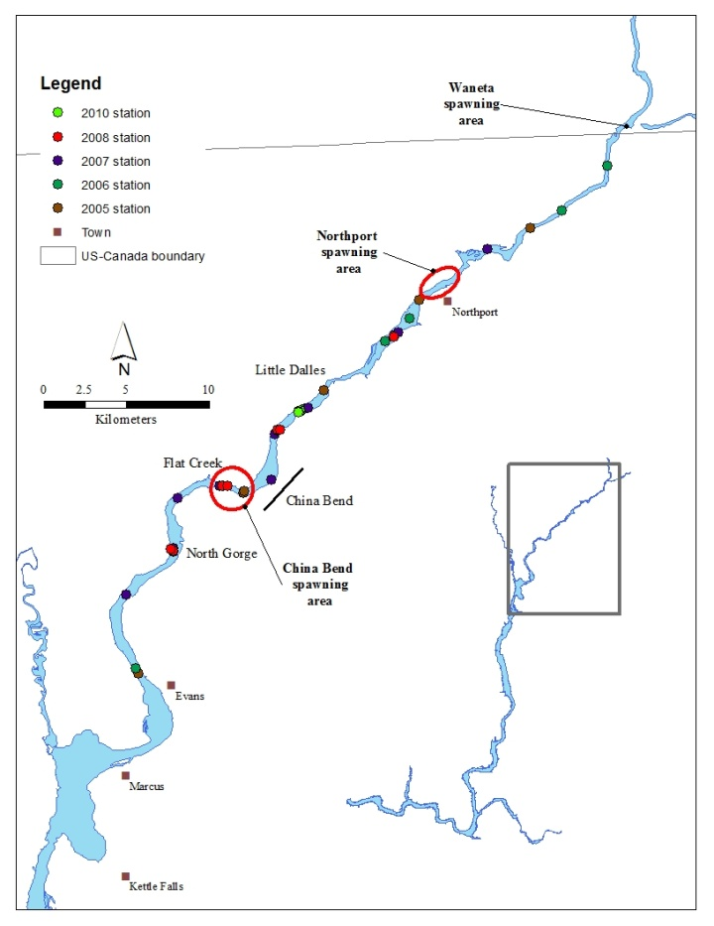
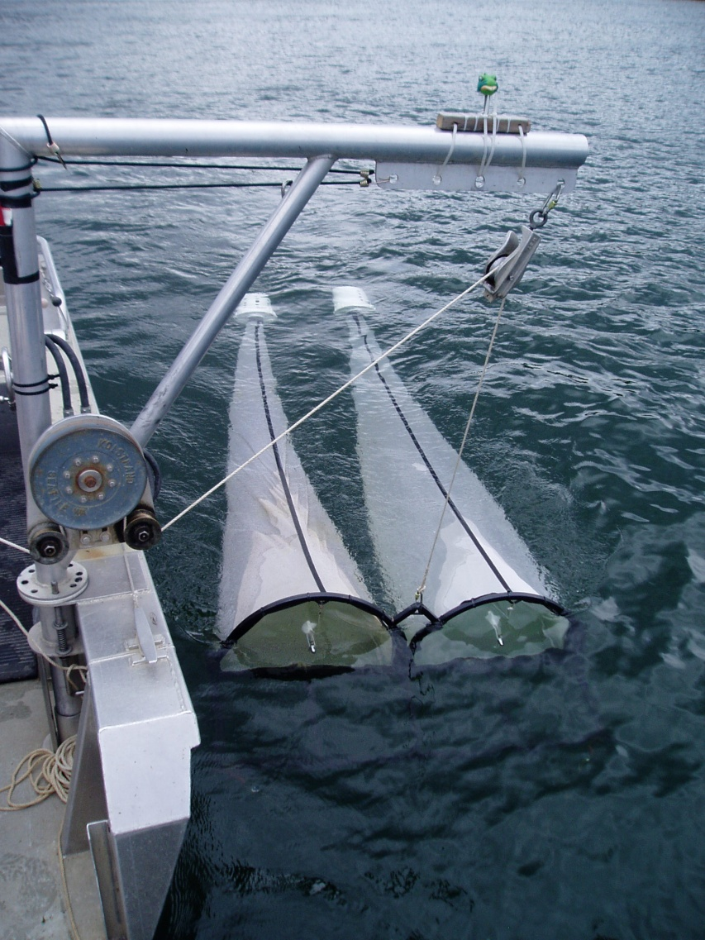
Early Life History
-Post hatch-
D-ring frame

Slide 13
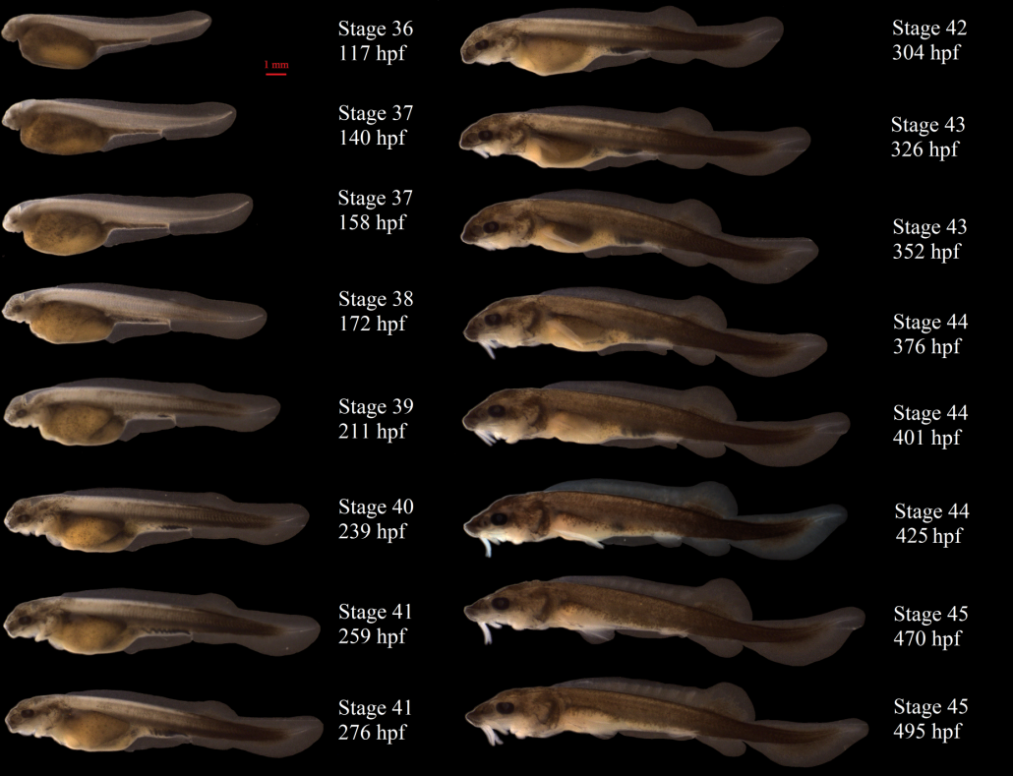
Early Life History
-post hatch-
D-ring catch composition
2008 D-ring data
(prey principally chironomid
pupae/larvae)

Slide 14
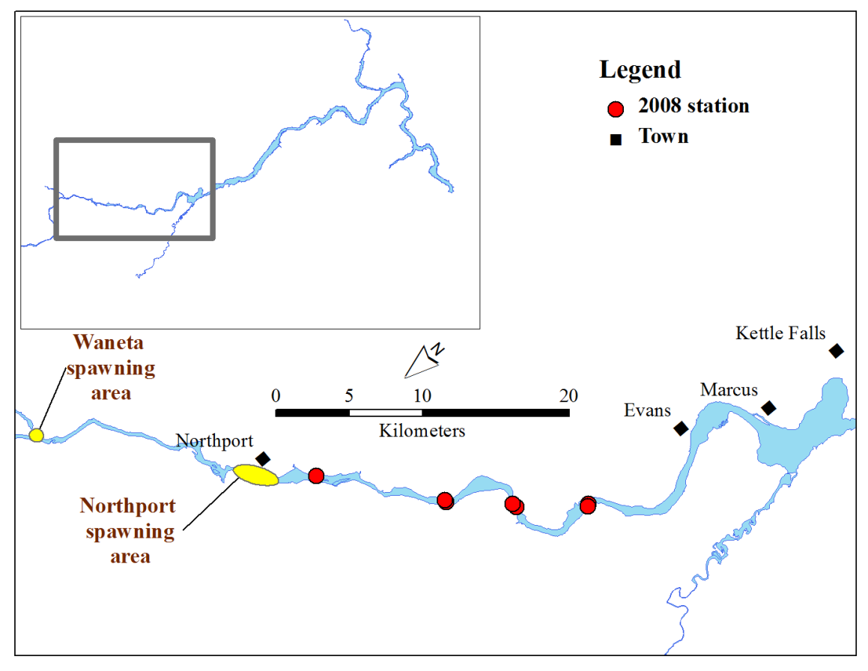
Early Life History
-post hatch-
2008 D-ring
D-ring (late June-July)
  Larval abundance declines downstream
Trawling (July-August)
  No larvae in upper reservoir
Fall gill nets (October)
  No age-0 subyearlings
Survival bottleneck
  Between larval and age-0 juvenile stages (July-October)
  Upper transition zone
  Predation? Contaminants? Prey base?
Riverine
Upper transition zone

Slide 15
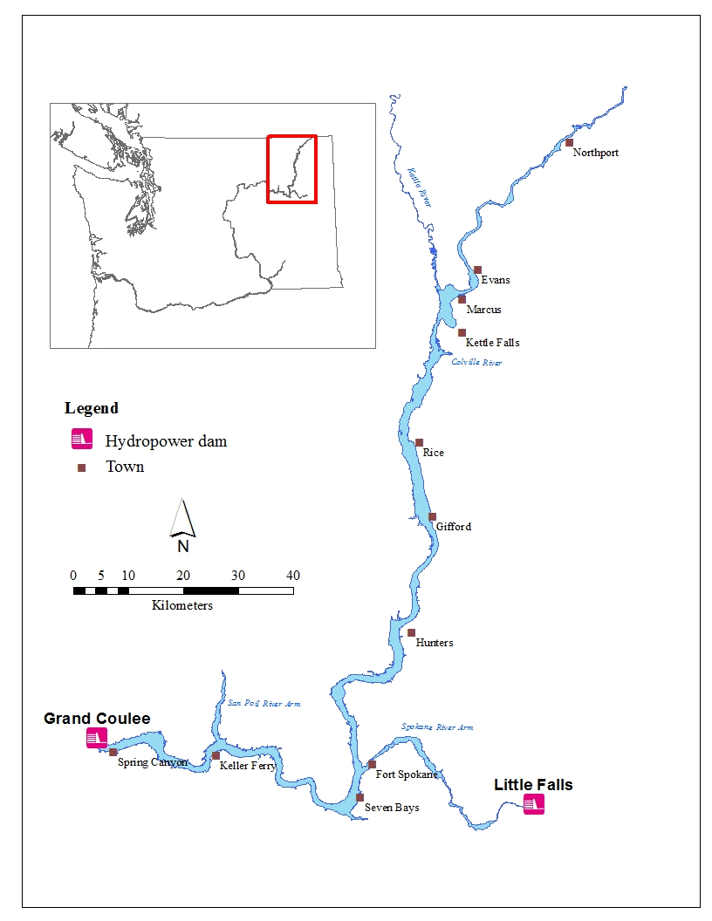
Recruitment Failure Mechanisms
Predator sampling
  Electro-fishing
  July-August 2005
  520 gut samples, 13 species
  No sturgeon in diets
Macro-invertebrate sampling
  Various gears
  July 2007-2010

Slide 16
Recruitment Failure Mechanisms
-Larval Transport-
Catch drops
off at sunrise
Power peaking

Slide 17
2013-2017
WA Co-Managers Operations Plan Outline
LRSRP and WSEP
Core Program
Habitat Assessment
Recruitment Failure
Data Management
Aquaculture
Population Monitoring
Telemetry
Fall Gill Net
Setline
Larval transport
Empirical testing
Proximate mechanisms
Predation
Food
Flow/Habitat modeling
WQM
MBES
ADCP
Contaminants
Larval releases
Mass Marking

Slide 18
Project Specific Components
LRSRP 1995-027-00
WSEP 2008-116-00
Core Program
  Stock Assessment
  Sub-yearling gill net
  Aquaculture
  Telemetry
Recruitment Failure
  Predator assessment
  Food availability
  Chemical mass marking
Core Program
  Data Management
Habitat Assessments
Recruitment Failure
  Flow/habitat modeling
  Contaminant assessments
  Larval release experiment

Slide 19
Management Implications/Alternatives
Larval transport hypothesis
“Net and Jet”
Hydro-ops
Proximate
Mechanisms
Food availability
Predation
Predator control
Contaminants
Increase productivity
(fertilization)
CERCLA
process
Turbidity
Behavioral and sensory impacts
Decreased prey densities
Behavioral and sensory impacts

Slide 20
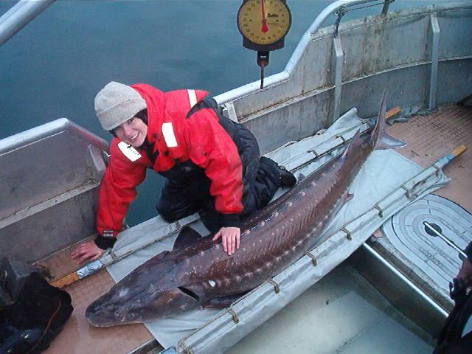
Questions?

