Slide 1
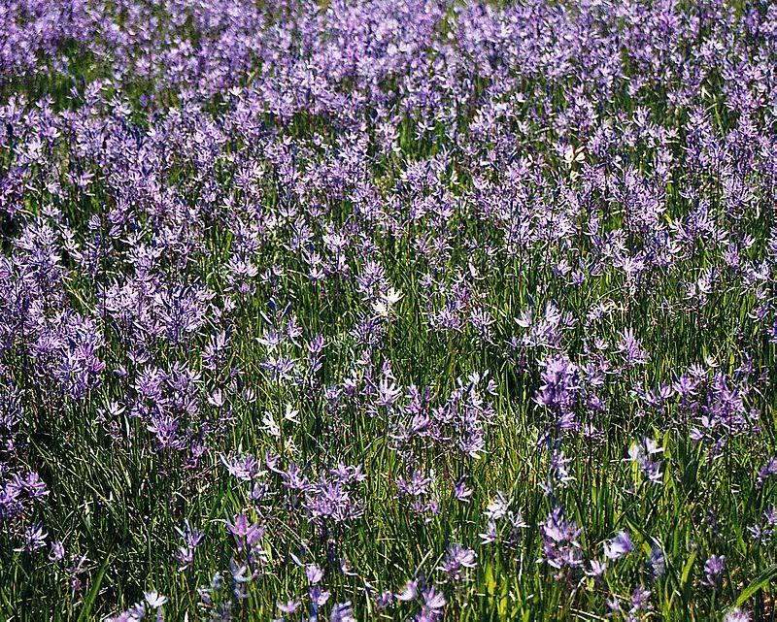


Kalispel Tribe Resident Fish Program
1995-001-00
  Hatchery-Wayne Gould
  Habitat- Michele Andersen

Slide 2
Kalispel Tribe Resident Fish Program
Hatchery Objectives
Create a subsistence fishery for Tribal members.
Provide a healthier specimen for consumption by cutting down on bio-accumulated toxins.

Slide 3
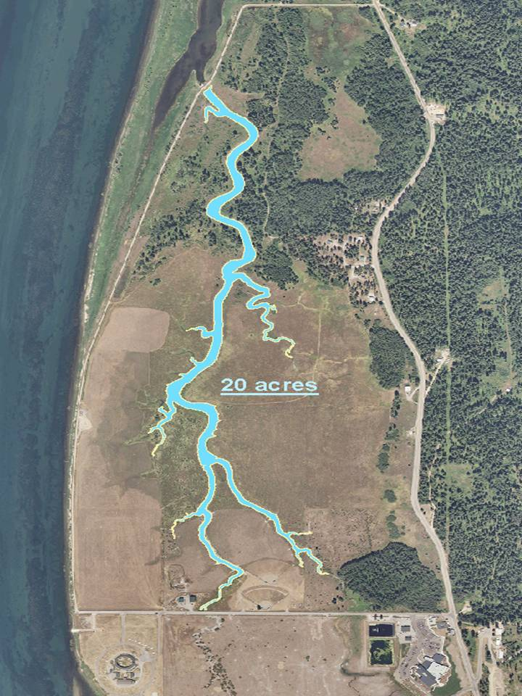
Kalispel Tribe Resident Fish Program-Hatchery’s
New Largemouth Bass stocking location
WDFW approved fish screen to be installed.
Stocking of the slough will utilize an unused body of water for fishing opportunities.
New stocking location is easily accessible for Tribal fishing.

Slide 4
Kalispel Tribe Resident Fish Program-Hatchery Operations
2013-2017
KTFH will collect 14-20 brood stock in early spring from the Box Canyon reservoir for spawning.
100,000 Fry will be hatched and reared at the hatchery until a growth of approximately 15-20mm. is achieved.
Fry will be held in fertilized outdoor ponds until total length exceeds 35mm.
Plant 100,000 35-50mm. large mouth bass fingerlings into the isolated south dyke slough.
Release brood stock into the Box Canyon Reservoir.

Slide 5
Kalispel Tribe Resident Fish Program
Habitat Objectives
Conduct habitat assessments in Pend Oreille River tributaries.
Determine fish population distribution and abundance.
Implement restoration actions where necessary.
Monitor, evaluate and maintain restoration actions.

Slide 6
Kalispel Resident Fish Program-Habitat
Importance/Significance
Identify native fish populations.
Quantify habitat suitable for supporting native fish.
Recommend and implement restoration actions which will benefit native fish.

Slide 7
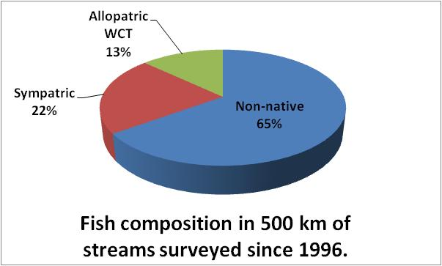
Kalispel Resident Fish Program-Habitat
Adaptive Management
1995-2006
  Comprehensive tributary habitat assessment and population sampling approach.
  Prescriptive habitat enhancement.
  Not targeting native fish priorities.
2007-
  Native fish distribution dictate habitat assessment.
  Habitat enhancement/restoration actions implemented based on benefit to native fish.

Slide 8
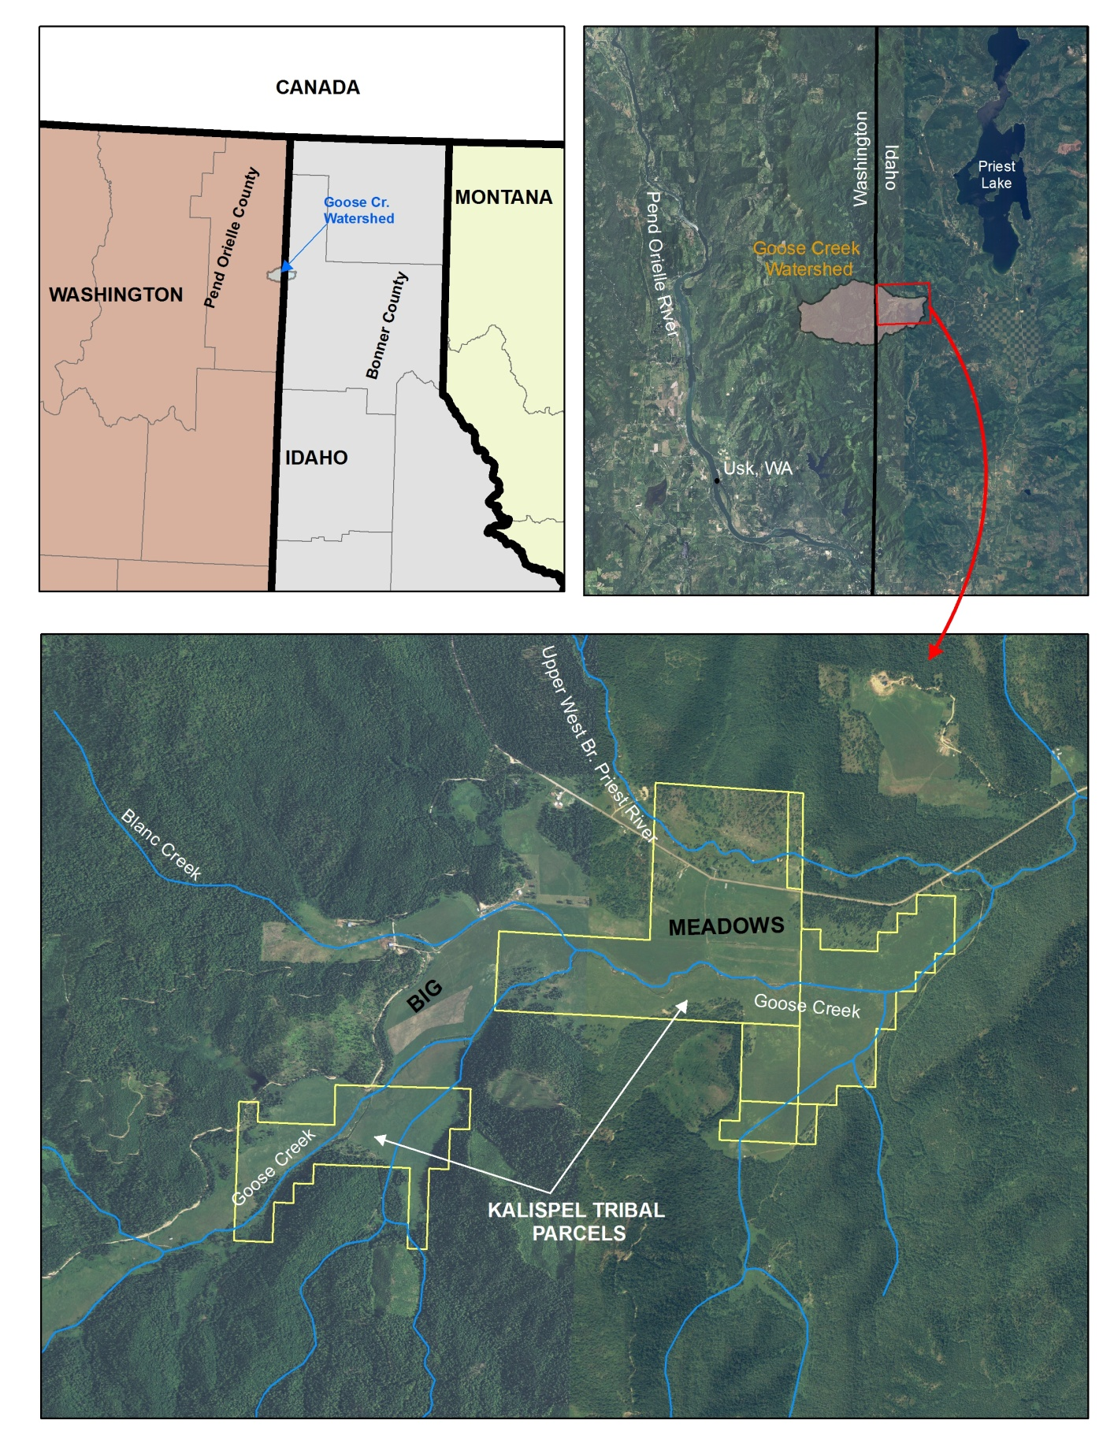
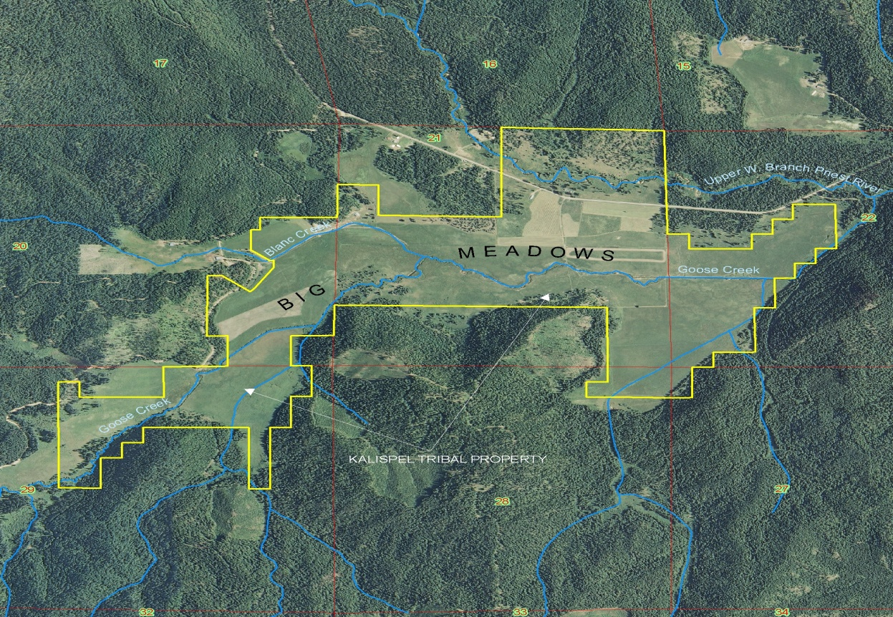
Big Meadows Restoration
Big Meadows
Tribe acquired in 2007 & 2010.
773 acre parcel.
6.6 km of Goose Creek.
12 miles southwest of Priest Lake in Idaho panhandle.
Previous land management; cattle grazing/hay production, channelizing, dredging.
Goose Creek
56 km² drainage area.
4th order tributary to UWB Priest River.

Slide 9
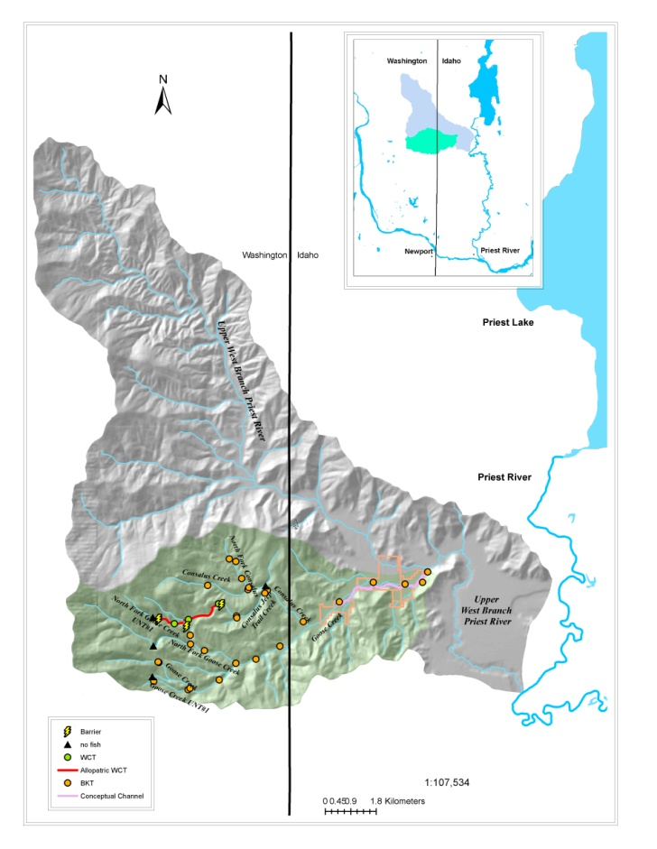
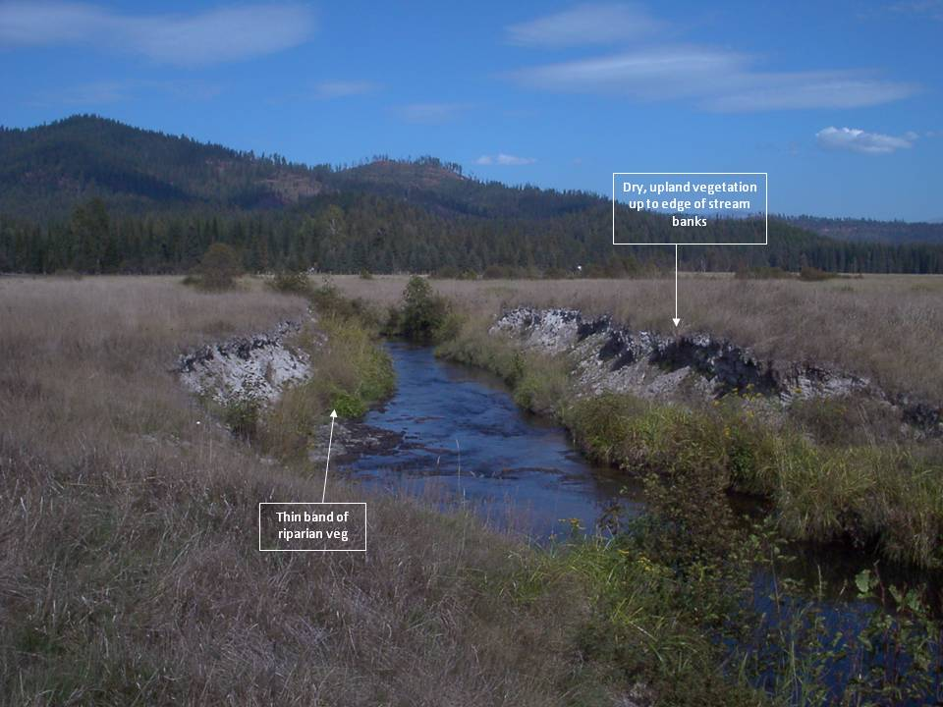
Big Meadows Restoration Investigations
2008-2009
Eroding banks.
Reduced channel length.
Lateral and vertical instability.
Poor habitat complexity.
Disconnected floodplain.
2008- Channel morphology surveys.
Fish population sampling in 2009 identified isolated reaches of WCT in Goose Creek headwaters.

Slide 10
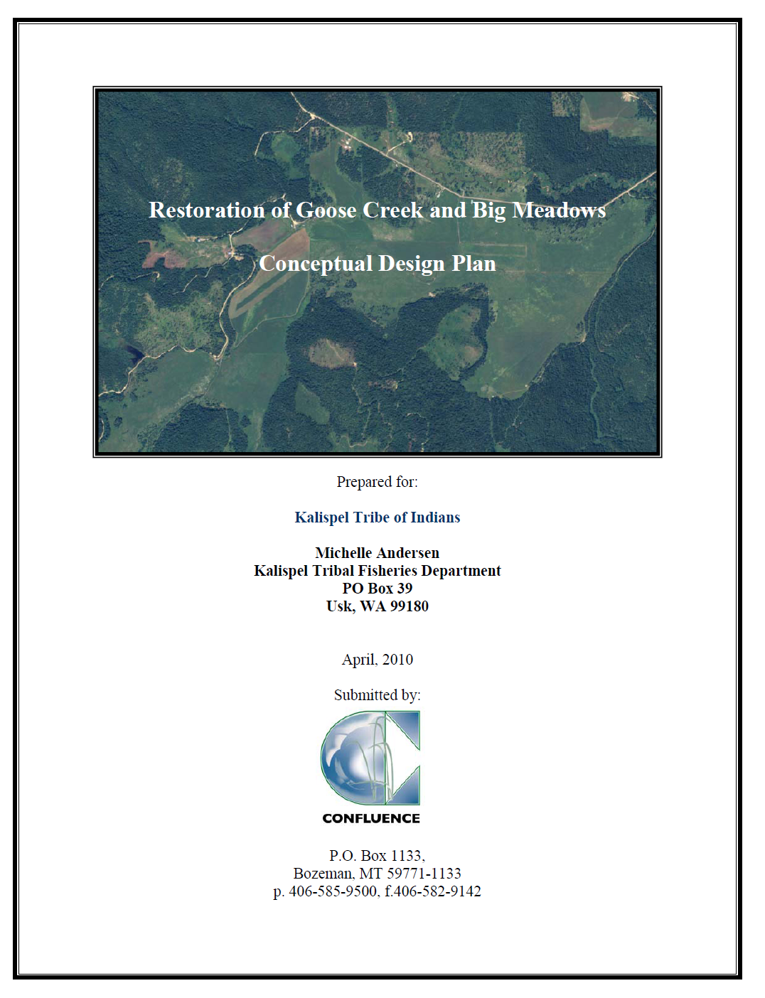
Planning 2009-2010
Conceptual Design Plan
Objectives
Morphological and hydraulic variability.
Lateral Connectivity.
Near natural abundance and diversity of riparian and floodplain vegetation.
Native fish composition.
Diversity of fish habitat.

Slide 11
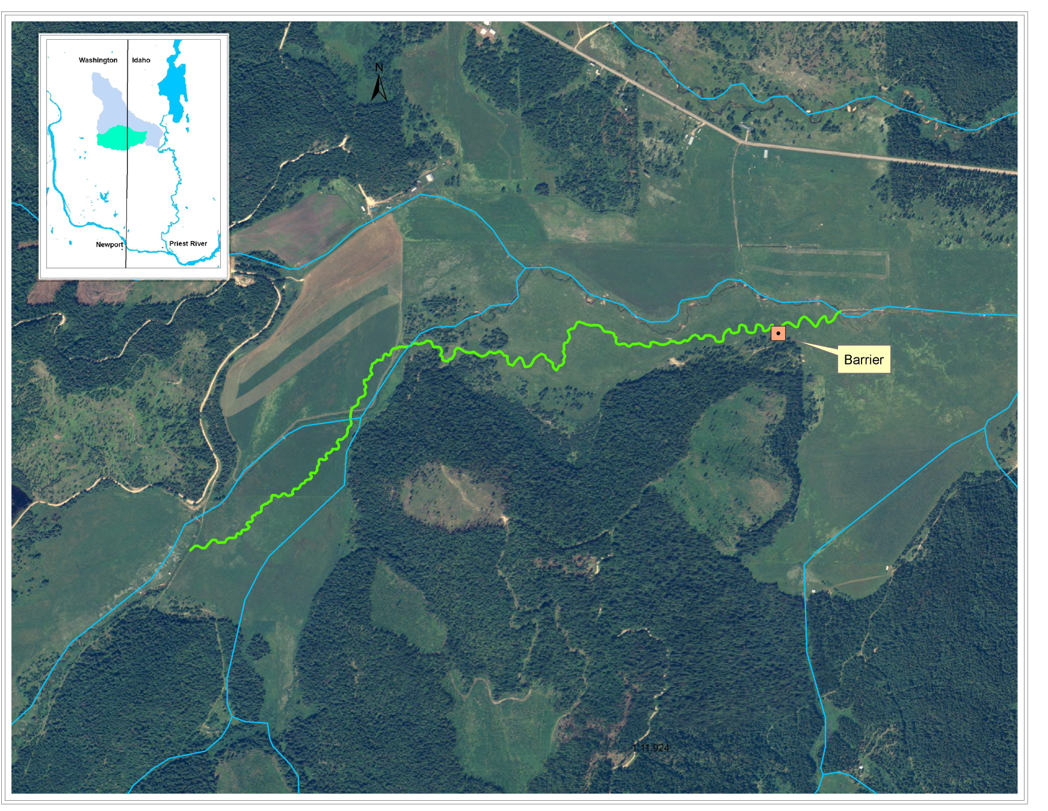
3.9 km new channel construction.
Design sinuosity 1.4-1.7.
Design slope 0.12%-0.16% .
Design Discharge 150-160 cfs (Qbf)
Design W/D 11.

Slide 12
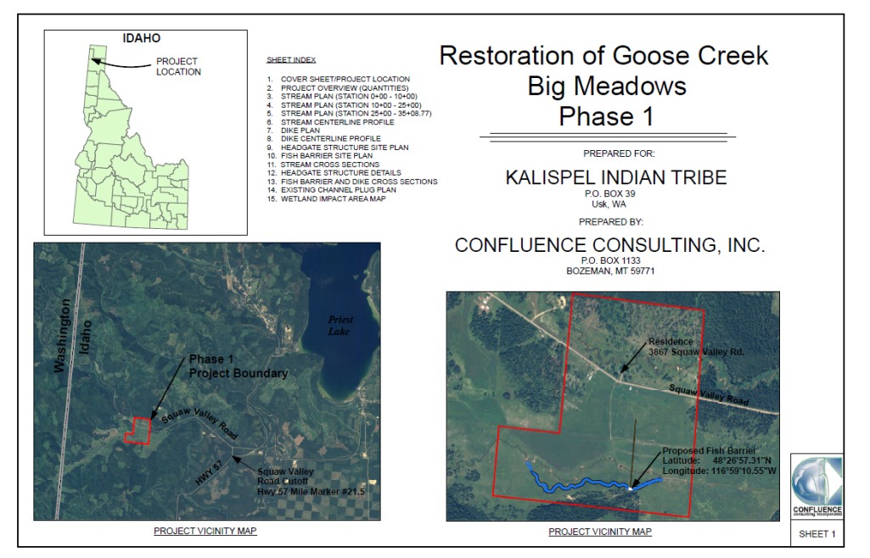
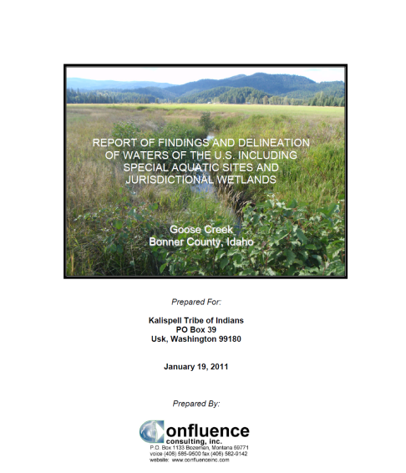
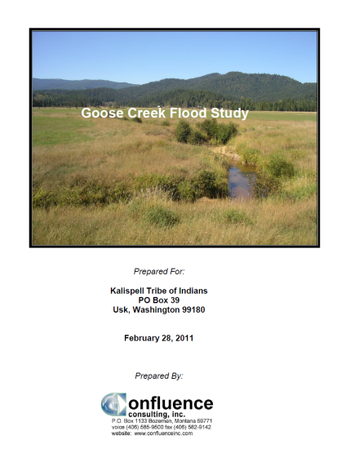
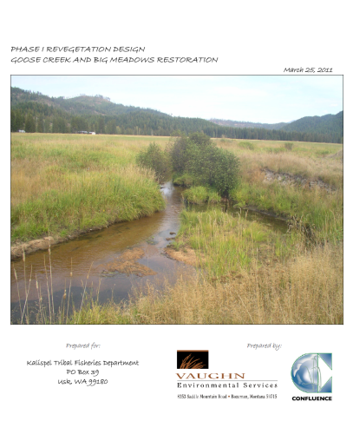
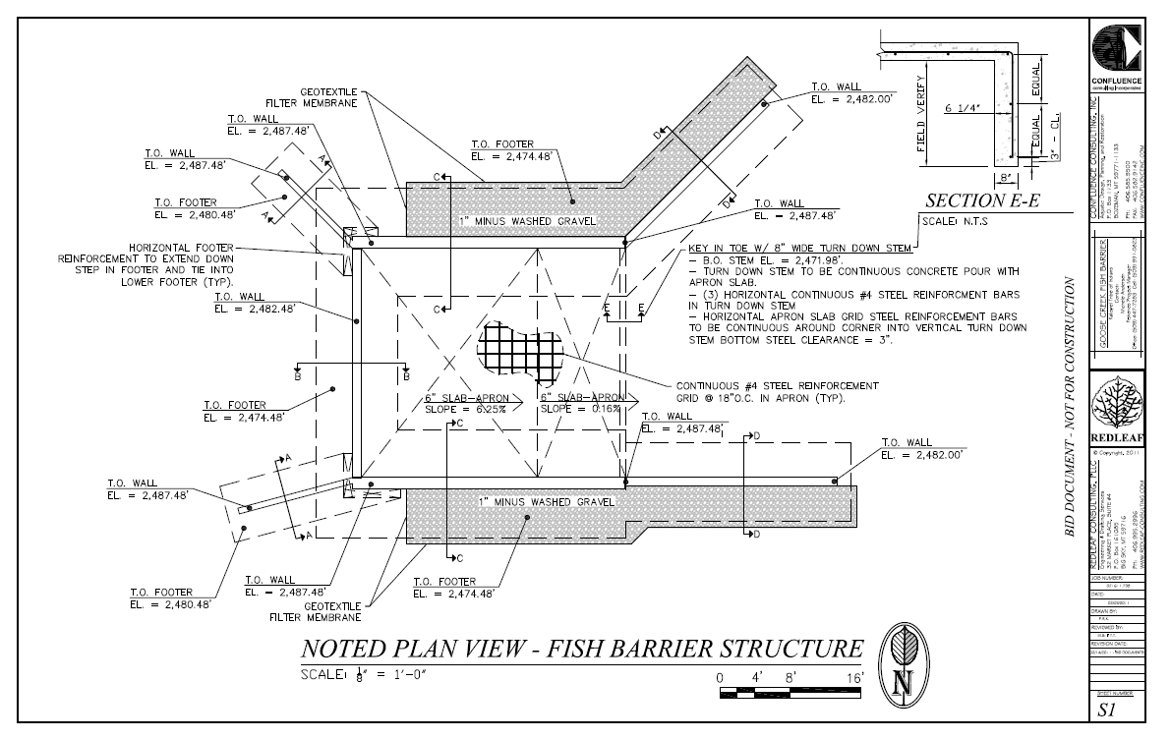
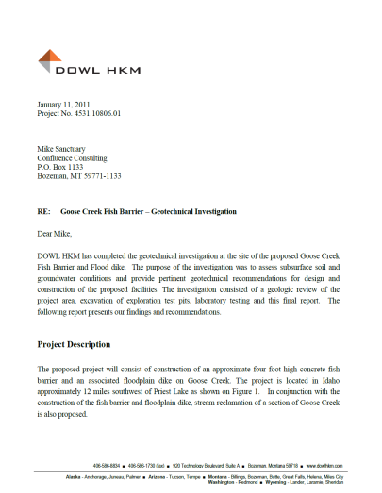
Design 2010-2011

Slide 13
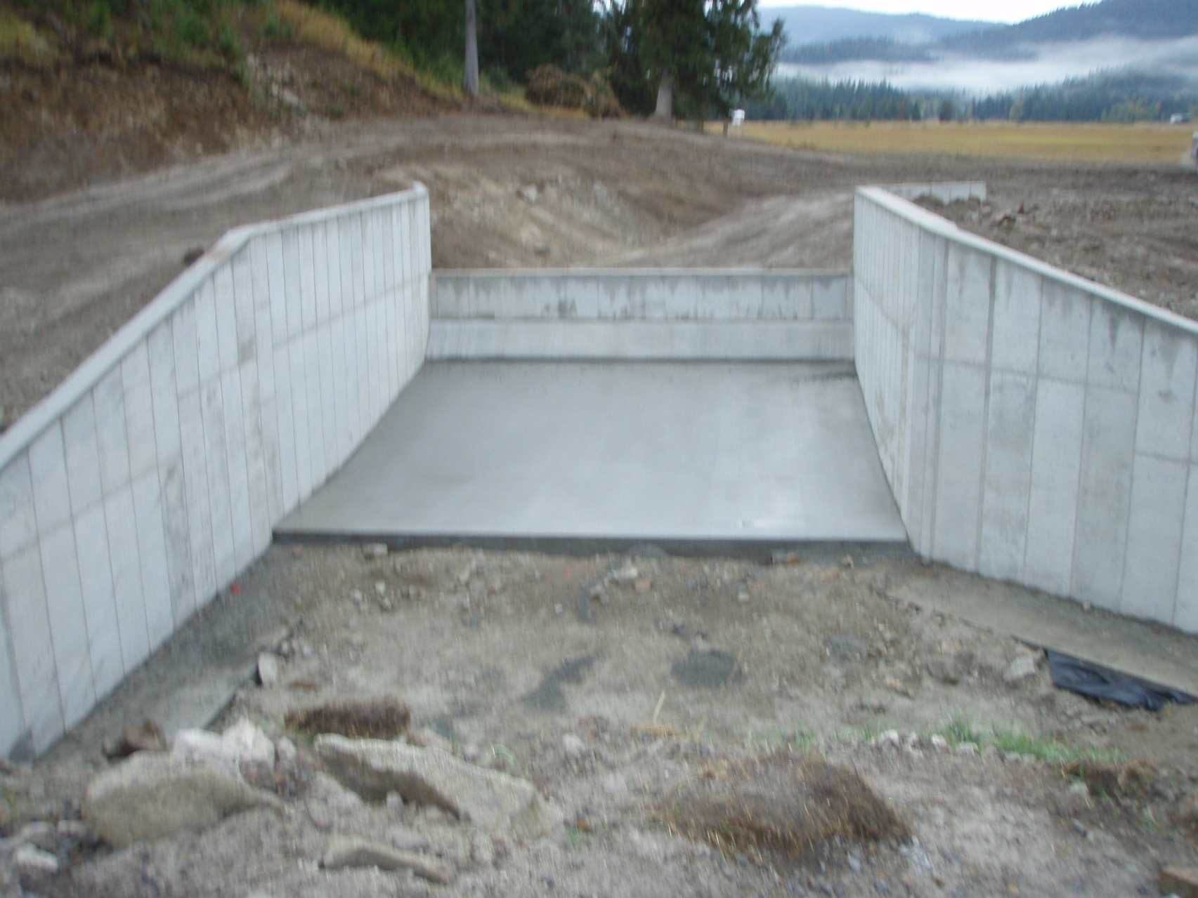
Implementation 2011-2017.
Barrier and floodplain dike completed 10/1/11.

Slide 14
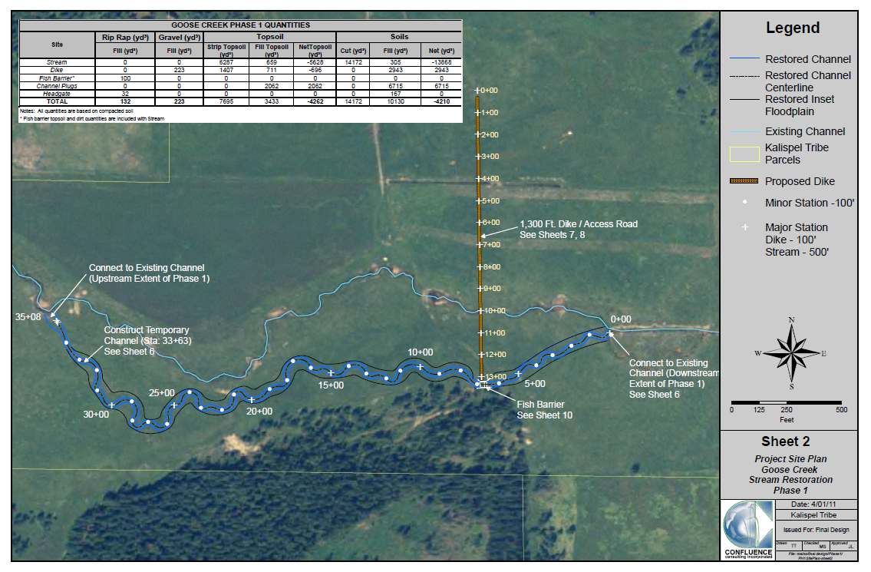
Phase I Channel Construction 2012.

Slide 15
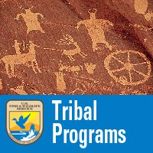


Implementation 2013-2017
FY11
$200,000
2013 Activate and plant phase I channel.
2013 Construct phase II channel.
2014 Activate and plant phase II channel
2014 Construct phase III channel
2015 Construct new channel crossing and access road.
2016 Construct channel plug.
2016 Activate and plant phase III channel.
2017 Backfill abandoned channel.
2017 Backfill spoil areas.
FY11
$25,000
FY12
$25,000
FY12 $50,000
FY13 $50,000
FY14 $50,000

