Slide 1
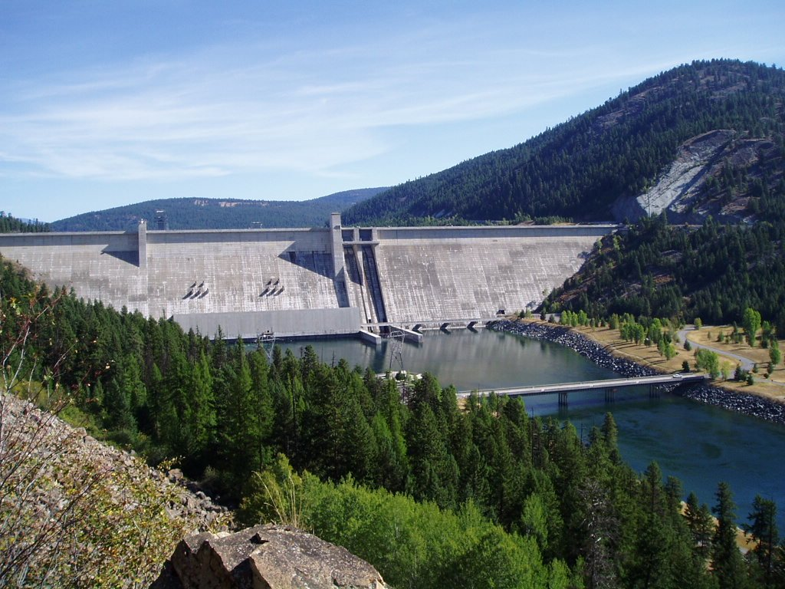


Libby Dam Mitigation
Project
(199500400)
Jim Dunnigan
Fisheries Biologist
Notes:
The primary purpose of this overview today is to give the ISRP the information required to understand the Kootenai System and FWP’s mitigation program on the Kootenai.

Slide 2
Discussion Outline
Brief history of Libby Dam, summary of impacts
from construction and operation
Summary of our mitigation strategies and
historical perspective of our program
Accomplishments to date
Future Work

Slide 3
Libby Dam
- Fragmented the Kootenai River
- Changed the species composition above
Libby Dam by changing the habitat
Altered hydrograph and thermograph
downstream of the dam
Notes:
Construction began in 1966 and was completed in 1972, first filled in July, 1974 creating a 90 mile long reservoir with a surface area of 188 km² The dam is operated by the USACE. The dam was primarily constructed for power production and to a lesser extent flood control. There is no upstream passage for fish at the facility although downstream passage occurs.
Kootenai SubBasin: Second largest tributary to Columbia River with 73% in BC, 21% MT, 6% in ID.

Slide 4
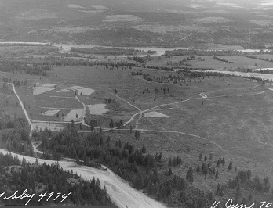
Fisheries Losses
Libby Reservoir
175 km of the Kootenai River inundated
Annually 15,000 trout and 377,000 mountain whitefish lost
134 km of tributary stream habitat inundated
Annual loss of 57,000 juvenile trout inundated tributaries
25 km Tributaries blocked by road construction
Annual loss of 5,990 juvenile trout from blocked tributaries
Kootenai River
Annual loss of 2,100 juvenile westslope cutthroat trout
95+ percent reduction in burbot fishery
White sturgeon endangered due to limited recruitment and habitat issues
Bull trout threatened
Kootenai River 1970
(Near Rexford)
Notes:
Mention: Fisheries loss statement in the Libby Mitigation and Implementation Plan (1998). MFWP and 2 Tribes
Explain the loss statement and the tabulated results.

Slide 5
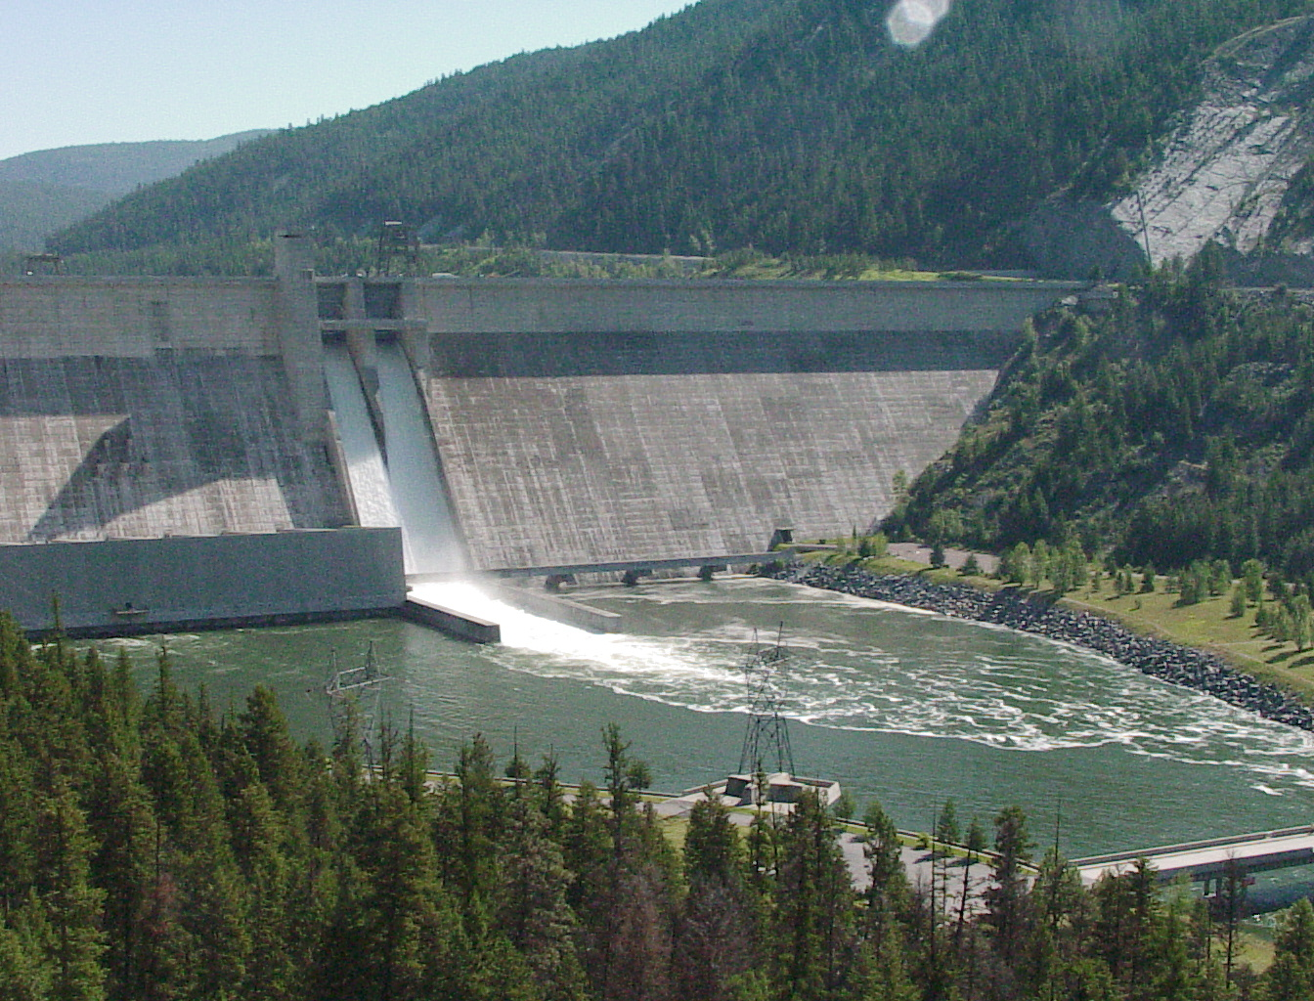
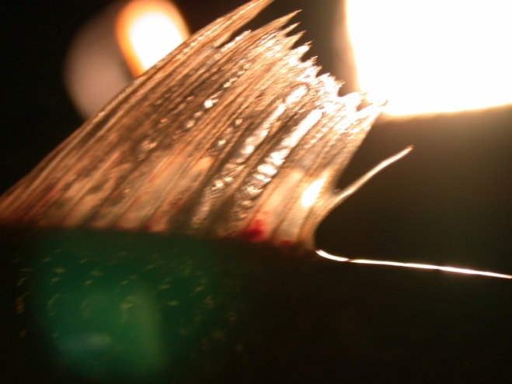
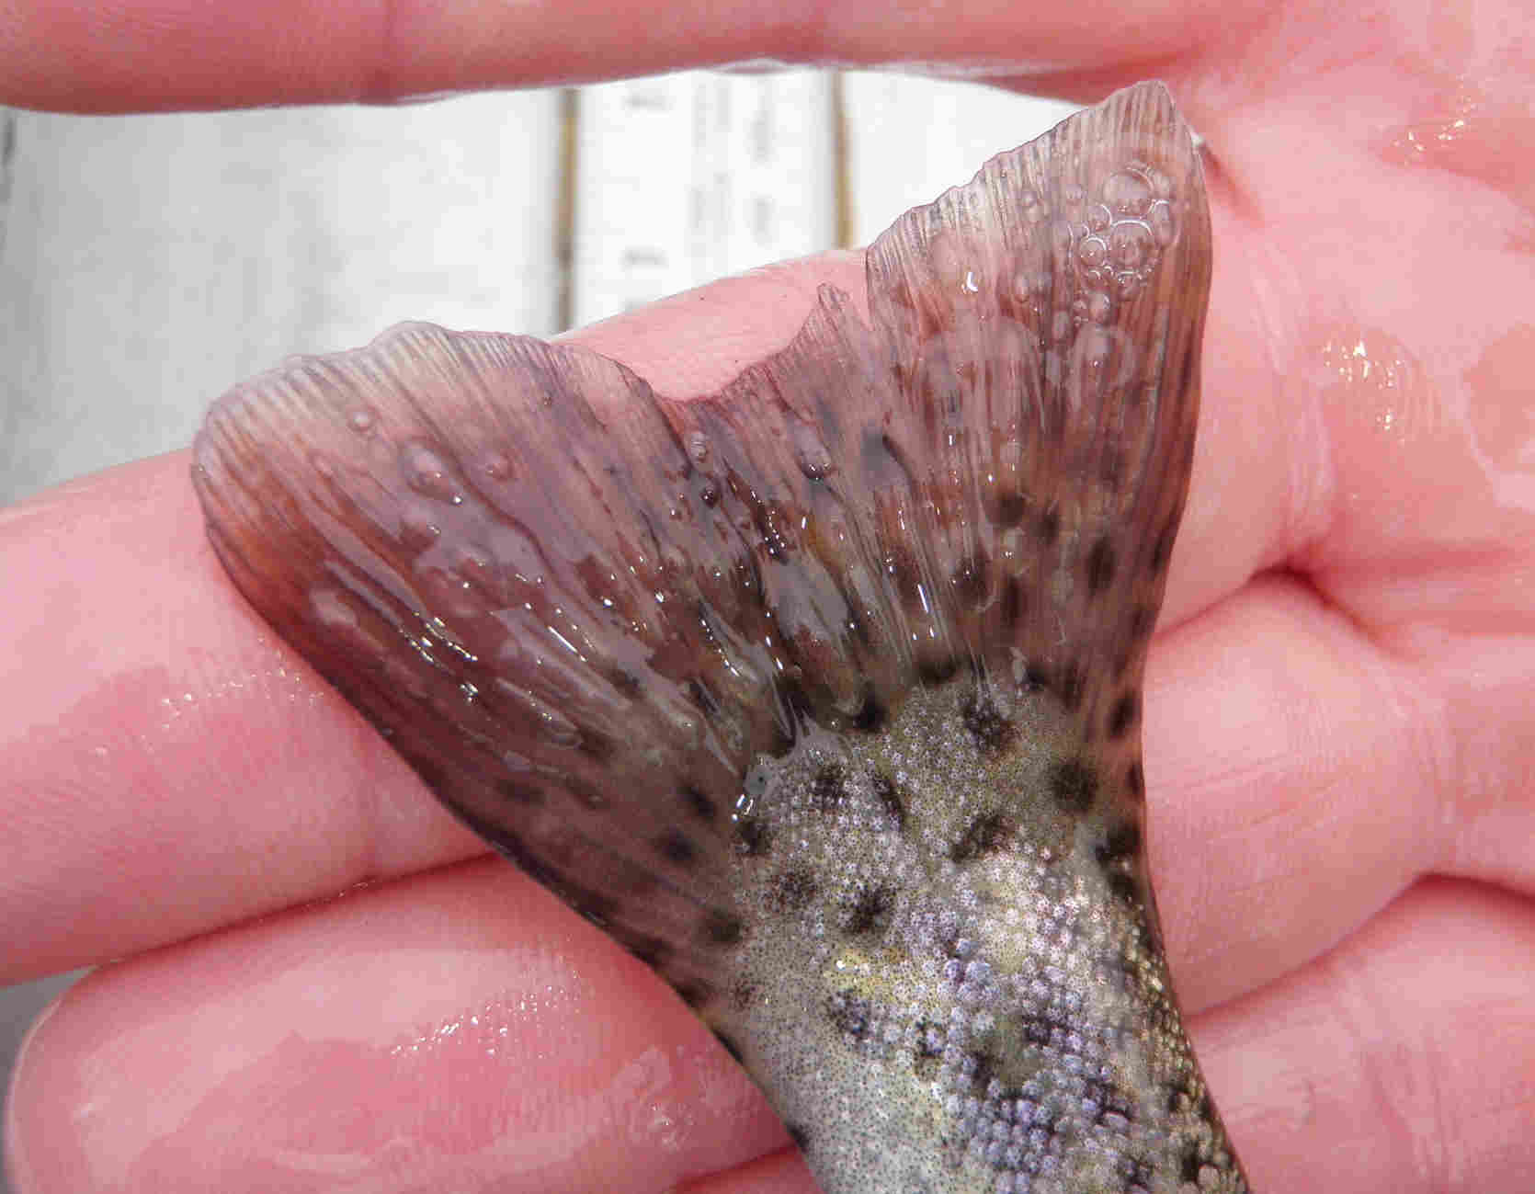
Spill operations in 2002, 2006, and 2010
Sluice gate operations in 1981 and 2011
Notes:
More recently spill operations for either emergency operations or sturgeon have had impacts related to dissolved gas. This impact is only observed in MT portion of Kootenai, especially tailrace. Spill or Sluice operations have occurred in 1981, 2002, 2006, and 2010. TDG levels during some operations have exceeded 134%.

Slide 6
Libby Mitigation Project History
Phase I (1983-87):Quantify seasonal water levels and develop ecologically sound operations
Phase II (1988-96): Determine biologic impacts of construction/operation
Phase III (1996-present): Implement mitigation and enhancement measures, and implement associated effectiveness monitoring, population trend/status
monitoring and applied research.
Notes:
Associated monitoring includes providing data for evaluation of operational strategies, river and reservoir condition monitoring, and project effectiveness monitoring.

Slide 7
Mitigation Implementation Strategies
(Kootenai Sub-basin Plan)
Continue to refine and develop hydro-power operations that promote normative ecological conditions to the extent possible.
Prevent the introduction and spread of non-native species
On and Offsite mitigation measures include:
-improving degraded habitats & water quality
-providing fish passage
-reduce introgression/predation/competition
-providing offsite opportunities for angling
Notes:
The impacts have been large in magnitude, and it may not be possible to completely mitigate for loss of most productive waters impacted. Simple Priorities:
Preserve/protect the best habitat for native species
Improve/restore habitats critical for native species as well as slightly to moderately degraded habitat
Improve restore non-native species in most severely degraded habitats.

Slide 8
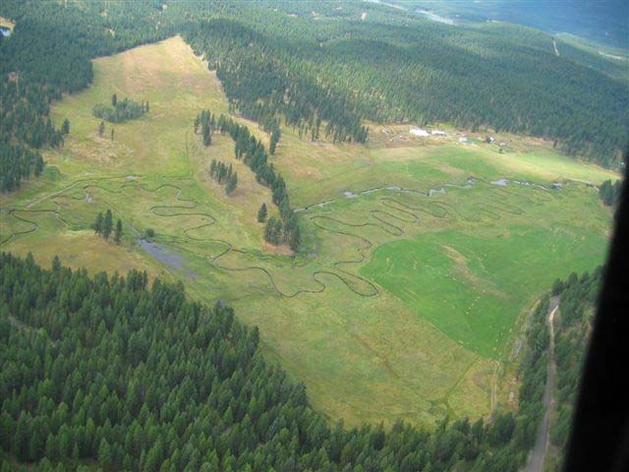
Mitigation History
Conservation Easement
-Fisher River CE (RB, BT)
Habitat improvement
-Pipe Creek (WCT, BT)
-Sinclair Creek (WCT)
-Parmenter Creek (WCT)
-O’Brien Creek (WCT, BT)
-Libby Demo (RB, BT)
-Grave Creek Demonstration (BT, WCT)
-Grave Creek Phases I & II (BT, WCT)
-Libby Cleveland (3 Phases) (RB, BT)
-Young Creek (WCT)
Non-Native Species Control
-Loon Lake (WCT)
-Boulder Lake (WCT)
-Kilbrennan Lake (RB)
-Libby Area Office Spring (RB)
Offsite Mitigation
-Bootjack Lake (WCT)
-Topless Lake (WCT)
-Cibid Lake (WCT)
-Banana Lake (RB)
-Troy Community Fishing Pond (WCT)
-Eureka Community Fishing Pond (WCT)
Fish Screens
-O’Brien Creek (WCT, BT)
-Libby Creek (RB, BT)
-Young Creek (WCT)
-Deep Creek (WCT, BT)
-Libby Area Office Spring (RB)
Notes:
This is a laundry list of activities the mitigation project has completed. Additional details on these efforts will be in the proposal. This is a diverse group of project because there is no magic bullet that will achieve mitigation objectives.

Slide 9
Eureka
Notes:
Grave Creek – tributary to Tobacco River, largest US spawning population of BT in MT portion of basin.

Slide 10
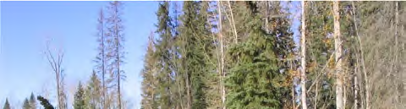
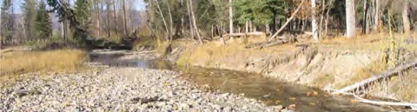
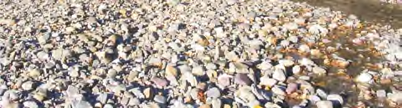
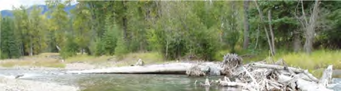
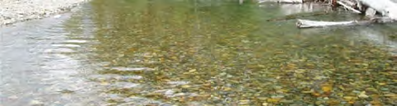
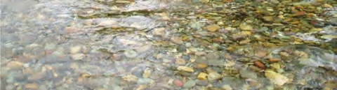
Grave Creek
Physical Monitoring
Riffle Width (-48%)
Riffle Depth (+49%)
Width/Depth Ratio (-67%)
# Pools (+400%)
Pool Depth (+30%)
Total Pool Area (+240%)
Total Pool Volume (+329%)
Bank Erosion (-45%)
2001
2010

Slide 11
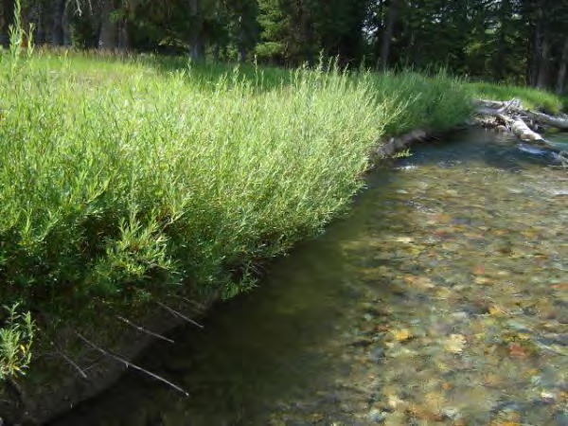
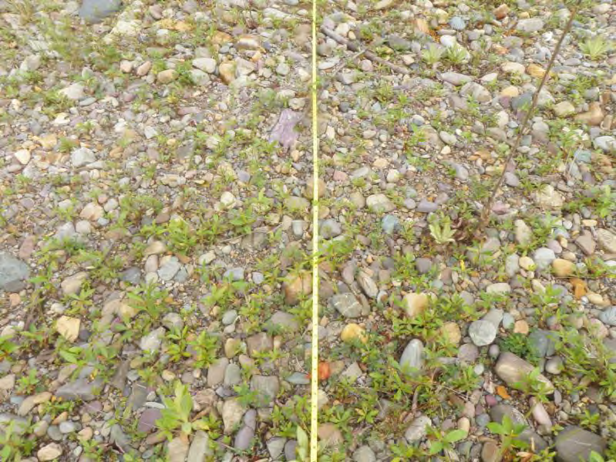
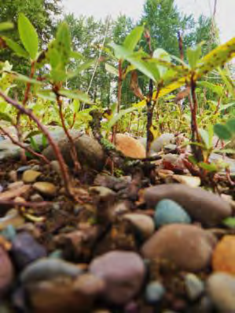
Grave Creek
Revegetation Efforts
Cottonwood
Seedlings
Notes:
In recent years our efforts have focused more on revegetation. Relying mostly on natural processes to develop the ecologic processes needed to create a diverse mosaic of vegetation that will promote long term stability and habitat diversity.

Slide 12
Eureka
Notes:
Young Creek – Tributary to reservoir. Strongest WCT population in MT portion of Kootenai.

Slide 13
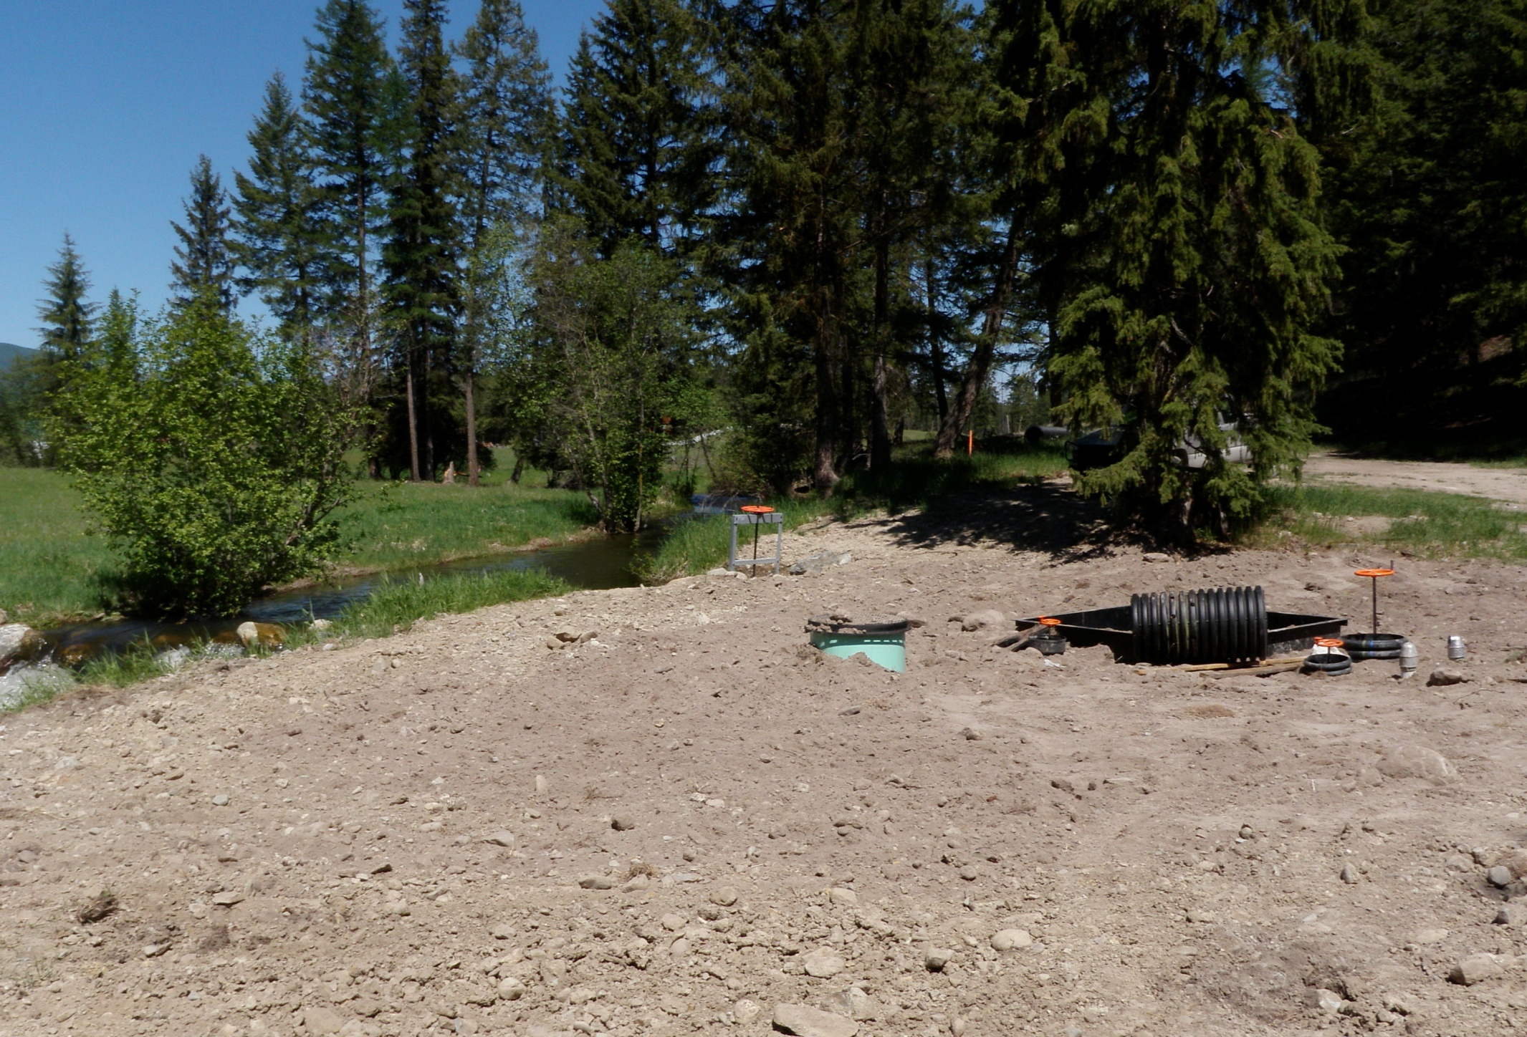
Young Creek Screen
Headgate
Turbulent Fountain
Fish Screen
Fish Return Pipe (Buried)
2 Irrigation
Lines
May 2009
Notes:
Legal water right about 8 cfs instantaneous.

Slide 14
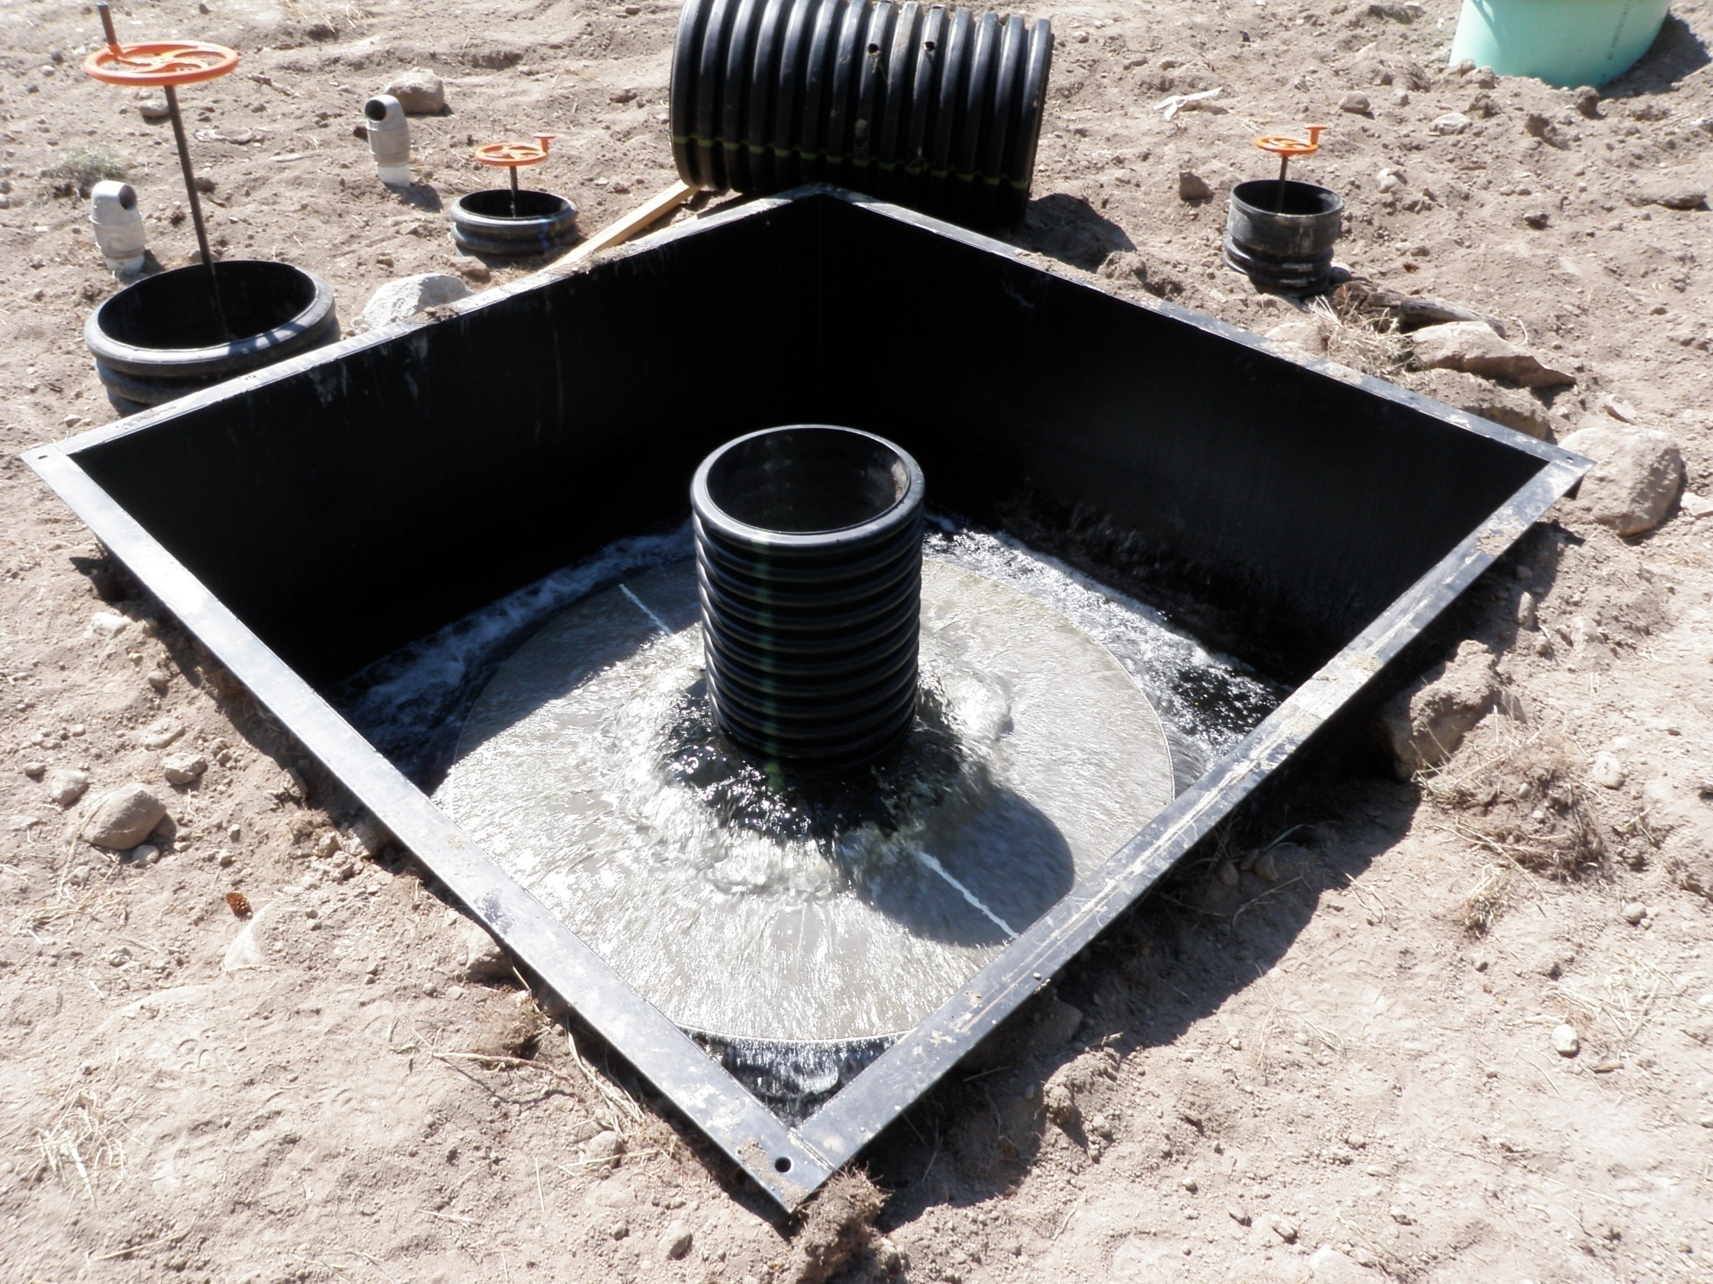
Water Out
Fish Out
Fish + Water
In

Slide 15
Eureka
Boulder
Lake

Slide 16
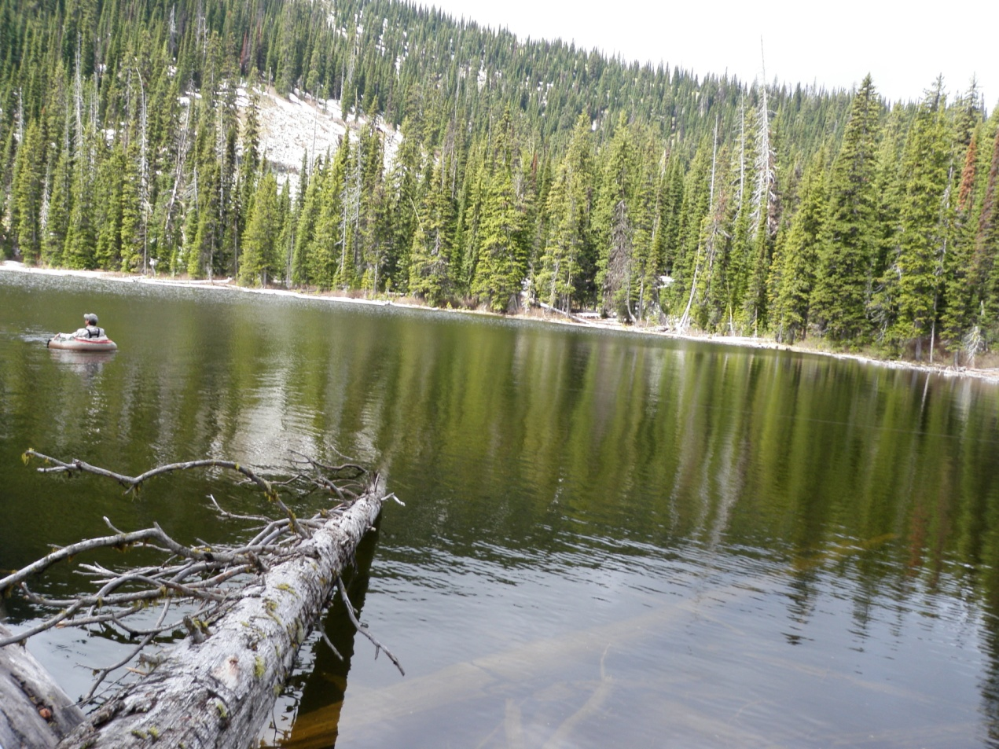
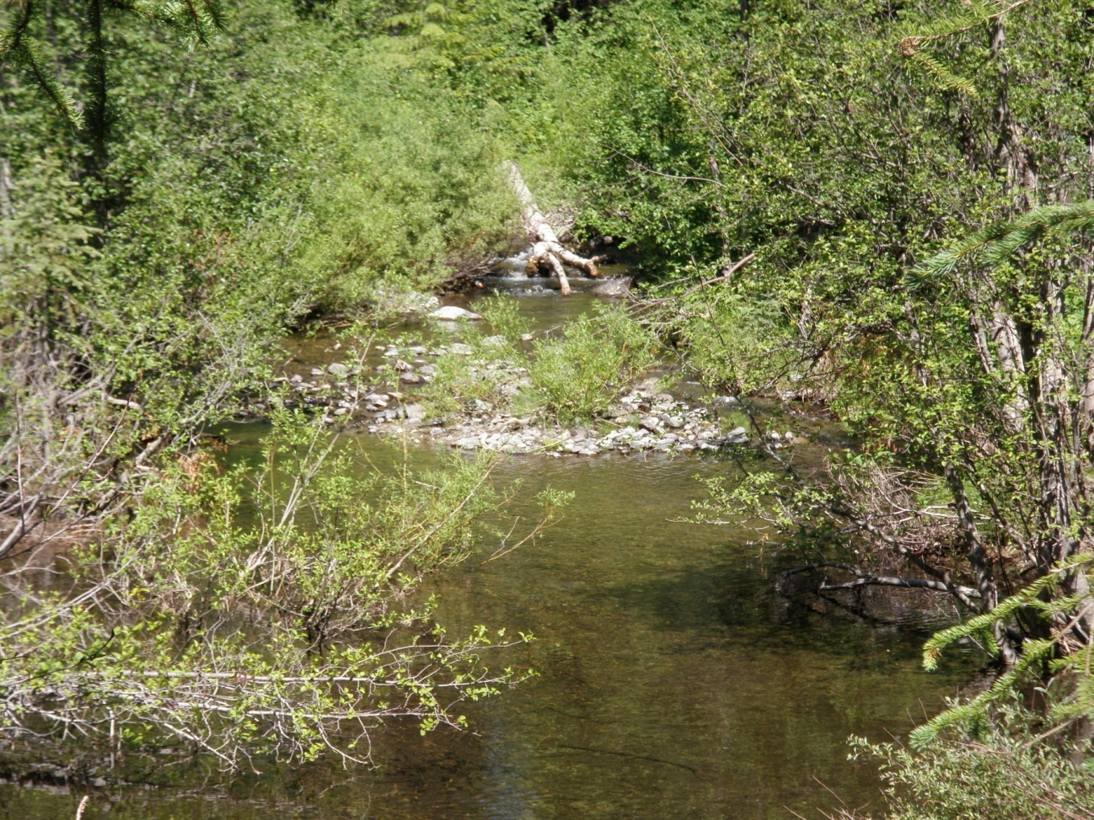
WCT
Conservation Project
2009
Boulder Creek
(~ 8 miles)
Boulder Lake
(6 acres)

Slide 17
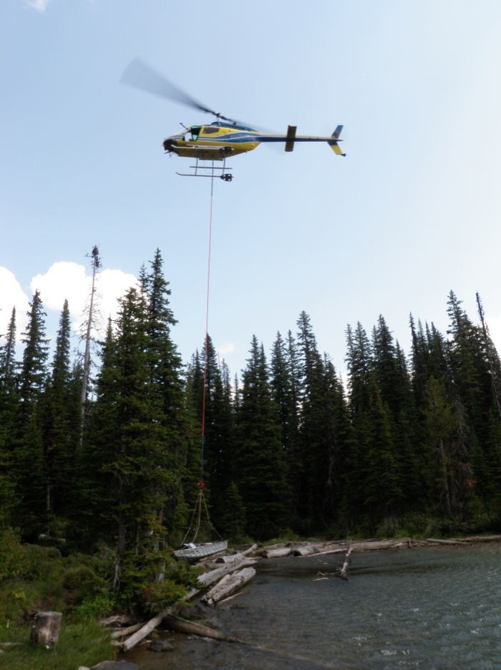
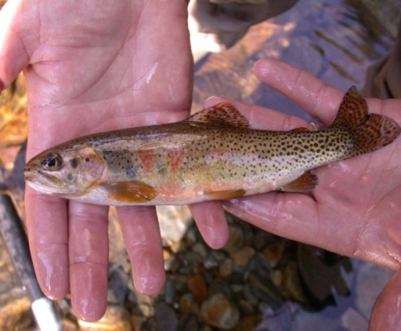
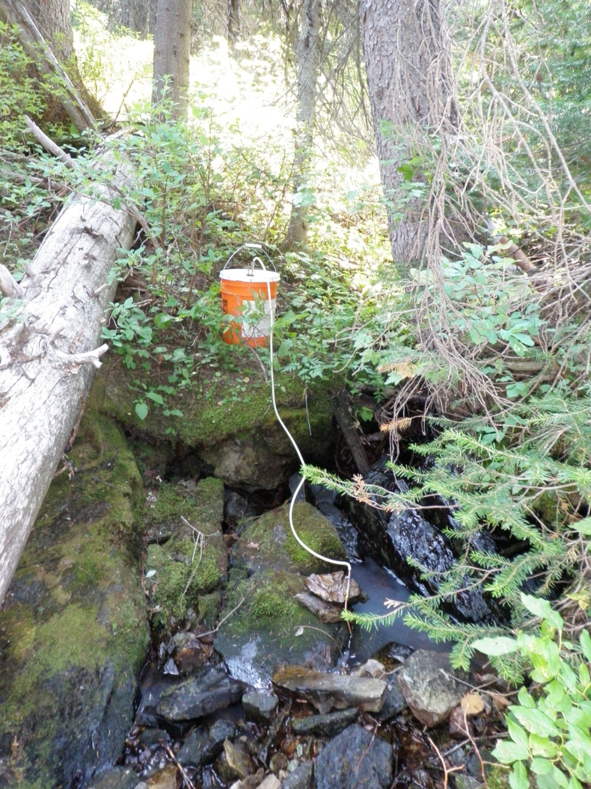
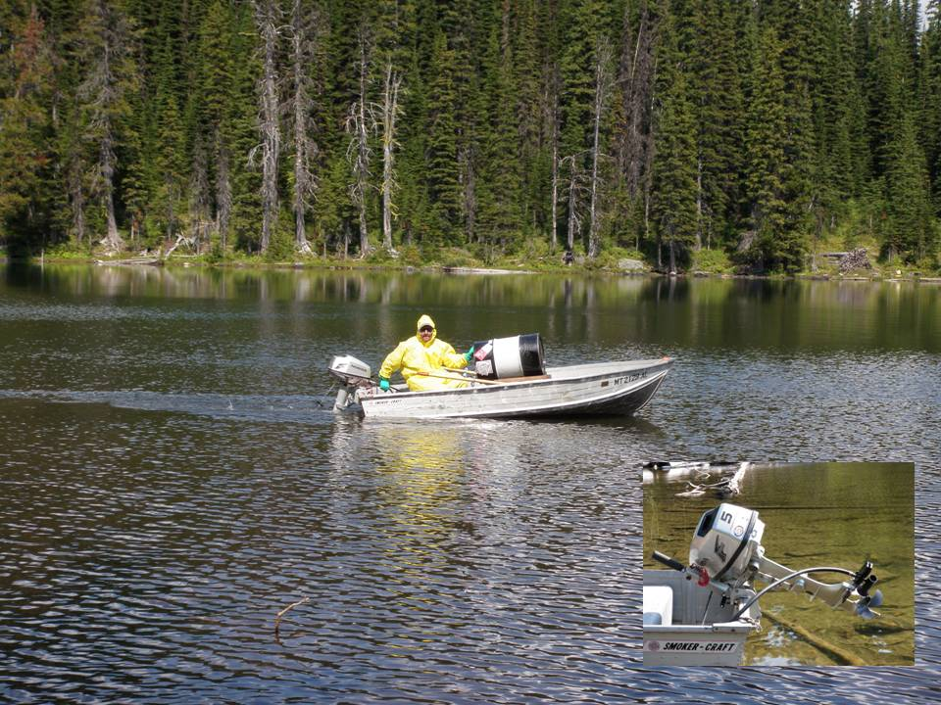
20% Increase in WCT
Distribution

Slide 18
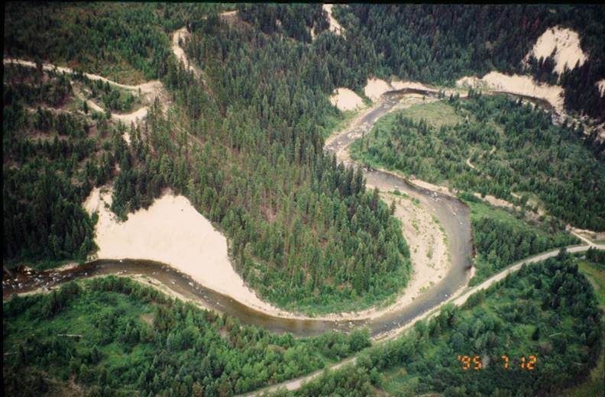
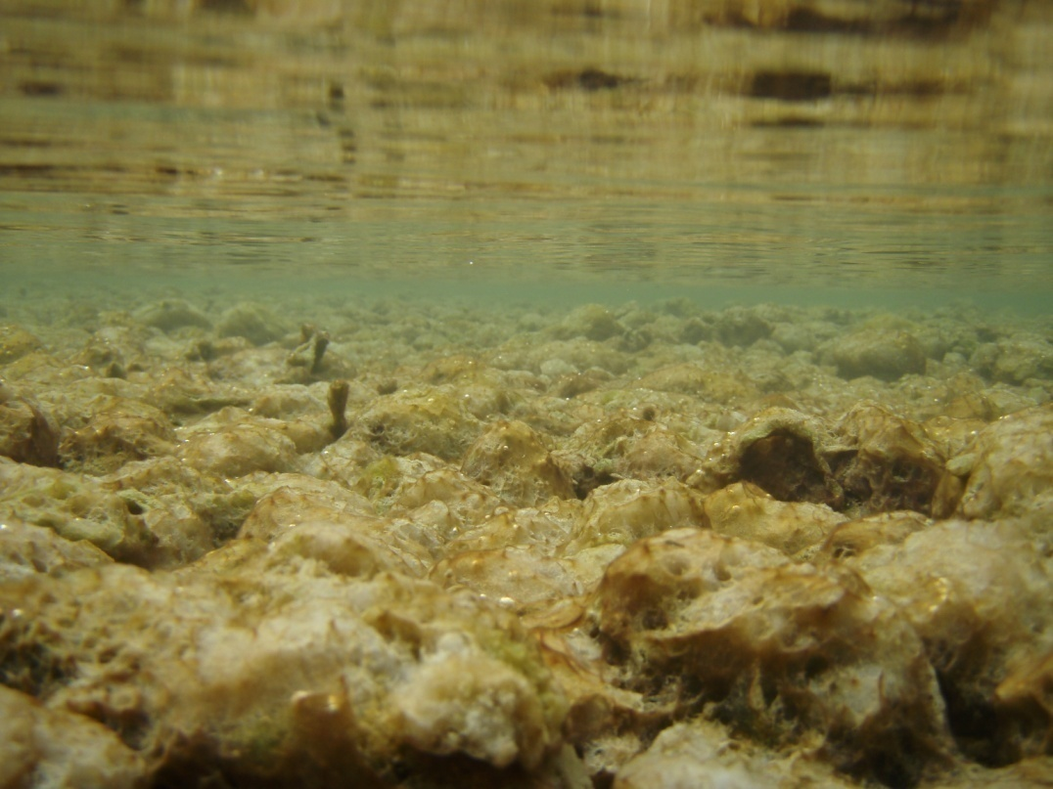
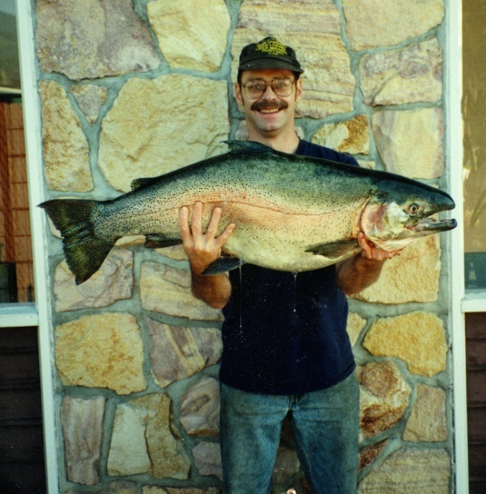
Future Work
Fisher River Restoration
Fisher River
Kootenai River RBT Growth, Survival and genetic origin
Didymo
Didymosphenia geminata
MT State Record
Kootenai River RBT
Growth/Survival/Origin

Slide 19
Mitigation
&
Restoration
Projects
Applied
Research
Libby
Mitigation
Project
Biological and Physical
Monitoring

Slide 20
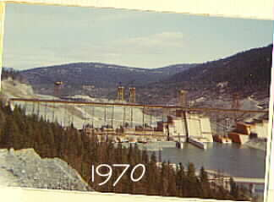
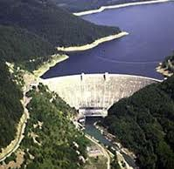
Mainstem Amendment Monitoring BPA Project 200600800
Kootenai River Drainage
Flathead River Drainage
Libby Dam
Ryan Sylvester and Amber Steed
Fisheries Biologist Fisheries Biologist
Notes:
Construction of Libby and Hungry Horse Dam has impacted both physical and biological communities of the Kootenai and Flathead River drainages. Impacts include changes to fish species composition, water temperature, fragmentation of habitats and fish populations, and altered hydrographs. Following construction of these dams, operation of the dams throughout the Columbia River Basin has been variable as new scientific information, listing of species under the ESA, and power and flood control concerns have occurred. One of these recent modifications to dam operations includes the Mainstem Amendments to the Columbia River Basin Fish and Wildlife Program. The impacts of these operations are currently being monitored in the Kootenai and Flathead River drainages.

Slide 21
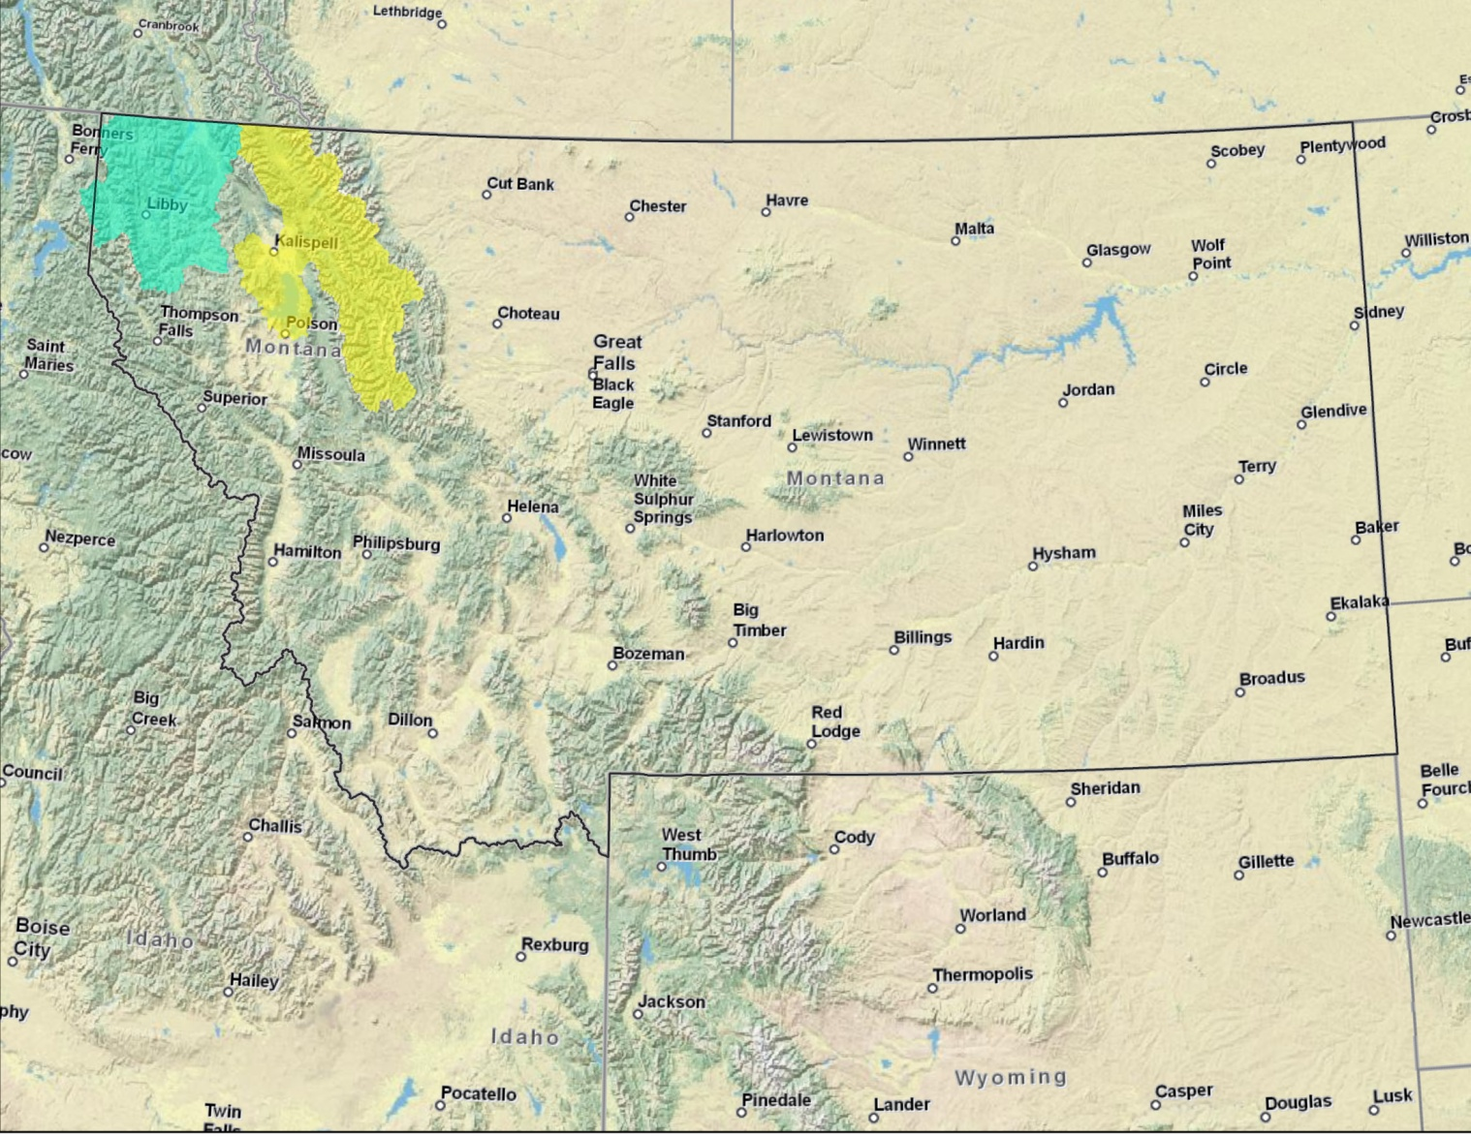
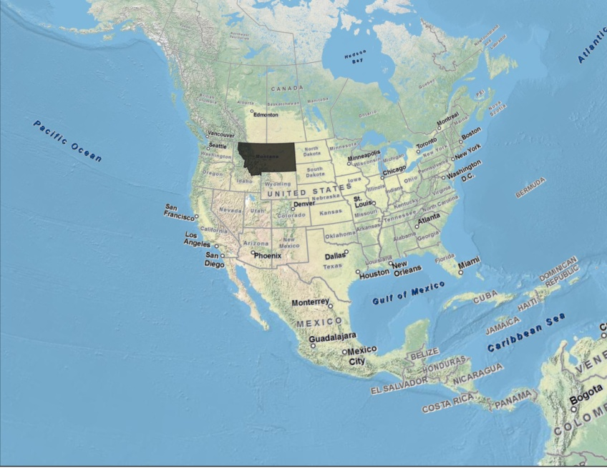
Notes:
For those unfamiliar with the area, the drainages are located in NW Montana. The Flathead River (yellow) contains one regulated fork (South) impacted by Hungry Horse Dam and two unregulated forks (North and Middle) while the Kootenai River is entirely impacted by Libby Dam.

Slide 22
Mainstem Amendments
Implementation and monitoring were called for by the NW Power & Conservation Council
Objectives and measures for protection, mitigation, and enhancement of fish, wildlife, water quality , water management, and habitats
Changes in Montana
Limit summer reservoir drawdown
  Limits for extreme drought and wet years based on water forecasts
Stabilize discharges using seasonal and directional ramping rates
Notes:
Mainstem Amendments designed to benefit both resident fishes and anadromous fishes and habitats by protecting, enhancing, and mitigating biological and physical impacts from constructing dams throughout the Columbia River Basin. Goals is to restore more normative river conditions and ecological functions throughout the Columbia River Basin while considering resident and anadromous fishes, flood control, and power production

Slide 23
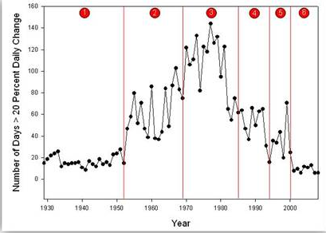
Pre-Dam vs. Post Dam
160
1
2
3
4
5
6
140
120
100
80
Number of days > 20% daily change
60
40
20
0
1930
1940
1950
1960
1970
1980
1990
2000
Year
Year
Notes:
The Mainstem Amendments were not fully implemented until October 2008, but operations from 2000-2008 were very similar to MA operations. Highlight that recent dam operations in the South Fork Flathead closely resemble pre-dam conditions in terms of discharge variability. Similar trends observed in the Kootenai River.
Graph is for the South Fork Flathead River. HH Dam completed in 1952 and Libby Dam 1972

Slide 24
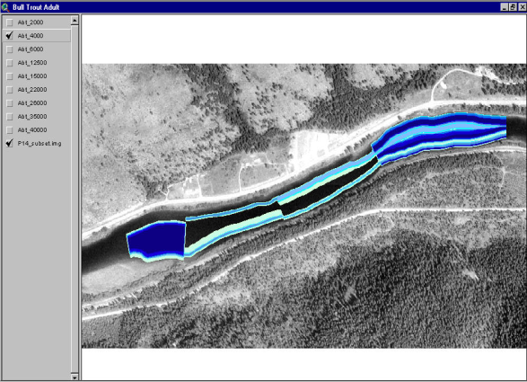
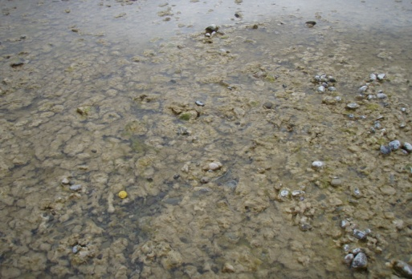
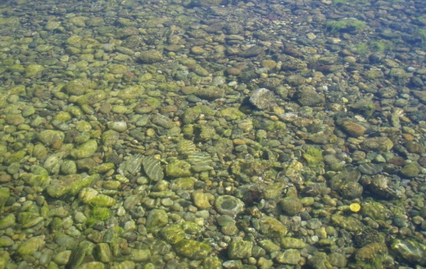
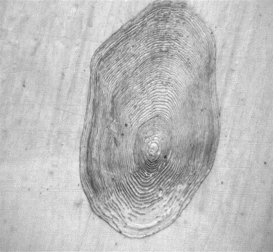
Kootenai River Drainage
Modeling
  Wetted perimeter
  Weighted usable area
  Water residence time
  Biological metrics
Field Validation
  Fish growth
  Fish condition
  Survival
  Chlorophyll a / AFDM
  Water temperature
  Draft and refill rates
  Surface elevation
  Discharge
Notes:
Monitoring of the MA operations in the Kootenai River drainage includes comparisons of past conditions (pre- and post dam) to the present conditions observed under the MA operations using model simulations and field data.
Model data can quickly inform system operators and policymakers about the potential biological and physical impacts of modified dam operations and allows different operating strategies to be ranked in terms of the desired metric. Field data will be used to validate these model results to confirm or refute trends predicted by models. Validation of results and documentation of physical and biological changes resulting from dam operations will inform policymakers and system operators in both Canada and the United States when future changes are being considered.

Slide 25
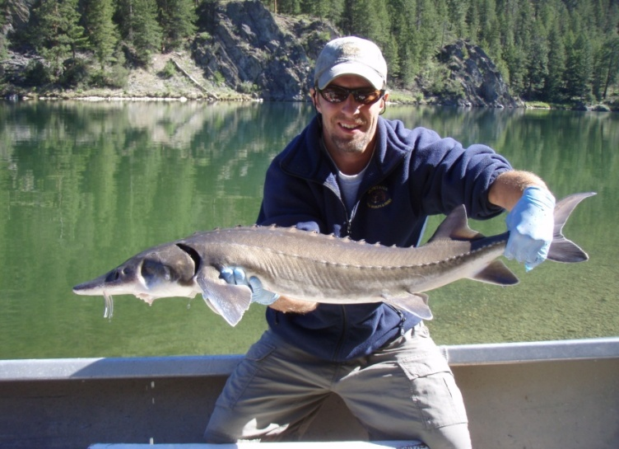
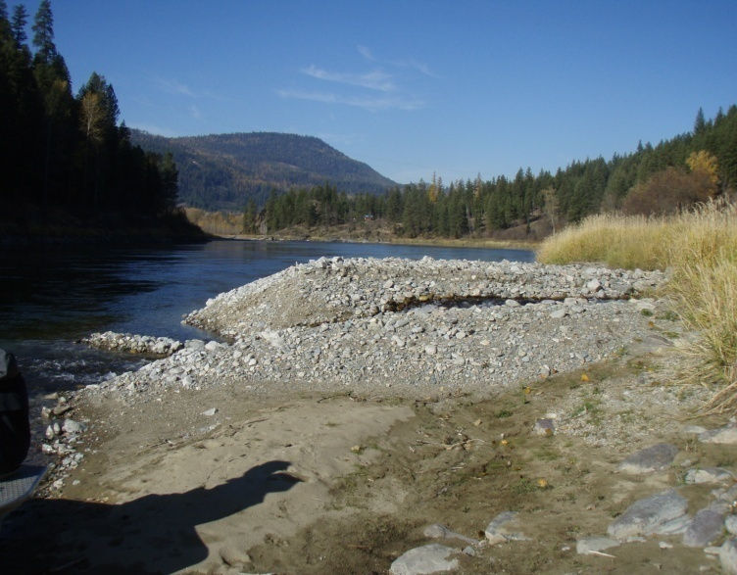
Other Monitoring
  Status of white sturgeon in Montana
  Didymosphenia geminata
  Aggradation of tributary deltas
Future Work
  Continued monitoring of physical and biological impacts of MA operations
  Expansion of white sturgeon monitoring in Montana
Notes:
Monitoring of D. geminata showed that blooms were highest under low flow conditions in the winter and is leading to expanded research and work proposed by the Libby Mitigation Project.
Pilot monitoring of the status of white sturgeon in Montana showed that 62% of white sturgeon in Montana migrated upstream from Idaho, which had been previously undocumented by radio telemetry and sonic tagging of white sturgeon in Idaho and British Columbia since the 1980’s. We hope to expand monitoring efforts in Montana.
Assessing the limiting / influential factors of trout populations in the Kootenai River including benthic invertebrates, diet, D. geminata, and water temperatures

Slide 26
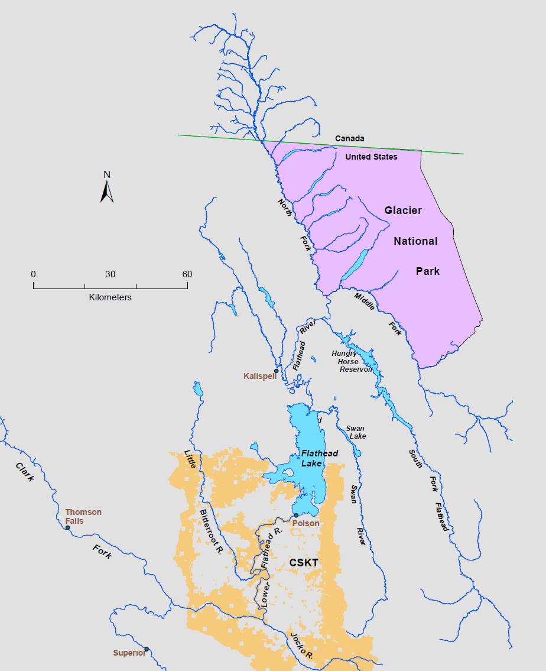
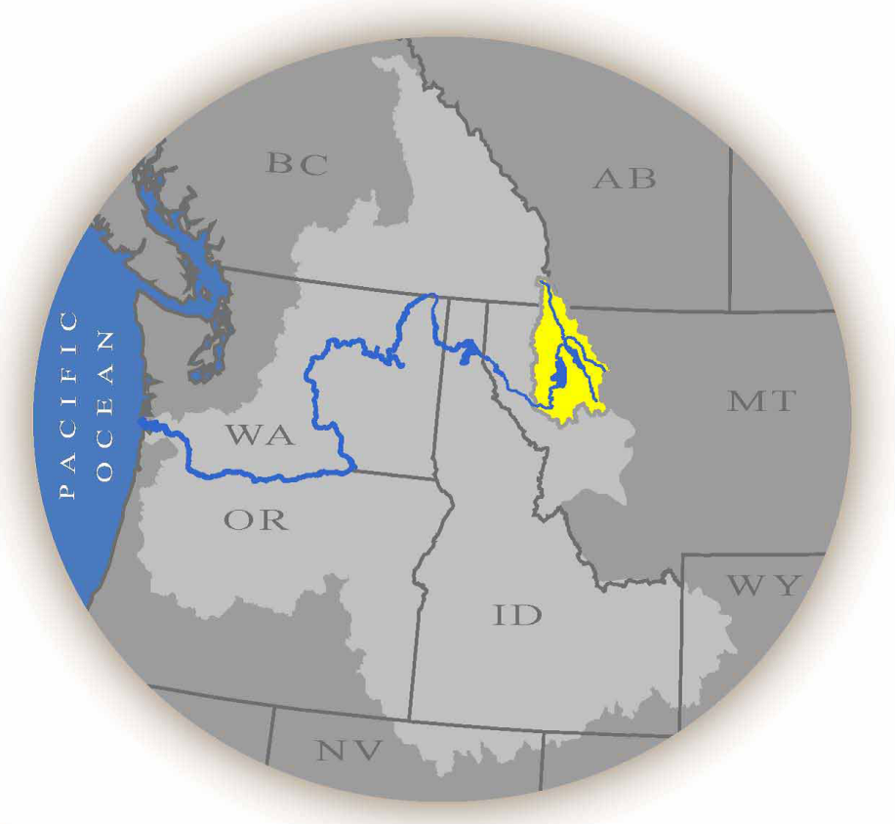
Flathead Subbasin

Slide 27
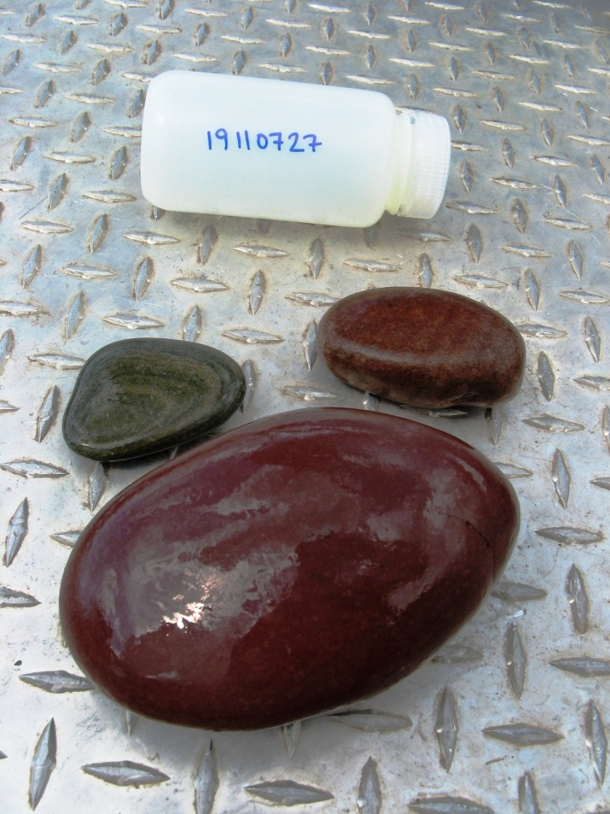
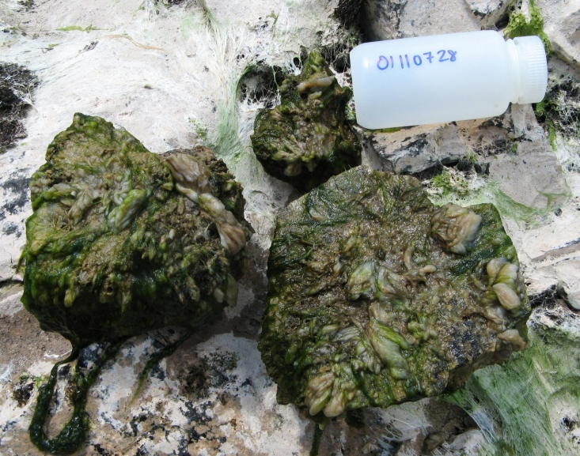
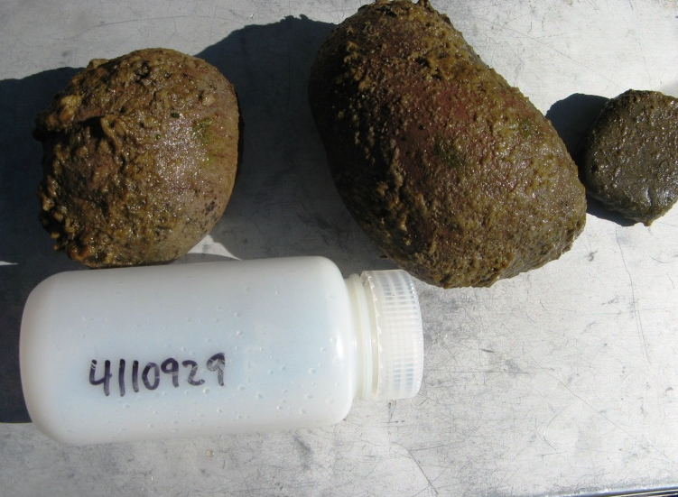
Biology below Hungry Horse Dam
Didymosphenia geminata
  Seasonal abundance and distribution
  Associated
  abiotic variables
  Impacts of dam
  operations
Water and periphyton site
Periphyton only site
Notes:
Abiotic variables measured: DO, temp, velocity, light, turbidity, pH, conductivity
Water chemistry variables measured: chlorophyll, ammonium, nitrogen, nitrate/nitrite, phosphorus species, silica, sulfate, iron

Slide 28
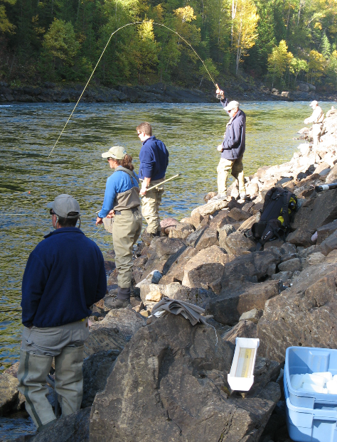
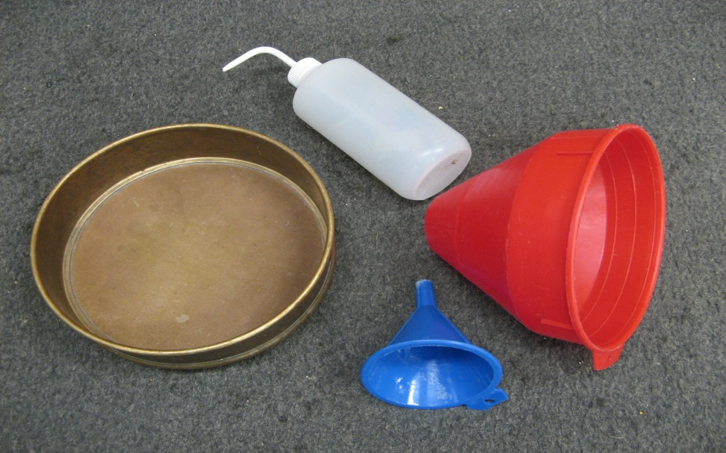
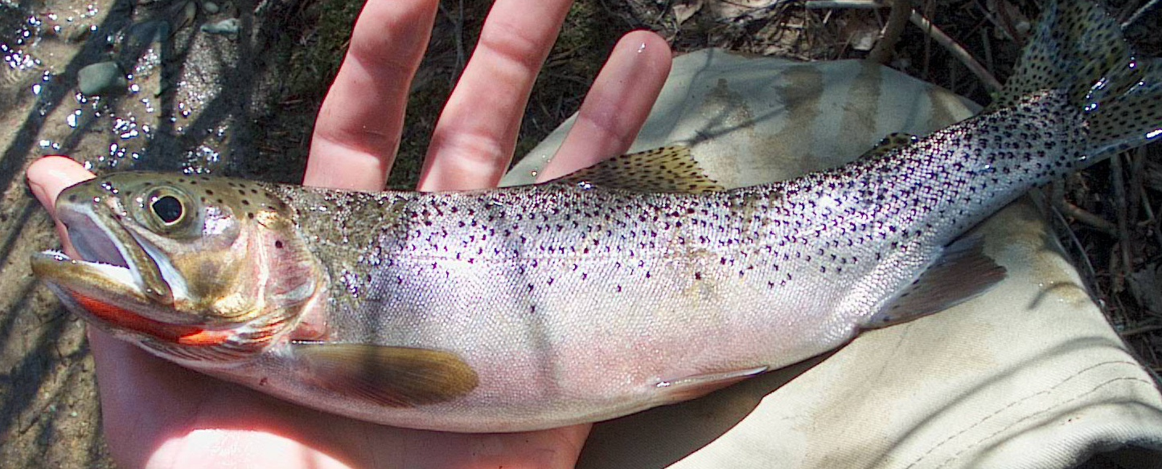
Biology below Hungry Horse Dam
Westslope cutthroat trout in the South Fork Flathead River
  Spawning movement
    54% spawn annually
    89% spawn in unique tributaries
  Diet
    50% lower diversity at dam
  Condition
    No significant difference

Slide 29
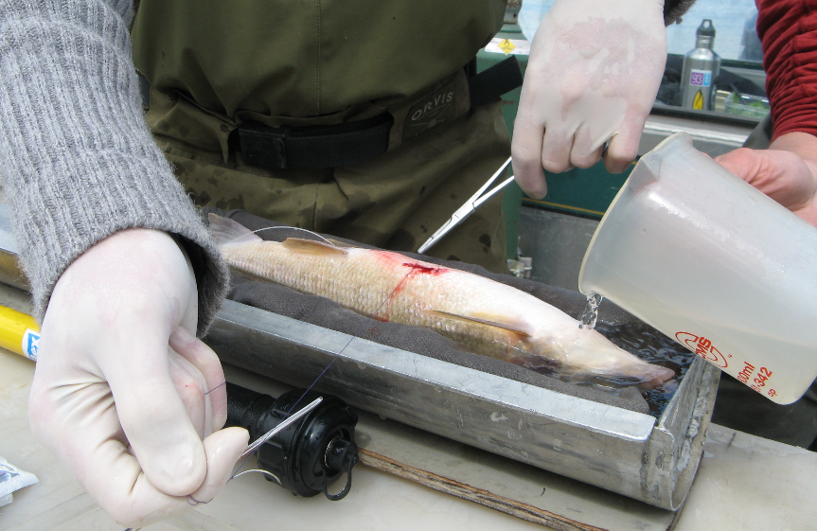
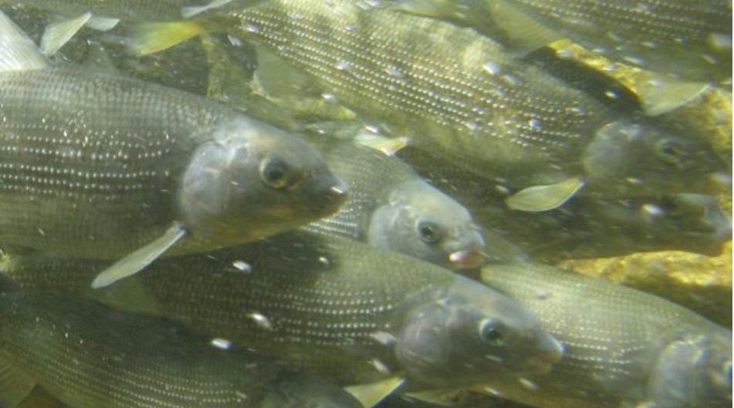
Downstream dynamics
Mountain whitefish
  Seasonal movement
    Diverse, large movements
    Dam influenced areas
  Spawning locations
    Repeat spawning
  Genetic structure
    Low divergence
    Lake whitefish
  Microchemistry

Slide 30
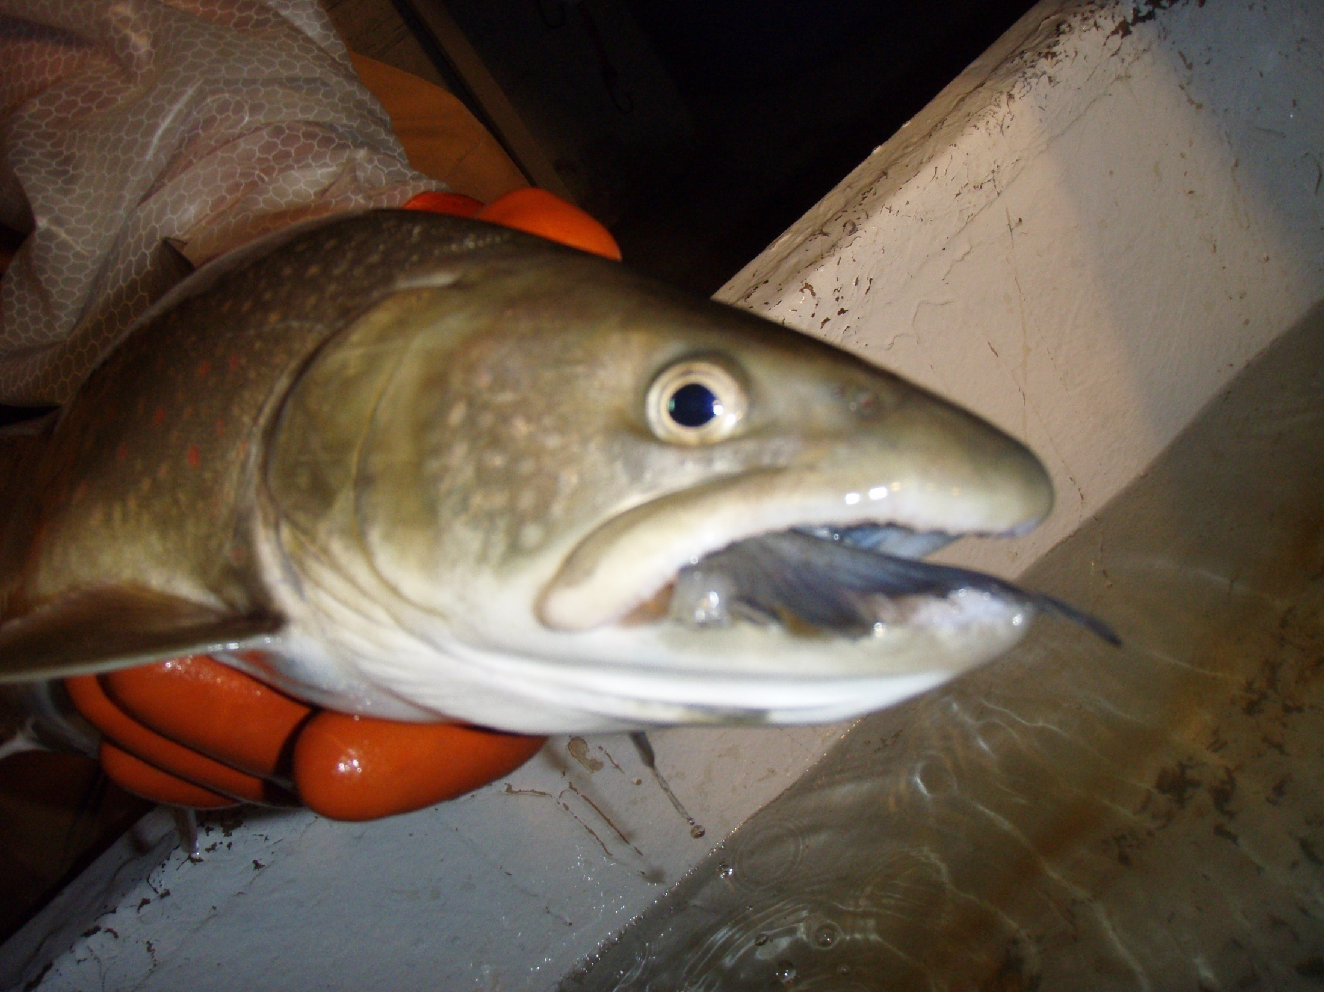
Mainstem Amendment Monitoring
Questions?

Slide 31
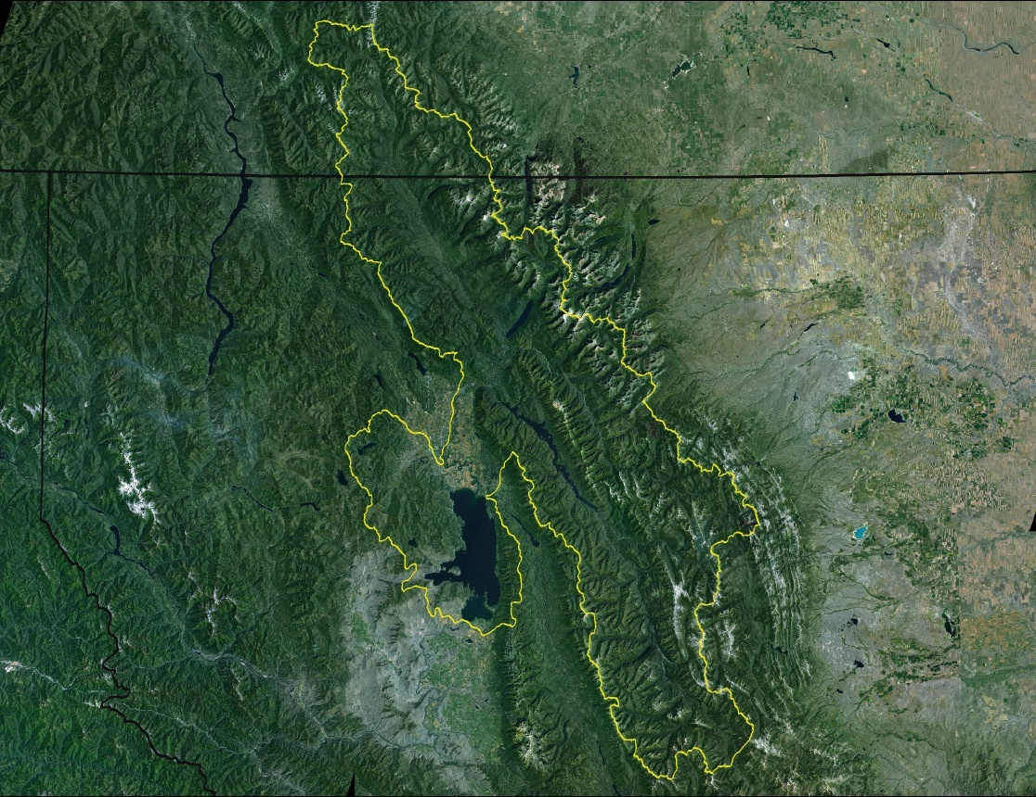

Hungry Horse Mitigation Program
BPA Project # 1991-019-03
Matt Boyer
Fisheries Biologist

Slide 32
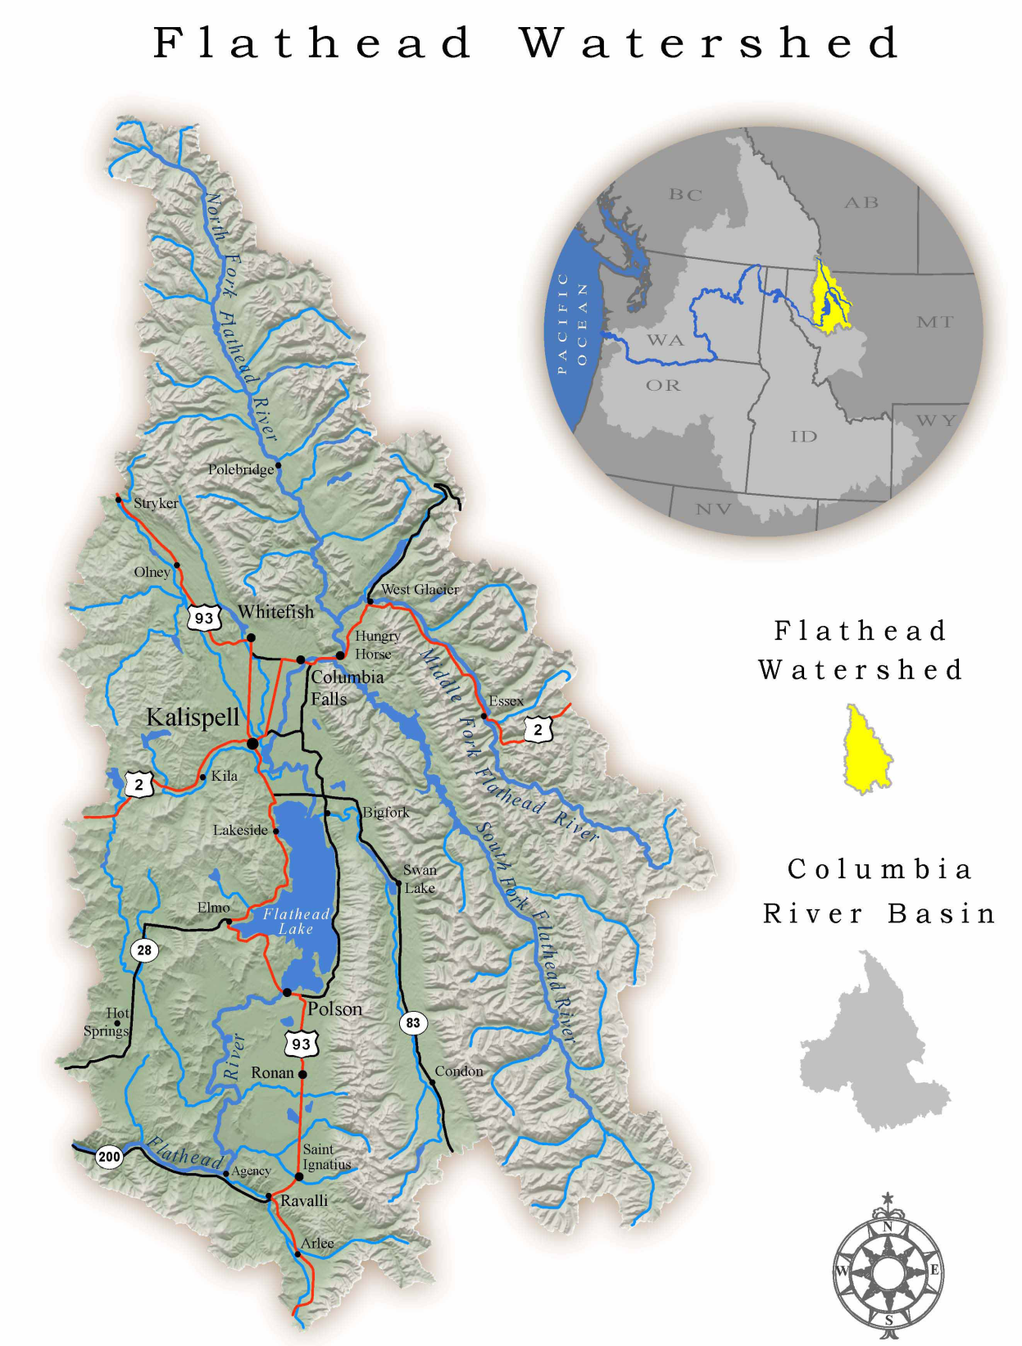


Salvelinus confluentus
Oncorhynchus clarkii lewisi
Map courtesy of Mobile LoGIStics Mapping, 2010
Produced for the Flathead Watershed Sourcebook

Slide 33


CSKT and MFWP 2004 Flathead Subbasin Plan

Slide 35

Historically fishless lakes planted with trout (1920-1960)

Slide 36
Quantified temporal spread of hybridization
Environmental gradients do not constrain the spread of hybridization among populations
WCT
Hybrid
Hitt et al. 2003 CJFAS
Notes:
36

Slide 37

52°00’W
Identified sources of rainbow trout hybridization and described how increased straying rates of hybrids contributes to the spread of hybridization
Boyer et al. 2008 CJFAS
114°25’W

Slide 38


Effects of hybridization on fitness
X
Parentage analysis documented a decline in smolt production resulting from hybridization with rainbow trout
X
Muhlfeld et al. 2009 Biology Letters

Slide 39
Bioenergetics model estimated annual consumption of 13,000 WCT and 3,500 bull trout by introduced northern pike in the Flathead River and sloughs
Muhlfeld et al. 2008 TAFS

Slide 40


Slide 41

Estimated sources of redd count observer error to improve the accuracy and precision of redd counts as a population monitoring tool
Muhlfeld et al. 2006 TAFS
Modeled population viability for Flathead Lake bull trout based on long term redd count trend data
Taper et al. In revision Cons. Bio.
Estimated effective number of spawning bull trout from noninvasive genetic samples
Leary and Boyer In prep.
Joel Sartore/National Geographic stock with Wade Fredenberg

Slide 42




Restore connectivity
Isolation management
Habitat restoration

Slide 43
Hungry Horse Mitigation Program
Goal: conduct applied research and population monitoring to inform adaptive conservation management
Proposed work:
Replicate genetically diverse wild populations to aid in WCT conservation
Develop genetic and microelemental tools to improve population monitoring
Refine our understanding of the system’s limiting factors to better direct habitat restoration work.

Slide 44


