Slide 1
Resource Adequacy Assessment for 2015 Resource Adequacy Forum Technical Committee Meeting October 1, 2010

Slide 2
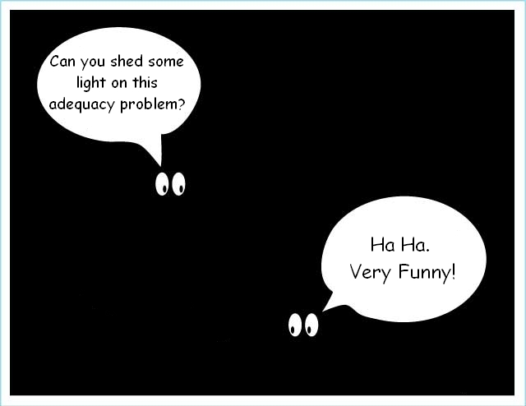

Slide 3
Outline
2015 Power Supply Adequacy
Review of current adequacy standard
Changes since 2008
LOLP sensitivities
Observations
Proposed Changes
Next Steps

Slide 4
2015 Power Supply Adequacy (Inadequate if LOLP > 5%)
LOLP (%) | Winter Cap | Winter Energy | Summer Cap | Summer Energy
Current Standard | 4.3 | 6.2 | 0.5 | 11.5

Slide 5
2015 Power Supply Adequacy
Current standard, no new resources Supply is inadequate
Flawed conclusion – adding no new conservation is wrong
With new conservation (~1,400 MWa) Supply is adequate

Slide 6
2015 Power Supply Adequacy (Inadequate if LOLP > 5%)
LOLP (%) | Winter Cap | Winter Energy | Summer Cap | Summer Energy
Current Standard | 4.3 | 6.2 | 0.5 | 11.5
With Cons | 0.0 | 0.5 | 0.0 | 1.9

Slide 7
Current Adequacy Standard
5% Loss of Load Probability (LOLP)
Winter energy, winter capacity and summer capacity (no summer energy)
LOLP = # games with problems divided by the total number of games
Games with problems
Winter Energy: When total Dec-Feb curtailment > 28,800 MW-hrs
Winter and Summer Capacity: When curtailment in any hour > 3,000 MW

Slide 8
Resource & Load Assumptions
Existing resources only¹
No new conservation¹
Full IPP in winter, 1000 MW in summer
3000 MW market in winter, none in summer
Allow use of provisional draft (water below PDP) 2000 MW winter, 1000 MW summer²
¹Assumed in the analysis but not specified in the standard, included resources under construction ²These amounts were not linked directly to the analysis

Slide 9
Changes since 2008
Load: New short-term load model Yields higher monthly average and peak loads in Dec, Jan, Jul, Aug and Sep
Non-hydro resources: 254 MW more thermal, 928 MW more wind, 217 MW less IPP
Hydro: Loss of energy and capacity due to wind DEC reserves and new BiOp constraints, better bypass spill simulation for peak capacity
Model: Better provisional hydro simulation and revised hourly hydro shaping logic (also added an option for light-load hour purchases)

Slide 10
Monthly Loads w/conservation Forecast for 2015 using 1929 Temperatures
 | STM | HELM | Diff
Dec | 22999 | 21740 | 1259
Jan | 25984 | 24799 | 1185
Feb | 20862 | 24111 | -3249
Jul | 20469 | 18344 | 2125
Aug | 21014 | 18569 | 2445
Sep | 18651 | 18504 | 147
Annual | 20340 | 20340 | 0
HELM = EPRI’s Hourly Energy Load Model STM = Council’s Short-term Load Forecasting Model

Slide 11
Monthly Loads w/conservation Forecast for 2015 using 1929 Temperatures
Big Change in Summer

Slide 12
Hourly Peak Loads w/conservation Forecast for 2015 using 1929 Temperatures
 | STM | HELM | Diff
Dec | 28673 | 26876 | 1797
Jan | 33903 | 32543 | 1360
Feb | 26109 | 33046 | -6937
Jul | 25972 | 21745 | 4227
Aug | 27029 | 22168 | 4861
Sep | 22879 | 22812 | 60
HELM = EPRI’s Hourly Energy Load Model
STM = Council’s Short-term Load Forecasting Model

Slide 13
Hourly Peak Loads w/conservation Forecast for 2015 using 1929 Temperatures
Big Change in Summer

Slide 14
Changes since 2008
Load: New short-term load model Yields higher monthly average and peak loads in Dec, Jan, Jul, Aug and Sep
Non-hydro resources: 254 MW more thermal, 928 MW more wind, 217 MW less IPP
Hydro: Loss of energy and capacity due to wind DEC reserves and new BiOp constraints, better bypass spill simulation for peak capacity
Model: Better provisional hydro simulation and revised hourly hydro shaping logic (also added an option for light-load hour purchases)

Slide 15
Net Existing Resource Capacity for 2015 2008 Database vs. 2010 Database
Wind
IPP
Thermal

Slide 16
Changes since 2008
Load: New short-term load model Yields higher monthly average and peak loads in Dec, Jan, Jul, Aug and Sep
Non-hydro resources: 254 MW more thermal, 928 MW more wind, 217 MW less IPP
Hydro: Loss of energy and capacity due to wind DEC reserves and new BiOp constraints, better bypass spill simulation for peak capacity
Model: Better provisional hydro simulation and revised hourly hydro shaping logic (also added an option for light-load hour purchases)

Slide 17
Hydro Peaking Capacity Change Compared to 2008 Data (MW)
 | Peak Hour Duration
Period | 2-Hr | 4-Hr | 6-Hr | 8-Hr | 10-Hr | 12-Hr
Dec | -1423 | -1383 | -1566 | -1564 | -1550 | -1525
Jan | -1561 | -1629 | -1670 | -1591 | -1507 | -1431
Feb | -836 | -432 | -130 | -43 | 45 | 110
Jul | -2682 | -2568 | -2244 | -2101 | -2051 | -1965
Aug 1 | -2996 | -2759 | -2236 | -2144 | -2120 | -1961
Aug 2 | -3250 | -3297 | -3423 | -3343 | -3129 | -2912
Sep | -1201 | -1097 | -1047 | -1016 | -853 | -706

Slide 18
Peaking Capacity Change due to Wind Reserve Requirements (MW)
 | Peak Hour Duration
Period | 2-Hr | 4-Hr | 6-Hr | 8-Hr | 10-Hr | 12-Hr
Dec | -19 | -149 | -404 | -387 | -365 | -325
Jan | -64 | -186 | -406 | -407 | -393 | -341
Feb | -192 | -274 | -512 | -509 | -472 | -416
Jul | 0 | -41 | -169 | -255 | -321 | -318
Aug 1 | 0 | 0 | -36 | -149 | -295 | -316
Aug 2 | -227 | -652 | -951 | -942 | -820 | -669
Sep | -33 | -444 | -699 | -778 | -742 | -612

Slide 19
NW Power Supply LOLP (%) (new model, existing resources, no new conservation)
For 2015 | Winter Cap | Winter Energy | Summer Cap | Summer Energy
Current Std | 4.3 | 6.2 | 0.5 | 11.5
Old Loads¹ | 0.5 | 0.5 | 0.0 | 0.5
Old Hydro² | 4.8 | 6.7 | 0.0 | 1.9
¹Same as “Current Std” but using old load forecasting model (HELM), same annual average load but different monthly and hourly shapes
²Same as “Current Std” but using 2008 BiOp and no hydro reserve requirement for wind

Slide 20
Observations
New load forecast has greatest effect on both winter and summer LOLP
New hydro peaking data has little effect in winter but large effect in summer
New resources have less effect overall

Slide 21
Parameters Affecting LOLP
LLH purchase ahead option
New conservation
Provisional draft
IPP availability
Stochastic forced outages
Winter spot market
Wind DEC reserve requirement

Slide 22
LOLP Sensitivity (%) to Provisional Draft
2015 | W Cap | W Eng | S Cap | S Eng
Current Std (2K) | 4.3 | 6.2 | 0.5 | 11.5
1K Prov Draft | 5.3 | 8.6 | 1.4 | 22.0
No Prov Draft | 9.6 | 13.9 | 11.0 | 36.8

Slide 23
LOLP Sensitivity (%) to New Conservation
2015 | W Cap | W Eng | S Cap | S Eng
Current Standard | 4.3 | 6.2 | 0.5 | 11.5
New Conservation | 0.0 | 0.5 | 0.0 | 1.9

Slide 24
LOLP Sensitivity (%) to NW and SW Markets
2015 | W Cap | W Eng | S Cap | S Eng
Current Standard | 4.3 | 6.2 | 0.5 | 11.5
LLH Purchase | 6.2 | 6.7 | .5 | 7.7
Full IPP (NW Mkt) | 4.3 | 6.2 | 0.0 | 0.5
No Spot MKT | 9.6 | 19.6 | 0.5 | 11.5

Slide 25
LOLP Sensitivity (%) to Stochastic Forced Outage
2015 | W Cap | W Eng | S Cap | S Eng
Current Standard | 4.3 | 6.2 | 0.5 | 11.5
Fixed FOR | 4.4 | 5.8 | 0.0 | 1.5

Slide 26
LOLP Sensitivity (%) to Hydro Wind Reserve Requirement
2015 | W Cap | W Eng | S Cap | S Eng
Current Standard | 4.3 | 6.2 | 0.5 | 11.5
No Wind Reserves¹ | 3.8 | 5.7 | 0.0 | 10.5
¹Hydro sustained-peaking capacities for this study are calculated without the wind DEC requirement

Slide 27
LOLP Sensitivity (%) Conservation and Provisional
2015 | W Cap | W Eng | S Cap | S Eng
Current Standard¹ | 4.3 | 6.2 | 0.5 | 11.5
Proposed Case² | 1.0 | 1.0 | 0.0 | 1.0
Proposed No Prov | 1.4 | 3.8 | 3.4 | 24.5
¹Existing resources only, no new conservation, no LLH purchase, 2000 MWa maximum provisional draft
²Proposed case adds new conservation and LLH purchases to Current Standard case

Slide 28
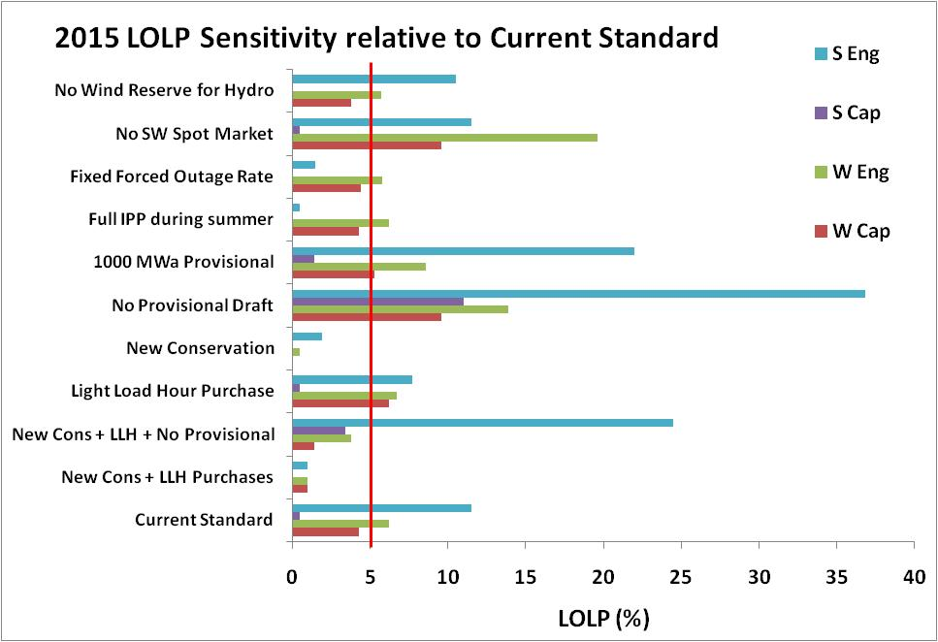
LOLP Sensitivities (Changes the specified parameters from the Current Standard case)
Inadequate when LOLP > 5%

Slide 29
Observations
Most critical period is summer in terms of energy needs (especially in August)
Implementation of 6th Plan, especially conservation, alleviates problems
Maintaining adequacy without the use of provisional draft would be very expensive (study pending)

Slide 30
Proposed Changes (for Steering Committee consideration)
Add some level of new conservation
Add required new RPS resources
Allow light-load-hour purchases (up to 3,000 MW year round)

Slide 31
Next Steps¹
Review adequacy methodology and assumptions (underway)
Explore ways to improve capacity analysis
Find ways to incorporate adequacy standard into long-term resource planning process
Provide a clear explanation of the relationship between minimum build levels to maintain adequacy and higher build levels for economic purposes
¹See Adequacy Forum Work Plan for more details

Slide 32
Additional Slides

Slide 33
Revised Existing Resource Capacity for 2015 2008 Database vs. 2010 Database (Still Being Reviewed)
Wind
IPP
Thermal

Slide 34
LOLP Sensitivities (%)
2015 | W Cap | W Eng | S Cap | S Eng
Current Std | 4.3 | 6.2 | 0.5 | 11.5
LLH Purchase | 6.2 | 6.7 | 0.5 | 7.7
New Cons | 0.0 | 0.5 | 0.0 | 1.9
No Prov Draft | 9.6 | 13.9 | 11.0 | 36.8
1K Prov Draft | 5.3 | 8.6 | 1.4 | 22.0
Full IPP | 4.3 | 6.2 | 0.0 | 0.5
Fixed FOR | 4.4 | 5.8 | 0.0 | 1.5
No Spot MKT | 9.6 | 19.6 | 0.5 | 11.5
No Wind Res Mar | 3.8 | 5.7 | 0.0 | 10.5
Cons/LLH/No Prov | 1.4 | 3.8 | 3.4 | 24.5

