Slide 1
Simulated vs. Real
Hourly Dispatch
Resource Adequacy Forum
Technical Committee Meeting
October 1, 2010

Slide 2
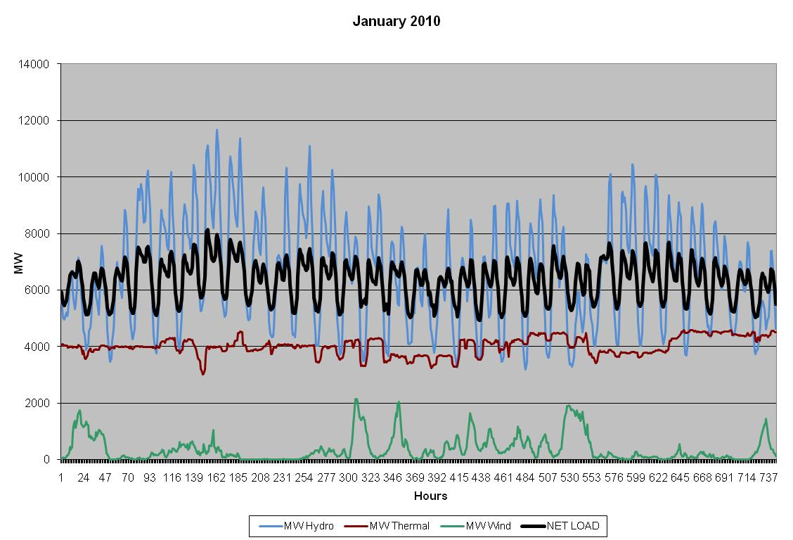
Historic Resource Dispatch (BPA Balancing Area)

Slide 3
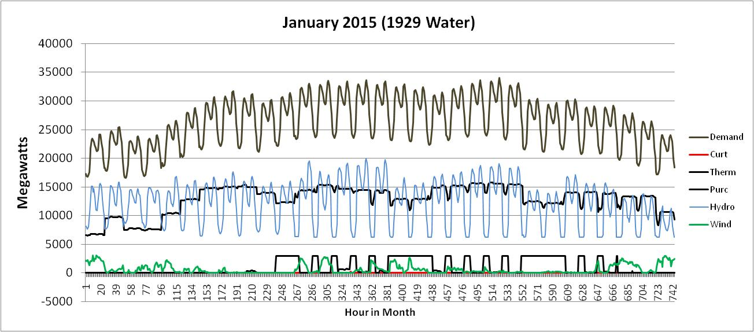
Simulated Regional Resource Dispatch

Slide 4
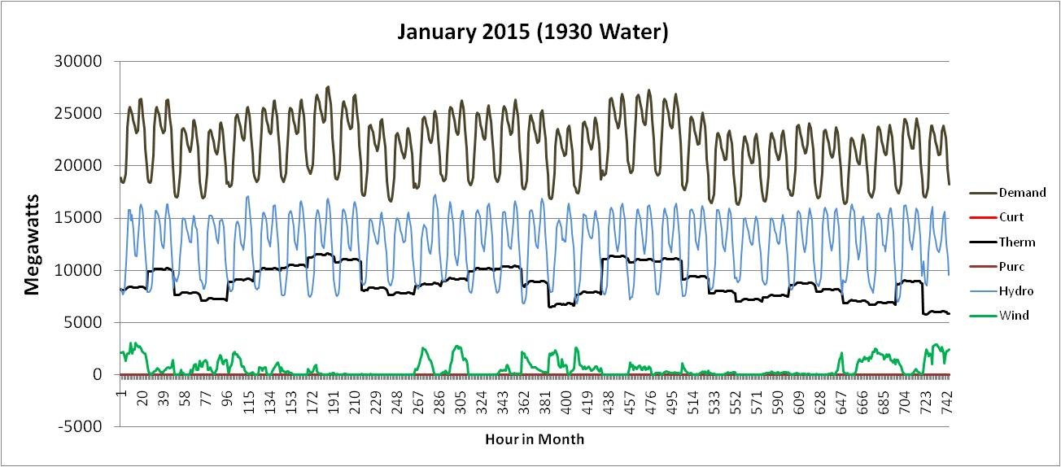
Simulated Regional Resource Dispatch

Slide 5
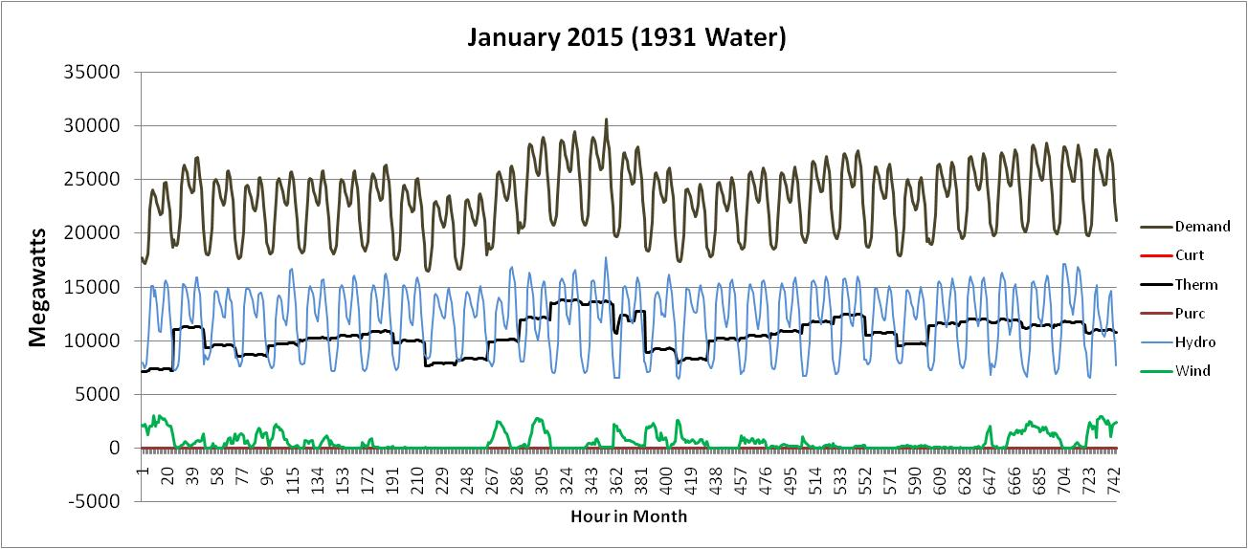
Simulated Regional Resource Dispatch

Slide 6
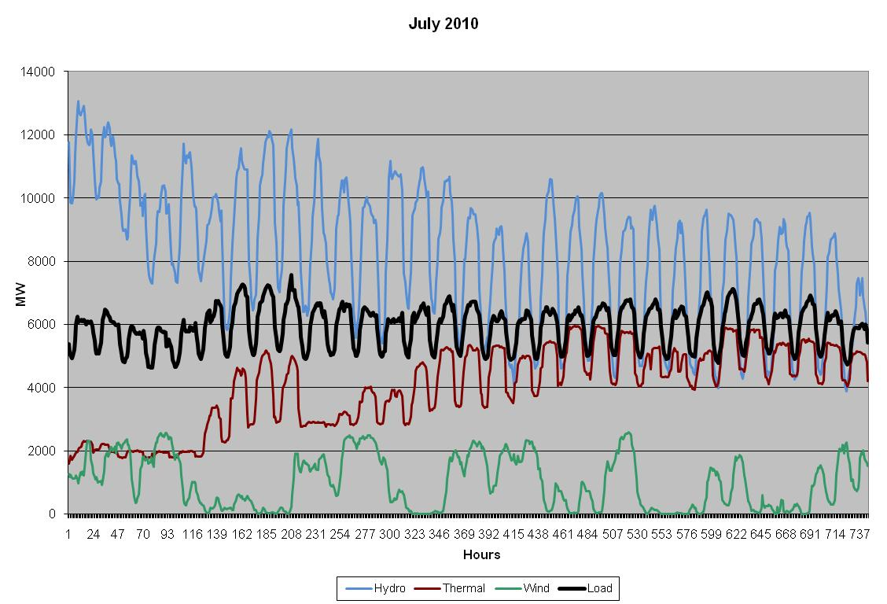
Historic Resource Dispatch (BPA Balancing Area)

Slide 7
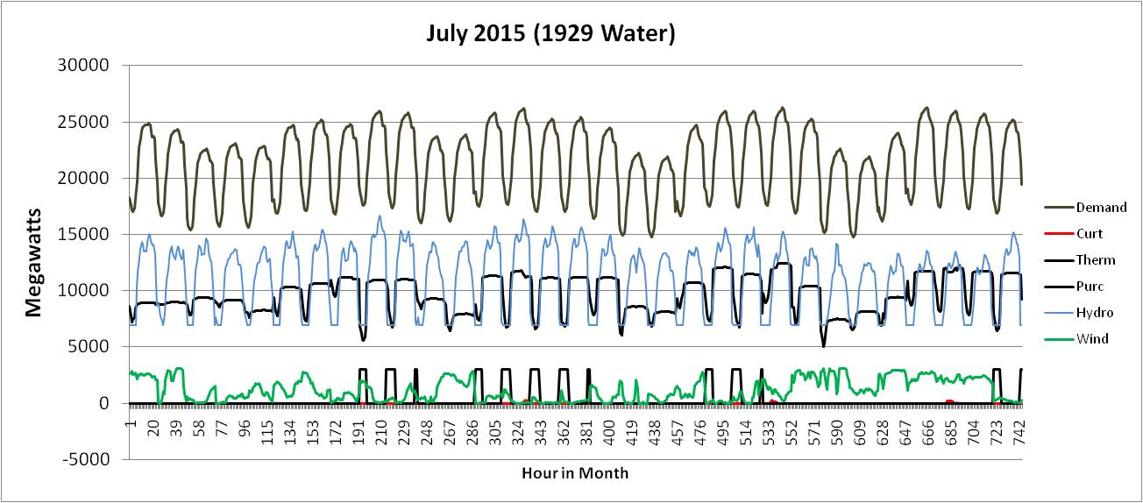
Simulated Regional Resource Dispatch

Slide 8
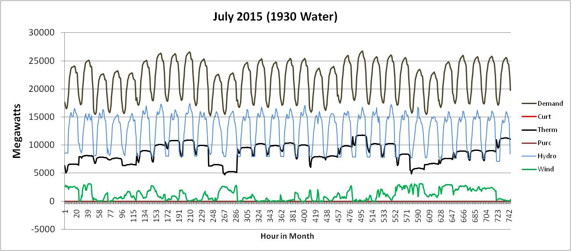
Simulated Regional Resource Dispatch

Slide 9
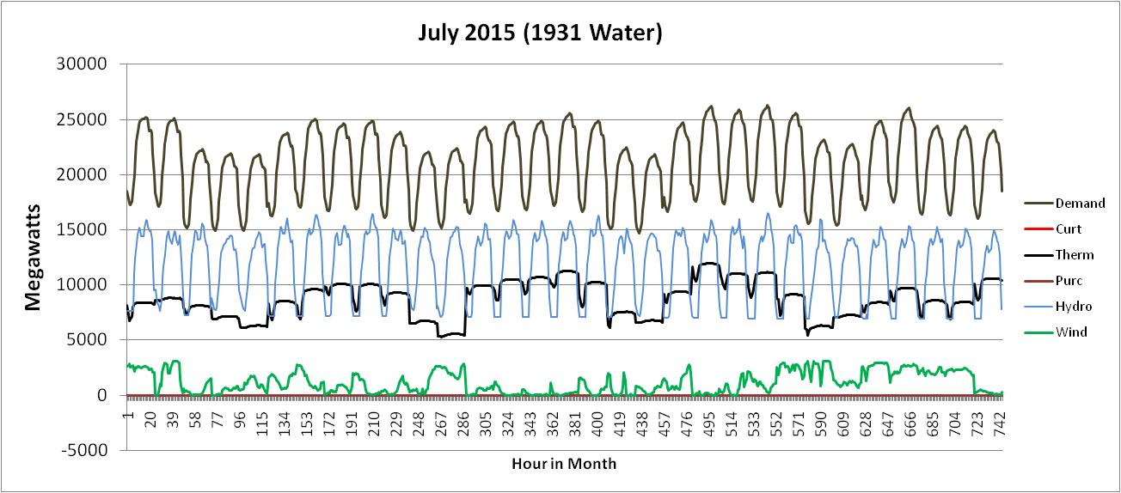
Simulated Regional Resource Dispatch

Slide 10
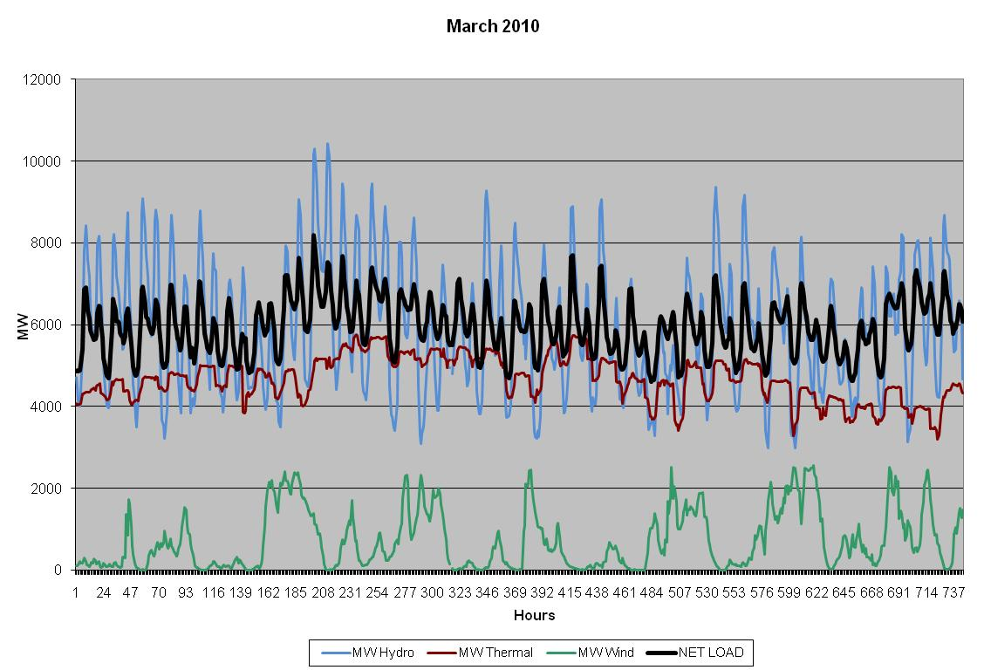
Historic Resource Dispatch (BPA Balancing Area)

Slide 11
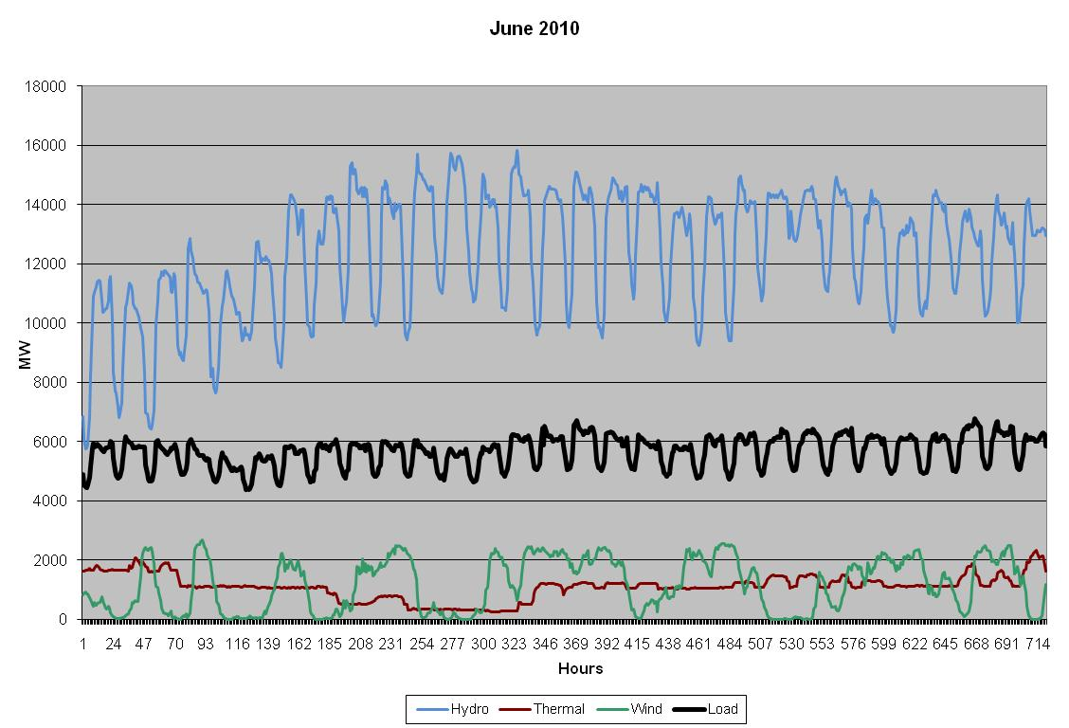
Historic Resource Dispatch (BPA Balancing Area)

Slide 12
A Few Observations
Thermal dispatch is situational and can vary substantially by month
Difficult to make direct comparisons
Could conclude that thermal is base loaded in winter, displaced in June, and used for peaking in summer
Overall there doesn’t appear to be anything in the simulated dispatch that stands out as being non-representative of real operations

