Slide 1
Random Variable Configuration for Stochastic Analysis
Resource Adequacy Forum
Technical Committee Meeting
October 1, 2010

Slide 2
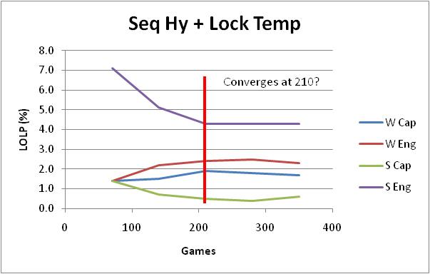
Minimum Number of Games to Converge

Slide 3
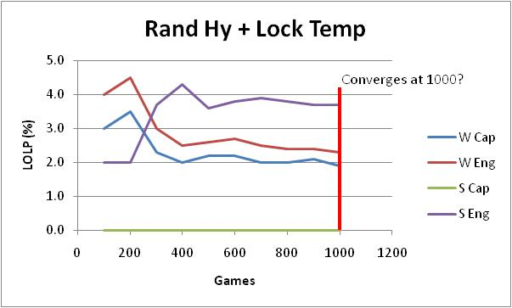
Minimum Number of Games to Converge

Slide 4
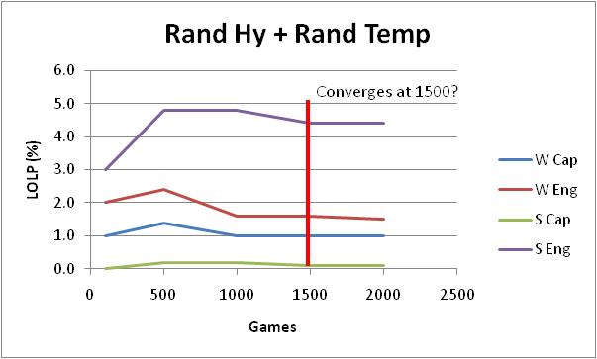
Minimum Number of Games to Converge

Slide 5
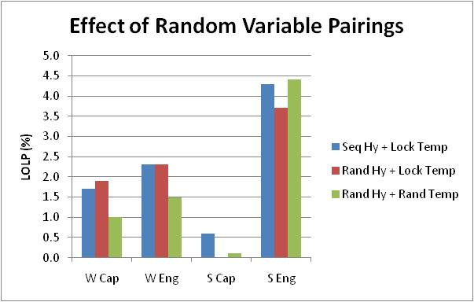
LOLP Values at Convergence Point

Slide 6
Recommendations
For sensitivity studies – run 210 games with sequential hydro and lockstep temperature (30 min/study)
For final studies – run 1,500 games with random hydro and random temperature (4 hrs/study)
Reevaluate when temperature-correlated wind data is ready

