Slide 1
Power System Research, Inc. Review of the PNW Adequacy Standard
Resource Adequacy Forum Technical Committee Meeting October 1, 2010

Slide 2
Statement of Work
Summarize probabilistic adequacy metrics
Critique the NW methodology – provide an alternative
Critique the use of deterministic metrics
Critique BPA’s proposed methodology
Summarize how adequacy standards are incorporated into long-term resource planning
Suggest how the NW standard can be incorporated into our long-term resource planning tools
Meet with regional planners to discuss results (if needed)
Provide a final written report on findings and recommendations

Slide 3
Outline of Draft Report
Introduction
Power supply adequacy metrics
Adequacy standards
Translating results into reserve margins
Metrics for Hydro-dominated Systems
Current NW Methodology
Using Deterministic Metrics
BPA’s Proposed Methodology
Using Adequacy Standards in Resource Planning

Slide 4
Summary of Report (1)
Report is 1st draft – much more detail to be added
NW standard is OK
But could be better
Capture magnitude of problems
Better ways to incorporate into resource planning
Easier ways to “translate” into deterministic metrics
More information that could aid in developing solutions

Slide 5
Summary of Report (2)
Implies 2 stages for adequacy assessment
Likelihood of having to use contingency resources (i.e. how often are we willing to call on them)
Likelihood of actual curtailment (i.e. how often are we willing to allow curtailments)

Slide 6
Summary of Report (3)
Implies that adequacy assessments can be tied more directly to economic system expansion
Portfolio model shows higher build level than standard
Which means the implied curtailment cost in the standard is too low
Use the RPM to “calibrate” the standard to get same result
Not sure we want to do this for the NW because
There may be a useful distinction between physical adequacy and economic system expansion
Other parameters (besides curtailment cost) come into play (i.e. greenhouse gas emissions, etc.)

Slide 7
Summary of Report (4)
LOLP provides probability of curtailment but not magnitude
Expected Unserved Energy (EUE) provides magnitude but not probability
CVaR provides the magnitude of extreme (but relatively unlikely) events plus;
Has good properties (coherence)
Easier to interpret
Easier to incorporate into planning models

Slide 8
Conditional Value at Risk
An assessment used to reduce the probability of incurring large losses
It assesses the likelihood that a loss will exceed the value at risk
Similar to the TVar90 metric used in the Regional Portfolio Model

Slide 9
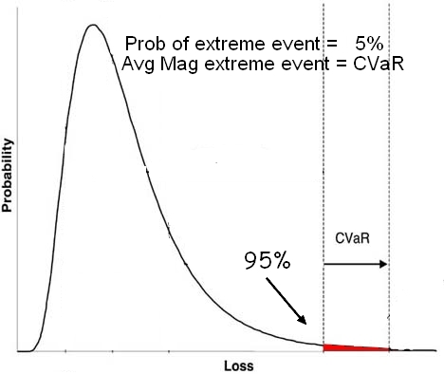
CVaR Illustration

