Slide 1

A Resource Adequacy Standard for the
Pacific Northwest
Resource Adequacy Steering Committee
October 4, 2011

Slide 2
outline
Current Adequacy Standard
Proposed Revisions
State of the System Report
Sample Report
Next Steps

Slide 3
Current Adequacy standard
Current standard in use for 3 years
Led to some confusion – L/R balance
Peer reviewed in 2010
  Eliminate translation to static measures
  Eliminate seasonal assessments
  Add measure for size of problem
  Measure use of standby resources

Slide 4
Proposed Revisions to be approved by the forum
Keep the current methodology, which includes non-firm resources
Keep the LOLP metric and the 5% threshold
Annual assessment (all months)
Quantify demand response (DR) and standby resources (SR) that are contractually available
Count events that exceed the energy and capacity limits of DR and SR

Slide 5
State of the system report
Adequacy assessment
Other commonly used adequacy measures
Reliance on non-firm and standby resources
Monthly assessment of potential shortfalls
Frequency, duration and magnitude of events
Conditions under which events occur

Slide 6
Sample Report – for illustration only
Not an official assessment
LOLP is 6.7% = inadequate supply
Dec, Jan and Aug only months with shortfalls
LOLP driven by peak shortfalls in August
(LOLP = 1.4% not counting peak events)
Adding 400 MW of capacity in August will bring LOLP below 5%

Slide 7
Comparison to old standard
Old standard
  Winter capacity LOLP = 2.4%
  Winter energy LOLP = 1.0%
  Summer capacity LOLP = 4.3%
  Summer energy LOLP = 1.9%
  Interpretation – Adequate
New standard
  LOLP = 6.7%
  Interpretation – Inadequate
Winter and summer capacity problems occur in different games thus, seasonal assessment will underestimate overall adequacy.

Slide 8
Adequacy summary - IPP
Availability:
  3,500 MW winter (approximate)
  1,000 MW summer
Percent of time used:
  To some degree every winter
  To some degree every summer
Dispatch:
  Winter months (avg): 750 to 1,500 MW-months
  Summer months (avg): 250 to 600 MW-months

Slide 9
Adequacy summary – sw market
Availability:
  On peak (3,000 MW winter , 0 MW summer)
  Proposed Off peak (1,000 MW year round)
Percent of time used:
  On peak used up to 11% of the time in winter
  Off peak used up to 27% of the time in summer
Dispatch:
  Highest on-peak: 1000 MW-months in one Dec
  Highest off-peak: 400 MW-months in one Aug

Slide 10
Adequacy summary – Borrowed hydro
Availability:
  1,000 MW-months all months
Percent of time used:
  Mostly in summer, about 90% of the time in Aug
  Less in winter, about 14% in Dec
Dispatch:
  About 700 MW-months in one August
  About 400 MW-months in one December

Slide 11
Adequacy summary – dr, sr and lolp
Availability:
  DR capacity only, 60 MW winter, 120 MW summer
  SR 602 MW capacity, 83,000 MW-hrs all year
Percent of time used:
  DR is used to some degree in 8.6% of the years
  SR is used somewhat less (no approx yet)
Dispatch:
  DR is generally used up to its availability
  SR energy may be used up before summer

Slide 12
Adequacy metrics and values
Adequacy Metrics
Metric | Description
LOLP | Loss of load probability = number of games with a problem divided by the total number of games
DR and SR | Demand response and standby resources that are contractually available = measure of
CVaR (energy) | Conditional value at risk = average annual curtailment for 5% worst games
CVaR (peak) | Conditional value at risk = average single-hour curtailment for worst 5% of games
EUE | Expected unserved energy = total curtailment divided by the total number of games
LOLE | Loss of load expectation = total number of hours of curtailment divided by total number of games

Slide 13
Adequacy metrics and values
Adequacy Metrics
Metric | Value | Units
LOLP | 6.7 | Percent
Use of DR and SR | 8.6 | Percent
CVaR (energy) | 67,618 | MW-hours
CVaR (peak) | 2,277 | MW
EUE | 3,399 | MW-hours
LOLE | 3.3 | Hours/year

Slide 14
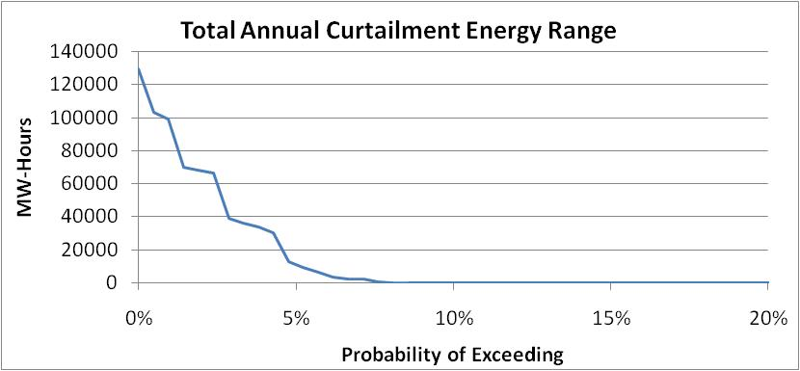
Annual curtailment energy

Slide 15
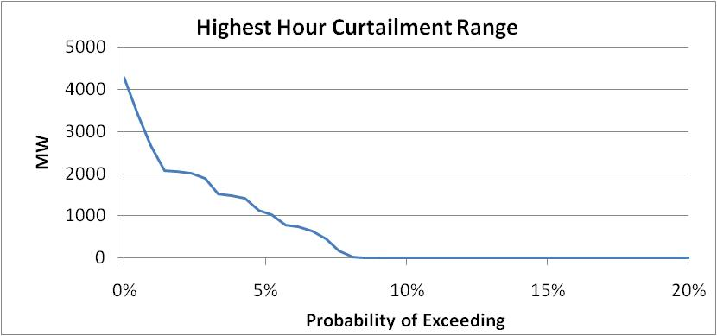
Annual highest hour peak curtailment

Slide 16
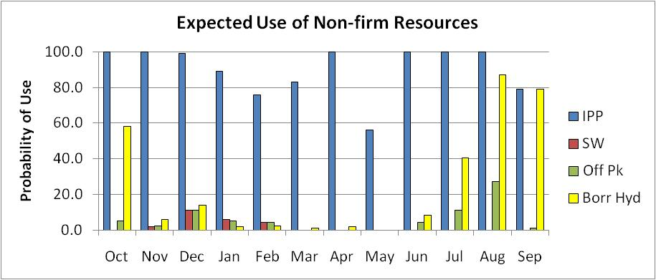
Non-firm resources: % of time used

Slide 17
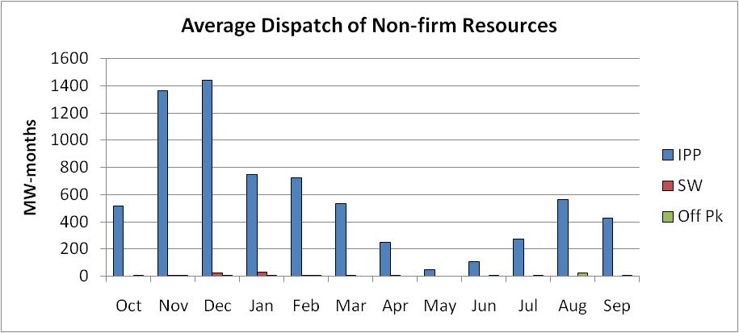
Non-firm resources: dispatch

Slide 18
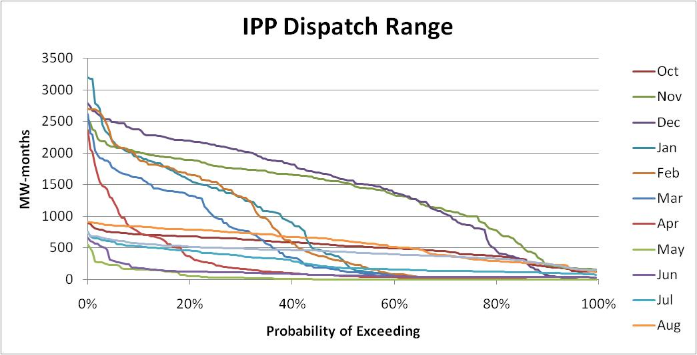
Independent power producers

Slide 19
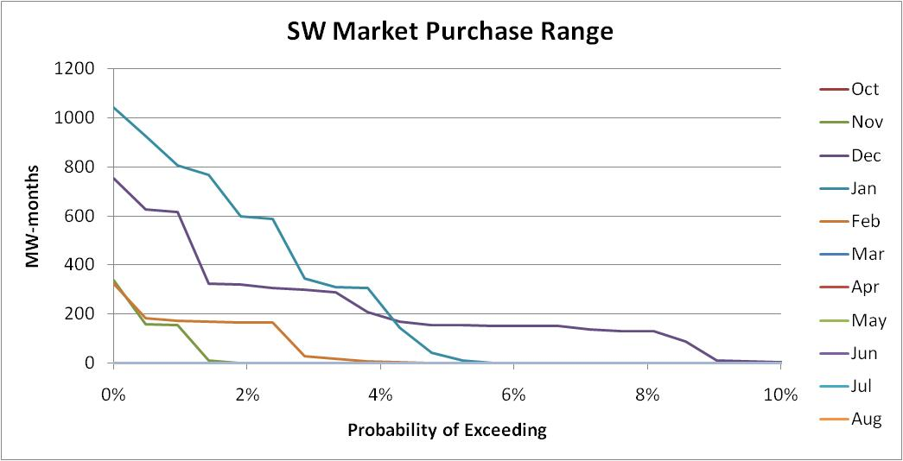
SW market purchases

Slide 20
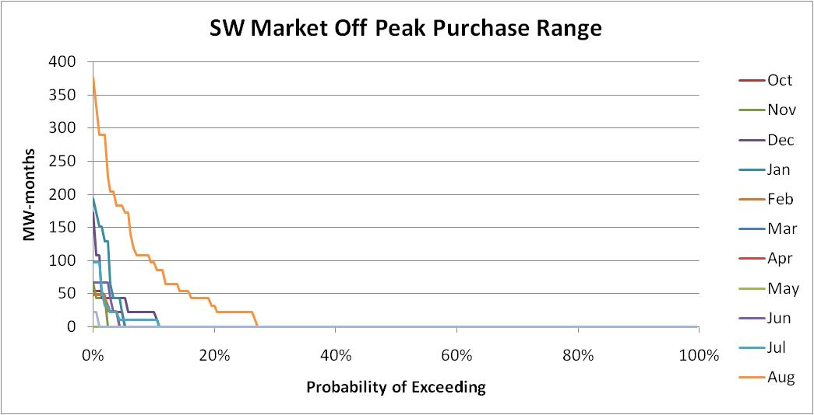
SW off-peak purchases

Slide 21
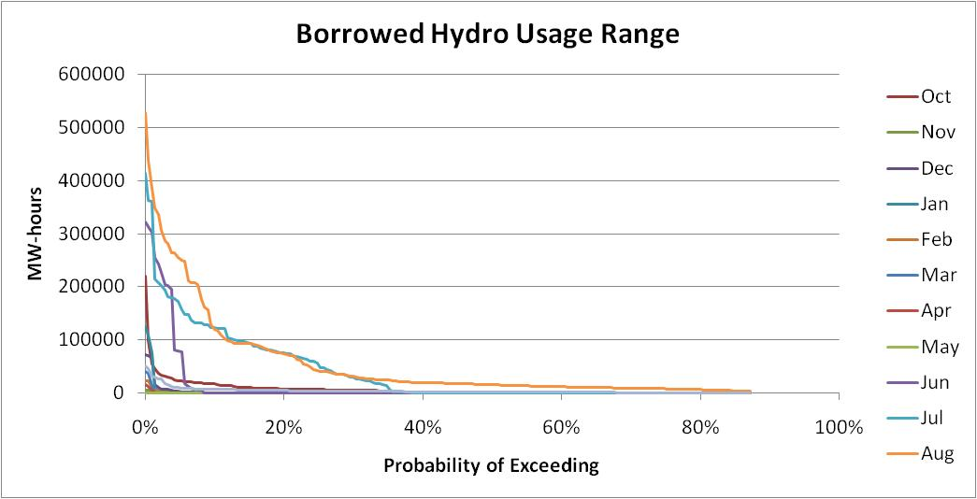
Borrowed hydro

Slide 22
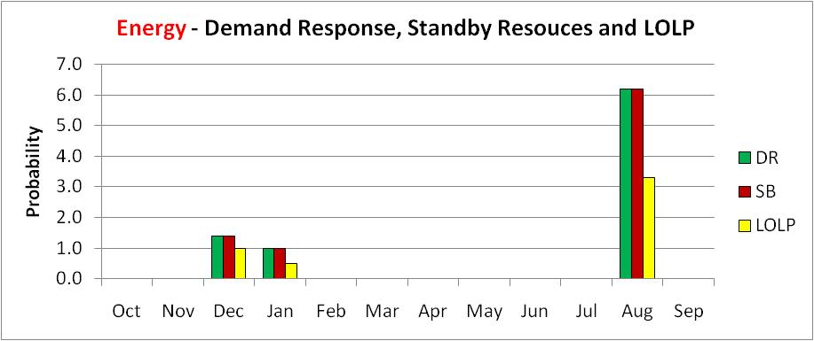
Energy – Dr, sr and LOLP

Slide 23
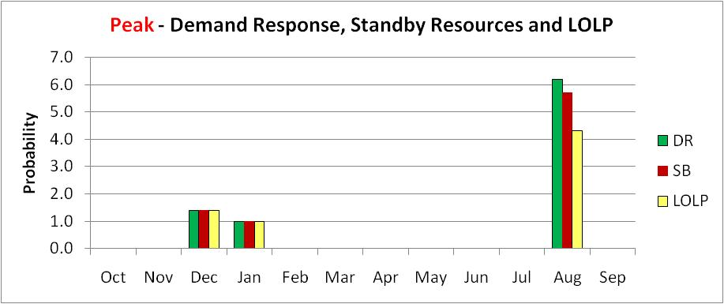
Peak – dr, sr and lolp

Slide 24
Curtailment statistics
Expected Number of Events* | 0.23 | per year
Average Event Duration | 14 | Hours
Average Event Magnitude | 14569 | MW-hrs
Average Event Peak Shortfall | 1098 | MW
Expected Number of Shortfall Hours | 3.3 | per year
Percent of Games With an Event | 8.6 | percent
*An event is defined as a contiguous set of hours of shortfall.

Slide 25
Next steps
Forum approves revised standard (namely the elements on slide number 4)
Forward proposed revisions to Council
Work continues on better defining non-firm resource assumptions, use of borrowed hydro, demand response and standby resources
Debate using off-peak summer purchases
2012: Forum approves revised assumptions

