Slide 1

Pacific Northwest Smart Grid Demonstration
Presented to the Pacific Northwest Demand Response Project, Northwest Power and Conservation Council, Portland, Oregon
Don Hammerstrom, Principal Investigator, Pacific Northwest Smart Grid Demonstration, Battelle, PNWD
April 27, 2010

Slide 2
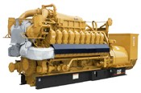
Olympic Peninsula GridWise® Demonstration
IBM
Invensys
Market
ancillary services
$
distribution congestion
transmission congestion
MW
wholesale cost
Internet broadband
communications
Clallam County
PUD Water
Supply District
0.2 MW DR
Clallam PUD & Port Angeles
n = 120, 0.5 MW DR
Sequim Marine
Sciences Lab
0.3 MW DR
0.5 MW DG
Johnson
Controls
Johnson
Controls

Slide 3
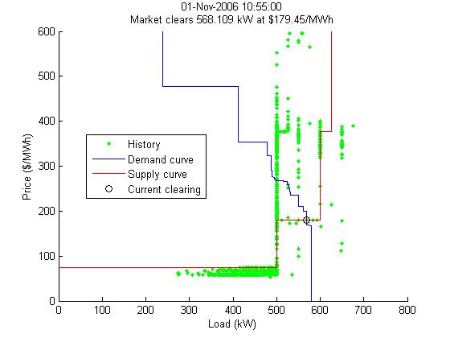
A 5-minute Energy Market

Slide 4
Price-based Distribution Dispatch
Unresponsive loads (control/fixed/TOU res, and large unmanaged commercial loads)
Price ($/MWh)
Large commercial customers with asynchronous DG or managed loads
Second synchronous DG unit
P_{clear}
First synchronous DG unit
Residential RTP customers
Feeder
Q_{clear}
Quantity (kW)

Slide 5
Transactive Thermostat Control
(cooling mode example)
P_{average}+ k_{T_H} σ
bid curve
P_{bid}
bid price
average price
P_{average}
price
market price
maximum temperature limit
P_{clear}
current zone temperature
desired temperature
min. temp. limit
adjusted set point
P_{average}- k_{T_L} σ
T
min
T
set,a
T
set
T
current
T
max
temperature

Slide 6
Tenets of Transactive Control
Communicate value via one nodal value signal
Dynamic signals
Facilitate interoperability
Multitask
Respond 24/7
Customer-friendly
Distributed control
Low bandwidth

Slide 7
Simplified Functional Block Diagram of a Node
Upstream
(toward generation)
Downstream
(toward demand)
Value Signal
Modified Value Signal
Modified Demand Signal
Demand Signals
Prediction & Control Machine

Slide 8
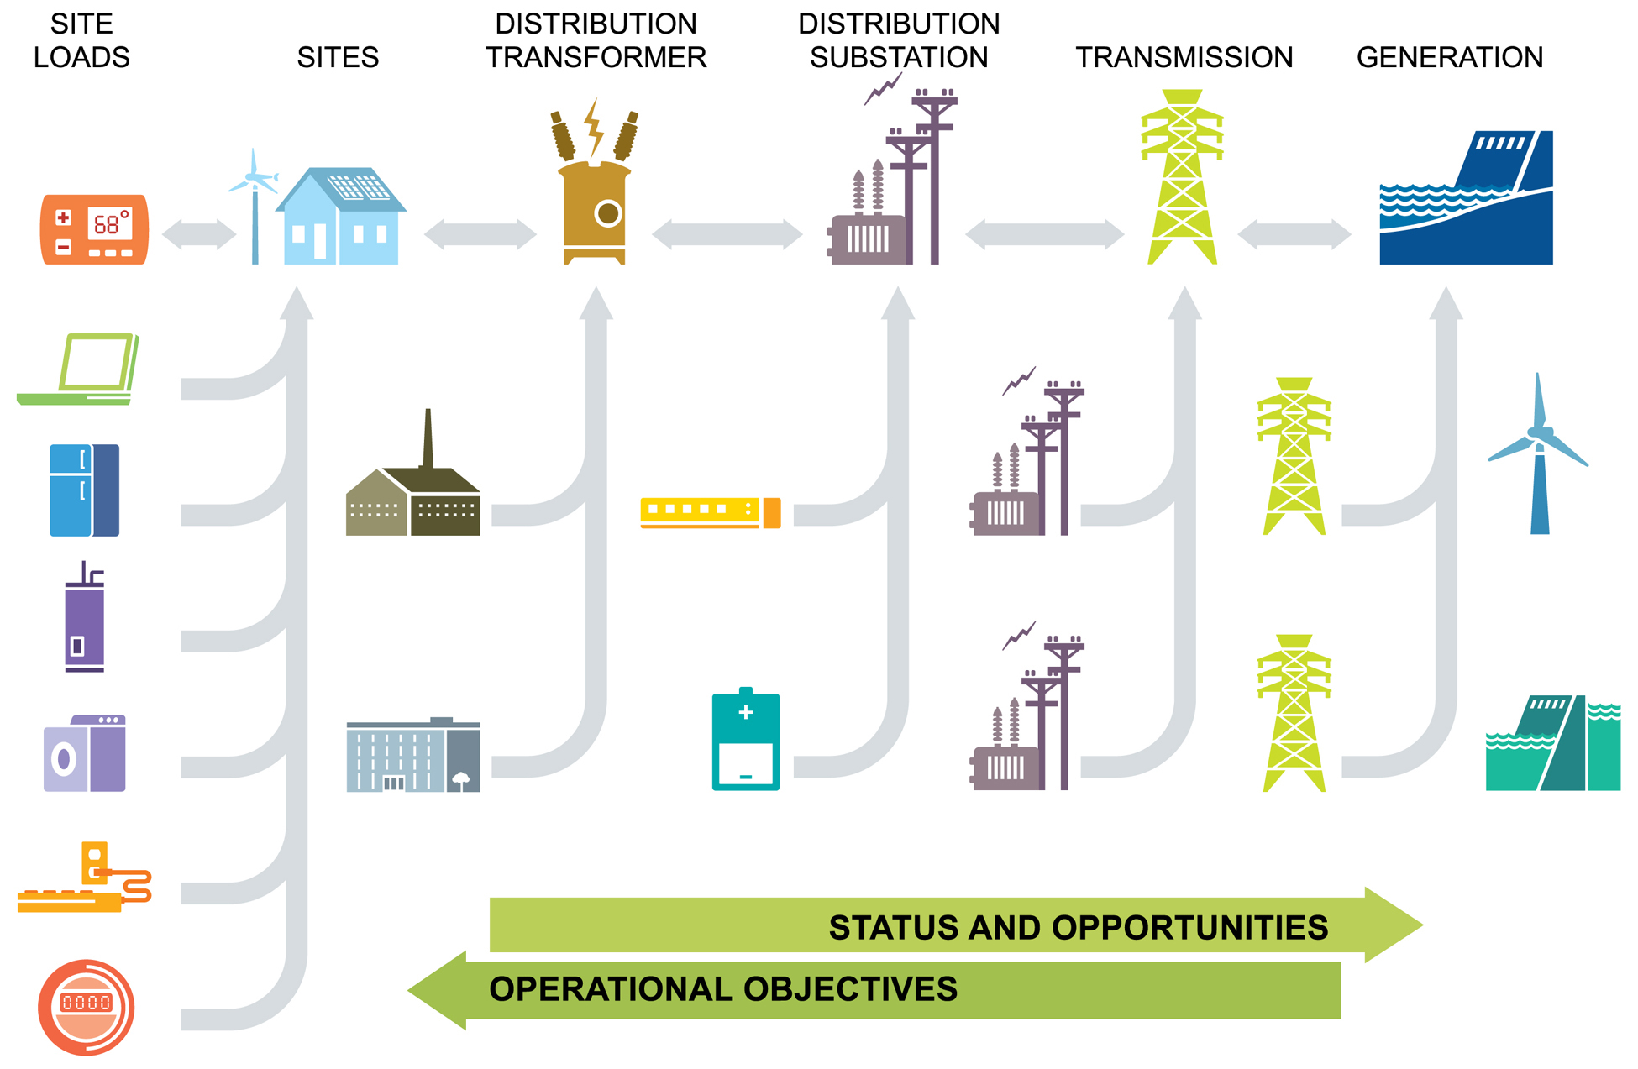
A Nodal Hierarchy

Slide 9
Understanding the Transactive Behavior—Negotiated Elastic Behavior
Next 15 Minutes
$
Next Four Quarter Hours
z
P
Next 24 Hours
Today
Tomorrow
Today
Tomorrow
Day After Tomorrow

Slide 10
Conceptual Design – Regional Perspective
Don Hammerstrom 509-372-4087 don.hammerstrom@battelle.org

Slide 11
Conceptual Design – Utility Perspective
Don Hammerstrom 509-372-4087 don.hammerstrom@battelle.org

Slide 12
Smart Grid Myths and Misconceptions
We would like to buy a smart grid, please
The efficiency department is down the hall
All we need are more standards
Our customers need more reliable service
Smart grid is the Internet overlaid on the power grid
We need a “big red button” to push
Loads have to act like generators

Slide 13
Myths that are Holding us Back (continued)
Electrical customers
  Want to know more about their electrical consumption
  Will change their behaviors for a few cents/kWh
  Will not respond unless they are paid
Only a couple residential appliances are worth controlling
My dryer just called and wants to know the electricity price
Loads cannot provide down-regulation

Slide 14
Contacts and Links
Don Hammerstrom, PI, Pacific Northwest Smart Grid Demonstration Project
  Battelle, Pacific Northwest Division
  902 Battelle Blvd.
  P.O. Box 999, MSIN: K1-85
  don.hammerstrom@battelle.org
  (509) 372-4087
Relevant links and references:
Olympic Peninsula Project final report: www.gridwise.pnl.gov
“Standardization of a Hierarchical Transactive Control System” conference paper: www.gridwiseac.org/pdfs/forum_papers09/don-business.pdf.
Hammerstrom DJ. 2010. "Smart Grid Load Management." Presented by Don Hammerstrom (Invited Speaker) at 2010 Northwest Energy Systems Symposium, Seattle , WA on February 17, 2010. PNNL-SA-70842.

