Slide 1
Introduction to the
Regional Portfolio Model
Michael Schilmoeller
NW Power and Conservation Council
Thursday, June 10, 2010

Slide 2
The Northwest Power and Conservation Council
Notes:
The Northwest Power and Conservation Council was created by Congress to give the citizens of Idaho, Montana, Oregon and Washington a stronger voice in determining the future of key resources common to all four states — namely, the electricity generated at and fish and wildlife affected by the Columbia River Basin hydropower dams.
The Council is a unique organization that helps the Pacific Northwest states make critical decisions that balance the multiple purposes of the Columbia River and its tributaries.
The Council is funded by wholesale power revenues from the Bonneville Power Administration, the federal agency that markets the electricity generated at federal dams on the Columbia River.
The Council was authorized in the Northwest Power Act of 1980 and approved by a vote of the legislatures of all four states. The governor of each state appoints two members to serve on the Council. The Power Act contains three principal mandates for the Council to carry out:
Develop a 20-year electric power plan that will guarantee adequate and reliable energy at the lowest economic and environmental cost to the Northwest. Energy conservation, renewable resources, such as wind power, solar, geothermal and biomass, and high-efficiency resources, such as those that use heat from manufacturing processes to also generate electricity, are listed in the Power Act as priorities.
Develop a fish and wildlife program to protect and rebuild populations affected by hydropower development in the Columbia River Basin.
Conduct an extensive program to educate and involve the public in the Council's decision-making processes.
The plans and policies the council develops and approves are implemented by numerous agencies including Bonneville Power Administration, U.S. Army Corps of Engineers, Bureau of Reclamation, and Federal Energy Regulatory Commission.
State, tribal and local governments often work closely with the Council as it develops its power and fish and wildlife plans, and these entities also implement measures in those plans. The power plan and fish and wildlife program are updated at least every five years.

Slide 3
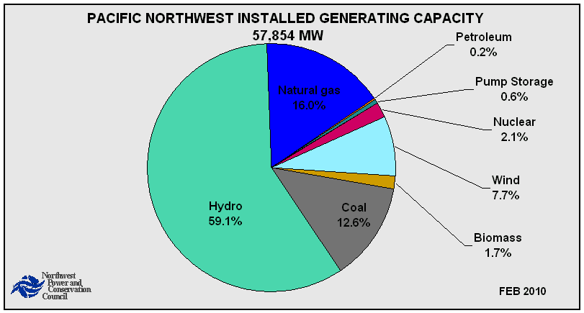
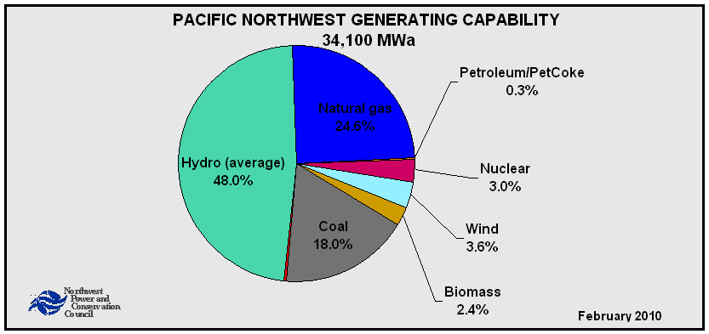
Generation Resources

Slide 4
Forecasts Have
Not Improved

Slide 5
Market Forecasts
Have Not Improved
3.50
3.00
2.50
2.00
1.50
Current $/MMBTU
1.00
0.50
0.00
source:Q:\MS\Admin\Contracts\Marty Howard\Uncertainty and Prediction\20080511 Gas Price Forecast Error Characteristics 6 mjs.doc

Slide 6
How the NWPCC
Approach Differs
No perfect foresight, use of decision criteria for capacity additions
Likelihood analysis of large sources of risk (“scenario analysis”)
Adaptive plans that respond to futures
Notes:
6

Slide 7
Special Terms
Futures: aspects of the future we cannot control, combinations of uncertainties
Plans: actions or policies that we can control
Scenario: a particular plan under a particular future

Slide 8
Sources of Uncertainty
Fifth Power Plan
  Load requirements
  Gas price
  Hydrogeneration
  Electricity price
  Forced outage rates
  Aluminum price
  Carbon allowance cost
  Production tax credits
  Renewable Energy Credit (Green tag value)
Sixth Power Plan
  aluminum price and aluminum smelter loads were removed
  Power plant construction costs
  Technology availability
  Conservation costs and performance
Notes:
8

Slide 9
Excel Spinner Graph Model
Represents one plan responding under each of 750 futures
Illustrates “scenario analysis on steroids”
Notes:
9

Slide 10
Uncertainty and the
Construction Cycle
Planning
Committed construction
Early Construction
In service
Delay
Capacity
time

Slide 11
Distribution of
Cost for a Plan
Number of Observations
Cost for
Future 2
Cost for
Future 1
10000
12500
15000
17500
20000
22500
25000
27500
30000
32500
Power Cost (NPV 2006 $M)->

Slide 12
Risk and Expected Cost Associated With A Plan
Avg Cost
Risk = average of
costs> 90% threshold
Likelihood (Probability)
10000
12500
15000
17500
20000
22500
25000
27500
30000
32500
Power Cost (NPV 2006 $M)->

Slide 13
Feasibility Space
Increasing TailVaR90
Increasing Average Cost

Slide 14
Finding Robust Plans
Space of feasible solutions
Reliance on the likeliest outcome
Efficient Frontier
Risk Aversion

Slide 15
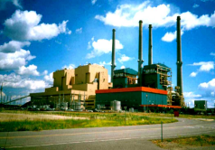


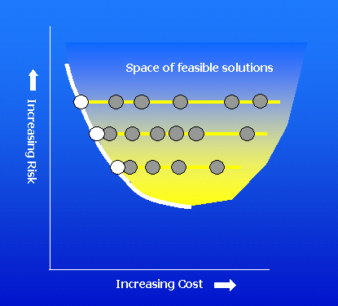
Modeling Process
The portfolio model
$
Notes:
The modeling process consists of several elements.
The portfolio calculates costs for a given future and plan
Another module changes futures to produce the distribution of costs
A third module changes plans, and tries to locate least-cost plans for each level of risk

Slide 16
Picking a Plan
Considerations
The strategies along and removed from the efficient frontier
Other sources of risk, not necessarily captured by the efficient frontier
The timing of commitments
Controllable costs

Slide 17
Option Costs and Risk Benefits
Notes:
This is an exercise to show that the costs of siting and licensing power plants -- and of acquiring conservation at prices above market price for electricity -- is comparable to premiums paid for more conventional forms of insurance. The costs of the power planning options, however, are probably overstated. For decisions beyond five years, we do not have to make commitments today. When we do make the commitments, much of that uncertainty will have been resolved and some options will not be necessary.

Slide 18
What the Risk Modeling
Teaches Us
Power plant construction lead time is critical to economic risk
It is better to be a little surplus in resources than a little deficit, but…
The biggest blunder is overbuilding. This is consistent with history, too.

Slide 19
What the Risk Modeling
Teaches Us
Utilities that are reliant on fossil fuels may become economically “short” if carbon control legislation is passed
If so, they may face a triple whammy:
  greater reliance on the market,
  higher electricity prices in the market, and
  lower value for generation

Slide 20
What the Risk Modeling
Teaches Us
If we ignore risk, the least-cost plan is relying on the market for new capacity
Least-risk plan resources need not be “used” to be useful

Slide 21
What the Risk Modeling
Teaches Us

Slide 22
End

Slide 23
NWPCC Forecasts
Have Not Improved

