Slide 1
A Choice of Platform:
Excel® and Crystal Ball ®
Michael Schilmoeller
Thursday, December 2, 2010
SAAC

Slide 2
Overview
The importance of transparency and accessibility
  Availability of diagnostics
The topography of the RPM
High-performance Excel
  XLLs
  Carefully controlled calculations
Crystal Ball and CB Turbo
Olivia
The efficient frontier

Slide 3
Observing States
C:\Backups\Plan 6\Studies\Model Development\Construction Cost Uncertainty\FixedCst_08.xls
Transparency

Slide 4
Observed States
C:\Backups\Plan 6\Studies\Model Development\Construction Cost Uncertainty\FixedCst_08.xls
Transparency

Slide 5
Overview
The importance of transparency and accessibility
  Availability of diagnostics
The topography of the RPM
High-performance Excel
  XLLs
  Carefully controlled calculations
Crystal Ball and CB Turbo
Olivia
The efficient frontier

Slide 6
Layout of the RPM

Slide 7
Logic Structure
Source: Q:\MS\Plan 5\Appendix Model\AppL_060227.doc

Slide 8
Overview
The importance of transparency and accessibility
  Availability of diagnostics
The topography of the RPM
High-performance Excel
  XLLs
  Carefully controlled calculations
Crystal Ball and CB Turbo
Olivia
The efficient frontier

Slide 9
High-Performance Excel
XLLs – special dynamic link library (DLL) files containing both C/C++ “native” add-in functions via Excel “C” API and “flat” functions to control Excel memory
Bypass Excel’s calculation tree
  Strict enforcement of the calculation order with Range.calculate method
  Store function values for recall
  Enable functions selectively

Slide 10
High-Performance Excel
(An Aside)
Windows Server 2008 r2 provides an High Performance Computing (parallel-processing) add-on, now in beta 3
The HPC initiative is aimed at Excel users and Excel 2010 has provisions for user to configure Server 2008/HPC for enhanced workbook performance

Slide 11
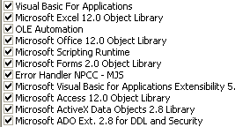
Requirements
Windows XP
Excel 2000 or better
COM Typelibs:
  NWPCC
    Errdll.dll – error handling and reporting
    NWPCC07Risk.xll – dispatch algorithms, etc.
  Microsoft:

Slide 12
Overview
The importance of transparency and accessibility
  Availability of diagnostics
The topography of the RPM
High-performance Excel
  XLLs
  Carefully controlled calculations
Crystal Ball and CB Turbo
Olivia
The efficient frontier

Slide 13
Crystal Ball and CB Turbo
It seemed like a good idea at the time….
The trials and tribulations of third-party software
Current status

Slide 14
Overview
The importance of transparency and accessibility
  Availability of diagnostics
The topography of the RPM
High-performance Excel
  XLLs
  Carefully controlled calculations
Crystal Ball and CB Turbo
Olivia
The efficient frontier

Slide 15

Olivia

Slide 16

Olivia

Slide 17
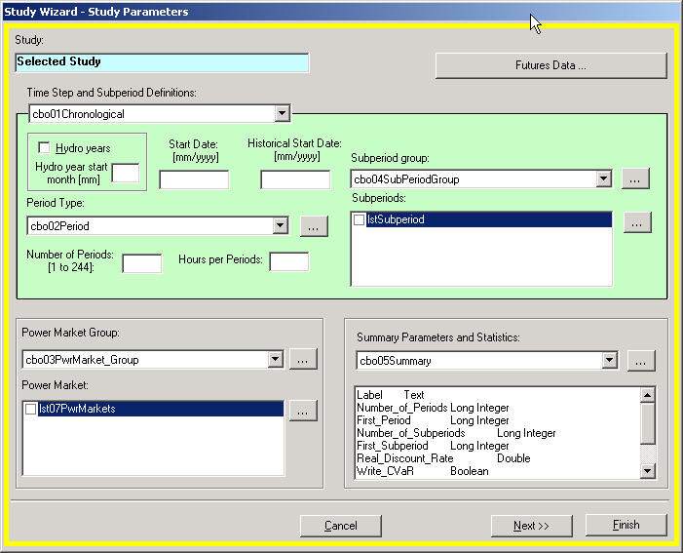
Olivia

Slide 18
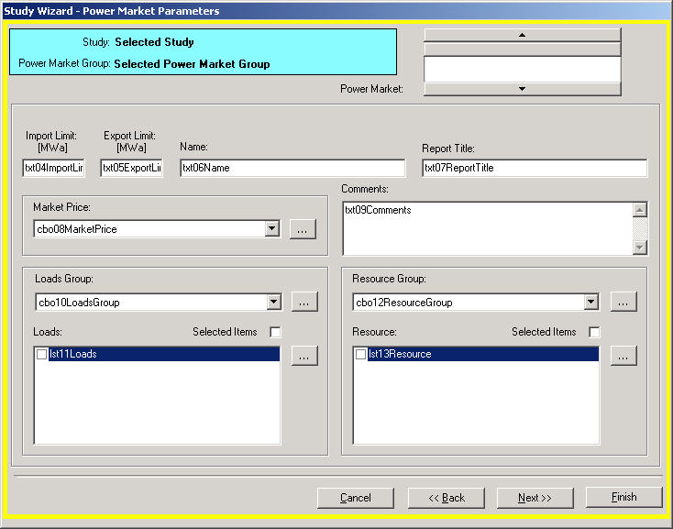
Olivia

Slide 19
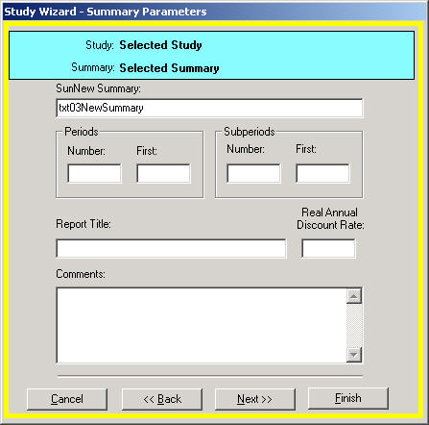
Olivia

Slide 20
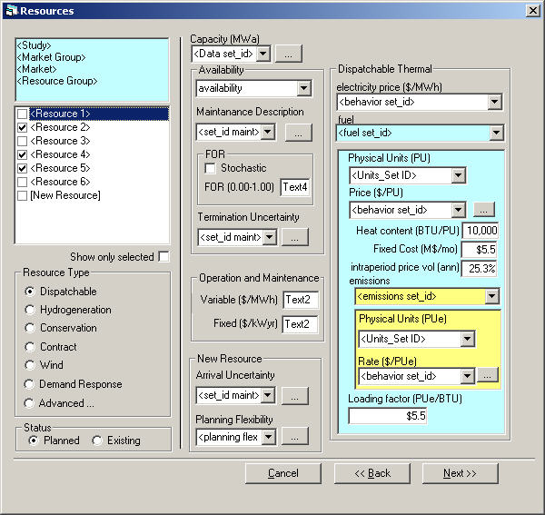
Olivia

Slide 21
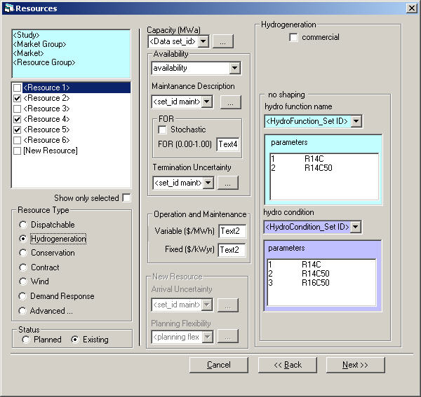
Olivia

Slide 22
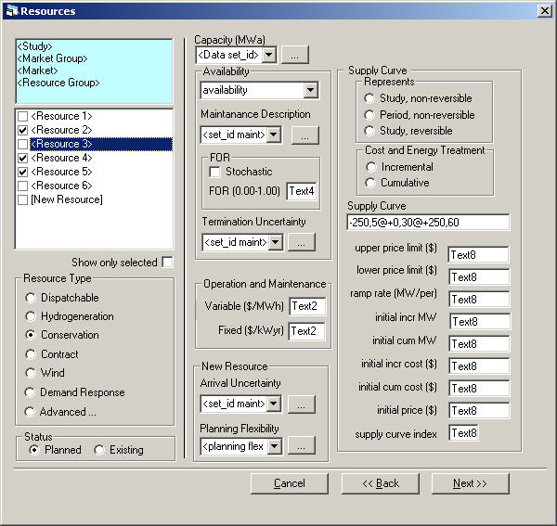
Olivia

Slide 23
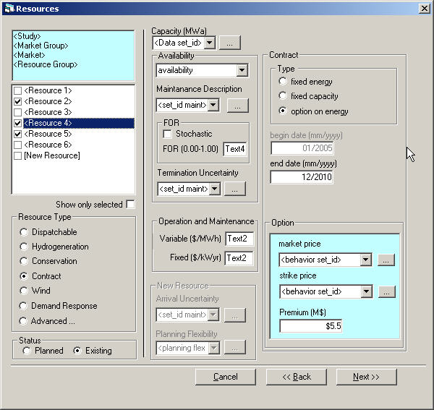
Olivia

Slide 24
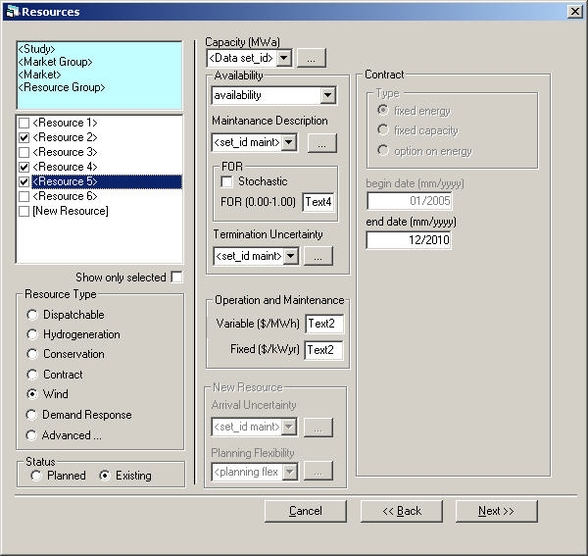
Olivia

Slide 25
Overview
The importance of transparency and accessibility
  Availability of diagnostics
The topography of the RPM
High-performance Excel
  XLLs
  Carefully controlled calculations
Crystal Ball and CB Turbo
Olivia
The efficient frontier

Slide 26
The Efficient Frontier
A device for filtering out “bad” plans (not to be confused with “bad” NPV outcomes)
One plan “dominates” another if it is no worse in any regard, and better in at least one regard, than the other
The bad plans are the dominated plans

Slide 27
Evaluating Vaccines

Slide 28
A
B

Slide 29
A
B

Slide 32
The Efficient Frontier

Slide 33
What does the
Efficient Frontier Tell Us?
The Efficient Frontier does not tell us what to do
The Efficient Frontier tells us what not to do
Most useful if there are a large number of choices

Slide 34
Resources
Fifth power plan
http://www.nwcouncil.org/energy/powerplan/5/(06)%20Risk%20Section.pdf
http://www.nwcouncil.org/energy/powerplan/5/(07)%20Portfolio%20Analysis.pdf
http://www.nwcouncil.org/energy/powerplan/5/AppendixP.pdf
http://www.nwcouncil.org/energy/powerplan/5/Appendix%20L%20(Portfolio%20Model).pdf
Sixth power plan
http://www.nwcouncil.org/energy/powerplan/6/final/SixthPowerPlan_Ch9.pdf
http://www.nwcouncil.org/energy/powerplan/6/final/SixthPowerPlan_Appendix_J.pdf

Slide 35
End

