Slide 1

Adequacy Assessment for the
2017 Pacific Northwest Power Supply
Steering Committee Meeting
October 26, 2012
Portland, Oregon

Slide 2
Outline
Final 2017 Resource Adequacy Assessment
Changes since August Draft
Additional Slides (if needed)

Slide 3
NW Adequacy Standard
Metric: Loss-of-load probability (LOLP)
Threshold: Maximum of 5 percent
LOLP is the probability that extraordinary actions would have to be taken in a future year to avoid curtailment of electricity service
Calculated assuming existing resources only and expected efficiency savings

Slide 4
2017 Assessment
The expected LOLP is 6.6%
January, February and August most critical months
Interpretation: Relying only on existing resources and expected efficiency savings yields a power supply in 2017 whose likelihood of curtailment exceeds our agreed upon threshold

Slide 5
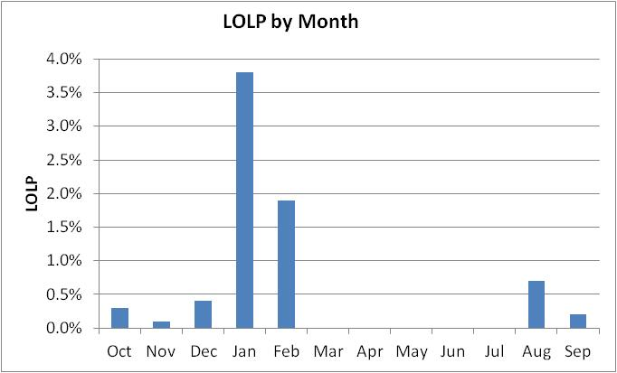
2017 Monthly LOLP

Slide 6
Actions to Alleviate Inadequacy
350 MW of new generating resource capacity drops the expected LOLP to 5%
Equivalently, 300 MWa of additional energy efficiency does the same
  Equals 50 MWa per year above the target
  Which was accomplished in 2010-11
Demand response measures could also help
This is consistent with utility plans and the Council’s resource strategy

Slide 7
Major Assumptions
Existing resources (sited and licensed)
6th Power Plan conservation
Market supplies
  NW: 3,450 MW winter, 1,000 MW summer
  SW on-peak: 1,700 MW winter, none summer
  SW off-peak: 3,000 MW year round
Council’s medium load forecast

Slide 8
Sixth Plan Target Efficiency Levels
Year | Incremental Savings (MWa) | Cumulative Savings (MWa)
2010 | 200 | 200
2011 | 220 | 420
2012 | 240 | 660
2013 | 260 | 920
2014 | 280 | 1,200*
2015 | 300 | 1,500
2016 | 320 | 1,820
2017 | 340 | 2,160
*Council’s target for 2014 is 1,200 MWa with a high-end range of 1,400 MWa. Extrapolating this data yields a high-end value of 2,400 MWa for 2017 (or 240 MWa more than the target).

Slide 9
Major Uncertainties
Explicitly modeled
  Water supply
  Temperature load variation
  Wind
  Forced outages
Not modeled explicitly
  Economic load growth
  Uncertainty in SW market

Slide 10
Effects of Uncertainties
Load | SW Winter Market | LOLP
Low | High | 2.8%
Low | None | 8.4%
High | High | 7.8%
High | None | 16.8%
Expected | Expected | 6.6%

Slide 11
Variation in LOLP due to Load and Market

Slide 12
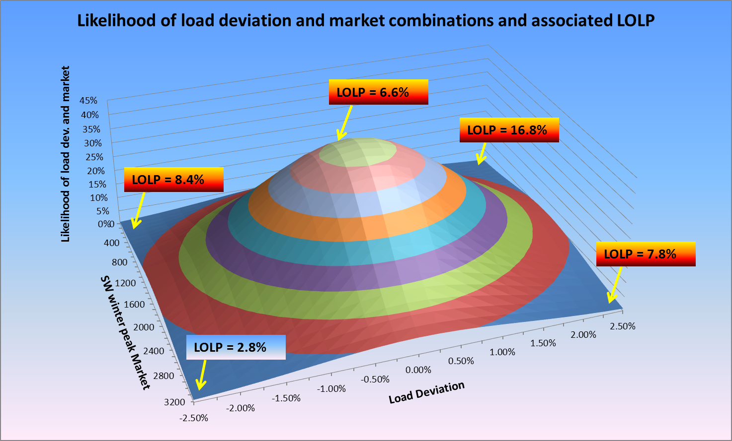
Illustration of LOLP Probability

Slide 13
Effects of Adding Resources
350 MW of new resource moved the reference case LOLP of 6.6% down to 5.0%
2,850 MW of new resource moved a high LOLP of 13.3% down to 5.0%
Sum of utility planned* resources exceeds 3,000 MW
*In this context “planned” means request for proposals or RFPs.

Slide 14
Adding 350 MW of CCCT

Slide 15
Adding 2,850 MW of CCCT

Slide 16
Changes Since the last Draft
Many changes were made based on comments from the technical committee
Expected LOLP changed from 6.9 to 6.6%

Slide 17
Revisions since August Draft
Code fix (related to Canadian operations, eliminated anomalous June curtailments)
80 year hydro record and updated Canadian reservoir operations
LLH Summer purchase-ahead changed to 3000 MW (previous value was 1000 MW)
Net regional wind dedicated to serving regional load changed to 4266 MW due to removals, additions and adjustments (previous value was 4421 MW)

Slide 18
Revisions since August Draft
Thermal resource changes
  IPP now 3451 MW (was 3586 MW)
    Centralia 1 (670 MW IPP changed to 290 MW IPP and 380 MW firm)
    Tenaska (245 MW firm changed to 245 MW IPP)
  Firm 12746 MW changed to 12881 MW
  Mill Creek/Dave Gates Generating Station changed to 47 MW (33% of 143 MW, previous value was 49.5 MW – 33% of 150 MW)
  Highwood Generating Station removed (previously supplied 13 MW)

Slide 19
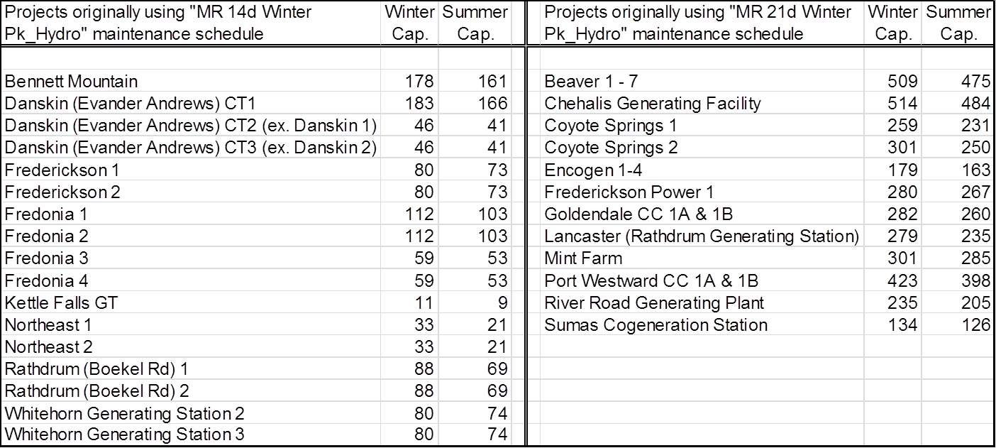
Summer Thermal Derates

Slide 20
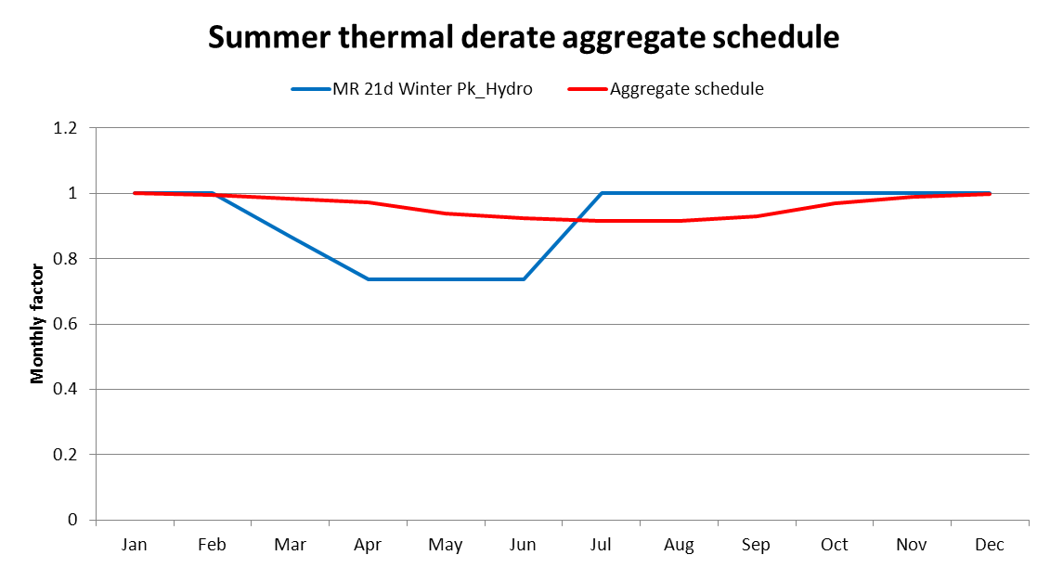
Illustration of Summer Derate

Slide 21
Revisions since August Draft
Wind capacity factor set
  Studied 20 sets of temperature-correlated wind capacity factors, LOLP differed by 1 to 2% depending upon which set was used
  Selected a set that tested at the middle of the LOLP range
Number of games
  6160 games ( = 80 hydro x 77 load), all unique combinations of water and load (wind is locked to load)

Slide 22
LOLP Surface Map from August

Slide 23
Current LOLP Surface Map

Slide 24
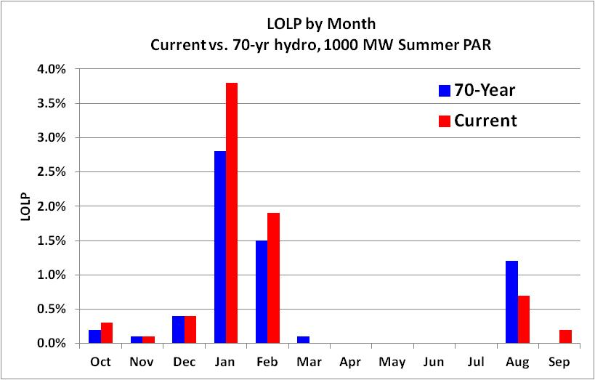
Effects of 70-yr vs. 80-yr hydro

Slide 25
Additional Slides

Slide 26
Final 2017 Assessment Results

Slide 27
Revisions since August Draft
Thermal resource changes
  Summer derate for thermal plants
    Project capacity is represented by a single number (winter capacity)
    Reduced summer capacity is achieved through adjustment to the maintenance schedule
    Reviewed summer and winter capacity figures and specific schedules in the White Book (from PNUCC submittals) to create customized maintenance schedules

Slide 28
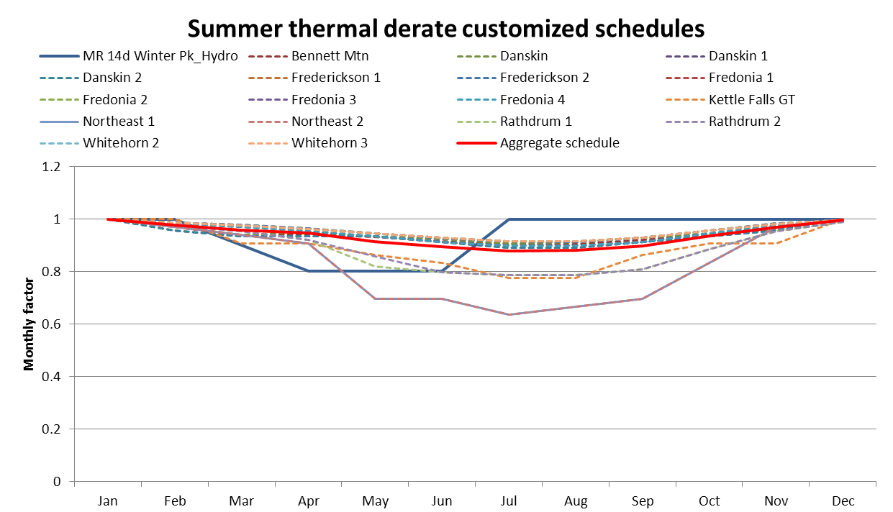
Thermal derate schedules

Slide 29
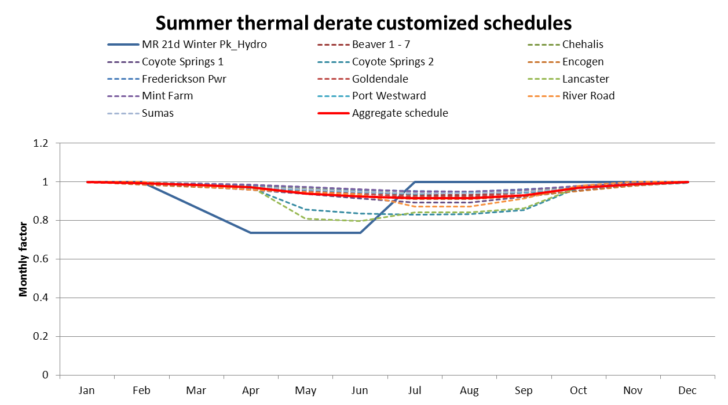
Thermal derate schedules

Slide 30
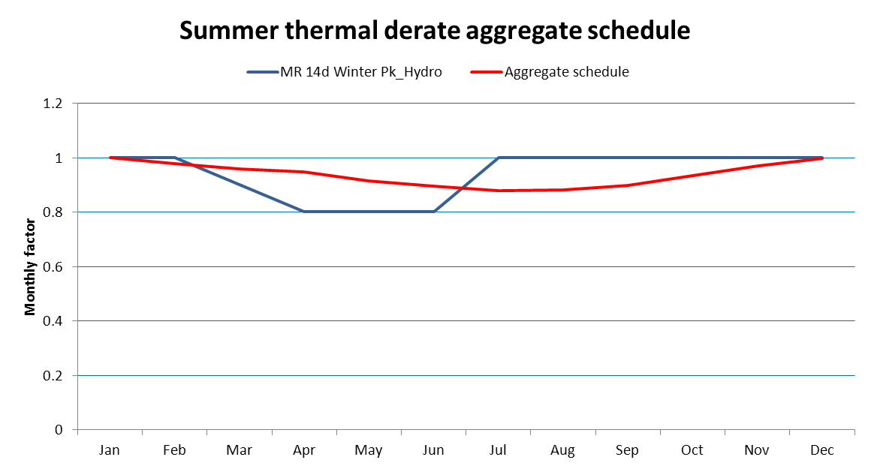
Thermal derate schedules

Slide 31
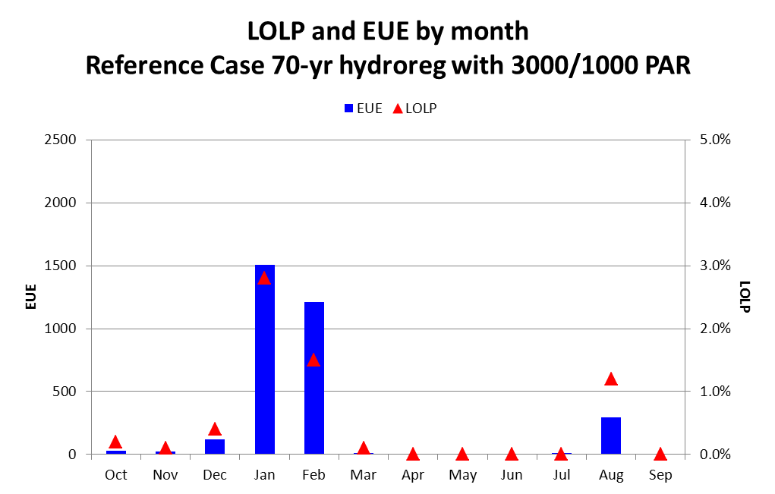
Effects of 70-yr vs. 80-yr hydro
Run the reference case with 70-yr hydro and 1000 MW summer purchase-ahead resource. Note that August issues, which are not as apparent with 80-yr hydro, appear when switching back to 70-yr hydro

Slide 32
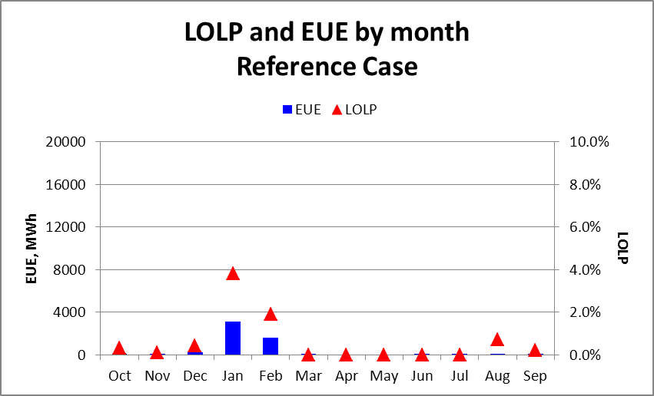
Monthly LOLP
Monthly LOLP and EUE for each of the study cases is shown on the following charts

Slide 33
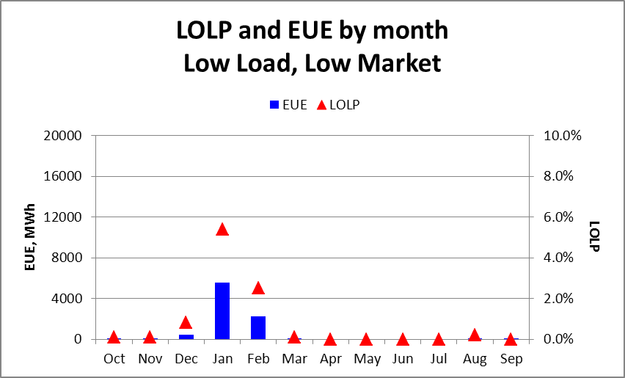
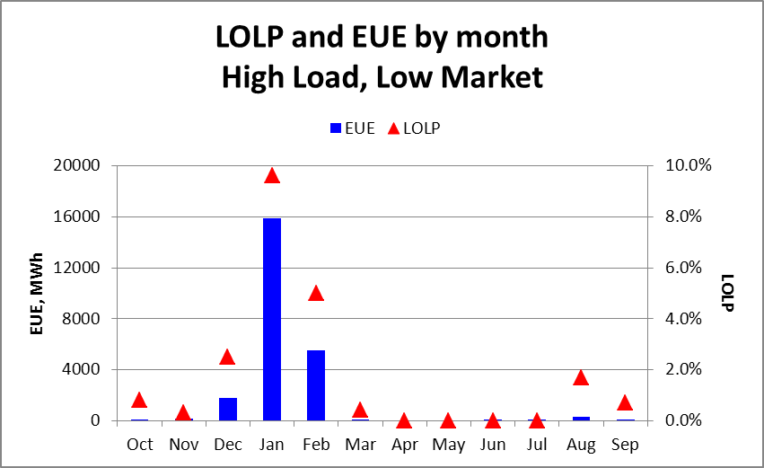
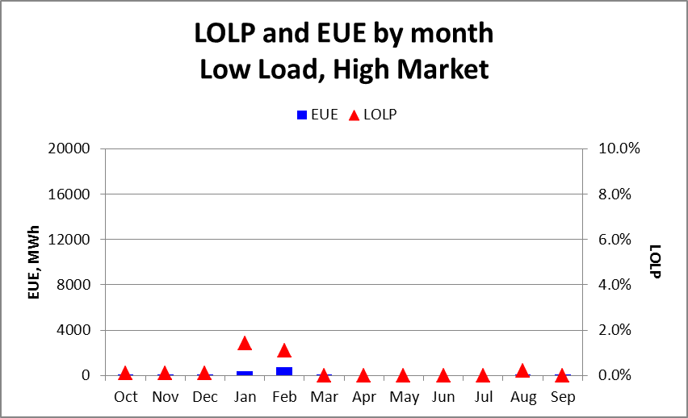
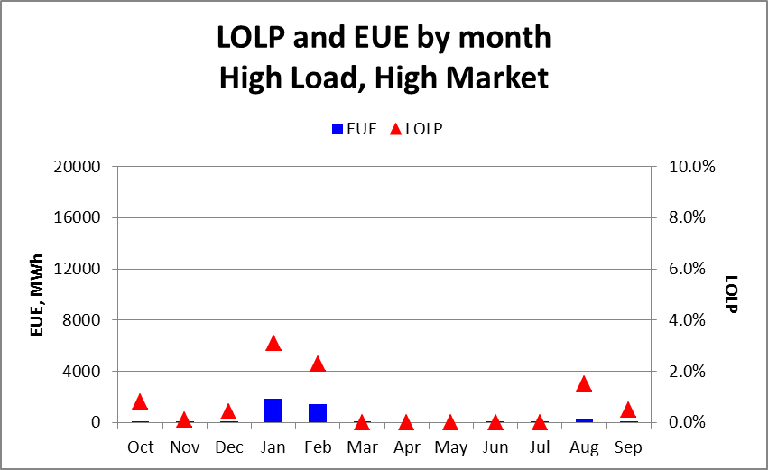
Monthly LOLP

Slide 34
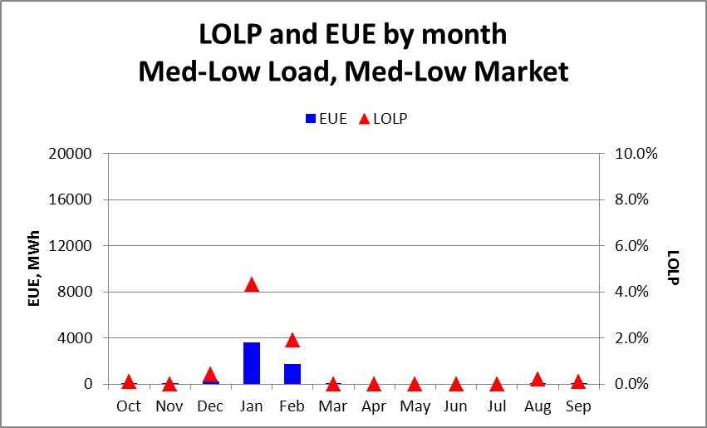
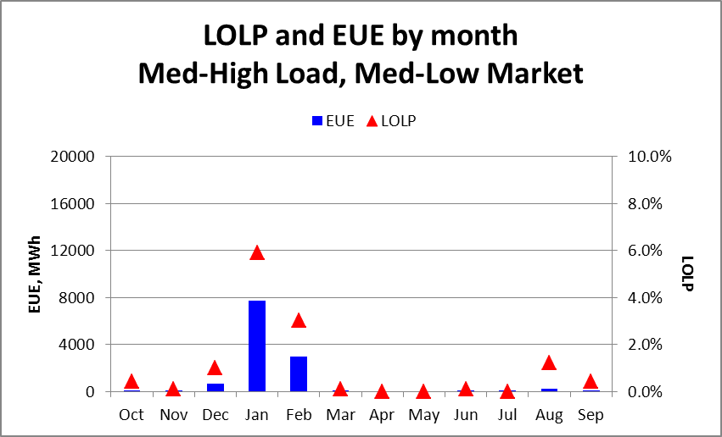
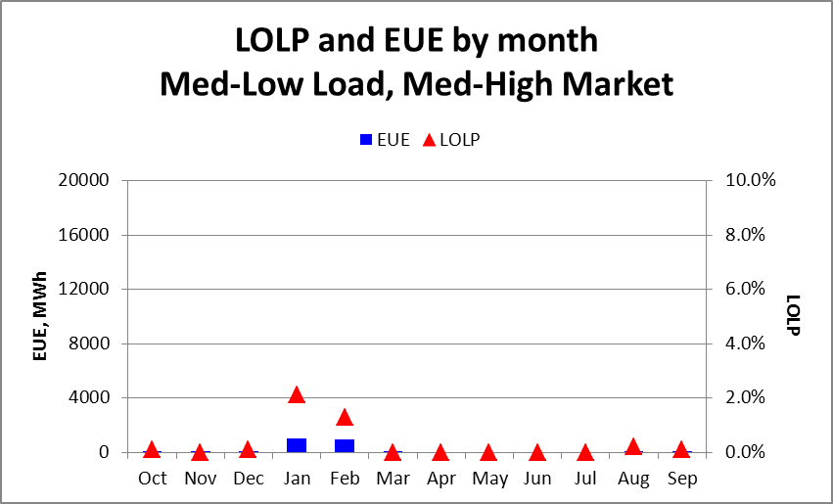
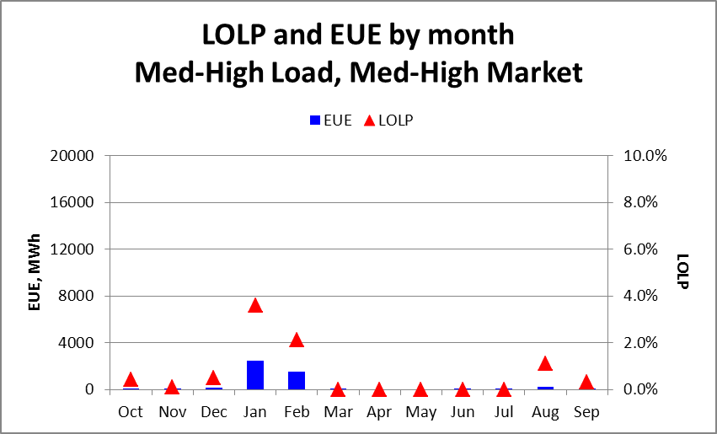
Monthly LOLP

Slide 35
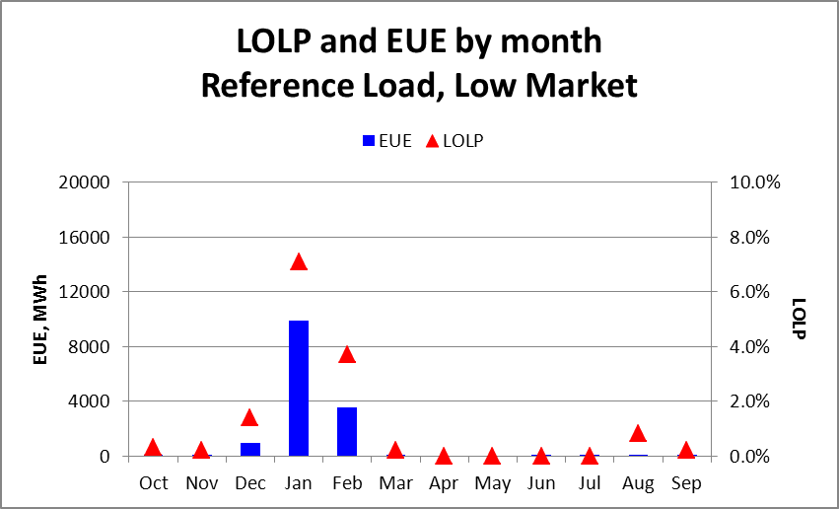
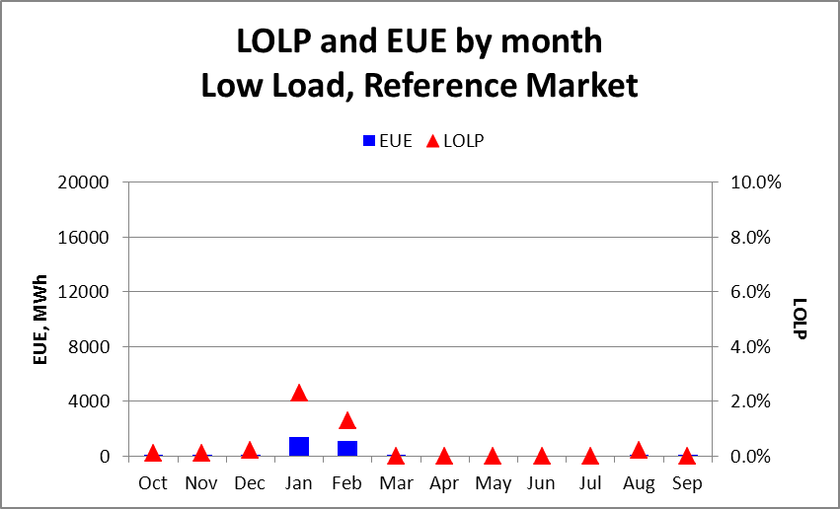
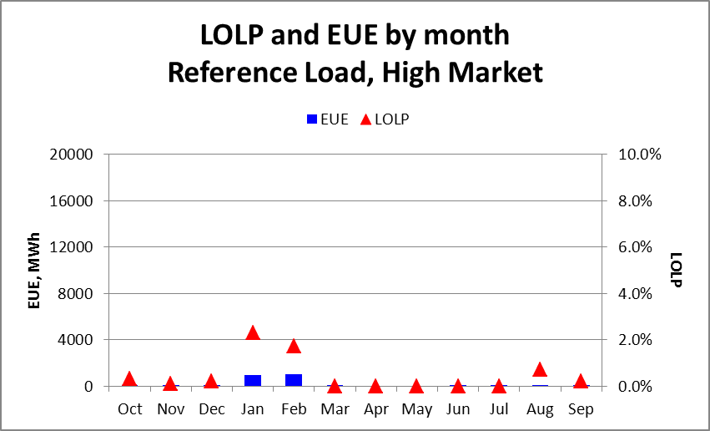
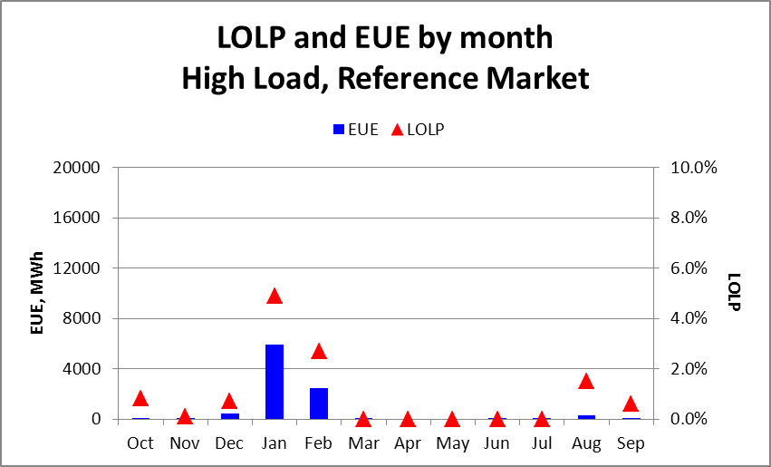
Monthly LOLP

Slide 36
January LOLP surface map

Slide 37
How much CT gets you to 5%
Add a CT resource that will bring study cases with >5.0% LOLP down to 5.0%

Slide 38
How much CT gets you to 5%

Slide 39
Add Standby Resources
Increase Standby Resources to bring study cases with >5.0% LOLP down to 5.0%

Slide 40
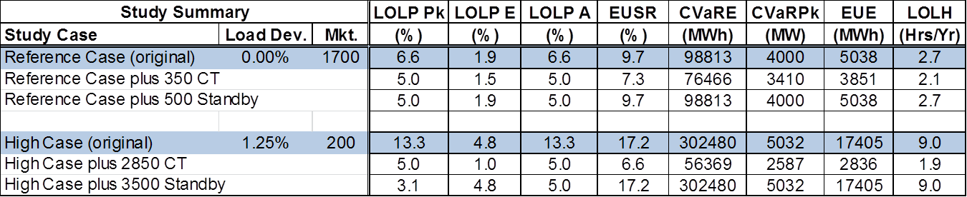
Effects of Adding Resources
500 MW of additional standby resources moved the reference case LOLP of 6.6% down to 5.0%
3,500 MW of additional standby resources moved a high LOLP of 13.3% down to 5.0%
The existing standby resource thresholds are 660 MW Oct-Mar and 720 MW Apr-Sep

Slide 41
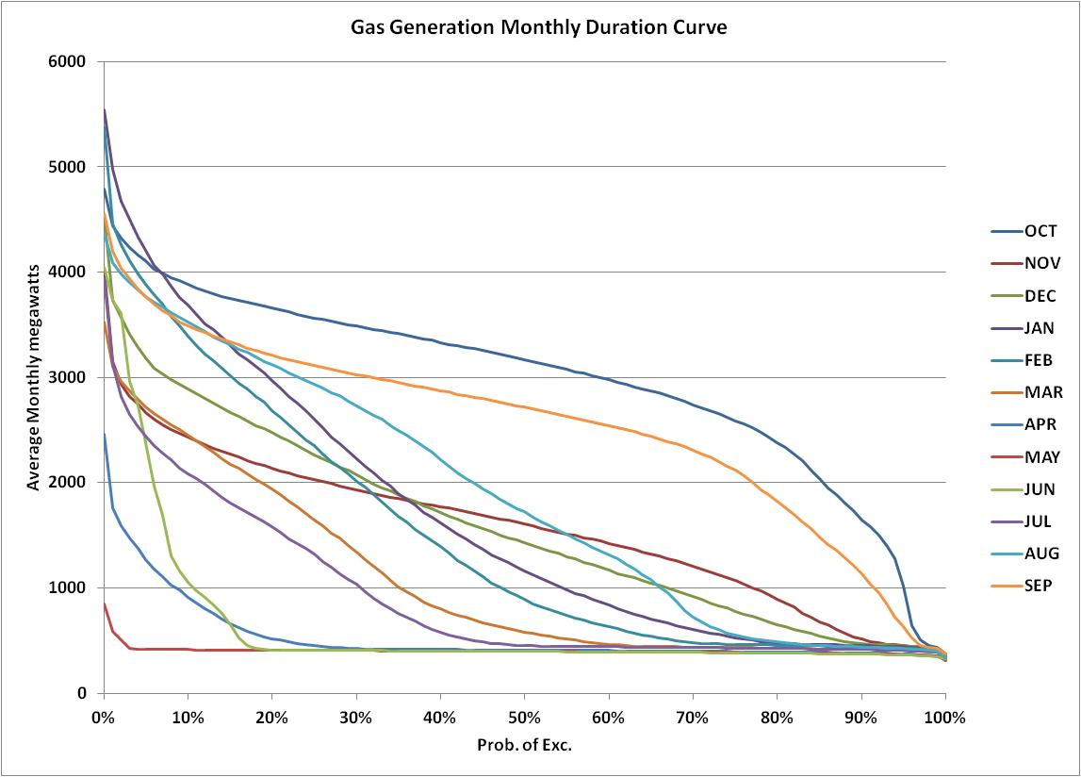

Slide 42
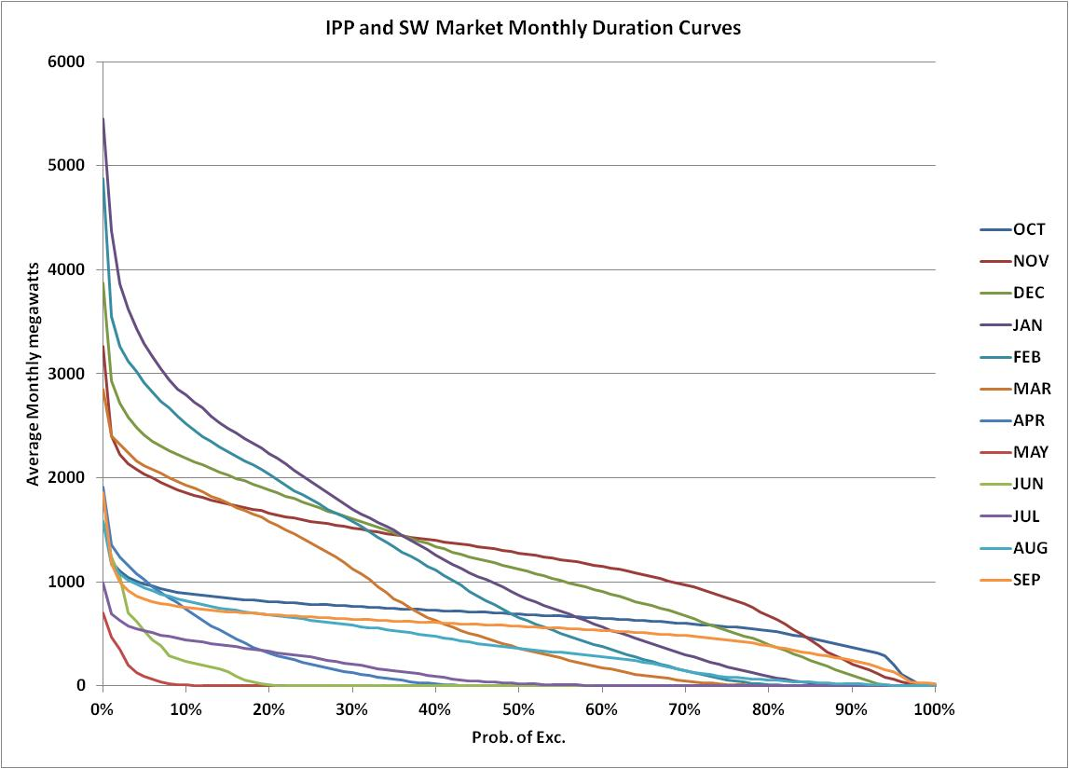

Slide 43
