Slide 1
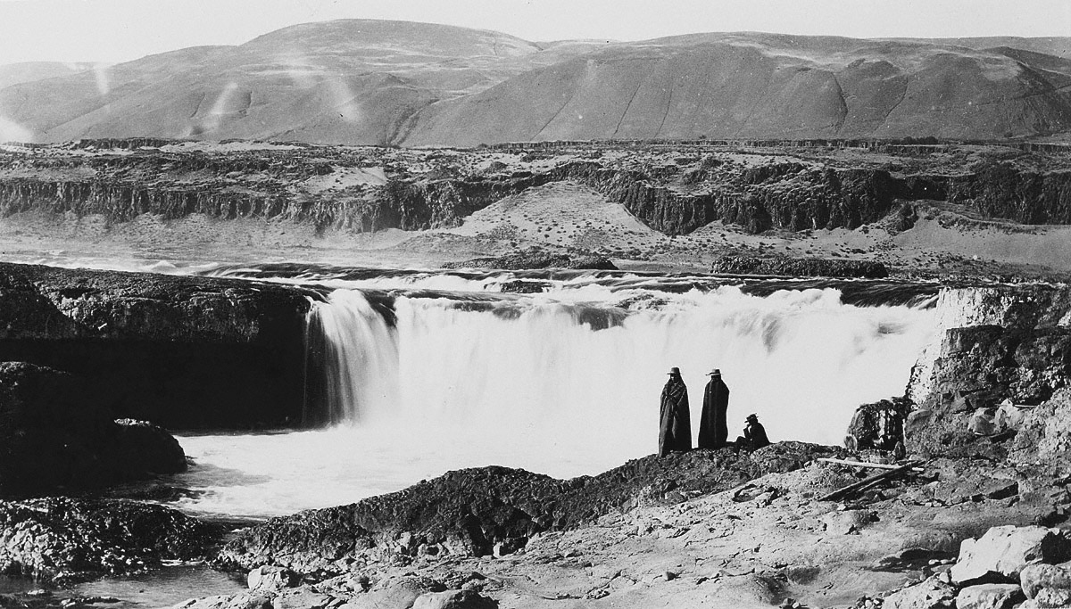
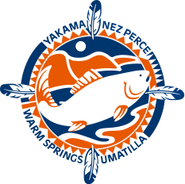
Implement Wy-Kan-Ush-Mi Wa-Kish-Wit
Project #: 1998-031-00
Aja DeCoteau, CRITFC Watershed Department Manager
1
Notes:
Columbia river and its tributaries flows through the homelands of the four tribes
The four tribes entered into peace treaties with the U.S., ceding millions of acres of land but reserving some lands and many rights to themselves, among these the right to fish at all usual and accustomed fishing places and stations
The Columbia River Treaty greatly affects the tribes’ exercise of its right to take fish
This presentation will provide some background about each of the four tribes, describe their efforts to protect and enhance their rights to take fish, the affects of the Columbia River treaty on these efforts, and then identify the issues with the current Treaty and proposed solutions to those issues

Slide 2

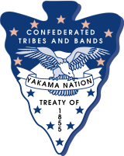
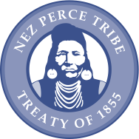

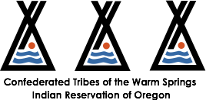
To ensure a unified voice in the overall management of the fishery resources, and as managers, to protect reserved treaty rights through the exercise of the inherent sovereign powers of the tribes.
Notes:
Introduce CRITFC and describe its membership and organizational structure

Slide 3
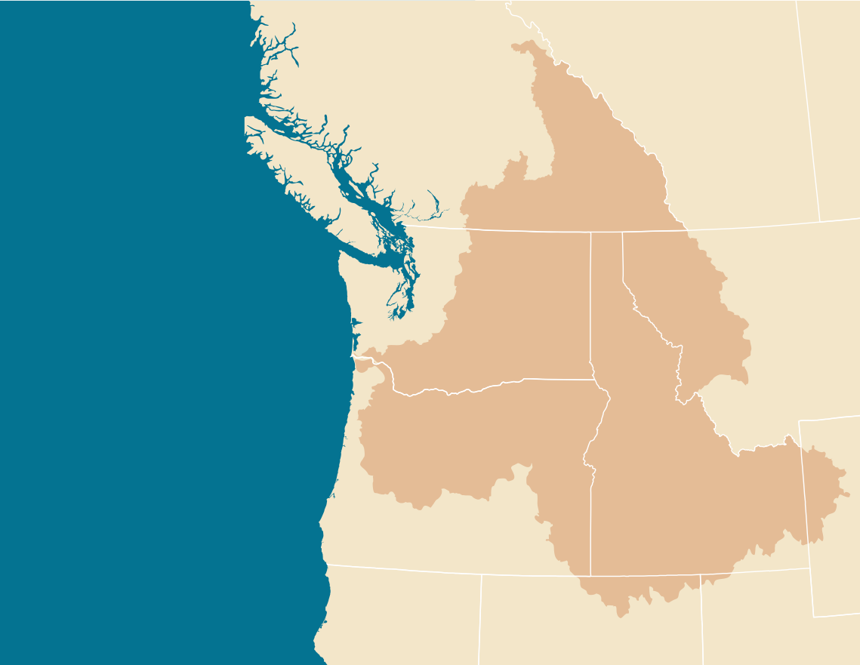
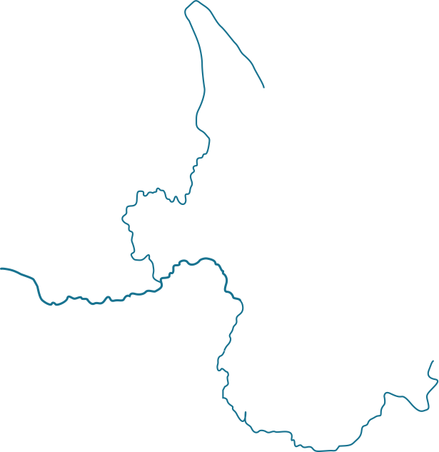
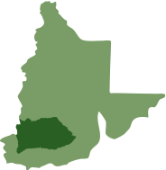
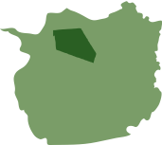


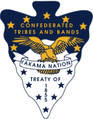
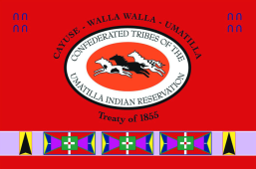

Four Tribes’
Ceded Lands
Combined
66,591 total square miles
More than 25% of the entire Columbia Basin
55% of the rivers and streams still accessible to salmon
YN
NPT
CTUIR
CTWSR
3
Notes:
Total land cessions by the four tribes of 35.4 million acres but rights to take fish at all usual and accustomed fishing places were retained throughout this entire area
With the reserved right to take salmon comes the responsibility and authority to manage, protect, enhance and restore this shared resource

Slide 4
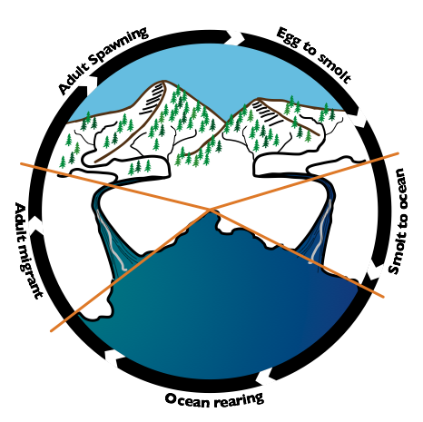
Wy-Kan-Ush-Mi Wa-Kish-Wit
Spirit of the Salmon
Tribal Restoration Plan (TRP): 1995-2020
“Put fish back in the rivers…and protect the watersheds where fish live.”
Provides a framework for restoring anadromous fish stocks throughout their lifecycle (Salmon, Pacific lamprey and White Sturgeon) in upriver areas above Bonneville Dam
Incorporates protection of treaty rights, habitat protection and restoration, natural production, holistic decision-making and recommendations for technical and institutional issues.
Notes:
Gravel to Gravel management

Slide 5
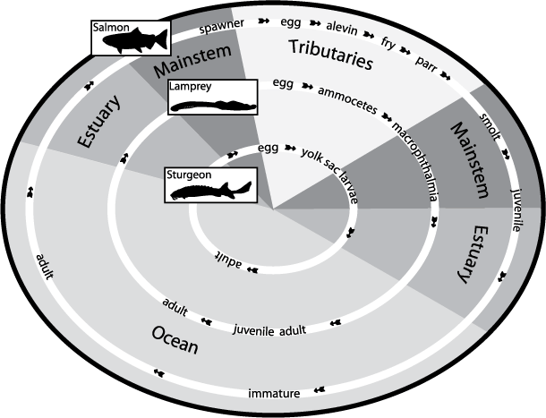
Wy-Kan-Ush-Mi Wa-Kish-Wit
Spirit of the Salmon
Tribal Restoration Plan (TRP): 1995-2020
“Put fish back in the rivers…and protect the watersheds where fish live.”
7 years: Halt the decline of salmon, sturgeon and lamprey upstream of Bonneville Dam.
25 years: Increase total adult salmon returns above Bonneville to 4 million annually and in a manner that sustains natural production to support tribal fisheries.
25 years: Increase sturgeon and lamprey populations to naturally sustainable levels that supports tribal harvest.

Slide 6
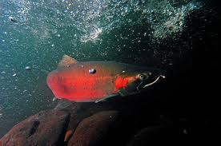

Wy-Kan-Ush-Mi Wa-Kish-Wit
Spirit of the Salmon
Brief History of Project
Project began in 1998 based on the need for regional coordination among the CRITFC tribes in implementing Wy-Kan-Ush-Mi Wa-Kish-Wit.
Created Watershed Department
Utilizes adaptive management framework
Provides technical, policy, funding & outreach assistance to CRITFC tribes
Accord project as of 2008

Slide 7
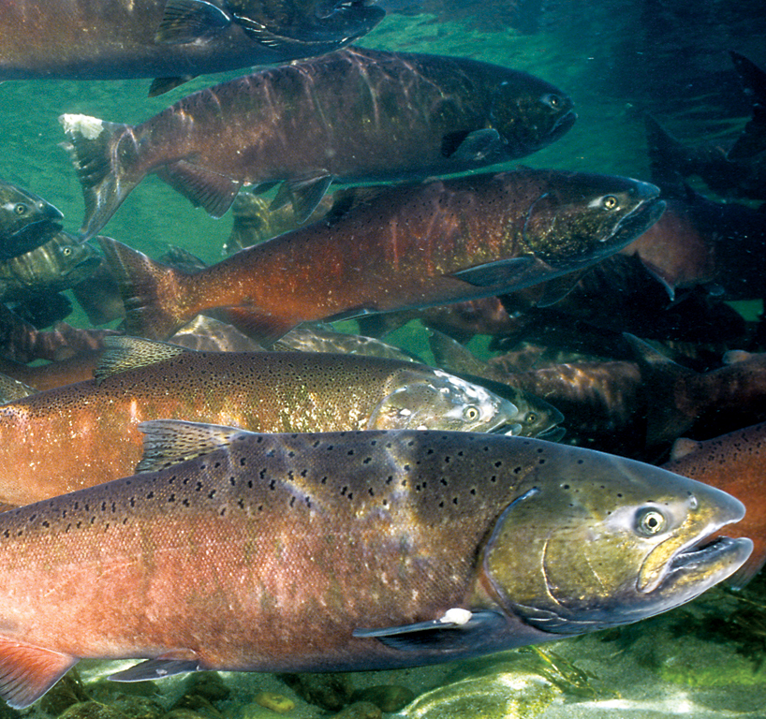
Wy-Kan-Ush-Mi Wa-Kish-Wit
Spirit of the Salmon
Objective 1: Implement Tribal Restoration Plan (TRP)
Project administration
Regional coordination: Ensure goals and principles of TRP are implemented in regional decision-making processes.
Tribal coordination: Coordinate and improve the implementation of tribal projects using adaptive management principles in response to updated science, technology & policy.
Technical review: Provide technical, scientific, funding & policy coordination in preparing, reviewing & implementing strategies that integrate TRP principles into BPA’s Fish & Wildlife program.
2012 Update to TRP
Notes:
Provide effective and efficient watershed restoration through coordination and support of tribal restoration planning & project implementation consistent with WW
Provide technical, scientific ,funding & policy coordination in preparing, reviewing & implementing strategies that integrate principles into BPA and the NPCC’s Fish & Wildlife programs

Slide 8
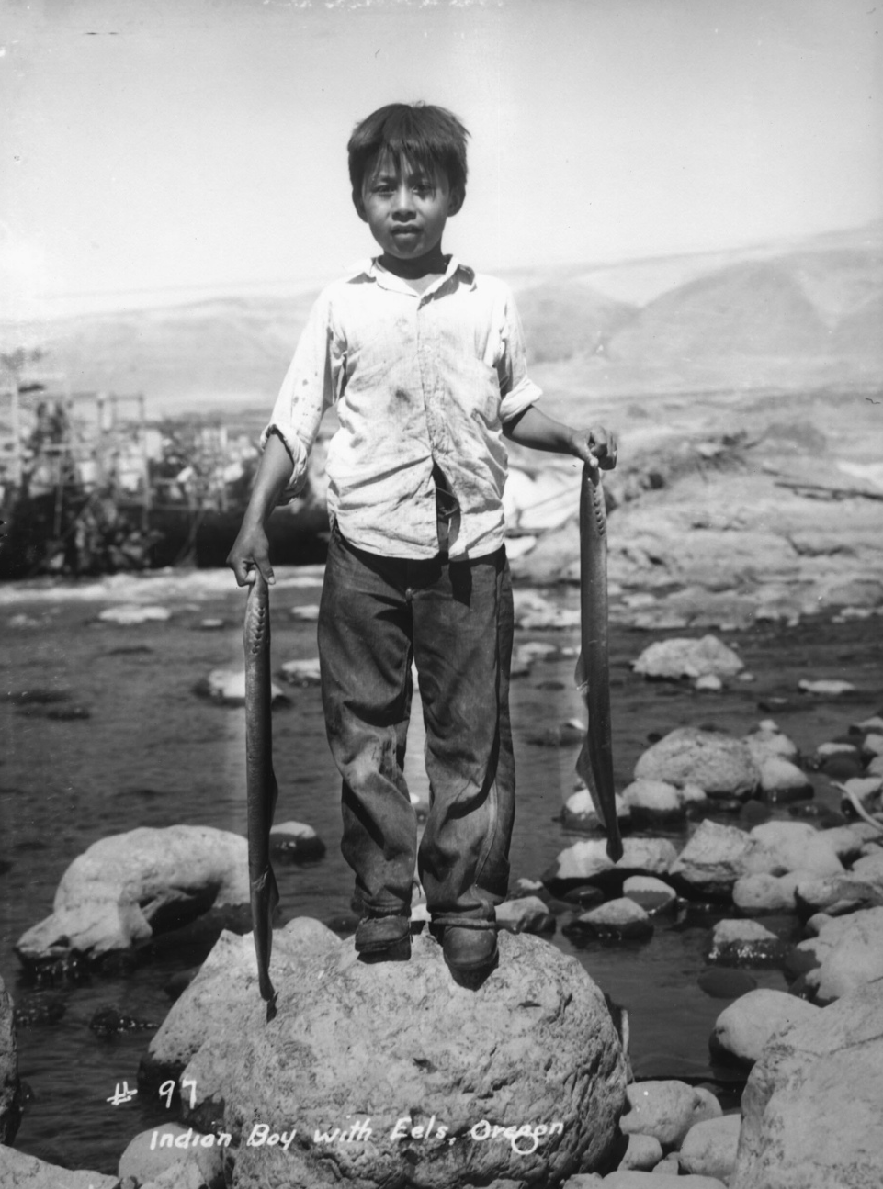
Wy-Kan-Ush-Mi Wa-Kish-Wit
Spirit of the Salmon
Objective 1: 2012 Update of Tribal Restoration Plan
Updated Goals and Objectives
Updated Legal and Cultural Framework
Overview of tribal successes and accomplishments
Inclusion of emerging issues: legal, scientific, technical, policy-related, biological, etc.
Overview of achievements and obstacles
Updated Policy and Technical Recommendations

Slide 9
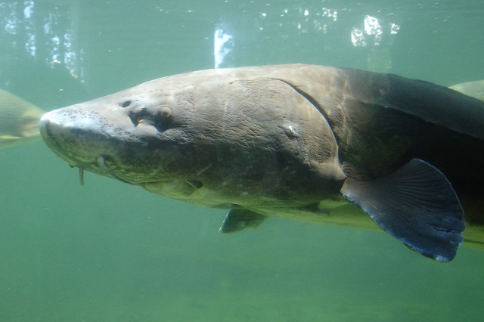
Wy-Kan-Ush-Mi Wa-Kish-Wit
Spirit of the Salmon
Objective 2: Provide coordination & outreach for the tribes
Tribal coordination:
  Priorities established by the Commission
  Provide tribal representation at regional forums, meetings & workgroups & report back to the Commission and tribes
  Advocate for implementation and collaboration of tribal projects & respond to emerging issues
Outreach and Education:
  Tribal workforce development program
  Development of outreach materials
Notes:
Outreach assistance in regional processes, basin-wide forums and funding opportunities.
Providing tribal representation: NPCC, CBFWA, PNAMP, US v OR, Columbia River Treaty

Slide 10
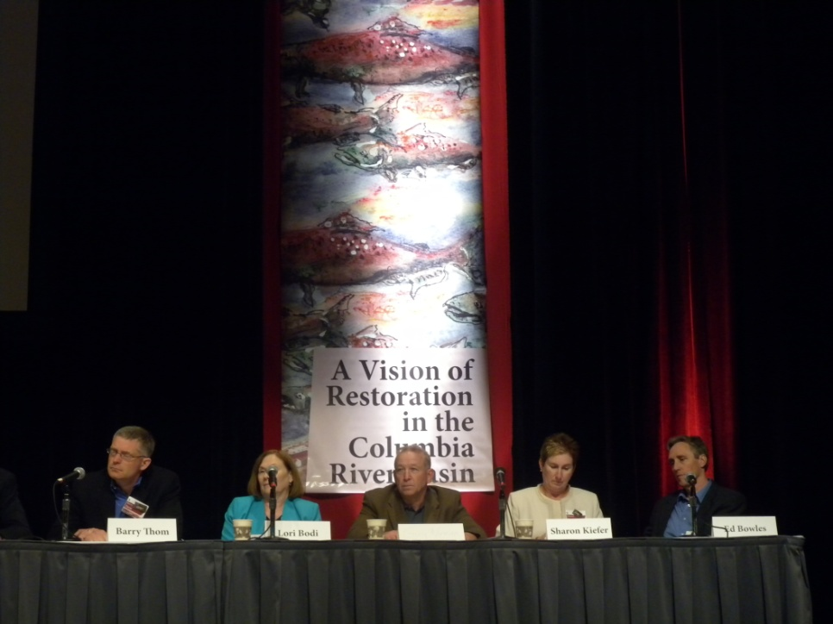
Wy-Kan-Ush-Mi Wa-Kish-Wit
Spirit of the Salmon
Brief synopsis of accomplishments
Developed 2002 calendar of tribal restoration projects and distributed 2000 copies
Participation in development of 2007 “Regional Coordination for the Fish & Wildlife Program Today & Tomorrow” document
Updating CRITFC website: maps of tribal restoration projects
Coordinated tribal response on regional issues: HSRG, Supplementation, etc.
June 2011 Future of Our Salmon: A Vision of Restoration in the Columbia River Basin
2011 Future of Our Salmon conference:
Executive Panel
  280 Registrants, 70 Evaluations received, 32 presentations, 16 Poster presentations, media coverage from 5 outlets & all post-conference material accessible on CRITFC website

Slide 11
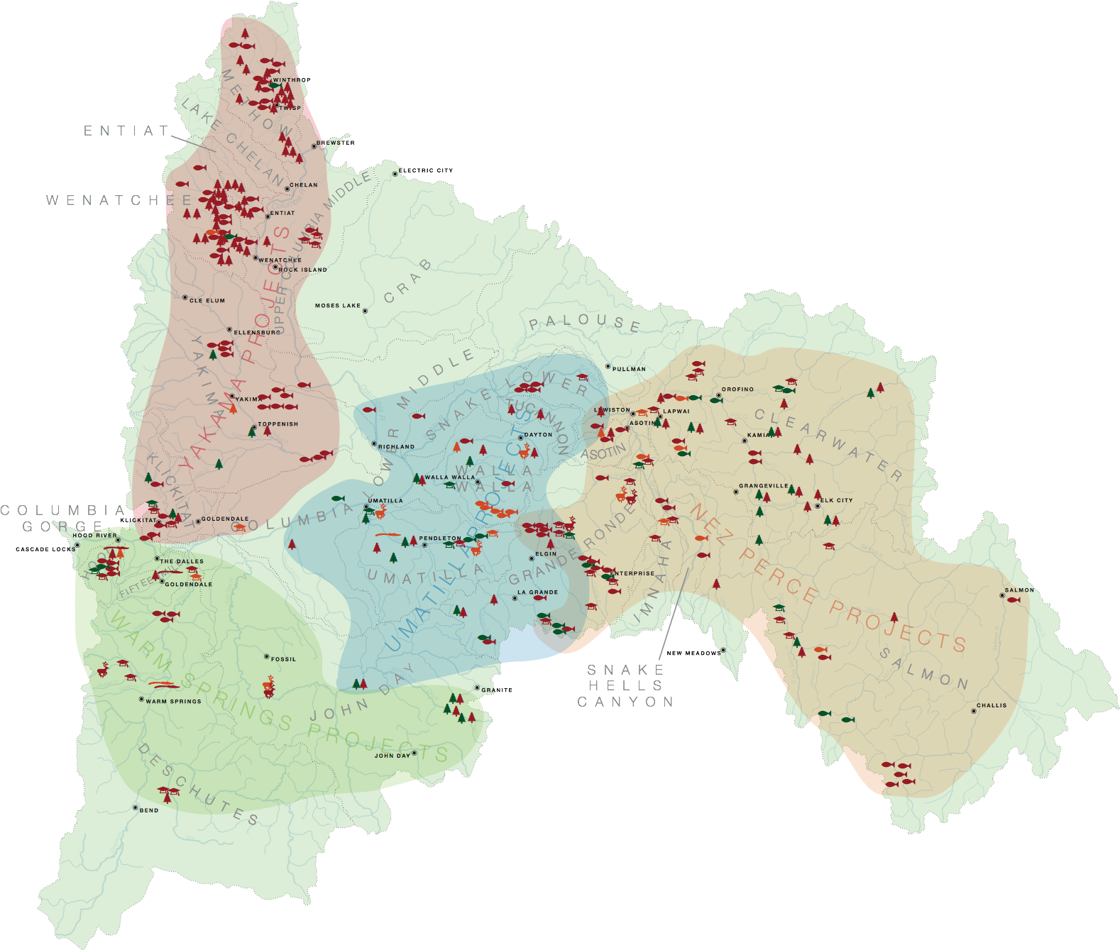
Wy-Kan-Ush-Mi Wa-Kish-Wit
Spirit of the Salmon
How does this project fit into work in the Basin?
Provides coordination & tracking of projects, programs and funding sources in the Basin.
Ensures coordination of projects to reduce overlap.
Facilitates, participates and represents tribal interests in local, regional and national forums.
Provides technical and outreach assistance to tribes and agencies.
Provides outreach and education to tribes, outside agencies and the public about tribal recovery efforts.
Tribal restoration projects

Slide 12
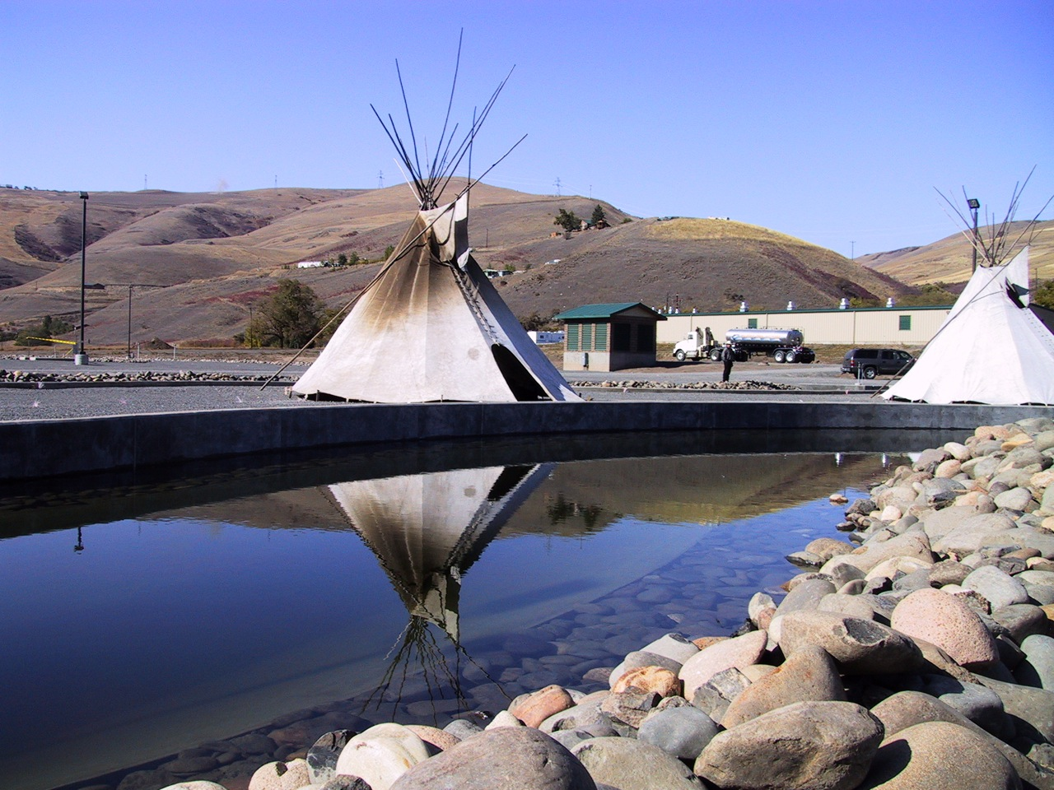
Wy-Kan-Ush-Mi Wa-Kish-Wit
Spirit of the Salmon
Future Work
Oct. 17-18, 2012 Future of Our Salmon conference with a focus on Hatchery Policy
June 2012 Toxics Reduction Workshop
Development of strategies to respond to emerging issues such as:
  Hatchery policy, toxics reduction/water quality, tribal workforce development, legislation, BiOp, climate change, etc.
Update of TRP in 2012: Provide analysis of progress in achieving the original goals & objectives and will develop future recommendations
Nez Perce Tribal Hatchery
Notes:
Stats from conference:

Slide 13
Wy-Kan-Ush-Mi Wa-Kish-Wit
Spirit of the Salmon
How are we measuring success?
Progress towards TRP goals & objectives: (Halt the decline, 4 million by 2020)
Protection of tribal sovereignty & treaty rights
Preserving tribal institutional capacity and leadership to deliver on the ground projects
Improved trends of target species and populations
Improved ecosystems and watersheds
Safeguarding tribal leadership role in Basin-wide coordination efforts
Sustaining and building partnerships
Salmon decline: 1855-2010
Returning Columbia River salmon
(Chinook, steelhead, sockeye, Coho)
~17,000,000
1,754,334
1995-present

Slide 14
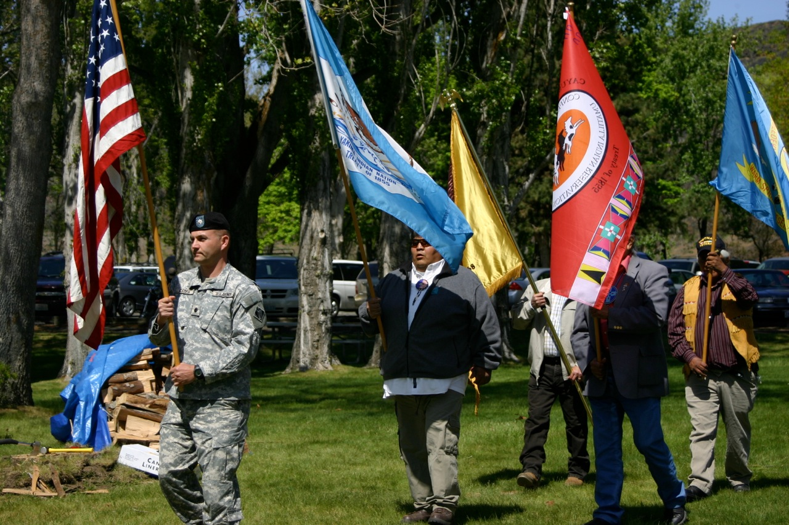
Wy-Kan-Ush-Mi Wa-Kish-Wit
Spirit of the Salmon
Conclusions
Coordination: “the Sovereign’s ability to represent their interests and engage in the processes that affect those interests as they relate to the Columbia River Fish & Wildlife Program (Regional Coordination for the F&W Program Today and Tomorrow, 2007).”
Type of coordination: “wholly dependent on the work that needs to be accomplished and the particular entities identified that need to work together to accomplish it (NPCC Program Amendments, 2009).”
CRITFC coordination continues to evolve as: 1) tribes continue to build capacity within their fisheries programs and 2) priorities within the Commission and tribes change to respond to emerging issues.
1st Anniversary of Fish Accords

