Slide 1
SAAC Review
Michael Schilmoeller
Tuesday February 2, 2011
SAAC

Slide 2
Sources of Uncertainty
Fifth Power Plan
  Load requirements
  Gas price
  Hydrogeneration
  Electricity price
  Forced outage rates
  Aluminum price
  Carbon allowance cost
  Production tax credits
  Renewable Energy Credit (Green tag value)
Sixth Power Plan
  aluminum price and aluminum smelter loads were removed
  Power plant construction costs
  Technology availability
  Conservation costs and performance
Scope of uncertainty

Slide 3
Characteristics
Buying an automobile?
Resource Planning?
No "do-overs", irreversibility
✔ ✔
Reduce size and likelihood of bad outcomes
✔ ✔
Cost – risk tradeoff: reducing risk is a money-losing proposition
✔ ✔
Imperfect Information
✔ ✔

Slide 4
Characteristics
Buying an automobile?
Resource Planning?
Use of scenarios
✔ ✔
Some resources in reserve, used only if necessary
✔ ✔
Resource allocations reflect likelihood of scenarios
✔ ✔
… even if "we cannot assign probabilities"
✔ ✔
Resource allocations reflect severity of scenarios
✔ ✔

Slide 5
Identifying Long-Term Ratepayer Needs
Why and for whom is a plant built?
  For the market or the ratepayer?
  Built for independent power producers (IPPs) for sales into the market, with economic benefits to shareholders?
How much of the plant is attributable to the ratepayer?
  This is usually a capacity requirement consideration
  To what extent does risk bear on the size of the plant’s share ?

Slide 6
How the NWPCC
Approach Differs
No perfect foresight, use of decision criteria for capacity additions
Likelihood analysis of large sources of risk (“scenario analysis”)
Adaptive plans that respond to futures
Notes:
6

Slide 7
Excel Spinner Graph Model
Represents one plan responding under each of 750 futures
Illustrates “scenario analysis on steroids”
Notes:
7

Slide 8
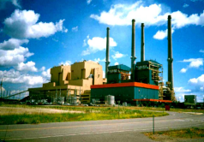
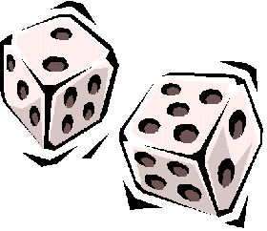

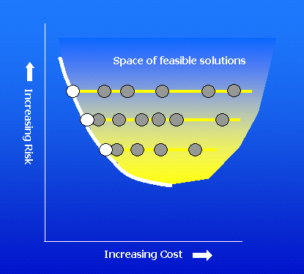
Modeling Process
The portfolio model
$
Notes:
The modeling process consists of several elements.
The portfolio calculates costs for a given future and plan
Another module changes futures to produce the distribution of costs
A third module changes plans, and tries to locate least-cost plans for each level of risk

Slide 9
Finding Robust Plans
Space of feasible solutions
Reliance on the likeliest outcome
Efficient Frontier
Risk Aversion

Slide 10
Impact on NPV Costs and Risk
C:\Documents and Settings\Michael Schilmoeller\Desktop\NWPCC - Council\SAAC\Presentation materials\L813 NPV Costs.xlsm
Scope of uncertainty

Slide 11
Decision Trees
Estimating the number of branches
  Assume possible 3 values (high, medium, low) for each of 9 variables, 80 periods, with two subperiods each; plus 70 possible hydro years, one for each of 20 years, on- and off-peak energy determined by hydro year
  Number of estimates cases, assuming independence: 6,048,000
Studies, given equal number k of possible values for n uncertainties:
Impact of adding an uncertainty:
Decision trees & Monte Carlo simulation

Slide 12
Monte Carlo Simulation
MC represents the more likely values
The number of samples is determined by the accuracy requirement for the statistics of interest
The number of samples m_{k} necessary to obtain a given level of precision in estimates of averages grows much more slowly than the number of variables k:
Decision trees & Monte Carlo simulation

Slide 13
Monte Carlo Samples
How many samples are necessary to achieve reasonable cost and risk estimates?
How precise is the sample mean of the tail, that is, TailVaR₉₀?
Implication to Number of Futures

Slide 14
Assumed Distribution
C:\Documents and Settings\Michael Schilmoeller\Desktop\NWPCC - Council\SAAC\Presentation materials\L813 NPV Costs 02.xlsm
Implication to Number of Futures

Slide 15
Dependence of Tail Average on Sample Size
C:\Documents and Settings\Michael Schilmoeller\Desktop\NWPCC - Council\SAAC\Presentation materials\L813 NPV Costs 02.xlsm, worksheet “Samples_75”
σ=1.677
Implication to Number of Futures

Slide 16
Accuracy and Sample Size
Estimated accuracy of TailVaR₉₀ statistic is still only ± $3.3 B (2σ)!*
*Stay tuned to see why the precision is actually 1000x better than this!
Implication to Number of Futures

Slide 17
Accuracy Relative to the Efficient Frontier
C:\Backups\Plan 6\Studies\L813\Analysis of Optimization Run_L813vL811.xls
Implication to Number of Futures

Slide 18
Conclusion
At least 75 samples are needed for determining the value of our risk metric
  Known distribution of statistic
  The precision of the sample
Our risk metric is 1/10 of the total number of futures
We need to test our plan under 750 futures to obtain defensible results
Implication to Number of Futures

Slide 19
Finding the Best Plan
Each plan is exposed to exactly the same set of futures, except for electricity price
Look for the plan that minimizes cost and risk
Challenge: there may be many plans (Sixth Plan possible resource portfolios:
1.3 x 10³¹)
Implication to Number of Plans

Slide 20
The Set of Plans Precedes the Efficient Frontier
Space of feasible solutions
Reliance on the likeliest outcome
Efficient Frontier
Implication to Number of Plans
Risk Aversion

Slide 21
Finding the “Best” Plan
C:\Documents and Settings\Michael Schilmoeller\Desktop\NWPCC - Council\SAAC\Presentation materials\Asymptotic reduction in risk with increasing plans.xlsm
Implication to Number of Plans

Slide 22
How Many 20-Year Studies?
How long would this take on the Council’s Aurora2 server?
Implication to Computational Burden

Slide 23


On the World’s Fastest Machine
Assume a benchmark machine can process 20-year studies as fast:
  Xeon 5365, 3.0 MHz, L2 Cache 2x4, 4 cores/4 threads per core
  38 GFLOPS on the LinPack standard
  To the extent this machine underperforms the Council server, the time estimate would be longer
Total time requirement for one study on the Tianhe-1A: 3.54 days (3 days, 12 hours, 51 minutes) and estimated cost $37,318
Implication to Computational Burden
Notes:
The estimate is based on a 2005 article (http://www.betanews.com/article/IBM-Rents-Out-Supercomputer-Time/1110515653) entitled, IBM Rents Out Supercomputer Time. Time on their 5.7 Teraflop unit goes for $1/hour.

Slide 24
How Do We Achieve
Our Objectives?
If it takes more that a workday to perform the simulation, the risk of making errors begins to dampen exploration
In the next presentation, we consider alternatives and the RPM solution
Implication to Computational Burden

Slide 25
End

