Slide 1
How the RPM Meets the Requirements for a Risk Model
Michael Schilmoeller
Tuesday, February 2, 2011
SAAC

Slide 2
Overview
Statistical distributions
  Estimating hourly cost and generation
  Application to limited-energy resources
  The price duration curve and the revenue curve
Valuation costing
An open-system models
Unit aggregation
Performance and precision

Slide 3
Computation

Slide 4
Statistical Distributions
Alternative strategies for speeding up calculation
  More computer processing power
    Previous presentation raises concerns about the limitations of this approach
  Using selected hours of each week
    A type of statistical sampling
  Statistical distributions
    Origins in older production cost models that used load duration curves
Statistical distributions

Slide 5
Dispatchable Resources
Statistical distributions

Slide 6
Estimating Energy Generation
Price duration curve (PDC)
Statistical distributions

Slide 7
Estimating Energy Generation
Statistical distributions

Slide 8
Estimating Energy Value
Set of hours H={h}
Price of electricity p_{e}(h)
Price of fuel p_{g}(h)
Statistical distributions

Slide 9

Gross Value of Resources
Then for a turbine with capacity C MW, the value is
Statistical distributions

Slide 10
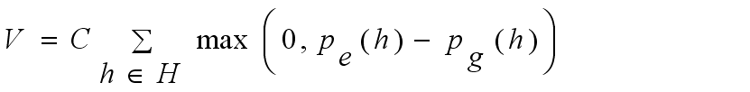
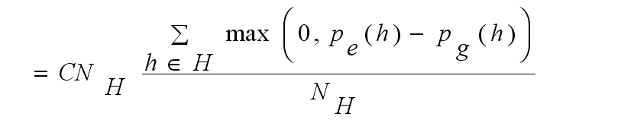
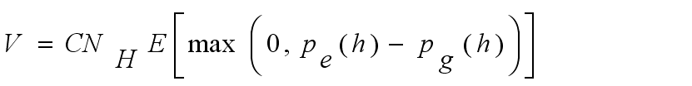
Gross Value of Resources
Statistical distributions

Slide 11
Gross Value of Resources Using Statistical Parameters of Distributions
V
Assumes:
prices are lognormally distributed
1MW capacity
No outages
Statistical distributions

Slide 12
Estimating Energy Generation
Applied to equation (4), this gives us a closed-form evaluation of the capacity factor and energy.
Statistical distributions

Slide 13
Variable Fuel Price
Assume lognormal distribution
Include information about price volatility and correlation with electricity price
Statistical distributions

Slide 14
Implementation in the RPM
Distributions represent hourly prices for electricity and fuel over hydro year quarters, on- and off-peak
  Sept-Nov, Dec-Feb, Mar-May, June-Aug
  Conventional 6x16 definition
  Use of “standard months”
Easily verified with chronological model
Execution time <30µsecs
56 plants x 80 periods x 2 subperiods
Statistical distributions

Slide 15
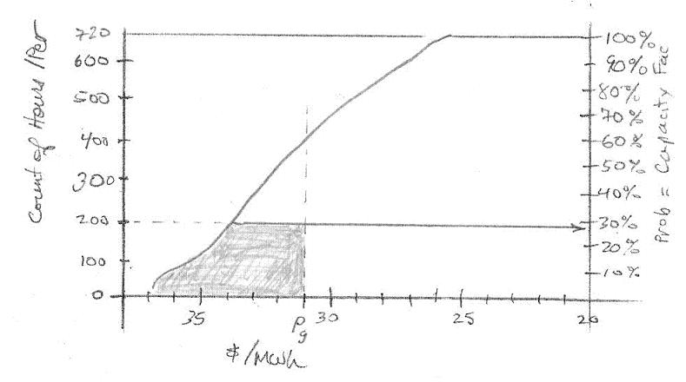
Application of PDC to Energy-Limited Resources
Statistical distributions

Slide 16
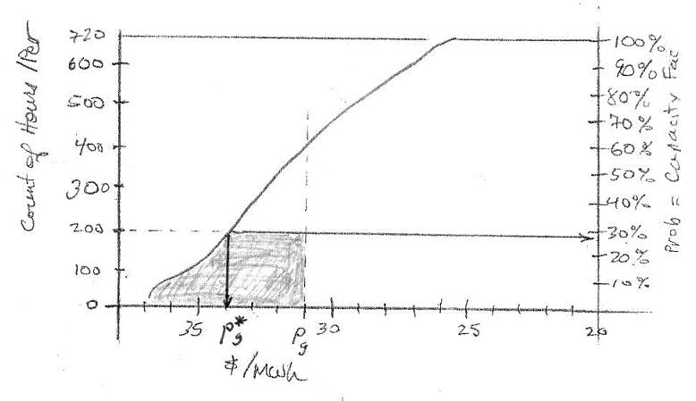
Energy-Limited Dispatch
Statistical distributions

Slide 17
Energy-Limited Dispatch
Statistical distributions

Slide 18
Energy-Limited Dispatch
If p_{g}* > p_{g} then use energy and value associated with p_{g}*
Otherwise, use energy and value associated with p_{g}
Statistical distributions

Slide 19
Application of Revenue Curve Equilibrium Prices
Source: page 5, Figure 3, Q:\MS\Markets and Prices\Market Price Theory MJS\Price Relationships in Equilibrium2.doc
Statistical distributions

Slide 20
Overview
Statistical distributions
  Estimating hourly cost and generation
  Application to limited-energy resources
  The price duration curve and the revenue curve
Valuation costing
An open-system models
Unit aggregation
Performance and precision

Slide 21
Challenges Using Distributions
Complications arise when we use extended time periods
price
Loads (solid) & resources (grayed)
Valuation Costing

Slide 22
Challenges Using Distributions
Average loads and resources are the same, but in the first case, our system has net cost and in the second it has net benefit.
Valuation Costing

Slide 23
Traditional Costing
Hourly variable cost calculation:
Valuation Costing

Slide 24
Traditional Costing
N*(N+1)/2 correlations (upper triangular matrix)
Valuation Costing

Slide 25
Traditional Costing
Valuation Costing

Slide 26
“Valuation” Costing
Only correlations are now those with the market
Valuation Costing

Slide 27
Valuation Costing
Solves the correlation problem by decoupling fuel price variation
We get the value term for dispatchable resources from the earlier calculation (V)
For wind and most renewables, the resource is non-patchable and correlation is fixed (we typically assume zero), which makes an easy calculation
For the p_{m}Q term, hourly correlation of prices and load is important
Valuation Costing

Slide 28
Overview
Statistical distributions
  Estimating hourly cost and generation
  Application to limited-energy resources
  The price duration curve and the revenue curve
Valuation costing
An open-system models
Unit aggregation
Performance and precision

Slide 29
Closed-System Models
Open-System Models

Slide 30
Open-System Models
?
Open-System Models

Slide 31
Modeling Evolution
Problems with open-system production cost models
  valuing imports and exports
  desire to understand the implications of events outside the “bubble”
As computers became more powerful and less expensive, closed-system hourly models became more popular
  better representation of operational costs and constraints (start-up, ramps, etc.)
  more intuitive
Open-System Models

Slide 32
Open Systems Models
The treatment of the Region as an island seems like a throw-back
  We give up insight into how events and circumstances outside the region affect us
  We give up some dynamic feedback
Open systems models, however, assist us to isolate the costs and risks of participant we call the “regional ratepayer”
Any risk model must be an open-system model
Open-System Models

Slide 33
Relationship of electricity price to fuel price
In a closed model, there are no imports or exports
(Hourly) electricity price is entirely determined by the value of other variables, such as fuel price
energy
require-
ments
dispatch
price
fuel price
energy
generation
market
price
for
electricity
Only one electricity price balances requirements and generation
Open-System Models

Slide 34
Closed-system models
A closed system has by definition certain “constant” relationships, a preserved quantity such as energy
Introducing uncertainty means introducing additional variables ε_{i} for error or uncertain variation
Doing so creates an “over-specified” system which generally has no solution
Open-System Models

Slide 35
Closed-system models
Consequently, when we introduce uncertainty into systems that are closed with respect to electrical energy, we are actually creating an open-system model with respect to total energy, and
There is a equal and opposite response among the variables we elect to make dependent, and
There is a “perfect correlation” among our “sources of uncertainty,” with unknown consequences. (CCCTs are always marginal.)
Open-System Models

Slide 36
The New Open-System Model
If fuel price is the only “independent” variable, the assumed source of uncertainty, electricity price will move in perfect correlation
That is, outside influences drive the results
We are back to an open system
energy
require-
ments
dispatch
price
fuel price
+ε_{i}
energy
generation
market
price +ε_{i}
for
electricity
Only one electricity price balances requirements and generation
Open-System Models

Slide 37
The RPM Convention
Respect the first law of thermodynamics: energy generated and used must balance
The link to the outside world is import and export to areas outside the region
Import (export) is the “free variable” that permits the system to balance generation and accommodate all sources of uncertainty
We assure balance by controlling generation through electricity price. The model finds a suitable price by iteration.
Open-System Models

Slide 38
Equilibrium search
Open-System Models

Slide 39
Overview
Statistical distributions
  Estimating hourly cost and generation
  Application to limited-energy resources
  The price duration curve and the revenue curve
Valuation costing
An open-system models
Unit aggregation
Performance and precision

Slide 40
Unit Aggregation
Forty-three dispatchable regional gas-fired generation units are aggregated by heat rate and variable operation cost
The following illustration assumes $4.00/MMBTU gas price for scaling
Source: C:\Backups\Plan 6\Studies\Data Development\Resources\Existing Non-Hydro\100526 Update\Cluster_Chart_100528_183006.xls
Unit Aggregation

Slide 41
Cluster Analysis
Source: C:\Backups\Plan 6\Studies\Data Development\Resources\Existing Non-Hydro\100526 Update\R Agnes cluster analysis\Cluster Analysis on units.doc
Unit Aggregation

Slide 42
Overview
Statistical distributions
  Estimating hourly cost and generation
  Application to limited-energy resources
  The price duration curve and the revenue curve
Valuation costing
An open-system models
Unit aggregation
Performance and precision

Slide 43
Performance
The RPM performs a 20-year simulation of one plan under one future in 0.4 seconds
A server and nine worker computers provide “trivially parallel” processing on bundles of futures. A master unit summarizes and hosts the optimizer.
The distributed computation system completes simulations for one plan under the 750 futures in 30 seconds
Results for 3500 plans require about 29 hours
Performance and Precision

Slide 44
Repeatability Over Futures
Source: C:\Backups\Olivia\SAAC 2010\101202 SAAC First Meeting\Presentation materials\Reproducibility restored for illustration 101130.xls
Performance and Precision

Slide 45
Precision
Source: email from Schilmoeller, Michael, Monday, December 14, 2009 12:01 PM, to Power Planning Division, based on Q:\SixthPlan\AdminRecord\t6 Regional Portfolio Model\L812\Analysis of Optimization Run_L812.xls
Performance and Precision

Slide 46
Model Resolution:
At Least $10 million NPV
Typically, plans have over 70 of the 75 high-cost futures in common
The model results then come to resemble sensitivity analyses, rather than statistical sampling
Of course, we could not have anticipated this beforehand
The most interesting results occur when the high-cost futures differ
Performance and Precision

Slide 47
End

