Slide 1

Status of
Resource Adequacy Analysis
NW Resource Adequacy Forum
Steering Committee Conference Call
November 4, 2010

Slide 2
Initial Observations
No definitive adequacy standard exists
Most regions use probabilistic methods
Probabilistic methods vary radically
Council adopted NW standard in 2008
  To be tested for a couple of years
  Then to be reevaluated and peer reviewed
Reevaluation and review underway
Capacity issues greatly increase complexity
Standard will likely have to be modified

Slide 3
Early Results & Recommendation
Analysis indicates summer is the critical period
Conservation is critical to maintaining adequacy
Must address summer energy as well as summer capacity
Based on current standard and assumptions, supply is adequate in 2015
However, assumptions regarding borrowed hydro¹ and contingency resources¹ are likely out of date
Recommendation: Due to the high sensitivity of LOLP to the variables mentioned above, postpone releasing a report until major issues are resolved.
¹Defined later in this presentation

Slide 4
Status of work
Model has been enhanced to focus on capacity
  Greatly increases the complexity of the problem
  Must be more thoroughly tested and benchmarked
Data has been updated
  Temperature-correlated wind data not yet ready
LOLP very sensitive to certain variables
  Need to better define use of borrowed hydro
  Need to better define contingency resources
Methodology undergoing peer review

Slide 5
Adequacy Assessments¹ (for 2015)
LOLP (%) | Winter Capacity | Winter Energy | Summer Capacity | Summer Energy
Jun 2008 | 0.0 | 0.0 | 0.0 | N/A²
¹Loads are forecast using the HELM algorithm (old methodology and data) and include (implicit) new conservation . BiOp assumptions and hydro peaking capability are based on 2008 data.
²Summer energy LOLP is not defined in the current standard. The Forum assumed that satisfying the winter energy need would suffice for summer – this turned out to be a bad assumption.

Slide 6
Adequacy Assessments (for 2015)
LOLP (%) | Winter Capacity | Winter Energy | Summer Capacity | Summer Energy
Jun 2008 | 0.0 | 0.0 | 0.0 | N/A
6th Plan¹ | 0.0 | 0.0 | 5.0 | N/A
¹These 6th plan LOLP values are inferred from deterministic metrics. For example, the summer capacity minimum reserve margin (based on a 5% LOLP) is 24%. The calculated 2015 reserve margin using 6th plan loads, existing resources and (implicit) new conservation is 24%, implying a 5% summer capacity LOLP.

Slide 7
Changes since 2008
(all result in a higher LOLP)
Better load forecasting tools
  Higher monthly and hourly loads
Better hydro peaking analysis
  Lower sustained peaking capability
Lots more wind
  More variation to load
Wind reserves
  Reduce peaking capability
New BiOp
  Increases hydro constraints

Slide 8
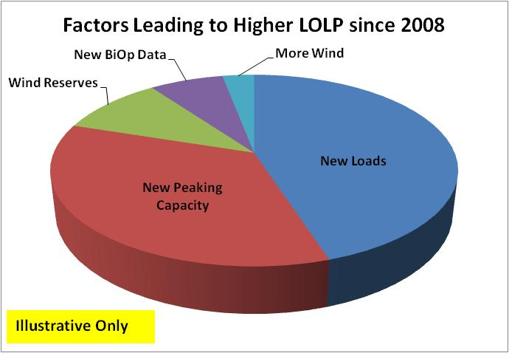

Slide 9
Preliminary Assessment (for 2015)
Not for Distribution
LOLP (%) | Winter Capacity | Winter Energy | Summer Capacity | Summer Energy
Jun 2008 | 0.0 | 0.0 | 0.0 | N/A
6th Plan | 0.0 | 0.0 | 5.0 | N/A
Draft 2010¹ | 1.0 | 2.9 | 0.0² | 4.8
¹This preliminary assessment includes loads from the short-term model that have been calibrated to those used in the 6th plan. Current adequacy standard assumptions are used.
²This drop in LOLP is somewhat misleading. After model enhancements, resulting summer curtailments dropped below the event threshold (3,000 MW) but did not go away. For example, using a 1,200 MW threshold changes the summer capacity LOLP to 6.7% and the winter capacity LOLP to 2.9%.

Slide 10
Major Issues Remaining
Use of “borrowed” hydro
Curtailment event thresholds (surrogate for contingency resources)
Temperature-correlated wind data

Slide 11
Borrowed Hydro
Hydro energy below PNCA drafting rights rule curve elevations
If drafted, paid back as soon as possible
Used in normal operations, not just during emergencies
Concern: Borrowed hydro operating assumptions are 10 years old and may not reflect current practices
Action Items:
  BPA staff to assess current use of borrowed hydro
  Model will be modified to simulate current use and limitations

Slide 12
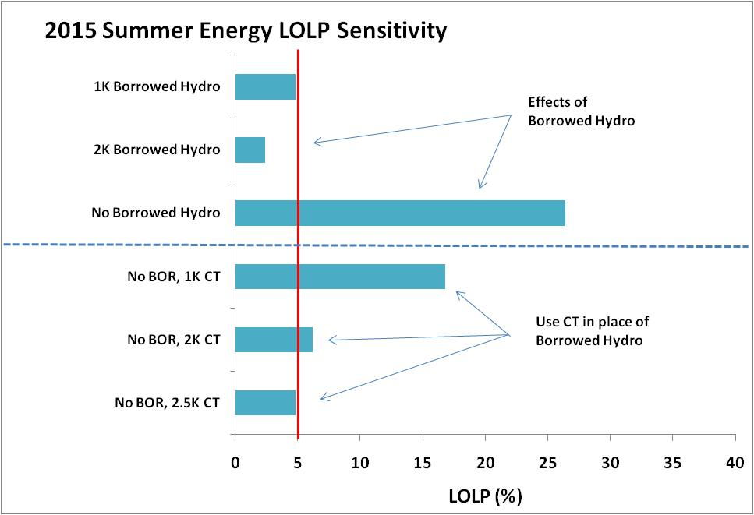

Slide 14
Curtailment Event Thresholds
Energy Adequacy: Any winter or summer period in which total curtailment exceeds 28,800 MW-hours
Capacity Adequacy: Any winter or summer period in which curtailment in any hour exceeds 3,000 MW
Used as a surrogate for contingency resources
Concern: May no longer be representative of current emergency resources and actions
Action Items
  BPA will develop a list of available contingency resources
  Future event thresholds will be modified accordingly

Slide 15
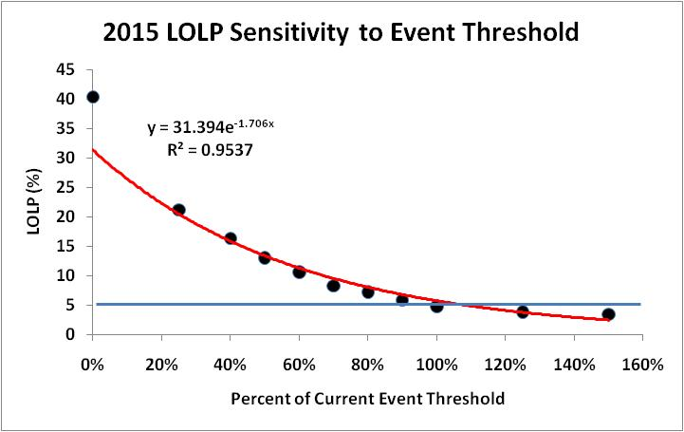

Slide 16
Temp-correlated Wind Data
Wind generation appears to be inversely proportional to large temperature diversions
New data probably not available until spring 2011
Concern: Currently used hourly wind data is not temperature correlated and could result in overly optimistic adequacy assessments
Action Items
  BPA will complete work on temperature-correlated data
  Interim solution: investigate modifying the model to discount wind during extreme temperature deviations

Slide 17
Peer Review of Methodology
Independent third party review (PSRI)
No national or international standard or methodology
Stochastic assessment is most used methodology
LOLP only captures probability and not magnitude
Action Items
  Complete review by early 2011
  Revise methodology to include measure of magnitude
  Modify current standard as needed

Slide 18
Work Plan for 2011
November 2010
  Status report to Council
February 2011
  Remaining major issues resolved
March 2011
  Assessment based on current standard
April 2011
  Technical committee completes proposed revisions to the standard
June 2011
  Steering committee votes on revisions
August 2011
  Council votes on adopting new standard
October 2011
  Adequacy assessment for 2016 with revised standard
June 2012
  Adequacy assessment for 2017

Slide 19
Optional:
A Brief History of Adequacy

Slide 20
A Brief History of Adequacy (1)
2007: First unofficial assessment
  Adequate through 2012
  LOLP = zero for winter and summer
April 2008: Standard adopted
August 2008: First official assessment
  Used deterministic metrics (no LOLP)
  Adequate through 2013
  But summer capacity RM only 5% above limit
  No summer energy metric in standard

Slide 21
A Brief History of Adequacy (2)
June 2009: 2015 assessment deferred to Power Plan
Oct 2009: Chapter 14 (draft Power Plan)
  Used deterministic metrics
  Summer capacity RM = 24% = Limit
  Implies a 5% LOLP
January 2010: Steering Committee
  Wanted reassessment using LOLP
  Tentative due date June 2010

Slide 22
A Brief History of Adequacy (3)
June 2010: Reassessment not ready
  Data not fully updated
  Underestimated work required to overhaul hourly dispatch algorithms
July 2010: Technical Meeting
  Work not yet complete
  Early results show summer capacity issue (LOLP ~ 6%)
  Consistent with 2009 assessment

Slide 23
A Brief History of Adequacy (4)
September 2010: Key Discoveries
  Load model includes implicit conservation
    Standard does not define what resources to include (but we assumed existing only)
    2008 and 2009 assessments included implicit conservation
  Error in hourly hydro shaping logic
    Undervalued hydro peaking capability
    Resulting capacity problems were unrealistically high

Slide 24
A Brief History of Adequacy (5)
October 2010: Technical Committee
  2015 assessment + plan conservation (1200 MWa)
  Winter
    Capacity LOLP = 1.0%
    Energy LOLP = 2.9%
  Summer
    Capacity LOLP = 0.0%
    Energy LOLP = 4.8%
  With 6th plan conservation supply is adequate
  Most critical period – summer energy
  Summer capacity problems (6th plan analysis) didn’t go away – they simply fell below the 3000 MW threshold

Slide 25
A Brief History of Adequacy (6)
October 2010: Technical Committee (cont’d)
Effect of new conservation
  2015 assessment – no new conservation
  Winter
    Capacity LOLP = 5.3%
    Energy LOLP = 8.6%
  Summer
    Capacity LOLP = 1.4%
    Energy LOLP = 22.0%
  Without new conservation, supply is not adequate
  Most critical period – summer energy

