Slide 1
Uses and Abuses of the Efficient Frontier
Michael Schilmoeller
Thursday May 19, 2011
SAAC

Slide 2
Overview
Background
Construction of the Efficient Frontier
Populating the Space
Using the Efficient Frontier
Abusing the Efficient Frontier

Slide 3
Example of a Decision with Multiple Attributes
A public power utility is trying to select a resource plan
Attributes for each plan include
  Cost
  Rates to customers
  Shareholder perspective
  CO2 emissions and CO2 penalty cost
  Cost sensitivity to loads, fuel price
  Technology diversity
Background

Slide 4
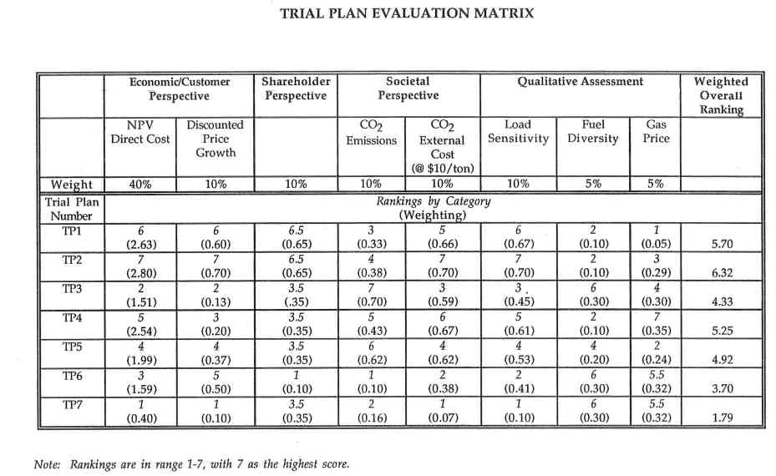
Using a Decision Matrix or “Scorecard”
Background
Notes:
One approach to evaluating the multiple, and often conflicting attributes of a plan is what some refer to as the “score card” method. With this method, the different objectives and measures of each plan are laid out in a matrix. Weights are then applied to the scores for the attribute values. The weighted scores for each attribute are added to obtain the relative score for each plan. This has the appeal of reflecting what must go on in the minds of decision makers, a weighting of the virtues and disadvantages for each plan.
However….

Slide 5
Issues
Weights are typically developed and presented after the plans have been studied and the values for each attribute are known
Weights communicate the decision, but
The weights often are presented without any clear basis. Consequently,
They give the appearance of gilding a foregone conclusion
The planner must defend the “equivalence” of the attributes (The example of medical treatment)
Background

Slide 6
Efficient Frontier
Provides an alternative to weighting
Preserves the trade-off decision
Background

Slide 7
Overview
Background
Construction of the Efficient Frontier
Populating the Space
Using the Efficient Frontier
Abusing the Efficient Frontier

Slide 8
Comparing Plans
We would like an objective basis for comparing plans with multiple attributes
  By “comparing” here, we mean placing the plans on a line, so that we can say whether one is “better than” or “worse than” another (e.g. “A” is worse than “B”, if plan A cost, “a”, is greater than plan B cost, “b”
When a plan has two attributes, (a₁,a₂), there are many ways to do this
Let’s say plan A=(a₁,a₂) is worse than plan B =(b₁,b₂) if a₁≥b₁ and a₂ ≥ b₂
Constructing the EF

Slide 9
Evaluating Vaccines
Constructing the EF

Slide 10
A
B
Constructing the EF

Slide 11
A
B
Constructing the EF

Slide 12
Constructing the EF

Slide 13
Constructing the EF

Slide 14
The Efficient Frontier
Our initial matrix had eight attributes. This space has only two. An efficient frontier for decisions with a larger number of attributes, however, is constructed the same way.
Constructing the EF

Slide 15
What does the Efficient Frontier Tell Us?
The Efficient Frontier does not tell us what to do
The Efficient Frontier tells us what not to do
Most useful if there are a large number of choices
Constructing the EF

Slide 16
Overview
Background
Construction of the Efficient Frontier
NWPCC Plan Selection
Using the Efficient Frontier
Abusing the Efficient Frontier

Slide 17
Using the Efficient Frontier
If we cannot use the efficient frontier to select a plan, what good is it?
Unless we have a large number of plans, not much in itself, but ...
In combination with the space and with other objectives, it can be very useful ….
Using the EF

Slide 18
We Would Ask …
What are the similarities among strategies close to the efficient frontier?
How do strategies change as we move along the efficient frontier?
What are the similarities among strategies removed from the efficient frontier?
How do plans differ with respect to other sources of risk?
Using the EF

Slide 19
We Would Ask …
How do details within particular futures differ?
Are some plans more or less acceptable to other institutions?
Do you really have to make a choice?
What costs and elements can you control?
Using the EF

Slide 20
Overview
Background
Construction of the Efficient Frontier
NWPCC Plan Selection
Using the Efficient Frontier
Abusing the Efficient Frontier

Slide 21
Fooled by the Graph
Error 1: The geometry of the points on the efficient frontier has meaning or otherwise provides guidance, or equivalently …
There exists a formula or other objective means for determining an optimal point on the efficient frontier
Abusing the EF

Slide 22
Illustrating a Jump
Abusing the EF

Slide 23
Geometry Is Not Utility
If the side effect is a mild rash, why would we not take the solution that minimizes infections?
There may be other thresholds that the geometry masks
We may not be looking at factors over which we have control ….
Abusing the EF

Slide 24
Unclear About Control
Error 2: The “expected cost” on the efficient frontier is controllable, equivalently …
We can “buy” risk reduction with the increase in expected costs
Abusing the EF

Slide 25
The NWPPC Resource Portfolio Space
NWPCC Approach

Slide 26
What are the Trade Offs?
As we go from left to right, we are trading off the likely outcome with the worst outcome
Because we get only one future, this is purely an expression of risk aversion, not expected cost as we might encounter it is an economic feasibility study
The controllable costs are much smaller than the total system costs

Slide 27
Option Costs and Risk Benefits
Notes:
This is an exercise to show that the costs of siting and licensing power plants -- and of acquiring conservation at prices above market price for electricity -- is comparable to premiums paid for more conventional forms of insurance. The costs of the power planning options, however, are probably overstated. For decisions beyond five years, we do not have to make commitments today. When we do make the commitments, much of that uncertainty will have been resolved and some options will not be necessary.

Slide 28
Mislead by Averages
Error 3: “We know what ‘expected cost’ means.”
In fact, there are many different ways to compute an average, and they all have different meanings.
More important, the average of a distribution may be very meaningful in one situation and meaningless in another.
Abusing the EF

Slide 29
Efficient Frontier of a Financial Portfolio
from Van Horne, Financial Management and Policy, 6th ed.
Abusing the EF

Slide 30
Averages of Very Different Distributions
The average is a useful statistic for representing a stable, mean-reverting process over a long time period, such as (supposedly) the return on a portfolio over several years
The average is (almost) meaningless when describing a distribution due to multiple futures, where we get only one draw (one future)
Abusing the EF

Slide 31
Mislead by Averages
NWPCC cost and risk are not analogous to financial portfolio return and risk
  NWPCC expected costs refer to where the outcome is likely to fall, given our view of the future today
How significant would the “average” outcome be to your decision to play Russian Roulette?
Abusing the EF

Slide 32
Final Thoughts
The efficient frontier tells us what not to do
Relationships among plans on, off, and over the efficient frontier can provide insight into what are more and less successful strategies

Slide 33
Final Thoughts
The shape of the frontier may or may not have significance (usually not)
Be careful about the different kinds of uncertainties, as descriptive statistics may or may not be meaningful
Be careful about what is and is not controllable

Slide 34
End

Slide 35
Difference in Cost Distributions
1 of 3
Source: LR&LC_distributions.xls, worksheet “LR and LC”
Abusing the EF

Slide 36
Difference in Cost Distributions
2 of 3
Source: LR&LC_distributions.xls, worksheet “LR and LC”
Abusing the EF

Slide 37
Control
“The essence of risk management lies in maximizing the areas where we have some control over the outcome while minimizing the areas where we have absolutely no control over the outcome and the linkage between effect and cause is hidden from us.” (emphasis is the author’s)
--Peter L. Bernstein, Against the Gods, The Remarkable Story of Risk
Abusing the EF

Slide 38
End

