Slide 1
System Analysis
Advisory Committee
Futures, Monte Carlo Simulation, and CB “Assumption Cells”
Michael Schilmoeller
Tuesday, September 27, 2011

Slide 2
Overview
  Uncertainties
  Their representation
  Cells in the RPM

Slide 3
Uncertainties
Aluminum Prices
Carbon Penalty
Commercial Availability
Conservation Performance
Construction Costs
Electricity Price
  Hydrogeneration
  Natural Gas Price
  Non-DSI Loads
  Production Tax Credit Life
  REC Values
  Stochastic FOR

Slide 4
The Navigator
  Permits a user to find plants, cost and energy calculations, imbalance estimates, and so forth easily in the RPM
  Uses hyperlinks and windows

Slide 5
Aluminum Prices
  Aluminum Prices
  Carbon Penalty
  Commercial Availability
  Conservation Performance
  Construction Costs
  Electricity Price
  Hydrogeneration
  Natural Gas Price
  Non-DSI Loads
  Production Tax Credit Life
  REC Values
  Stochastic FOR

Slide 6
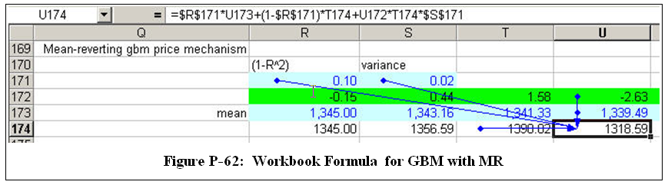
Aluminum Prices
80 random variables, one for each period, to generate geometric Brownian motion in aluminum prices
5th Plan, Appn P, page P-83 ff

Slide 7
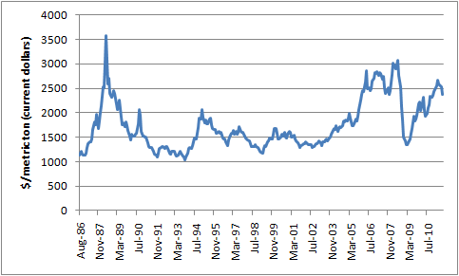
Aluminum Prices
Fifth Power Plan price assumption
Sixth Power Plan price assumption (oops)

Slide 8
  Carbon Penalty
  Aluminum Prices
  Carbon Penalty
  Commercial Availability
  Conservation Performance
  Construction Costs
  Electricity Price
  Hydrogeneration
  Natural Gas Price
  Non-DSI Loads
  Production Tax Credit Life
  REC Values
  Stochastic FOR

Slide 9
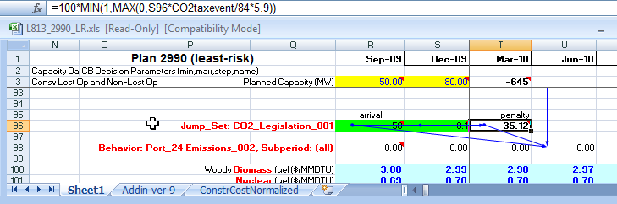
Carbon Penalty
2 random variables, determining the timing and size of penalty arrival

Slide 10
Carbon Penalty
5th Plan, Appn P, page P-133 ff
6th Plan, Appn J, page J-4 ff

Slide 11
  Commercial Availability
  Aluminum Prices
  Carbon Penalty
  Commercial Availability
  Conservation Performance
  Construction Costs
  Electricity Price
  Hydrogeneration
  Natural Gas Price
  Non-DSI Loads
  Production Tax Credit Life
  REC Values
  Stochastic FOR

Slide 12
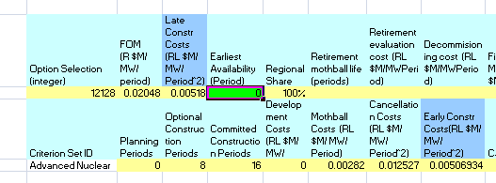
Commercial Availability
1 random variable, determining the delay (periods) after construction could begin, absent availability constraints
6th Plan, Appn J, page J-14, J-15

Slide 13
  Conservation Performance
  Aluminum Prices
  Carbon Penalty
  Commercial Availability
  Conservation Performance
  Construction Costs
  Electricity Price
  Hydrogeneration
  Natural Gas Price
  Non-DSI Loads
  Production Tax Credit Life
  REC Values
  Stochastic FOR

Slide 14
Technical Feasibility of Lost Opportunity Conservation

Slide 15
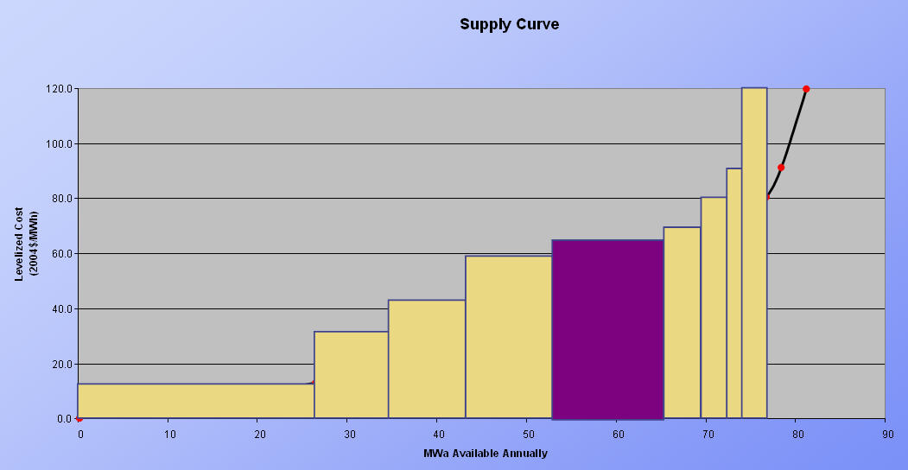
Effect on the Supply Curve
Supply curves

Slide 16
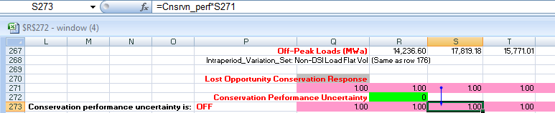
Conservation Performance
1 random variable, determining the scaled shift of all the supply curves in the future
6th Plan, Appn J, page J-5;
Power Committee Meeting, Tuesday May 11, 2010

Slide 17
  Construction Costs
  Aluminum Prices
  Carbon Penalty
  Commercial Availability
  Conservation Performance
  Construction Costs
  Electricity Price
  Hydrogeneration
  Natural Gas Price
  Non-DSI Loads
  Production Tax Credit Life
  REC Values
  Stochastic FOR

Slide 18
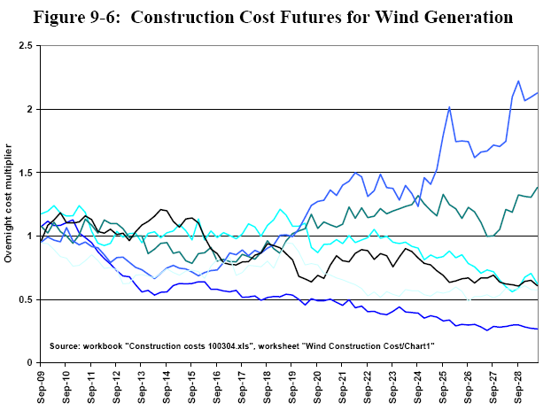
Construction Costs
6th Plan, Chap 9, page 9-14 ff;

Slide 19
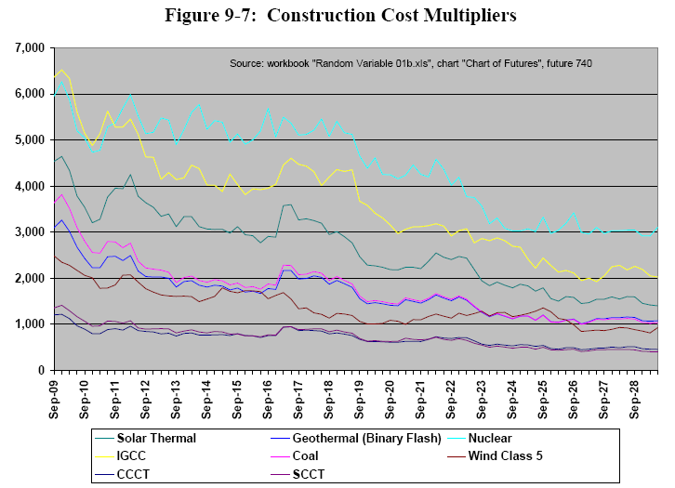
Construction Costs
6th Plan, Chap 9, page 9-14 ff;

Slide 20

Construction Costs
1 random variable, determining the scaled shift of all the supply curves in the future
Complex cost futures are pre-computed , stored in binary form in the workbook, and drawn according to this “seed” value
6th Plan, Appn J, page J-11 ff;
Generation Resource Advisory Committee, December 18, 2008 and January 22, 2009

Slide 21
  Electricity Prices
  Aluminum Prices
  Carbon Penalty
  Commercial Availability
  Conservation Performance
  Construction Costs
  Electricity Price
  Hydrogeneration
  Natural Gas Price
  Non-DSI Loads
  Production Tax Credit Life
  REC Values
  Stochastic FOR

Slide 22
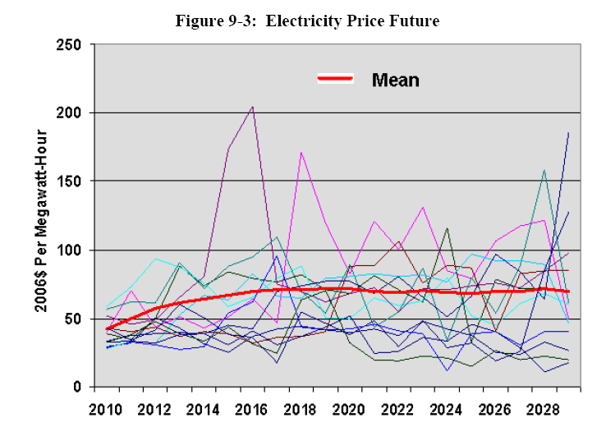
Electricity Prices
6th Plan, Chap 9, page 9-11 ff

Slide 23
Casual Regimes
Short-term (hourly to monthly)
  Positive correlation of electricity price with loads
  Hourly correlations to hydro, natural gas price
  Quarterly averages correlations to all three
Long-term (quarterly to yearly)
  Negative correlation of electricity price with loads
  Supply and demand excursions
  Changing technology, regulation
5th Plan, Appn P, page P-65 ff

Slide 24
Electricity Prices Before Adjustments
Adjustments for longer-term response include
Hydro year selection
Quarterly loads
Gas price effects
Energy balance (supply vs. demand) effects
The model generates an “independent” electricity price future devoid of these effects; adjustments for these effects are made deterministically during the chronological simulation
5th Plan, Appn P, page P-65 ff

Slide 25
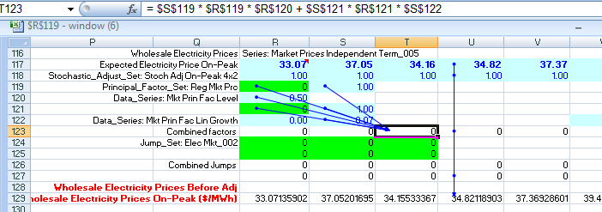
“Independent” Electricity Price
8 random variables, determining the underlying scenario path of electricity price and the nature of up to two excursions

Slide 26
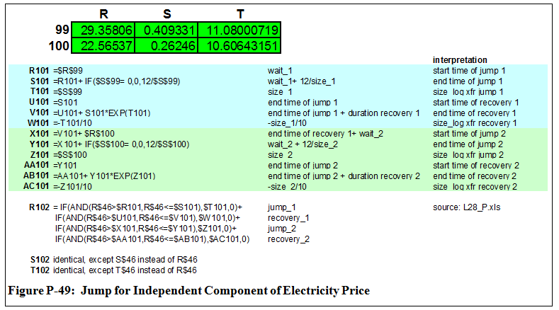
Jumps in Electricity Price
5th Plan, Appn P, page P-65 ff

Slide 27
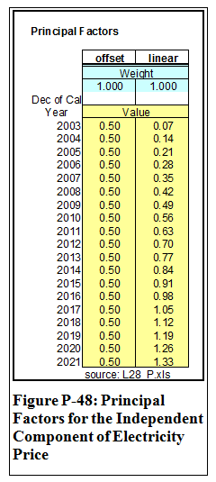
Underlying “Path” of
Electricity Price
The underlying path consists of the original benchmark forecast and the combined effects of a random offset and a random change in slope
A more complete description will be provided with the description of natural gas prices
5th Plan, Appn P, pages P-25 ff and P-65 ff

Slide 28
  Hydrogeneration
  Aluminum Prices
  Carbon Penalty
  Commercial Availability
  Conservation Performance
  Construction Costs
  Electricity Price
  Hydrogeneration
  Natural Gas Price
  Non-DSI Loads
  Production Tax Credit Life
  REC Values
  Stochastic FOR

Slide 29
Hydrogeneration
Monthly energies, east and west of the cascades, are provided by the HYDREG model and are consistent with GENESYS
Sustained peaking estimates based on these energies enable us to allocate hydrogeneration energy on and off peak
Hydro years are selected at random from among the 70 years of hydrogeneration available

Slide 30
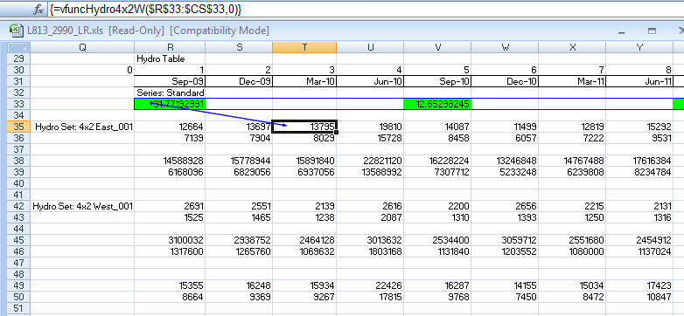
Hydrogeneration
20 random variables determine the hydro year
5th Plan, Appn P, pages P-55 ff

Slide 31
  Natural Gas Price
  Aluminum Prices
  Carbon Penalty
  Commercial Availability
  Conservation Performance
  Construction Costs
  Electricity Price
  Hydrogeneration
  Natural Gas Price
  Non-DSI Loads
  Production Tax Credit Life
  REC Values
  Stochastic FOR

Slide 32
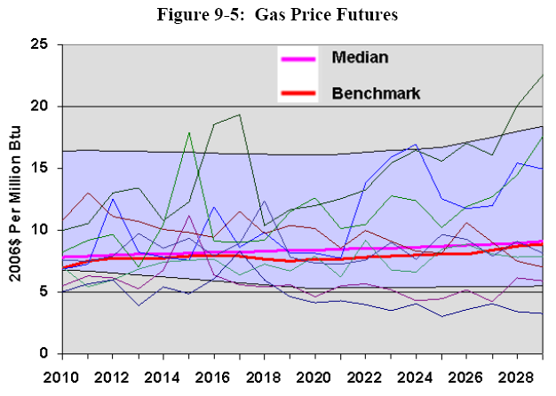
Natural Gas Price
6th Plan, Chap 9, page 9-13 ff

Slide 33
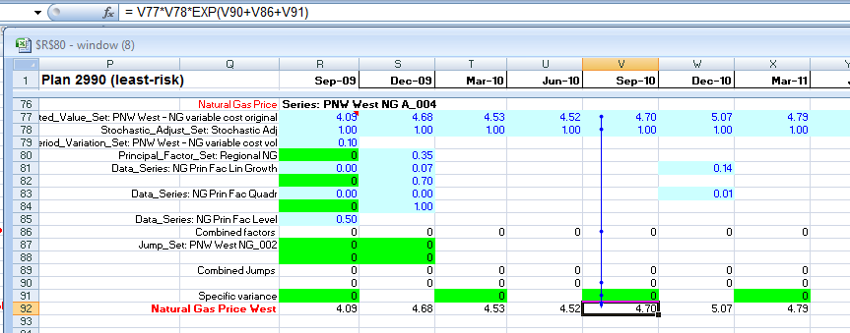
Natural Gas Price
47 random variables: three factor multipliers, two for each of two possible jumps, and 40 seasonal specific variances (fall and spring)

Slide 34
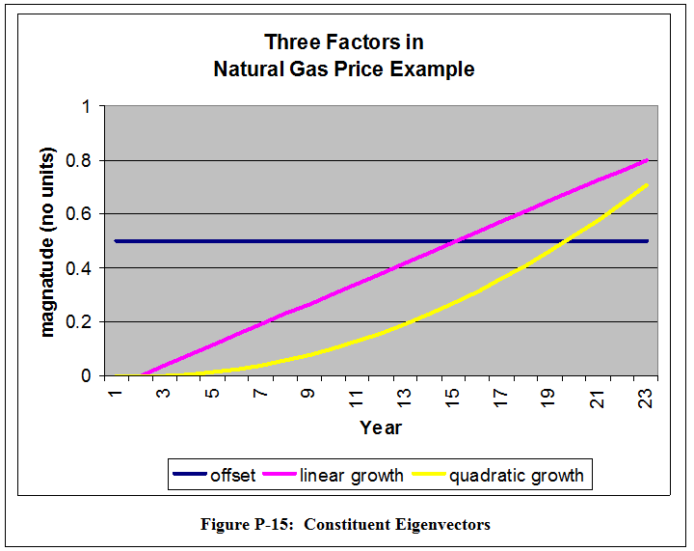
NGP: Factor Multipliers
5th Plan, Appn P, pages P-26 ff

Slide 35
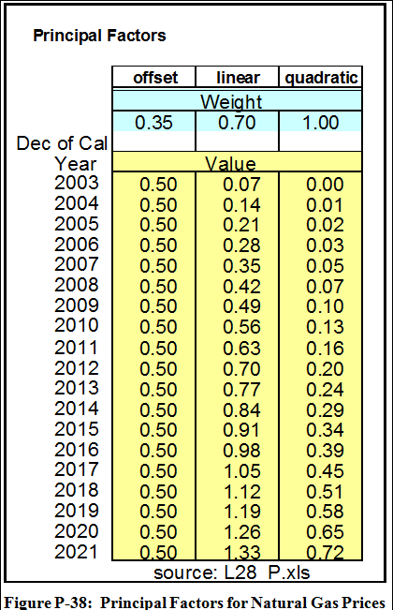
NGP: Factor Multipliers
5th Plan, Appn P, pages P-49 ff

Slide 36
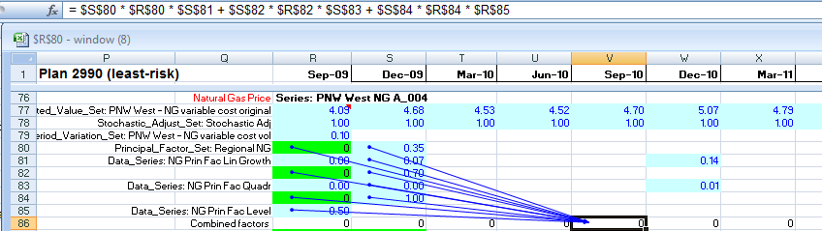
NGP: Specific Variances
5th Plan, Appn P, pages P-55 ff

Slide 37
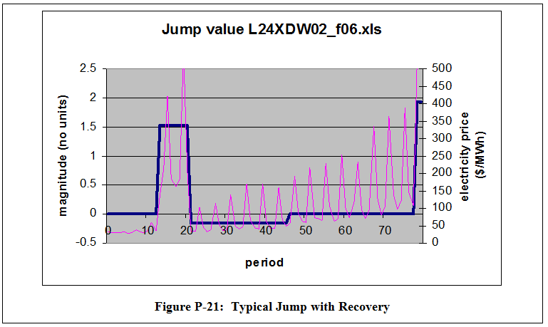
Jumps
Note: this example is for electricity price
5th Plan, Appn P, pages P-33 ff

Slide 38
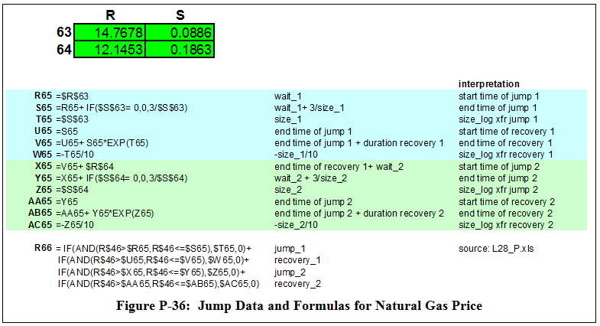
NGP: Jumps
5th Plan, Appn P, pages P-49 ff

Slide 39
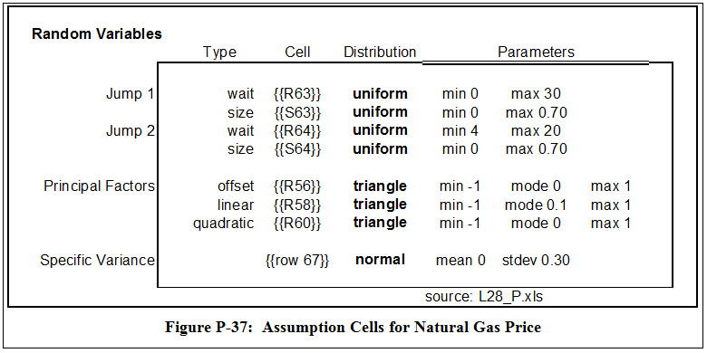
NGP: Distributions
5th Plan, Appn P, pages P-49 ff

Slide 40
  Non-DSI Frozen Efficiency Load
  Aluminum Prices
  Carbon Penalty
  Commercial Availability
  Conservation Performance
  Construction Costs
  Electricity Price
  Hydrogeneration
  Natural Gas Price
  Non-DSI Loads
  Production Tax Credit Life
  REC Values
  Stochastic FOR

Slide 41
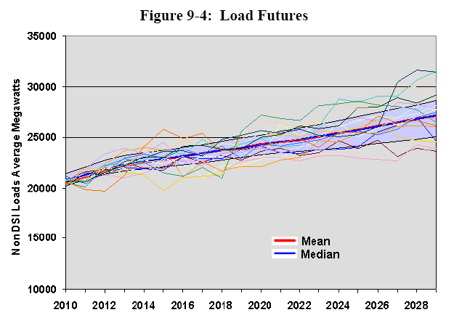
Non-DSI Frozen Efficiency Load
6th Plan, Chap 9, page 9-13

Slide 42
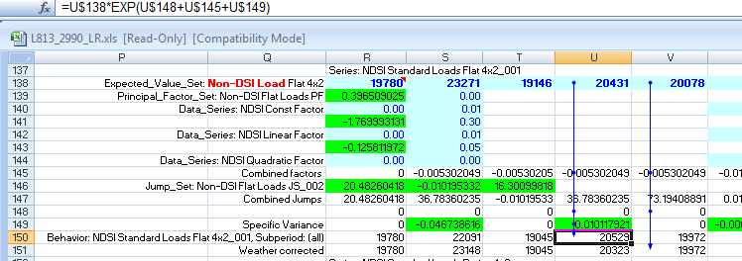
Non-DSI Frozen Efficiency Load
Note: our “weather corrected” load does not include the specific variance terms
46 random variables: three factor multipliers, three for a possible jump, and 40 seasonal specific variances (summer and winter)

Slide 43
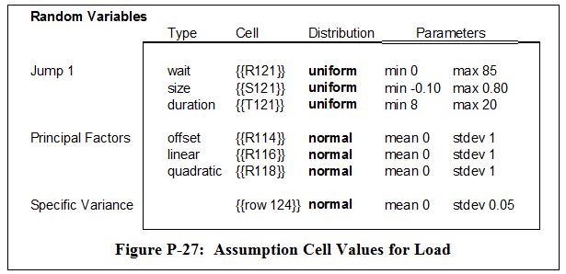
Non-DSI Frozen Efficiency Load
5th Plan, Appn P, pages P-37 ff

Slide 44
  Production Tax Credit Life
  Aluminum Prices
  Carbon Penalty
  Commercial Availability
  Conservation Performance
  Construction Costs
  Electricity Price
  Hydrogeneration
  Natural Gas Price
  Non-DSI Loads
  Production Tax Credit Life
  REC Values
  Stochastic FOR

Slide 45
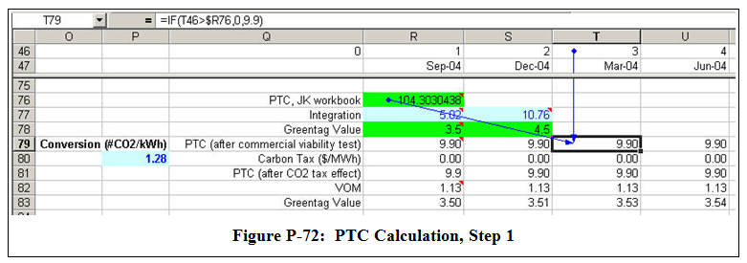
Production Tax Credit Life
1 random variable, representing the likely life of tax credits, assuming no carbon penalty and assuming the purpose of the credit is primarily to make the technology commercially competitive

Slide 46
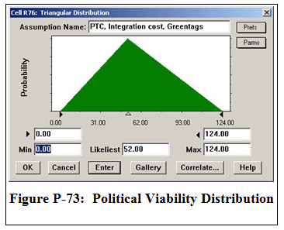
Production Tax Credit Life
5th Plan, Appn P, pages P-90 ff

Slide 47
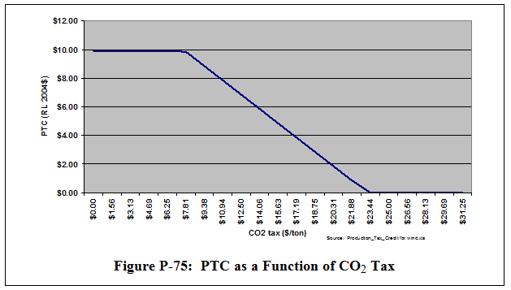
Production Tax Credit Value
5th Plan, Appn P, pages P-90 ff

Slide 48
  Renewable Energy Credit Value
  Aluminum Prices
  Carbon Penalty
  Commercial Availability
  Conservation Performance
  Construction Costs
  Electricity Price
  Hydrogeneration
  Natural Gas Price
  Non-DSI Loads
  Production Tax Credit Life
  REC Values
  Stochastic FOR

Slide 49
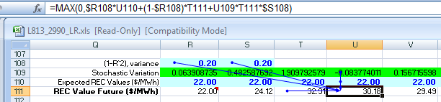
Renewable Energy Credit Value
80 random variables, one for each period, to generate geometric Brownian motion in aluminum prices
5th Plan, Appn P, pages P-95 ff, but modified for the 6th Plan (see Chap 9, page 9-19)

Slide 50
  Stochastic Unit Forced Outages
  Aluminum Prices
  Carbon Penalty
  Commercial Availability
  Conservation Performance
  Construction Costs
  Electricity Price
  Hydrogeneration
  Natural Gas Price
  Non-DSI Loads
  Production Tax Credit Life
  REC Values
  Stochastic FOR

Slide 51

Stochastic Unit Forced Outages
1 random variable, representing “seed” value for an endogenous calculation of beta and gamma-distributed random variables

Slide 52
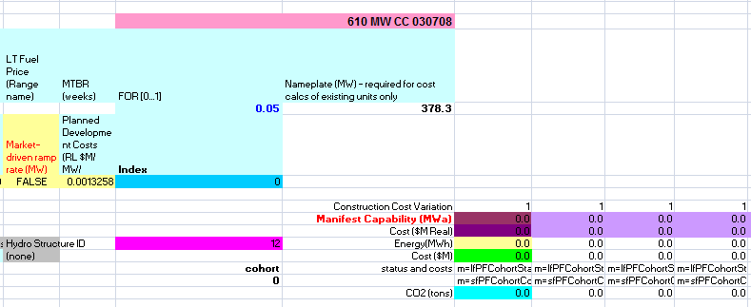
Stochastic Unit Forced Outages
In the RPM, real estate is expensive and used intensively. A single row of energy data will represent multiple units added over distinct points in time, each with its own construction cycle modeled.

Slide 53
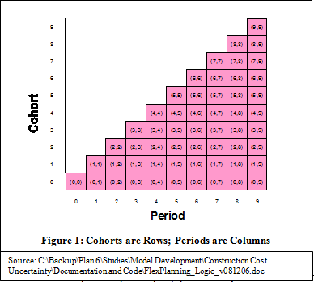
Stochastic Unit Forced Outages
Getting the forced outage calculation right, where each cohort can consist of multiple units, and units are added over time, is solved by making the calculation internally.
6th Plan, Appn J, page J-15 ff

Slide 54
Summary

Slide 55
Concluding Remarks
The values for the 288 random variables are drawn at the beginning of each game, or “future”
All aspects of the future are calculated in the model before the chronological simulation of the resource portfolio’s performance
Where decisions are necessary during the chronological simulation, the model references only “past” values of the given future
You can use the Navigator feature in the RPM to explore these on your own

