Slide 1

State of the System Report
Technical Committee Meeting
January 27, 2012

Slide 2
Overall Structure of Report
Adequacy Assessment – Green, Yellow or Red
  Multiple adequacy metrics
  Curtailment statistics and conditions when they occur
Annual probability curves [Not sure we need this]
Monthly probability curves and LOLP values
  Market resources
  Borrowed hydro
Hourly probability curves by month
  Market resources
  Borrowed hydro

Slide 3
Preliminary Adequacy Assessment for 2015 - GREEN
Metric | Value | Units
LOLP | 0.9 | Percent
SRUP | 1.1 | Percent
CVaR (energy) | 6968 | MW-hours
CVaR (peak) | 516 | MW
EUE | 348 | MW-hours
LOLH | 0.3 | Hours/year

Slide 4
Curtailment Statistics
Statistic | Value | Unit
Expected Events/year | 0.02 | Events
Average Event Duration | 15 | Hours
Average Event Magnitude | 21206 | MW-hrs
Average Event Peak | 1697 | MW
Expected Curt Hours/year | 0.3 | Hours
% of games With curtailment | 1.1 | %

Slide 5
Curtailment Events
 |  | Duration | Magnitude | Peak | Hydro | Forced Out | Temp | Wind
Game | Mon | hours | mw-hrs | mw-hrs | (%) | (%) | (%) | (%)
3 | Aug | 5 | 473 | 117 | 94 | 10 | 83 | 18
12 | Aug | 15 | 17647 | 1459 | 88 | 16 | 83 | 17
12 | Aug | 19 | 4911 | 479 | 88 | 17 | 48 | 2
16 | Jan | 8 | 6681 | 2970 | 89 | 8 | NA | 3
72 | Mar | 6 | 355 | 73 | 91 | 21 | 16 | 18
72 | Mar | 29 | 30340 | 2133 | 91 | 20 | 1 | 12
285 | Oct | 11 | 11006 | 1414 | 77 | 19 | 68 | 4
430 | Jan | 19 | 27248 | 1592 | 89 | 8 | NA | 67
781 | Dec | 39 | 44293 | 2125 | NA | 13 | 91 | 31
781 | Dec | 2 | 511 | 336 | NA | 9 | 100 | 61
855 | Aug | 17 | 11594 | 1064 | 94 | 17 | 58 | 3
913 | Jan | 35 | 37111 | 1928 | 84 | 9 | 1 | 22
918 | Dec | 5 | 2616 | 719 | 93 | 11 | 54 | 1
918 | Dec | 14 | 5909 | 554 | 93 | 13 | 54 | 3
918 | Dec | 2 | 1615 | 842 | 93 | 10 | 54 | 16
931 | Jan | 72 | 179994 | 5660 | 87 | 9 | NA | 5
940 | Dec | 8 | 51790 | 7800 | 98 | 11 | 88 | 42
995 | Oct | 3 | 1698 | 624 | 77 | 16 | 55 | 1
995 | Dec | 12 | 30110 | 3583 | 96 | 12 | 80 | 19
1068 | Aug | 1 | 166 | 166 | 94 | 17 | 65 | 62
1068 | Aug | 20 | 7017 | 707 | 94 | 18 | 65 | 42
1203 | Dec | 2 | 235 | 230 | 91 | 5 | 69 | 36
1259 | Jan | 11 | 14409 | 2460 | 79 | 3 | 1 | 7

Slide 6
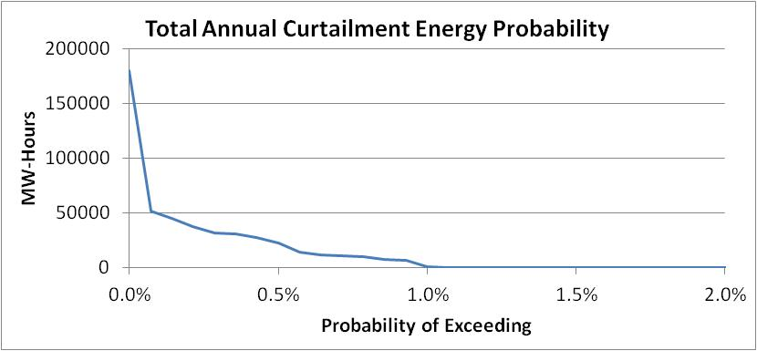
Annual Energy Curtailment Probability Curve

Slide 7
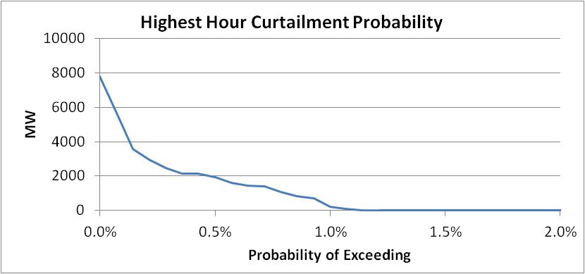
Highest Hour Curtailment Probability Curve

Slide 8
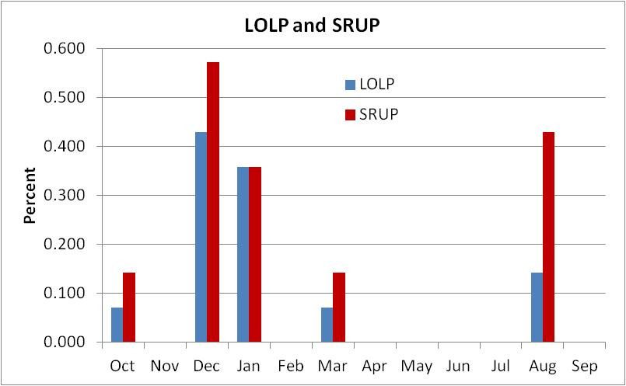
Monthly LOLP and Standby Resource Use Probability (SRUP)

Slide 9
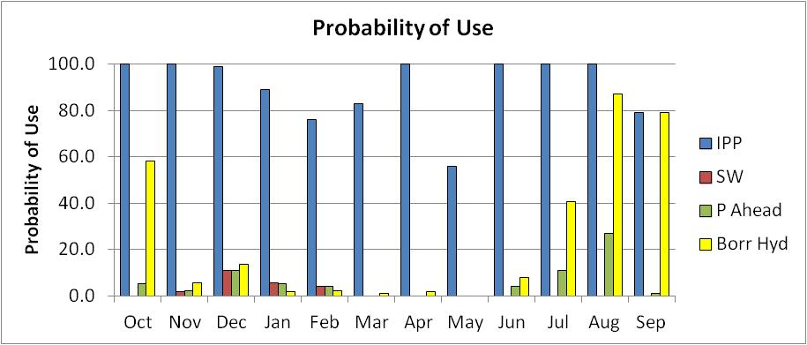
Likelihood of using Market Resources and Borrowed Hydro
For Illustration Only – From a Test Simulation

Slide 10
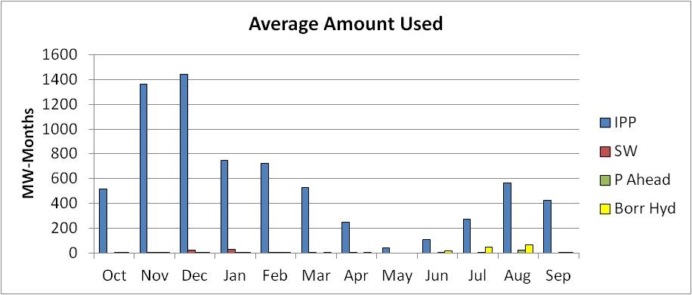
Average use of Market Resources and Borrowed Hydro
For Illustration Only – From a Test Simulation

Slide 11
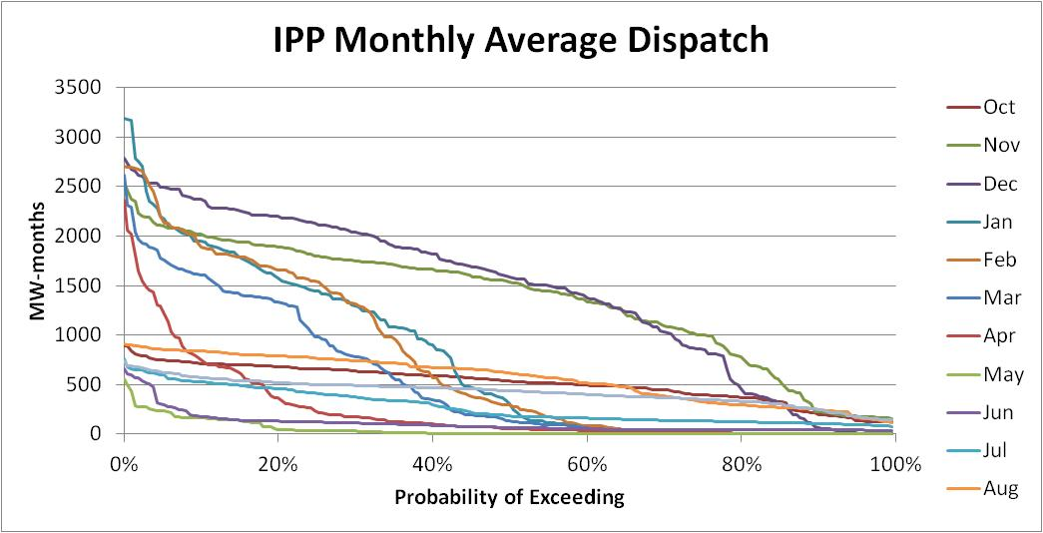
Monthly Average IPP Dispatch
Probability Curve
For Illustration Only – From a Test Simulation

Slide 12
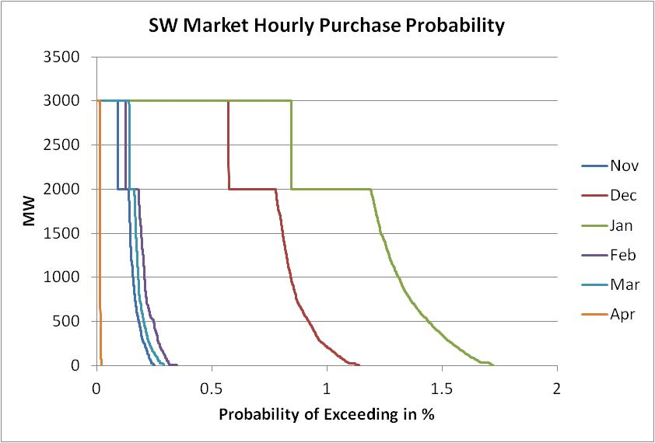
SW Market Hourly Purchase
Probability Curve
1000 MW of Off-Peak also

Slide 13
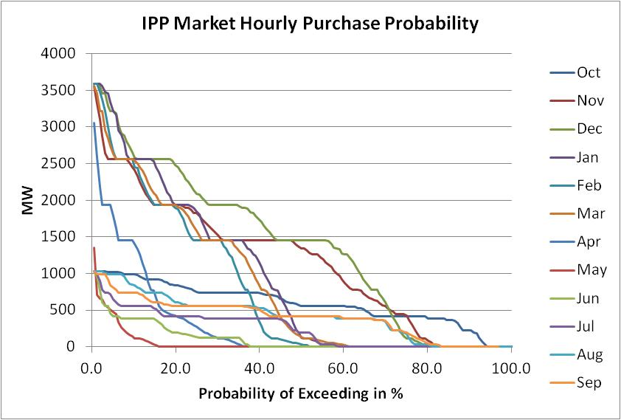
IPP Hourly Purchase
Probability Curve

Slide 14
Future Work
Finalize assumptions
Update data
  Load
  Resources
  Contracts
Develop a prototype State of the System report
Create a web site to host the State of the System results
Assess adequacy for 2017
Complete the State of the System report for 2017

