Slide 1

Big Wind Study
Technical Committee Meeting January 27, 2012
Notes:
1
The GENESYS model is being developed, in the short-term, to assess potential reliability problems in the Northwest. In the long-term, it is hoped that this model will become a useful economic tool to help guide the use of the multi-dam hydroelectric power system.

Slide 2
Outline
Impacts of INC and DEC wind reserves on hydro generating capability
Impacts of increasing wind capacity on hydro and thermal dispatch
Impacts of increasing wind capacity on the existing over generation problem
Assessing the load carrying capability for wind

Slide 3
Effects of INC and DEC Reserves on Hydroelectric Capability INC Reserve – Covers peak load when wind doesn’t blow DEC Reserve – Backs off generation during light load hours when wind does blow

Slide 4
Effects of INC and DEC Reserves on Hydroelectric Capability

Slide 5
DEC Reduces Hydro Peaking Capability (for 6K of installed wind)
Period | 2-Hr | 4-Hr | 6-Hr | 8-Hr | 10-Hr | 12-Hr
Sep | -33 | -444 | -699 | -778 | -742 | -612
Oct | -364 | -976 | -1115 | -1065 | -865 | -636
Nov | -2 | -108 | -354 | -351 | -356 | -322
Dec | -19 | -149 | -404 | -387 | -365 | -325
Jan | -64 | -186 | -406 | -407 | -393 | -341
Feb | -192 | -274 | -512 | -509 | -472 | -416
Mar | -54 | -142 | -479 | -501 | -465 | -424
Apr 1 | -855 | -1083 | -1057 | -928 | -778 | -597
Apr 2 | -319 | -349 | -380 | -357 | -319 | -304
May | 0 | 0 | -8 | -57 | -84 | -92
Jun | -114 | -233 | -373 | -432 | -434 | -377
Jul | 0 | -41 | -169 | -255 | -321 | -318
Aug 1 | 0 | 0 | -36 | -149 | -295 | -316
Aug 2 | -227 | -652 | -951 | -942 | -820 | -669
For Illustration Only

Slide 6
DEC Increases Minimum Hydro Generation
Hit minimum hydro generation often
For Illustration Only

Slide 7
Effects on Resource Dispatch

Slide 8
For Illustration Only

Slide 9
For Illustration Only

Slide 10
For Illustration Only

Slide 11
For Illustration Only

Slide 12
Future work
Identify resources whose dispatch is most affected by increasing wind capacity
Quantify how natural gas use decreases with increasing amounts of wind
Investigate how thermal ramp-ups and ramp-downs change with increasing wind
Should we investigate carrying some INC and DEC requirements with thermal resources?
Anything else?

Slide 13
Oversupply Problem*
Oversupply conditions occur when the minimum system generation exceeds firm load and secondary sales markets.
*Still working with BPA staff to review results.

Slide 14
No sales market assumed in this case
For Illustration Only

Slide 15
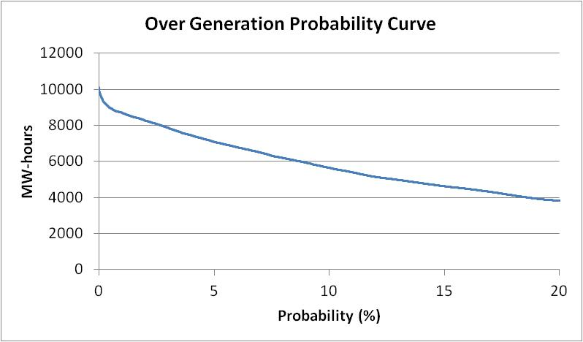
Intertie size
For Illustration Only

Slide 16
Assessing the Effective Load Carrying Capability of Wind (ELCC)

Slide 17
What is ELCC?
“Effective load carrying capability” is defined as the amount of incremental load a resource can serve without degrading adequacy.
It is usually expressed as a percentage of a resource’s capacity.
Example: a standalone CT with 5% FOR and infinite fuel supply has an ELCC of 95%
ELCC is a function of the system the new resource is added to – this is particularly important for wind.

Slide 18
Study Methodology
Base case
Remove all wind
Calculate total annual average curtailment
Study cases
Add 200 MWa of annual shaped load
Add increments of wind capacity until the total annual average curtailment equals that in the base
Repeat above with greater amounts of load

Slide 19
ELCC Results (+200 MWa load)
For Illustration Only

Slide 20
Annual Wind ELCC Results
For Illustration Only

Slide 21
Observations
ELCC declines with increasing amounts of wind because system flexibility is used up
Eventually wind ELCC will flatten out
Average annual wind generation is ~ 30%, yet currently aggregate ELCC is ~ 23% Thus, can’t plan on average wind generation
Adding storage will increase ELCC
Adding more diverse wind generation will also increase aggregate ELCC

