Slide 1
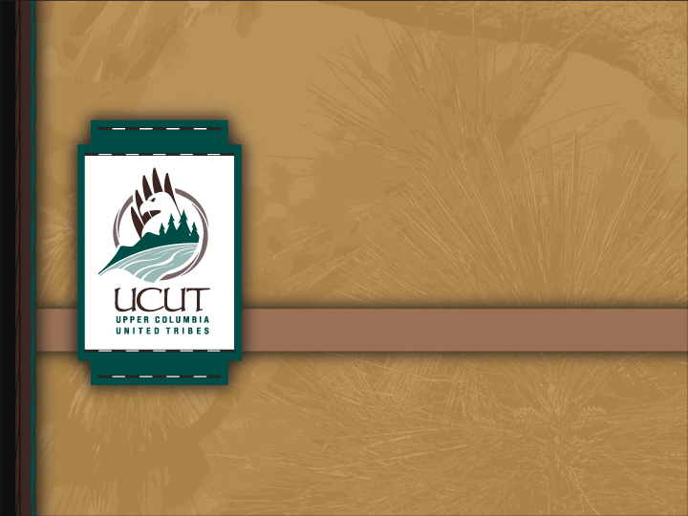
United for the benefit of all
Regional Coordination
Notes:
My name is D.R. Michel, Executive Director of the Upper Columbia United Tribes.
Today, we present our Regional Coordination project

Slide 2
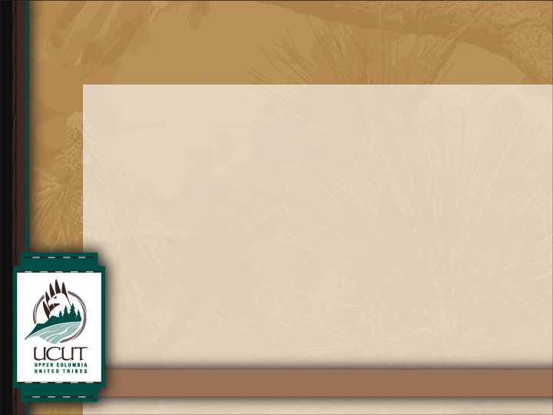
Our Mission
The mission of the Upper Columbia United Tribes (UCUT) is to unite for the protection, preservation, and enhancement of Treaty and Executive Order Rights, Sovereignty, Culture, Fish, Water, Wildlife, Habitat, and other interests and issues of common concern in our respective territories through a structured process of cooperation and coordination for the benefit of all people.
Notes:
The Mission of the Upper Columbia United Tribes is to unite for the protection, preservation, and enhancement of Treaty and Executive Order Rights, Sovereignty, Culture, Fish, Water, Wildlife, Habitat, and other interests and issues of common concern in our respective territories through a structured process of cooperation and coordination for the benefit of all people.
The UCUT Mission is our broad goal that supports specific measureable objectives and projects.
The five member tribes, through the UCUT Central Office, exchange information, find consensus, inform other regional decision-makers, and work to fulfill fish and wildlife protection, mitigation, and enhancement obligations of the Columbia River power, flood risk management, and irrigation system.

Slide 3
Who We Are:
Coeur d’Alene Tribe: Current enrolled membership: 2,188
  Reservation: (Idaho): 334,500 acres
Confederated Tribes of the Colville Reservation: Current enrolled membership: 9,353
  Reservation (Washington): 1.4 million acres
Kalispel Tribe of Indians: Current enrolled membership: 409
  Reservation (Washington): 4,700 acres
Kootenai Tribe of Idaho: Current enrolled membership: 145
  Reservation (Idaho): 2,200 acres
Spokane Tribe of Indians: Current enrolled membership: 2,621
  Reservation (Washington): 156,000 acres
Notes:
The Upper Columbia United Tribes (UCUT) was formed in 1983 by the Coeur d’Alene Tribe, Kalispel Tribe of Indians, Kootenai Tribe of Idaho and the Spokane Tribe of Indians; with the Confederated Tribes of the Colville Reservation joining in 1999.
The UCUT Central Office Coordination funding is comprised of a portion of each of the UCUT regional coordination projects. This enables each of the individual tribal fish and wildlife staff, and the small (total 5 Full Time Employees) Central Office staff to synergistically work together on unified issues in an efficient and cost-effective manner.

Slide 4
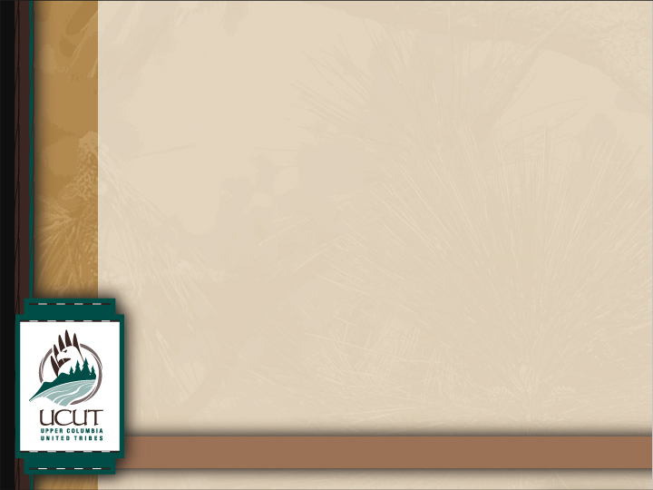
Upper Columbia Basin (U.S.)
Notes:
Together, the Upper Columbia United Tribes manage and influence nearly 2 million acres of reservation land and waterways, and millions of acres more of off-reservation areas, for the betterment of the people, forests, fish, and wildlife of the greater Inland Northwest.
As Sovereign Nations, we are charged with using our land and natural resources in ways that protect and enhance those resources.
The UCUT is five tribes that have come together to maintain our vital resources for present and future generations.

Slide 5

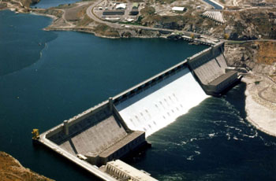
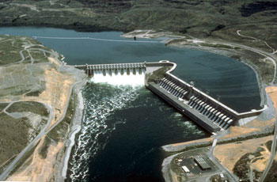
Grand Coulee Dam
Chief Joseph Dam
  40% of Columbia River anadromous fish that originated in the upper Columbia River and were blocked by hydroelectric, irrigation, and flood control dams.
  Passage to the Spokane, Pend Oreille and Kootenai rivers and the main stem Columbia River. Was completed blocked
  At least 37% of all Wildlife losses occurred in the Intermountain Province
Notes:
Grand Coulee Dam, built in 1941, and Chief Joseph Dam, built in 1955, completely blocked salmon, steelhead, and other anadromous fish (such as bull trout, sturgeon, and lamprey) to the Spokane River, Pend Oreille River, Kootenai River, and the main stem Columbia River and all of its upriver tributaries.
The 1980 Northwest Power Act and its Columbia Basin Fish & Wildlife Program did not provide adequate relief for the restoration or recovery of either salmon or native resident fish.
Resident fish substitution as an alternative to anadromous fish mitigation has not mitigated for lost anadromous fish nor lost native resident fish species.
Native resident fish restoration and recovery never fully occurred.
Wildlife mitigation partially replaced lands with habitat values lost to construction and inundation of the dams. Continuous impacts to wildlife from dam operations were not addressed.

Slide 6
Regional Coordination :
Is the Sovereigns’ ability to represent their interests and engage in the processes that affect those interests.
Is accomplished at various levels , not just among and between F&W managers, BPA, and NWPCC; but also many other entities (City, County, State, National, International).
Is dynamic and cuts through many layers of project, province, program, regional , national, and international issues towards meeting PME obligations of the Columbia River Power system.
Regional Coordination|
Notes:
Regional coordination is the Sovereign’s ability to represent their interests and engage in the processes that affect those interests.
It is accomplished at various levels, not just among and between fish and wildlife managers, Bonneville Power, and the Power Planning and Conservation Council; but also with many other entities (City, County, State, National, and International).
Regional coordination is dynamic and cuts through many layers of Project, Province, Program, Regional, National, and International issues.
Coordination must be tied to the individual sovereign and grounded in each sovereign’s equality.
This Coordination Project helps the Upper Columbia United Tribes to be involved at all levels:
from the local stakeholder, to
Cities, Counties and local governments,
regional forums and essential government-to-government relations with other tribes, states and federal agencies;
and at the national level with U.S. government Departments and their agencies.
In addition, the UCUT is significantly important in international issues due to:
the trans-boundary nature of the river,
the geographic proximity of the UCUT to Canada, the
UCUT priority reliance on a healthy ecosystem, and
large numbers of tribal family relations across the borders.

Slide 7
The UCUT…
Provides a unified regional voice
Includes representation from each tribe
Works to ensure a healthy future for the traditional lands and waters of our ancestors for the benefit of all people
Takes a proactive, coordinated, and science-based approach
Promotes culture, fish, wildlife, and healthy forests, range, and water habitats
Develops partnerships, including government-to-government relationships to accomplish its goals, objectives and strategies
Is directed by Tribal Councils
Regional Coordination|
Notes:
The UCUT efforts are directed by five unified tribal Councils, that are informed by technical scientific and legal support.
The UCUT provides a unified regional voice; it includes representation from each of our tribes; and uses a proactive, coordinated, and science-based approach.
Through the UCUT Coordination project, we form regional partnerships, including government-to-government relationships to accomplish our goals, objectives, strategies, and actions.
UCUT coordination is not an action or a subject by itself – it is incidental to and directive of the need to make progress on issues that work to protect, mitigate, and enhance fish and wildlife, their habitats, and the associated cultures that the tribes rely on.

Slide 8
Past Accomplishments and Present Work
UCUT Wildlife Monitoring and Evaluation Program
Wildlife Crediting Forum – Settlement Agreements
Resident Fish Habitat Loss Assessments
MERR Plan – Implementation Strategies
Toxics Reduction
Data Management
Drumheller Springs
McKenzie Wetland Project (Newman Lake)
Salmon Harvest Sharing
Notes:
To assist in protecting remaining resources the UCUT coordinates a team of expert staff to mitigate and restore past damages, prevent additional losses, and build a strategic future that will benefit all people and the resources we rely on. The small central UCUT Office staff assist in the facilitation, coordination and funding of issues of mutual concern.
In May 2005, UCUT and the Bonneville Power Administration entered into a Memorandum of Understanding (MOU) to coordinate fish and wildlife mitigation efforts. The MOU was updated in April 2010, and supports Regional Coordination and our efforts to restore and recover all aspects of the ecosystem including forests, fish, wildlife, rangelands, natural and cultural resources.
Examples of efforts that the UCUT coordinates include:
the UCUT Wildlife Monitoring and Evaluation Project;
involvement in the Wildlife Crediting Forum;
development of Resident Fish Habitat Loss Assessments;
comments to the development of the Monitoring, Evaluation, Research, and Reporting (MERR) Plan, and assistance in developing the MERR Implementation Strategies;
Columbia River Toxics Reduction and Fish Consumption Rates;
and Data Management.
Locally important projects include the continual maintenance of Drumheller Springs, a Conservation Area of Tribal Significance in the City of Spokane – including a mural painting on a retaining wall to prevent graffiti and provide public outreach.
Another project we are coordinating with local governments is the McKenzie Wetland at Newman Lake.
Member Tribes initiated salmon harvest sharing in 2010, restoring a centuries-old tradition.

Slide 9
Present Work (cont.)
Columbia River Treaty
  Governance
  Ecosystem-Based Function
  Passage
Lake Roosevelt Forum and Conference
Public Outreach and Education
Affiliated Tribes of Northwest Indians
Predator and Invasive Species Control
Continued Development of a UCUT Strategic Plan
Regional Coordination
Notes:
The UCUT Coordination program has greatly assisted the UCUT in solidifying a unified approach for the Columbia Basin tribes in the Review of the Columbia River Treaty.
The Columbia Basin tribes have successfully worked together on this issue for the past three years, and have developed a Common Views document; Goals and Objectives for river and reservoir operations; and were instrumental in the development of a Sovereign’s Participation Paper that includes a Prologue, Sideboards, Purpose and Objectives, and Framework used by the tribes, federal and state government participation in the Treaty Review.
With the critical assistance of the UCUT, the Columbia Basin tribes have succeeded in achieving a sovereign governance voice in the Treaty Review. That voice has succeeded in getting ecosystem-based function recognized as a critical driver in the Treaty – co-equal with power production and flood risk management.
The UCUT has also played a significant role in achieving discussions and building historic relationships with the First Nations and Indian Bands in Canada – and continue to discuss issues of common interest regarding the Treaty and its Review.
Other Coordination activities include public outreach at Powwows and other tribal and general public events; and outreach and assistance with Predator and Invasive Species Control – such as the Kalispel Tribe initiative to control Northern Pike in the Pend Oreille River.

Slide 10
Future
Protect & Restore Fish & Wildlife Habitat
Recover & Restore Fish & Wildlife Harvest
Improve Hydro-System
Restore & Protect Salmon Passage
Cultural & Ceremonial Use of Salmon
Notes:
To continue working toward its mission, the UCUT are dedicated to the restoration and best management practices for the ecosystem as a whole.
We continue to develop a Strategic Plan for future operations of the hydro-system, habitat restoration, harvest sharing, fish passage to all historic locations; and cultural and ceremonial use of the fish and wildlife resources of the Columbia River system.

Slide 11
Hydro-System
Our goal is to manage reservoir levels, river flows, drafting and flood risk, while allowing passage for native species.
Habitat
Our goal is to protect, mitigate and restore resident and anadromous fish and wildlife and their habitats.
Harvest
Our goal is to recover and restore resident and anadromous fish and wildlife to fulfill subsistence, cultural and other needs and uses.
Notes:
HYDROSYSTEM: Our goal is to develop measureable system-wide objectives and implement actions to manage reservoir levels, river flows, drafting, and flood risk. We will also strive to allow passage for native species into all historic areas that meet the needs of healthy ecosystem function and native anadromous and resident fish life stages and wildlife throughout the complex system of dams and tributaries.
Additionally, we will manage the river to restore and preserve tribal resources and culture consistent with tribal resource management plans.
HABITAT: We plan to develop objectives and implement actions for land and water uses that meet the needs of the ecosystem, in order to protect, mitigate and restore native fish and wildlife habitats. Additionally, we work to achieve water quality and quantity necessary for a healthy ecosystem, tribal subsistence, and for sustainable economic development and growth.
HARVEST: Anadromous and resident fish, wildlife and other cultural resources have been degraded to the point where use by the UCUT membership is severely reduced or eliminated. Coordination helps us reconcile and restore these resources for subsistence, cultural and other needs and uses. Specific goals, objectives and actions are being developed and implemented that are aimed at restoring anadromous and resident fish and all First Foods’ use and sharing for tribal sustenance.
We work to ensure an equitable allocation of lower-Columbia River and ocean harvest in order to protect upper Columbia River resource investments, meet escapement and provide for the needs of the member Tribes.

Slide 12
Salmon Passage
Our goal is to restore and protect salmon passage to their original habitats in the Upper Columbia River.
Cultural & Ceremonial Use
Our goal is to continue the sharing of salmon and other resources, including fishing and processing techniques and locations, among member Tribes.
Notes:
FISH PASSAGE: We plan to restore and protect salmon, steelhead and other fish passage to their original habitats in the Upper Columbia River and its tributaries. This includes science-based investigation and the potential development of juvenile and adult fish passage capacity at Chief Joseph Dam, Grand Coulee Dam and in the Spokane River.
It’s important to note that these efforts will not conflict with current and on-going resident fish and wildlife mitigation efforts.
CULTURAL & CEREMONIAL USE: A common goal among all of the Upper Columbia United Tribes is to continue the sharing of salmon and other fish resources, including the sharing of Selective Harvest, and other fishing and processing techniques.
Additionally, this takes into account the incorporation of ceremonial and sustenance use, including the sharing of cultural and ceremonial knowledge and techniques, wherever practicable.

Slide 13
Summary:
The UCUT were the first to be impacted by the development of the Columbia River – and are the last to be mitigated.
The UCUT are the most impacted by the development of the Columbia River – and are the least mitigated.
Coordination is critical to unify common concerns and solutions.
                .
Notes:
The UCUT were the First to be impacted by the development of the Columbia River – and are the Last to be mitigated.
The UCUT are the Most impacted by the development of the Columbia River – and are the Least mitigated.
Coordination is critical to unify our common concerns and implement solutions.

Slide 14
Upper Columbia United Tribes
25 W. Main, Suite 434
Spokane, WA 99201
509.838.1057
www.ucut.org
info@ucut-nsn.org
Regional Coordination
Notes:
Include name and contact information of presenter.
If you have questions, comments or would like to learn more, please visit our website at www.ucut.org, or contact us at info@ucut-nsn.org or 509.838.1057.
Thank you!

