Slide 1
System Analysis
Advisory Committee
Review
Michael Schilmoeller
Friday, January 25, 2013

Slide 2
Sources of Uncertainty
Fifth Power Plan
  Load requirements
  Gas price
  Hydrogeneration
  Electricity price
  Forced outage rates
  Aluminum price
  Carbon penalty
  Production tax credits
  Renewable Energy Credit
Sixth Power Plan
  aluminum price and aluminum smelter loads were removed
  Power plant construction costs
  Technology availability
  Conservation costs and performance
Scope of uncertainty

Slide 3
Characteristics
Buying an automobile?
Resource Planning?
No "do-overs", irreversibility
✔ ✔
Reduce size and likelihood of bad outcomes
✔ ✔
Cost – risk tradeoff: reducing risk is a money-losing proposition
✔ ✔
Imperfect Information
✔ ✔

Slide 4
Characteristics
Buying an automobile?
Resource Planning?
Use of scenarios
✔ ✔
Some resources in reserve, used only if necessary
✔ ✔
Resource allocations reflect likelihood of scenarios
✔ ✔
… even if "we cannot assign probabilities"
✔ ✔
Resource allocations reflect severity of scenarios
✔ ✔

Slide 5
Identifying Long-Term Ratepayer Needs
Why and for whom is a plant built?
  For the market or the ratepayer?
  Built for independent power producers (IPPs) for sales into the market, with economic benefits to shareholders?
How much of the plant is attributable to the ratepayer?
  This is usually a capacity requirement consideration
  To what extent does risk bear on the size of the plant’s share ?

Slide 6
How the RPM Differs from
Other Planning Models
No perfect foresight, use of decision criteria for capacity additions
Likelihood analysis of large sources of risk (“scenario analysis”)
Adaptive plans that respond to futures
Planning to minimize risk rather than expected cost
Notes:
6

Slide 7
Uncertainties
Aluminum Prices
Carbon Penalty
Commercial Availability
Conservation Performance
Construction Costs
Electricity Price
  Hydrogeneration
  Natural Gas Price
  Non-DSI Loads
  Production Tax Credit Life
  REC Values
  Stochastic FOR

Slide 8
Excel Spinner Graph Model
Represents one plan responding under each of 750 futures
Illustrates “scenario analysis on steroids”
Notes:
8

Slide 9
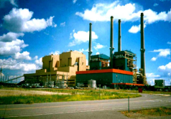


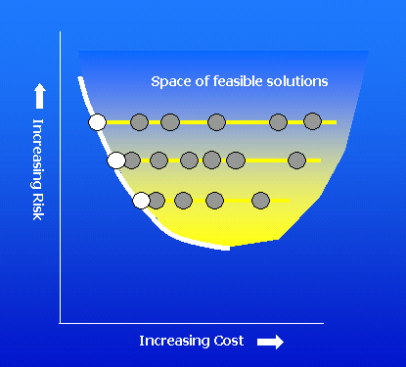
Modeling Process
The portfolio model
$
Notes:
The modeling process consists of several elements.
The portfolio calculates costs for a given future and plan
Another module changes futures to produce the distribution of costs
A third module changes plans, and tries to locate least-cost plans for each level of risk

Slide 10
Finding Robust Plans
Space of feasible solutions
Reliance on the likeliest outcome
Efficient Frontier
Risk Aversion

Slide 11
Impact on NPV Costs and Risk
C:\Documents and Settings\Michael Schilmoeller\Desktop\NWPCC - Council\SAAC\Presentation materials\L813 NPV Costs.xlsm
Scope of uncertainty

Slide 12
Decision Trees
Estimating the number of branches
  Assume possible 3 values (high, medium, low) for each of 9 variables, 80 periods, with two subperiods each; plus 70 possible hydro years, one for each of 20 years, on- and off-peak energy determined by hydro year
  Number of estimates cases, assuming independence: 6,048,000
Studies, given equal number k of possible values for n uncertainties:
Impact of adding an uncertainty:
Decision trees & Monte Carlo simulation

Slide 13
Monte Carlo Simulation
MC represents the more likely values
The number of samples is determined by the accuracy requirement for the statistics of interest
The number of games m_{n} necessary to obtain a given level of precision in estimates of averages grows much more slowly than the number of variables n:
Decision trees & Monte Carlo simulation

Slide 14
Monte Carlo Samples
How many samples are necessary to achieve reasonable cost and risk estimates?
How precise is the sample mean of the tail, that is, TailVaR₉₀?
Implication to Number of Futures

Slide 15
Assumed Distribution
C:\Documents and Settings\Michael Schilmoeller\Desktop\NWPCC - Council\SAAC\Presentation materials\L813 NPV Costs 02.xlsm
Implication to Number of Futures

Slide 16
Dependence of Tail Average on Sample Size
C:\Documents and Settings\Michael Schilmoeller\Desktop\NWPCC - Council\SAAC\Presentation materials\L813 NPV Costs 02.xlsm, worksheet “Samples_75”
σ=1.677
Implication to Number of Futures

Slide 17
Accuracy and Sample Size
Estimated accuracy of TailVaR₉₀ statistic is still only ± $3.3 B (2σ)!*
*Stay tuned to see why the precision is actually 1000x better than this!
Implication to Number of Futures

Slide 18
Accuracy Relative to the Efficient Frontier
C:\Backups\Plan 6\Studies\L813\Analysis of Optimization Run_L813vL811.xls
Implication to Number of Futures

Slide 19
Finding the Best Plan
Each plan is exposed to exactly the same set of futures, except for electricity price
Look for the plan that minimizes cost and risk
Challenge: there may be many plans (Sixth Plan possible resource portfolios:
1.3 x 10³¹)
Implication to Number of Plans

Slide 20
The Set of Plans Precedes the Efficient Frontier
Space of feasible solutions
Reliance on the likeliest outcome
Efficient Frontier
Implication to Number of Plans
Risk Aversion

Slide 21
Finding the “Best” Plan
C:\Documents and Settings\Michael Schilmoeller\Desktop\NWPCC - Council\SAAC\Presentation materials\Asymptotic reduction in risk with increasing plans.xlsm
Implication to Number of Plans

Slide 22
How Many 20-Year Studies?
How long would this take on the Council’s Aurora2 server?
Implication to Computational Burden

Slide 23


On the World’s Fastest Machine
Assume a benchmark machine can process 20-year studies as fast:
  Xeon 5365, 3.0 MHz, L2 Cache 2x4, 4 cores/4 threads per core
  38 GFLOPS on the LinPack standard
  639 years, 3 months, 7 days
Total time requirement for one study on the Tianhe-1A: 3.54 days (3 days, 12 hours, 51 minutes) and estimated cost $37,318
Implication to Computational Burden
Notes:
The estimate is based on a 2005 article (http://www.betanews.com/article/IBM-Rents-Out-Supercomputer-Time/1110515653) entitled, IBM Rents Out Supercomputer Time. Time on their 5.7 Teraflop unit goes for $1/hour.

Slide 24
How the RPM Satisfies the Requirements of a Risk Model
Statistical distributions of hourly data
  Estimating hourly cost and generation
  Application to limited-energy resources
  The price duration curve and the revenue curve
Valuation costing
An open-system models
Unit aggregation
Performance and precision

Slide 25
Estimating Energy Generation
Price duration curve (PDC)
Statistical distributions

Slide 26
Gross Value of Resources Using Statistical Parameters of Distributions
V
Assumes:
prices are lognormally distributed
1MW capacity
No outages
Statistical distributions

Slide 27
Estimating Energy Generation
Applied to equation (4), this gives us a closed-form evaluation of the capacity factor and energy.
Statistical distributions

Slide 28
Implementation in the RPM
Distributions represent hourly prices for electricity and fuel over hydro year quarters, on- and off-peak
  Sept-Nov, Dec-Feb, Mar-May, June-Aug
  Conventional 6x16 definition
  Use of “standard months”
Easily verified with chronological model
Execution time <30µsecs
56 plants x 80 periods x 2 subperiods
Statistical distributions

Slide 29
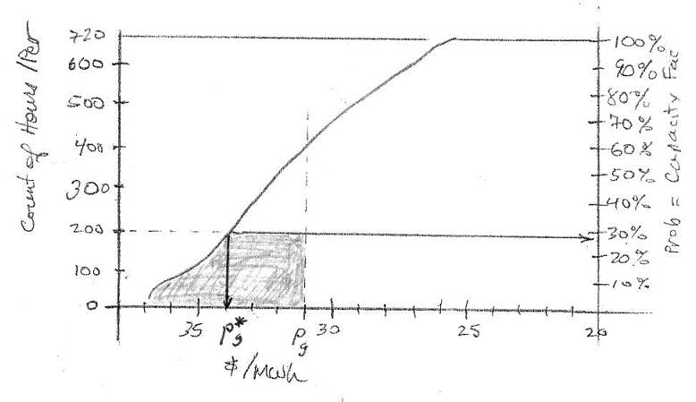
Energy-Limited Dispatch
Statistical distributions

Slide 30
“Valuation” Costing
Complications from correlation of fuel price, energy, market prices
Loads (solid) & resources (grayed)
price
∑
Only correlations are now those with the market
c
=
p
Q
−
q
(
p
−
p
)
m
i
m
i
i
Valuation Costing

Slide 31
Open-System Models
?
Open-System Models

Slide 32
Modeling Evolution
Problems with open-system production cost models
  valuing imports and exports
  desire to understand the implications of events outside the “bubble”
As computers became more powerful and less expensive, closed-system hourly models became more popular
  better representation of operational costs and constraints (start-up, ramps, etc.)
  more intuitive
Open-System Models

Slide 33
Open Systems Models
The treatment of the Region as an island seems like a throw-back
  We give up insight into how events and circumstances outside the region affect us
  We give up some dynamic feedback
Open systems models, however, assist us to isolate the costs and risks of participant we call the “regional ratepayer”
Any risk model must be an open-system model
Open-System Models

Slide 34
The Closed- Electricity
System Model
If fuel price is the only “independent” variable, the assumed source of uncertainty, electricity price will move in perfect correlation
That is, outside influences drive the results
We are back to an open system
energy
require-
ments
dispatch
price
fuel price
+ε_{i}
energy
generation
market
price +ε_{i}
for
electricity
Only one electricity price balances requirements and generation
Open-System Models

Slide 35
The RPM Convention
Respect the first law of thermodynamics: energy generated and used must balance
The link to the outside world is import and export to areas outside the region
Import (export) is the “free variable” that permits the system to balance generation and accommodate all sources of uncertainty
We assure balance by controlling generation through electricity price. The model finds a suitable price by iteration.
Open-System Models

Slide 36
Equilibrium search
Open-System Models

Slide 37
Unit Aggregation
Forty-three dispatchable regional gas-fired generation units are aggregated by heat rate and variable operation cost
The following illustration assumes $4.00/MMBTU gas price for scaling
Source: C:\Backups\Plan 6\Studies\Data Development\Resources\Existing Non-Hydro\100526 Update\Cluster_Chart_100528_183006.xls
Unit Aggregation

Slide 38
Cluster Analysis
Source: C:\Backups\Plan 6\Studies\Data Development\Resources\Existing Non-Hydro\100526 Update\R Agnes cluster analysis\Cluster Analysis on units.doc
Unit Aggregation

Slide 39
Performance
The RPM performs a 20-year simulation of one plan under one future in 0.4 seconds
A server and nine worker computers provide “embarrassingly parallel” processing on bundles of futures. A master unit summarizes and hosts the optimizer.
The distributed computation system completes simulations for one plan under the 750 futures in 30 seconds
Results for 3500 plans (2.6 million 20-year studies) require about 29 hours
Performance and Precision

Slide 40
Precision
Source: email from Schilmoeller, Michael, Monday, December 14, 2009 12:01 PM, to Power Planning Division, based on Q:\SixthPlan\AdminRecord\t6 Regional Portfolio Model\L812\Analysis of Optimization Run_L812.xls
Performance and Precision

Slide 41
Choice of Excel as a Platform
The importance of transparency and accessibility, availability of diagnostics
Olivia
The ability of Olivia to write VBA code for the model
RPM’s layout of data and formulas
High-performance Excel
  XLLs
  Carefully controlled calculations
System requirements
Crystal Ball and CB Turbo

Slide 42
What do the Risky Futures Look Like?
See Appendix J of the Sixth Power Plan
  Section Quantitative Risk Analysis identifies electricity prices, loads, carbon penalty, and natural gas prices to be the principal sources of risk
Risky Futures

Slide 43
Regression Analysis
Table J-3: Regression Model Coefficients
  What do these have in common? Persistence.
Risky Futures

Slide 44
Intuition About Risk
  Worst Futures Spinner.xls
Noticed that high-cost (high-risk) futures are high-load futures
Began our discussion of unit-energy costs
Risky Futures

Slide 45
Uses and Abuses of the Efficient Frontier
Efficient Frontier

Slide 46
Efficient Frontier
Provides an alternative to weighting
  Easily constructed
  General application
Preserves the trade-off decision
Efficient Frontier

Slide 47
What does the
Efficient Frontier Tell Us?
The Efficient Frontier does not tell us what to do
The Efficient Frontier tells us what not to do
Most useful if there are a large number of choices
Efficient Frontier

Slide 48
Fooled by the Graph
Error 1: The geometry of the points on the efficient frontier has meaning or otherwise provides guidance, or equivalently …
There exists a formula or other objective means for determining an optimal point on the efficient frontier
Abusing the EF

Slide 49
Unclear About Control
Error 2: The “expected cost” on the efficient frontier is controllable, equivalently …
We can “buy” risk reduction with the increase in expected costs
Abusing the EF

Slide 50
Unclear About Control
Controllable costs are typically much smaller
Abusing the EF

Slide 51
Option Costs and Risk Benefits
Notes:
This is an exercise to show that the costs of siting and licensing power plants -- and of acquiring conservation at prices above market price for electricity -- is comparable to premiums paid for more conventional forms of insurance. The costs of the power planning options, however, are probably overstated. For decisions beyond five years, we do not have to make commitments today. When we do make the commitments, much of that uncertainty will have been resolved and some options will not be necessary.

Slide 52
Mislead by Averages
Error 3: “We know what ‘expected cost’ means.”
In fact, there are many different ways to compute an average, and they all have different meanings.
More important, the average of a distribution may be very meaningful in one situation and meaningless in another.
Example of “average” SCCT dispatch across futures of a low-risk portfolio
Abusing the EF

Slide 53
Conservation Representation
  The construction of conservation supply curves
    Discretionary and lost opportunity
  Fifth Power Plan findings
    Conservation risk premium
  Sources of premium value …
  Sixth Power Plan findings …
Conservation

Slide 54
Sources of Premium Value
Capacity deferral
Protection from fuel and electricity price excursions, in particular due to carbon risk
Short-term price reduction
Purchases at below-average prices (“dollar-cost averaging”)
Opportunity to develop and resell conservation energy
C:\Backup\Plan 5\Portfolio Work\Olivia\SAAC 2010\110519 SAAC Meeting\Conservation Premium\The sources of premium value 101206 1600.lnk
Conservation

Slide 55
Effect of Premium on 6th Plan Conservation Energy and Cost
Conservation

Slide 56
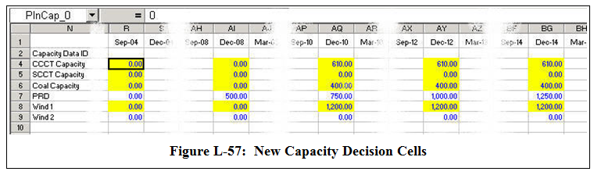
Crystal Ball Decision Cells and the Resource Portfolio (“Plan”)

Slide 57
…And From the Last Meeting,
September 27, 2012 …

Slide 58
  Random Variables in the RPM
  Aluminum Prices
  Carbon Penalty
  Commercial Availability
  Conservation Performance
  Construction Costs
  Electricity Price
  Hydrogeneration
  Natural Gas Price
  Non-DSI Loads
  Production Tax Credit Life
  REC Values
  Stochastic FOR

Slide 59
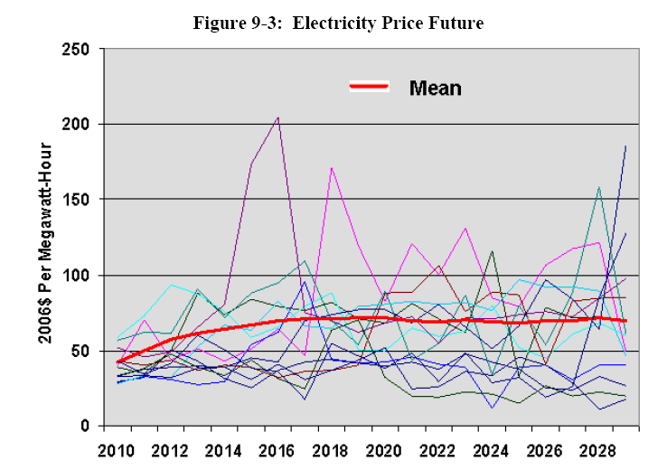
Electricity Prices
6th Plan, Chap 9, page 9-11 ff

Slide 60
Causal Regimes
Short-term (hourly to monthly)
  Positive correlation of electricity price with loads
  Hourly correlations to hydro, natural gas price
  Quarterly averages correlations to all three
Long-term (quarterly to yearly)
  Negative correlation of electricity price with loads
  Supply and demand excursions
  Changing technology, regulation
5th Plan, Appn P, page P-65 ff

Slide 61
Electricity Prices Before Adjustments
Adjustments for longer-term response include
Hydro year selection
Quarterly loads
Gas price effects
Energy balance (supply vs. demand) effects
The model generates an “independent” electricity price future devoid of these effects; adjustments for these effects are made deterministically during the chronological simulation
5th Plan, Appn P, page P-65 ff

Slide 62
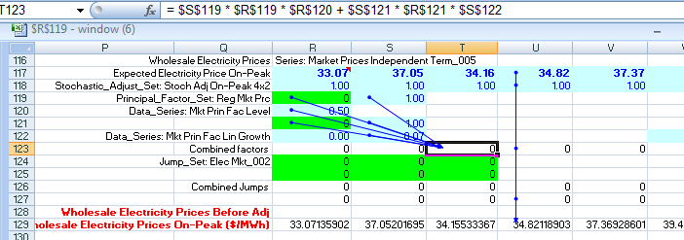
“Independent” Electricity Price
8 random variables, determining the underlying scenario path of electricity price and the nature of up to two excursions

Slide 63
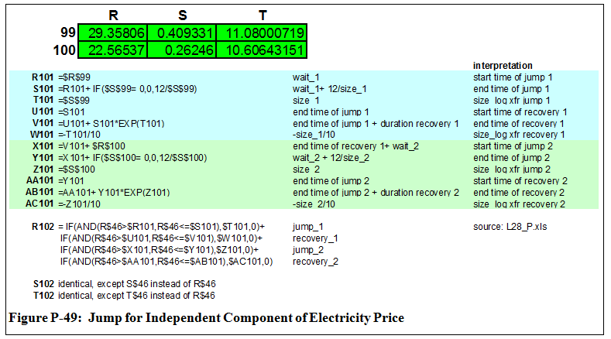
Jumps in Electricity Price
5th Plan, Appn P, page P-65 ff

Slide 64
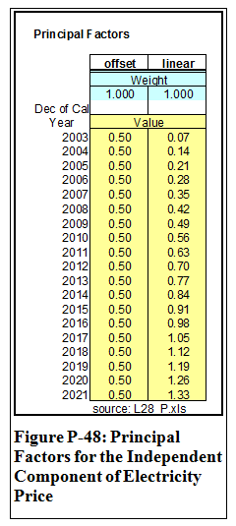
Underlying “Path” of
Electricity Price
The underlying path consists of the original benchmark forecast and the combined effects of a random offset and a random change in slope
A more complete description will be provided with the description of natural gas prices
5th Plan, Appn P, pages P-25 ff and P-65 ff

Slide 65
Random Variables
The values for the 288 random variables are drawn at the beginning of each game, or “future”
All aspects of the future are calculated in the model before the chronological simulation of the resource portfolio’s performance
Where decisions are necessary during the chronological simulation, the model references only “past” values of the given future
You can use the Navigator feature in the RPM to explore these on your own

Slide 66
A Unit-Service Cost
The Council has emphasized the least-risk plans on the efficient frontier
The choice of least-risk plans is strongly (exclusively?) influenced by a handful of futures. About 70 of the 75 “worst” (highest-cost) futures are common among all the plans on the efficient frontier
The costs in these futures is largely determined by the higher loads in these futures
Is it appropriate that least-risk plans are strongly influenced by high-load futures?

Slide 67
What’s the Difference?
If there is only a single, fixed load forecast, there isn’t any difference: a plan that provides for minimum cost for the Region provides minimum unit energy cost.
However, if loads vary from future to future, however, there may be a significant difference

Slide 68
A Few Key Points
Loads are “frozen efficiency” loads
  Loads changes therefore do not reflect any energy efficiency measures
A unit-service cost (¢/kWh) is NOT a utility rate (¢/kWh)

Slide 69
… And Costs Are Distributed Over Fewer Units of Energy
While cost in the last year goes down 8.5 percent, unit-service cost per kWh increases by 6.4 percent !
Higher load future: 29,571 MWa
Lower load future: 25,428 MWa
Difference: 4,143 MWa (-14 %)
Higher load future cost: $23.5 B
Lower load future cost: $21.5 B
Difference: $2.0 B (-8.5 %)

Slide 70
What do Plans Selected Using the Modified Metric Look Like?

Slide 71
Differences between the
Least-Risk Plans
Because high-load futures play a less prominent role in the selection of resources, we would expect to see less resource capacity optioned

Slide 72
Differences between the
Least-Risk Plans
The effect on conservation targets, CO2 produced, and rate variation is minimal, however (e.g., conservation drops 184MWa)
With fewer new, cleaner turbines, CO2 production increases slightly

Slide 73
Conclusions
This cost measure provides an alternative concept of “bad” – or risky – and “good” futures.
The calculation of average and risk would remain the same
Will result in different least-risk plans, probably with less capacity and conservation optioned
The new cost and risk metrics would be added to the existing metrics, not replace them

Slide 74
End

