Slide 1
System Analysis
Advisory Committee
Sufficiency of
Imbalance Reserves and
Requirements
Michael Schilmoeller
Friday, January 25, 2013

Slide 2
Overview
What are we talking about?
Why does it matter?
First example: increasing response
Second example, response and recovery
The significance to resource sufficiency
Proofs and refutations

Slide 3
What are we talking about?
We want to characterize this requirement:
We would like to know what kinds of resources are necessary to provide this service (whether a given ensemble suffices)

Slide 4
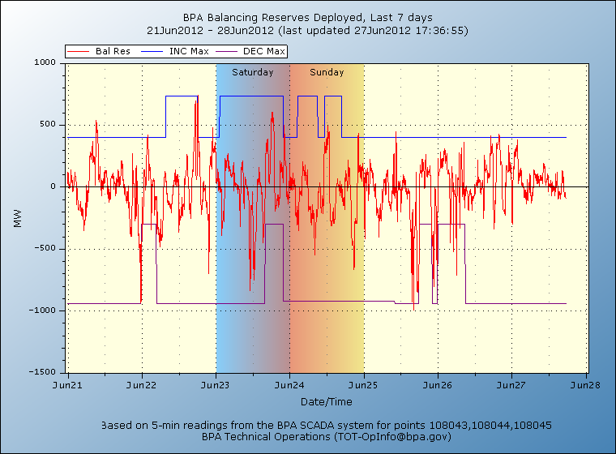
Why does it matter?
For some systems, it may not matter today
If you have large amounts of fast-ramping hydrogeneration and opportunity costs are small, all you need to know is the size of the excursion

Slide 5
A typical assessment

Slide 6
Why does it matter?
But the current practice does not capture the requirement very well
  Simple statistics do not capture chronology. The order of requirements matters.
  Statistics do not capture critical information about ramp rates or the required duration of services
  Even statistics on the ramp rates cannot tell you the duration of ramping required

Slide 7
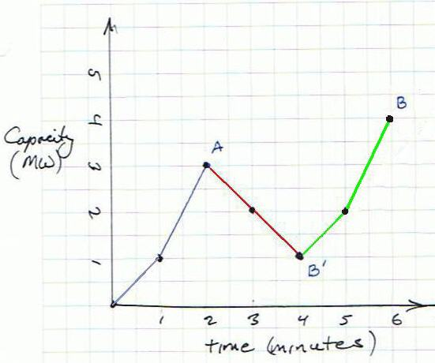
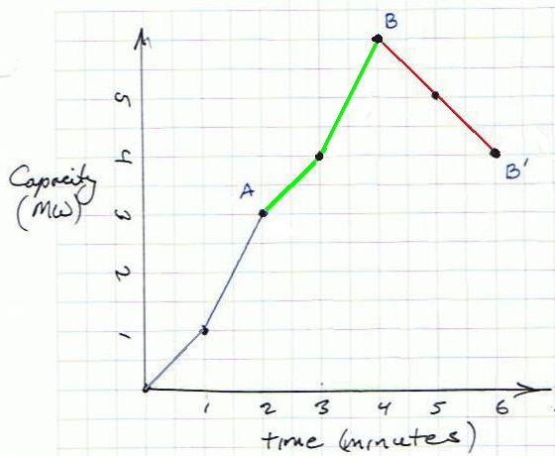
The order of events matters

Slide 8
Why does it matter?
For some systems, especially those more reliant on thermal resources and those with constrained access to hydrogeneration, it may matter quite a bit
  Higher penetration of variable generation resources (wind and solar)
  Greater competition for ancillary services
  OPUC Order 12-013, UM 1461, Sec II. D. Integrated Resource Planning Flexible Resources Guidelines

Slide 9
Why does it matter?
If we expect that the hydro system’s ability to meet imbalance needs will eventually be exhausted, it matters to all systems
Having a better description of requirements means greater likelihood of finding resources or practices that meet the requirement at lowest cost
It would help us to see the value of a broader array of solutions

Slide 10
A peek ahead
Requirement
Supply

Slide 11
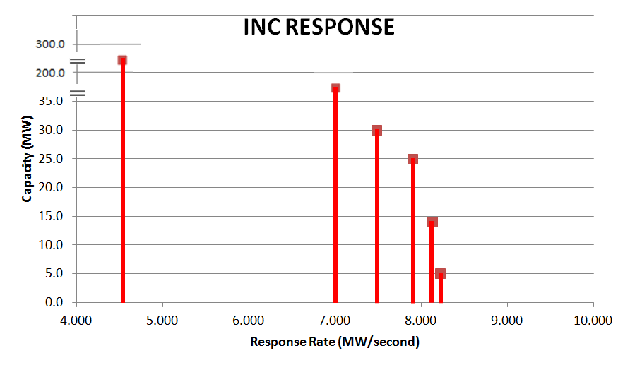
A peek ahead alternative spectral representation

Slide 12
Overview
What are we talking about?
Why does it matter?
First example: increasing response
Second example, response and recovery
The significance to resource sufficiency
Proofs and refutations

Slide 13
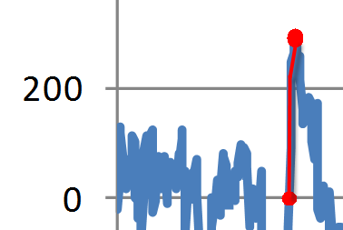
First example
Increasing “up” requirements only
All imbalance resources start out at “standby”, without power deployment

Slide 14
Increasing “up” requirement

Slide 15
First example
Assume imbalance resource is completely characterized by
  Ramp rate (MW/min)
  Response duration (min)
  Direction (up or down)
  Type of control (automatic vs command control)
  Frequency of use
  Available energy or fuel (MWh)
  Value ($/MW, $/MWh)
I will focus on the first two

Slide 16
Sorting the ramp events
We will call this the Ramping Duration Curve (RDC)
It tells us how much power we need

Slide 17
Can you do that, sort them?
If the sufficiency of alternative ramping resources is the issue, then “Yes!”
Requirements can be described in terms of a minimal ensemble of resources sufficient to meet the requirement
As long as an ensemble has enough capability or maximum power to provide a ramp rate for the required amount of time, the order of the events is immaterial

Slide 18
You can think of power as imbalance “fuel”
Area under the RDC corresponding to each blocks is power = ramp rate x time
2 MW
5 MW
7 MW

Slide 19
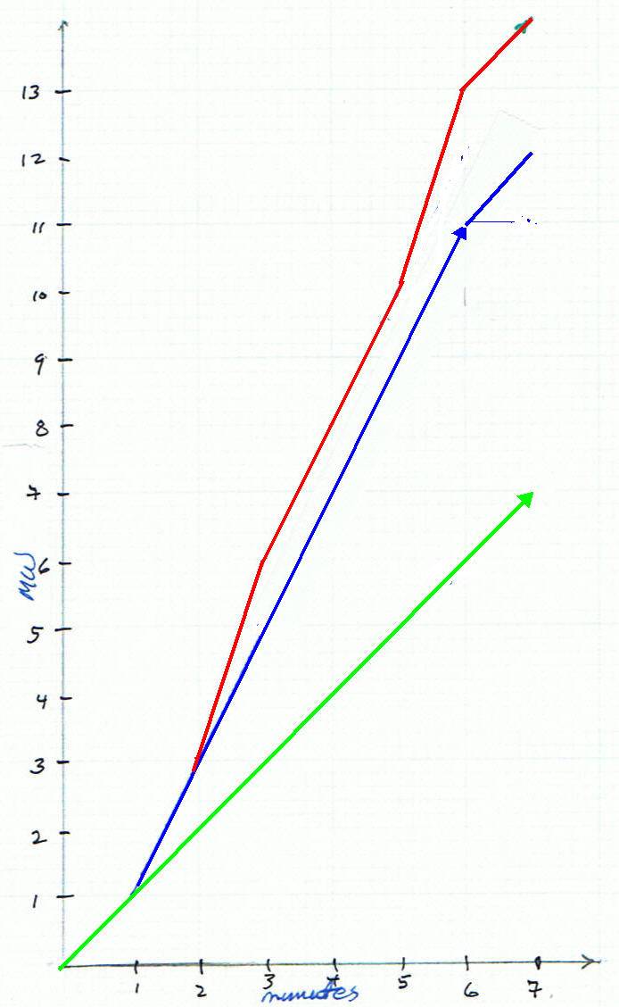
Making the “round trip”
2 MW
5 MW
7 MW

Slide 20
Another representation
6 MW
6 MW
2 MW

Slide 21
Substitution
If we had the ideal resources in hand, we would recognize an asymmetry in substitution: fast response resources can substitute for slow response resources, but not conversely
How would we figure out whether a resource ensemble other than our ideal ensemble could meet the same need?

Slide 22
Comparing the pictures

Slide 23
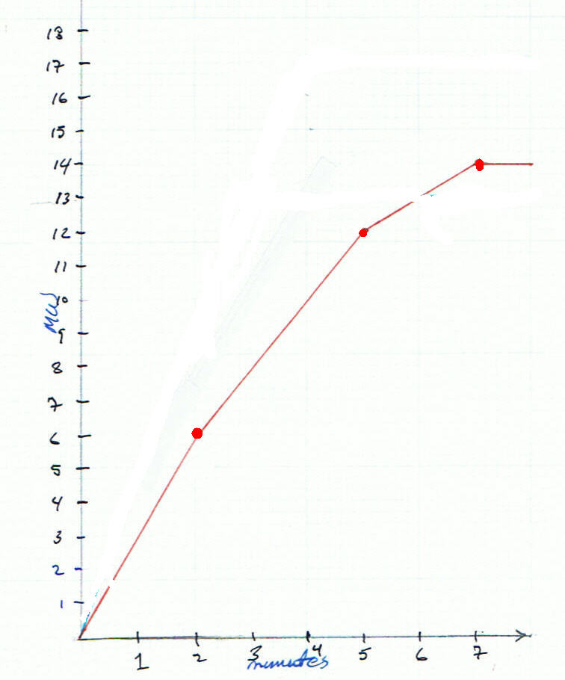
The CRDC
Cumulative Ramping Duration Curve (CRDC) is the cumulative power, summing from higher to lower ramp rate

Slide 24
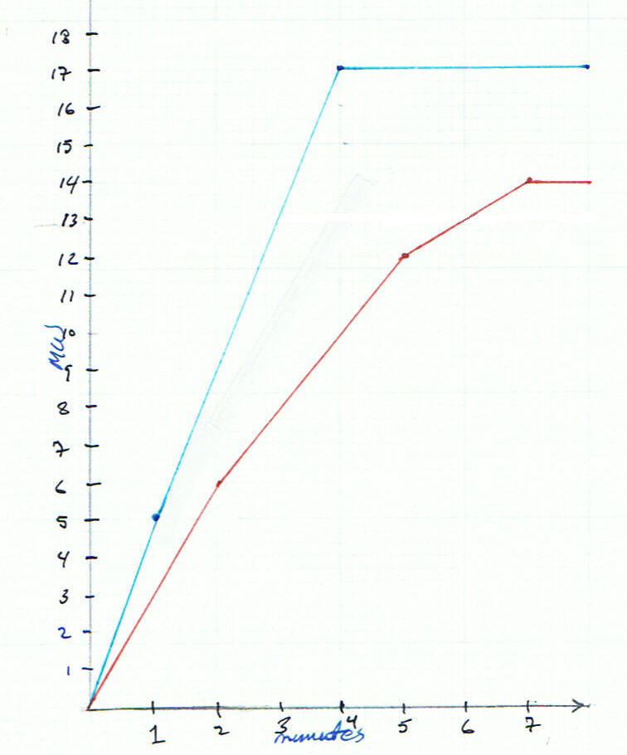
Supply and Demand CRDCs
The CRDC helps us more easily visualize whether one ensemble can meet the same requirements as another

Slide 25
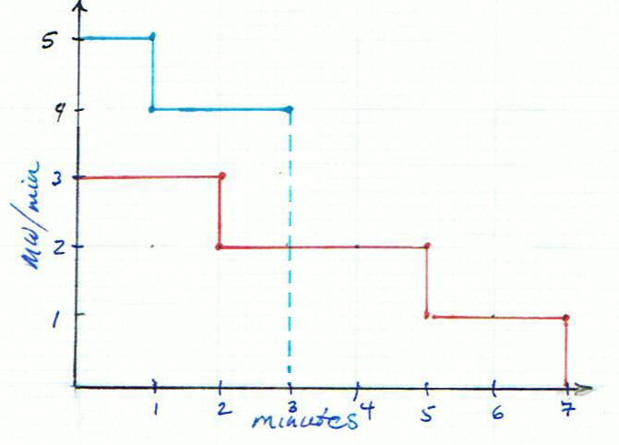
Inadequate Supply and Demand CRDCs

Slide 26
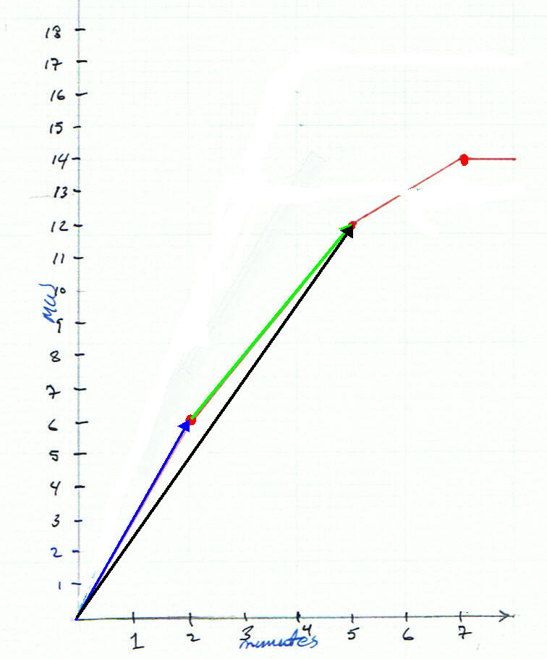
CRDC math
Edges are interpreted as vectors
Summing vectors adds the power and duration and averages the ramp rates

Slide 27
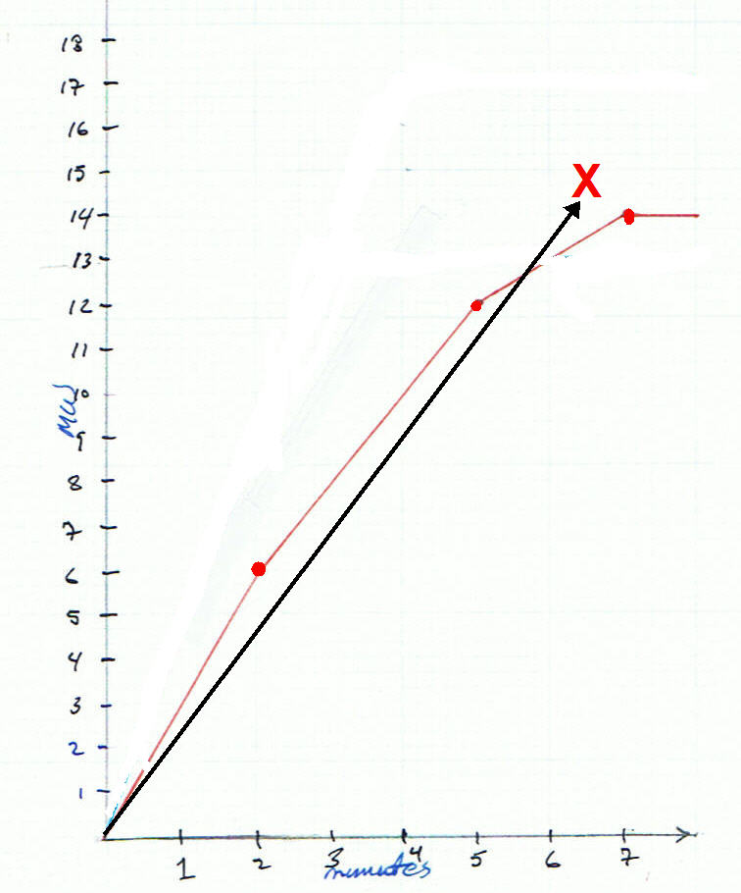
Infeasible ramps
Points above the supply CRDC correspond to vectors (ramp rates) that the resources cannot achieve
Each point on the CRDC is the maximum power available in that amount of time

Slide 28
Summary
An increasing response can be sorted by ramp rate
The CRDC captures substitution of high-ramp rate resources for low-ramp rate resources
The CRDC has interpretation as maximum available ramp rates attainable by any combination of minimally sufficient resources

Slide 29
Congratulations!
What are we talking about?
Why does it matter?
First example: increasing response
Second example, response and recovery
The significance to resource sufficiency
Proofs and refutations

Slide 30
Second example, with recovery

Slide 31
Two responses

Slide 32
Recovery

Slide 33
Key concept: the “path”
A path is an initial condition (net machine power deployed after recoveries) and a response. There can be many prior responses and recoveries.
A path captures all of the power recovery practices, back to the beginning on an excursion

Slide 34
“Snack break” (whew)
Step through path “B” slowly to figure out the initial condition B´ for path “B”

Slide 35
CRDCs of the two responses

Slide 36
The Path Union CRDC satisfies both paths

Slide 37
Does that really work?

Slide 38
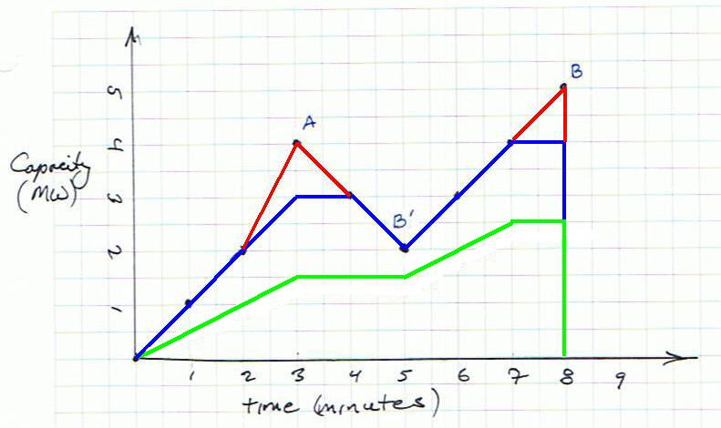
Huh! (There is a proof, too)

Slide 39
Intuitive argument for the union
The path union captures ramp requirements with higher rates or greater power requirement at a given ramp rate
The path union avoids double-counting requirements when recoveries take place

Slide 40
Amp-ing it up

Slide 41
Congratulations!
What are we talking about?
Why does it matter?
First example: increasing response
Second example, response and recovery
The significance to resource sufficiency
Proofs and refutations

Slide 42
A CRDC for resources
It makes a lot of difference whether deployment is automatic (“simultaneous”) or on command (“sequential”)

Slide 43
“Sufficiency” of an ensemble
Requirement
Supply

Slide 44
Isolating the insufficiency

Slide 45
But what about…?
Alternative assumptions for recovery
Representations of “down” or DEC excursions
  Do the responses and recoveries change roles?
The diversity of practices among operators and of the resources available
Energy-limited resources (e.g., batteries)

Slide 46
You really want this?
What are we talking about?
Why does it matter?
First example: increasing response
Second example, response and recovery
The significance to resource sufficiency
Proofs and refutations

Slide 47
The main theorem
“The imbalance supply is sufficient to meet a system imbalance requirement if and only if the CRDC of supply lies above (weak sense) that of the CRDC of requirements”

Slide 48
Summary
An increasing response can be sorted by ramp rate
The CRDC captures substitution of high-ramp rate resources for low-ramp rate resources
The CRDC has interpretation as maximum available ramp rates attainable by any combination of minimally sufficient resources

Slide 49
Summary
Recoveries are opportunities to restore valuable ramping power
A path is a response and its initial condition (expressed as power loadings)
The initial condition of a path captures the effect of all responses and recoveries preceding the path’s response

Slide 50
Summary
The order in which we evaluate paths makes no difference – any chronological factors are “encoded” in the initial conditions
The union CRDC reveals only incremental requirements for imbalance resources, that is, only higher ramp rates or higher power requirements at a given ramp rate
Sufficiency is evaluated by overlaying the union CRDC for requirements with the CRDC for resources

