Slide 1
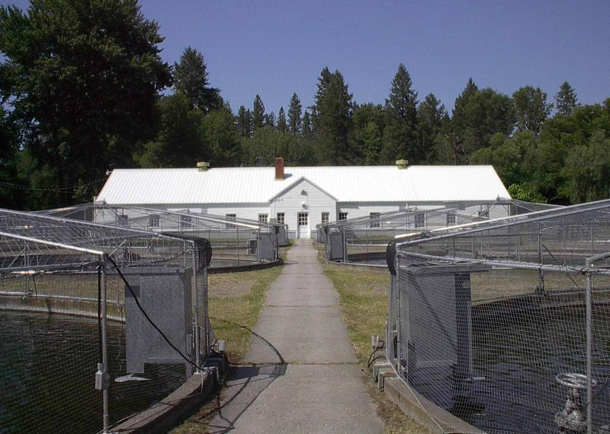

Ford Hatchery O & M
(Project 2001-02-900)
Rich Watson, Project Manager
Washington Department of Fish and Wildlife

Slide 2
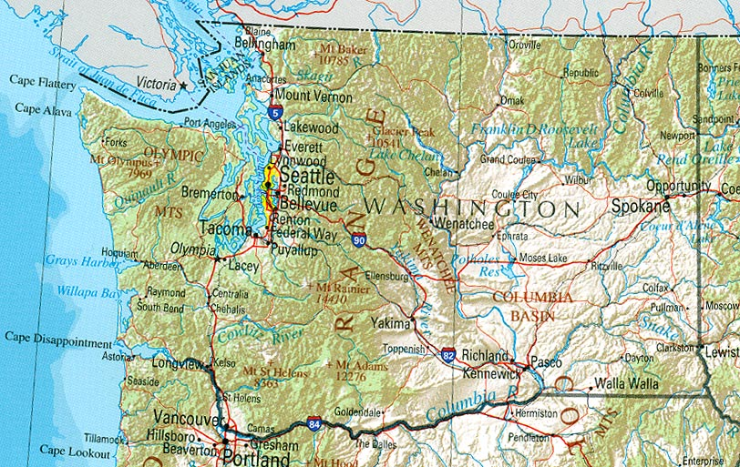
Ford Hatchery Location
Ford Hatchery

Slide 3
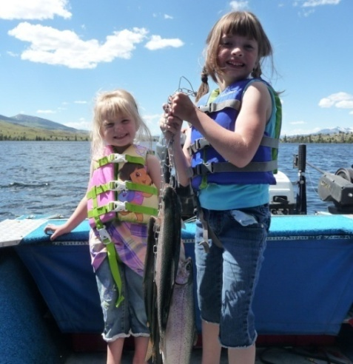
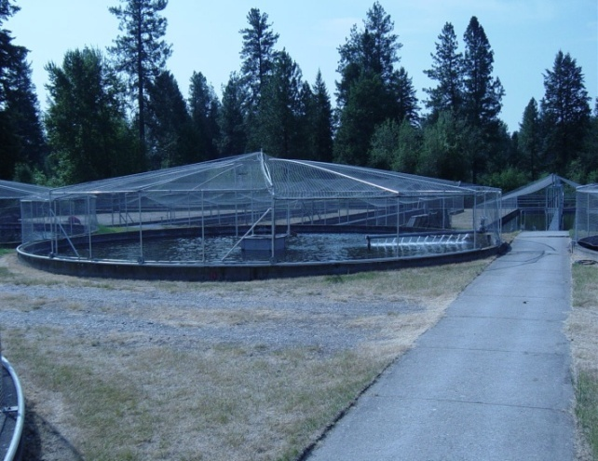
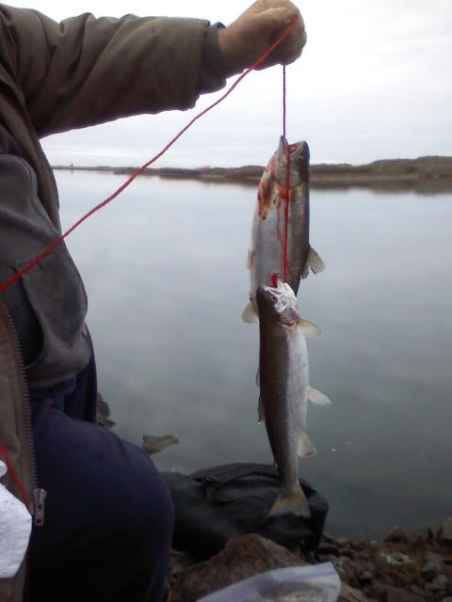
Ford Hatchery Background
Ford Hatchery was constructed in 1941 by the Bureau of Reclamation to partially mitigate for resident and anadromous fish losses due to construction of the Grand Coulee Dam.
Ford Hatchery was used initially to stock Lake Roosevelt.
Within 2-3 years federal funding declined and resident trout production was shifted to lowland lakes. Since the 50’s the Wash. Dept. of Game utilized Ford Hatchery to supply lowland lakes with resident trout.

Slide 4
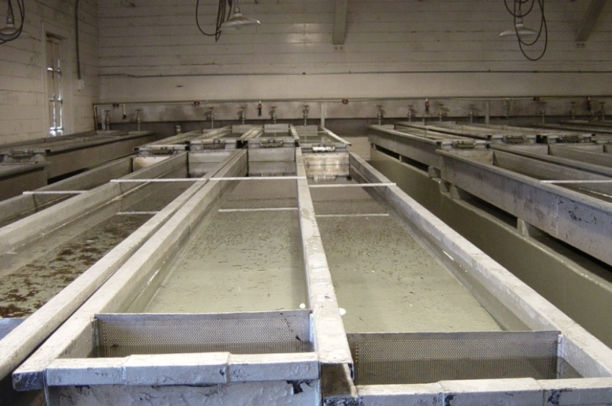
Background
Beginning in 2001, 33 percent of Ford Hatchery’s funding has come from Bonneville Power Administration to produce kokanee for Banks Lake as mitigation.
BPA has provided the funding for a new well and degassing tower, which enhanced the water quality at Ford Hatchery and improved rearing environment for fry rearing.
BPA funding covers staff time necessary for the rearing of 700,00 kokanee produced annually at Ford Hatchery.

Slide 5
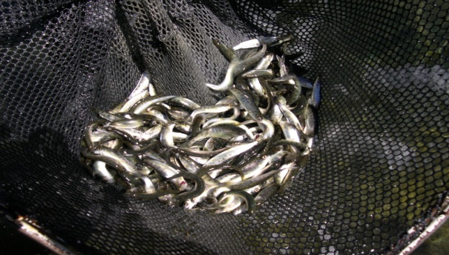
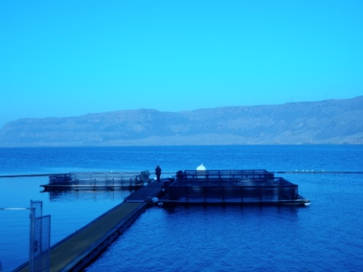
Plant Numbers
Since 2001 Ford Hatchery has directly planted - on average, 497,000 kokanee, at an ave. size of 56 fpp, annually into Banks Lake.
Ford Hatchery has also supplied the Net-Pen Project at Banks Lake with kokanee which produced - on average, 113,000 kokanee, at an ave. size of 18 fpp, annually planted into Banks Lake.

Slide 6
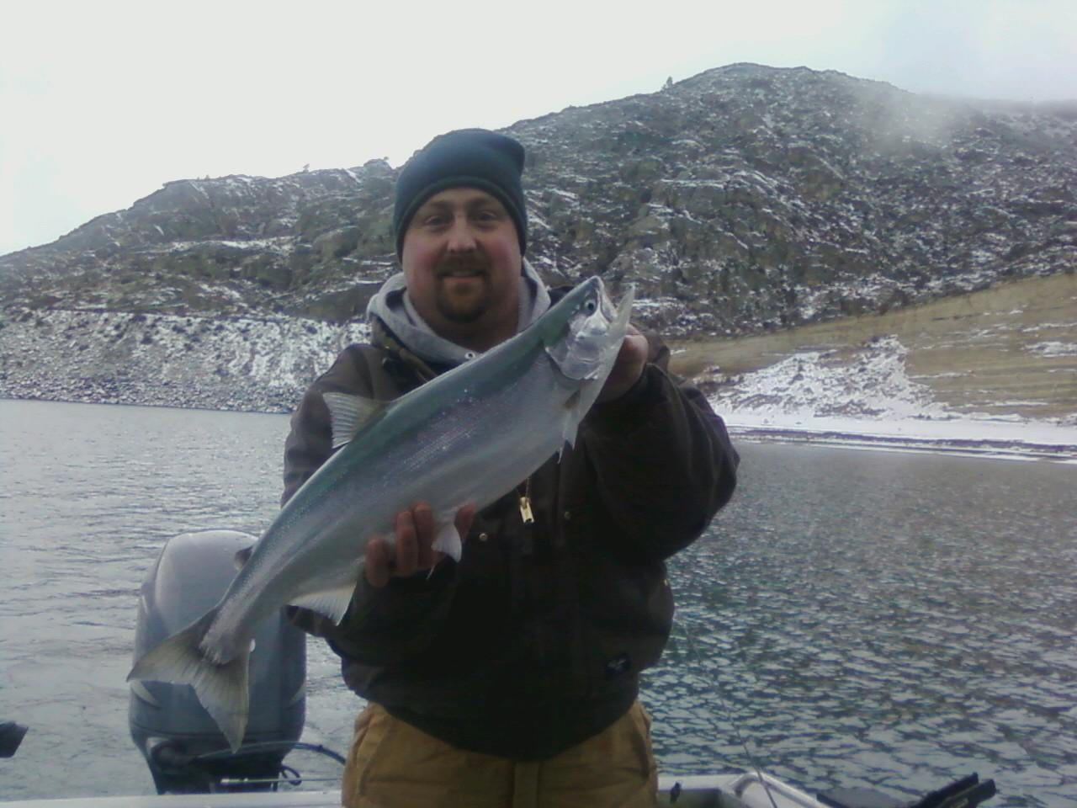
Primary Goal
Enhance the recreational fishery in Banks Lake and continue mitigation for fish losses due to the construction and operation of Grand Coulee Dam.

Slide 7
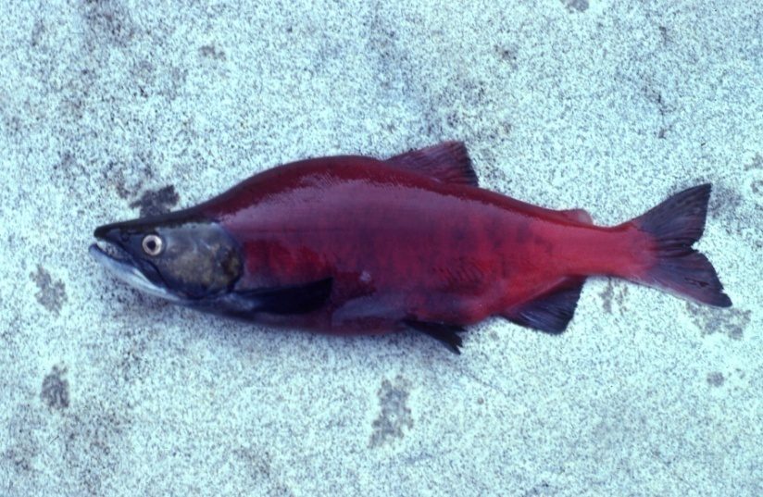
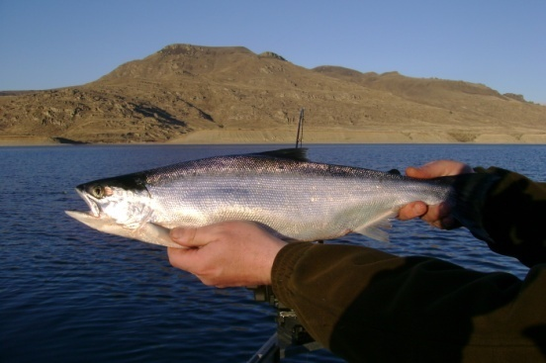
Objectives
The Ford Hatchery will produce 11,666 lbs. (700,000) kokanee for Banks Lake as mitigation for the Bonneville Power Administration, (BPA) annually.
572,000 fish at 60 fpp will be directly planted into Banks Lake and 128,000 fish at 60 fpp will be transferred to net pens and over wintered and released the following spring into Banks Lake.

Slide 8
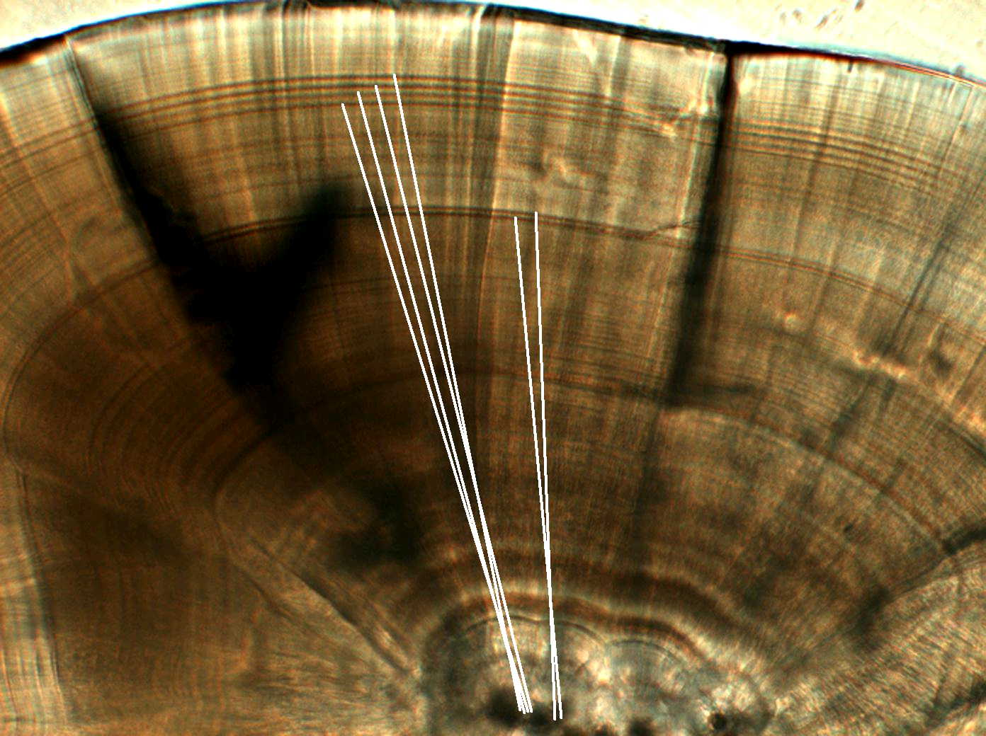
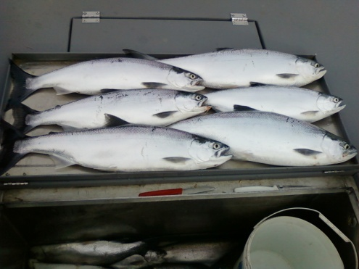
Marking
All kokanee destined for Banks Lake receive a thermal mark. Individual marks for direct plants, and for net-pen plants.
Each group is reared separately while at Ford Hatchery.
Monitoring and Evaluation of the kokanee stocking program for Banks Lake is conducted under the Banks Lake Fisheries Evaluation Program, BPA contract 2001-028-00.

