Slide 1
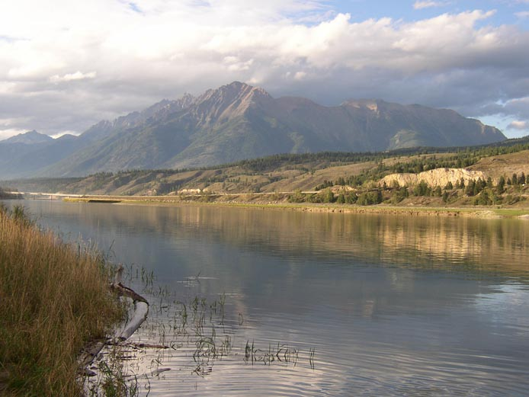

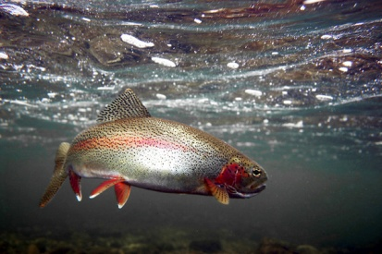
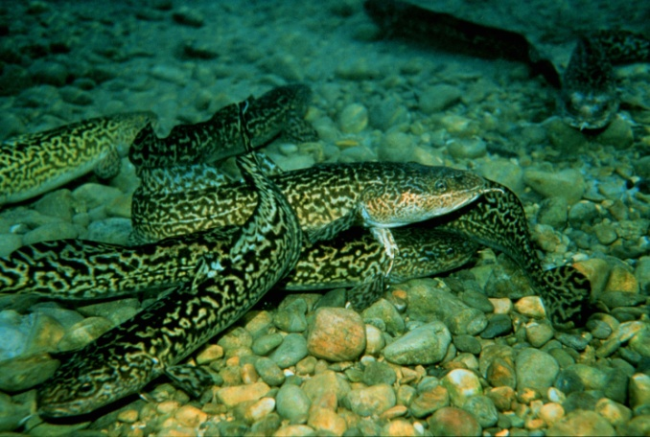
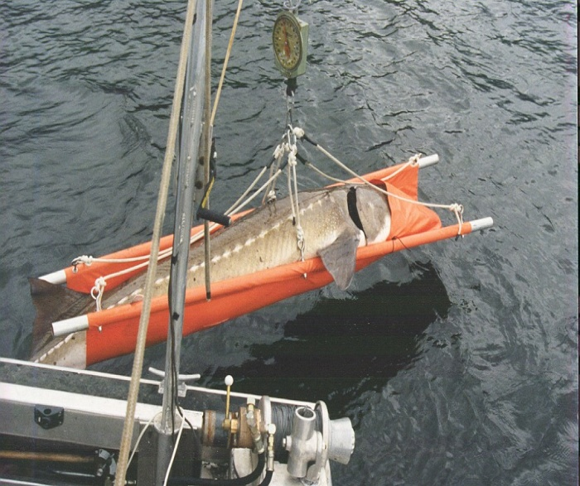
KOOTENAI RIVER RESIDENT FISH MITIGATION
Idaho Department of Fish and Game: 1988-065-00

Slide 2
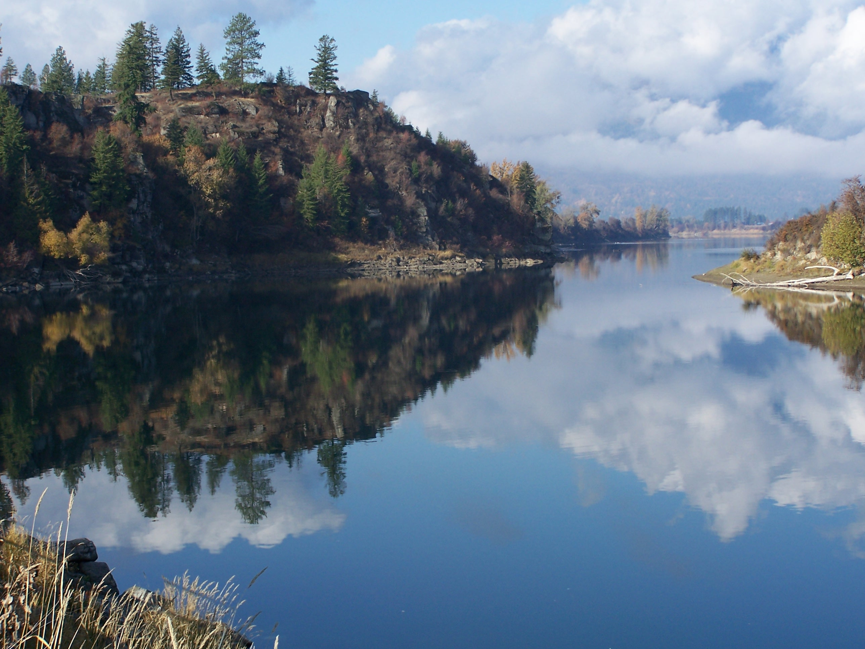
Project Overview
Project responding to changes from Libby Dam
Comprised of multiple studies on white sturgeon, burbot, and native salmonids
Cooperative fishery evaluation of 1988-064-00; 1994-04-900; and 2002-002-00
Goal: Restore these fish populations to the Kootenai River

Slide 3
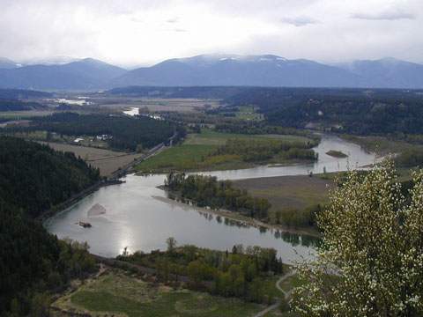
Project Objectives
Restore natural recruitment of white sturgeon
Restore natural recruitment of burbot
Increase resident salmonid densities

Slide 4
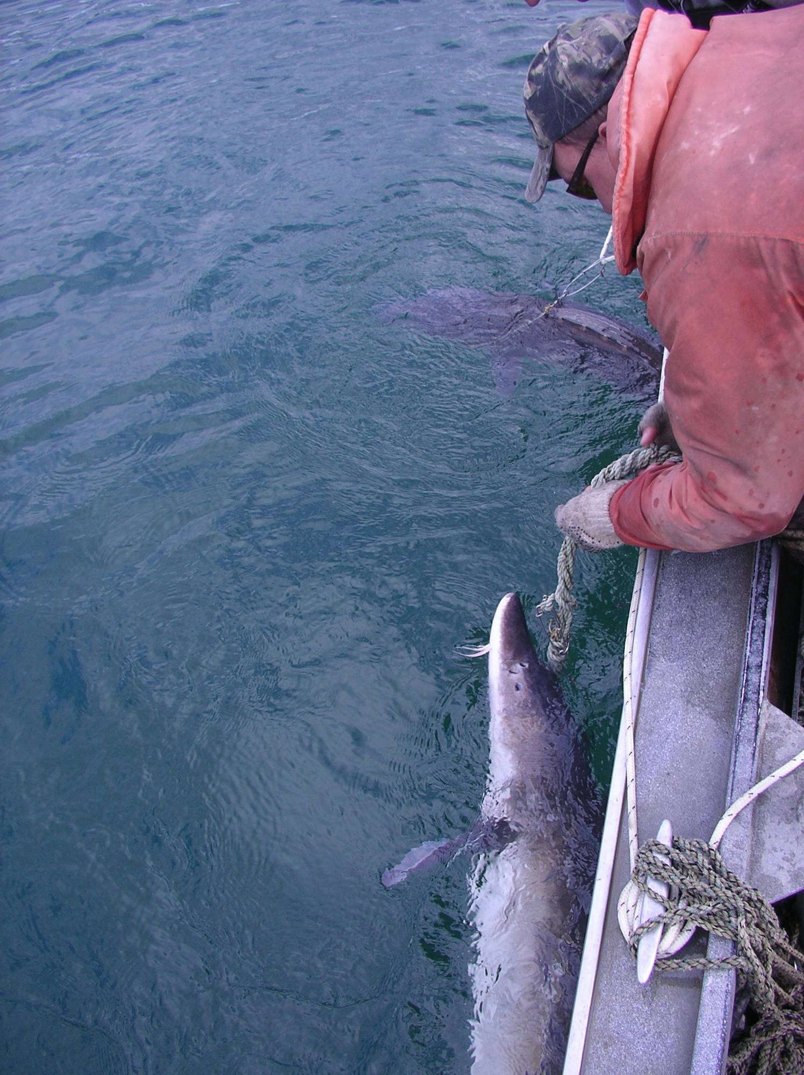
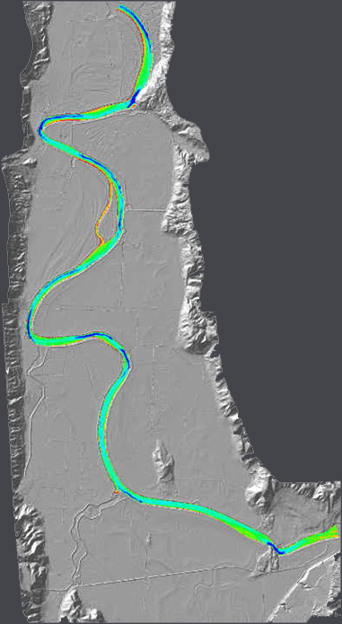

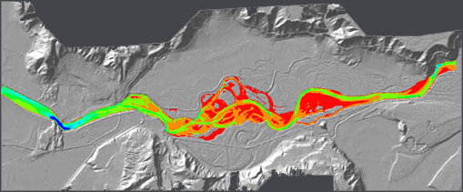
Kootenai River White Sturgeon
Problem: Temperature, discharge, and other physiochemical changes resulting from the operation of Libby Dam are not adequate for sturgeon recruitment.
River depth (m) at 8,500 m/s
12+
9
ALLUVIAL SAND AND SILT
6
3
0
COBBLE, GRAVEL, AND SAND

Slide 5
Kootenai River White Sturgeon
Accomplishments
Larval sturgeon habitat requirements identified
Advanced egg development sampled
Rock Pile Pilot Study
Understanding effects of Libby operations and spawning events

Slide 6
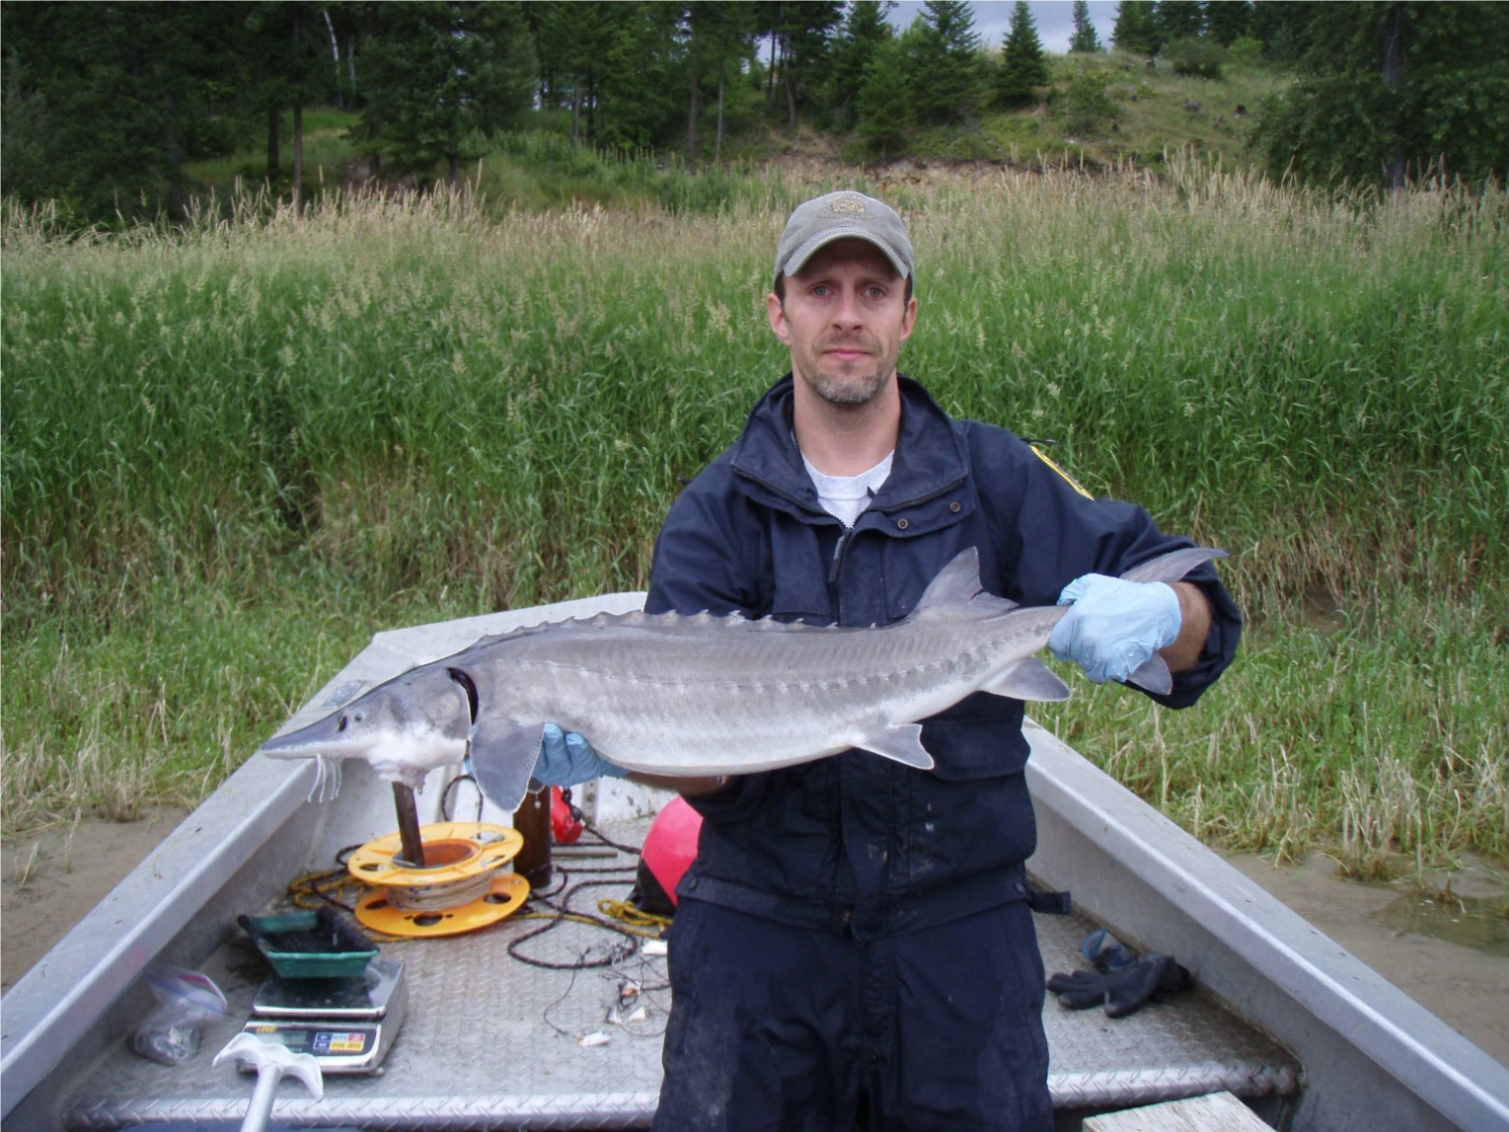
Kootenai River White Sturgeon
Accomplishments
Larval sturgeon habitat requirements identified
Advanced egg development sampled
Rock Pile Pilot Study
Understanding effects of Libby operations and spawning events
Juveniles captured upstream of Bonners Ferry

Slide 7
White Sturgeon Related Publications
North American Journal of Fisheries Management
Paragamian, V. L., and M. J. Hansen. 2008. Evaluation of recovery goals for endangered white sturgeon in the Kootenai River, Idaho.
Canadian Journal of Fisheries and Aquatic Science
Justice, C., B. J. Pyper, R. C. P. Beamesderfer, V. L. Paragamian, P. J. Rust, M. D. Neufeld, and S. C. Ireland. 2009. Evidence of density- and size-dependent mortality in hatchery-reared juvenile white sturgeon (Acipenser transmontanus) in the Kootenai River.
Journal of Fisheries Management and Ecology
Paragamian, V. L. and D. V. Wakkinen 2011. White sturgeon spawning and discharge augmentation.
Journal of Applied Ichthyology
Paragamian, V. L., R. McDonald, G. John Nelson, and G. Barton. 2009. Kootenai River velocities, depth, and white sturgeon spawning site selection – a mystery unraveled?
Neufeld, M. D. and Rust, P. J. 2009. Using passive sonic telemetry methods to evaluate dispersal and subsequent movements of hatchery-reared white sturgeon in the Kootenay River.
Rust, P. J. 2011. Translocation of pre-spawn adult Kootenai River white sturgeon.

Slide 8
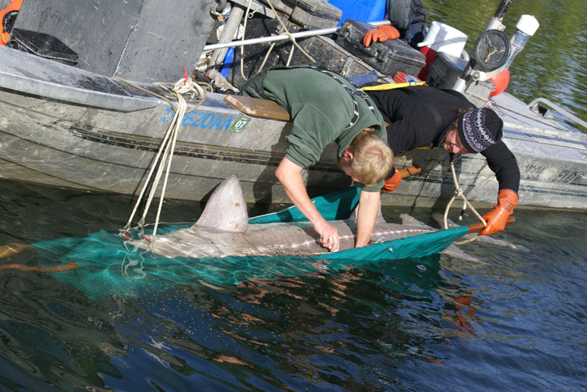
Proposed work
Expand sampling above Bonners Ferry
Telemetry of large juveniles above Bonners Ferry
Analyze movements in relation to habitat improvements.
Effects of nutrients on growth.
Egg mat sampling above Bonners Ferry
Determine effects of substrate additions to the Meander Reach
Free Embryo Releases
Aid Libby Operations

Slide 9
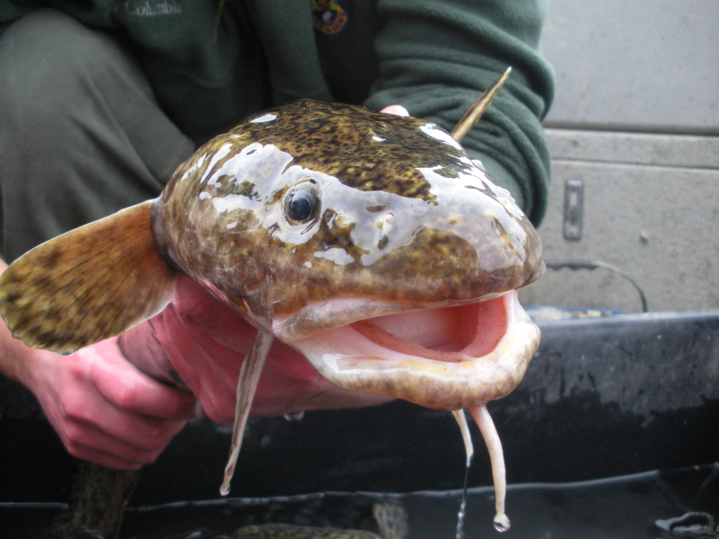
Burbot
Problem: Temperature and discharge resulting from the operation of Libby Dam are not adequate for burbot spawning.

Slide 10
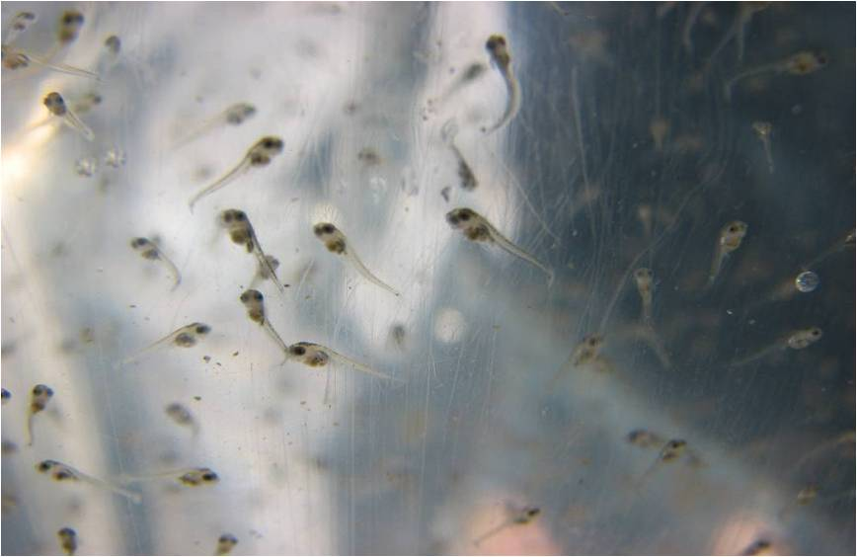
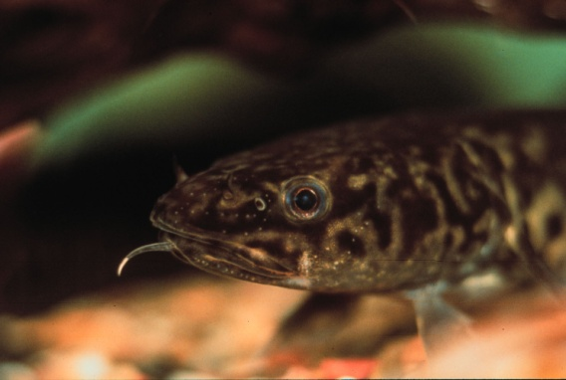
Burbot
Accomplishments
Confirmed success of hatchery releases
Burbot extensive rearing implemented
Identification of variation in mitochondrial DNA
Burbot flow SOR was recommended
Stocking criteria identified
Burbot population targets identified

Slide 11
Burbot Related Publications
Journal of Freshwater Ecology
Paragamian, V. L., J. McCormick, and C. Laude. 2008. Changes in Population Indices of a Diminishing Burbot Population in the Kootenai River, Idaho, USA and British Columbia, Canada.
Paragamian, V. L. 2010. Increase in abundance of signal crayfish may be due to decline in predators.
North American Journal of Fisheries Management
Paragamian, V. L. and M. J. Hansen. 2009. Rehabilitation needs for burbot in the Kootenai River, Idaho, USA and British Columbia, Canada.
Journal of Applied Ichthyology
Paragamian, V. L. and M. J. Hansen 2011 (in Press) Stocking goals for rehabilitation of burbot in the Kootenai River, Idaho, USA and British Columbia, Canada.
Paragamian, V. L., C. Laude, K. Cain, N, Jensen, and J. Barron 2011 (in press) Pen rearing burbot larvae - a novel technique.
American Fisheries Society Symposium 59.
Hardy, R., and V. L., Paragamian. 2008. Zooplankton communities and burbot relative abundance of some oligotrophic lakes in Idaho.
Paragamian, V. L., and V. D. Wakkinen. 2008. Seasonal movement and the interaction of temperature and discharge on burbot in the Kootenai River, Idaho.
Paragamian, V. L., Pyper, B. J., M. J. Daigneault, R. P. Beamesderfer, and S. C. Ireland. 2008. Population dynamics and extinction risk of burbot in the Kootenai River, Idaho.
Powell, M, V. L. Paragamian, and J. Dunnigan. 2008. Mitochondrial variation in Western North American burbot with special reference to the Kootenai River in Idaho and Montana, USA.

Slide 12
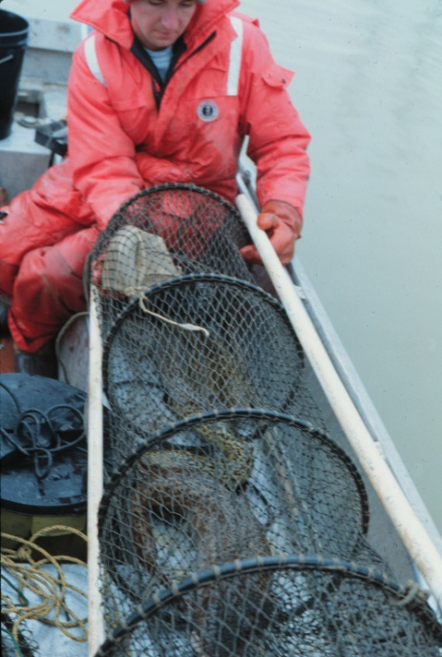
Proposed work
Evaluate natural production.
Evaluate release sites on survival.
Habitat selection of juvenile burbot.
Extensive rearing ponds
Correlate optimal flow regime conducive to spawning.
Aid ACOE in Libby Operations.

Slide 13
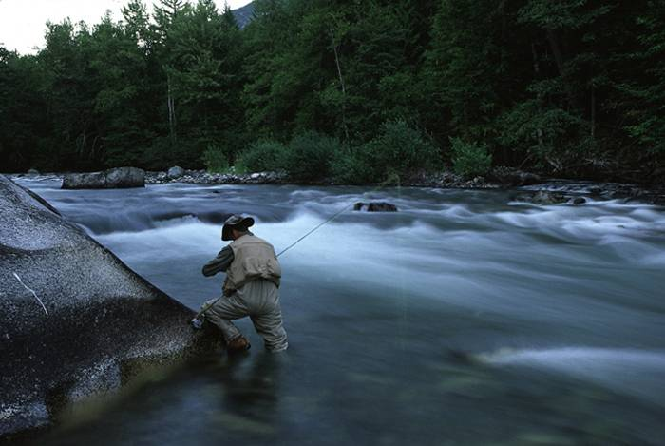
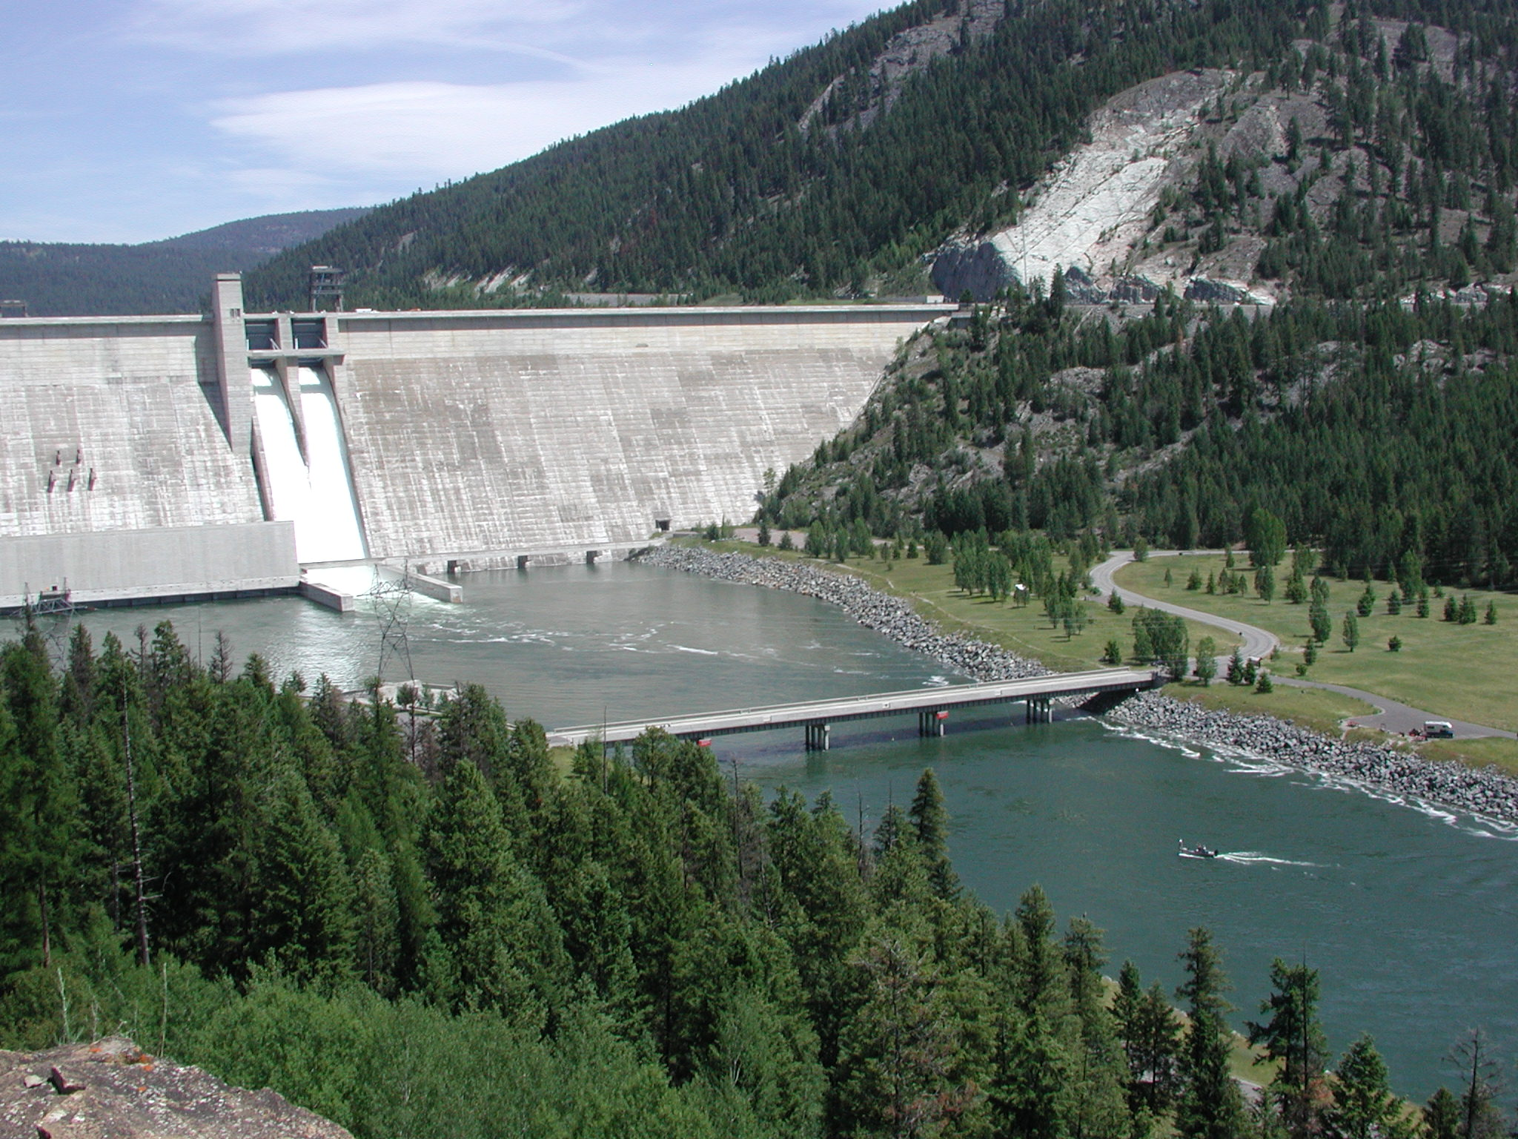
Native Salmonids
Problem: Libby dam traps macro nutrients resulting in low fish production in the lower Kootenai River.
Spawning and overwintering habitat seems to additionally limit rainbow trout recruitment.

Slide 14
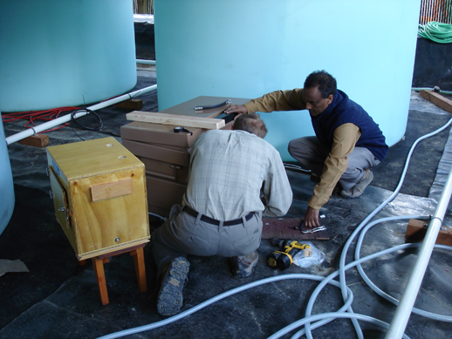
Nutrient Addition
cooperative management with KTOI of nutrient addition site
sample fish metrics at established monitoring locations

Slide 15
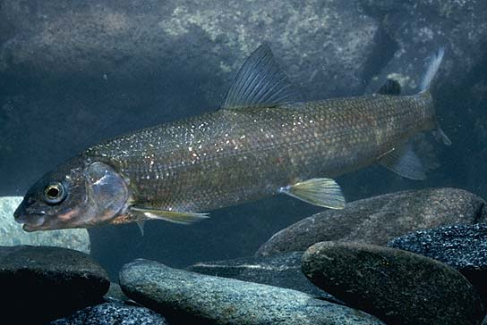
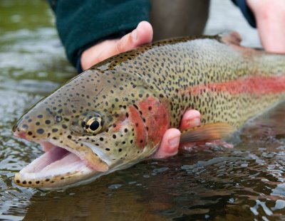
Native Salmonids
Accomplishments
Six full years of nutrient additions

Slide 16
Native Salmonids
Accomplishments

Slide 17
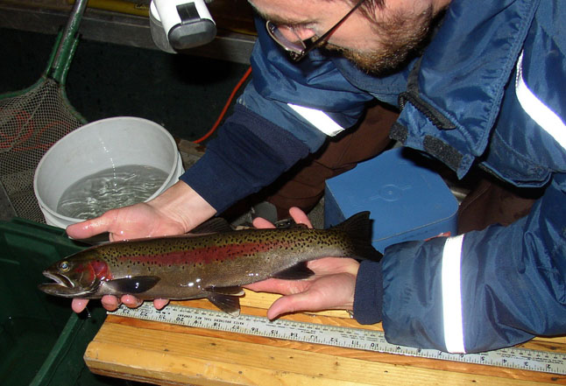
Proposed work
Continue cooperative nutrient additions.
Continue fishery evaluation at trend locations.
Address limiting factors of growth and density with rainbow trout
Otolith microchemistry
Determine success of rearing strategy
Overwintering habitat limitations
Habitat improvements to increase spawning.

Slide 18
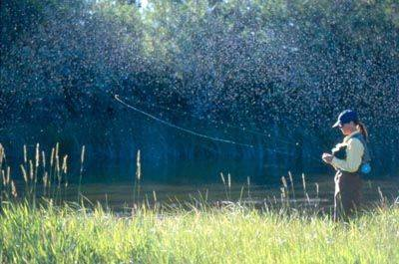
Questions

Slide 19
Native Salmonids
Accomplishments
Nutrients Added (2005)

