Slide 1
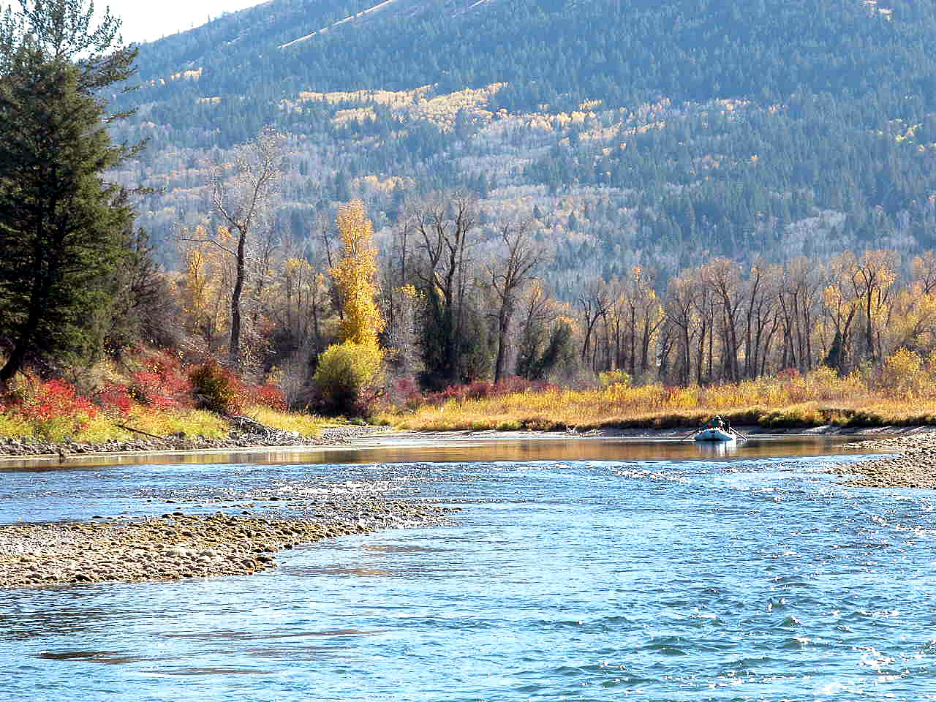
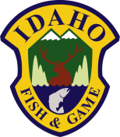
South Fork Snake River
Brett High
Regional Fisheries Biologist
Idaho Department of Fish and Game

Slide 2
Outline
Background/Study Area
Results
Weir Operation & Maintenance
Entrainment
How it fits

Slide 3
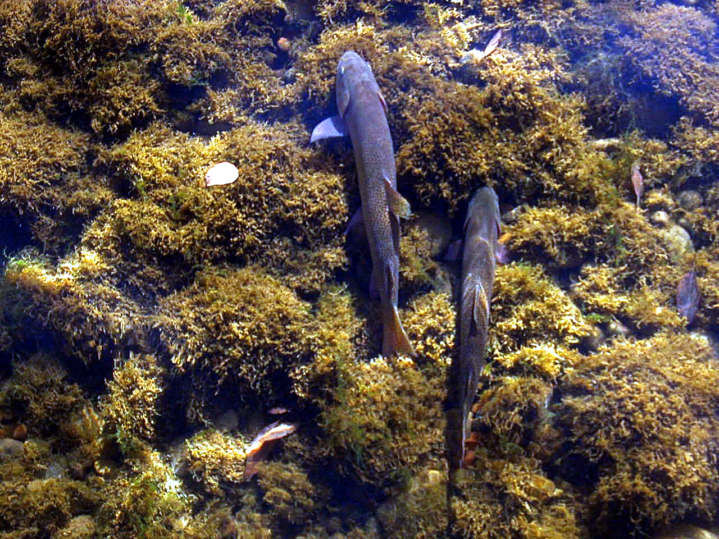
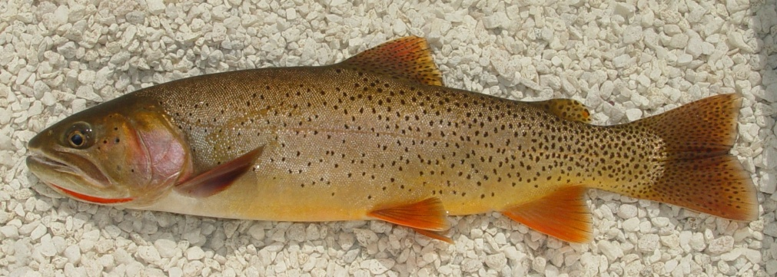

Slide 4
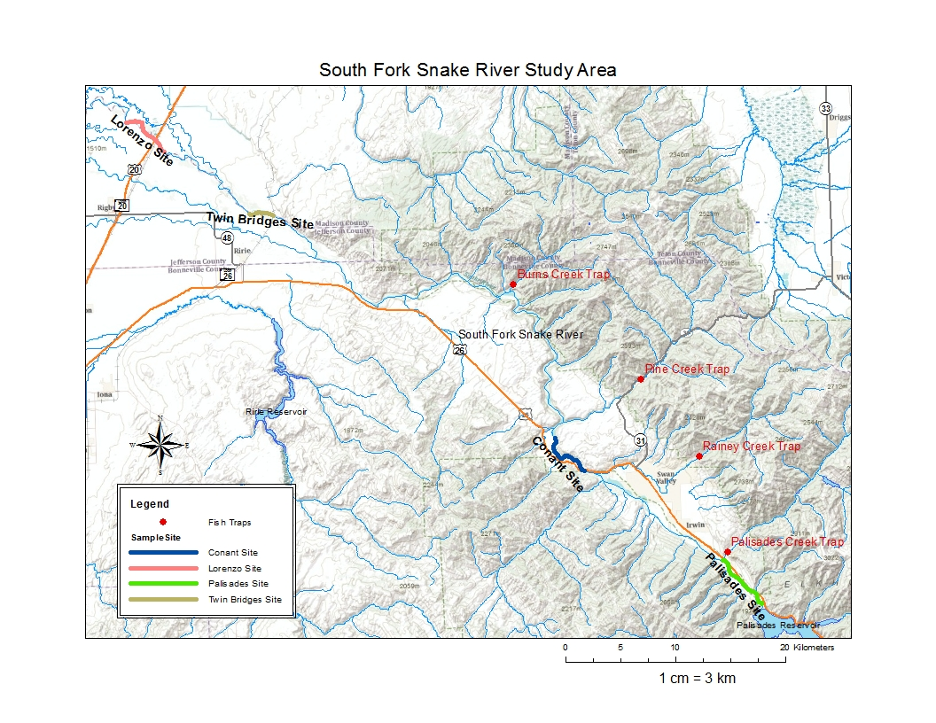
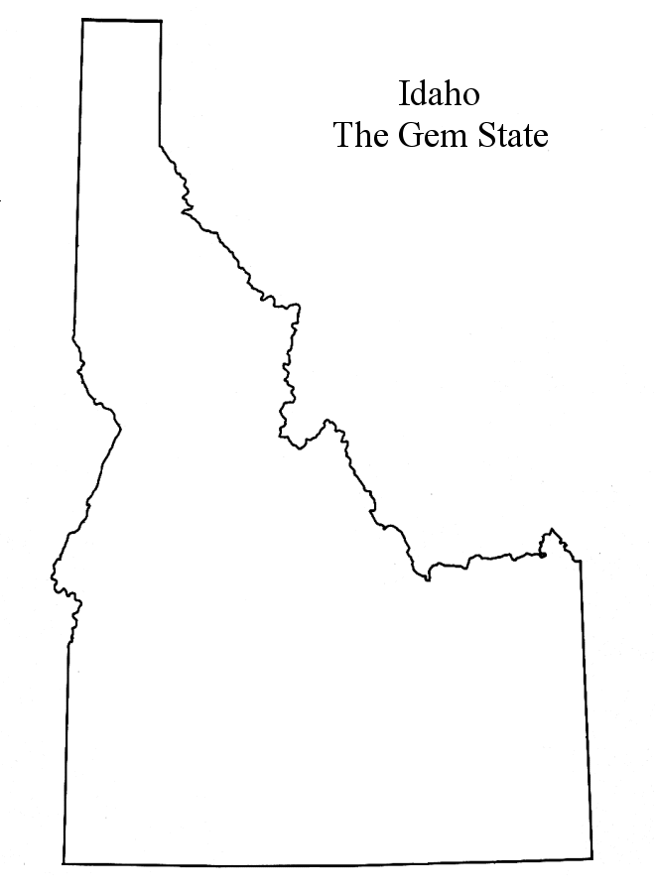
Great Feeder Diversion

Slide 5
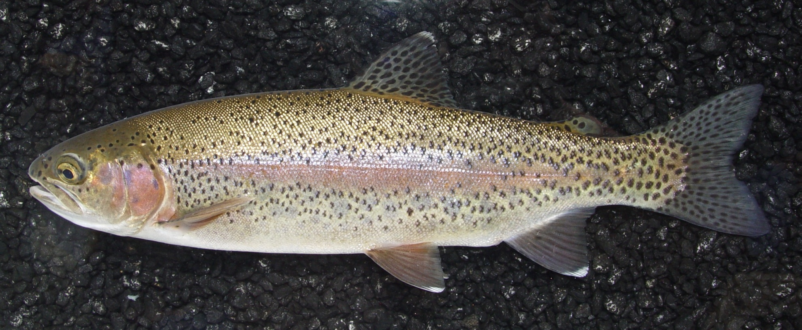
Primary threats
Notes:
Major threat identified in Upper Snake Provisional Assessment and subbasin plan

Slide 6
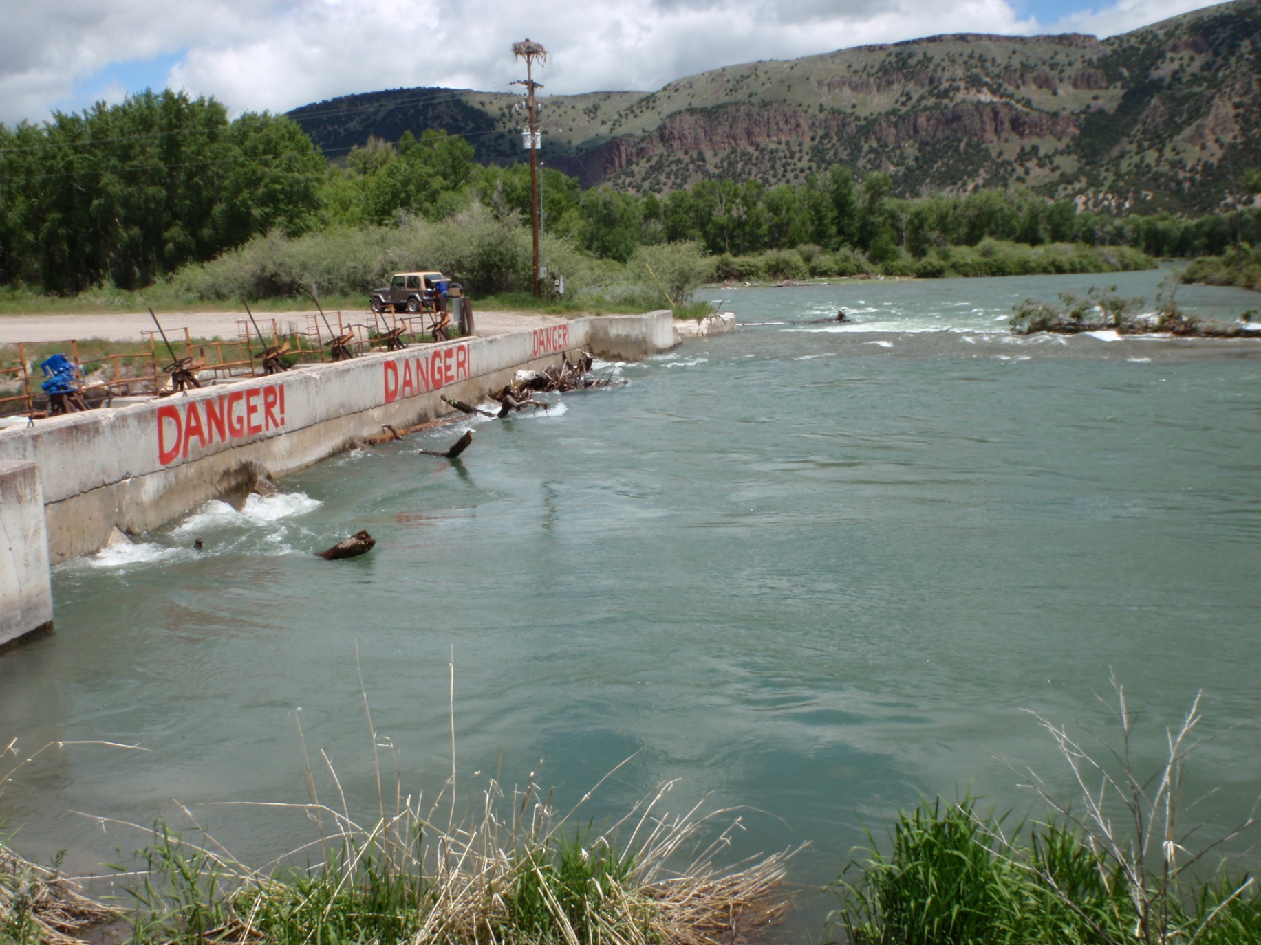
Primary threats
Notes:
Major threat identified in Upper Snake Provisional Assessment and subbasin plan – but no funding has been allocated to address these large diversions at the state or local level

Slide 7
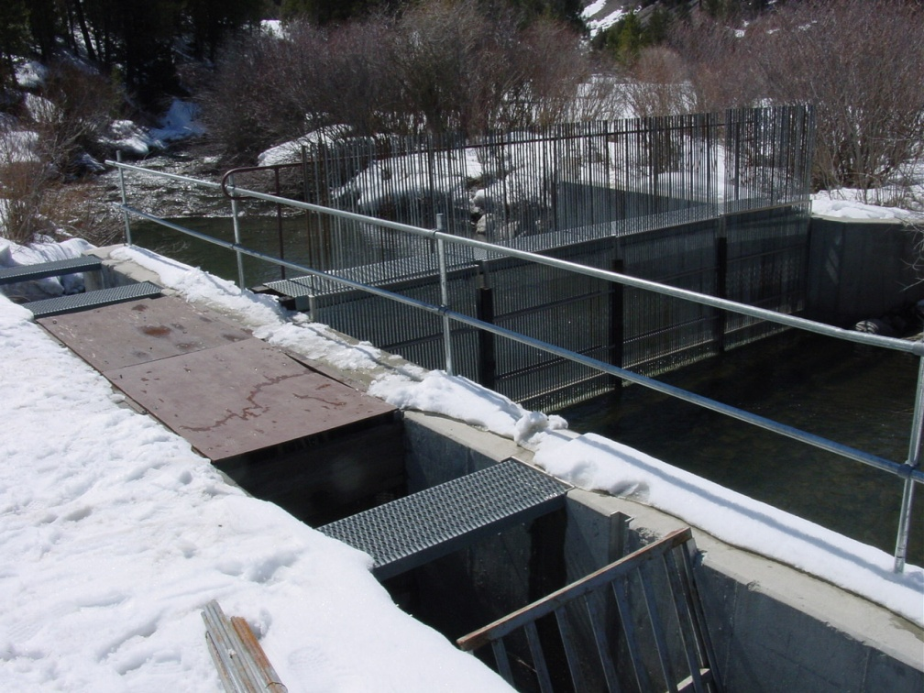
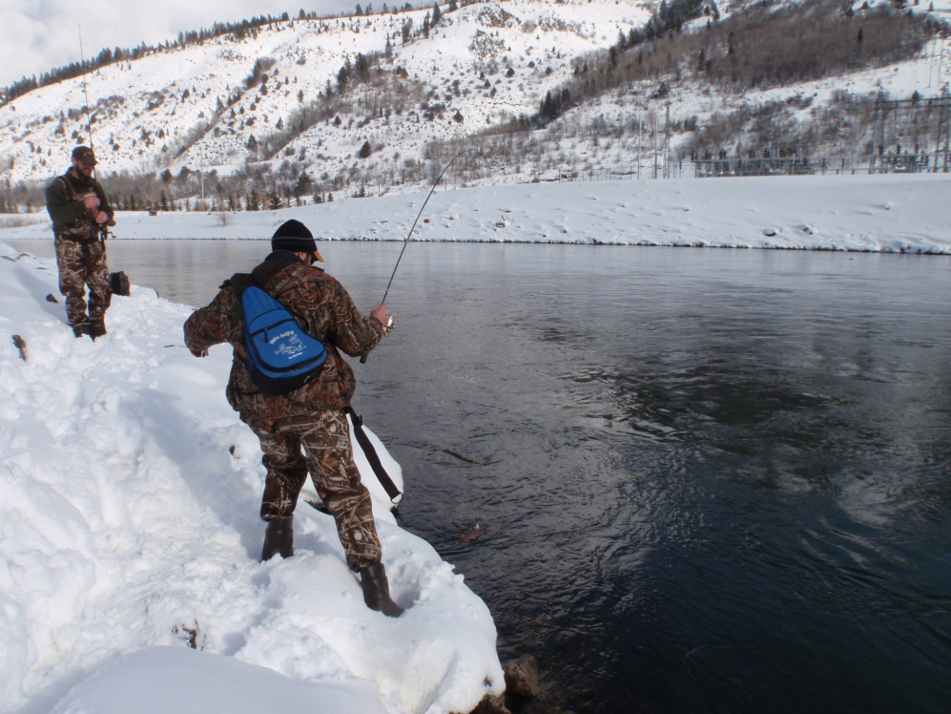
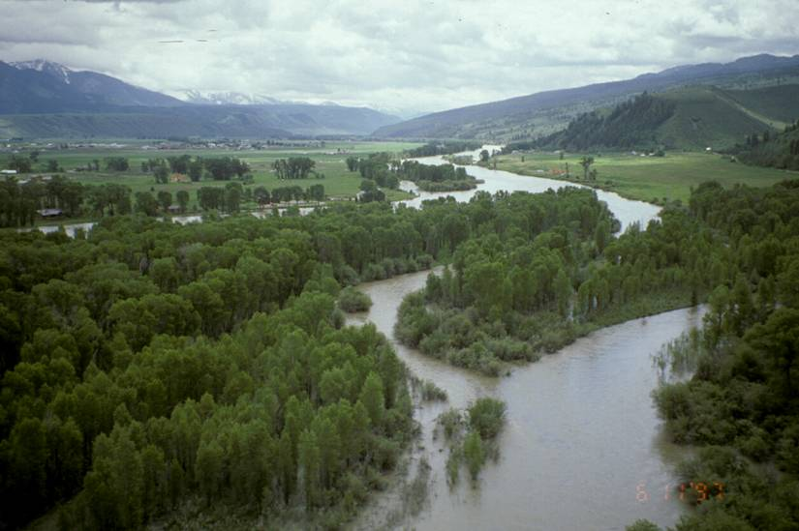
Management Goals
Maintain Yellowstone cutthroat trout population
  Three-pronged approach

Slide 8
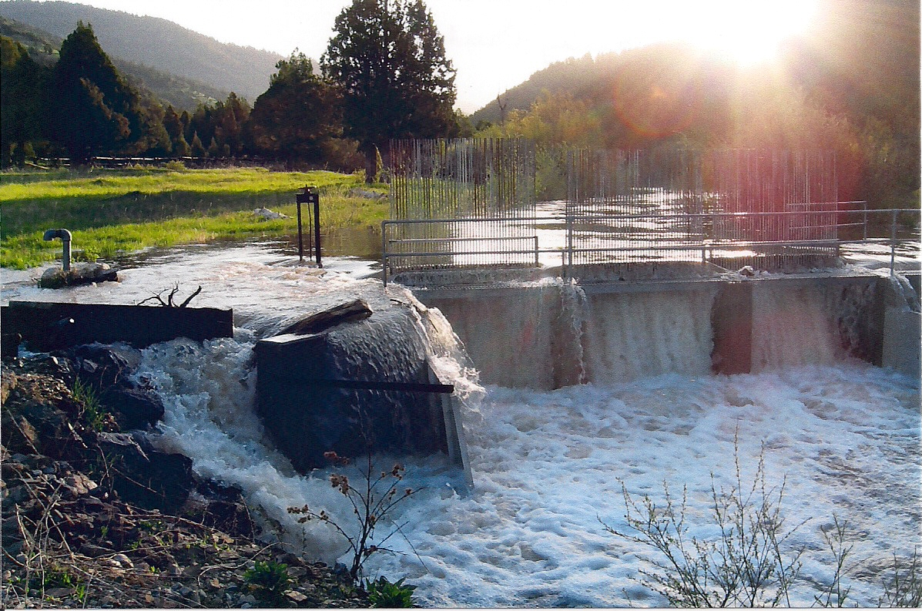
Notes:
Unfortunately, although traditional weirs are effective for large fish such as salmon and steelhead, they have proven to be difficult to operate in the South Fork Snake River tributaries. This picture is of the Rainey Creek weir during a year with average run-off conditions. During years with normal or above normal spring flows, debris gets trapped on the pickets of the weir and cause the water to back up and start flooding around the structure despite concerted efforts to keep the pickets cleaned off. In order to avoid damage to the structure and the banks, the pickets of the weir have had to be removed during these years with average or above average spring flows. As mentioned earlier, this time of the year around peak run-off is when rainbow trout are moving upstream to spawn, and without the pickets in place, they are not caught in the trap and removed from the spawning run.

Slide 9
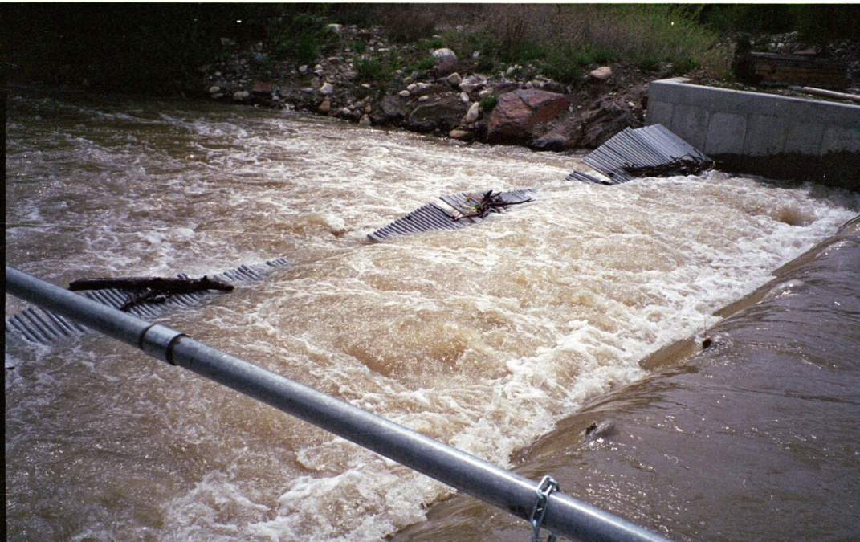
Notes:
In order to better accomplish the goal of protecting cutthroat trout spawning tributaries against invasion by non-native rainbow trout, the Idaho Department of Fish and Game has tried different weir designs in search of one that would be effective in high flows with debris. All types of weirs tested that have had a physical barrier to fish movement, including this floating panel weir at Palisades Creek, have failed during high flows.

Slide 10
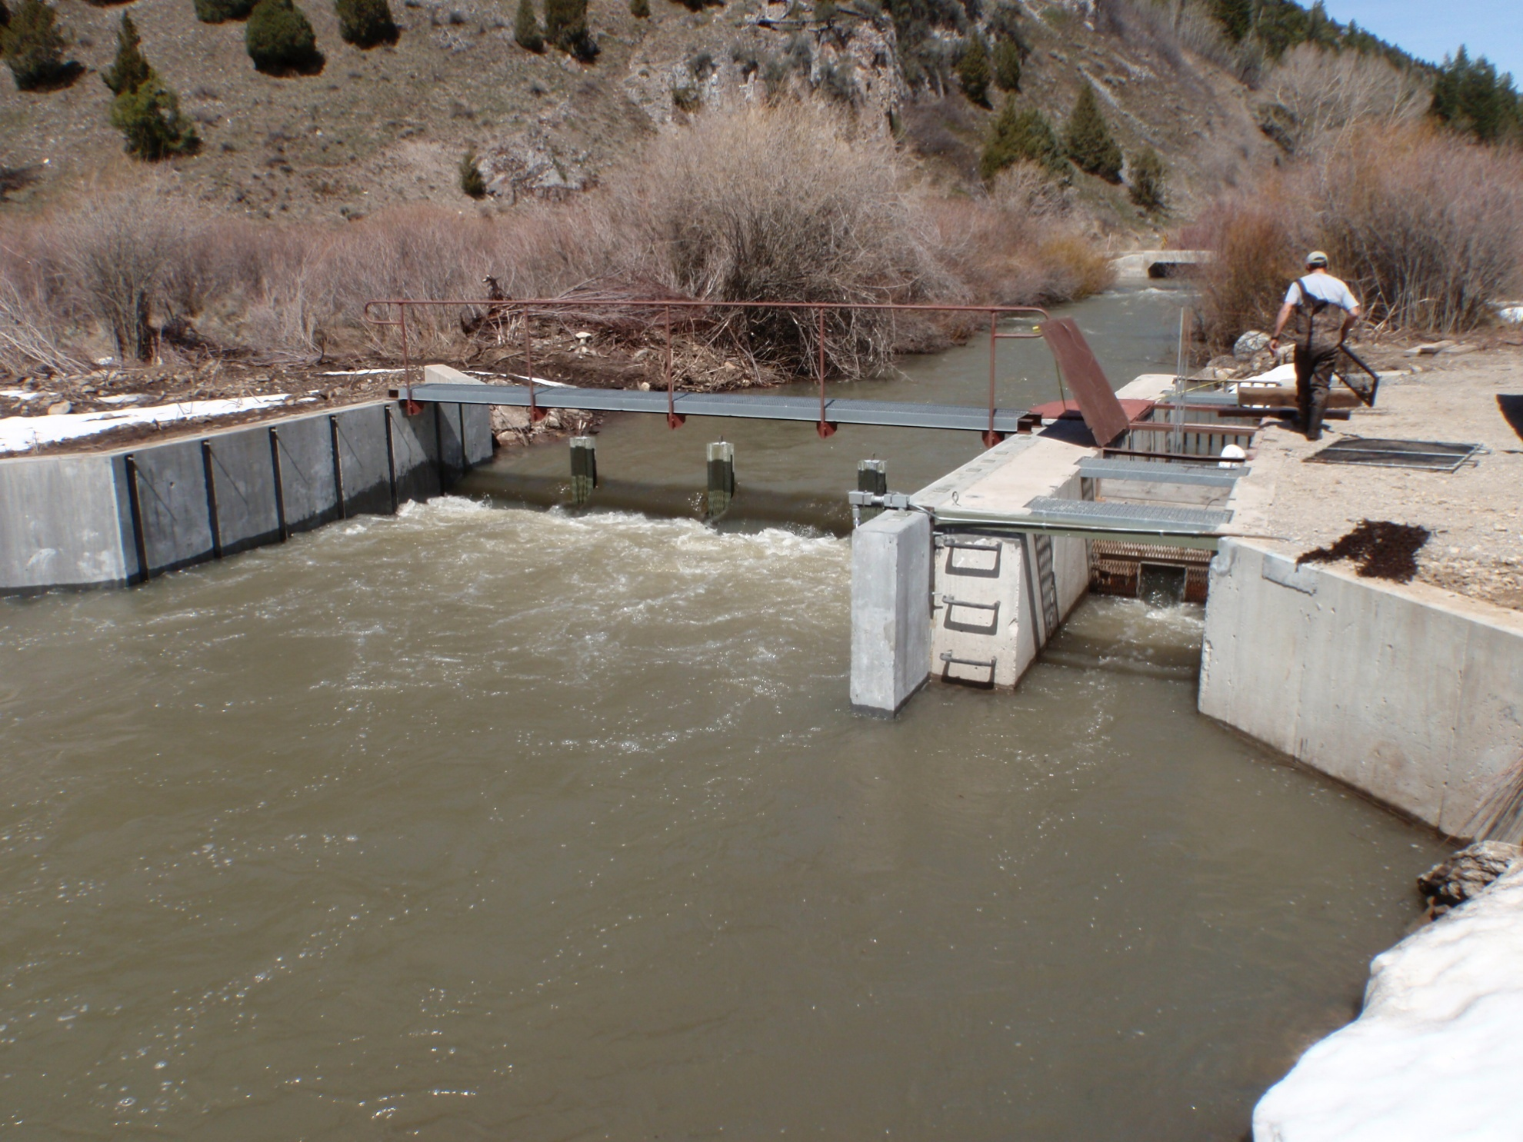
Notes:
The is the modified Pine Creek electric fish weir. The electrodes, visible on the left wall create and an electric field that increases in strength from the downstream to upstream direction. As trout first encounter the electric barrier, they can detect the electric field while still maintaining swimming ability. If they persist and try to swim upstream through the electric field, the electrical current forces them to turn sideways to the stream flow and they are swept downstream. A grounding mat in the stream bed at the trap entrance ensures that fish have a electric-free path on the side of the stream that leads to the fish trap. Pine Creek was the second electric barrier installed, and it was completed in 2010.

Slide 11
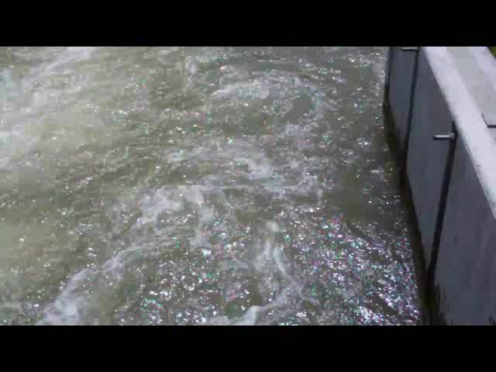

Slide 12
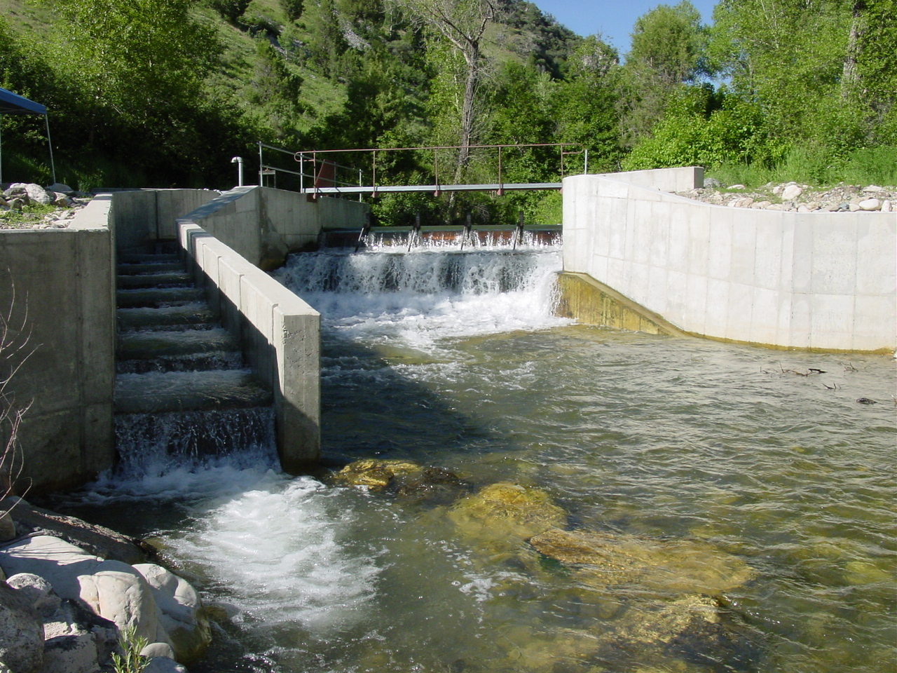
Notes:
The fourth tributary to have its weir modified was Burns Creek. Burns Creek is located in the canyon section of the South Fork Snake River where electricity is not available. Idaho Department of Fish and Game engineers and biologists designed a structure to facilitate trapping trout during high spring flows.

Slide 13
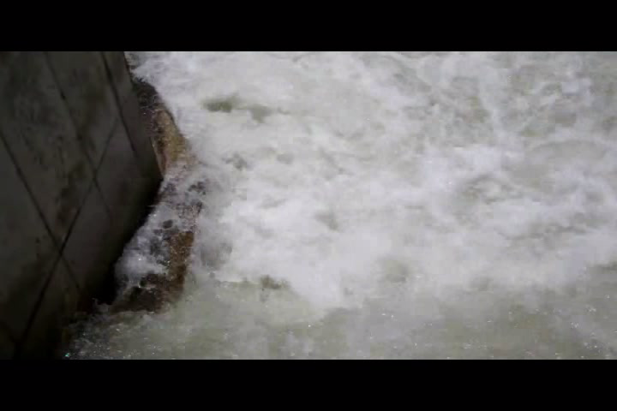

Slide 14
Weir catch table
 | Before modification |  |  |  | After modification
 | n | efficiency | inoperable days |  | n | efficiency | inoperable days
Burns Cr | 4 | 27% | 17 |  | 3 | 96% | 0
Pine Cr | 8 | 52% | 40 |  | 2 | 72% | 0
Rainey Cr | 8 | NA | 27 |  | 1 | NA | 0
Palisades Cr | 5 | 37% | 10 |  | 3 | 86% | 0*

Slide 15
Project 2007-170-00
2013 – 2017 Proposal
Objective 1 – Population genetics
Objective 2 – Survival rate

Slide 16
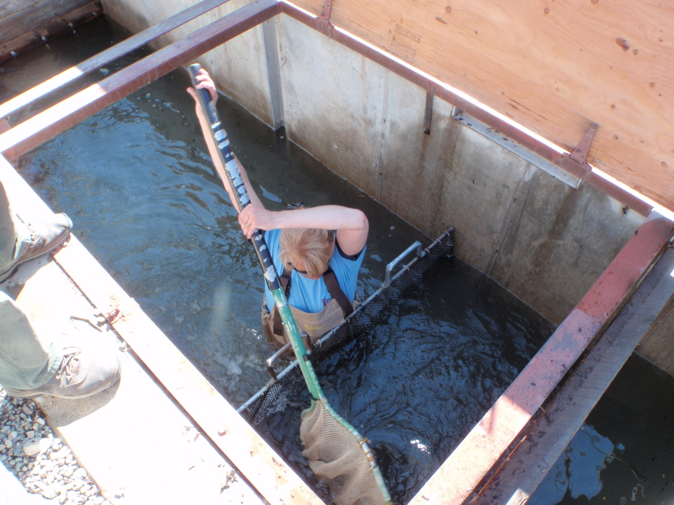
Objective 1
Deliverable 1 – Weir operation
  FY13 through FY17

Slide 17
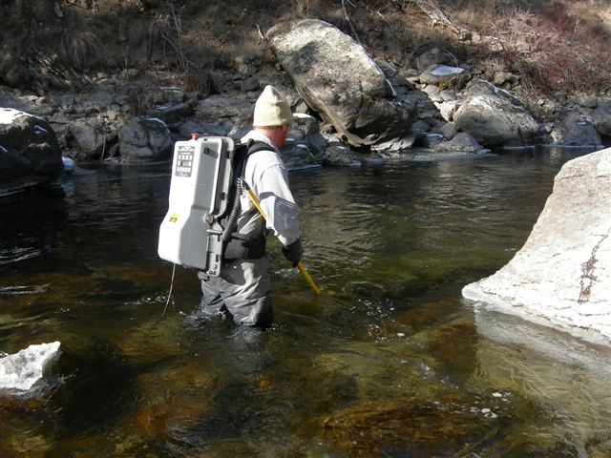
Objective 1
Deliverable 2 – Resident RBT removal
  FY13 through FY17

Slide 18
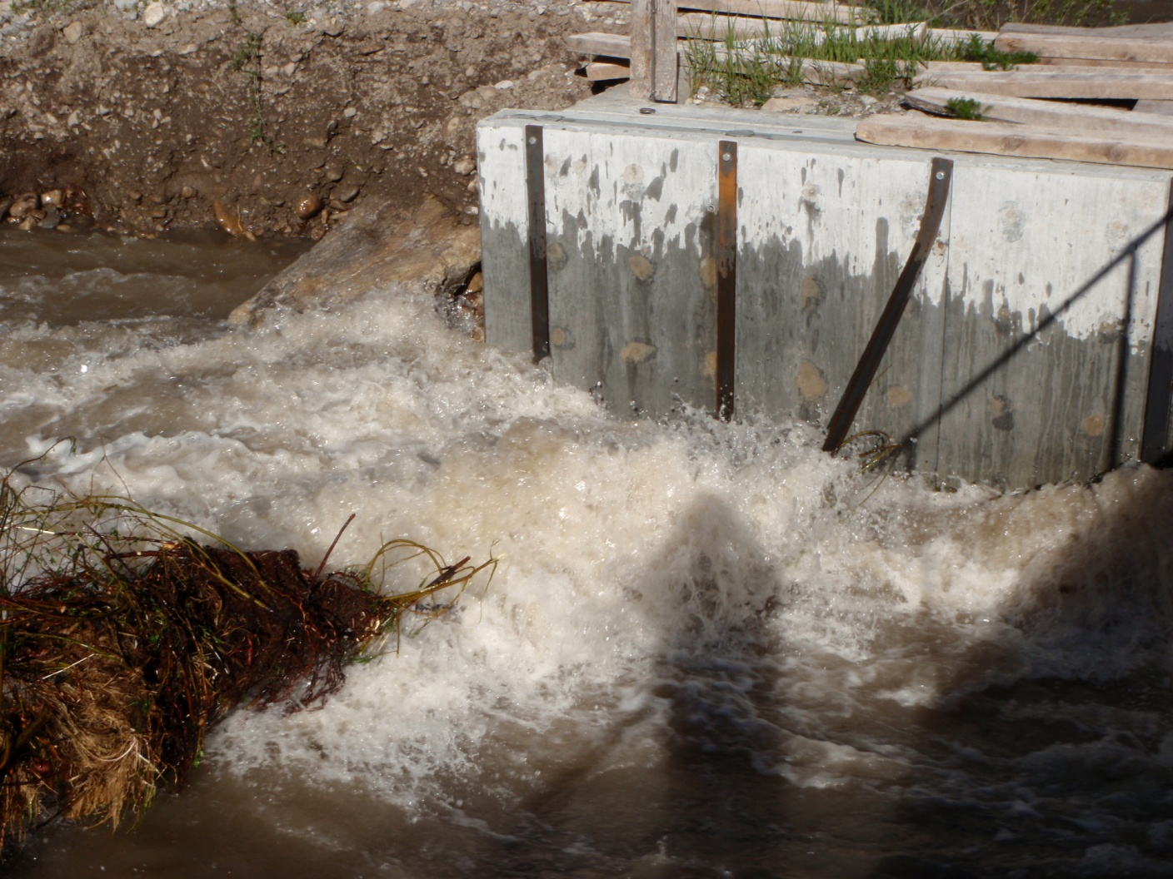
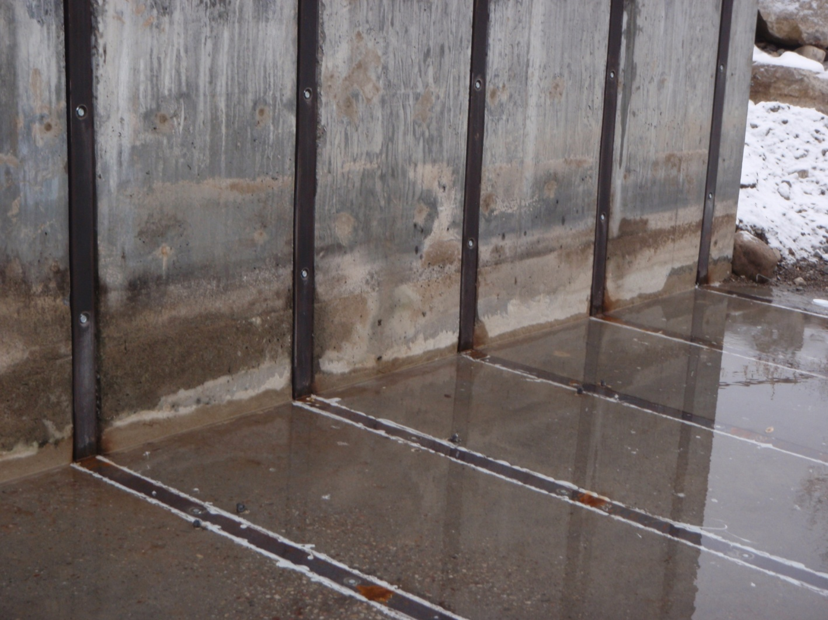
Objective 1
Deliverable 3 – Weir maintenance
  FY13 through FY17

Slide 19
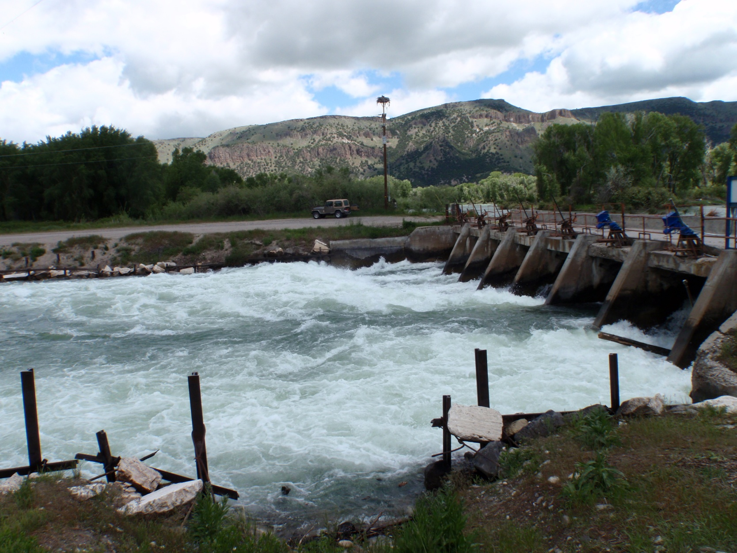
Objective 2 - Entrainment

Slide 20
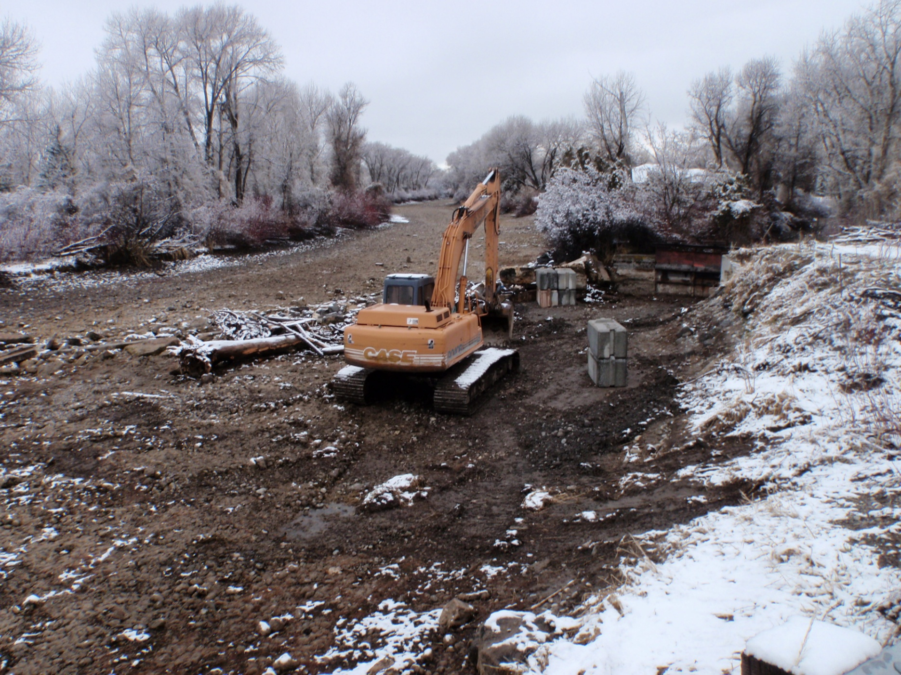
Objective 2 - Entrainment

Slide 21
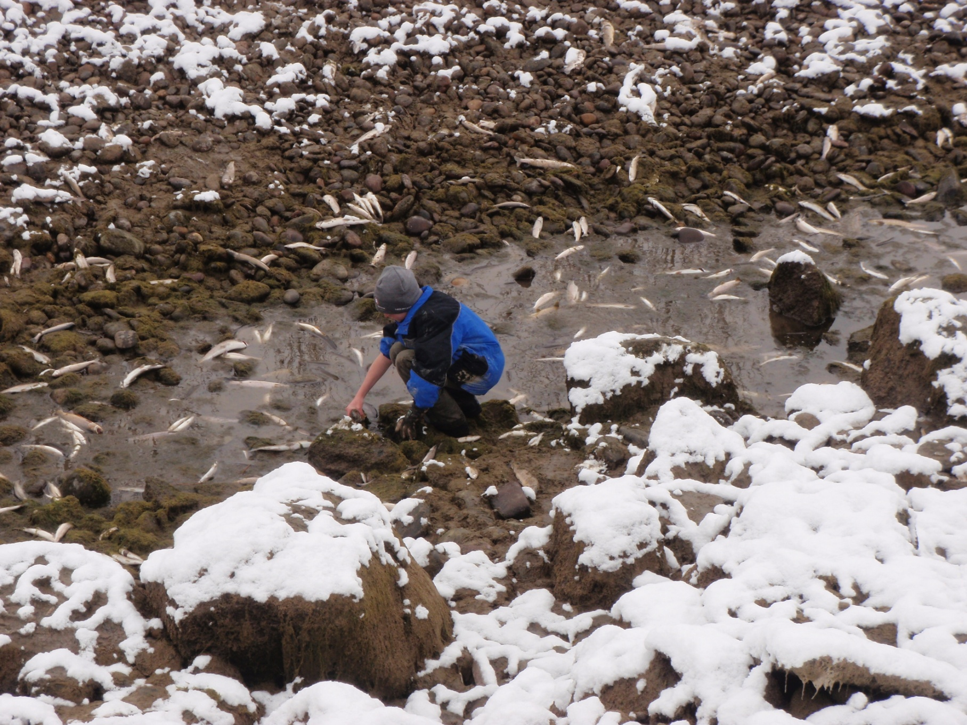
Objective 2 - Entrainment

Slide 22
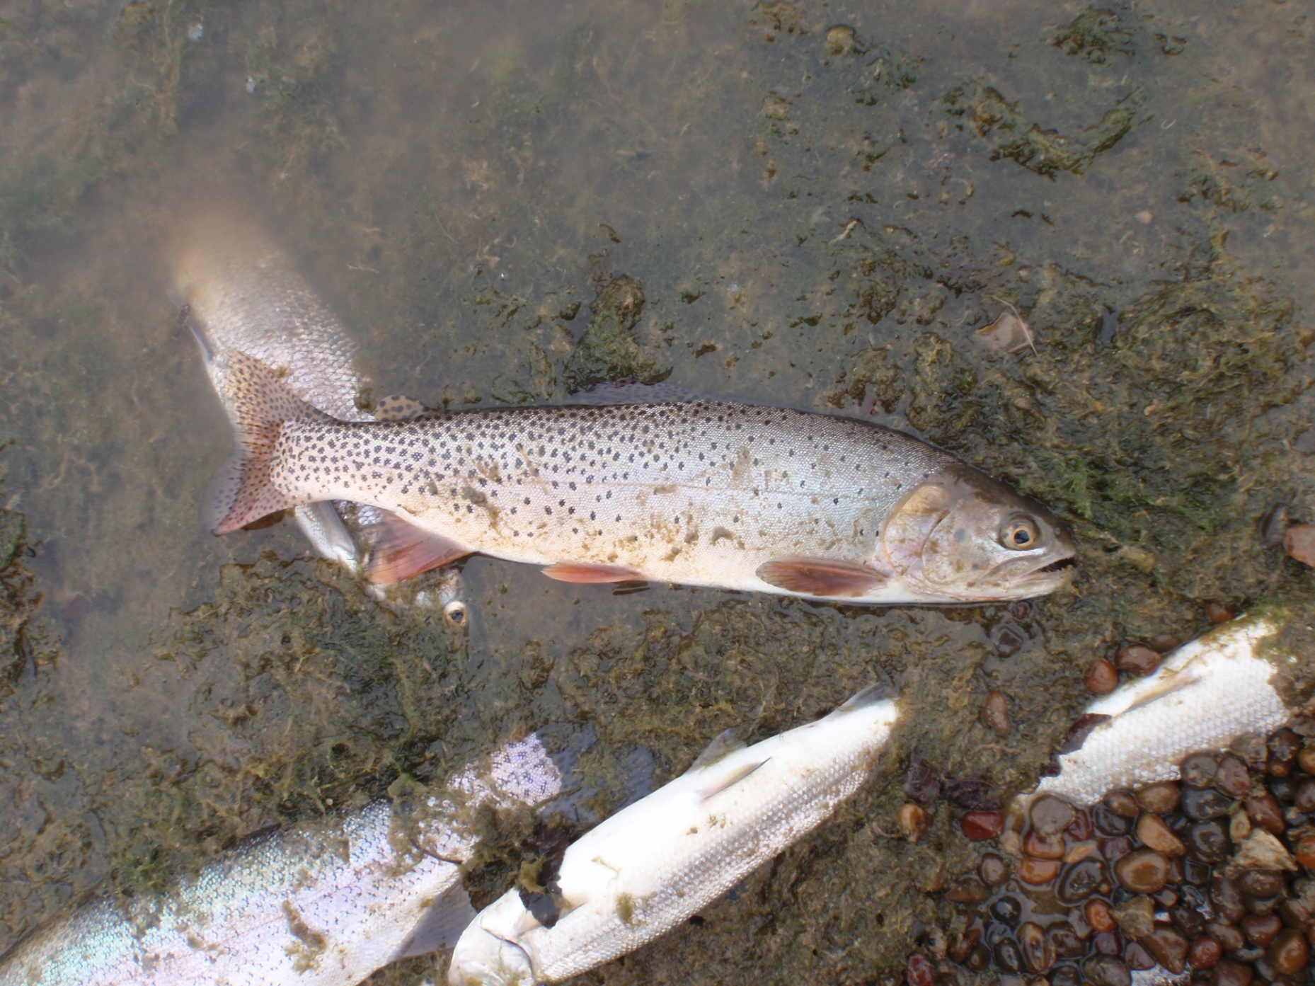
Objective 2 - Entrainment

Slide 23
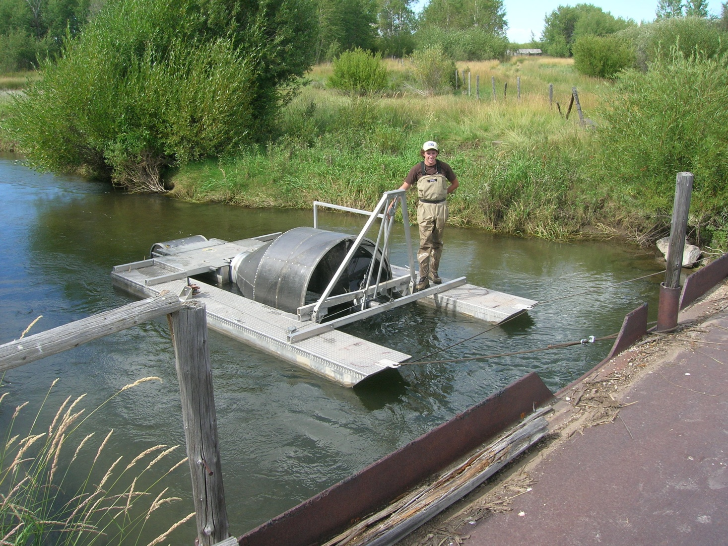
Objective 2
Deliverable 4 – Entrainment in Dry Bed
  FY13 through FY16

Slide 24
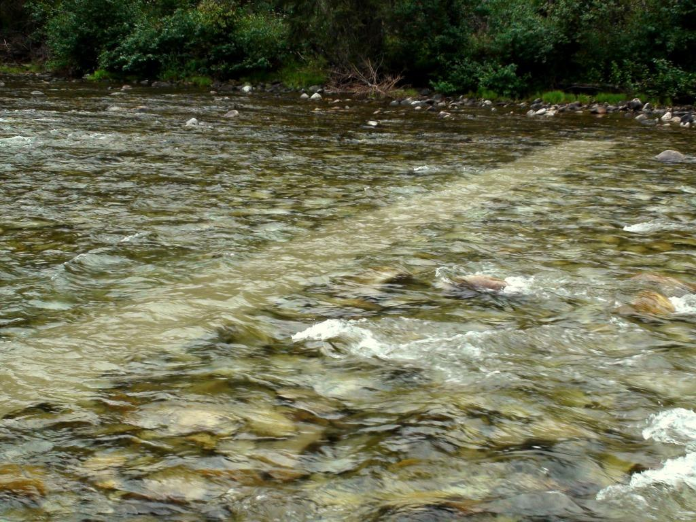
Objective 2
Deliverable 4 – Entrainment in Dry Bed

Slide 25
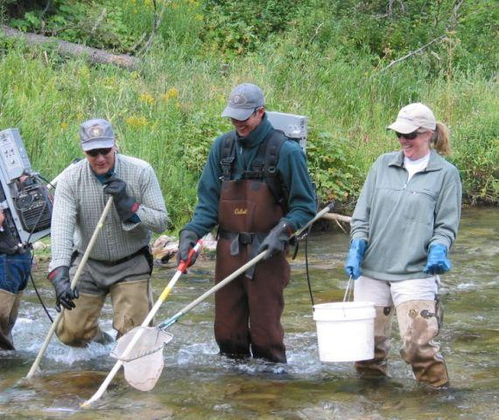
Objective 2
Deliverable 4 – Entrainment in Dry Bed

Slide 26
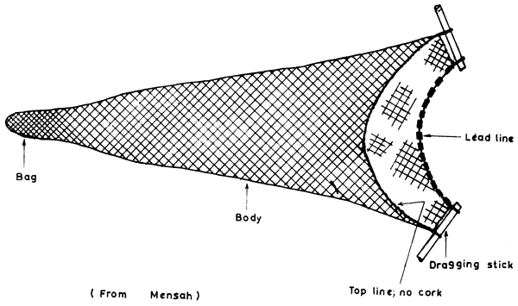
Objective 2
Deliverable 4 – Entrainment in Dry Bed

Slide 27
Objective 2
Deliverable 5 – Entrainment in Dry Bed’s secondary canals
  FY13 through FY16
    Rotary screw traps
    Electrofishing

Slide 28
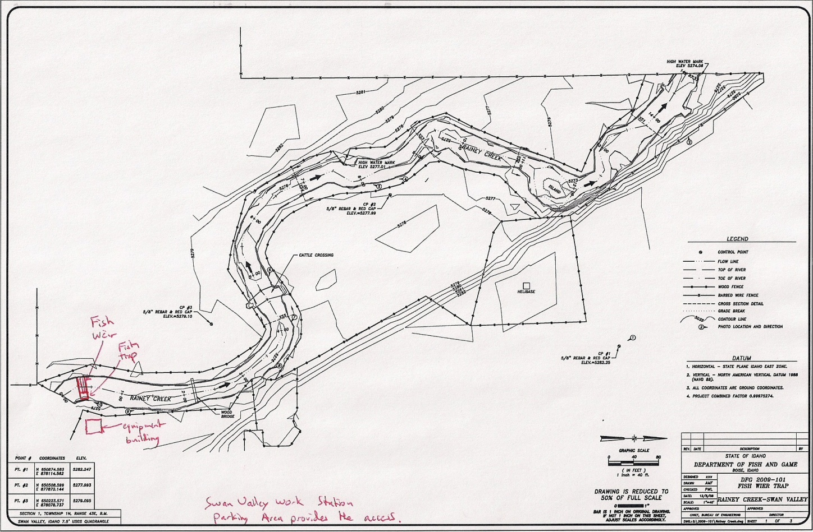
Objective 2
Deliverable 6 – Restoration Design
  FY17

Slide 29
Significance to Regional Programs
Council’s basin-wide objective: “maintaining and restoring healthy ecosystems and watersheds that preserve functional links among ecosystem elements to ensure the continued persistence, health, and diversity of all species including game fish, non-game fish, and other organisms” (CBFWA 2009)
Upper Snake Provincial Assessment: RBT identified as a major threat to YCT persistence
Proposed actions are supported by the Council under the non-native species strategy (CBFWA 2009)
Habitat strategies: screening listed as an accepted tool (would benefit all fish), and direction given to “build from strength”

Slide 30
