Slide 1
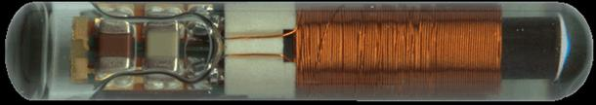
Passive Integrated Transponder Tags
Overview of PIT-Tag Applications
in the
Columbia River Basin
Photo: Oregon RFID
NPCC Fish Tagging Forum
22 March 2012

Slide 2
Passive Integrated Transponder Tags
Outline
Overview of PIT-Tag Applications
Follow the life cycle of anadromous salmon and steelhead
  Juvenile tagging
  Juvenile detections
  Adult detections, tagging, detections
No Study, Species, Behavior or Location emphasis
Describe:
  Purpose and locations of tagging
  Detection and analysis locations
Coordination and Collaboration among tagging projects
NPCC Fish Tagging Forum
22 March 2012

Slide 3
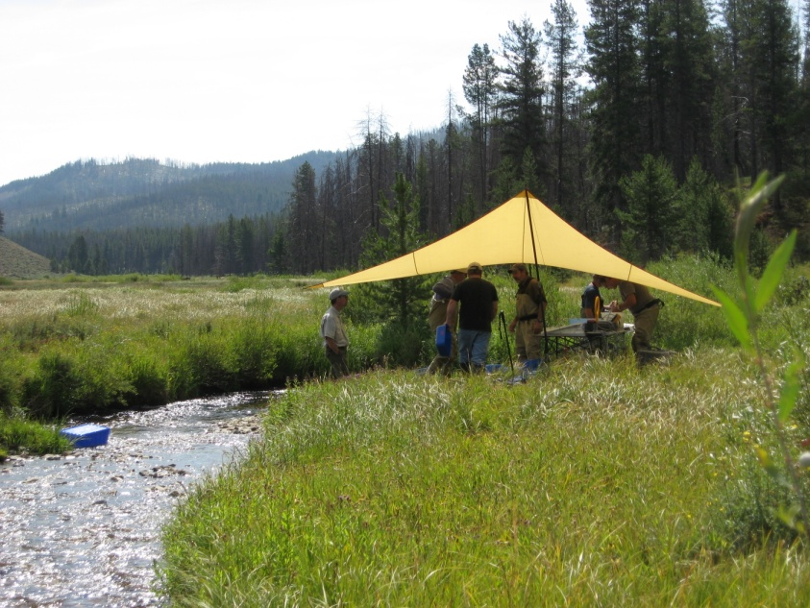
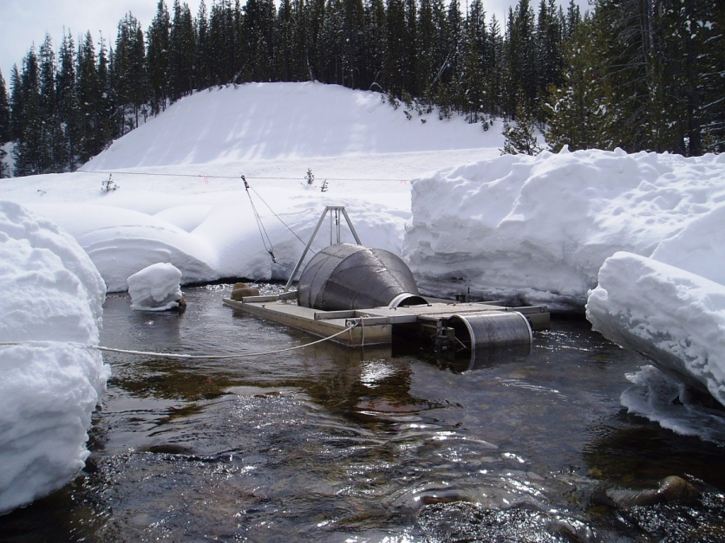
Passive Integrated Transponder Tags
Juvenile Tagging
Juvenile Tagging – Wild/Natural
Tagging Protocols
  Min. size, temperature, recovery
Sample size determinations
Collections via:
  Seines, traps, electrofishing, fishing
Life stages tagged:
  Summer parr
  Fall pre-smolt
  Smolt (sub-yearling & yearling)
NPCC Fish Tagging Forum
22 March 2012
Notes:
Substantial temporal and spatial separation between tagging locations and recoveries/detections
this is not different from other tag types

Slide 4
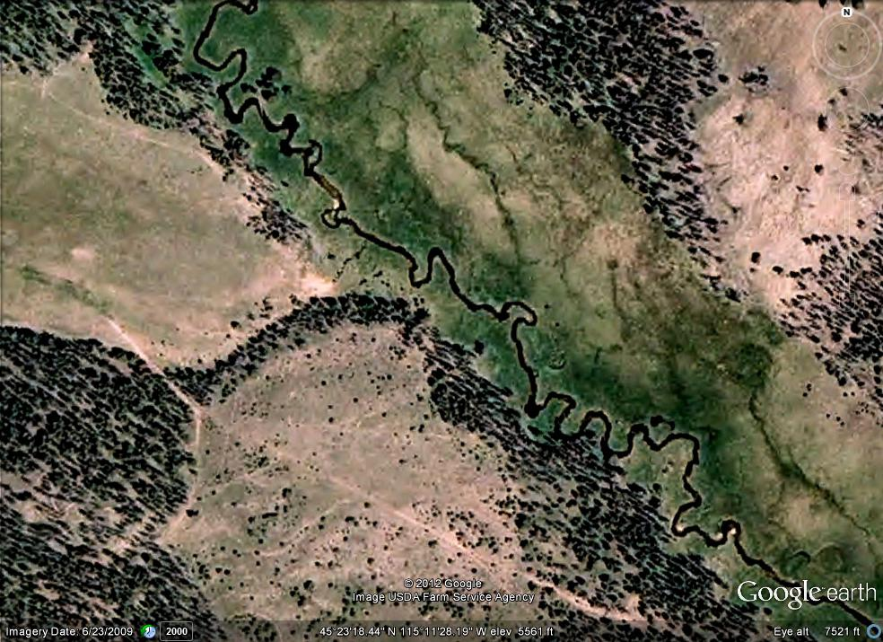
Passive Integrated Transponder Tags
Juvenile Tagging

Slide 5
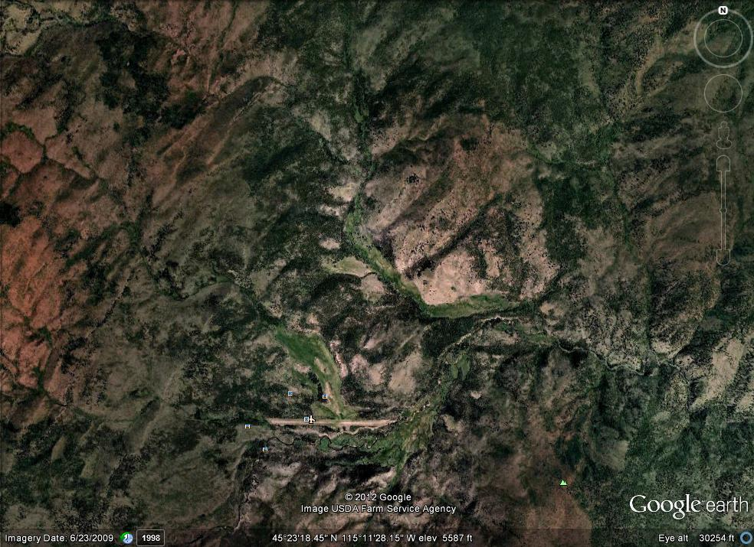
Passive Integrated Transponder Tags
Juvenile Tagging

Slide 6
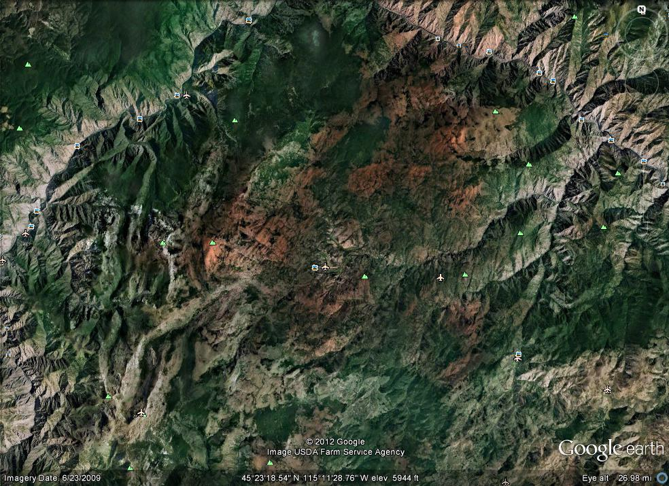
Passive Integrated Transponder Tags
Juvenile Tagging

Slide 7
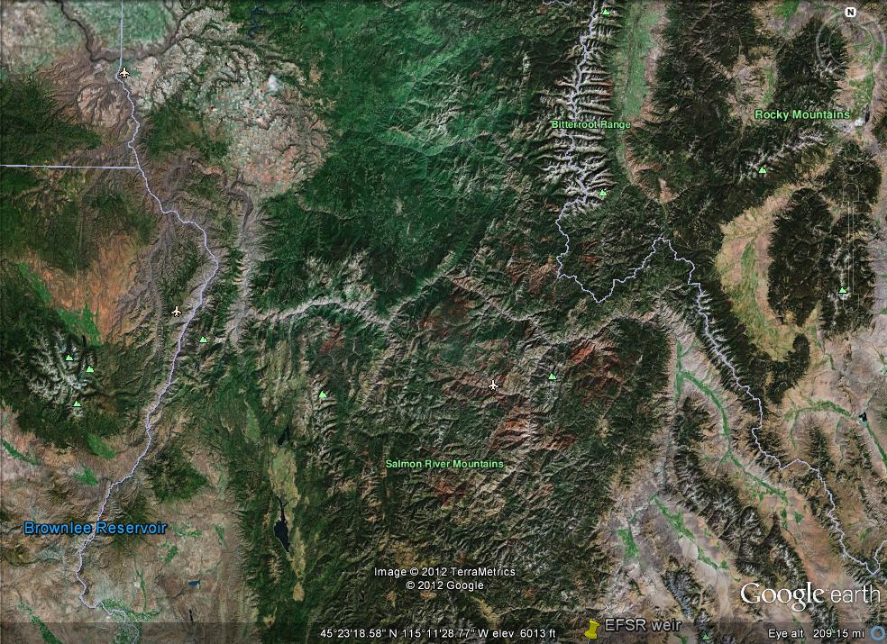
Passive Integrated Transponder Tags
Juvenile Tagging

Slide 8
Passive Integrated Transponder Tags
Juvenile Tagging

Slide 9
Passive Integrated Transponder Tags
Juvenile Tagging
Juvenile Information and Metrics
Estimated number of outmigrants
Overwinter survival (e.g. parr to smolt)
Arrival timing at downstream detection sites
Migration rate to downstream detection sites
Survival to downstream detection sites
Reach survivals in mainstem
NPCC Fish Tagging Forum
22 March 2012

Slide 10
Passive Integrated Transponder Tags
Juvenile Tagging
Juvenile Information and Metrics
Estimated number of outmigrants
Overwinter survival (e.g. parr to smolt)
Arrival timing at downstream detection sites
Migration rate to downstream detection sites
Survival to downstream detection sites
Reach survivals in mainstem
NPCC Fish Tagging Forum
22 March 2012

Slide 11
Passive Integrated Transponder Tags
Juvenile Tagging
Map from www.fpc.org

Slide 12
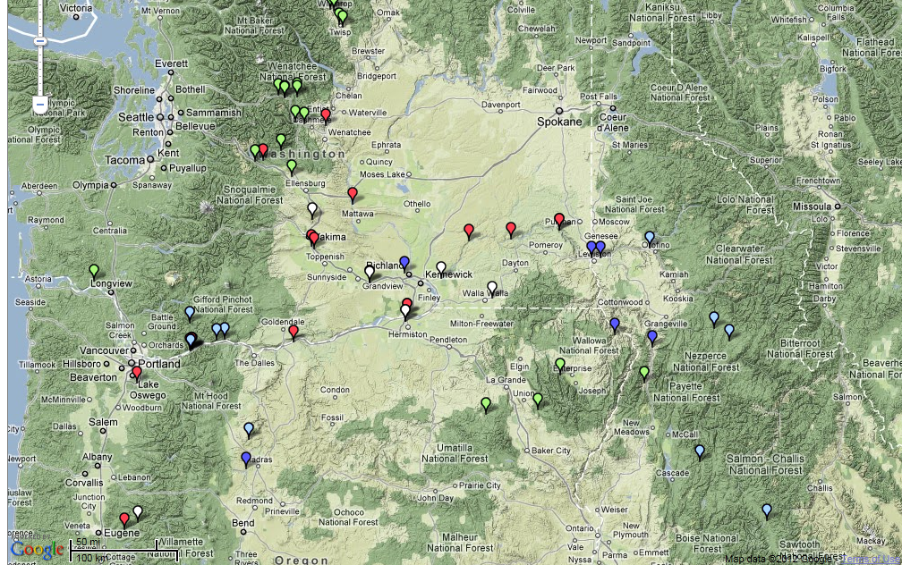
Passive Integrated Transponder Tags
Juvenile Tagging
Hatchery Acclimation
Smolt Bypass
Hatchery
Smolt Trap
Hatchery
Map from www.ptoccentral.org
Notes:
Green = hatchery acclimation
Light blue = hatchery sites
Dark blue = smolt traps
Red and white = juvenile and adult bypass

Slide 13
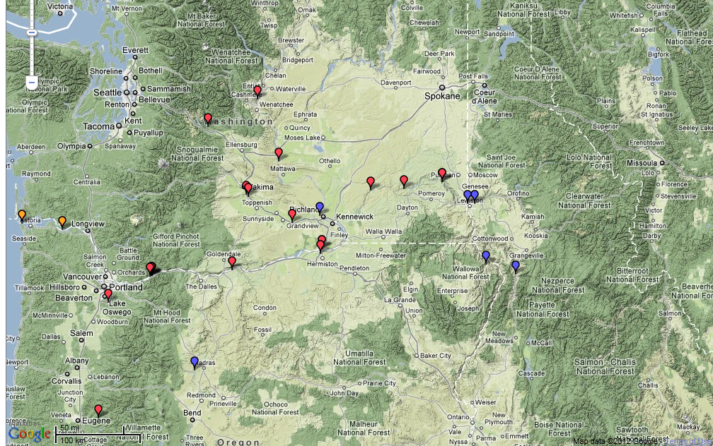
Passive Integrated Transponder Tags
Juvenile Detection
Smolt Bypass
Smolt Trap
Map from www.ptoccentral.org
Notes:
Red symbols = bypass detection sites
Blue = SMP traps
Note estuary trawl detections
Orange = trawl sites

Slide 14
Passive Integrated Transponder Tags
Juvenile Detection
NPCC Fish Tagging Forum
22 March 2012

Slide 15
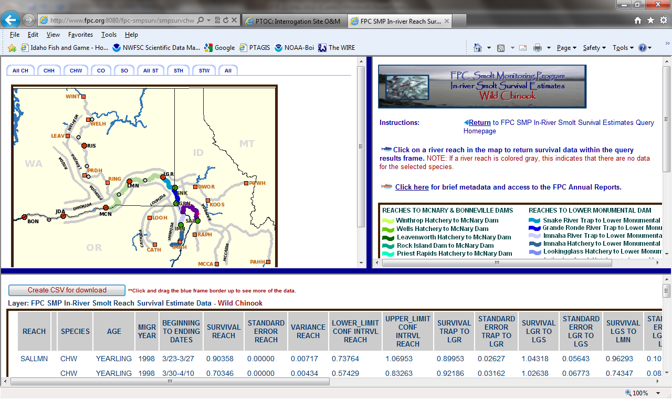
Passive Integrated Transponder Tags
Juvenile Detection
Tagging Site = Mainstem Smolt Trap
NPCC Fish Tagging Forum
22 March 2012
Notes:
Tagging site = smolt trap

Slide 16
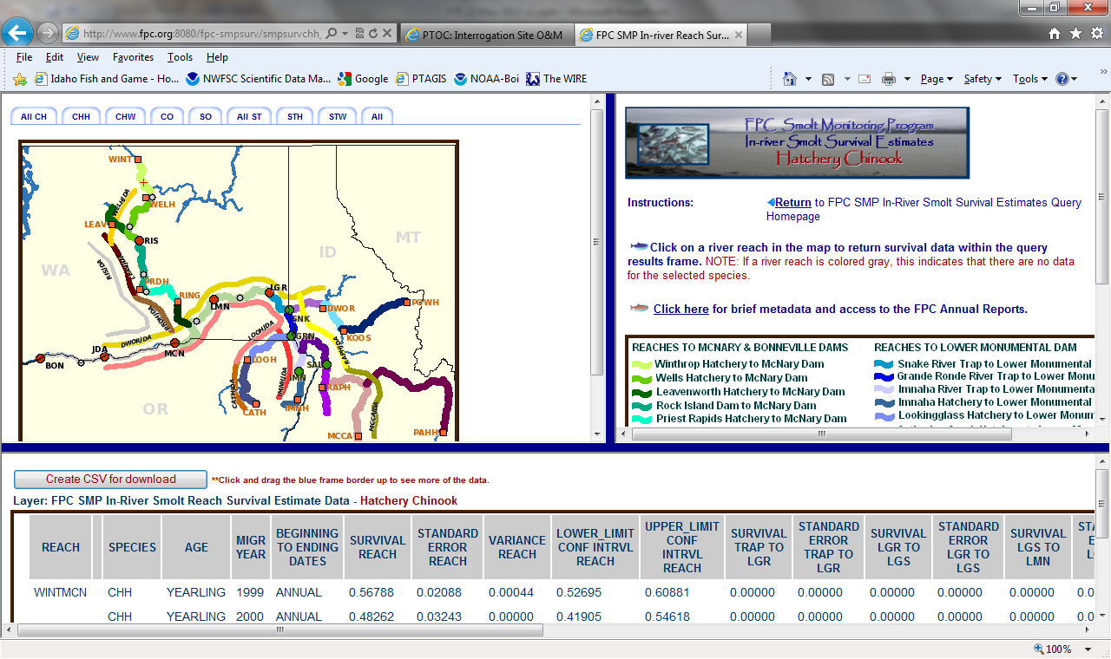
Passive Integrated Transponder Tags
Juvenile Detection
Tagging Site = Hatchery Release Group
NPCC Fish Tagging Forum
22 March 2012
Notes:
Tagging site = hatchery

Slide 17
Passive Integrated Transponder Tags
Juvenile Tagging
Mainstem Dam Tagging and Collection Sites
Provides a site to apply tags to the aggregate run
  Only fish bypassed-collected fish can be tagged
    Tagged smolts: Transported or returned to river
Ability to apply “new” treatment to previously tagged fish captured in bypass systems
  Sort by Code to designate route of migration
    Transport smolts or return to river
  Requires pre-tagging coordination
NPCC Fish Tagging Forum
22 March 2012

Slide 18
Passive Integrated Transponder Tags
Juvenile Tagging
Juvenile Life Stage Summary
Many TAGGING sites
  Species
  Life Stage
  Rearing Type
  Release Type
Few DETECTION sites
  Mainstem dams
    Smolt bypass systems
      “Thorough”
    Tags compiled from upstream studies for mainstem studies
    Missing surface passage routes, turbines
NPCC Fish Tagging Forum
22 March 2012

Slide 19
Passive Integrated Transponder Tags
Adult Detections
Adult Detections
Ocean
Columbia Estuary
Bonneville Dam
Upstream Mainstem Dams
NPCC Fish Tagging Forum
22 March 2012

Slide 20
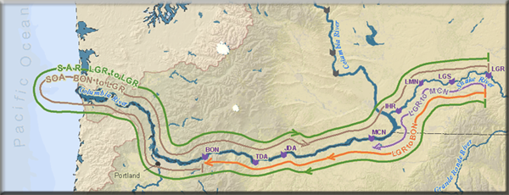
Passive Integrated Transponder Tags
Adult Detections
NPCC Fish Tagging Forum
22 March 2012

Slide 21
Passive Integrated Transponder Tags
Adult Detections
Data and Analyses Supported by Basin-wide PIT-tagging
Return timing
Smolt to Adult Return
Survival and smolt to adult return by route of passage, evaluation of transportation
Straying
Age at maturity/age composition
Run Size Prediction (Harvest management)
NPCC Fish Tagging Forum
22 March 2012

Slide 22
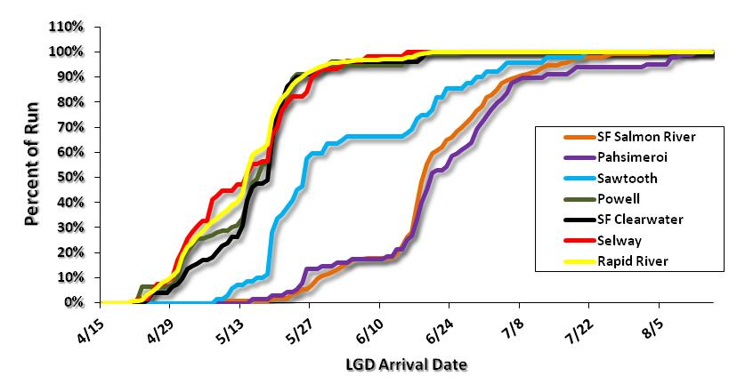
Passive Integrated Transponder Tags
Adult Detections
NPCC Fish Tagging Forum
22 March 2012

Slide 23
Passive Integrated Transponder Tags
Adult Detections
Data from 9 May 2011
NPCC Fish Tagging Forum
22 March 2012
Notes:
Worksheets updated daily
Weekly coordination calls
Refer to LSRCP and IPC management tags

Slide 24
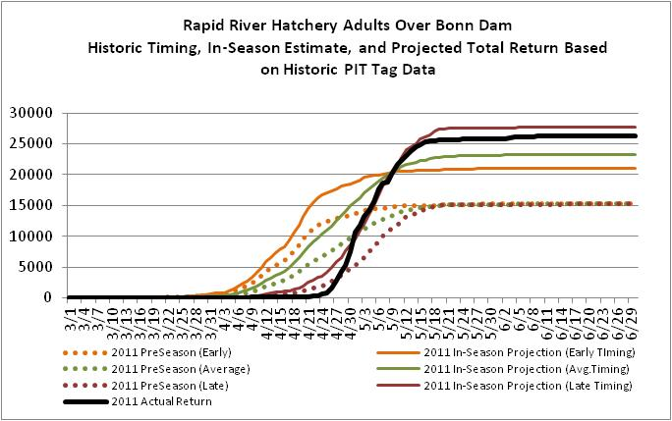
Passive Integrated Transponder Tags
Adult Detections
NPCC Fish Tagging Forum
22 March 2012

Slide 25
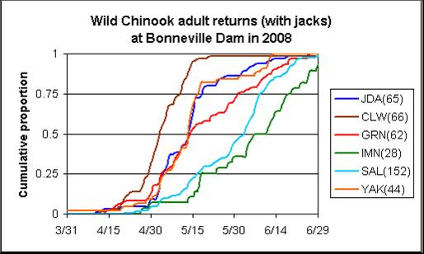
Passive Integrated Transponder Tags
Adult Detections
NPCC Fish Tagging Forum
22 March 2012

Slide 26
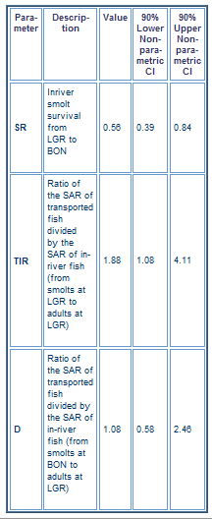
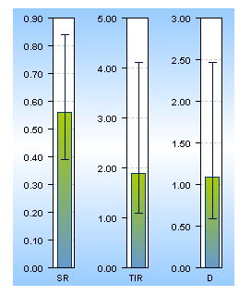
Passive Integrated Transponder Tags
Adult Detections
NPCC Fish Tagging Forum
22 March 2012

Slide 27
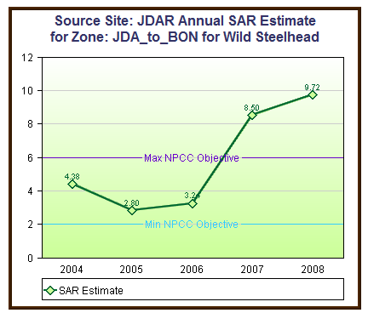
Passive Integrated Transponder Tags
Adult Detections
NPCC Fish Tagging Forum
22 March 2012

Slide 28
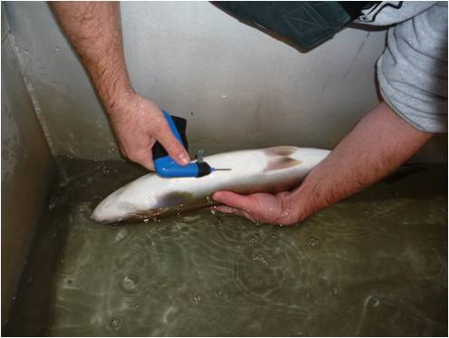
Passive Integrated Transponder Tags
Adult Tagging
Adult Tagging – Wild/Natural
Tagging at Lower Granite
Estimate adult escapement into tributaries.
NPCC Fish Tagging Forum
22 March 2012
Notes:
Reference public access data system

Slide 29
Passive Integrated Transponder Tags
Adult Tagging
PIT Tag Arrays and Antennas
Management Question = steelhead population or MPG abundance
Problem = spawning steelhead are difficult to sample using weirs
NPCC Fish Tagging Forum
22 March 2012

Slide 30
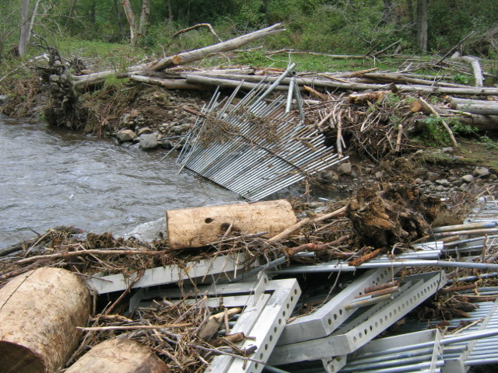
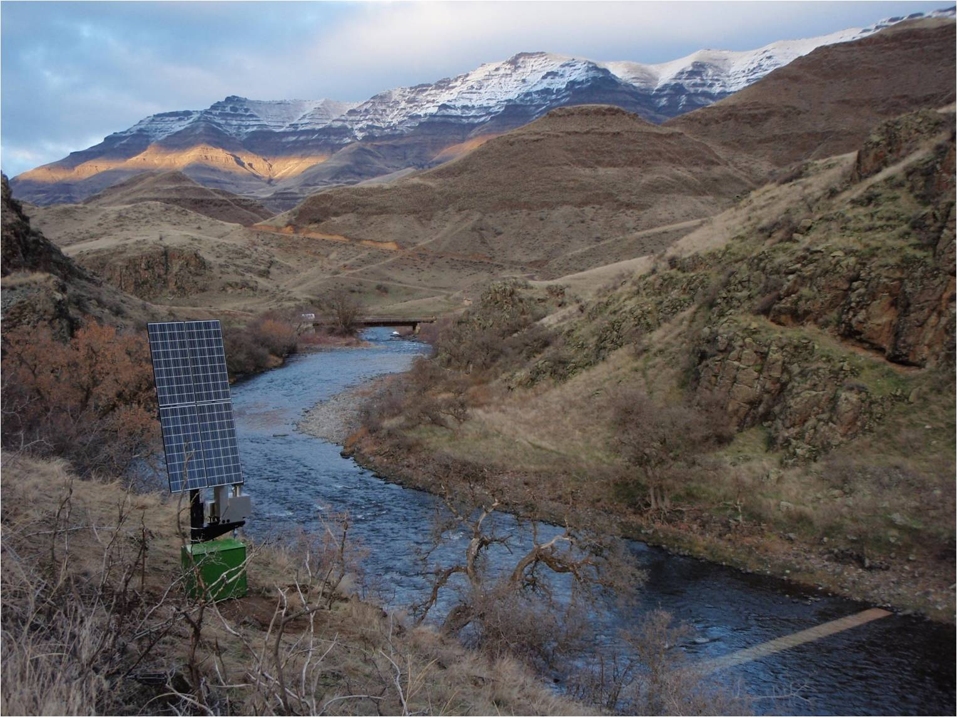
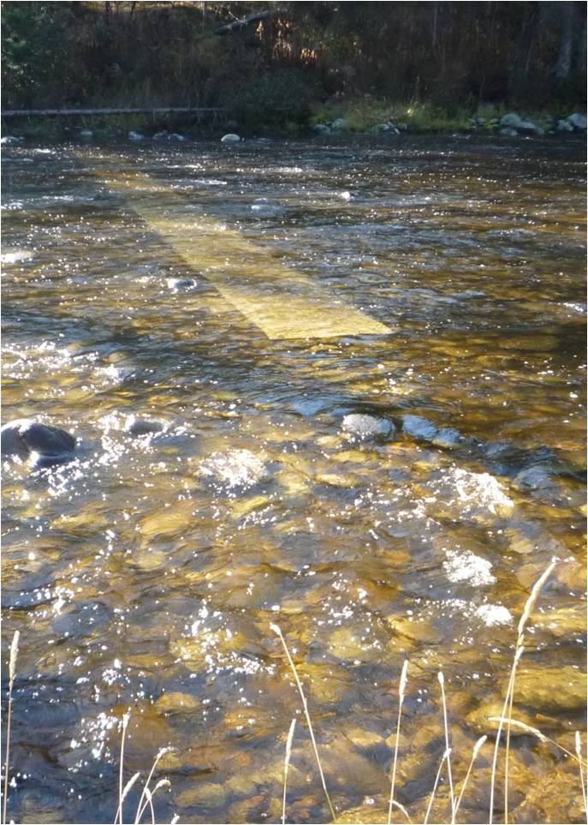
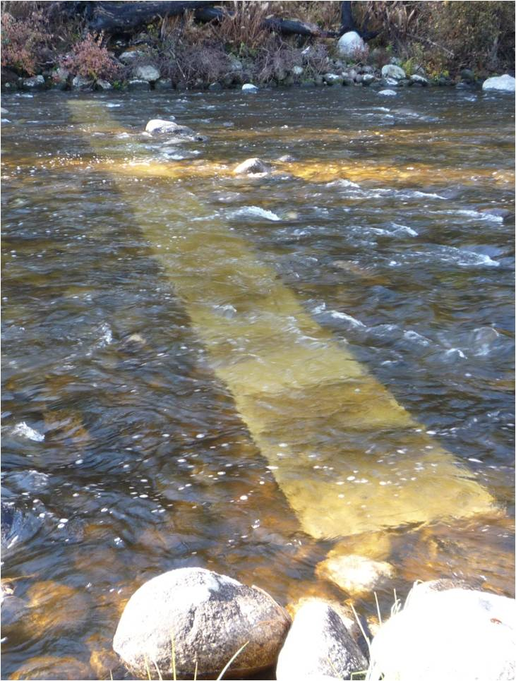
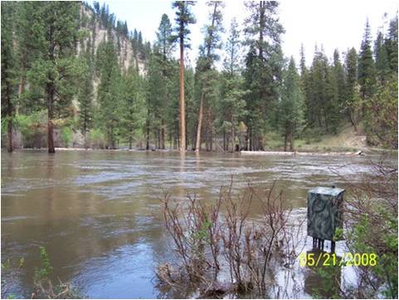
Passive Integrated Transponder Tags
Adult Tagging
Photos courtesy of Nez Perce Tribe
Notes:
Power : solar, propane, grid
Satellite uplink

Slide 31
Passive Integrated Transponder Tags
Adult Tagging
PIT Tag Arrays and Antennas
Management Question = steelhead population or MPG abundance
Problem = spawning steelhead are difficult to sample using weirs
Can be used on big rivers.
PIT arrays provided for unattended monitoring in most conditions.
NPCC Fish Tagging Forum
22 March 2012

Slide 32
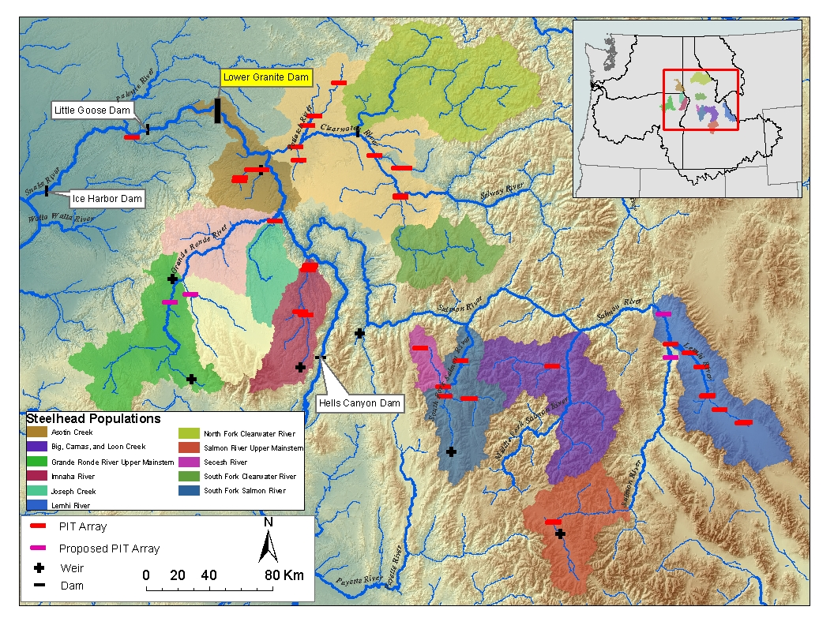
Passive Integrated Transponder Tags
Outline
NPCC Fish Tagging Forum
22 May 2012

Slide 33
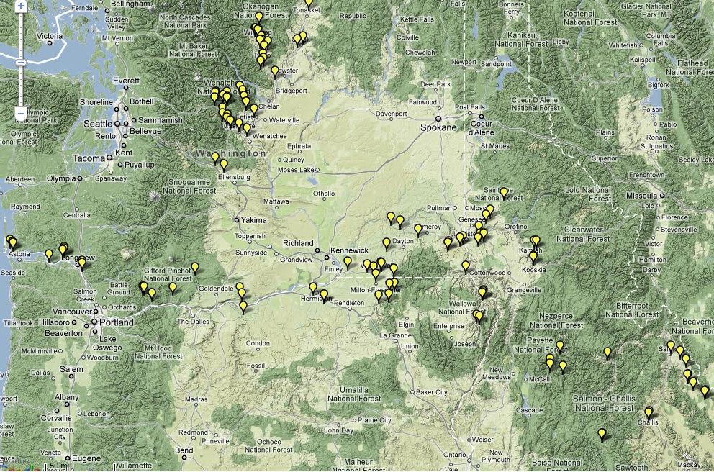
Instream Antenna Arrays
Map from www.ptoccentral.org

Slide 34
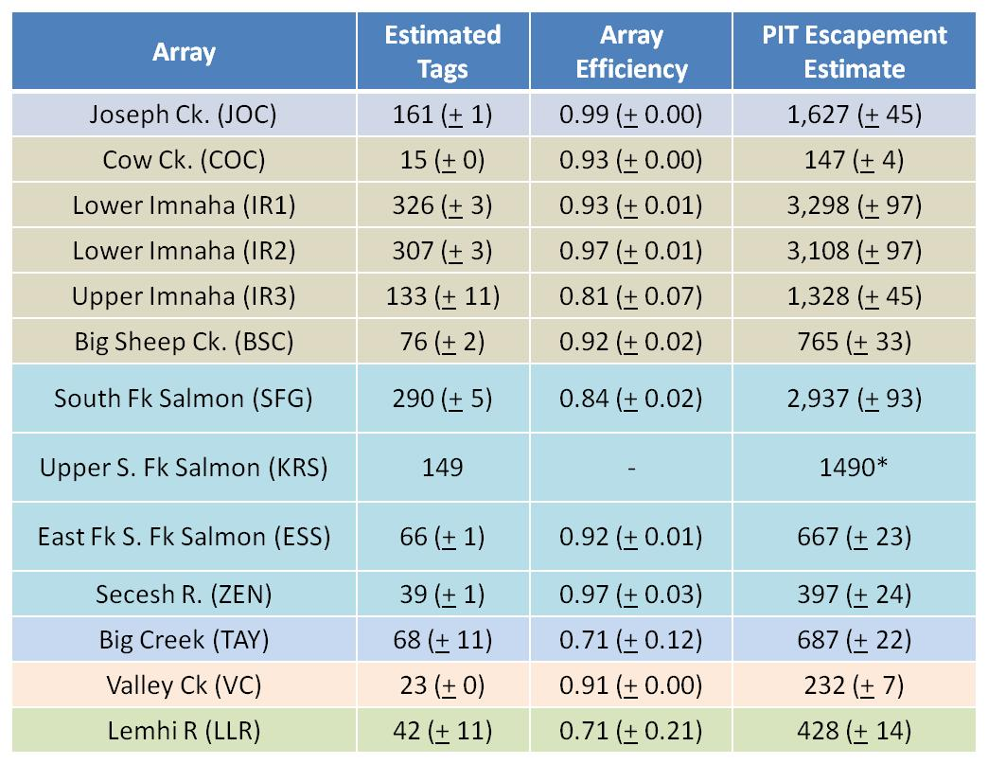
Passive Integrated Transponder Tags
Adult Detections
Run-year 2010-2011 Steelhead
ISEMP Project Data

Slide 35
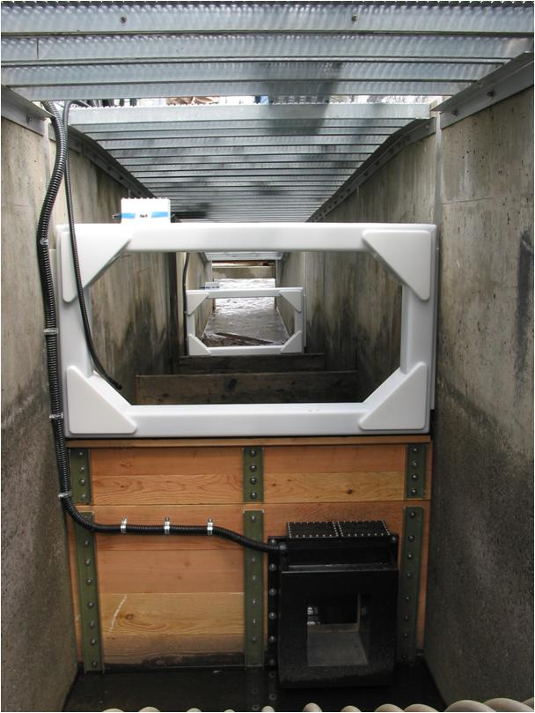
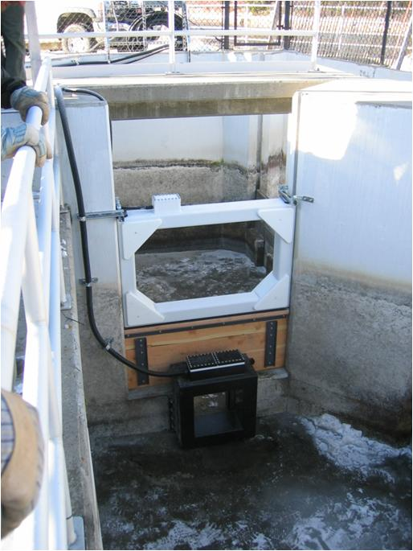
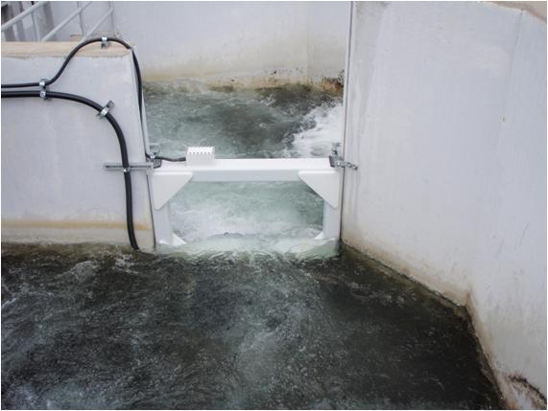
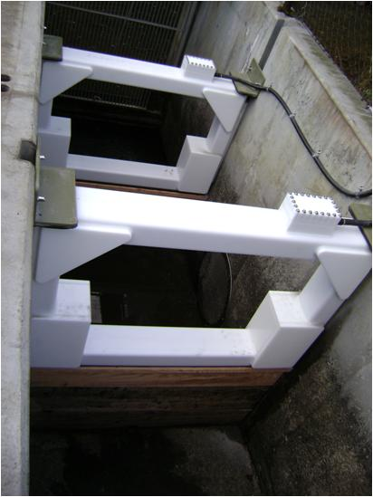
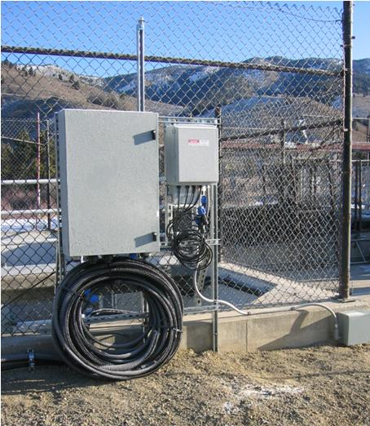
Passive Integrated Transponder Tags
Adult Detections
Hatchery Weir and Ladder Detectors
Management Question = detection efficiency of sampling
Problem = bias if tags missed; loss of tags

Slide 36
Passive Integrated Transponder Tags
Adult Detections
Findings from: Hatchery Weir and Ladder Detectors
Hand scanning misses about 10-20% of PIT tags
Bottom-exit issues at Sawtooth Hatchery
This work has generated regional interested and follow up studies are ongoing
NPCC Fish Tagging Forum
22 March 2012

Slide 37
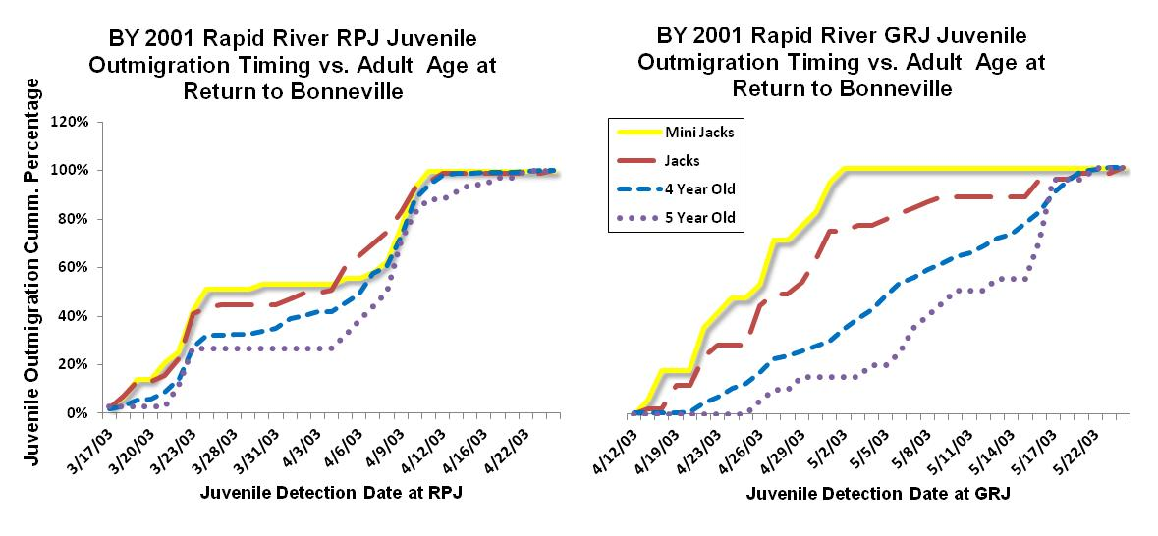
Passive Integrated Transponder Tags
Juvenile and Adult Detections
Juvenile Outmigration Timing vs. Age at Return
Cassinelli - IDFG
NPCC Fish Tagging Forum
22 March 2012

Slide 38
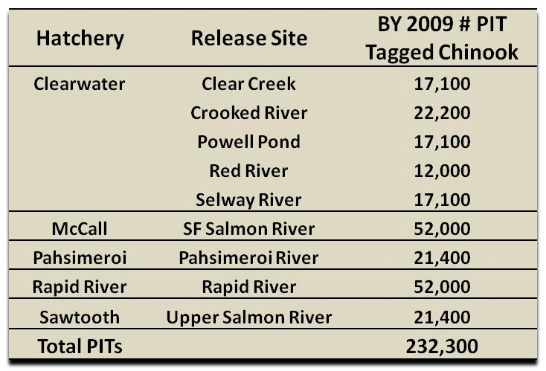
Passive Integrated Transponder Tags
Coordinated Tagging
NPCC Fish Tagging Forum
22 March 2012

Slide 39
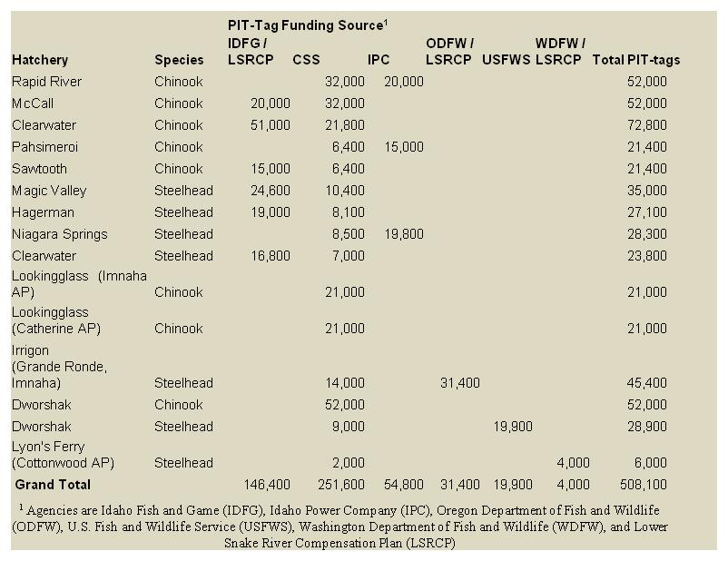
Passive Integrated Transponder Tags
Coordinated Tagging
Snake River hatchery groups
2011 smolt outmigration
Through cooperative efforts pre-assignments are carried out by either the CSS or the other associated agencies.
NPCC Fish Tagging Forum
22 March 2012

Slide 40
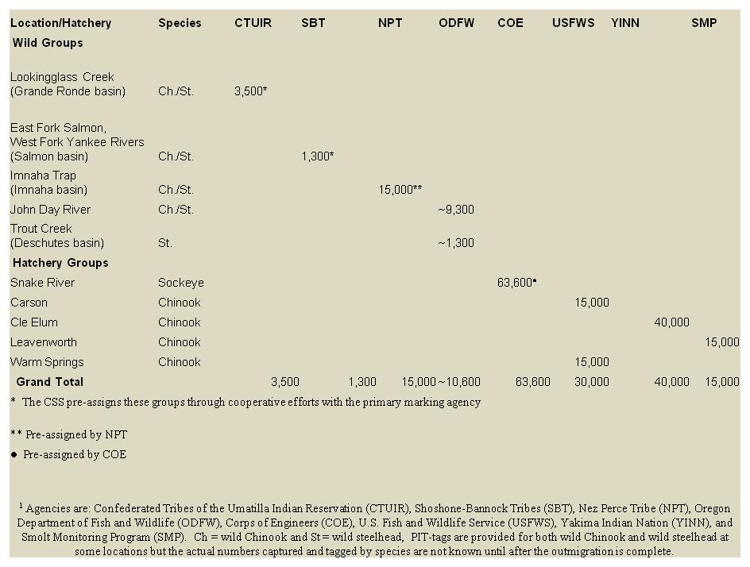
Passive Integrated Transponder Tags
Coordinated Tagging
Columbia Basin wild fish tag groups
2011 smolt outmigration
Non-CSS tags included in CSS study
Agency/Tribe pre-assignment or random pre-assignments
NPCC Fish Tagging Forum
22 March 2012
Notes:
Use as segue to life cycle summary

Slide 41
Passive Integrated Transponder Tags
Coordinated Tagging

Slide 42
3D9.1BF2328B20
3D9.QBF1641BB4
3D9.1UF1955DD2
3D9.1BE1970B60
3D9.1BFS971444
3D9.1BF1TE288A
3D9.1BF1AI1964
3D9.1BF232OD0D
3D9.1BF2330NF0
3D9.1BF236AFS8
3D9.1BF23884D?
3D9.1BF23A0EB4
NPCC Fish Tagging Forum
22 March 2012

