Slide 1
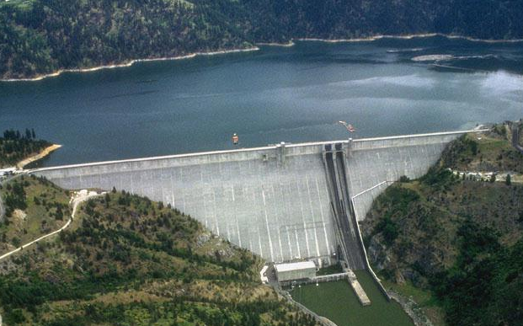
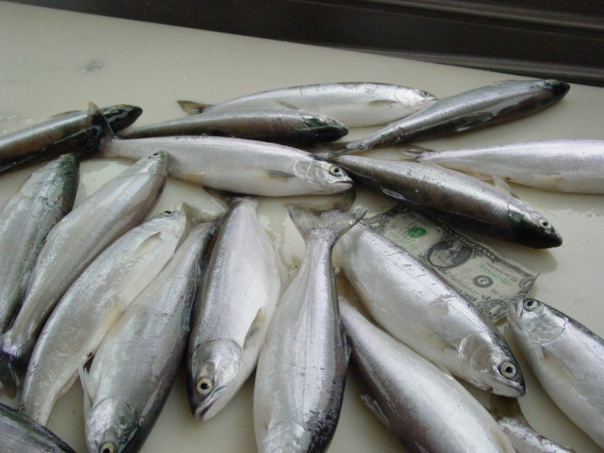
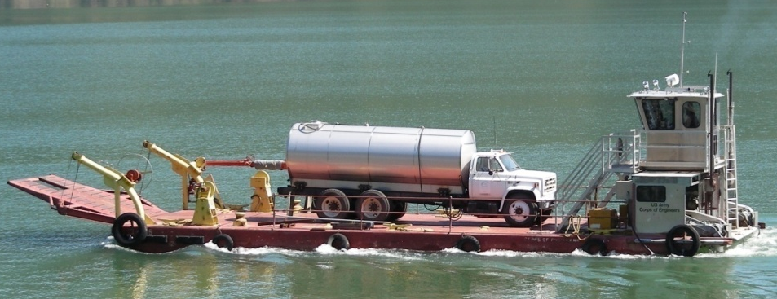
Dworshak Dam Resident Fish Mitigation Project
Andy Dux and Sean Wilson
Idaho Department of Fish and Game
Project #2007-003-00

Slide 2
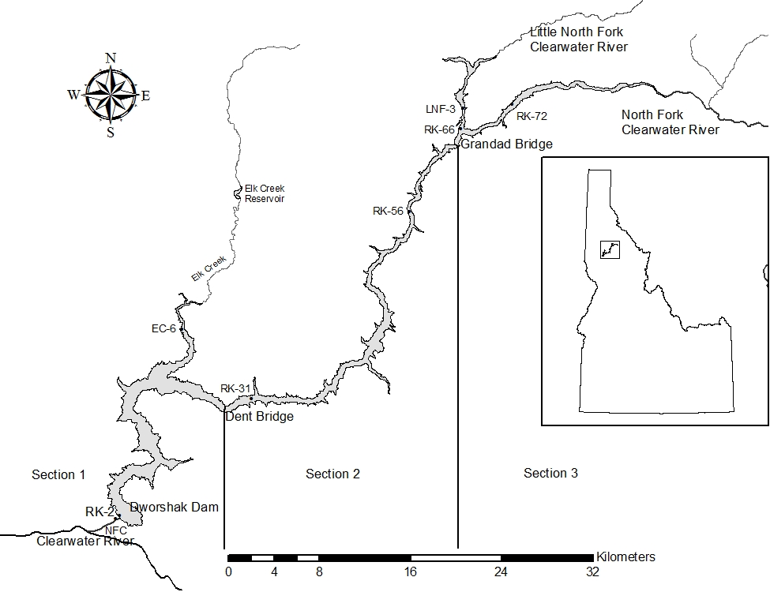
Dworshak Reservoir
Created in 1972
54 miles long
17k surface acres
>600 ft deep
No fish passage

Slide 3
Background
  Dam blocked access to NF Clearwater basin for anadromous salmonids
    Loss of marine derived nutrients
  Resident native species (e.g., bull trout, westslope cutthroat) still present
  Resident fisheries for kokanee, smallmouth bass, rainbow trout established in reservoir (partial mitigation)
  Reservoir productivity has declined (N limited)

Slide 4
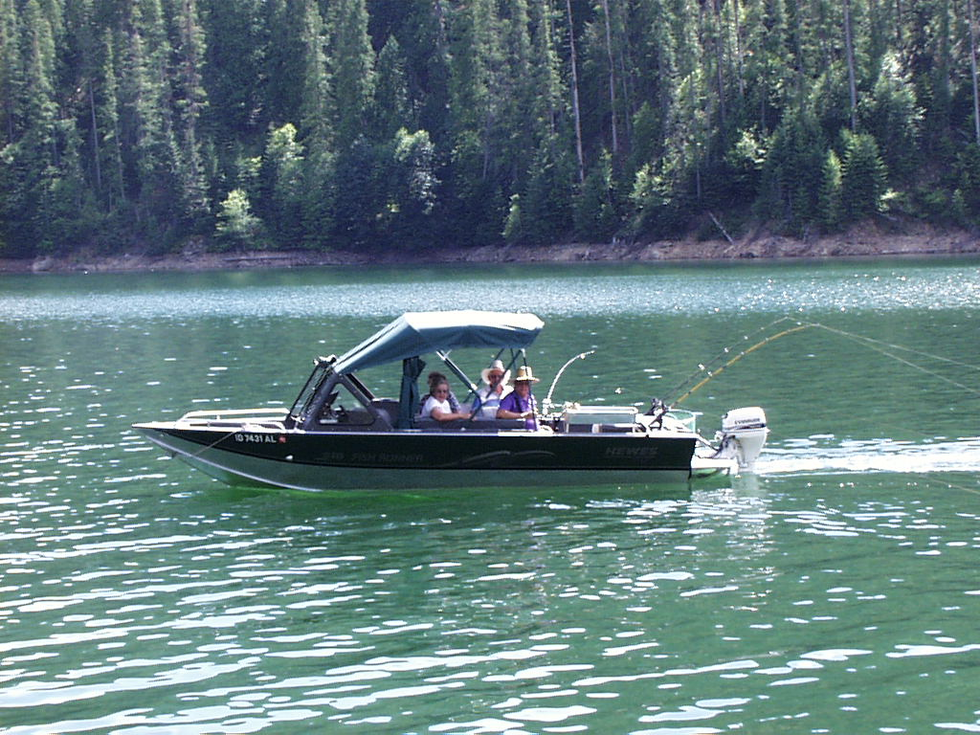
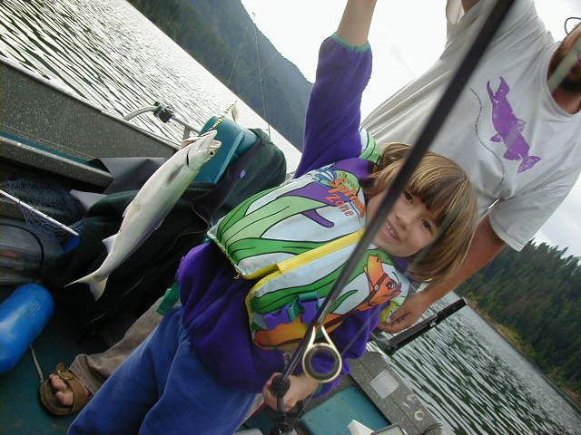
Dworshak Reservoir Fishery
Popular fishery
  41,435 trips/yr
Economically valuable
  $5.9 million/yr spent on fishing
Kokanee - keystone species
  Most popular sport fish
  Transport nutrients upstream
  Prey source for predators
Limiting factors for kokanee
  Reservoir productivity
  Entrainment

Slide 5
Project Objectives
Enhance reservoir productivity
  Improve N:P ratio and food web efficiency
  Increase ‘edible’ phytoplankton
  Decrease N₂ fixing cyanobacteria (blue-greens)
  Increase zooplankton size and abundance
2. Enhance kokanee population/fishery
  Increase kokanee size and abundance
  Fishery with catch rate of 0.7 fish/hr and mean length of 254 mm
3. Nutrient cycling
  Increase nutrient transport by kokanee to tributaries

Slide 6
Dworshak Nutrient Supplementation
Pilot study initiated
  5 year duration
  Began fertilizing in 2007
Who’s involved?
  USACE – nutrient application
  IDFG – limnological and kokanee monitoring

Slide 7

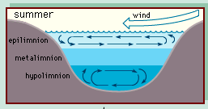
Fertilizer Application Methods
Urea ammonium nitrate fertilizer
Weekly application
Added to surface water (epilimnion) during stratification
  Typically May – Sept.
  Does not mix with hypolimnion

Slide 8
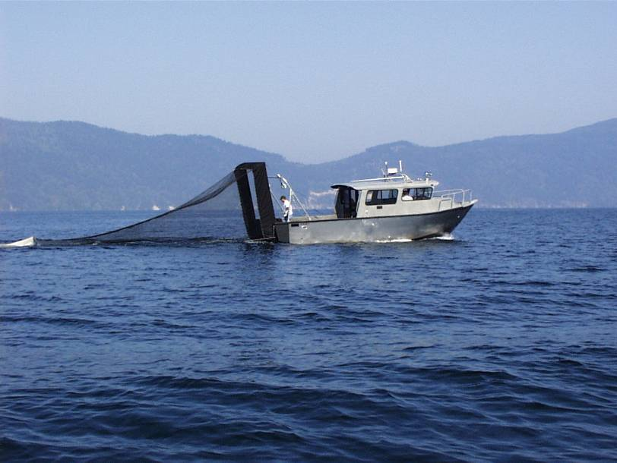
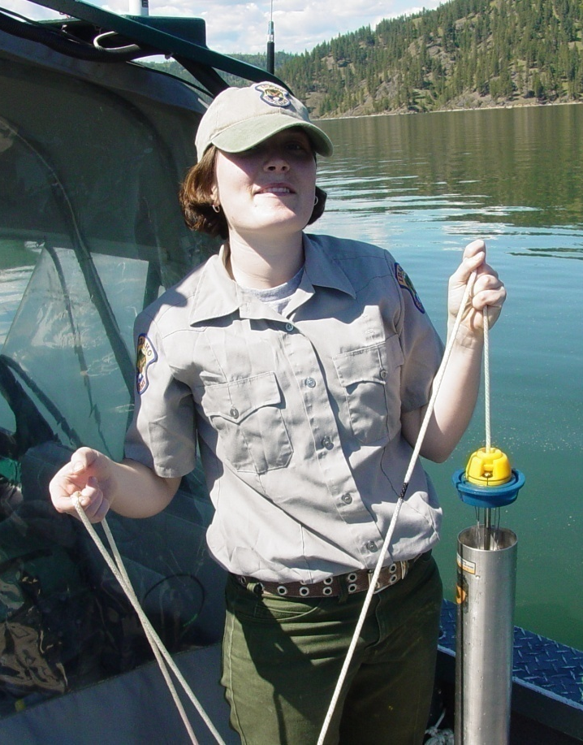
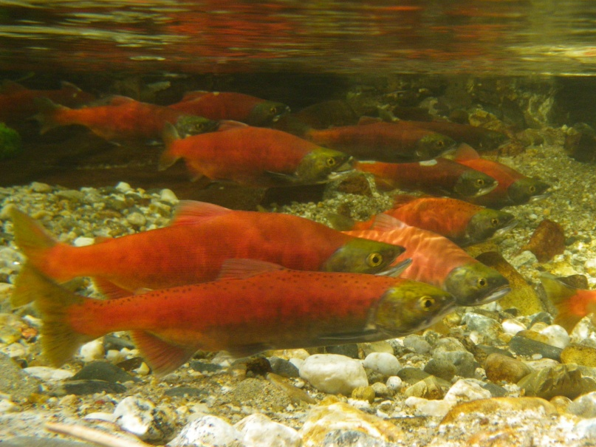
Monitoring Methods
Limnological monitoring
  Physical, chemical, and biological
  Occurs twice monthly
  Serves several purposes:
  1. Adaptively manage N applications
  2. Assure water quality meets permit standards
  3. Evaluate project effectiveness
Kokanee monitoring
  Population dynamics (age-specific abundance, biomass, growth, etc)
  Hydroacoustics, trawling, spawner counts
  Allows fish response to be evaluated

Slide 9
Biological Responses – Years 1-4
Desirable food web response
  Picoplankton
    100-400% density increase
  Phytoplankton
    Proportion of ‘edible’ taxa increased 50%
    Substantially reduced N₂ fixing cyanobacteria
  Zooplankton
    Increased 100%
  Kokanee
    Increased abundance and biomass
    Increased size at similar density and improved body condition

Slide 10
Kokanee Abundance Response
Pre-fertilization
Fertilization
*Estimate obtained from mid-water trawl

Slide 11
Project Interruption
Difficulties in 2010
  Local resident filed intent to sue
  Nutrient application permit questioned
  Project was in compliance
  However, new determination by EPA that a NPDES permit should be obtained
  Nutrient application halted
What happened in 2011?
  No treatments, but monitoring continued
  NPDES permit acquired

Slide 12
Biological Response - 2011
(No fertilization)
Picoplankton
  Densities declined
Phytoplankton
  Increase in N₂ fixing cyanobacteria
  Decline in proportion of edible taxa
Zooplankton
  Densities declined
Kokanee
  Reduced growth
Blue-green taxa response

Slide 13
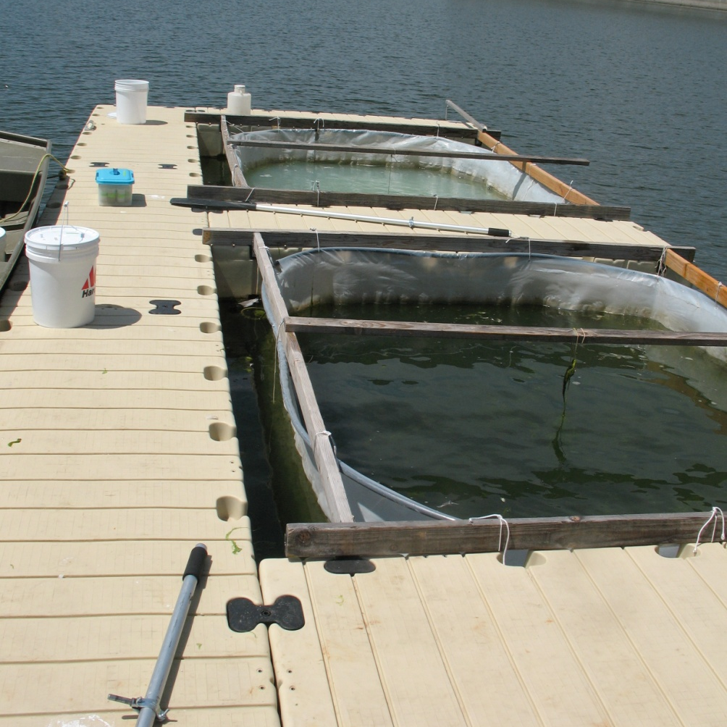
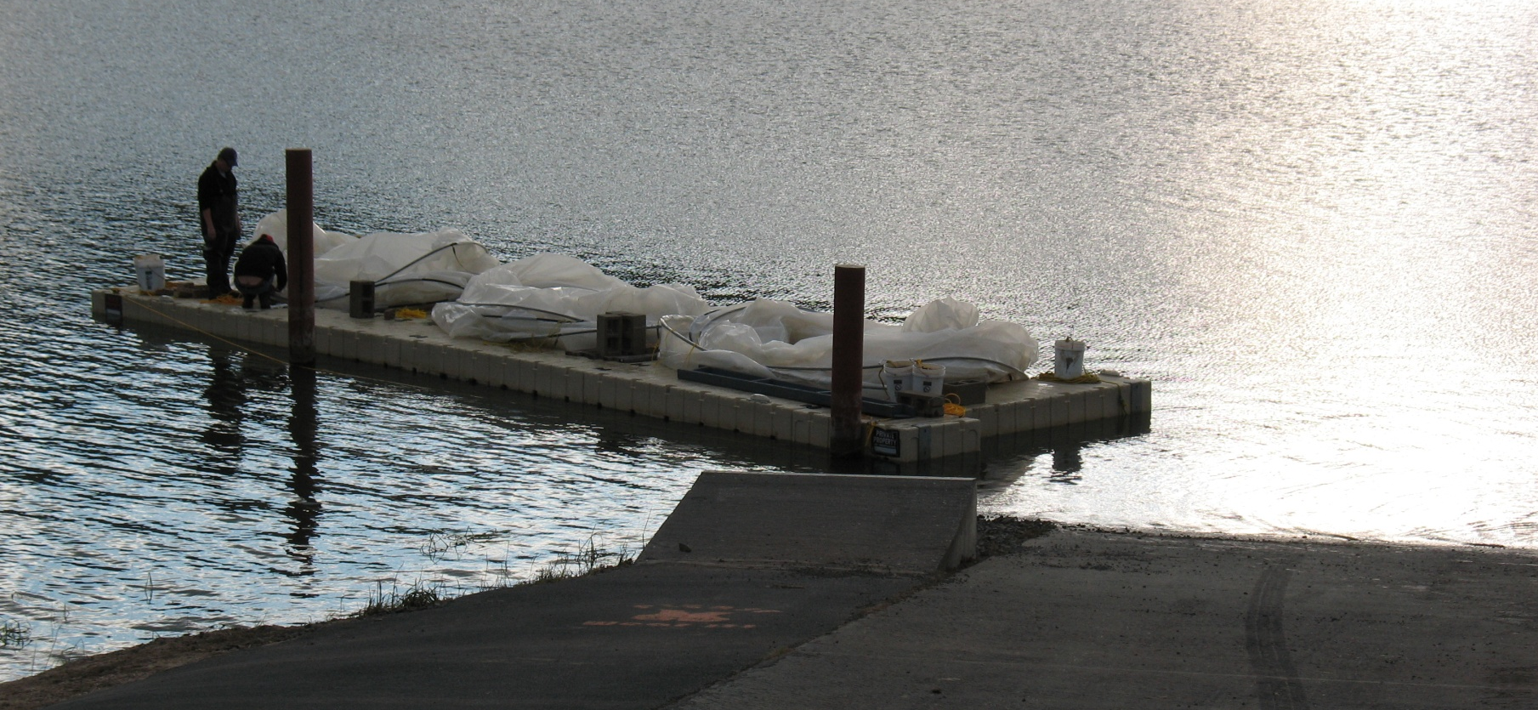
Proposed Project
Extend pilot study
  Interruption negated cumulative effects
  Additional time needed to evaluate project
Limnological and kokanee monitoring will continue in existing form
Controlled experiment to asses effects of nitrogen addition

Slide 14
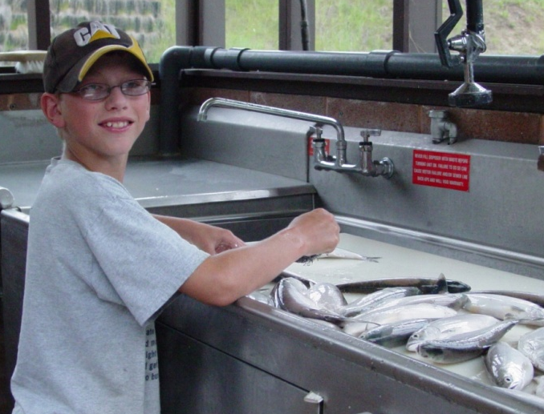
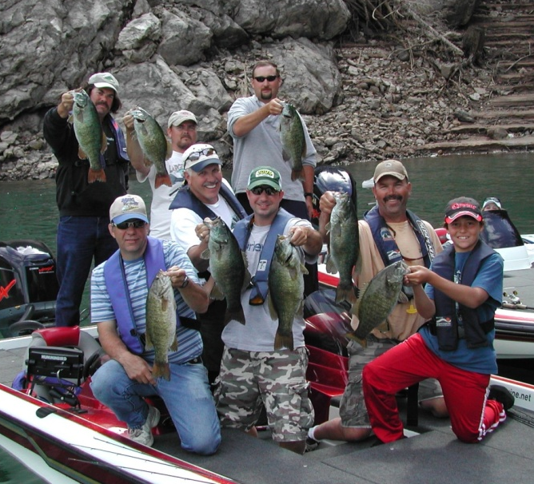
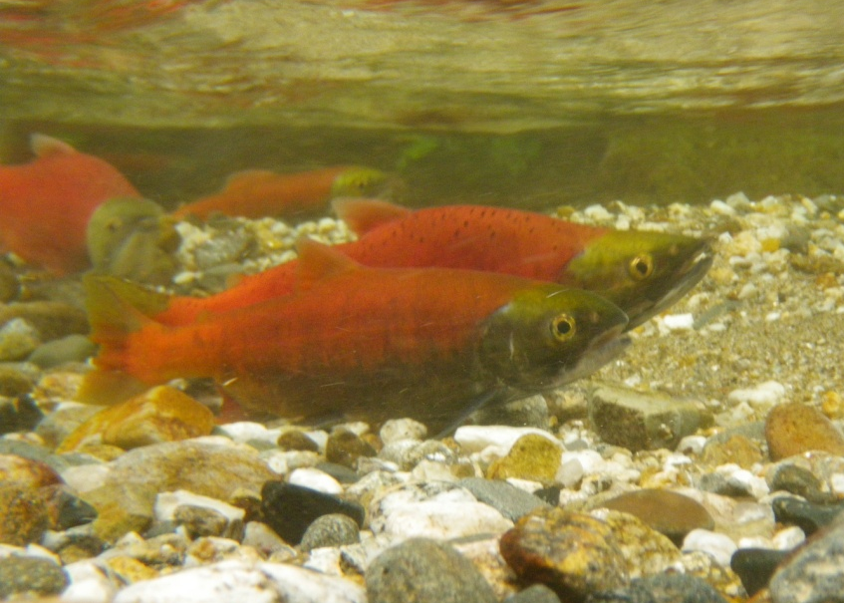
Conclusions and Implications
Reservoir responded positively to nutrient additions
Pilot study needs to be continued
Long-term implementation decision will follow
Monitoring costs much lower if implemented long-term
Potential to benefit entire NF Clearwater basin

Slide 15

Questions?

