Slide 1
Emerging Technology Appraisal
Presented to the NW Power Council – Conservation Resource Advisory Committee Meeting
Mark Rehley, Senior Manager, Emerging Technology / Product Mgmt
6/4/2014

Slide 2

Agenda
Emerging Technologies in the 6th plan
Hot Program Technologies
What’s Next (and should be in the 7th plan)
Notes:
2

Slide 3

Emerging Technologies from 6th Plan
  Ductless Heat Pump
  Heat Pump Water Heater
  SEM Industrial
  Consumer Electronics
  Network PC Management
  LED Streetlights

Slide 4

What’s Hot in Leading Programs
SEM
  Commercial
  Small industrial
LED Lighting
Residential Behavior

Slide 5
What’s Next
Technology Advances
Waves and Riptides
  6th Plan Example
  7th Plan Possibilities
Promising Technologies
  Residential
  Commercial
  Industrial
Action Plan Thoughts
Seventh
Power Plan

Slide 6
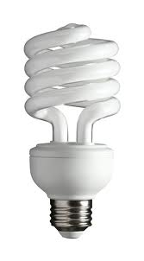

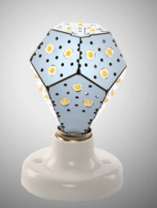

Technology Opportunities
16 LPW
66LPW
133 LPW
250LPW
Lumens Per Watt (LPW) = Light Output / Energy In

Slide 7
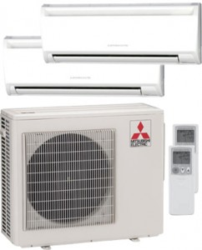
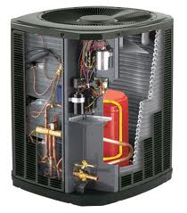
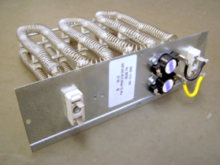
Another Example of Technology Advances
1 watt out
1 watt in
3 watts out
1 watt in
6 watts out
1 watt in
Coefficient of Performance = Energy Out / Energy In

Slide 8


Wave or Riptide
Waves carry you into shore, but you have limited choice on how fast or what beach you will land on.
Riptides require cooperative effort to get to shore.

Slide 9
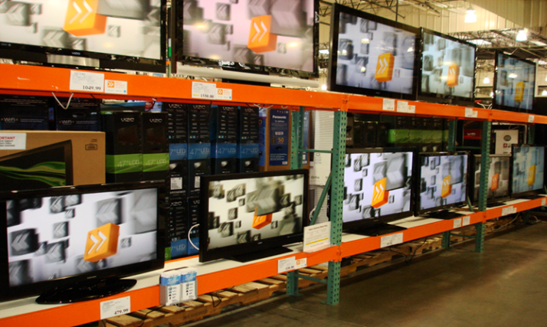
Televisions – A 6th Plan Wave
Notes:
We’ve done this before with televisions
We can leverage the retailer relationships we built with TVs to do the same with additional energy consuming products sold at retail

Slide 10
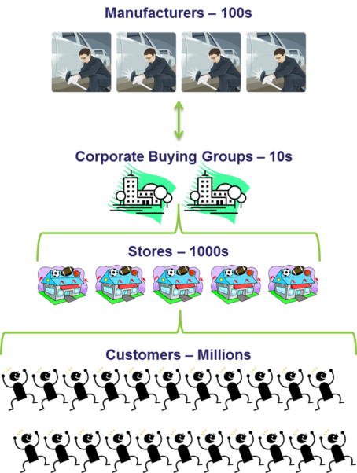
Leverage Made the Difference
National Retail is a key strategic asset that needs to be developed
Consumer Products Value Chain
Notes:
As we’ve seen, the savings potential in the consumer products market is big and usage continues to grow.
The Consumer Products market is huge, but because of the value chain, we believe it to be manageable.
There is a key point of leverage that can be addressed – The corporate buying groups of national retailers.
This group has the ability to influence the value chain upstream with manufacturers by the orders they place and downstream with end-users by the products they put on their shelves for sale.
Because of their unique role and ability to influence the entire value chain - National Retail is a key strategic asset that must be developed by the region in order to be successful in the Consumer Products market.

Slide 11
We Changed the Wave
“Panasonic, the biggest champion of plasma TVs, is giving up the ghost and will be closing its last plasma factory in 2014… For any size TV you want, plasma will provide a better deal…. For some reason, LCD is perceived as better.” (http://www.tomsguide.com/us/why-plasma-tv-dying,news-17668.html#why-plasma-tv-dying%2Cnews-17668.html?&_suid=138369661610907088299988064282)
“Panasonic kicked off its first TV model year without a plasma set in over a decade … That decision came after the company’s ZT plasma series TVs won rave reviews and shoot-outs for having one of the best pictures in the business. … Best Buy is getting near-exclusive access to several TV series, making Panasonic almost a house brand for the big-box chain.” (http://www.twice.com/news/tv/panasonic-revamps-tv-distribution-lifescreen/45264)

Slide 12
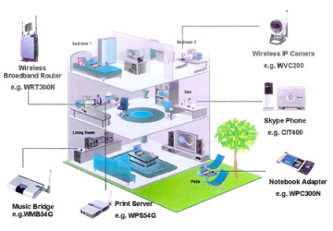
New Waves -The Connected Home
Risks
  No such thing as deemed, standard, prescriptive UES for a technology across a broad population.
  Product operation can and will be updated to serve the end user
Benefits
  Lots of data will be collected (can get our hands on it?)

Slide 13
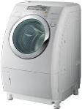

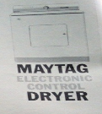
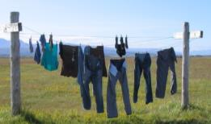
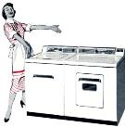
A New Riptide - Clothes Dryers
Paddling for Shore
  Test Protocol & Specs
  Economies of Scale & Data
  Federal Standards
2024? Laundry System
Heat Pump Dryers
2015 Energy Star Dryer
1963 Auto Termination
1938 Electric Resistance Clothes Dryers
Solar Clothes Drying

Slide 14

Promising Technologies: Residential
  Residential Clothes Dryers
  Combination water heater / ductless heat pump
  High Performance Manufactured Homes
  Advancing codes toward net zero ready
  Windows
  Advanced water heating systems
  LED Lighting

Slide 15
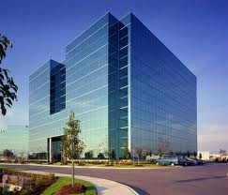
Promising Technologies: Commercial
  Commercial Interior Secondary Glazing
  Net zero ready construction
  Roof top units
    Controls
    Evaporative cooling
    Separation of conditioning & ventilation
  LED Lighting & Controls

Slide 16
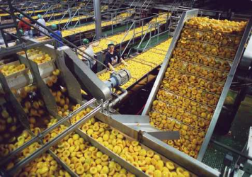
Promising Technologies: Industrial
  Power supplies
  Extended motor systems
  SEM Expansion
  LED Lighting

Slide 17

Action Plan - Catch a Wave
Residential
  Home / life automation
  Consumer electronics
  Advancing codes
Commercial
  Net zero ready – Trade off between efficiency and distributed energy
  Pervasive sensors, controls, & smart buildings
Industrial
  Global competition – the wave that never seems to go away

Slide 18

Action Plan – Paddle for Shore
Commit to supporting the long term, consistent investment needed for riptide initiatives
  Residential
  Clothes dryers
  DHP
  HPWH
  Combo Systems
  Commercial
  RTUs
  Deep retrofits
  Industrial
  Power Supplies
  Motor Systems
  SEM

Slide 19

Questions & Comments
Accelerating Market Adoption
Filling the Energy Efficiency Pipeline
Delivering Regional Advantage
Thank You!
Mark Rehley
mrehley@neea.org
503-688-5499
Notes:
19

