Slide 1
Value of Energy Efficiency White Paper

Slide 2
What is “The Value of EE White Paper”?
Problem Statement: The 7P assesses the value of energy efficiency regionally, but does not look at distribution of the costs and benefits across different utilities
Purpose of the Paper:
Provide an overview of value of energy efficiency broadly
Analyze how:
Revenue requirements of utilities are impacted by the development of efficiency
Benefits flow back through the utilities in different positions
Focus is on Bonneville utilities

Slide 3
Why We are Doing This
Response to Public Utility Concerns
Related 7th Plan Action items:
BPA-5: Quantify value of conservation in financial analysis & budget setting forums
BPA-6: Assess BPA’s current EE implementation model and compare to other implementation approaches
BPA-7: BPA and the Council should develop a report that identifies barriers to conservation acquisition by BPA’s customer utilities with recommended strategies to eliminate or minimize such barriers

Slide 4
White Paper Outline
Executive Summary
Value Stream of EE
Context of the Bonneville System
Utility-specific Value of EE
Findings on Barriers to EE
Conclusion

Slide 5
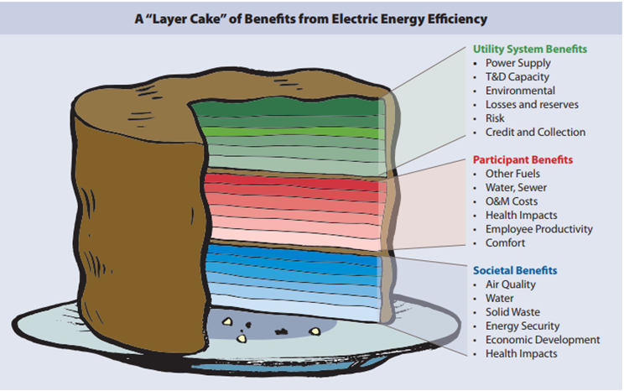
Paper documents the benefits of EE and describes how they flow to beneficiaries

Slide 6
Present Costs
BPA $
Customer Utility $
Citizen $
Council View
Customer Utility Portfolio
BPA Portfolio
Future Benefits
BPA Revenue Impacts
Increased Long-term/Short-term Sales
Reduced Transmission Upgrade/Maintenance Costs
Customer Utility Revenue Impacts
Reduced BPA Tier 1 Power Bill
Reduced Distribution Upgrade/Maintenance Costs
Citizen Impacts
Reduced Future Electric Bills
Other reductions in cost related to measure
Reduced Tier 2 Cost and Associated Risks
Avoided RPS and Reserves
EE Measure Implemented

Slide 7
Disclaimer
Bonneville rates are complex. This presentation has been sent to Bonneville for review but was not drafted by Bonneville rate staff. The Council staff has done our best to represent the value of EE and the impacts on Bonneville rates and customers, but given that complexity, it is still possible that some details are missing. We continue to solicit feedback from Bonneville and others in the region and with that assistance we anticipate the final white paper will accurately reflect the value and impact of EE on Bonneville and its customers.

Slide 8
Regional Dialogue
Allocate shares of the Federal System
Tiered Rates
Contracts go through 2028

Slide 9
Post 2028
All bets are off, this presentation looks at the consequences assuming a similar rate structure after 2028, which may not be likely

Slide 10
BPA Customer Utilities
 | FY 2014-2015 | FY 2016-2017 | FY 2018-2019 | FY 2020-2021
Total RHWM Available (aMW): (RT1SC*) | 7,116 | 6,983 | 6,945 | 7,025
Count of Utilities** | 133 | 133 | 134 | 134
Count of Utilities Below RHWM** | 52 | 53 | 57 | 66
Sum Annual Headroom Below RHWM (aMW)** | 106 | 108 | 183 | 278
Count of Utilities Above RHWM** | 81 | 80 | 77 | 68
Sum Annual Energy Above RHWM (aMW)** | 173 | 222 | 276 | 279
Contract Type | Customer Count | FY2018 Net Requirement Load (aMW)*
Load Following | 118 | 3,224
Block | 2 | 511
Slice/Block | 14 | 3,055
Slice Share |  | 1,597
Block Share |  | 1,458
Total | 134 | 6,790
* Forecasts from BP-18 Final Proposal

Slide 11
Key Definitions for Flow of EE Benefits
Contract High Water Mark (CHWM)
Rate Case High Water Mark (RHWM)
Tier One Cost Allocator (TOCA)
BPA Product Classes & Customer Charges
Load-Following
Slice
Block
Transmission
Load-shaping charges
Demand charges
Differential flow of EE benefits based on these characteristics

Slide 12
Tier 1 Cost Allocator
$TOCA=\frac{min\left[RHWM, Netreq\right]}{\sum{RHWM}}$
Note: $\sum{TOCA≤1}$
Forecasted EE impacts Annual Net Requirement
Load Following customers can purchase up to RHWM but Block and Slice/Block must look at Annual Net Requirement

Slide 13
Tier 2
Customers have options for Tier 2:
Bonneville can procure the power and pass through the cost
Customers can procure the power directly
Customers can have a third-party procure the power on their behalf
Tier 2 does not impact Bonneville’s revenue requirement – costs are directly passed through to the customer

Slide 14
First-Year Customer Utility Portfolio Revenue Requirement
Above RHWM
Surplus Sales / Reduced Purchases
Cost of EE
Portfolio Costs:
Decrease
Increase
Below RHWM
Tier 1 Rate
Cost of EE

Slide 15
First-Year Bonneville Portfolio Revenue Requirement
Above RHWM
Cost of EE
Portfolio Costs:
Decrease
Increase
Below RHWM
Surplus Sales / Reduced Purchases
Tier 1 Rate
Cost of EE

Slide 16
Category of Bonneville Charges | Below RHWM | Above RHWM
Tier 1 Composite Charge: Most Tier 1 Costs | Reduced proportional to amount of incremental EE | No change
Tier 1 Load-Shaping Charge: Costs to shape power to utility monthly and daily needs | Charges can be reduced or increased depending on relative change in monthly load profile | No change
Tier 1 Demand Charge: Costs for peak demand | Reduced if surpasses threshold | No change
Tier 1 Non-Slice Charge: Includes credits for incremental surplus sales due to energy efficiency | Reduced proportional to amount of incremental EE. A small amount of incremental surplus sales revenue due to EE is shared among all Tier 1 customers along with all other surplus sales revenue. | No change
Total Tier 1 Charges | Reduced | No change
Tier 1 Rate ($/MWh) | No change | No change
Tier 2 Charges | Zero | Reduced proportional to amount and cost of Tier 2 avoided
Tier 2 Demand and Shaping Charges | Zero | Charges can be reduced or increased depending on relative change in monthly load profile

