Slide 1
Fort Hall Stream Habitat Restoration
Project 199201000
Shoshone-Bannock Tribes
Fish and Wildlife Department

Slide 2
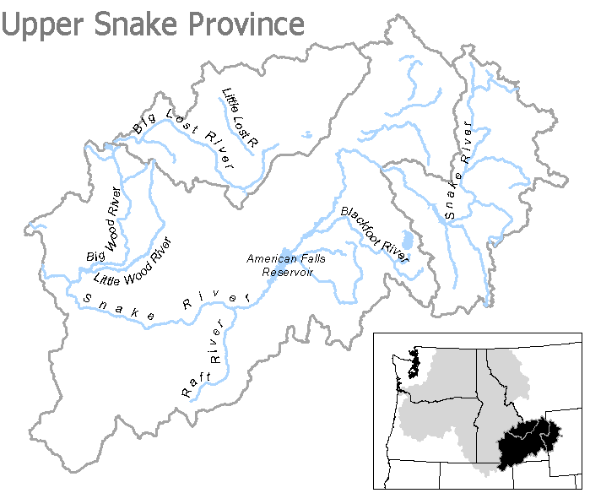

Slide 3
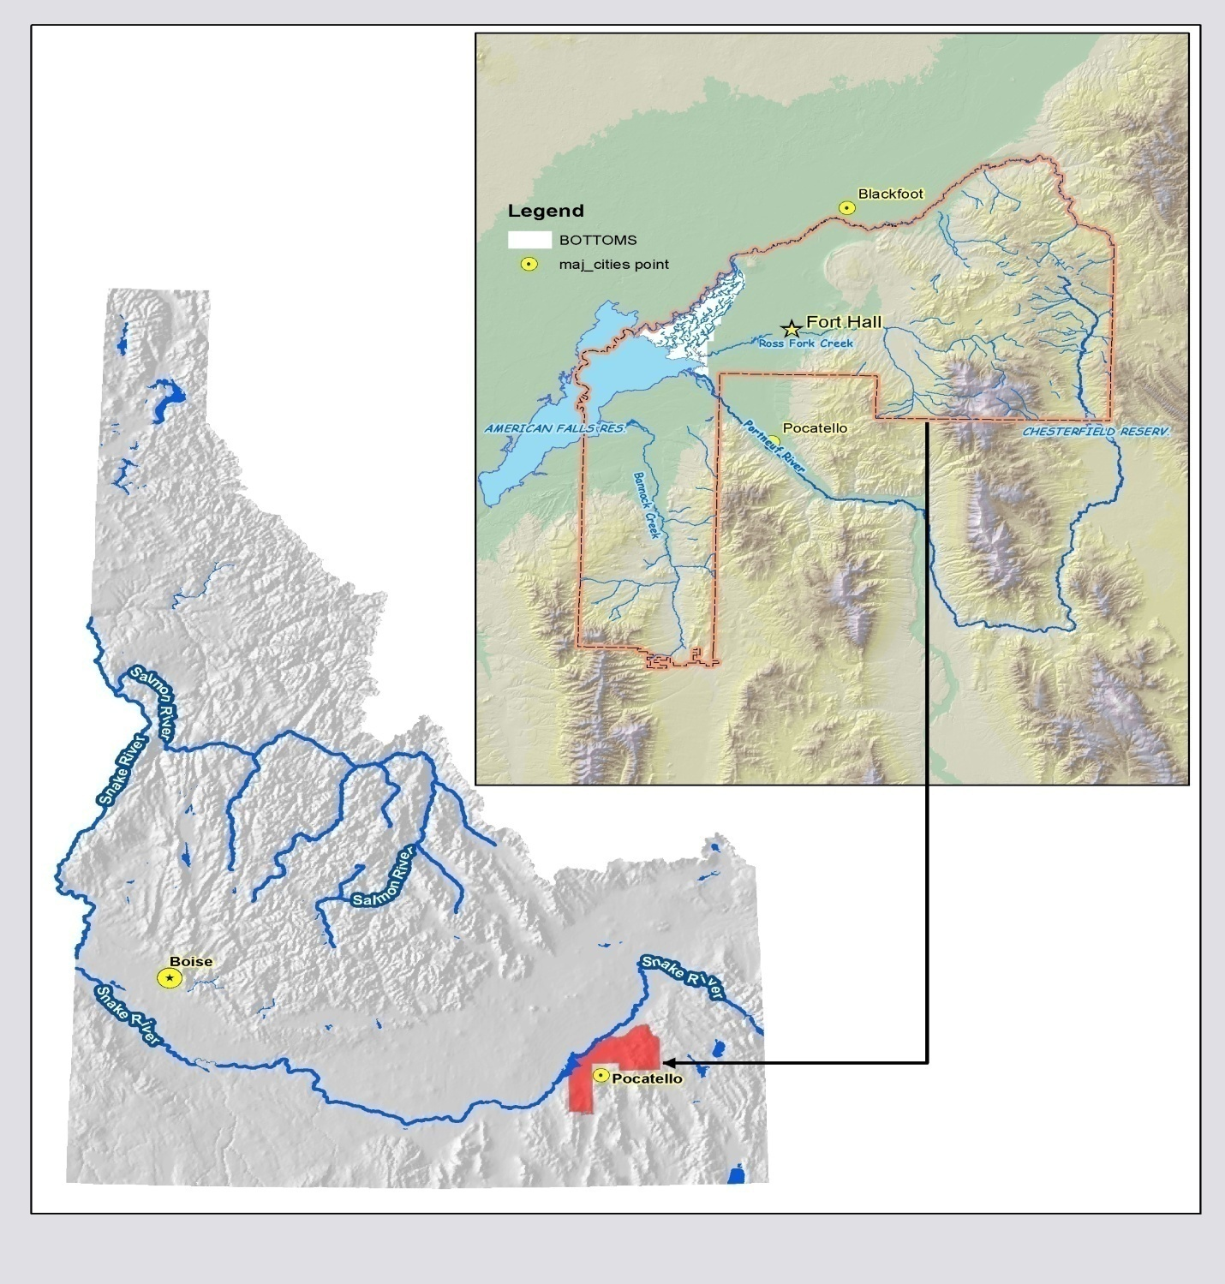
Fort Hall Reservation

Slide 4
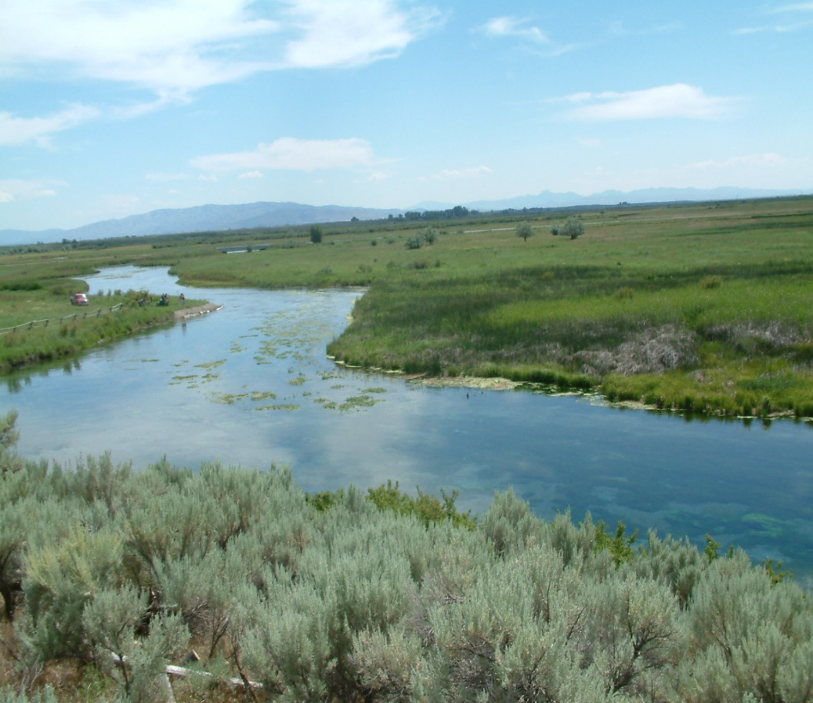
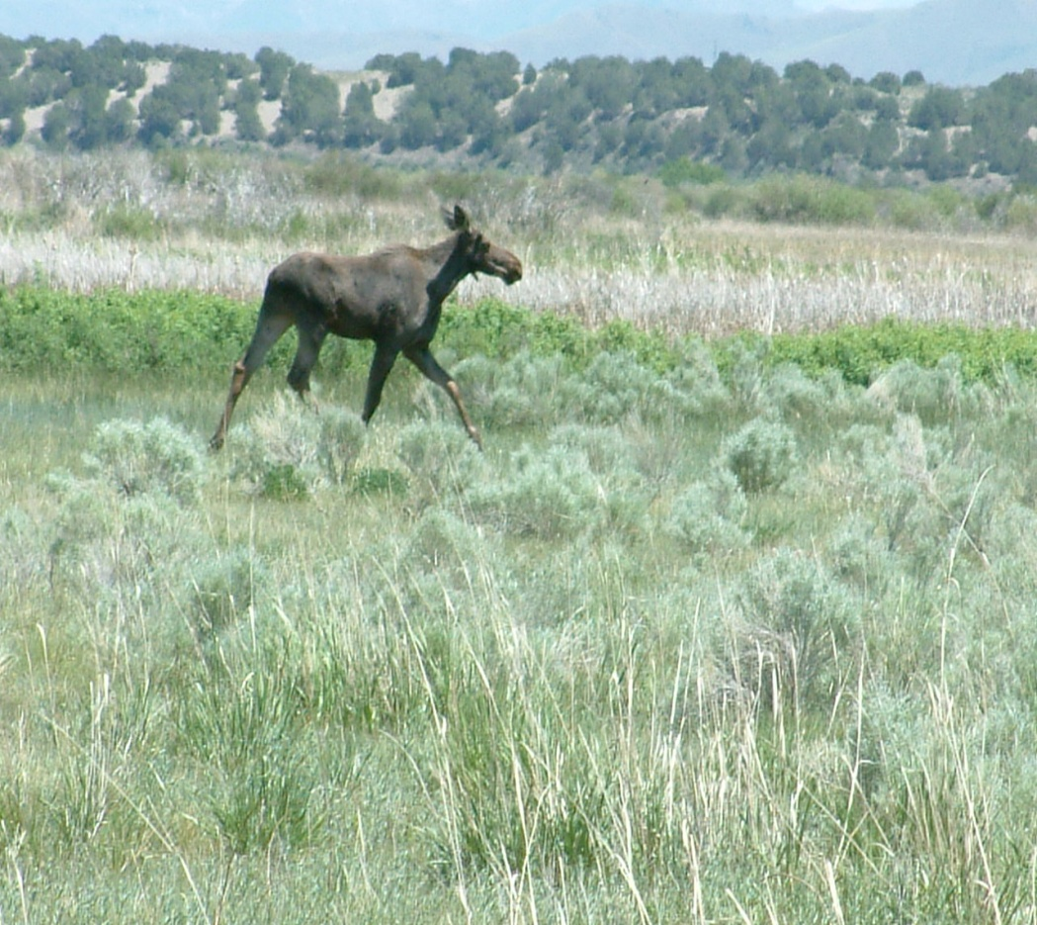
Fort Hall Bottoms
Notes:
A siginigicant portion of the project is focused on the Bottoms spring creeks. An area of approximatley 33,000 acres of wetlands fed by numerous spring creeks ranging from 20 to 280cfs.

Slide 5
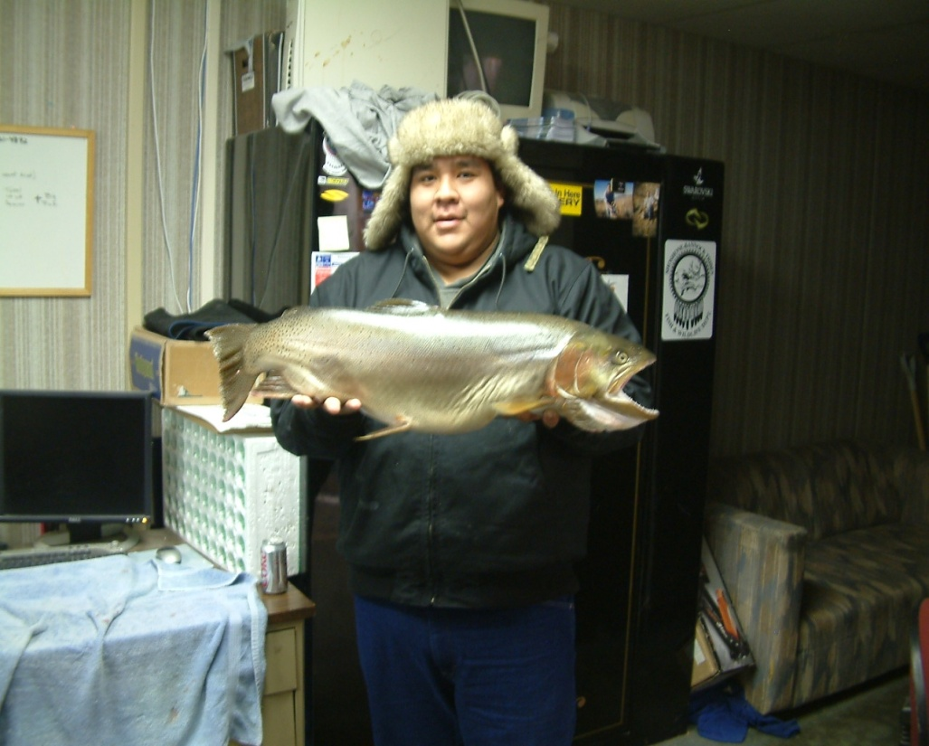
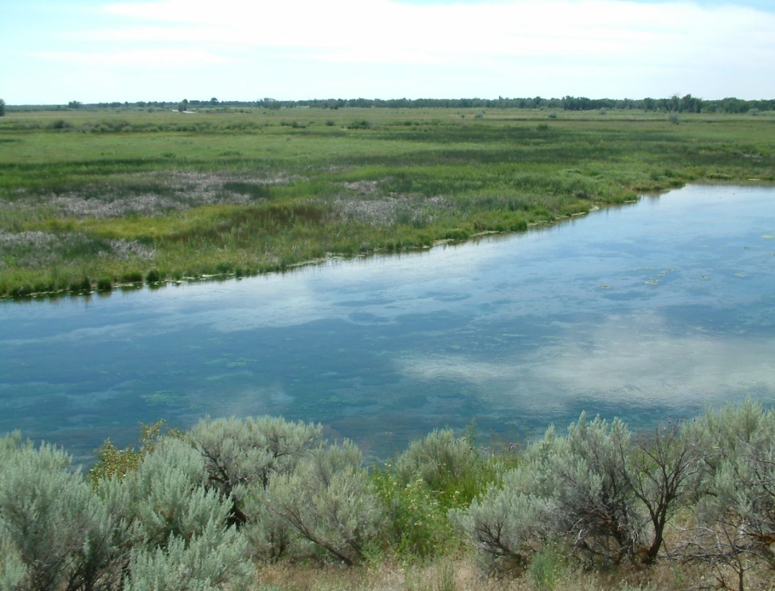
Tribal Policy and Objectives
Pursue promote and initiate efforts to restore the Snake River ecosystem to a normative state which supports diverse native assemblages of species.
Ensure and provide abundant opportunities for tribal trust and treaty right harvest for members of the Shoshone-Bannock Tribes
Notes:
Our “marching orders” are from our Natural Rivers Policy….

Slide 6
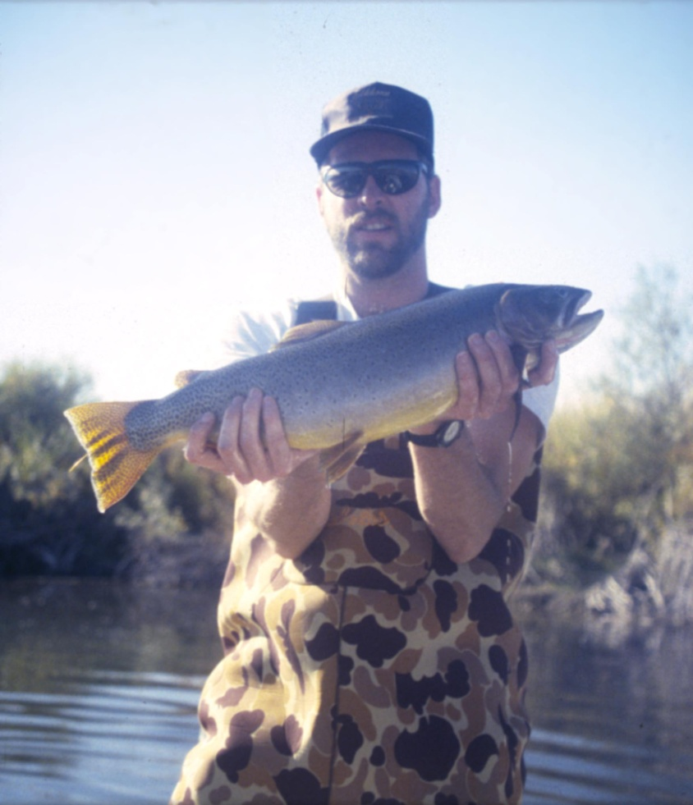
Project Objectives
Protect, Enhance, Restore
  Stream ecosystems to normative condition
    Facilitate the recovery of focal species (YCT)
Notes:
Primary objectives will include projects that protect enhance stream habitat for focal species such as yct. Facilitation of yct recovery through protection and enhancement projects is consistent with the objectives for the Upper Snake Subbasin Plans..

Slide 7
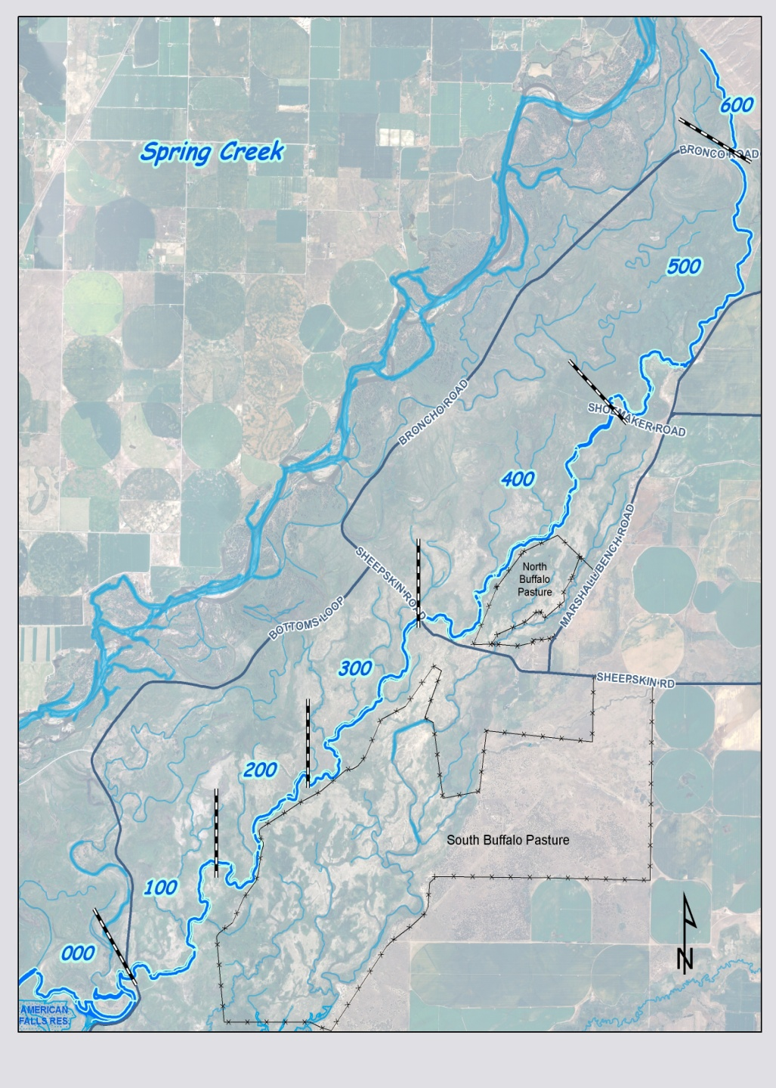
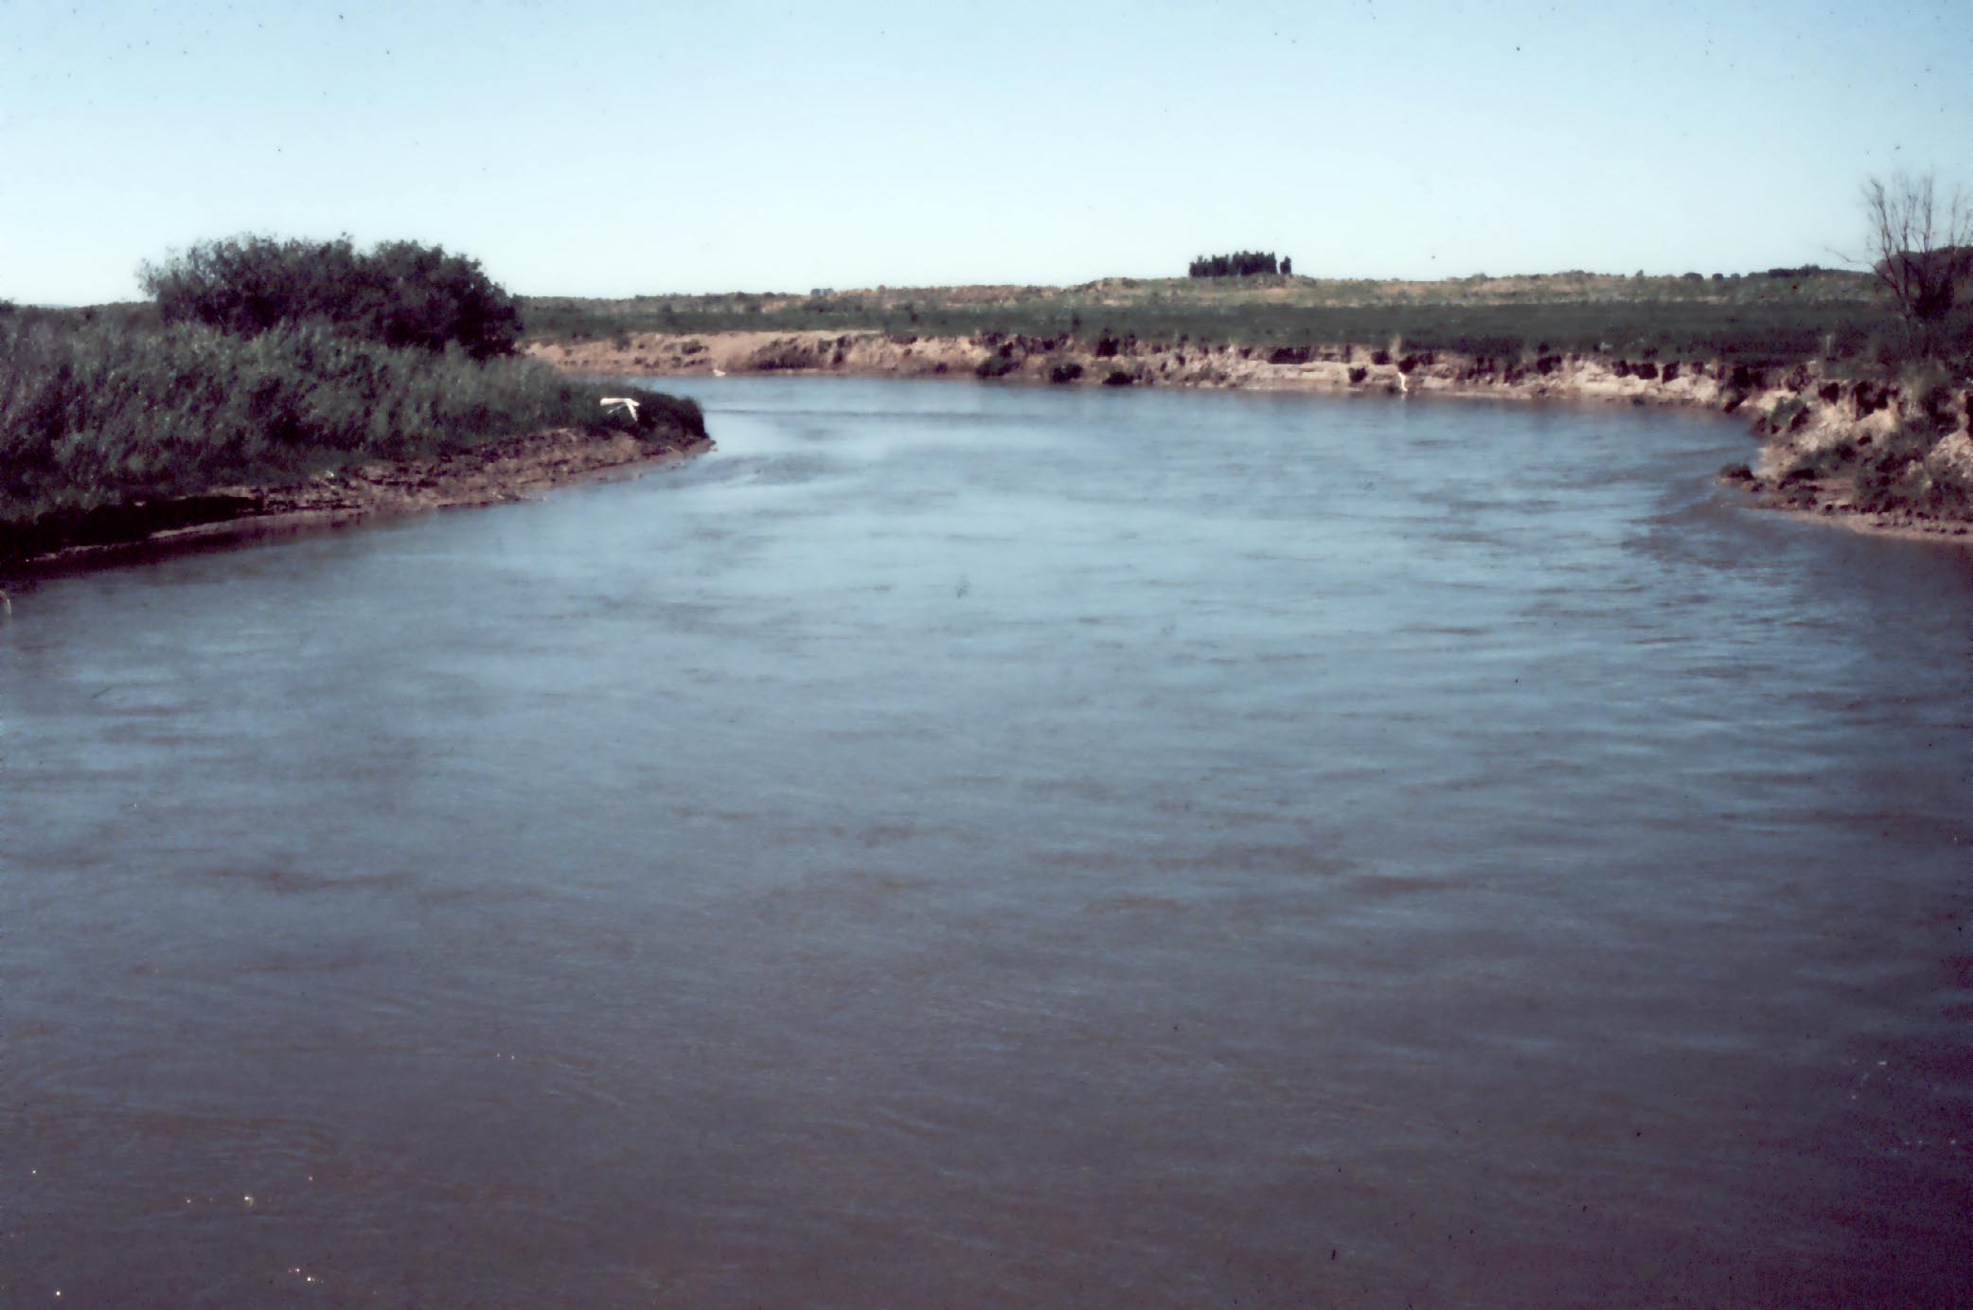
Project Sites/selection
Notes:
Projects are currently implemented at or near spawning areas and where access permits along an estimated 9kilometers of stream along Spring Creek. Efforts have been focused on Spring Creek during the last 7 years due to continued bank sloughing and erosion. Projects are implemented annually along with routine maintenance of past projects.

Slide 8
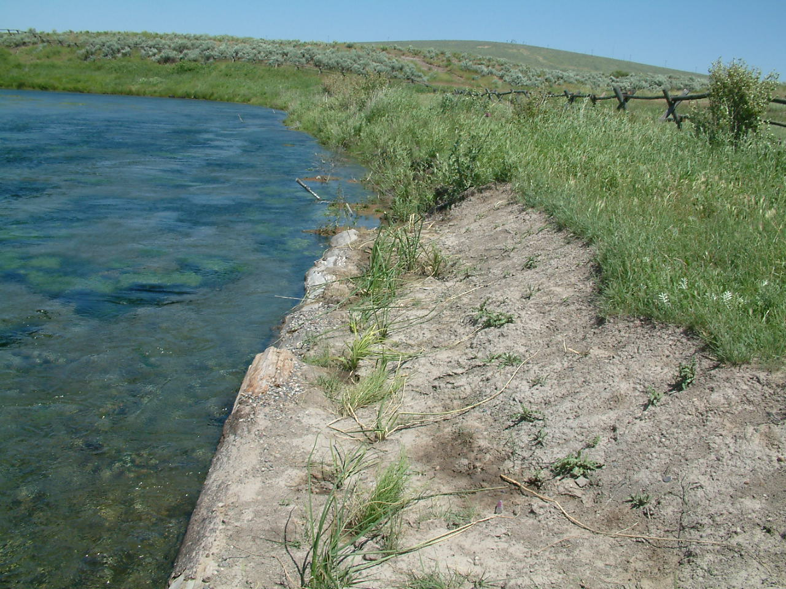
Types of Projects
Sloping
Revegetation
Fencing
Notes:
Types of enhancement/restoration projects include: protection of streambank….

Slide 9
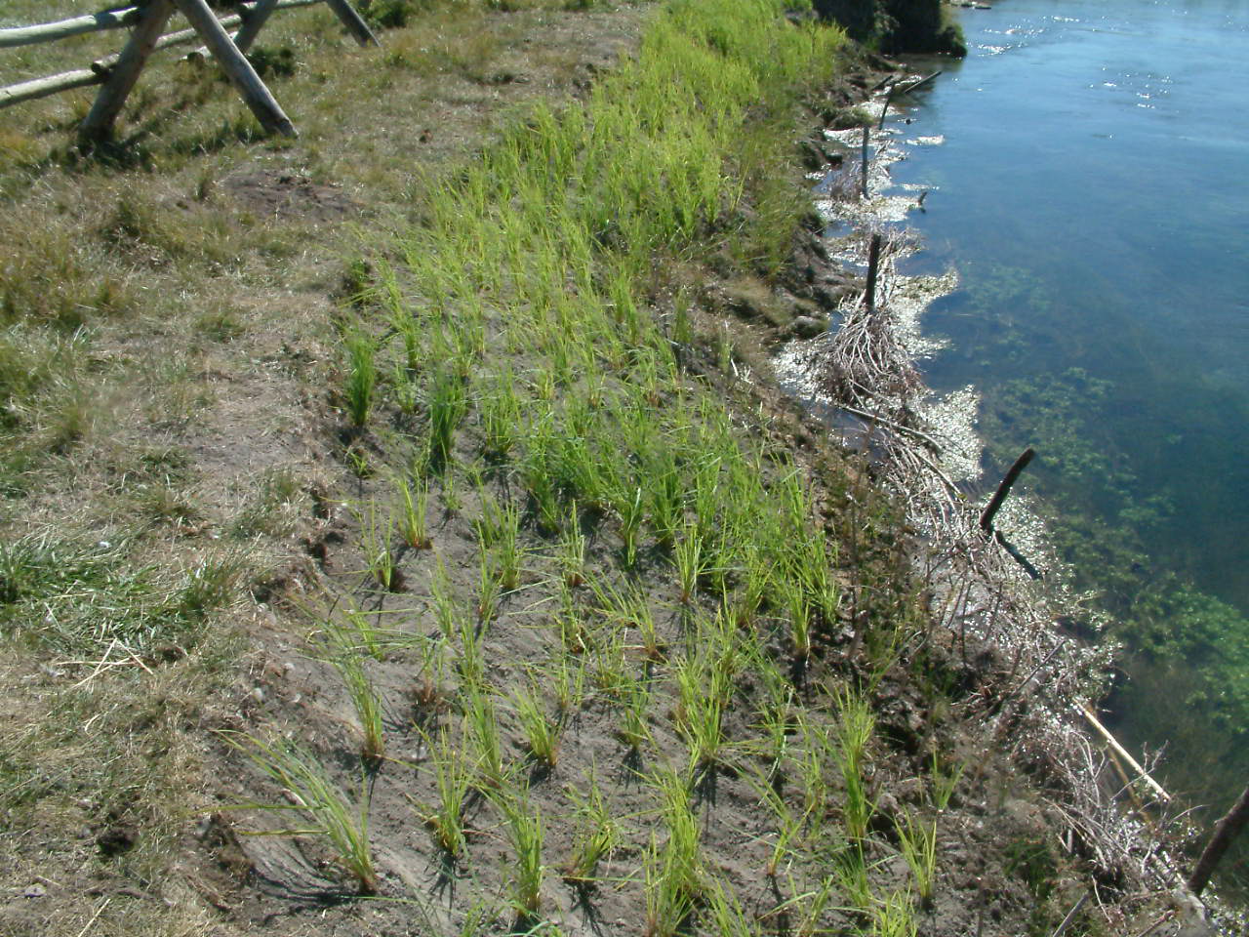
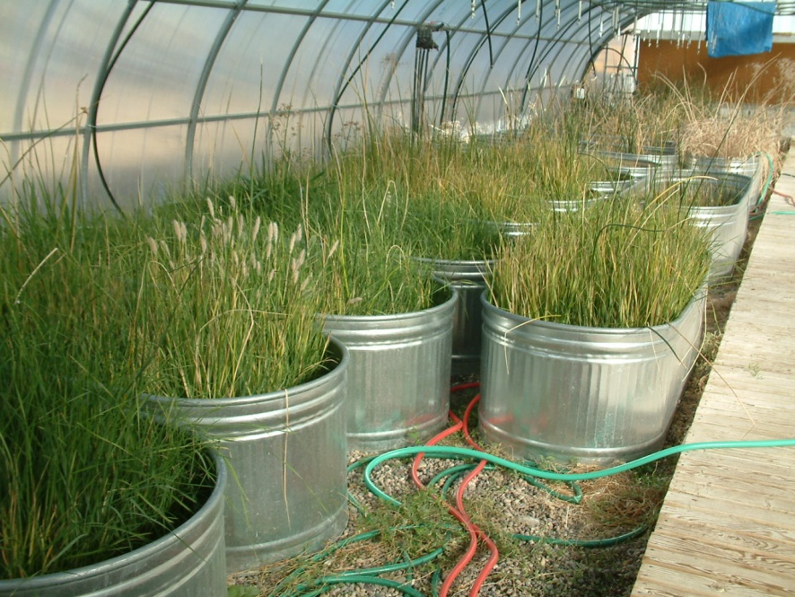
Tribal Nursery supplies plugs for planting
Notes:
Its important to note that native plants are propagated from seed stock from the Bottoms in the tribal nurseries.

Slide 10
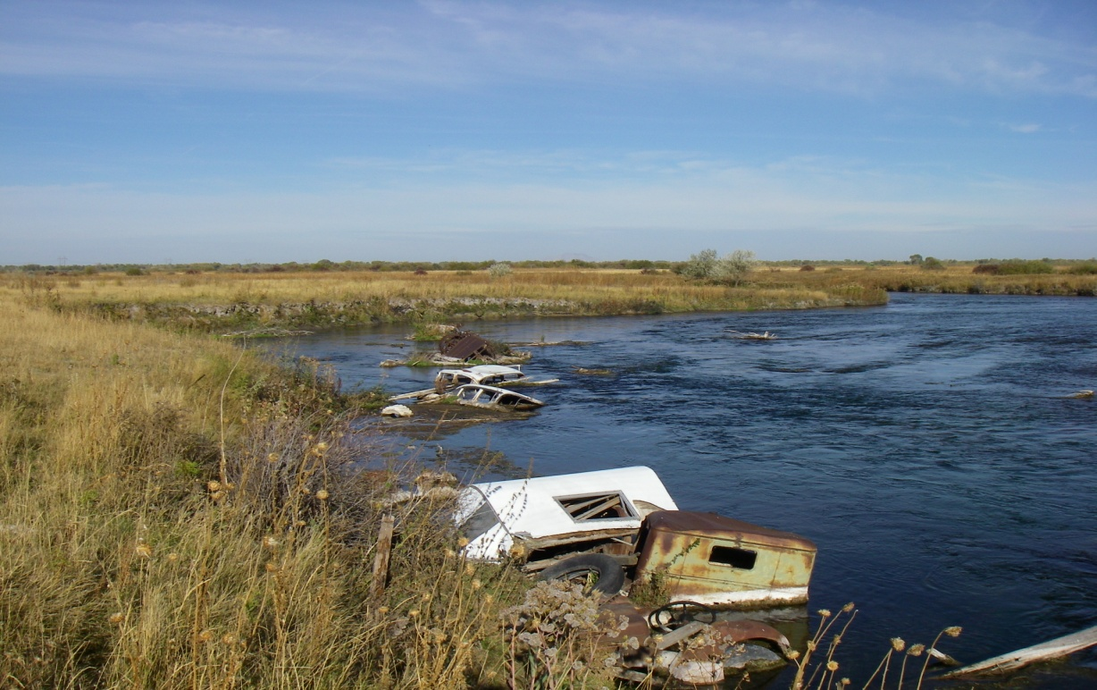
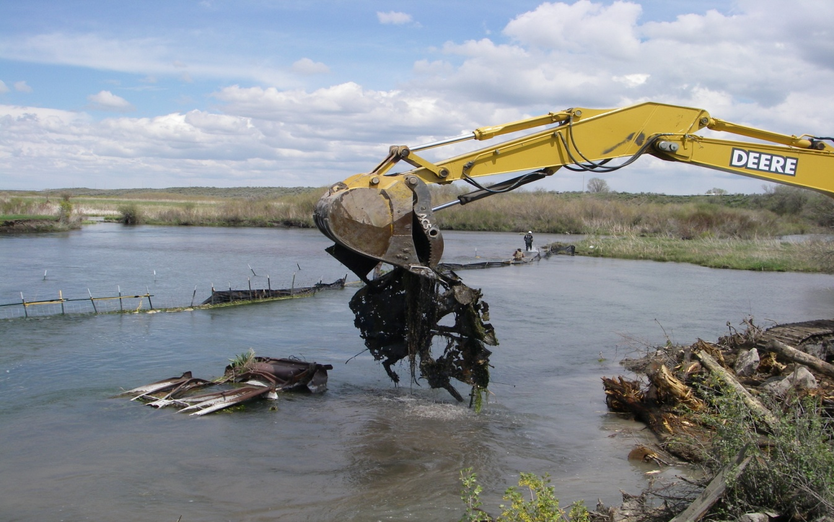
Notes:
Stream channel restoration, and habitat instream enhancement. This was a relatively large project implemented in 2010 on the Bottoms. Desired outcomes were increased aggrade sediments for spawning, increase depth for refuge of large trout.

Slide 11
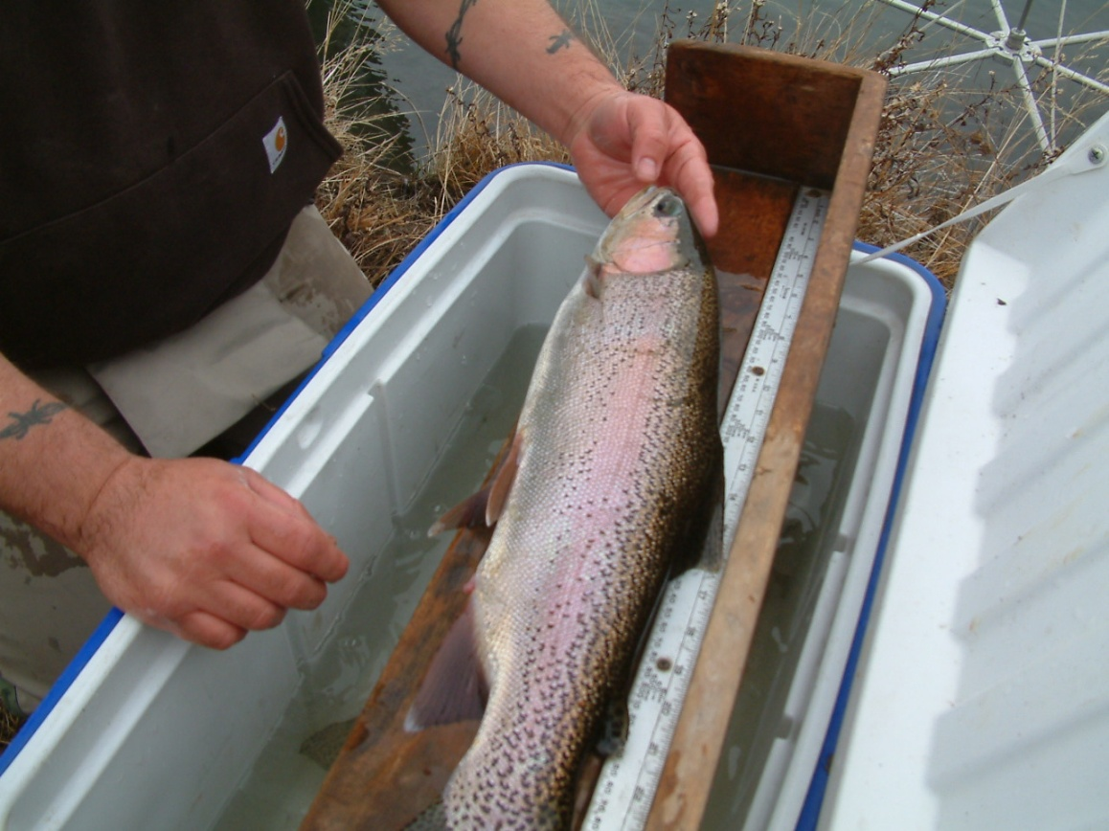
Monitoring
Pre and Post Implementation
  Stream channel morphology (width depth)
  Fish density and biomass
  Riparian vegetation
  Substrate (%fines)
Notes:
These are examples of some of the attributes monitored. All sites are monitored annually and include areas above the site and below to further track changes.

Slide 12
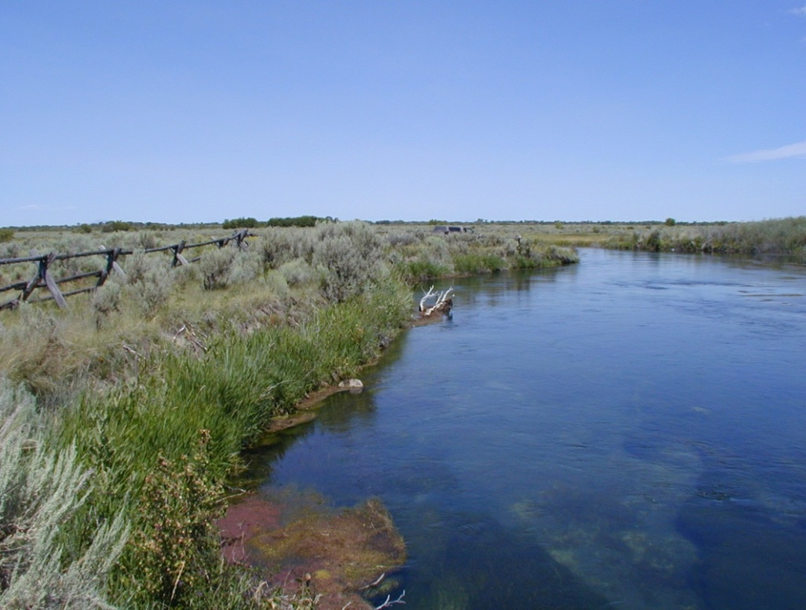
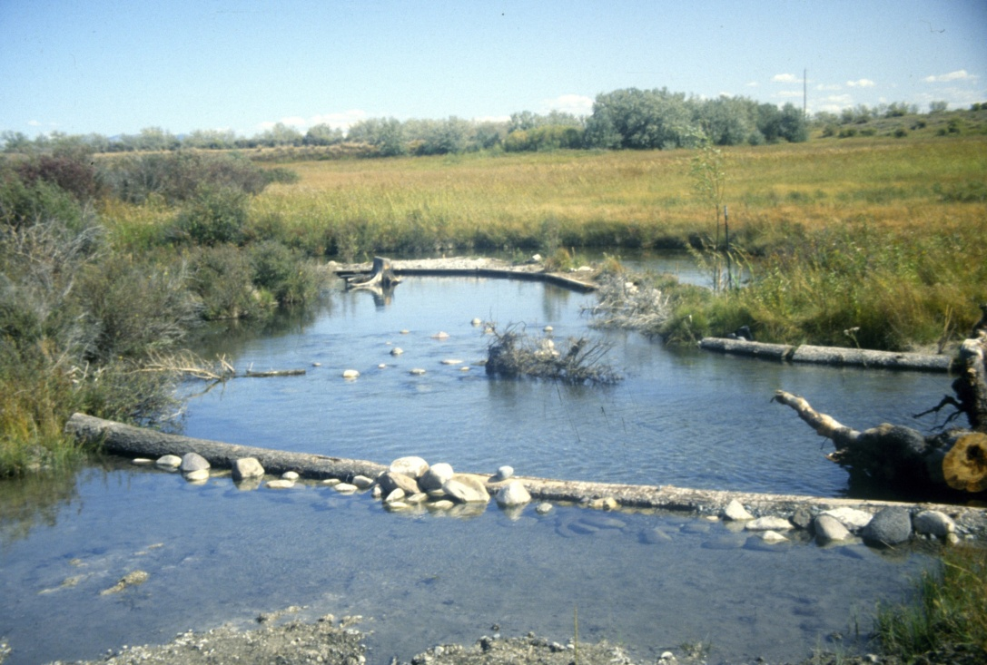
Results
Localized increase in trout densities
And biomass (fry and adult)
50-20 percent localized reduction of fines (<6.5mm) at treatment areas.
Reducing barebanks frequency at and near critical spawning sites to 50-5%.
Notes:
Brief results include: higher densities of trout at or near project sites, mean reductions in fine sediments and barebanks through sloping and reveg projects which included over 20,000 wetlands plugs with 50-80% survival estimates vs 20 – 0 % for willows alone.

Slide 13
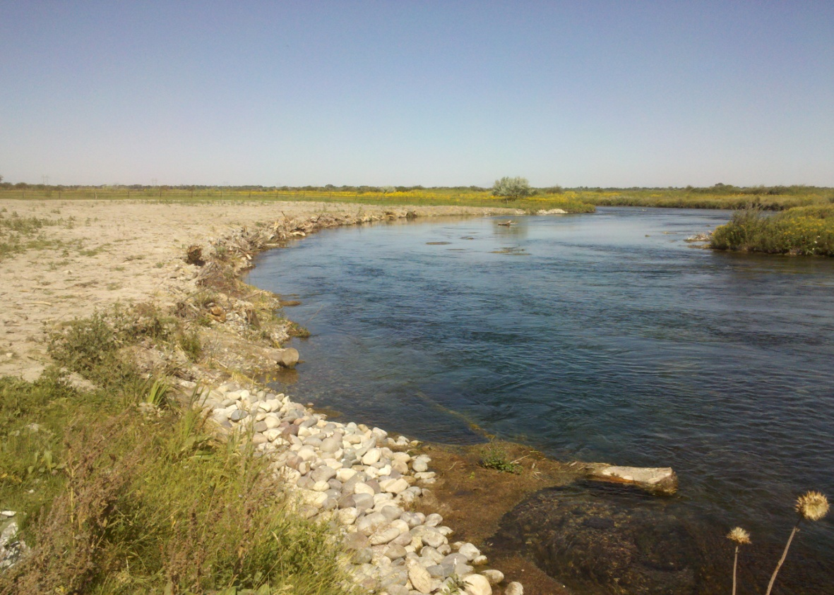
Results
Increases in biomass and densities for larger trout post-treatment.
Notes:
Early results for our larger project the car removal indicate increases in average densities and biomass. Increases like these are typical immediately post-projects, instream structures are where most trout were caught. this will be the trend for this site we believe due to the fact that substrate was removed to create a deeper channel and debris places strategically in the bank futher amoring it, and will require little to not routine maintenance as with other smaller scale projects. Bank sloping protection projects alone donot seem to yield higher densities of trout unless combined with instream placement of structures.

Slide 14
Discussion
Project meeting objectives
Further evaluation
How are projects affecting wild populations for the Bottoms?
Habitat assessments conducted for future projects on Bottoms.
Continues to protect preserve and enhance habitat for yct.
Upholds Tribal Policy
Promotes opportunities for Tribal Treaty and non-member fishing.
Notes:
Project continues to be beneficial as it provides “hotels” for wild trout but how are populations for Bottoms spring creeks affected? Are we providing for higher outcomes in densities, biomass, recruitment, etc.? Also, inventory and assessments should occur to develop a better understanding of project type, and site selection for the Bottoms. Grazing impacts need to be managed for future successes of projects through determination of what the Bottoms can support in terms of grazing animals, and reduce the numbers accordingly. This will be more cost effective as purchasing of fencing exclosures will be reduced.

Slide 15
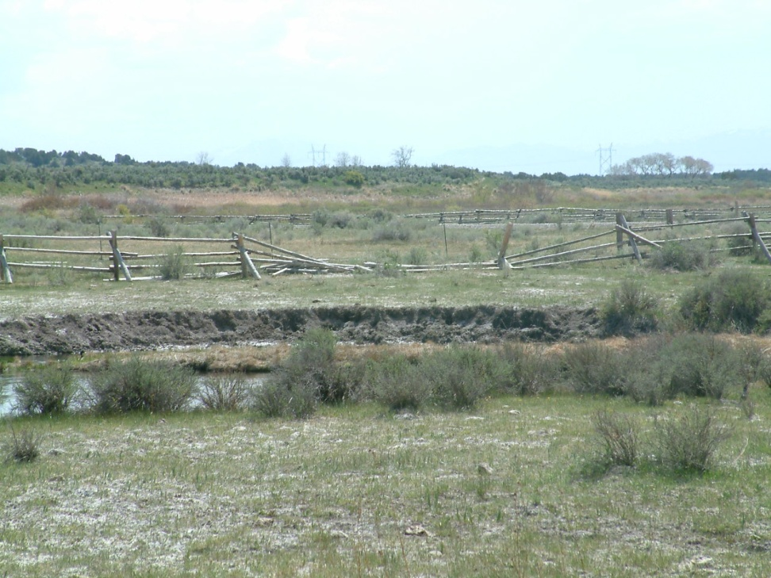
Conclusions
Lessons learned
Adequate exclosures are critical post project implementation.
More successful with revegetation strategies.
Treatment areas with instream structures vs bank sloping
Notes:
Through the years weve refined our strategies based on successes. Sucessful projects have been negatively affected by roaming buffalo, in which post project results are back to pre project levels. Since inception of the tribal nurseries revegetation has been more successful as planting now consists of plugs vs willow shoots. Bank sloping vs instream structures appear to be easier to maintain. All enhancement projects require annual maintenance and will at times require a large amount of resources.

Slide 16
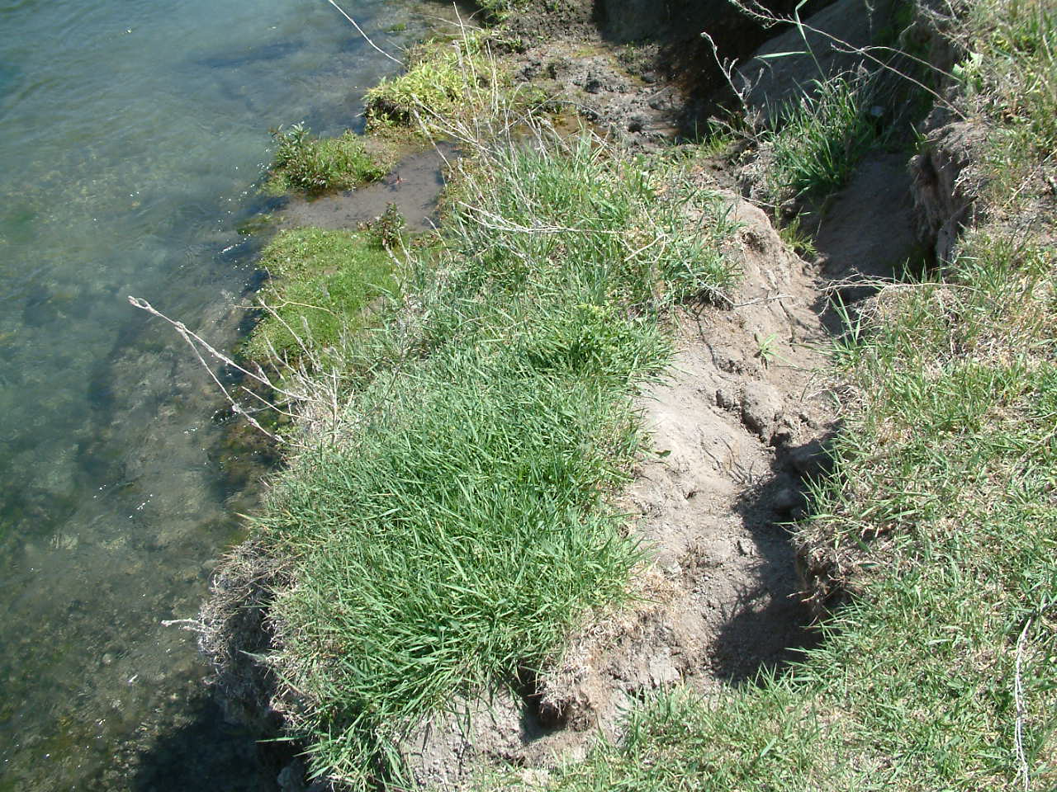
Conclusions
Habitat continues to be a limiting factor.
Increased channel widths and sedimentation.
Continue with larger restoration projects which enhance for multiple life stages for trout.
Notes:
Further, erosions is still a factor on most of Bottoms spring creeks, as reservoir operations and grazing also contribute, also, other more effective methodologies need to be implemented to better track changes on larger streams on the bottoms such as spring creek, where incidently most of the project work takes place.

Slide 17
