Slide 1

Evaluate the Life History of Native Salmonids in the Malheur River Subbasin,
1997-019-00:
New objectives and directions for FY2013-2017
Erica Maltz, Fisheries Program Manager
Drew Harper, Fish Biologist
Burns Paiute Tribe
18 January 2012

Slide 2
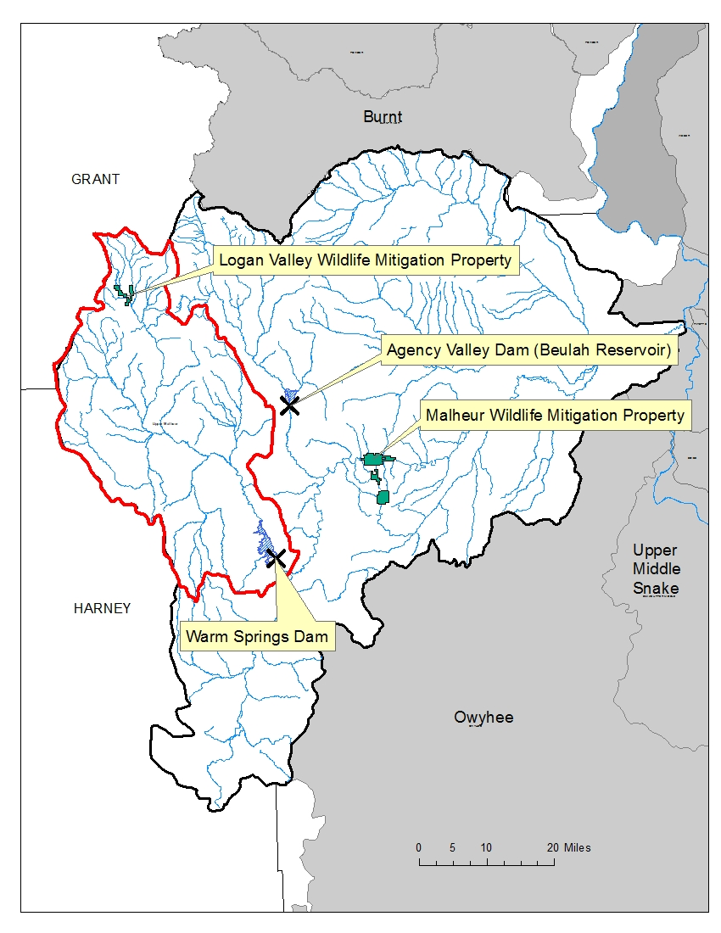
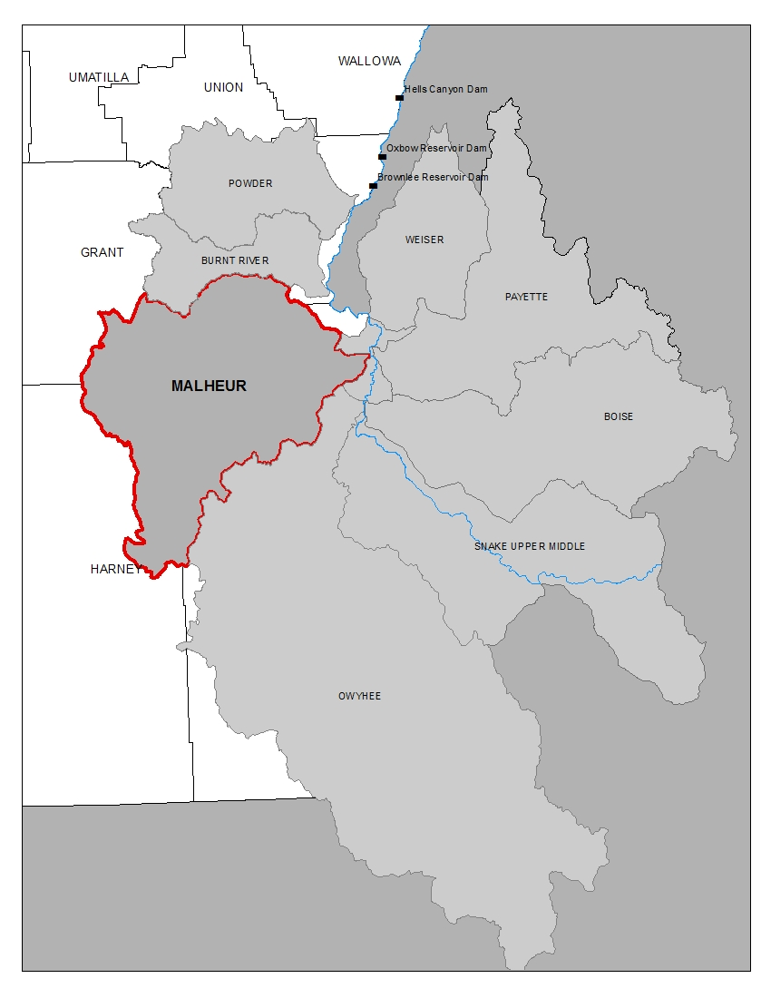
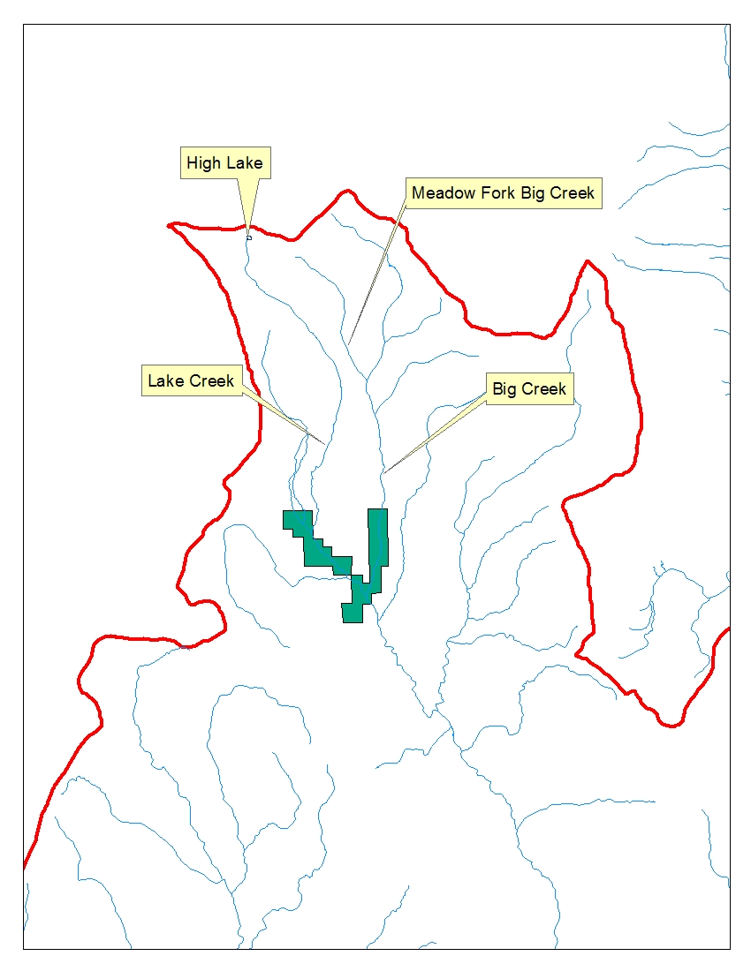
Proposed Work Area

Slide 3
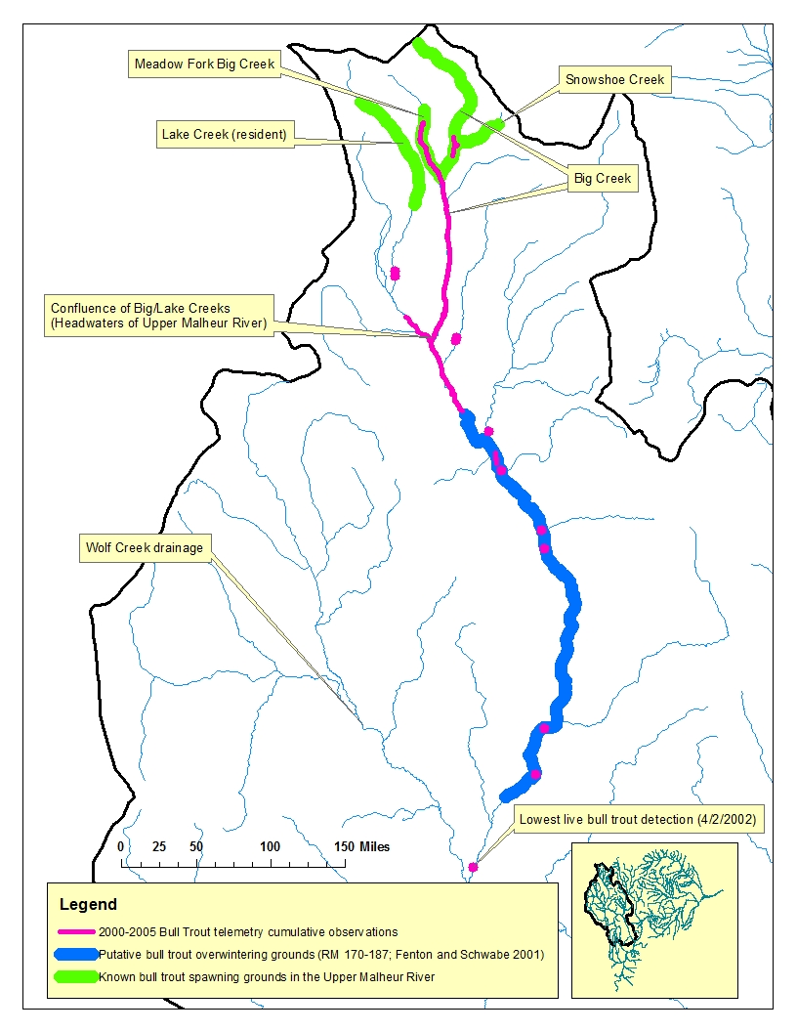
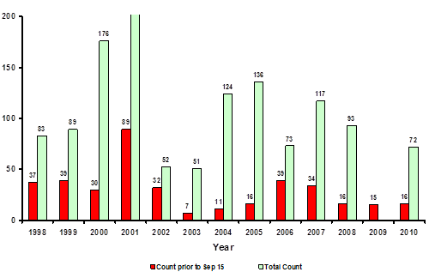
Problem Statement: Bull Trout
What we’ve accomplished through 1997-019-00 …
Timing and spatial extent of seasonal movement of migratory BUT
Resident vs. fluvial
Trends in adult abundance
BT are a primary limiting factor to recovery
From Perkins (2010).

Slide 4
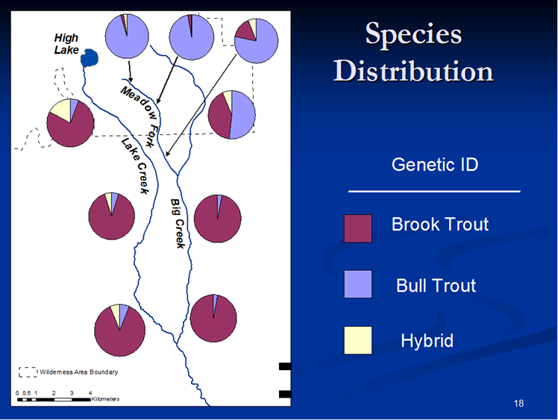
Primary Limiting Factor: Brook trout dispersal, competition, hybridization†
Lake Creek
  Highest occurrence (10:1)
  Dispersal from upstream seed source (atypical)
  Hybridization beyond F1/reciprocal backcrossing
  Pulse colonization
Big Creek
  Typical dispersal
  Headwaters are “stronghold” for BUT
*
Phenotypic characteristics→ good indicator of genetic identity
† Paul and Post (2001), Gunckel et al. (2002), DeHaan et al. (2009).
* Taken from an ORAFS presentation by Chad Abel (Feb. 25, 2010), “Upper Malheur Brook Trout Suppression Plan.”
Notes:
Sympatry, Atypical pattern of dispersal (Lake Creek)
Typical pattern of dispersal (Big Creek)
Phenotypic characteristics are good indicators of genetic identity

Slide 5
Objectives
Test the efficacy of mechanical methods to suppress brook trout populations in Lake and Big Creeks
→concurrent to additional BPT projects
Facilitate coordination between co-management agencies to develop a strategic brook trout management plan (Phase II)
  →BPA $$ to attract restoration/recovery activities
Produce annual assessment of bull trout adult abundance in regards to demographic target recovery criteria
Provide statistically rigorous annual redband trout abundance estimates to guide management

Slide 6
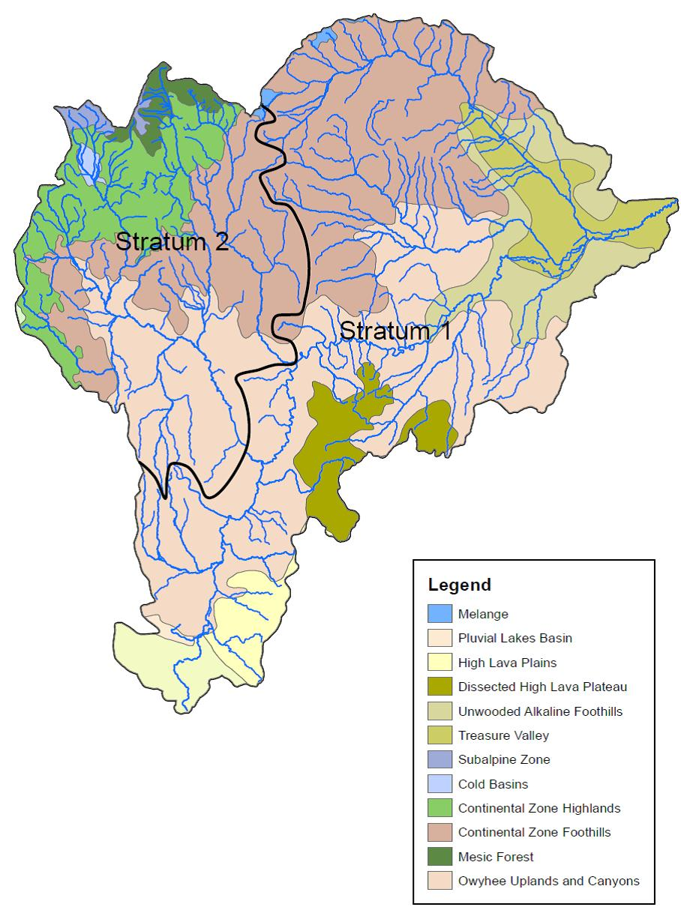
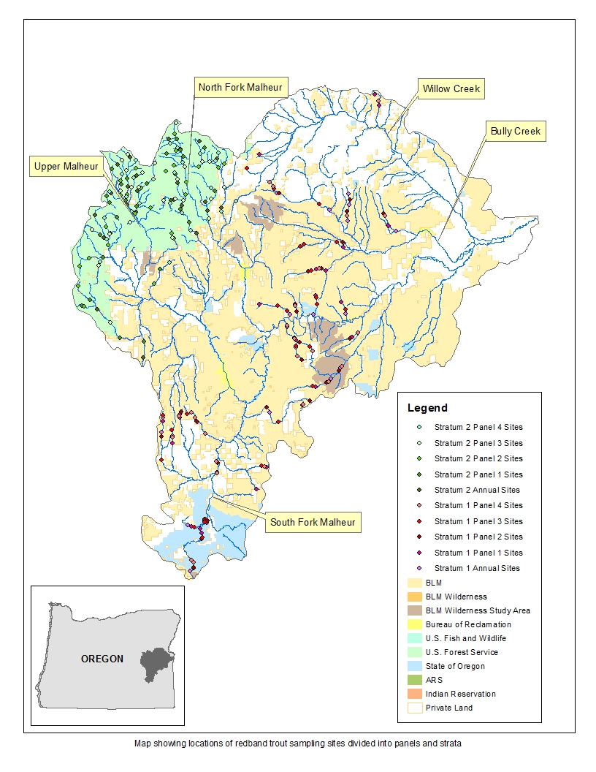
Study Design: Redband Trout Abundance and Distribution
2007-2011
Target total 108 sites/5yr
  No fixed panel
  No overdraw
  Refine distribution
High σ²
+
Low N
2013-2017
3 crews for target of 100 sites (50/each strata/year)
GRTS design rotating panel
34% target (estimated) precision across two strata
Notes:
Same issues that the state is wrestling with
HOW MANY SITES, SAMPLING FREQUENCY

Slide 7
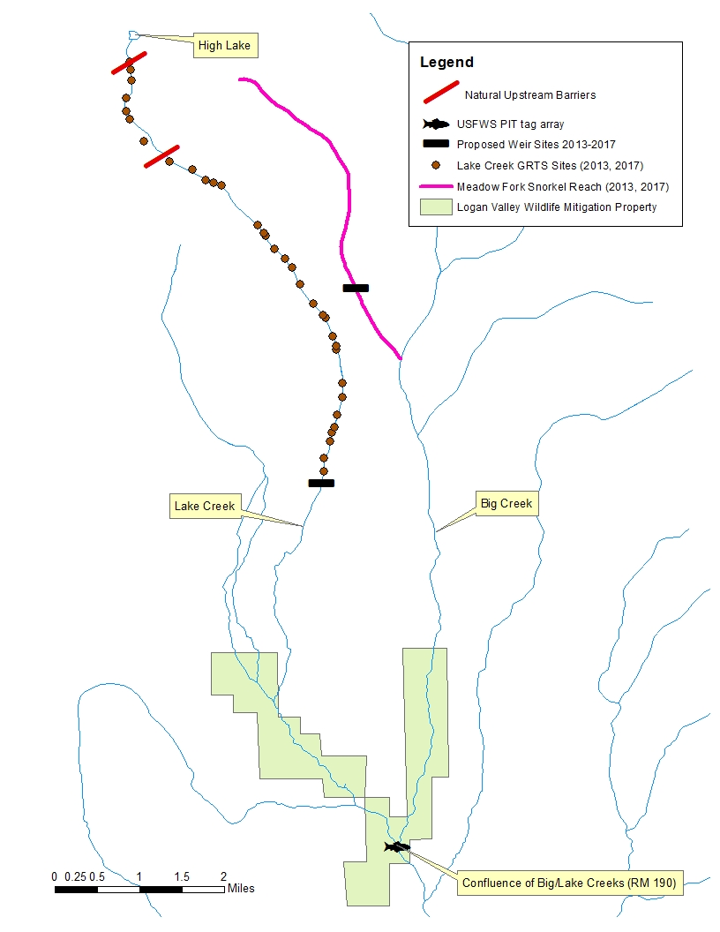
Study Design: BT Suppression
Lake Creek
Estimate abundance
GRTS design, extrapolate to sample frame
30 sites (30%), multiple pass depletion
10% of sites are calibration (mark-recapture)
→continuous removal
Impede BT emigration/active removal
Weir (June-Nov.)
Spatially coincides with thermal barrier to fluvial BUT
Monitor native species response
Δ Abundances, site densities, and condition factor
23 sites below waterfall (barrier)
BUT/RBT
Compensatory response
Δ Length at age/maturity
Relatedness of BT
Notes:
WHERE HAS THIS BEEN SHOWN TO BE EFFECTIVE?

Slide 8
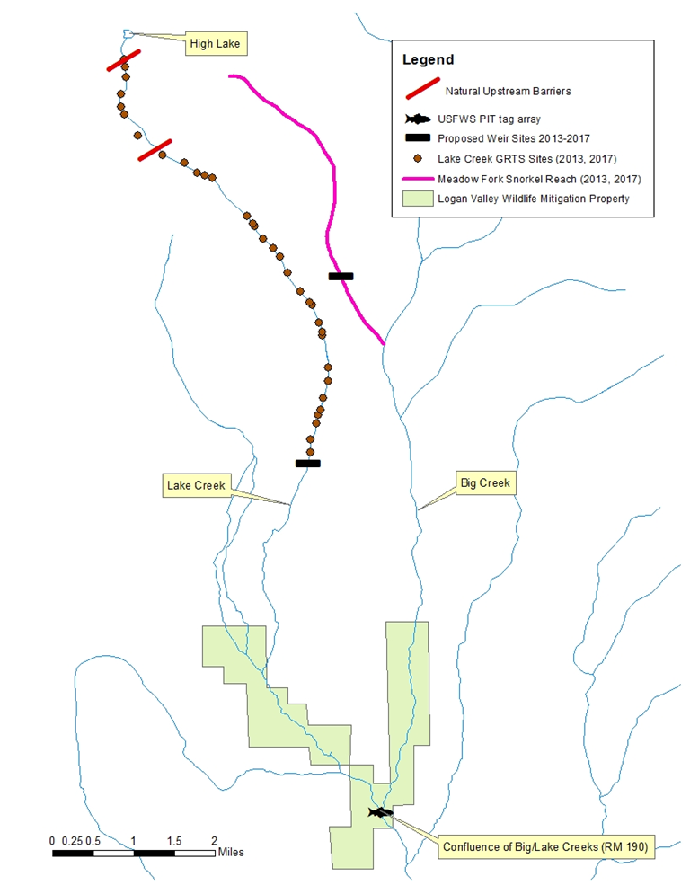
Study Design: BT Suppression
Big Creek
Impede brook trout expansion
Test efficacy of using barrier
Test location permanent barrier
Can impact relative abundances above?
Are BT moving upstream?
Native species response
Continuous snorkel surveys
Δ relative abundance over 5 years

Slide 9
Phase I actions
Reduce spawner recruitment from seed source
Response of native species/BT to electrofishing removal regime/barriers
Cooperative basinwide suppression plan utilizing both preliminary and final results
  LAKE CRK:
    E-fishing abundance
    Weir
  BIG CRK:
    Weir
    continuous snorkel surveys
2014-2016
  LAKE CRK: repeat 2013 to test efficacy of mechanical removal
  BIG CRK: repeat 2013 to test efficacy of utilizing barriers
  LAKE CRK:
  Continuous e-fishing removal/weir
  BIG CRK:
  weir operation above known BT distribution
2013
2017
2018-
Phase II actions
Phase II (co-management decisions):
Permanent barriers?
Mechanical removal of isolated patches?
Use of piscicides?
Notes:
Bull trout meeting is our venue for reporting preliminary results that guide phase II development

Slide 10
Relationship of proposal to other projects
USFWS Recovery Plan: Malheur Recovery Unit
Malheur River Subbasin Assessment and Management Plan
1997-019-00
Proposed
Bull trout status and trend monitoring
1997-019-00
Proposed
Threats-based targets
1997-019-00
Proposed
Redband trout status and trend monitoring
Primary limiting factor: brook trout (hybridization/competition)
Key uncertainties:
redband abundance over two ecological distinct strata
Interagency:
Spawning surveys
USBR: Seed source removal at High Lake
USBR: qPCR as an effectiveness monitoring tool
ODFW/FS/
USFWS:
Suppression/
restoration
USFWS:
WNTI Status Assessments
Notes:
BASED ON WHAT WE’VE LEARNED through previous funding cycles of 1997-019-00

Slide 11
Implications of results to F&W management
Redband abundance estimates over two ecologically distinct strata, estimated/target precision of 34%
  Identify key management areas
  Trend detection
Evaluation of efficacy of mechanical suppression
  Evaluate success of minimally invasive techniques
  Identify Phase II in BT suppression if chemical treatment/permanent barriers are needed and where (2018-)
  Address immediate limiting factors to recovery (USFWS Recovery Plan/Subbasin Plan)
  Produce/share results, applicable statewide
  Attract changes in FS management of sensitive areas
Notes:
What we’ll get → how it helps management
Emphasize the USFWS Recovery Plan

Slide 12
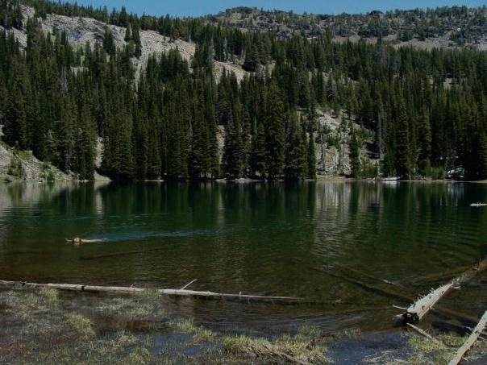
Adaptive Management
Identified limiting factors through 1997-019-00, shifting current focus to mitigating limiting factors
If mechanical methods are insufficient → utilize information gained to develop alternatives cooperatively
Adapt to suppression techniques as they become available
Develop/ incorporate new tools to monitor Δ in species abundance

Slide 13
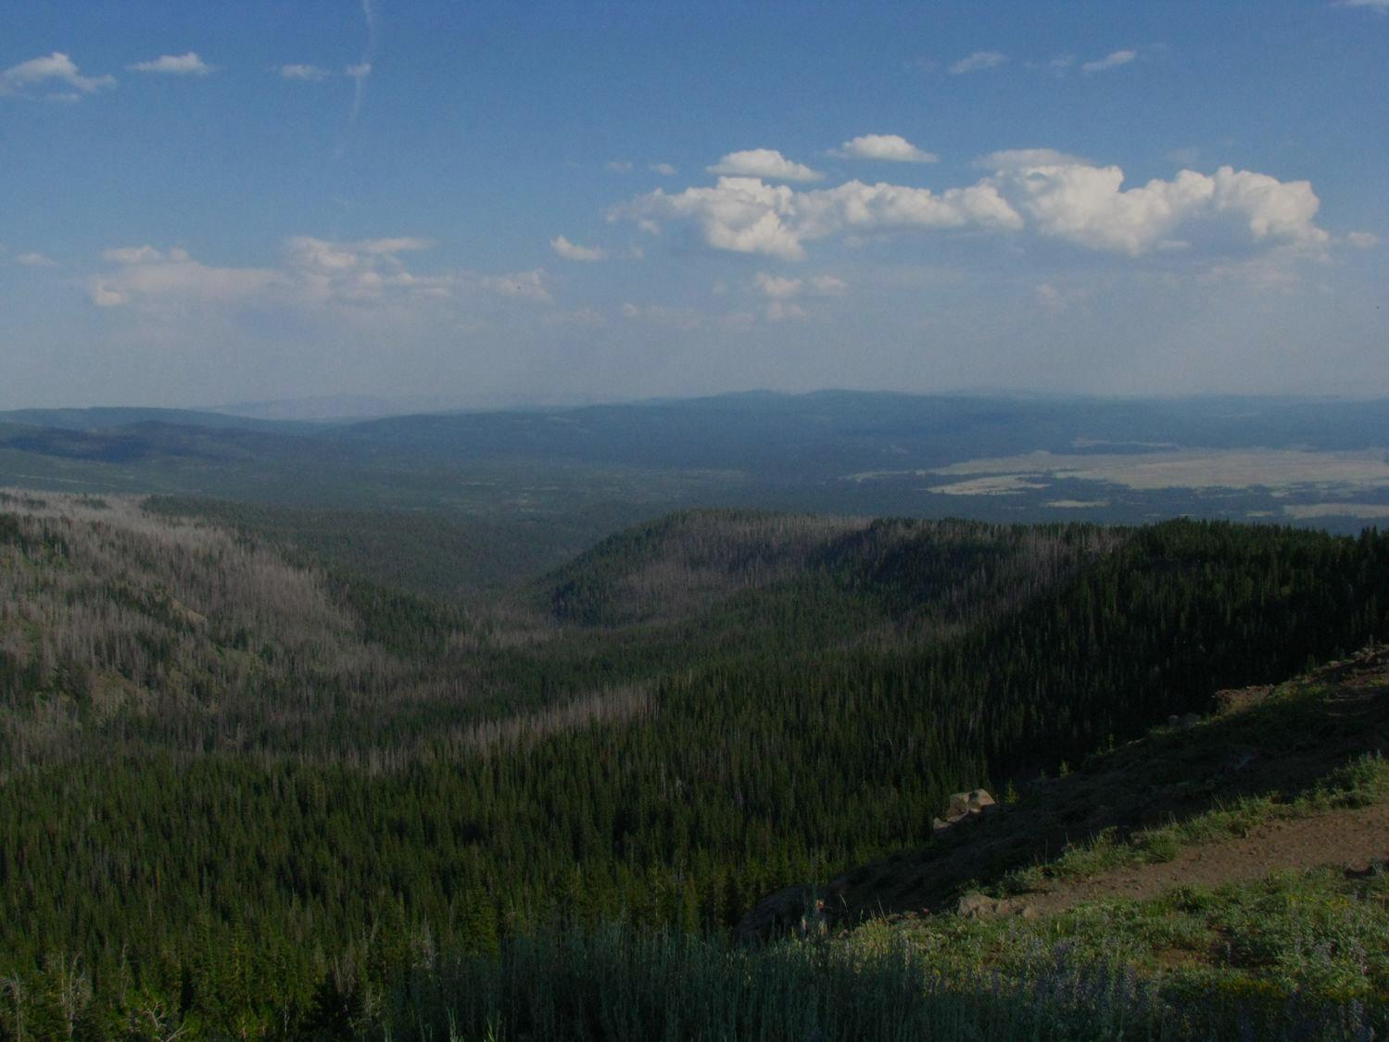
Conclusions
Taking what we’ve learned through 1997-019-00 and utilizing to develop an action-oriented project
Recovery Plan updates necessitate immediate action/identifies BT as primary limiting factor
Guide development of alternative treatment options, if needed
Utilizing regional/local expertise to develop all portions of proposal
Coincides with BOR project to disrupt/eliminate downstream dispersal and recruitment

Slide 14
Literature Cited
Bangs, B., S. Gunckel, and S. Jacobs. 2008. distribution and abundance of redband trout, Oncorhynchus mykiss, in the Malheur River Basin. In Evaluate the Life History of Native Salmonids in the Malheur River Subbasin. Burns Paiute Tribe Annual Report FY2007. Prepared for Bonneville Power Administration.
Gunckel, S., A. Hemmingsen, and J. Li. 2002. Effect of bull trout and brook trout interactions on foraging, habitat, feeding, and growth. Trans. Amer. Fish. Soc. 131: 1119-1130.
DeHaan, P., L. Schwabe, and W. Arden. 2009. Spatial patterns of hybridization between bull trout, Salvelinus confluentus, and brook trout, Salvelinus fontinalis, in an Oregon stream network. Cons. Gen. 11(3): 935-949.
Miller, S., S. Jacobs, S. Gunckel, and S. Richardson. 2010. Evaluation of a sampling approach to monitor the status of Great Basin redband trout in Southeastern Oregon. Oregon Department of Fish and Wildlife, Corvallis, OR.
Paul, A. and J. Post. 2001. Spatial distribution of native and nonnative salmonids in streams of the eastern slopes of the Canadian Rocky Mountains. Trans. Amer. Fish. Soc. 130: 417-430
Perkins, R. 2010. Annual bull trout spawning survey report. In Evaluate the Life History of Native Salmonids in the Malheur River Subbasin. Burns Paiute Tribe Annual Report FY2010. Prepared for Bonneville Power Administration.
Stevens, D. Jr., and A. Olsen. 2003. Variance estimation for spatially balanced sampling of natural resources. Envirometrics. 14: 593-610.
Stevens, D. Jr., and A. Olsen. 2004. Spatially balanced sampling of natural resources. J. Amer. Stat. Assoc. 99(465): 262-278.

